Slide 1

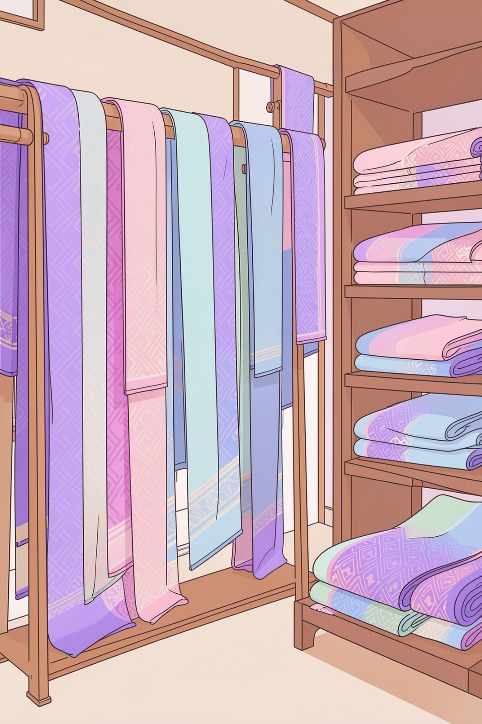

Presentation for the BDM Capstone Project
Data-Driven Strategies for Optimizing Profitability and Operations in a Saree Weaving Business
Submitted By
Name: Himanshu Gupta
Roll No: 24F1002302
IITM Online BS Degree Program, Indian Institute of Technology, Madras, Chennai Tamil Nadu, India, 600036

Slide 2
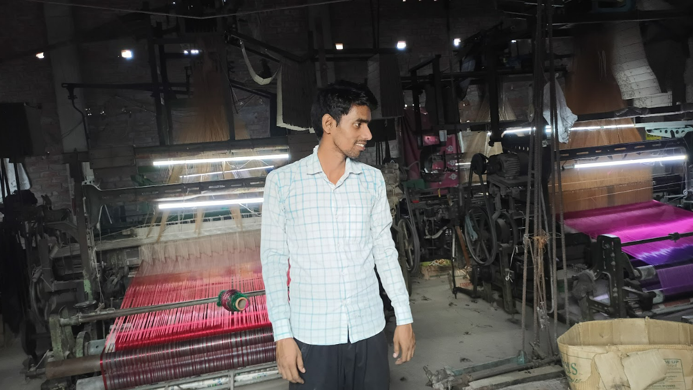
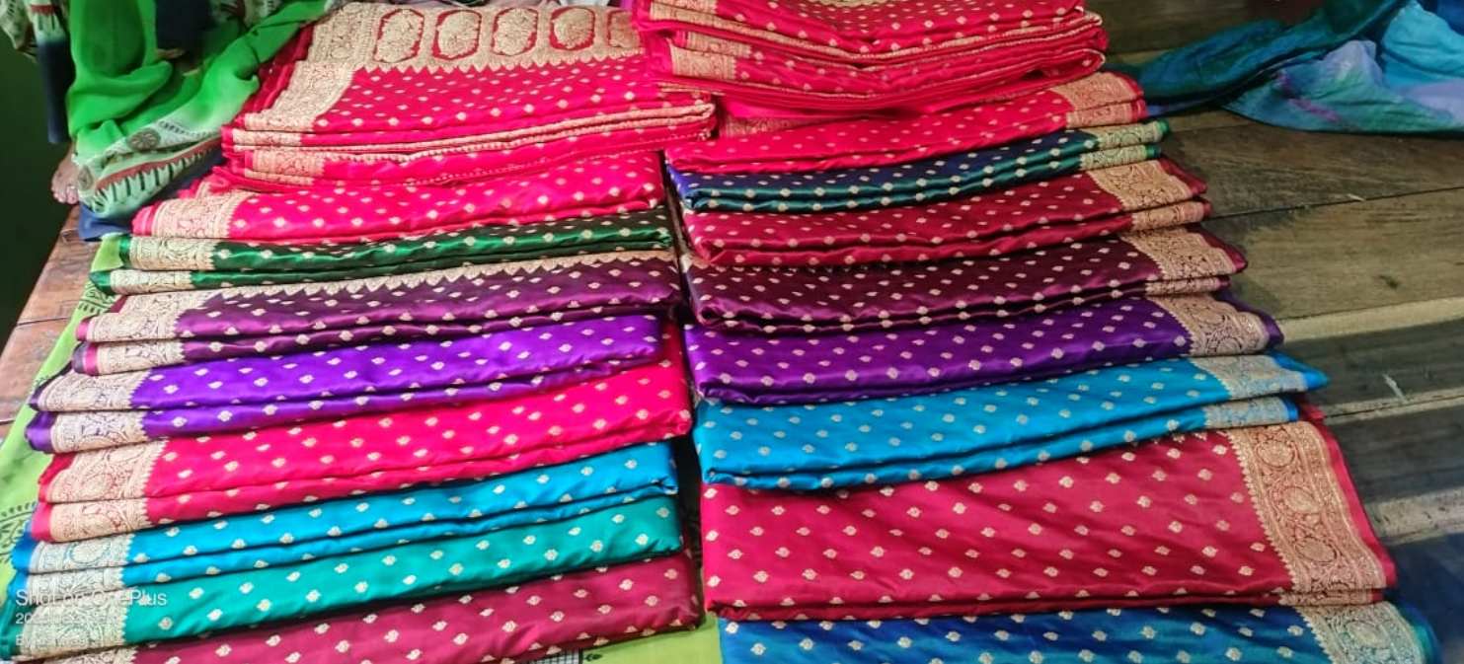
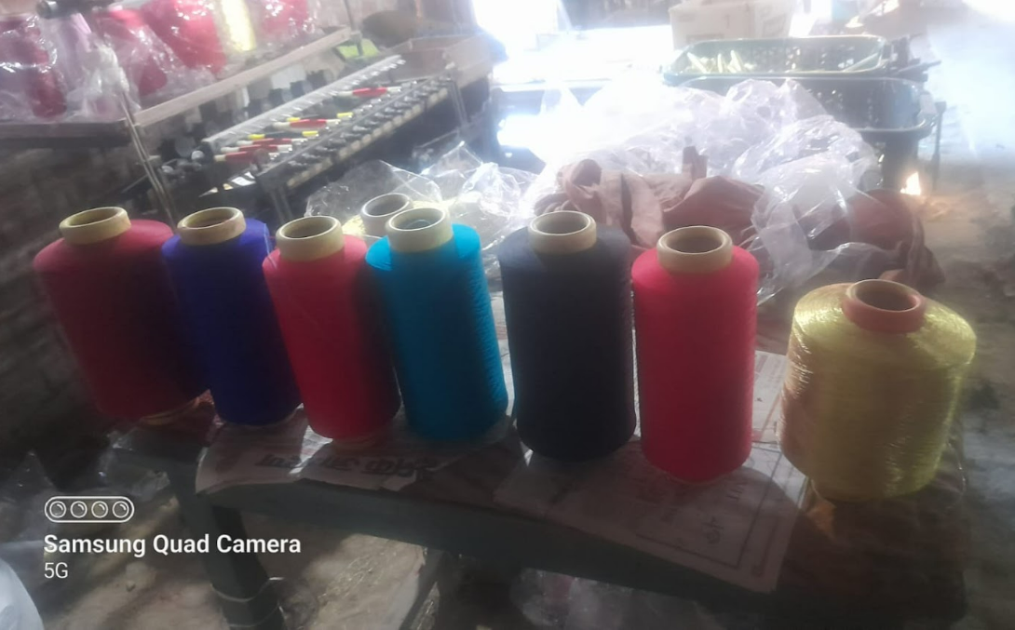

Organization Background
Business Profile
Business Name: Vishwas Maurya Textile
Location: Chhoti Koiran, Lohta, Varanasi
Owner Name: Mr. Vishal Maurya and Mr. Vishwas Maurya
Nature of Business
Primarily focus on B2B markets segment.
Powerloom sector with focus on Aara and Lachha designs saree.
Scale of Operations
Small-scale manufacturing.
Employed 4 waiver worker during Operation.
4 out of 6 Powerloom machines operate during Operation.

Slide 3

Problem Statement
Addressing critical operational gaps in cost visibility and demand planning:-
1
2
Unclear Profitability
Break-Even Awareness
Unable to determine cost per saree design or identify which products generate profit versus losses
No knowledge of minimum sales required for financial sustainability
3
4
Sales Forecasting Gap
Material Planning Issues
Absence of data-driven demand prediction for production planning
Poor raw material inventory management causing production bottlenecks

Slide 4

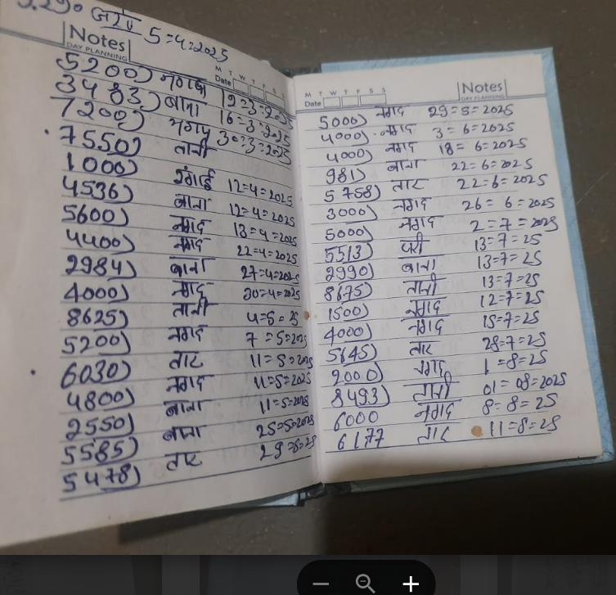
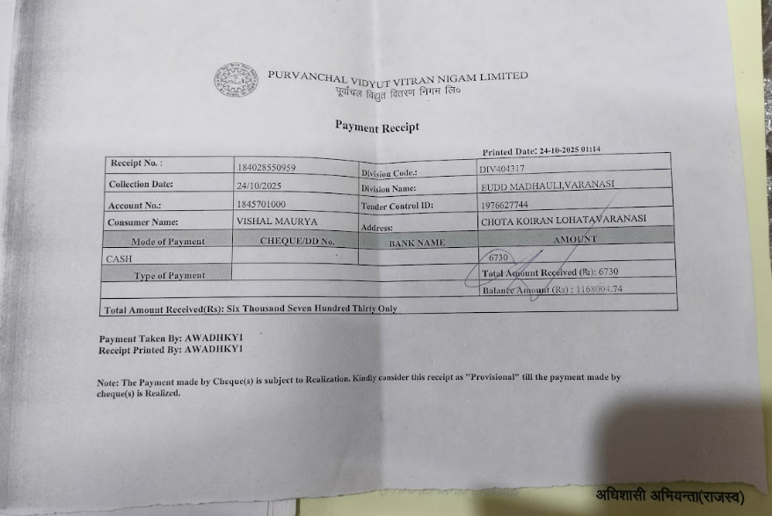
Data Collection, Preprocessing & Methodology
Data Preprocessing
Primary Data Sources
Handwritten record from April–October 2025.
Sales Data (50 entries) & Purchase Data (28 entries).
Electricity Bills.
Owner-provided material consumption ratios.
Manual data entry into Excel sheet : name, Value, date, etc.
Data Cleaning in sheet: remove duplicates, fix dates, standardize Column names, fill missing fields.
Data transformation: add month column, Weekly aggregation, quantities, and monetary values were standardized.
Methodological Approach
Tools
Limiting material production estimation.
Cost accounting principles
Break-even analysis.
Time series decomposition (STL).
ARIMA forecasting models.
Microsoft Excel for cost allocation and Profitability analysis.
ARIMA modelling using Python for forecasting.

Slide 5
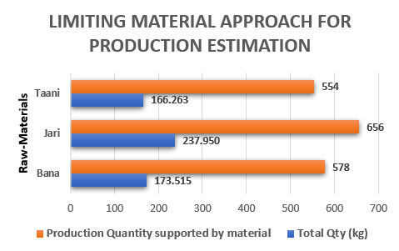
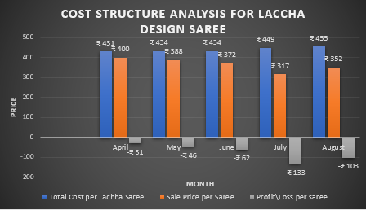
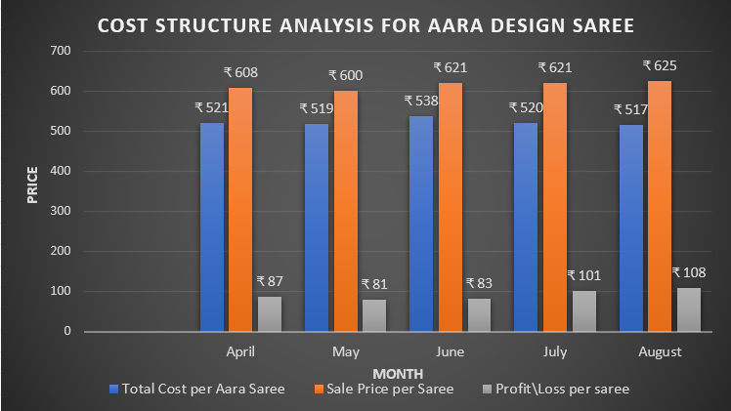
RESULTS & FINDING
Material Constraint
69% Lachha Share
Taani identified as limiting factor.
554 Total Units, Combined production capacity as Taani during Period.
Capacity underutilization observed
Dominant volume with 262 sarees sold
31% Aara Share
Lower volume but higher margin product
Cost Structure Insights
Aara: ₹517–₹538 per unit
Lachha: ₹431–₹455 per unit
Material costs dominate total
expenses

Slide 6
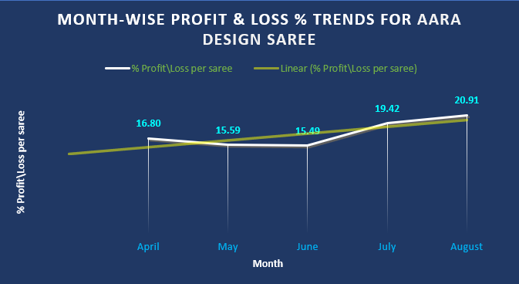
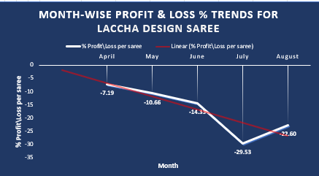
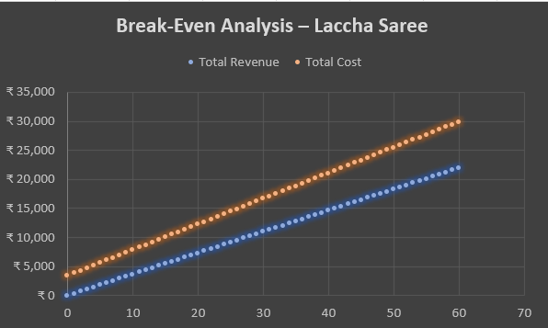
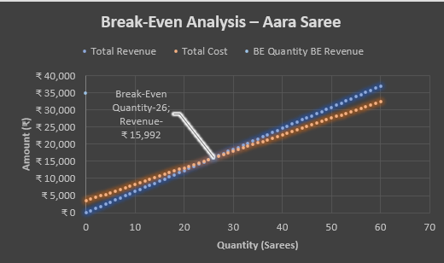
Profitability Analysis Findings
Aara Sarees: Profitable
Consistent positive margins of 15–21%
Lachha Sarees: Loss-Making
Negative contribution of ₹75 per unit
Break-Even Point
Aara: 26 units/month | Lachha: Not achievable
Key Financial Insight
Volume-driven strategy increases total losses
Current Lachha pricing insufficient
Minimum required: ₹441 per unit

Slide 7
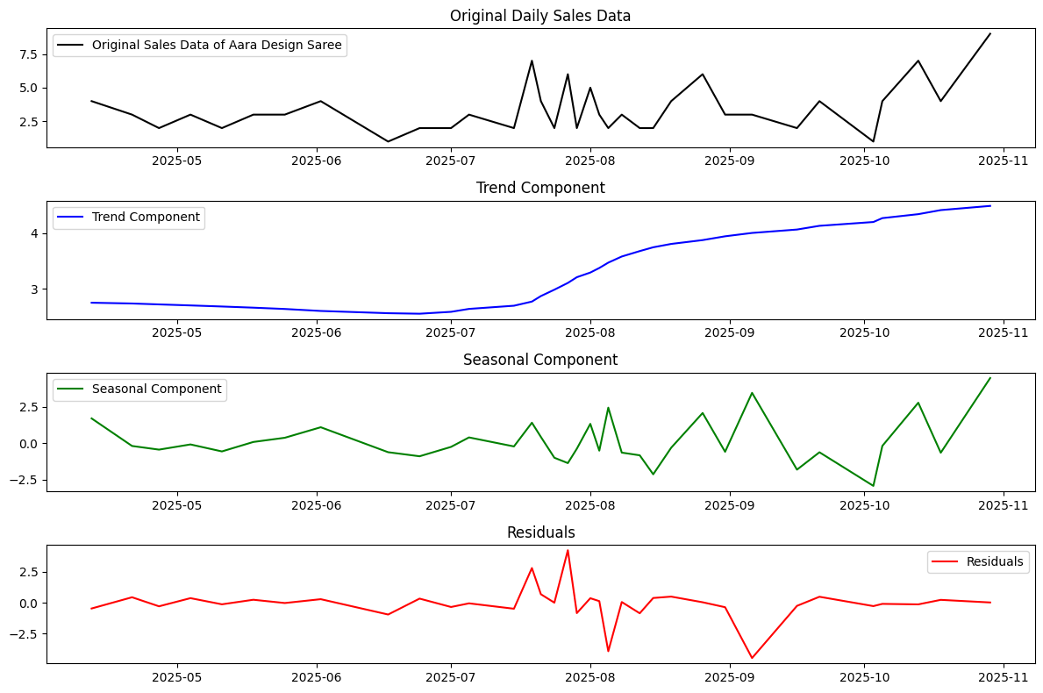
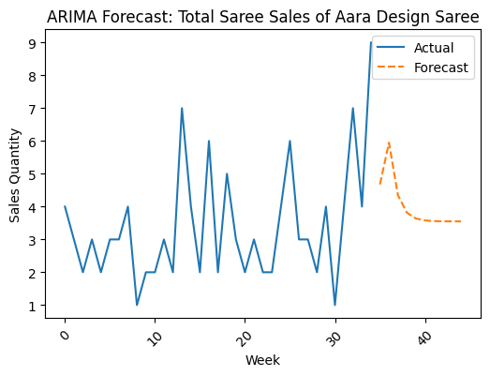
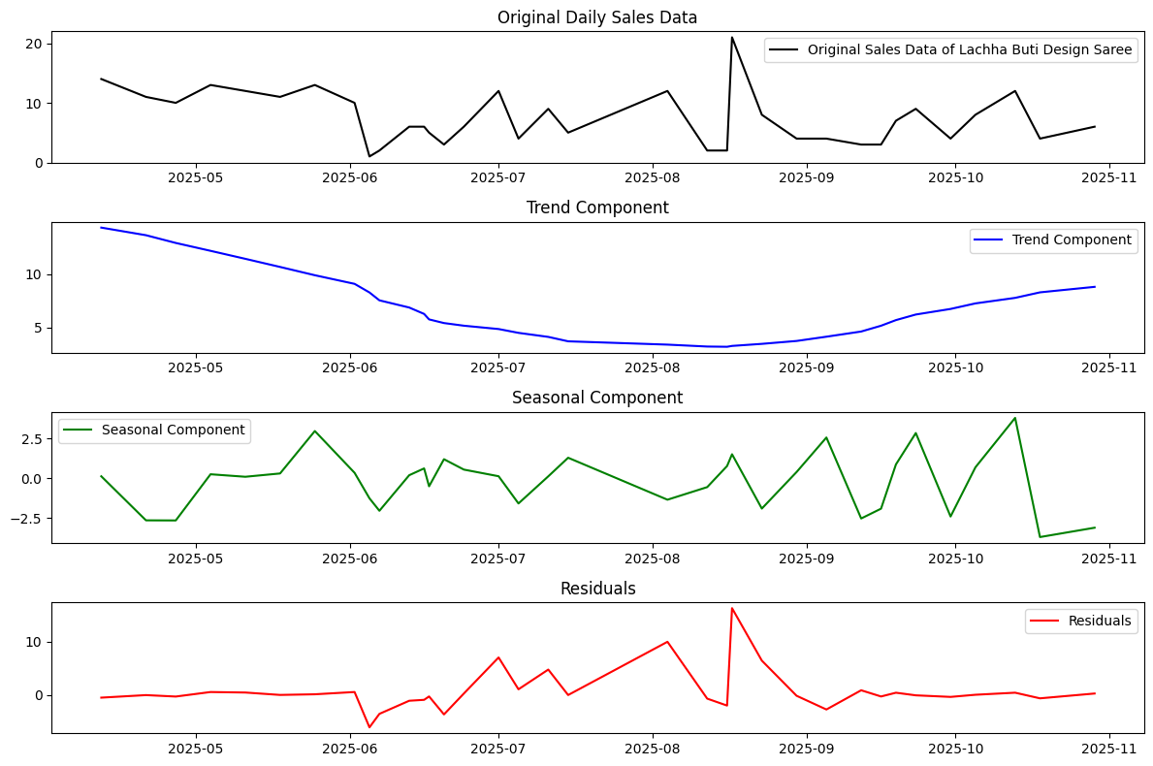
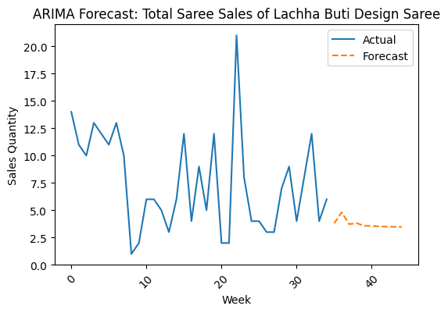
ARIMA Forecasting on Design Saree
Aara Design
Increasing Trend: Sales rise from ~3 to ~5 sarees/day → steady demand growth
• Weak Seasonality: Minor fluctuations (–2.5 to +3) → no strong repeating pattern
• Best Model: ARIMA(1,0,2) with lowest AIC (145.42)
• Model is Reliable: No autocorrelation (p = 0.71), residuals are normally distributed
• Stable Forecast: Demand settles around 3–4 sarees → steady, predictable sales
Lachha Buti
Declining then Recovering Trend: Sales drop from ~12–15 to ~3–4, then rise to ~8 → mid-period slowdown with recovery
• High Volatility: Sales vary widely (2 to 20 units) → more unstable demand than Aara
• Moderate Seasonality: Fluctuations between –3 to +3 → weak but present short-term cycles
• Best Model: ARIMA(2,0,1) with AIC = 148.01
• Stable but Imperfect Model: No autocorrelation (p = 0.97), but non-normal residuals & volatility present → captures pattern but not extreme spikes

Slide 8
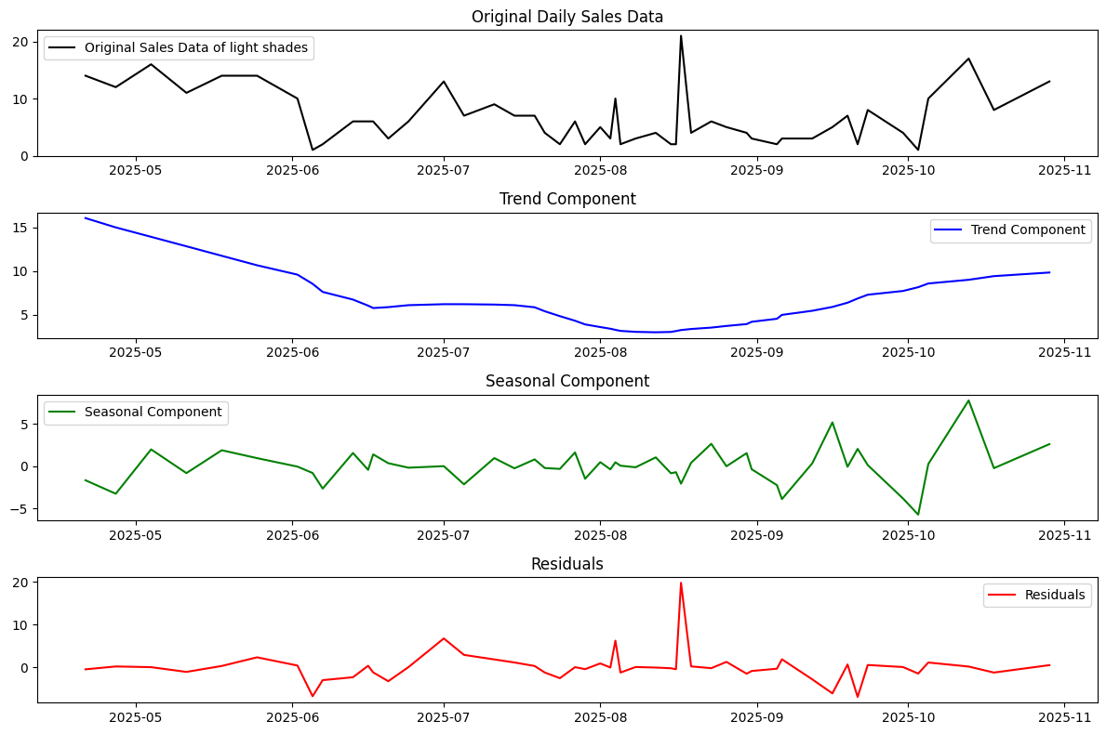
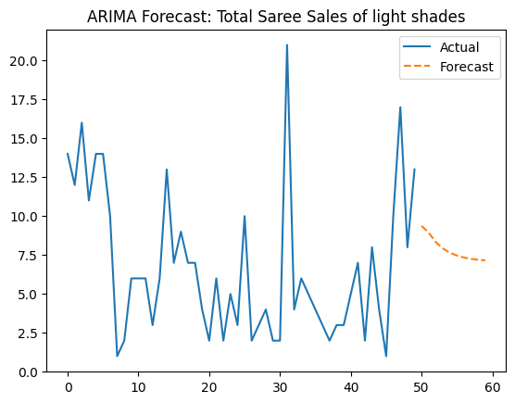
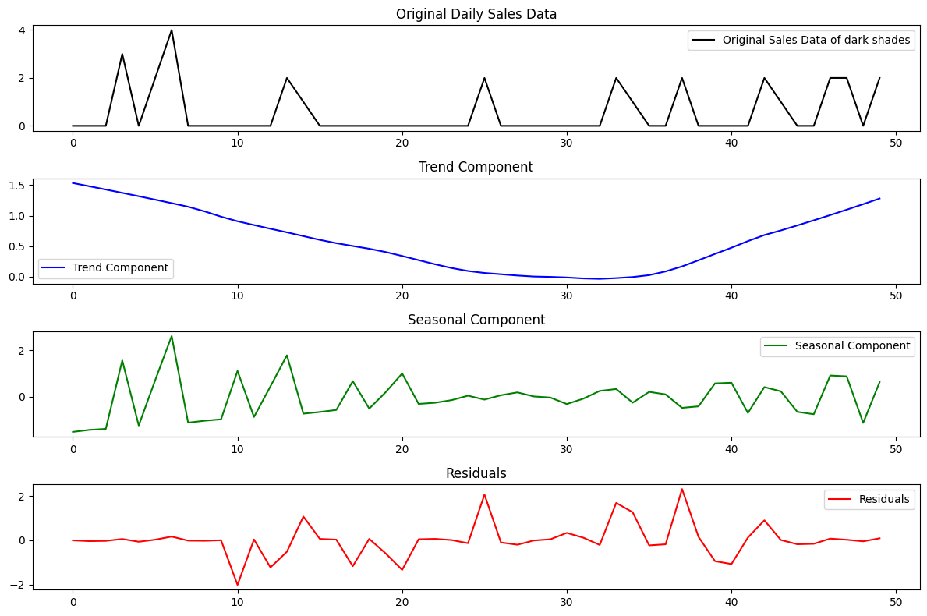
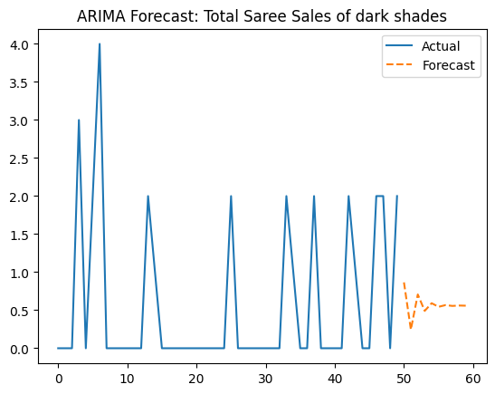
ARIMA Forecasting on Saree Shades
Light Shades Saree
• Strong Weekly Seasonality Detected: STL shows consistent fluctuations of around ±5–6 units
• Series is Stationary: ADF Test confirms stationarity (p < 0.05)
• Good Model Fit: Residual diagnostics show no autocorrelation and stable variance
• Technical Validation: Ljung-Box test confirms residual independence, ensuring no remaining temporal structure
• Statistical Note: Non-normal residuals (Jarque-Bera) indicate presence of outliers, but model remains reliable for mean forecasting.
Dark Shades Saree
Weak Seasonality Observed: STL shows small fluctuations (≈ –1 to +2 units), indicating low cyclic pattern
• Series is Stationary: ADF Test confirms stronger stationarity compared to light shades
• Higher Volatility: Residuals show random spikes with low overall demand levels
• Technical Validation: Model passes Ljung-Box test, confirming adequacy despite low signal strength
• Statistical Note: Lower signal-to-noise ratio reduces predictive power, making forecasts more directional than precise

Slide 9
Strategic Recommendations
01
02
Revise Lachha Pricing
(Urgent)
Monthly Cost Tracking
(Short-Term)
Implement minimum ₹441 per unit to achieve break-even,
then increase price aligns with observed cost structure.
Standardized Excel-based cost sheet for margin visibility
03
04
Taani Inventory Planning
(Short-Term)
Colour Strategy Adjustment
(Medium-Term)
Set monthly minimum Taani requirement based on average
consumption and proportion with other materials.
Plan to keep light shade inventory at around 9-11 units per week.
Promote dark shades during early winter event & occasions.
05
06
Dealer Classification
(Medium-Term)
Highway Shop Opportunity
(Long-Term)
Stable vs. volatile demand dealer prioritization
Open retail shop to direct sales to increase profit margin

Slide 10
Thank You

