Slide 1



Data Analytics Project - 2020
Course code : UE18CS312
Predictive And Prescriptive Analytics On Courses
Offered By Udemy
Rahil N Modi
PES1201802826
Sooryanath I T
PES1201802827
Himanshu Jain
PES1201802828
Team : DataTrios

Slide 2

Problem Selected For Solving
With the surge in MOOCs offered and taken during the recent times , we wanted to come up with predictive models which benefit both the course consumers and course producers.
Few problems we are trying to solve are as follows :
Associating the Key performance indicators (KPIs’) like number of subscribers to a course with the number of reviews given for a course.
Classifying the courses into paid ,unpaid before they are submitted into the Udemy platform with apriori knowledge of the course parameters like total tests and total hours of lecture.
Group the courses on an hierarchical basis based on their similarities , so that the consumer can subscribe to courses in an organized manner by covering pre-requisites.
When presented with a course title of interest , gather courses of similar category and context and present it to the client in an intelligent way.

Slide 3
Data Set(s) Used
We are performing our analysis on the development and IT category of courses offered by Udemy .
Both the datasets were integrated by matching the schemas , as a part of the preprocessing phase of the problem solving phase.
Links To Datasets:
kaggle.com/jilkothari/udemy-courses-development
kaggle.com/jilkothari/it-software-courses

Slide 4
Why is this problem an important one to be solved
The solutions provided by our work will definitely serve as an input to increase the business values for the course producers .Provides an idea to the course producers on what should they bring into MOOCs domain , where to focus?
How to pick a course ? Skip the pre-requisites? We provide the solution
Investigate the trend in the pandemic.
We can provide an interface to the user which intelligently recommends the courses with ratings as the weights.

Slide 5


Final Inferences and Results
Data Analytics Project - 2020
Course code : UE18CS312
Predictive And Prescriptive Analytics On Courses
Offered By Udemy
Team : DataTrios

Slide 6
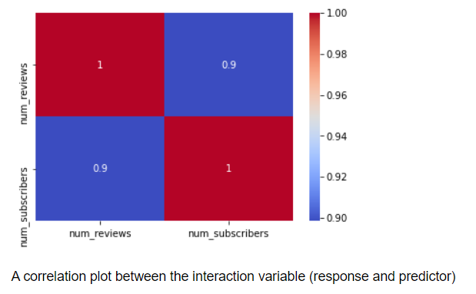
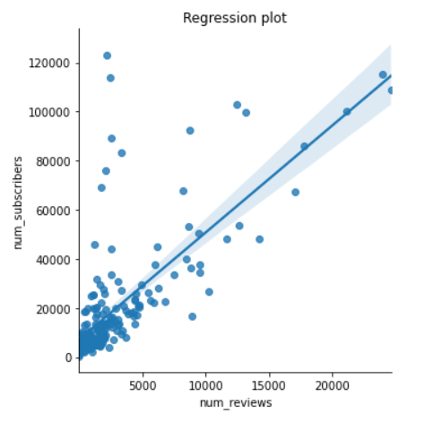
Simple Linear Regression:

Slide 7
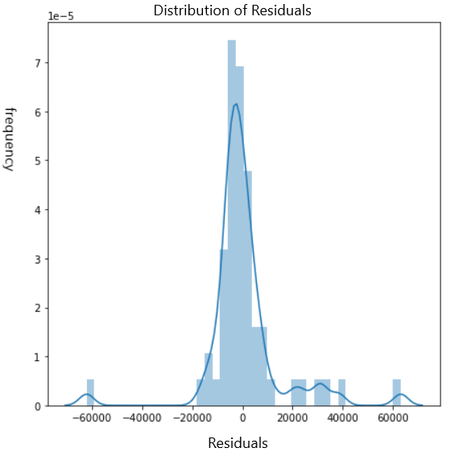
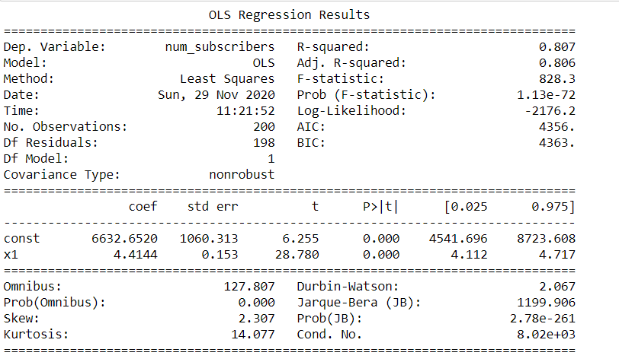
Simple Linear Regression:

Slide 8
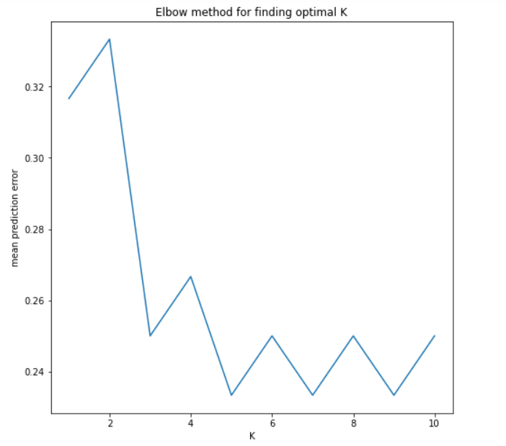
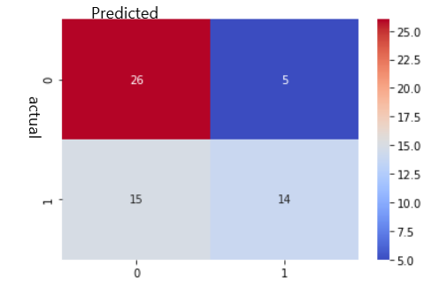
K-Nearest Neighbours:

Slide 9
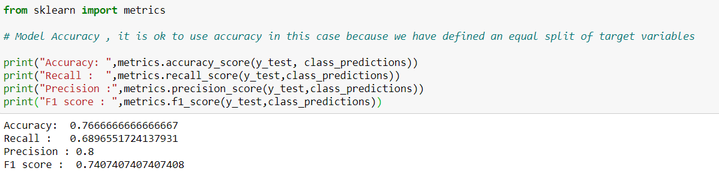
K_Nearest Neighbours:

Slide 10
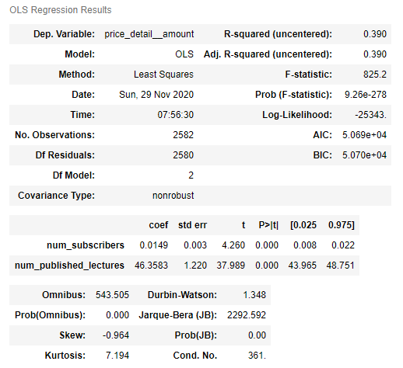
Multiple Linear Regression:

Slide 11
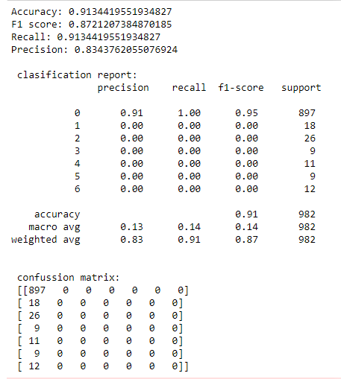
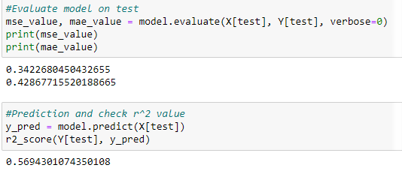
Artificial Neural Network (ANN):

Slide 12
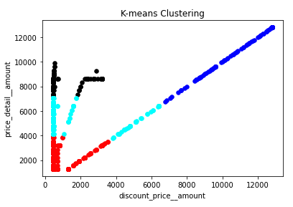
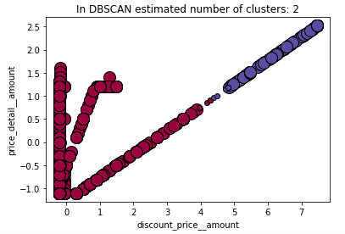
Clustering:

Slide 13
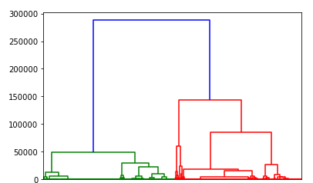
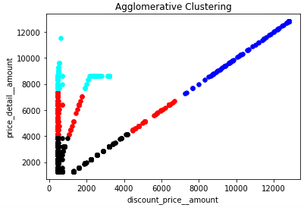
Clustering:

Slide 14

Recommended System:

Slide 15
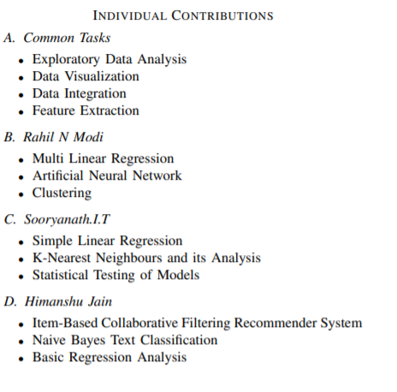

Slide 16


