Slide 1
Caching in ICN
Himanshu Joshi
MT2017048
International institute of information technology bangalore
28/04/18
Himanshu.Joshi@iiitb.org
<number>
Notes:
<number>

Slide 2
Overview
Internet in a minute
Caching in ICN
Different caching policies
Open challenges
My idea
Idea explanation and its advantages
References
28/04/18
Himanshu.Joshi@iiitb.org
<number>

Slide 3
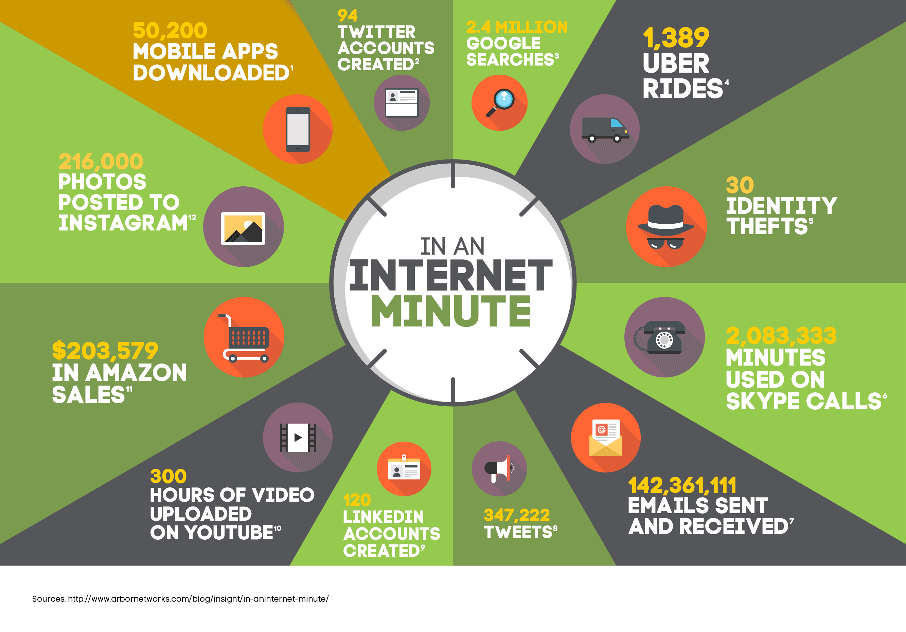
28/04/18
Himanshu.Joshi@iiitb.org
<number>

Slide 4
Caching in ICN
Hash Caching
Leave Copy Everywhere (LCE)
Prob
Leave Copy Down (LCD)
Move Copy Down (MCD)
WAVE
Most Popular Content (MPC)
28/04/18
Himanshu.Joshi@iiitb.org
<number>

Slide 5
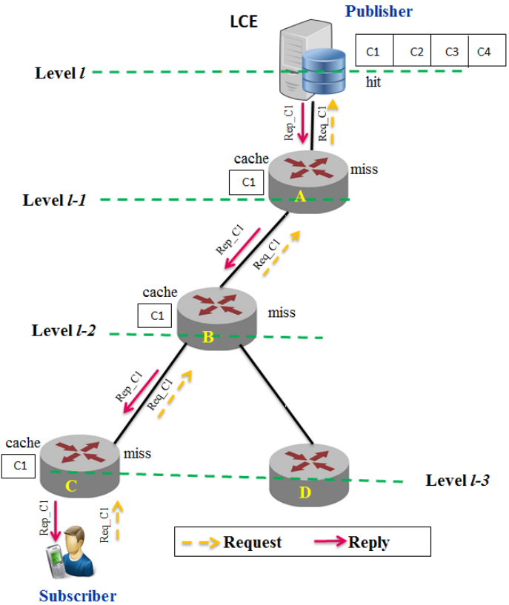




Leave copy everywhere
Prob
Caches at i’th level router with probability p
The LCE caches contents at all intermediate nodes, if a new content request arrives, it is not forwarded to the server but the intermediate node, which has a copy of that content, replies with data.
Data is cached at router
with probability ‘p’
Same copy of data
28/04/18
Himanshu.Joshi@iiitb.org
<number>

Slide 6
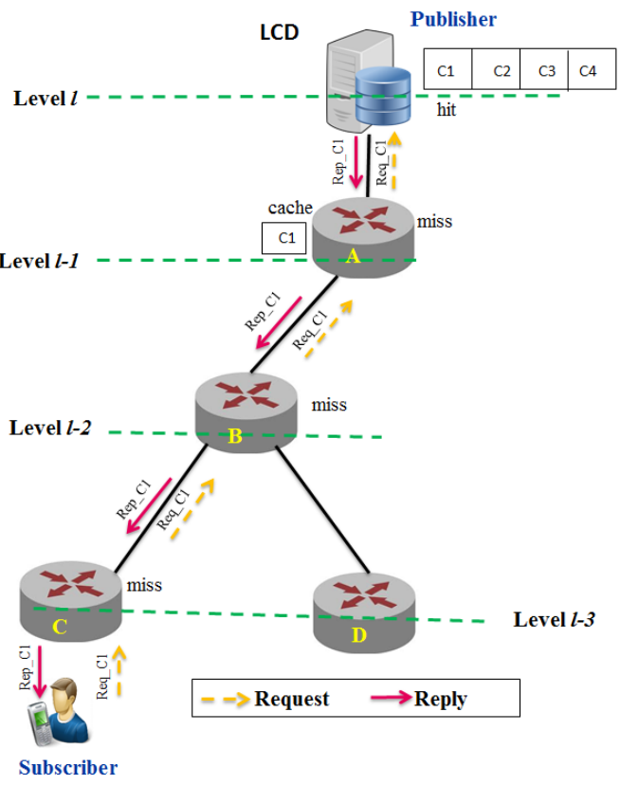




Leave copy down (LCD)
A copy of the requested content is stored merely at the (l − 1) level node
28/04/18
Himanshu.Joshi@iiitb.org
<number>

Slide 7
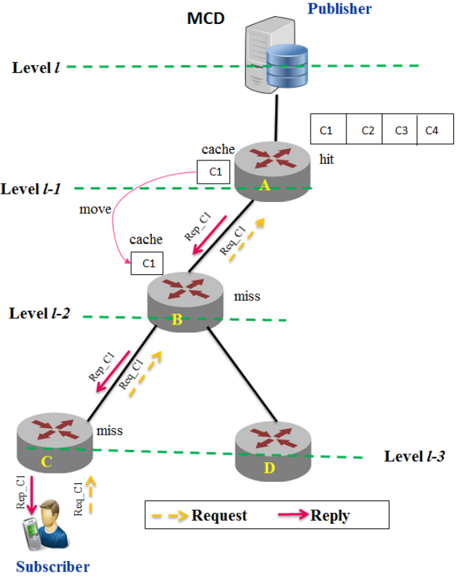


Move copy down (MCD)
The copy of the data is moved closer to subscriber on every subsequent request.
28/04/18
Himanshu.Joshi@iiitb.org
<number>

Slide 8
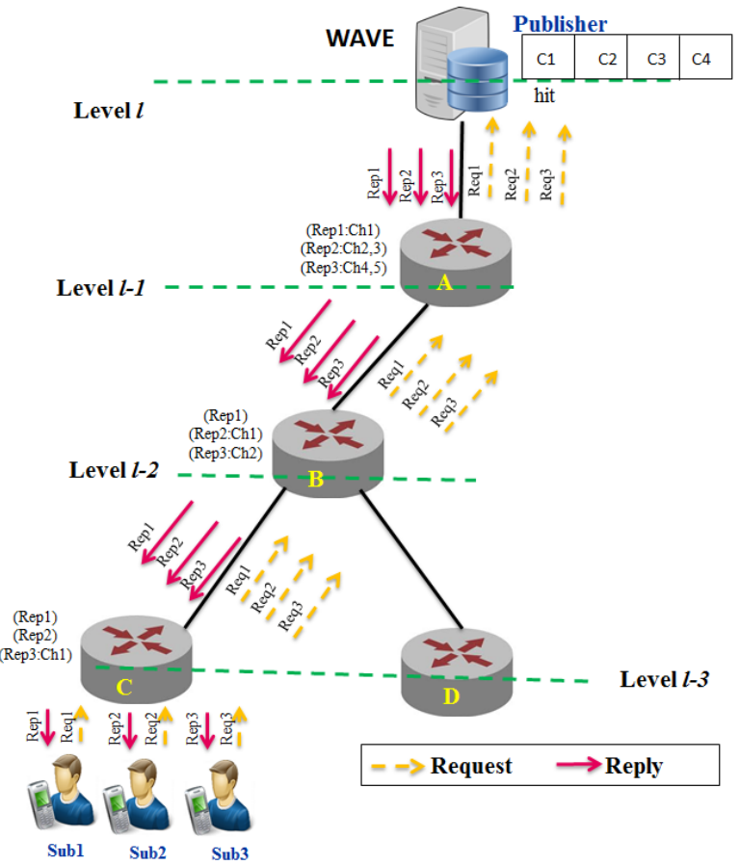




WAVE
The content is divided into chunks.
The chunks are organized based on the access count of the contents.
Upon increasing the access count, the number of chunks to be stored is increased exponentially and disseminated more widely
28/04/18
Himanshu.Joshi@iiitb.org
<number>

Slide 9
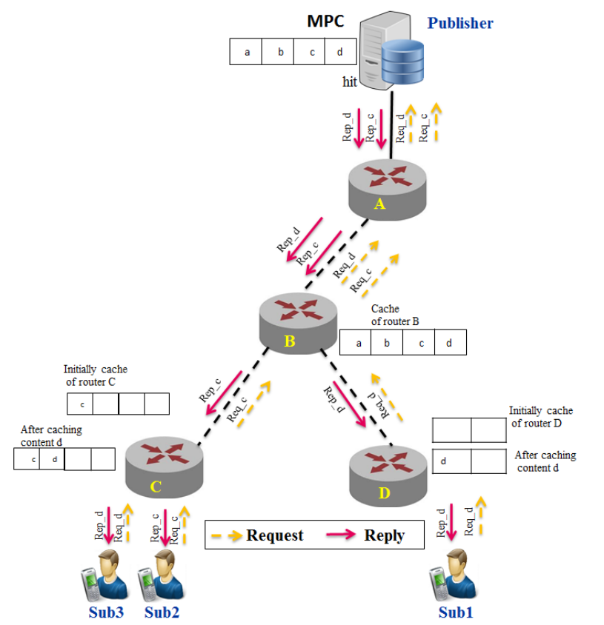



Most Popular Content (MPC)
Every router locally calculates the number of requests for each content name, and caches both content name and popularity count into a Popularity Table (PT)
The content name is labeled as being popular if it reaches a Popularity Threshold locally.
And if a router holds the content, it suggests its neighbors for caching it with a new Suggestion message.
28/04/18
Himanshu.Joshi@iiitb.org
<number>

Slide 10
Drawbacks:
Works well if individual nodes, but fails considering the entire network.
Case specific caching policies. Non of the policy is one for all solution.
28/04/18
Himanshu.Joshi@iiitb.org
<number>

Slide 11
Idea
Collect data from all the routers which are under the ICN manager extracts the relevant features from the packet received and send the data to cloud. In the cloud apply a deep learning algorithm to find out the popularity of the content. Once the popularity is predicted the popularity is sent back to the ICN manager and ICN manager decides which router should cache which data.
28/04/18
Himanshu.Joshi@iiitb.org
<number>

Slide 12
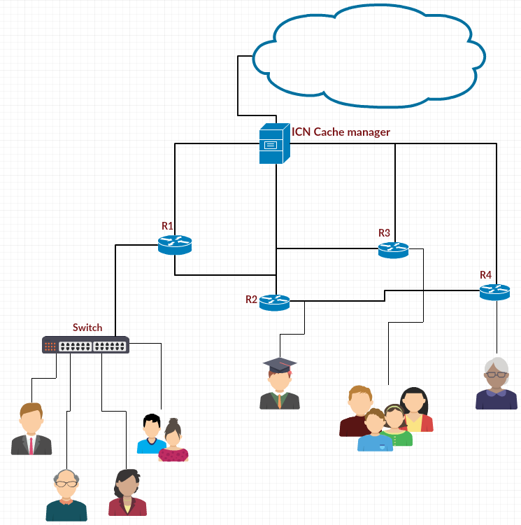
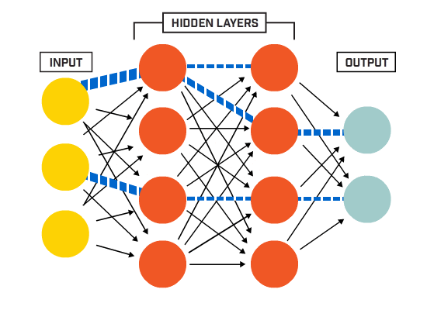
ICN based architecture for caching.
28/04/18
Himanshu.Joshi@iiitb.org
<number>

Slide 13
Parameters used:
At any node the total number of request that are received during t’th slot.
At any node the total number of request of content type ‘c’ during t’th slot.
Calculate the entropy of the content type ‘c’ during t’th slot.
At any node the total number of different types of request.
The total number of requests received in the network.
The total number of different types of requests received in the network.
Time of day, day of week, and month of the year.
Is there any special occasion based on the calendar data.
28/04/18
Himanshu.Joshi@iiitb.org
<number>

Slide 14
Advantages
Global knowledge based caching helps in removing redundancy.
Deep learning based algorithm predicts the popularity accurately.
Computation happens on cloud, which helps routers to be free from running caching algorithms.
Caching decisions are taken after every 10 minutes, helps in increasing the efficiency of the network.
28/04/18
Himanshu.Joshi@iiitb.org
<number>

Slide 15
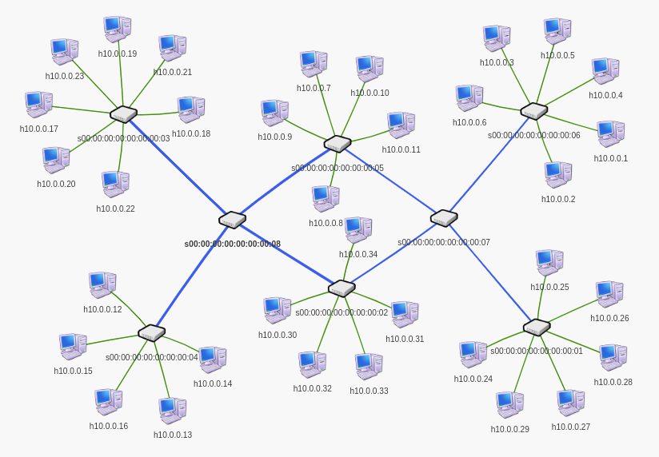
Topology for simulation

Slide 16
Work done so far...

Slide 17
References
[1] https://www.ptgrey.com/deep-learning
[2] Z. Li and G. Simon, “Time-shifted tv in content centric networks: The case for cooperative in-network caching,” in Communications (ICC), 2011 IEEE International Conference on. IEEE, 2011, pp. 1–6.
[3] L. Saino, I. Psaras, and G. Pavlou, “Hash-routing schemes for Information Centric Networking,” in Proceedings of the 3rd ACM SIGCOMM workshop on Information-centric networking. ACM, 2013, pp. 27–32
[4] N. Laoutaris, H. Che, and I. Stavrakakis, “The LCD interconnection of LRU caches and its analysis,” Performance Evaluation, vol. 63, no. 7, pp. 609–634, 2006
[5] K. Cho, M. Lee, K. Park, T. T. Kwon, Y. Choi, and S. Pack, “WAVE: Popularity-based and collaborative in-network caching for Content-oriented Networks,” in Computer Communications Workshops (INFOCOM WKSHPS), 2012 IEEE Conference on. IEEE, 2012, pp. 316–321.
28/04/18
Himanshu.Joshi@iiitb.org
<number>

Slide 18
[6] https://www.youtube.com/watch?v=gqGEMQveoqg
[7] Ikram Ud Din Student Member IEEE, Suhaidi Hassan Senior Member IEEE, Muhammad Khurram Khan Senior Member IEEE, Mohsen Guizani Fellow IEEE, Osman Ghazali Member IEEE, and Adib Habbal Senior Member IEEE, “Caching in Information-Centric Networking: Strategies, Challenges, and Future Research Directions”.
[8] S. Shailendra, B. Panigrahi, H. K. Rath and A. Simha, "A novel overlay architecture for Information Centric Networking," 2015 Twenty First National Conference on Communications (NCC), Mumbai, 2015, pp. 1-6.doi: 10.1109/NCC.2015.7084921
28/04/18
Himanshu.Joshi@iiitb.org
<number>

Slide 19
Questions?
28/04/18
Himanshu.Joshi@iiitb.org
<number>

Slide 20
Thank you
28/04/18
Himanshu.Joshi@iiitb.org
<number>

