Slide 1




ETHGLOBAL MUMBAI 2026
THE PROBLEM
Blockchain shows what happened.
But who understands the strategy behind it?
DeFi transactions are transparent. Liquidity-management behaviour is still difficult to understand.
1
Raw transactions are fragmented
2
LP strategy decisions are hard to reconstruct
3
Evaluating experienced LPs takes manual research
BUILT FOR New LPs · Experienced LPs · DeFi researchers & developers
TRACE
Turn public liquidity activity into understandable, evidence-backed strategy intelligence.
ON-CHAIN STRATEGY INTELLIGENCE
Notes:
[~45 s] Ethereum is transparent: every liquidity move is public. But a list of transactions is not an explanation. Look at an experienced Uniswap liquidity provider and you can see what they did, but not why: when they set a range, when they moved it, how they collected fees. Reconstructing that today means manual research across fragmented transactions. TRACE turns that public activity into strategy intelligence you can understand, with every claim linked to on-chain evidence. It's built for new LPs learning how concentrated liquidity is managed, experienced LPs who research other wallets by hand, and DeFi researchers who need structured data. Let me show you.

Slide 2
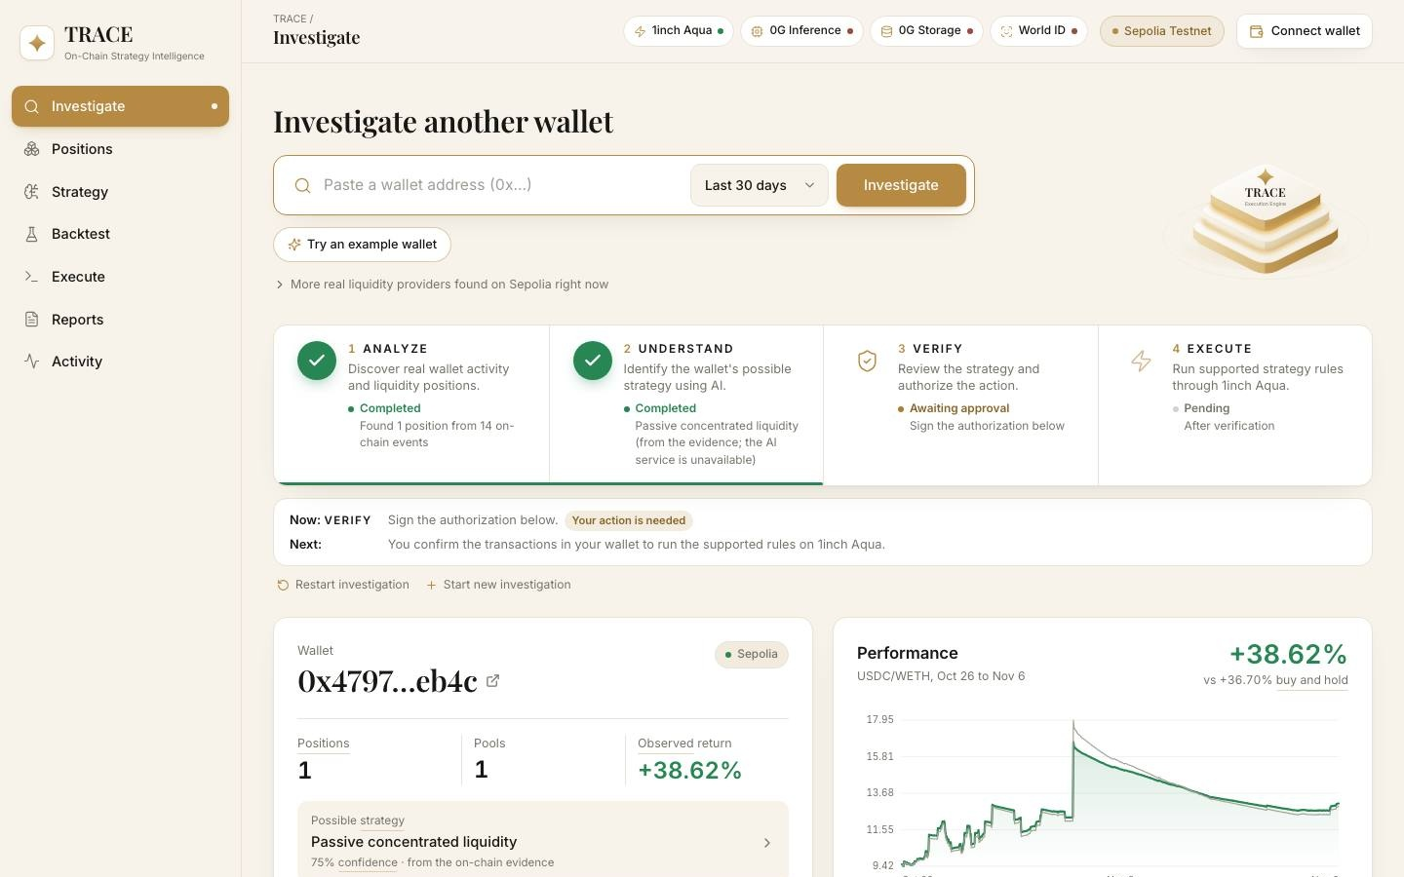
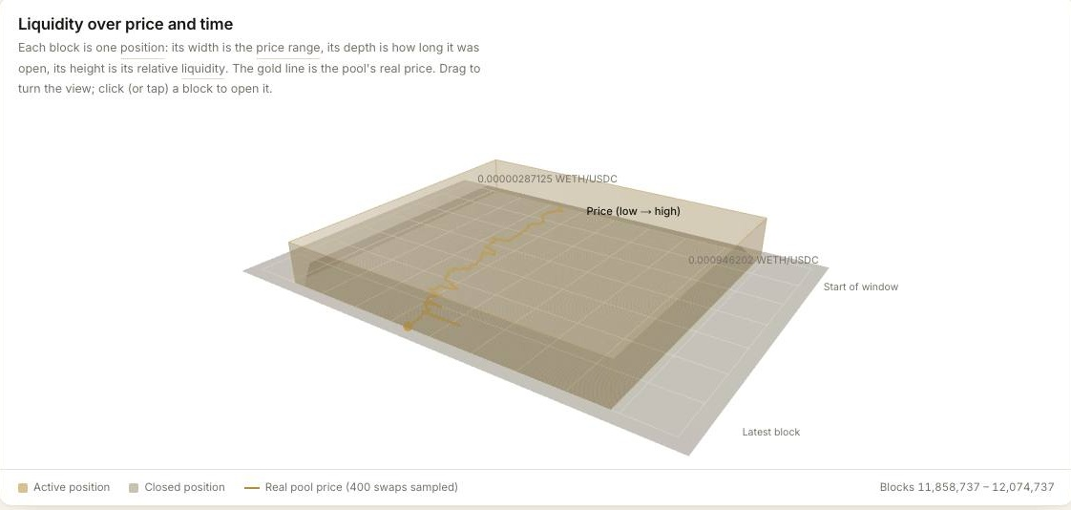
From a public wallet to an understandable liquidity strategy
THE PRODUCT · HOW IT WORKS
01
INVESTIGATE
trace-eth.vercel.app
Live product · Sepolia testnet
Enter any public Ethereum wallet address.
02
RECONSTRUCT
Rebuild Uniswap V3 positions: liquidity changes, range moves, fee collections.
03
UNDERSTAND
AI-assisted analysis names likely strategy patterns, each linked to on-chain evidence.
04
VALIDATE
Backtest candidate rules on historical swaps; compare return and risk.
05
EXECUTE
Check Aqua compatibility and prepare supported rules, with explicit human authorization.
Notes:
[~60 s, then switch to the LIVE DEMO] Example: someone with $10,000 wants to provide ETH/USDC liquidity and finds an experienced LP wallet. This is the live product on Sepolia. Paste a public wallet. TRACE rebuilds every Uniswap V3 position it held: deposits, withdrawals, range changes and fee collections. It proposes the strategy that best explains that behaviour, as a hypothesis with its evidence. You backtest the rules on real historical swaps, and if they are supported, TRACE prepares them for 1inch Aqua. Nothing executes without explicit human authorization. DEMO: pre-loaded wallet → positions → strategy with evidence → backtest → Aqua check → World ID approve AND one rejected attempt → on-chain transfer.

Slide 3







One intelligence layer. A powerful Web3 technology stack
BUILT WITH WEB3 ECOSYSTEM TECHNOLOGIES
Liquidity data
Execution layer · Aqua
V3 positions rebuilt from events; exact TickMath in BigInt
Order hash, approvals and price bounds verified before signing
Live on Sepolia
Ship verified · Sepolia test
TRACE
INTELLIGENCE ENGINE
Verifiable foundation
AI + storage
Every finding links back to its on-chain transaction
Private Computer inference; reports archived to 0G Storage
Live on Sepolia
Integrated · access + funding pending
Human authorization
Technologies TRACE builds with; no partnership or endorsement implied. Status as of 7 Nov 2026.
IDKit proof verified server-side; nullifier blocks replay
Green works today · Amber built, awaiting access
Integrated · awaiting app registration
Notes:
[~40 s] TRACE is one intelligence layer on an open stack. Uniswap is the source: we rebuild V3 positions from events, with Uniswap's exact tick math. Ethereum is the verifiable foundation: every finding links to its transaction. 1inch Aqua is the execution layer: we compile supported rules into an Aqua strategy and verify the order hash, approvals and price bounds before anyone signs. 0G provides private inference and storage for reports. World ID gates execution: the proof is verified on our server and the nullifier blocks replays. Green is working today; amber is built and waiting on access. UPDATE THESE PILLS BEFORE PITCHING if World or 0G come online.

Slide 4




WHY TRACE IS DIFFERENT
From tracking wallets to understanding strategies
TRADITIONAL ANALYTICS
TRACE
Transaction history
Position lifecycle reconstruction
Wallet balances
Behavioural strategy intelligence
Position monitoring
Evidence-linked AI hypotheses
Basic activity metrics
Historical strategy backtesting
Compatibility-aware execution
Uniswap made liquidity accessible.
TRACE wants to make the intelligence behind that liquidity accessible too.
WHAT'S NEXT Today: live on Sepolia · everything below is planned
01
Deeper intelligence
02
Personalized insights
03
Controlled automation
04
DeFi intelligence layer
TRACE — On-chain Strategy Intelligence
Understand. Reconstruct. Validate. Execute.
Don't just track what a wallet does. Understand the strategy behind it.
Notes:
[~60 s] Wallet analytics tell you what happened: transactions, balances, positions. TRACE tells you how a position was managed and why: lifecycle reconstruction, behavioural strategy intelligence, evidence-linked hypotheses, backtests, and a compatibility-aware path to execution. What's next: today it works on Sepolia. Next, deeper intelligence and personalized insights for each LP; then controlled automation, always with human authorization; long term, a reusable intelligence layer for DeFi. We grow step by step, validating every capability. Uniswap made liquidity accessible. TRACE wants to make the intelligence behind that liquidity accessible too. Thank you.

