Slide 1




ETHGLOBAL MUMBAI 2026
THE PROBLEM
Blockchain shows what happened.
But who understands the strategy behind it?
DeFi transactions are transparent. Liquidity-management behaviour is still difficult to understand.
1
Raw transactions are fragmented
2
LP strategy decisions are hard to reconstruct
3
Evaluating experienced LPs takes manual research
TRACE
Turn public liquidity activity into understandable, evidence-backed strategy intelligence.
ON-CHAIN STRATEGY INTELLIGENCE
Notes:
[~35 s] Ethereum is transparent: every liquidity move is public. But a list of transactions is not an explanation. Look at an experienced Uniswap liquidity provider and you can see what they did, but not why: when they set a range, when they moved it, how they collected fees. Reconstructing that today means manual research across fragmented transactions. TRACE turns that public activity into strategy intelligence you can understand, with every claim linked to on-chain evidence. Let me show you.

Slide 2
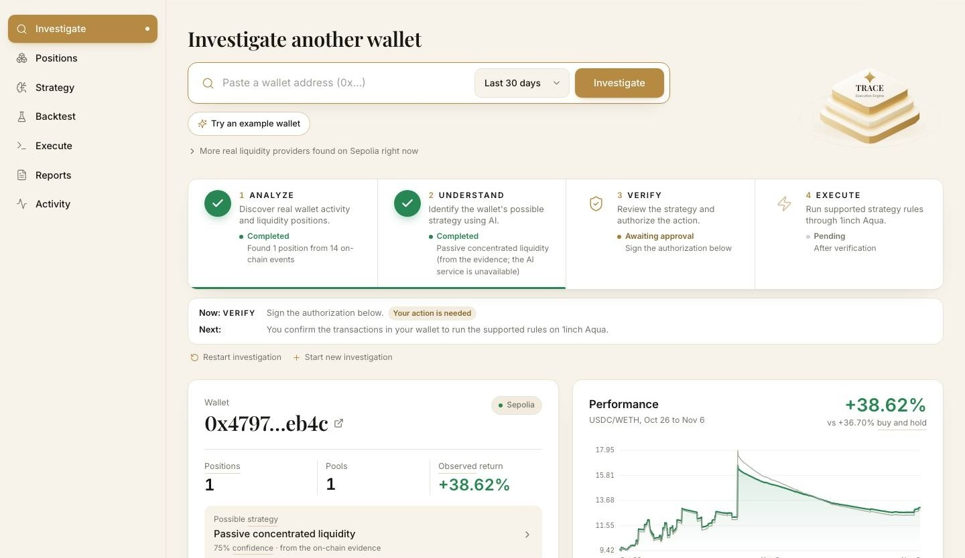
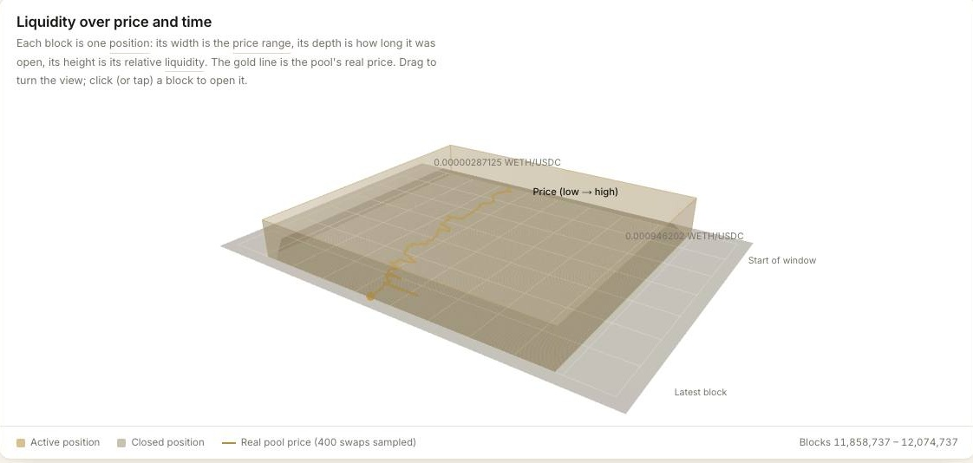
From a public wallet to an understandable liquidity strategy
THE PRODUCT · HOW IT WORKS
01
INVESTIGATE
trace-eth.vercel.app
Live product · Sepolia testnet
Enter any public Ethereum wallet address.
02
RECONSTRUCT
Rebuild Uniswap V3 positions: liquidity changes, range moves, fee collections.
03
UNDERSTAND
AI-assisted analysis names likely strategy patterns, each linked to on-chain evidence.
04
VALIDATE
Backtest candidate rules on historical swaps; compare return and risk.
05
EXECUTE
Check Aqua compatibility and prepare supported rules, with explicit human authorization.
Notes:
[~45 s, then switch to the LIVE DEMO] This is the live product on Sepolia. Paste a public wallet. TRACE rebuilds every Uniswap V3 position it held: deposits, withdrawals, range changes and fee collections. It proposes the strategy that best explains that behaviour, as a hypothesis with its evidence. You backtest the rules on real historical swaps, and if they are supported, TRACE prepares them for 1inch Aqua. Nothing executes without explicit human authorization. DEMO: pre-loaded wallet → positions → strategy with evidence → backtest → Aqua check → sign the authorization in MetaMask → approve + ship on Sepolia.

Slide 3



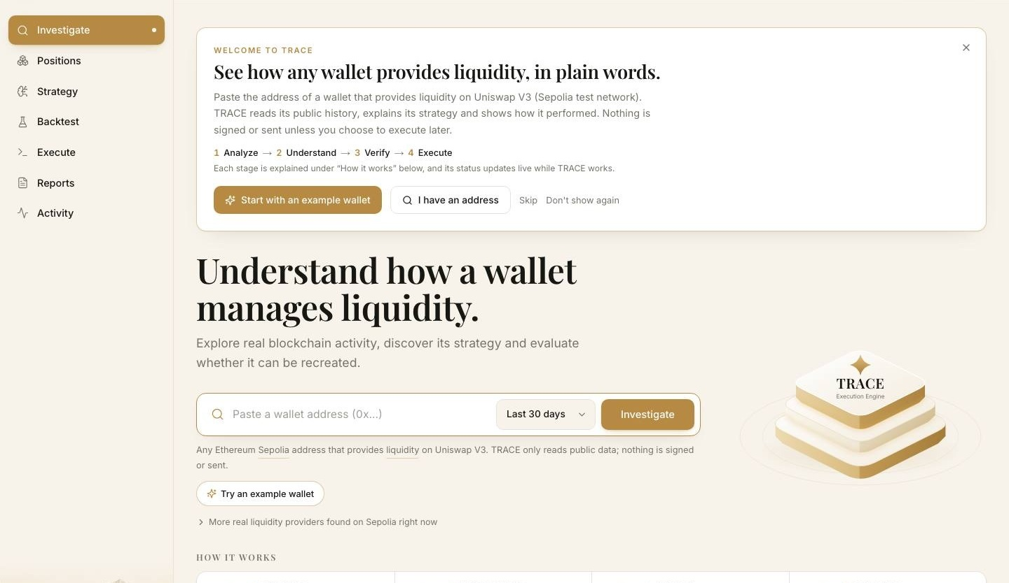
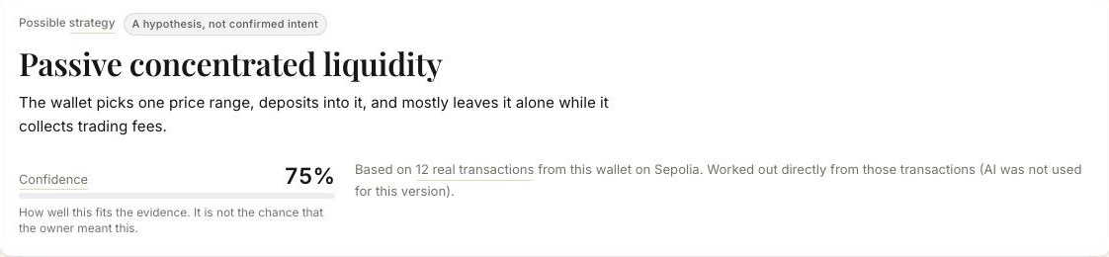
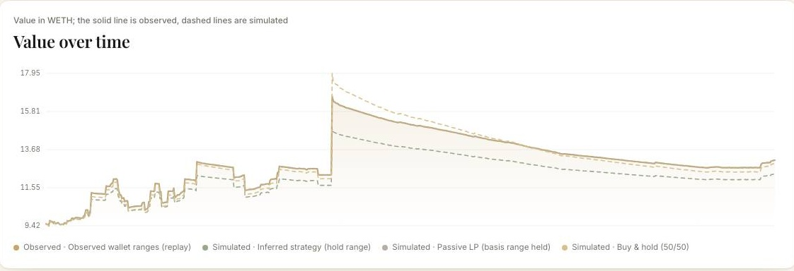


Built for people who want to understand liquidity, not just observe it
REAL USERS · REAL USE CASE
New liquidity providers
Experienced LPs
DeFi researchers & developers
PROBLEM Don't know how experienced LPs manage concentrated liquidity.
TRACE HELPS Study real LP behaviour and range moves; evaluate rules before deciding.
PROBLEM Researching and comparing other wallets by hand takes time.
TRACE HELPS Reconstruct positions, compare patterns and backtest candidate strategies.
PROBLEM Raw transactions are hard to turn into structured research.
TRACE HELPS Study position lifecycles and management patterns with linked evidence.
Illustrative scenario A user has $10,000 and wants to provide liquidity in an ETH/USDC Uniswap V3 pool.
1
Investigates a public LP wallet
2
TRACE rebuilds how it managed liquidity
3
Examines range changes and fee collection
4
Backtests a candidate strategy
5
Makes their own informed decision
Illustrative only. Not a promise of returns; historical backtests do not guarantee future results.
Notes:
[~40 s] Three groups need this. New LPs who don't yet know how concentrated liquidity is managed. Experienced LPs who spend hours researching other wallets. And researchers and developers who need structured data, not raw transactions. A simple example: someone has ten thousand dollars and wants to provide liquidity on ETH/USDC. They investigate a public LP wallet, TRACE rebuilds how it managed liquidity, they look at its range changes and fee collection, backtest a candidate strategy, and make their own decision. This is illustrative: TRACE informs a decision; it does not promise returns.

Slide 4






One intelligence layer. A powerful Web3 technology stack
BUILT WITH WEB3 ECOSYSTEM TECHNOLOGIES
Liquidity data
Execution layer · Aqua
V3 positions rebuilt from events; exact TickMath in BigInt
Order hash, approvals and price bounds verified before signing
Live on Sepolia
Ship verified · Sepolia test
TRACE
INTELLIGENCE ENGINE
Verifiable foundation
AI + storage
Every finding links back to its on-chain transaction
Private Computer inference; reports archived to 0G Storage
Live on Sepolia
Integrated · access + funding pending
Technologies TRACE builds with; no partnership or endorsement implied. Status as of 7 Nov 2026.
Green works today · Amber built, awaiting access
Notes:
[~40 s] TRACE is one intelligence layer on an open stack. Uniswap is the source: we rebuild V3 positions from events, with Uniswap's exact tick math. Ethereum is the verifiable foundation: every finding links to its transaction. 1inch Aqua is the execution layer: we compile supported rules into an Aqua strategy and verify the order hash, approvals and price bounds before anyone signs. 0G provides private inference and storage for reports. Every execution needs the user's own wallet signature, bound to this exact plan and verified on our server. Green is working today; amber is built and waiting on access. UPDATE THE 0G PILL BEFORE PITCHING if it comes online.

Slide 5


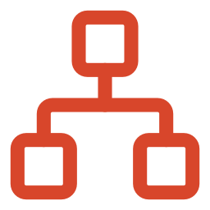
From understanding liquidity strategies to powering the future of DeFi
ROADMAP · LONG-TERM VISION
TODAY · LIVE ON SEPOLIA
Reconstruct Uniswap V3 positions · evidence-linked strategy hypotheses · backtests on real swaps · Aqua compatibility checks
01
02
03
04
PLANNED
PLANNED
PLANNED
PLANNED
Deeper intelligence
Personalized strategy intelligence
Controlled strategy automation
DeFi intelligence ecosystem
Expand Uniswap LP position and wallet analysis
Identify more liquidity-management patterns
Stronger evidence-backed strategy inference
Better backtesting and risk evaluation
User-specific strategy research
Risk-preference-aware comparisons
Wallet and strategy comparison
Alerts on meaningful strategy and position changes
More compatible Aqua execution workflows
Monitoring and condition-based actions
Controlled rebalancing where supported
Stronger human authorization and safety
Explore more protocols and liquidity markets
Developer APIs and research tools
Cross-protocol strategy analysis
More ecosystem integrations
Make liquidity behaviour easier to understand.
Make research relevant to each LP.
Less manual effort, users stay in control.
A reusable intelligence layer for DeFi.
Building progressively. Validating every step.
Notes:
[~40 s] Our immediate focus is making Uniswap liquidity behaviour understandable and verifiable; that works today on Sepolia. Next, we want to make that intelligence more personalized for individual LPs. Then, controlled strategy automation through compatible execution infrastructure, always with human authorization. Long term: a reusable intelligence layer that helps people understand and manage liquidity across DeFi. Everything right of 'today' is planned, not shipped. We want to grow step by step, validating every capability before expanding.

Slide 6




WHY TRACE IS DIFFERENT
From tracking wallets to understanding strategies
TRADITIONAL ANALYTICS
TRACE
Transaction history
Position lifecycle reconstruction
Wallet balances
Behavioural strategy intelligence
Position monitoring
Evidence-linked AI hypotheses
Basic activity metrics
Historical strategy backtesting
Compatibility-aware execution
Uniswap made liquidity accessible.
TRACE wants to make the intelligence behind that liquidity accessible too.
PRODUCT VISION
Make sophisticated liquidity-management behaviour easier to understand, evaluate and learn from.
TRACE — On-chain Strategy Intelligence
Understand. Reconstruct. Validate. Execute.
Don't just track what a wallet does. Understand the strategy behind it.
Notes:
[~35 s] Wallet analytics tell you what happened: transactions, balances, positions. TRACE tells you how a position was managed and why: lifecycle reconstruction, behavioural strategy intelligence, evidence-linked hypotheses, backtests, and a compatibility-aware path to execution. Our vision is to make sophisticated liquidity management easier to understand, evaluate and learn from. Uniswap made liquidity accessible. TRACE wants to make the intelligence behind that liquidity accessible too. Thank you.

