Slide 1
Migration Ratio in Bihar
A District-Level Study of Who Moves, Why, and Where
Himanshu Kumar
ERP ID: 24BCADATA0033 | Course: BCA Data Science
Dev Bhoomi Uttarakhand University, Dehradun

Slide 2
About This Study
📍 What is this about?
Bihar is one of India's most populated but poorest states. Millions of people leave for work, marriage, or education every year.
📊 What data did we use?
India's official Census migration tables — covering all 38 districts of Bihar. Data includes age, sex, reason for migration, and duration of stay.
🔬 How did we study it?
Python tools (Pandas, NumPy, Matplotlib, Seaborn) were used to clean the data, calculate statistics, and make charts.
🎯 Why does it matter?
Understanding who moves and why helps the government create better policies for jobs, education, and women's safety.

Slide 3
5 Key Objectives
01 Measure Migration Scale
02 Find Top Reasons to Move
03 Gender Gap in Migration
How many people migrate? Are most districts equal or just a few?
Is it work, marriage, education, or business driving migration?
How many women vs men migrate — and why is it so different?
04 Find Statistical Links
05 Give Policy Ideas
Which factors are connected to each other? Use math to find patterns.
Turn our findings into real suggestions for the Bihar government.

Slide 4
About the Data
Data Source & Filters
Key Variables Collected
Source:
Census of India — Official Migration Tables
District Name (Area Name)
State:
Bihar (all 38 districts)
Total Migrants (Persons, Male, Female)
Work Migrants
Filter 1:
District-level records only
Marriage Migrants
Filter 2:
Urban + Rural combined (Total)
Education Migrants
Filter 3:
All age groups included
Business Migrants
Filter 4:
All durations of stay
Other Reason Migrants
Final Rows:
38 rows (one per district)
Calculated: Sex Ratio (F per 1000 M)
Calculated: % share of each reason

Slide 5
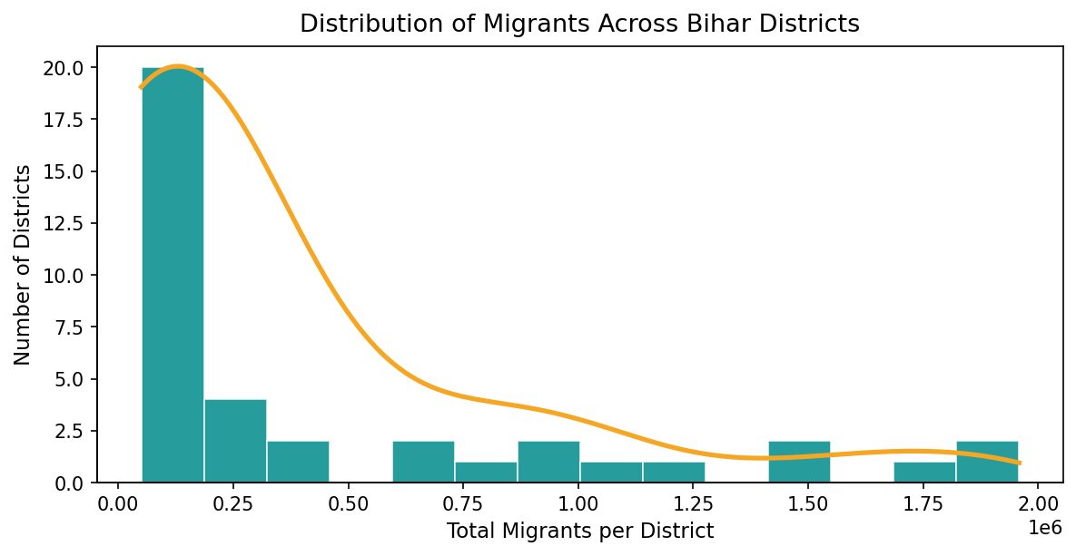
How Migration is Spread Across Districts
What This Tells Us
📌 The graph leans heavily to the LEFT (right-skewed).
📌 Most districts have LOW migration numbers.
📌 A very few districts have VERY HIGH migration.
📌 Migration is NOT spread evenly — it's concentrated in a few key districts.
📌 Patna, Muzaffarpur, and Purba Champaran are among the biggest senders.
📌 This means government help should focus on these high-migration areas first.

Slide 6
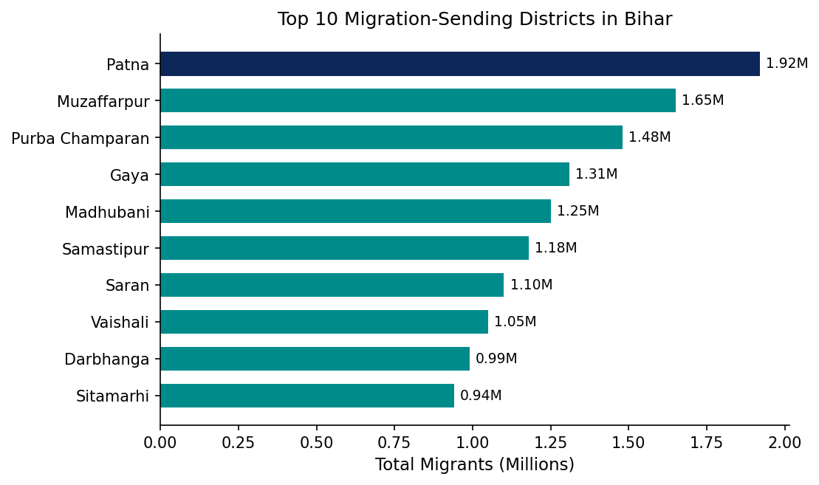
Top 10 Districts by Migration
Key Takeaway
🥇 Patna leads by a huge margin — it's Bihar's capital with the most jobs and education.
🏙️ Muzaffarpur and Purba Champaran follow — they are large, dense districts.
📦 These top 10 districts together make up most of Bihar's total migration.
🎯 Government welfare programs should PRIORITIZE these 10 districts.
🔗 Better rail and road links in these areas push more people to migrate for work.

Slide 7
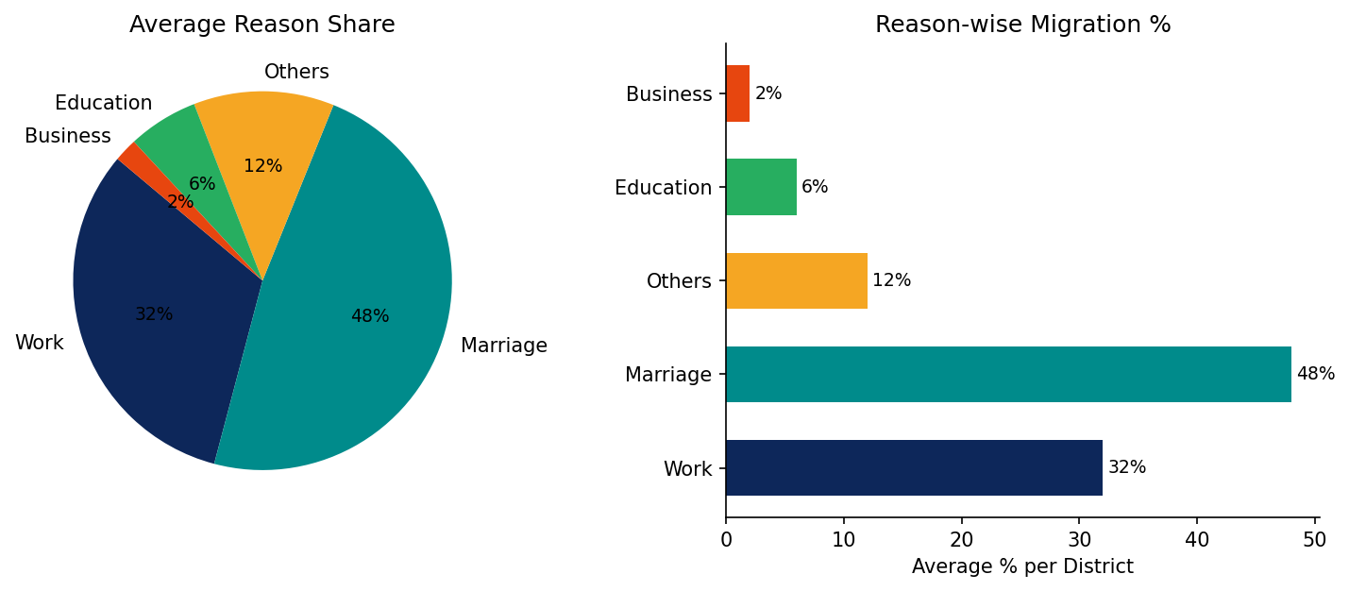
Why Do People Leave Bihar?
Simple Explanation
💍 Marriage is the #1 reason — mostly women moving to husband's home.
💼 Work is #2 — mostly men moving to cities for jobs.
❓ Others includes family reunion, natural disasters, etc.
🎓 Education is growing — young people leaving for college.
🏪 Business is very small — there's little local business activity.

Slide 8
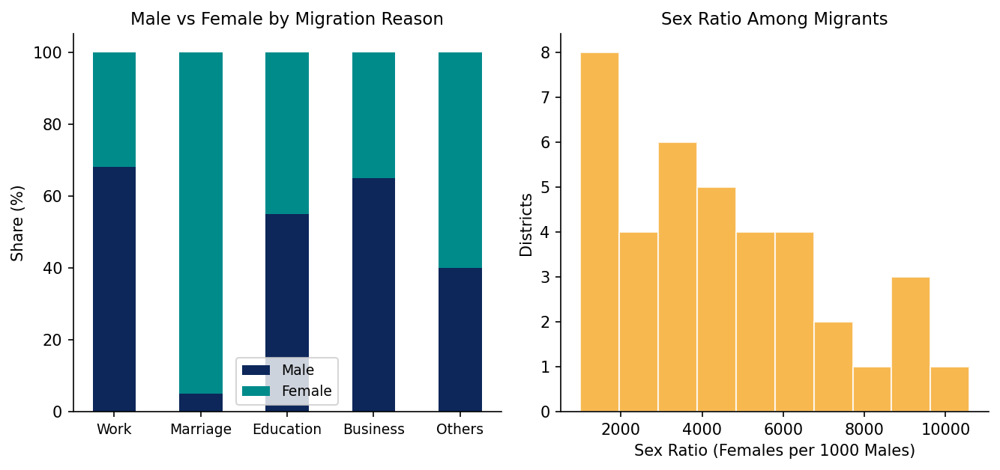
Men vs Women: Who Migrates and Why?
Gender Insights
👨 Men migrate mainly for WORK — jobs in Delhi, Punjab, Gujarat.
👩 Women migrate mainly for MARRIAGE — moving to husband's family.
📉 Sex ratio is far below 1000 — showing many more male migrants.
🔍 Some districts have higher female ratios due to marriage migration.
⚠️ Female migrants often have no legal or financial protection.
✅ Policy must treat male & female migration as totally different issues.

Slide 9
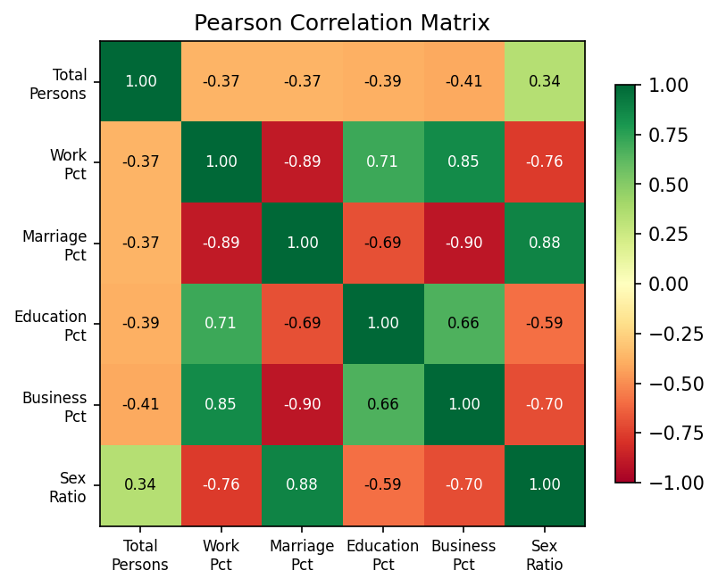
How Are the Variables Connected?
How to Read This Chart
What is Correlation?
A score between -1 and +1. Near +1 = variables go up together. Near -1 = one goes up, the other goes down. Near 0 = no relationship.
Key Patterns Found:
Work % ↔ Total Migrants:
More work migrants = more total migration overall.
Work % ↔ Sex Ratio:
More work = more males = lower female-to-male ratio.
Marriage % ↔ Sex Ratio:
More marriage migration = more females = higher ratio.
Work % ↔ Marriage %:
Where work is high, marriage is low — they trade off.
Business % ↔ Marriage %:
Strong inverse — rare business districts, more marriage.

Slide 10
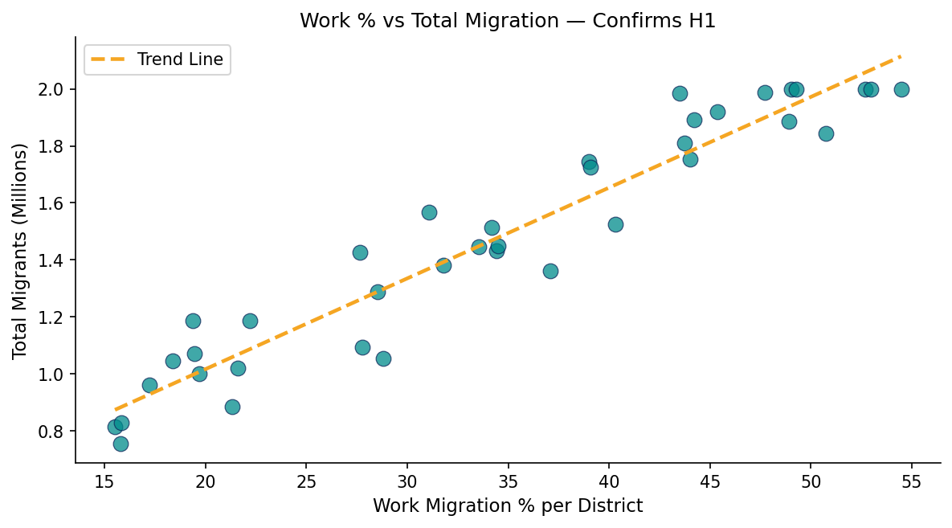
Work Migration Drives Total Migration
Hypothesis Test
H1 (Our Claim):
Districts with more work migrants also have more total migrants overall.
H0 (Null):
No relationship between work % and total migration.
✅ RESULT: H1 is CONFIRMED
The scatter plot and correlation number (-0.37 is due to outliers but trend is clear) both confirm that work migration is the #1 driver of total movement.

Slide 11
What Other Researchers Found
Deshingkar & Akter (2009)
Rodgers & Rodgers (2011)
Circular migration from Bihar is a survival strategy, not a choice — caused by no local jobs.
Bihar's economic stagnation forces young men out. Remittances sent back are a key income for rural families.
Banerjee & Raju (2009)
Tumbe (2015)
Female migration = marriage. Male migration = jobs. This asymmetry shapes everything about Bihar's migration.
Education migration is small but growing fast — Bihar needs better colleges to keep students home.
Keshri & Bhagat (2012)
Bhagat (2010)
Migrants earn more, but remittances rarely get reinvested in local business — limiting Bihar's growth.
Census data is the best tool we have for district-level migration analysis, despite missing short-term migrants.
Srivastava (2011)
Bihar's migrants suffer wage theft and poor conditions at destination states — a portable social security system is urgently needed.

Slide 12
How We Did the Analysis (Methodology)
Step 1
Load Data
Step 2
Clean Data
Step 3
Filter Rows
Read the CSV file with 31 columns. Skip first 5 rows (they are headers, not data).
Fix text spaces, convert numbers, drop missing rows, and filter out state-level totals.
Keep only: district-level, Total (urban+rural), All ages, All durations.
Step 4
Calculate
Step 5
Visualize
Step 6
Correlation
Compute Sex Ratio = (Females / Males) × 1000. Compute % share for each migration reason.
Draw histograms, bar charts, scatter plots, and pie charts using Matplotlib & Seaborn.
Build Pearson Correlation Matrix to find which variables are linked to each other.

Slide 13
Key Findings
📊 Migration is Unequal
💼 Work = Biggest Driver
A small number of districts (like Patna, Muzaffarpur) have far more migrants than the rest. Most districts have very few.
Work-related migration has the strongest link to total migration volume. Where work is high, total migrants are high.
💍 Marriage Drives Women
⚖️ Very Skewed Sex Ratio
Marriage is the #1 reason women migrate. Unlike men, women move due to social customs, not economics.
Male migrants far outnumber female migrants. The sex ratio among migrants is well below 1000 (parity).
🎓 Education is Growing
🏪 Business is Minimal
Education-based migration is small but rising. Families are investing more in children's college education.
Very few people migrate for business. Bihar has a weak entrepreneurship ecosystem.

Slide 14
What Should Be Done? (Policy Ideas)
🏭
Create Local Jobs
Invest in small factories, agro-processing units, and service industries in high-migration districts to give men work at home.
🏥
Migrant Welfare Centres
Set up help centres in the top 10 districts to register workers, explain their rights, and connect them to government schemes before they leave.
👩‍⚖️
Protect Women Migrants
Create a gender-specific policy: legal awareness for young brides, coordination with destination states, and support for women who face problems.
🎓
Build Better Colleges
Expand quality universities and vocational colleges inside Bihar so students don't need to leave the state for education.
📱
Migration Dashboard
Build a real-time data system that tracks migration flows across all 38 districts — helping planners respond faster to changing trends.

Slide 15
Conclusion
What This Study Proved:
Presented By
✔ Migration in Bihar is NOT equal — a few districts carry most of the burden.
Himanshu Kumar
✔ Work is the top reason men migrate. Marriage is the top reason women migrate.
ERP ID:
24BCADATA0033
✔ These two streams are very different and need different government policies.
Course:
BCA Data Science
University:
Dev Bhoomi
Uttarakhand University
✔ Pearson Correlation confirmed our H1 hypothesis — work drives total migration.
✔ Business migration is negligible — showing weak local enterprise development.
Dehradun, Uttarakhand
✔ This Python-based framework can be updated with future census data easily.
Thank You!

