Slide 1

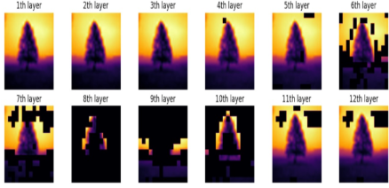
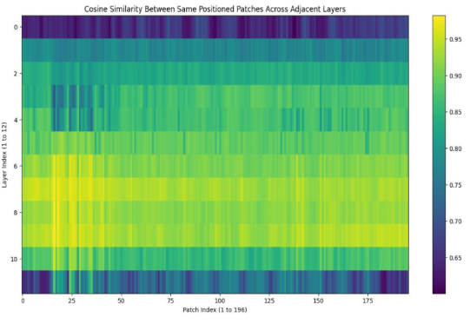
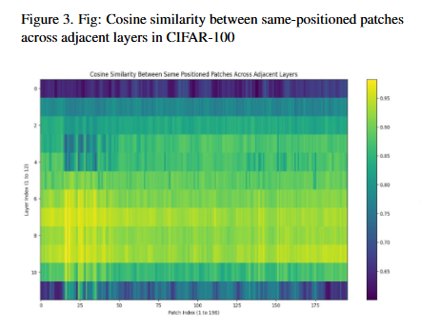
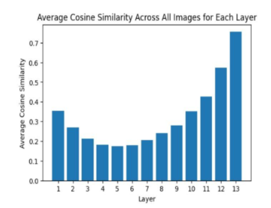
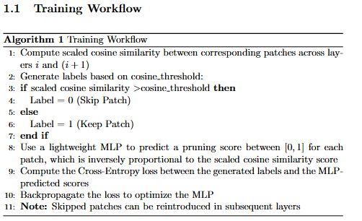
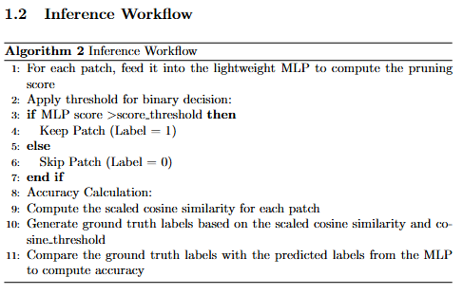
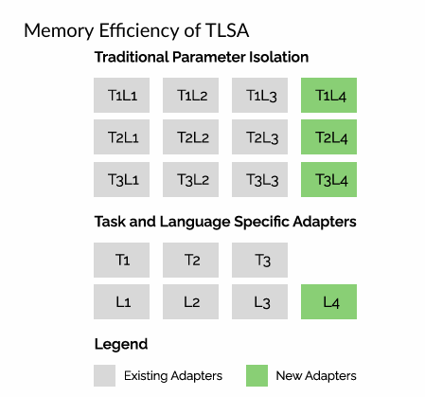
PATCH PRUNING IN VISION TRANSFORMERS
ENGINEERS’ CONCLAVE
Team ID: 39
IDEATION
BASIS OF THE APPROACH
Vision Transformers (ViTs) excel in visual tasks by modeling global context via self-attention, but this leads to high computational and memory costs, especially when processing redundant image patches. The quadratic growth of MHSA computations with the number of patches exacerbates inefficiencies.
This work introduces a novel pruning approach for ViTs that balances computation and accuracy, while enhancing the model’s explainability by identifying and skipping redundant patches.
We observed that, the average cosine similarity between the patches withing a layer is first decreasing and then rising to large values such as 0.6, 0.7, Also, we can observe that, as we go deep into the layers, the patches at same location have very close similarity, approaching nearly 0.9. This redundancy can be resolved by selectively pruning similarly positioned patches across the layers.
Above image depicts the layer wise pruned patch outputs, for ‘tree’ labelled image from CIFAR 100
PROTOTYPE DESCRIPTION
Optimization Objective for Task t and language l
Our mode aims to optimize Vision Transformers by dynamically pruning redundant patches using cosine similarity. A lightweight MLP predicts pruning scores to balance computation and accuracy while ensuring adaptability and model explainability
The prototype employs an MLP to predict pruning scores based on cosine similarity between patches.
During training, pruning labels are generated and refined, while at inference, patches are skipped or retained based on these scores, ensuring efficient and adaptive performance.
Following training and the testing workflows are employed in our approach
RESULT & CONCLUSION
Our patch pruning approach reduces the computational complexity of Vision Transformers (ViTs) while preserving accuracy. By dynamically identifying redundant patches using cosine similarity, it enhances efficiency and offers insights into ViT behavior. This improves model explainability and promotes more interpretable, resource-efficient models.
An illustration of adding new adapters with a new language is shown. The parameter isolation based approach grows adapters as O(T X L) . TLSA reduces this to linear complexity, O(T + L) .

