Slide 1
Computer Engineering Department
A.P. Shah Institute of Technology G.B.Road,Kasarvadavli, Thane(W), Mumbai-400615
UNIVERSITY OF MUMBAI
Academic Year 2019-2020

Slide 2
Decentralized Real Estate Application Using Blockchain
A Project Report on
Submitted in partial fulfillment of the degree of
Bachelor of Engineering(Sem-7)
in
Computer Engineering
By
Siddhant Bhadsavle(16202038) Himanshu Malhotra(17202006)
Under the Guidance of Prof.Sachin Malve

Slide 3
1.Project Conception and Initiation

Slide 4
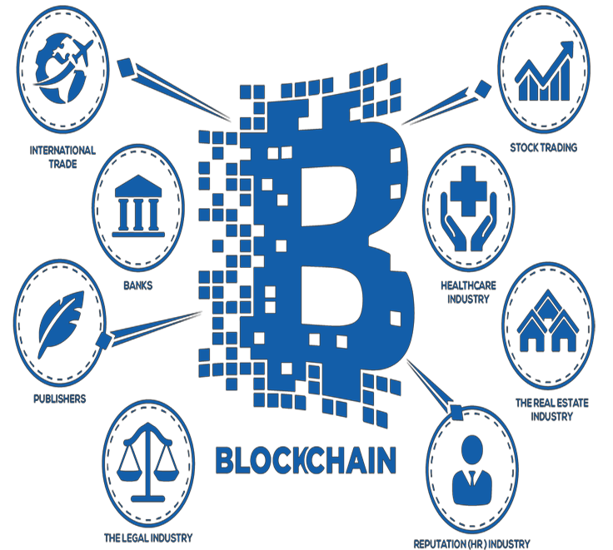
1.1 Abstract
Massive Momentum
Distributed Ledger
Real estate Transparency

Slide 5
1.2 Objectives
Trust between theparties.
Transparency in the system.
To reduce paperwork and its related costs.

Slide 6
1.3 Literature Review
Transparent Record Keeping
One of the easiest explanation is that we could define blockchain as a trusted
network for keeping and managing the records.

Slide 7
1.4 Problem Definition
Problems arised due to loopholes in law
Increasing frauds in land registrations

Slide 8
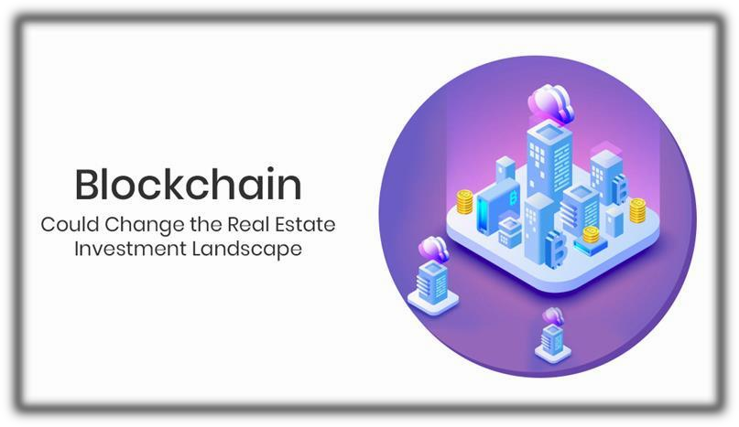
1.5 Scope
Blockchain based website.
Establish registration transparency.
Use of ERC20 token.

Slide 9
1.6 Technology stack
Ethereum
NodeJs
Solidity
Ethers.js
TestNets
MetaMask
React.js

Slide 10
1.7 Benefits for environment & Society
Curbs fraudulent registration
Establishes trust between the parties
Reduces registration cost

Slide 11
2. Project Design

Slide 12
2.1 Proposed System
Real estate on decentralized network
Transparancy in ownership
Reduction in paperwork

Slide 13
2.2 Design(Flow Of Modules)
Module 1:- Ethereum Wallet
Module 2:- KYC
Module 3:- Land Registration
Module 4:- Ownership Transaction

Slide 14
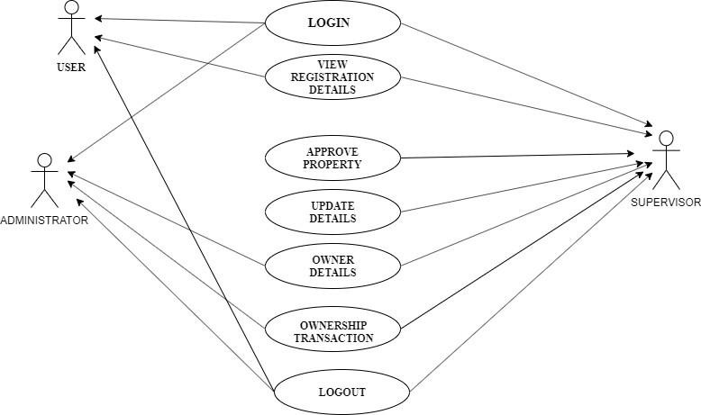
2.3 Description Of Use Case

Slide 15
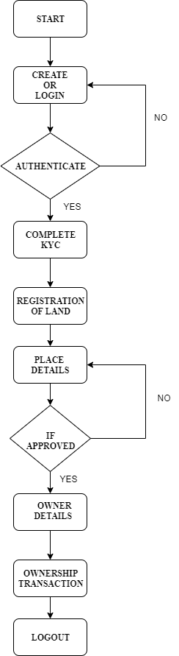
2.4 Activity diagram

Slide 16
2.6 Module-1
Ethereum Wallet:
What is Ethereum wallet?
How to create a Ethereum wallet?

Slide 17
Module-2
KYC:
KYC means ‘Know Your Customer’.
It is the process of a business verifying the identity of its clients and assessing their suitability, along with the potential risks of illegal intentions towards the business relationship.

Slide 18
Module-3
Land Registration:
The land registration module is the key module of the entire project
The user can actually register his/her land on an authenticated person's name without
actually involving any of the intermediaries like lawyer.

Slide 19
Module-4
Ownership Transaction
The seller can give the ownership to the buyer and at that moment ownership transaction will take place in the form of token .
The seller in a very authenticate way gives the land ownership to the buyer using a
blockchain platform.

Slide 20
2.7 References
Nathan Shedroff “Self-Managing Real Estate”, IEEE 2018.
Shuai Wang , Liwei Ouyang, Yong Yuan , Senior Member, IEEE, Xiaochun Ni,
Xuan Han,and Fei-Yue Wang ”Blockchain-Enabled Smart Contracts: Architecture,
Applications, andFuture Trends”
Alex Norta, Chad Fernandez and Stefan Hickmott “Commercial Property Tokenizing With Smart Contracts”, IEEE 2018

Slide 21
3.Planning for next semester

Slide 22
Planning
Wallet
Land Registration
Ownership Transaction

Slide 23
Thank You

