Slide 1
Computer Engineering Department
A.P. Shah Institute of Technology G.B.Road,Kasarvadavli, Thane(W), Mumbai-400615
UNIVERSITY OF MUMBAI
Academic Year 2019-2020

Slide 2
Decentralized Real Estate Application Using Blockchain
A Project Report on
Submitted in partial fulfillment of the degree of
Bachelor of Engineering(Sem-7)
in
Computer Engineering
By
Siddhant Bhadsavle(16202038)
Himanshu Malhotra(17202006)
Under the Guidance of Prof.Sachin Malve

Slide 3
1.Project Conception and Initiation

Slide 4
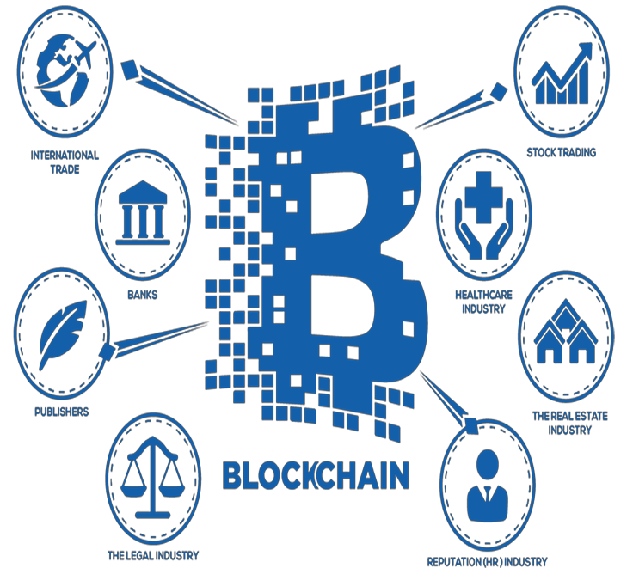
1.1 Abstract
What is blockchain?
Why it makes sense for
Land Records?

Slide 5
1.2 Objectives
Enables an ‘unhackable’ public record
Restore faith in Govt.
Paperless transactions

Slide 6
1.3 Literature Review
Self-Managing Real Estate - 10.1109/MC.2018.1151007
Blockchain-Enabled Smart Contracts: Architecture, Applications, and Future Trends
-10.1109/TSMC.2019.2895123
Commercial Property Tokenizing With Smart Contracts-10.1109/IJCNN.2018.8489534

Slide 7
1.4 Problem Definition
Time Delays
Human Intervention
Fraud Realtors
Involvement of middlemen

Slide 8
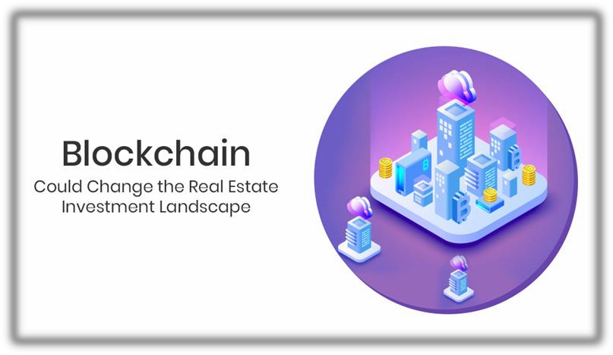
1.5 Scope
Blockchain based website.
Establish land record transparency.

Slide 9
1.6 Technology stack
Ethereum Test Network (Ropsten)
NodeJs
Solidity
Ethers.js
TestNets
MetaMask
React.js

Slide 10
1.7 Benefits for environment & Society
Accelerate the process
Reduces fraud cases
Avoids broker charges

Slide 11
2. Project Design

Slide 12
2.1 Proposed System
Land Records on blockchain
Include an Ethereum wallet

Slide 13
2.2 Design(Flow Of Modules)
Module 1:- Ethereum Wallet
Module 2:- KYC
Module 3:- Land Registration (Land Records)
Module 4:- Ownership Transaction

Slide 14
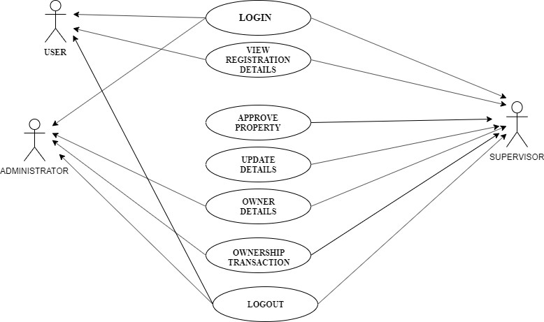
2.3 Description Of Use Case

Slide 15
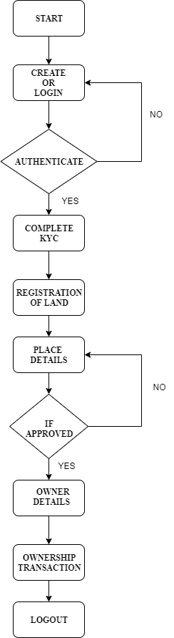
2.4 Activity diagram

Slide 16
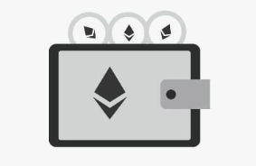
2.6 Module-1
Ethereum Wallet:
What is Ethereum wallet?
How to create a Ethereum wallet?

Slide 17
Module-2
KYC:
KYC means ‘Know Your Customer’.
It is the process of a business verifying the identity of its clients and assessing their suitability, along with the potential risks of illegal intentions towards the business relationship.

Slide 18
Module-3
Land Registration:
The land registration module is the key module of the entire project
The user can actually register his/her land on an authenticated person's name without the need of any intermediaries

Slide 19
Module-4
Ownership Transaction
The seller can give the ownership to the buyer and at that moment ownership
transaction will take place in the form of token .
The seller in a very authenticate way gives the land ownership to the buyer using a blockchain platform.

Slide 20
2.7 References
[1]Nathan Shedroff “Self-Managing Real Estate”, IEEE 2018.
[2]Shuai Wang , Liwei Ouyang, Yong Yuan , Senior Member, IEEE, Xiaochun Ni, Xuan Han,and Fei-Yue Wang ”Blockchain-Enabled Smart Contracts: Architecture, Applications, andFuture Trends”
[3]Alex Norta, Chad Fernandez and Stefan Hickmott “Commercial Property Tokenizing With Smart Contracts”, IEEE 2018

Slide 21
3.Planning for next semester

Slide 22
Planning
Wallet
Land Registration
Ownership Transaction

Slide 23
Thank You

