Slide 1

Air Filter Chamber
Problem Statement: Air Pollution
Project Leader:Himanshu Mishra

Slide 2
Air Pollution
Air pollution is a mixture of solid particles and gases in the air. Car emissions, chemicals from factories, dust, pollen and mold spores may be suspended as particles. Ozone, a gas, is a major part of air pollution in cities. When ozone forms air pollution, it's also called smog. Some air pollutants are poisonous.
Causes
Disastrous Effects of Air pollution
Causes
Disastrous Effects of Air pollution
Respiratory and heart problems.
Global warming.
Acid rain.
Depletion of the ozone layer.
Effect on wildlife.
The burning of fossil fuels.
Exhaust from factories and industries.
Mining operations.
Indoor air pollution.
Agricultural activities.
Respiratory and heart problems.
Global warming.
Acid rain.
Depletion of the ozone layer.
Effect on wildlife.
The burning of fossil fuels.
Exhaust from factories and industries.
Mining operations.
Indoor air pollution.
Agricultural activities.

Slide 3
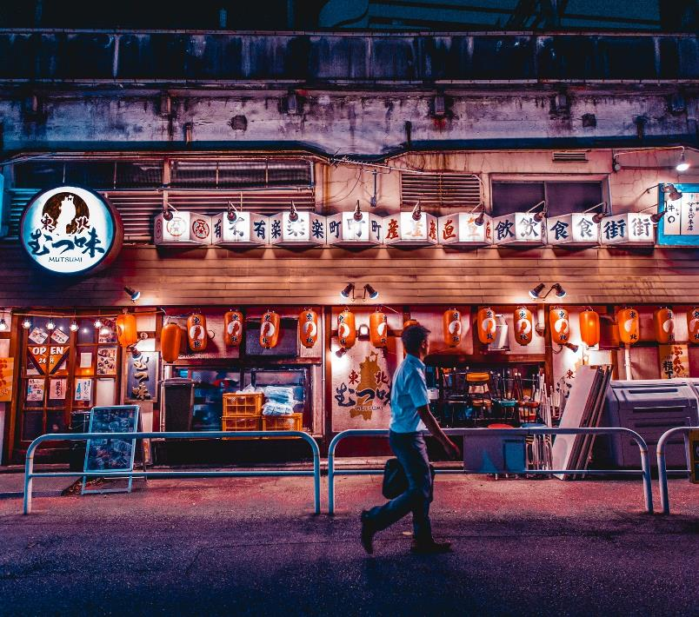
Objective
Our objective is to tackle the problem of air pollution and resolve it in cost effective way.
Our projects help in detecting the air quality of air within certain radius area and,
If it found air quality is bad then air filtration process start otherwise in sleep mode in order to save power.

Slide 4
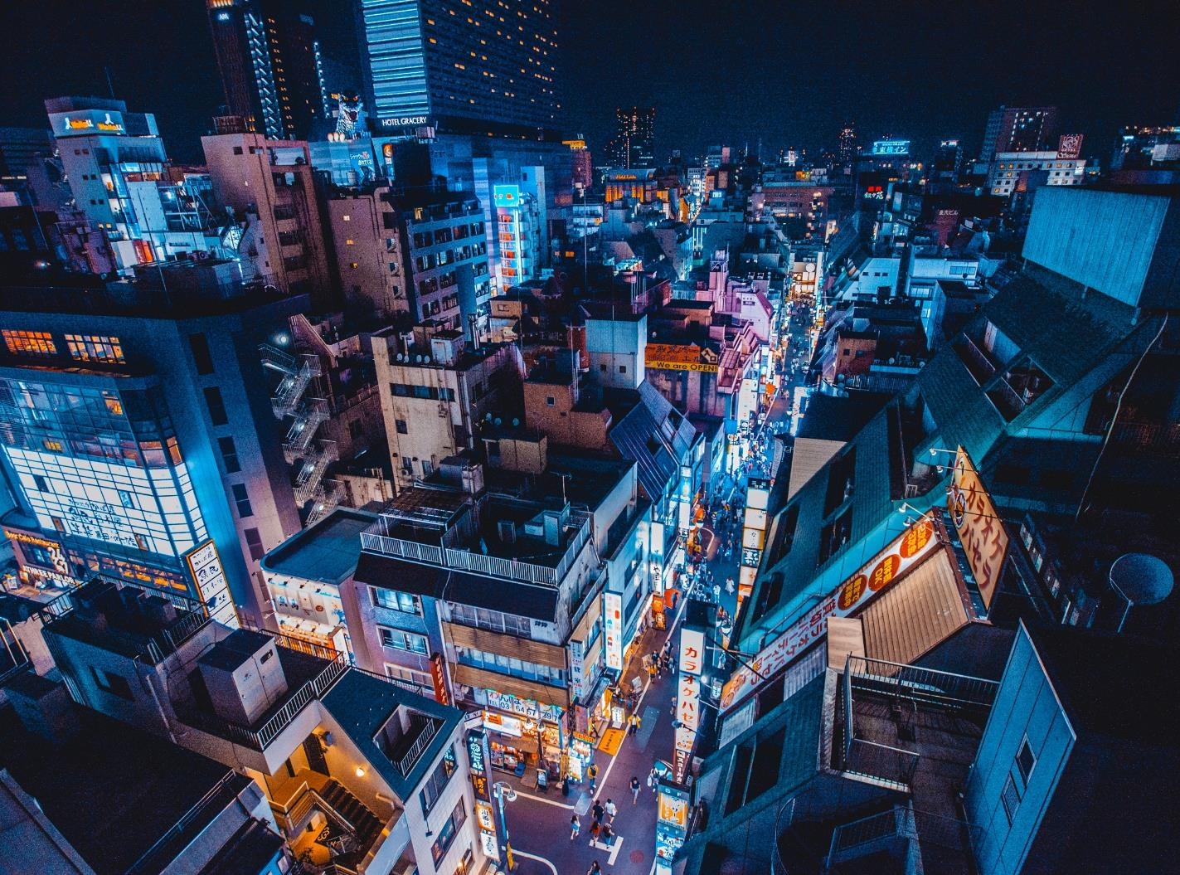
Section 1
Detect the surrounding air quality using different sensors and initiate air filter chamber if air quality is not good.

Slide 5
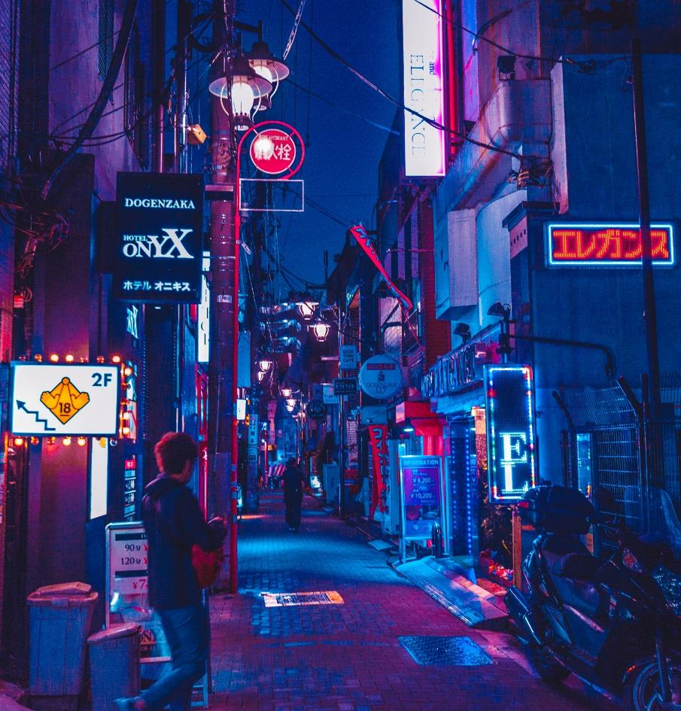
First stage
Air Quality detection
We will fix air quality sensor to check quality of air regularly and it shares its data with filter chamber.
If detected value is more than the threshold value then filtration process starts.
First we will use water sprinkler in to settle down major dust particles on ground and then (this process will be done in external area like park and field only),
In filtration, we will remove the micro dust particles of air.

Slide 6
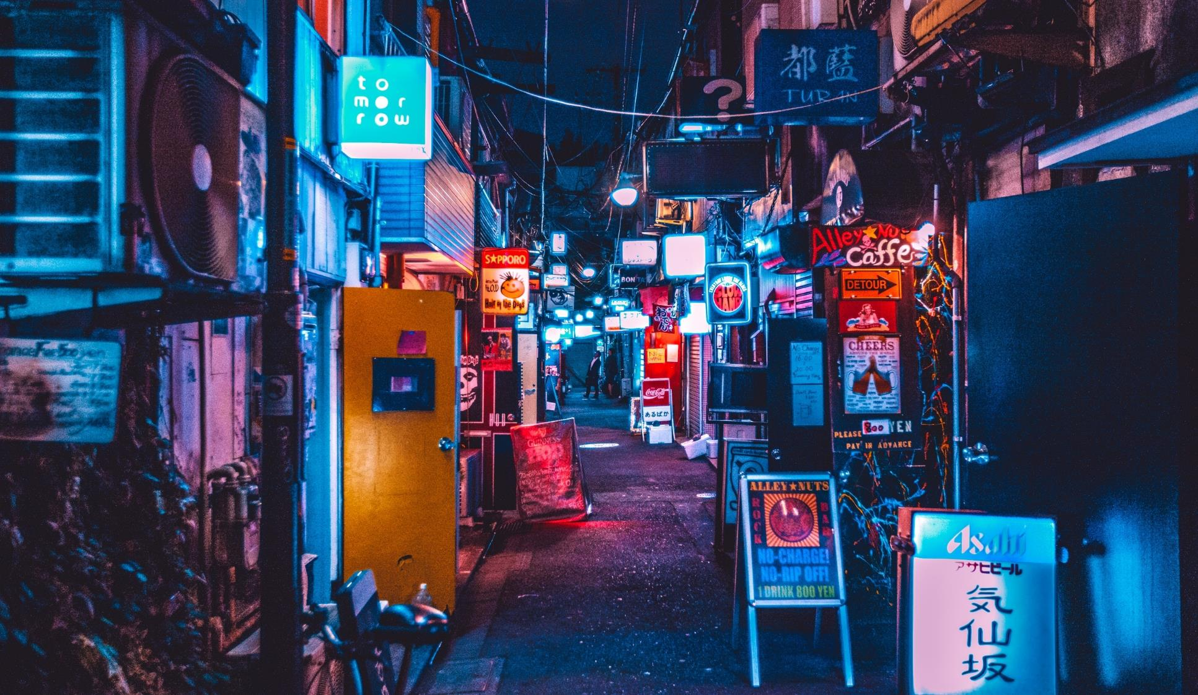
Section 2
Air filtration process start and releasing fresh air. Process continues until air quality detected didn’t reach below threshold value.

Slide 7
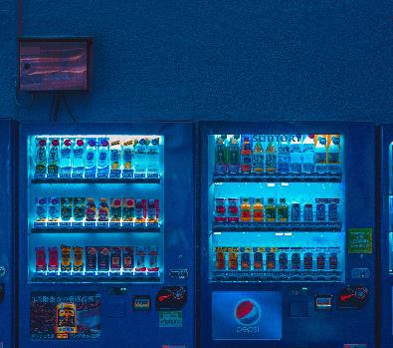
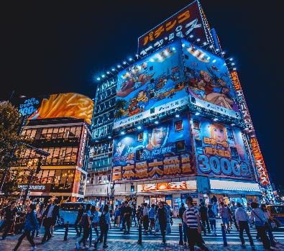
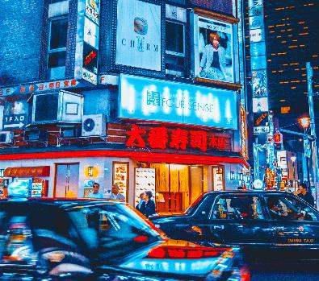
Second stage
Emitting fresh air
In filtration process, we will first remove dust particles and then by using HEPA filter we will filter micro level particles in polluted air.
Air exhaust chamber continuously exhaust fresh air outside.
This process will continue until external and internal air quality value gets same.

Slide 8
Technology Stack
Compare internal and external air quality
Check Air Quy
Exhaust Fresh air
Filtration starts
Air vacuum starts
Check Air Quality

Slide 9
Prototype View
Vacuum Blade
Air Funnel
MQ 135 Sensor for external air quality check
Internal filter Chamber
Outer Body
External filter Chamber
MQ 135 Sensor for internal quality check
Exhaust fresh air chamber
Movable Platform

Slide 10
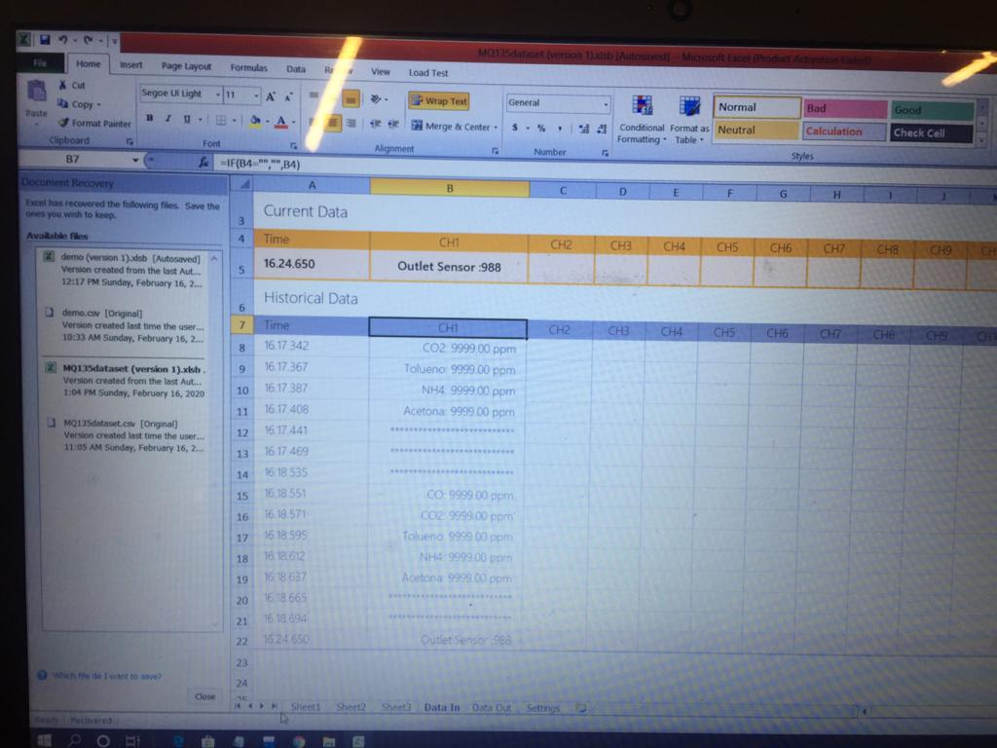
Live Data set fetch Image

Slide 11
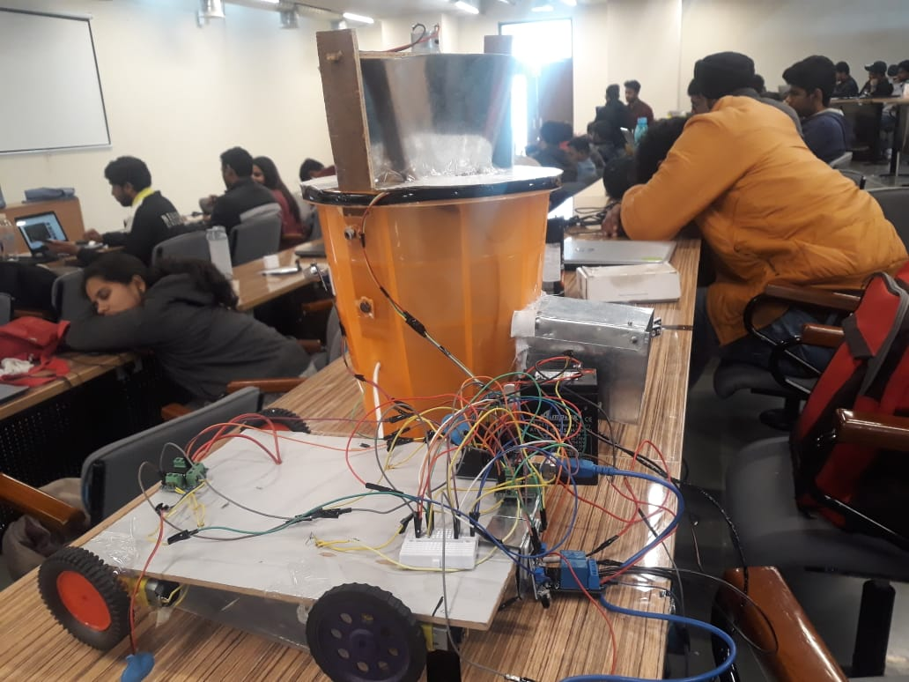
Movable platform

Slide 12
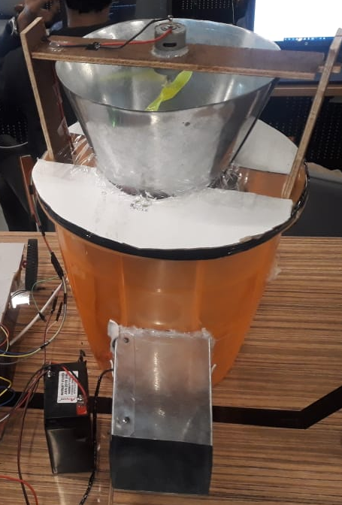
Filter body part

Slide 13
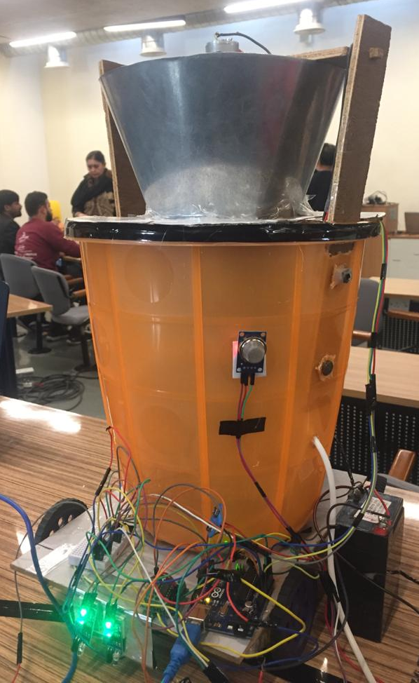
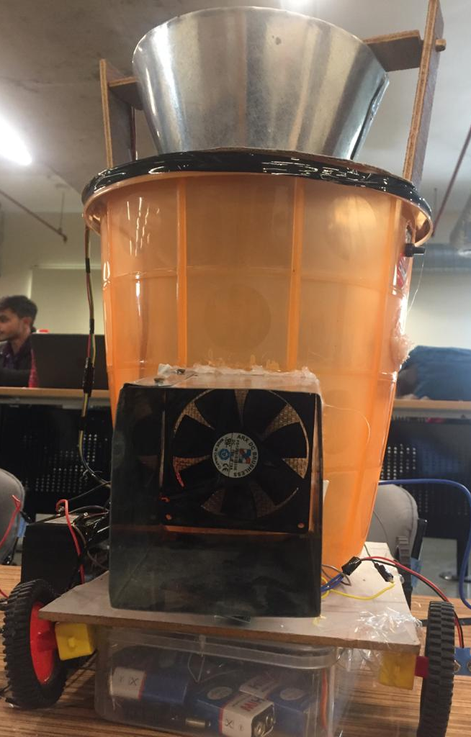
Final Prototype
Back Body Part
Front Body Part

Slide 14
Thank You !

