Slide 1

Azure Migration – PAM

Slide 2

PFI – Our Understanding of Project Scope
Objective:
Move to cloud by transformation monolith to microservices . Preferences more to Azure PaaS or Managed Kubernetes
Components | Current Teck Stack(with version)
Web application(External & Internal)/ UI
Batch Services
Utility Servers(Console applications)
COM libraries
DB
ETL/Reporting
Webservice (SOAP)
REST services
Notification Services
Authentication
FTP Server and SFTP
DB Objects(SP,Trigger,etc)
OS Layer
Disposition
In-Scope
Lay the foundation for target state through Azure Cloud technologies
Strategize decoupling of tightly coupled applications
Identify services in PAMS application
Dockerization containerization of applications
UI layer to be migrated/built in React JS
Set up CI/CD pipeline for deployment
Modernization of stored procedures to micro services ??
Out-of-Scope
Infra and access set-up is Out of scope
Testing is currently Out-of-scope, assuming it would be dealt by QA team
Setting-up Replication tools viz. CDC
Database setup and migration
2

Slide 3


High Level Solution Options

Slide 4
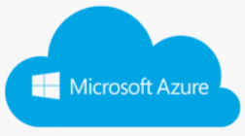

Overall Solution options, to cater to current Scope
Solution Tenets
Web UI-ReactJS
Cloud native assessment & Container driven approach
1
WPF UI
Refactor/ Remediate and Containerize
Re-platform /Refactor and containerize in Azure
WCF Services
Container Platform (AKS/ARO)
2
Re-Architect / Decompose & Containerize
Re-Architect microservices
Native C++
Integrated DevOps
Azure Batch & other services
Leverage Azure batch
Batch
Solutions and Accelerators

Slide 5
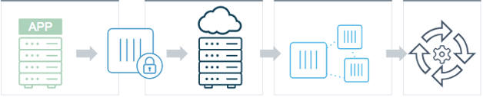
App Transformation Options
Eventual Modernization Journey…
Lift & Shift
Deploy/Manage Docker
Re-architect/Revise
CaaS/PaaS
App on VM server
Put on Container
Host it on Azure
Decompose into Microservices
Integrate into CICD & Automation systems
1
Option-1:
Remediate/Re-factor, Containerize (AKS/App Service)
Option-2:
Microservices on Azure AKS/ARO
2
Simplest option to start the journey, without disturbing many components in first-go
Least Risk, Minimal Code Change
Continues to bear have a higher Technical Debt and a longer Enhancement/Maintenance cycle
Eventual state for any Cloud based application
Enterprise Kubernetes offering so can scale run
Integrates easily with Azure DevOps
Getting locked into specific cloud provider

Slide 6
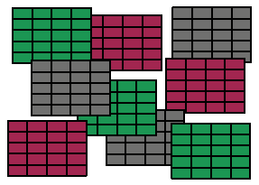
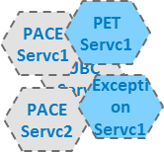
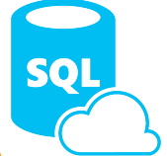
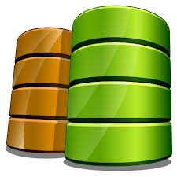
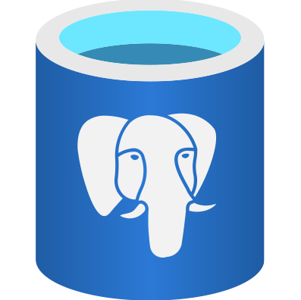
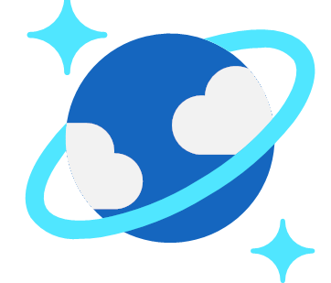
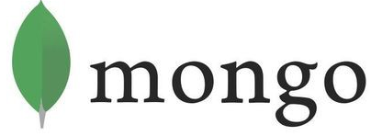

Data Transformation Options
Option-1:
Existing DB On-premise
Option-2:
Same monolith DB on Azure(RDBMS) SQL Azure sql/ Oracle
Option-3:
Decompose DB – Azure Postgres / NoSQL
Cloud Infra
Cloud Infra
Cloud Infra
Monoliths
Microservices
Monoliths
Microservices
Monoliths
Microservices
Move data to cloud
Maintain same monolith Database
Maintain the same DB objects – viz. Stored procs, etc
Move Data to Cloud
Decompose Databases to micro DBs
Leverage Cloud neutral DBs(Azure Postgres or NoSQL)
Just move app to cloud
Invoke On-Prem DB
Azure SQL
Oracle on IaaS
Integration Layer
Replication Layer
Replication Layer
On Premise DC
On Premise DC
On Premise DC
Oracle / MSSQL
Oracle / MSSQL
Oracle / MSSQL
Simplest option to start the journey, without disturbing many components in first-go
Least Risk, No place change. Most consumers/providers are same
Continues to bear cost, as DB and associated workloads continue to be on-Premise
Relatively less riskier, as it is a homogeneous migration
Log-based replication leveraging CDC for real-time sync. Options to address Latency issues available
Continues to bear cost and complexity due to the use of oracle and the monolith DB nature
Perhaps the right step in the cloud journey, inline with eventual Target state – Both cost & performance
Near match to performance norms

Slide 7
Re-platform to container
1

Slide 8


Application Transformation – Refactor/Remediate & Containerize
8
Containerize applications – Refactor/Remediate
Current
Containerization Phase
Determine the gaps in supporting containerization
Remediate the application code and configurations
Externalize the configurations
Identify regression and validation requirements before cutover
Upgrade to windows server 2019.
Containerization
with
Changes to the code w.r.t platform tech upgrade, externalization
Step 1
Step 2
Step 3
Analyze Application for tech stack upgrade or platform upgrade
Make code changes to cover tech upgrade, packaging and externalizing
Develop DevOps pipeline and Validate for cutover
Source Application & Databases
Remediate

Slide 9
Re-architect – Cloud native solution
2

Slide 10
Application Re-design & Decomposition – Microservices Dev.
PFI.. On Premise Setup
PFI.. Services
Micro Service on Cloud
REST
UI Layer
Servc1
UI Layer
Servc2
Service Identification
Servc2
Business Layer
Service Layer
Dependency libraries
Servc4
Servc5
Servc6
Dependency Injection
Spring Inversion of Control
REST with Spring MVC/JAX-RS
Spring Boot externalized Configuration
Data Access Layer
Servc..n
DB
Functionality3
Functionality2
Functionality2
Functionality1
Functionality1
Refactoring to Microservices
Domain to Sub-Domain
Right-sizing
Refactor Data
Refactor Code
“Container per
Service” pattern
Key Considerations
Degree of Independence
Technology Stack
Operational Complexity
Continuous Delivery
Team Organization

Slide 11
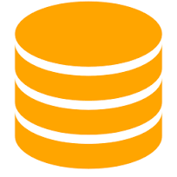
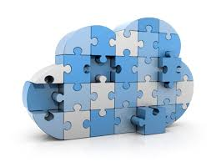

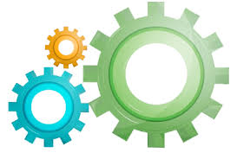
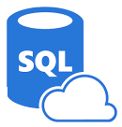
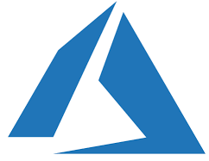
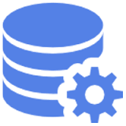
Data Migration solution approach
Source Data Extraction
DDL Conversion
Data Quality and Enrichment
** Source Data Migration to Cloud/Intermediate Layer
Data Migration to Target DB
** Data Transfer to Cloud or Intermediate Layer
Target Database
Source Database
Data Extractor Tool
Target Data Migrator Tool
DDL Converter Tool
Source Data Extractor
DDL Converter
Data Quality and Enrichment
Target Data Migrator
Source Data Extraction
Cloud/ Intermediate Layer
Extracts Source Data into File
Use Database Specific Inbuilt Utility to Extract
Compression
Converts Source DDL to Target DDL
Create Target Database Tables and Objects
Use Target Database Specific Function/Data Type Conversion
Provides Statistics of each Process Run
Data Profiling and Enrichment of data (Set Null, Default Value ..etc.)
Migrate Source Extract files into intermediate/ Cloud Layer
Use Best Compression Strategy
Ingest data into Target DB Tables
Uses Target Database ingestion best practices (large tables/Real-time/Large Records/ High frequency Access)

Slide 12
Key considerations while modernizing the platform.
State Street is planning to migrate the PAM for Investment platform to Azure Cloud, with the objective of reducing costs, modernizing application infrastructure, improving support, and providing higher scalability.
The key technical tenets from current proposal perspective are:
Decompose monolith to microservice-based applications
Deploy the transformed applications to MS Azure container platform
Reuse code elements to reduce development and testing effort
Standardize technology components across the layers
Migrate to cloud native .NET/Java technologies
Expose API as openapi 3.0 compliant and have API first approach
Enable automation built with DevSecOps

Slide 13
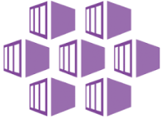

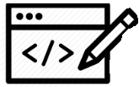
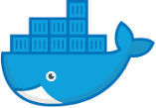



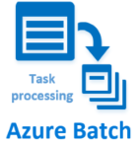

Application Re-architect Path for various components in Azure
13
Assess container suitability(if applicable)
Re-write WPF to Reactjs-based UI
Upgrade existing existing reactJS ui version for web ui
Containerize &
Package
Deploy on AKS (Windows 2019 containers)
UI Layer(WPF + ReactJS)
Assess for changes in application
Code changes to refactor/re-write .net core microservices
Containerize &
Package
Azure Services (DB/ Service Bus MQ)
Deploy on AKS (Windows 2019 containers)
Services(.NET 3.5- WCF)
Refactor to .NET Core
Create Azure batch task
Azure Service Bus/MQ
Deploy on VM using Azure batch
Assess for changes in application
Use Azure sql
Long running Batch(C/C++)
C++ Native code for utility functions
Assess for changes in application
Refactor to .NET Core
Create Azure functions
Use Azure sql
Azure Services
Deploy as Azure Functions
PaaS
Refactor to Spring boot
Containerize &
Package
Azure Services (DB/ Service Bus MQ)
Deploy on AKS (Windows 2019 containers)
Java Services / Message Posting
Assess for changes in application
Microservice

Slide 14
PFI - Current Architecture (On-prem)
WIP

Slide 15
PFI - Proposed application architecture
WIP

Slide 16
PFI – Mapping of existing and proposed technology stack
Components | Current Teck Stack(with version) | Proposed Technology stack(with version)
Client Tier | WPF and React JS
Application Middle tier - Batch Services
Application Middle tier – Web services (Java)
Application Middle tier – Web services (.NET)
Caching
DB
Messaging
CICD/DevOPS
Logging and monitoring

Slide 17


PFI - Proposed Azure-based platform deployment architecture
WIP
ON-PREMISES
FTP / SFTP
NAS
SMTP
PDR
ExpressRoute Connectivity

Slide 18
PFI– CICD/DevOps approach

Slide 19
PFI – Logging and monitoring approach on Azure

Slide 20
Infosys Cloud Native Development Platform
Accelerates development of cloud-native applications deployed as microservices, packaged in containers, and managed on elastic infrastructure through agile DevOps processes and continuous delivery workflows.
EVALUATION AND MIGRATION
ENVIRONMENT PROVISIONING
APPLICATION AUTOMATION
UTILITY
SERVICES
SECURITY
Open Source Product Evaluator
Install & setup container platform
Microservice & Batch* Automation
Monitoring, Logging & tracing
Authentication and authorization (RBAC)
Cloud Native Assessment for Applications
Install & configure 35+ OSS products on Kubernetes
UI Templates & Component Repository
Subscription Management & Metering
Vulnerability Scanning
PCF to Kubernetes Migration
One-click install of Infosys’ industry solutions
Integrated DevSecOps Pipeline
Open Source Observatory
Container Security
Infosys confidential. For internal use only.
https://www.infosys.com/services/open-source/offerings/cloud-native-development.html

