Slide 1
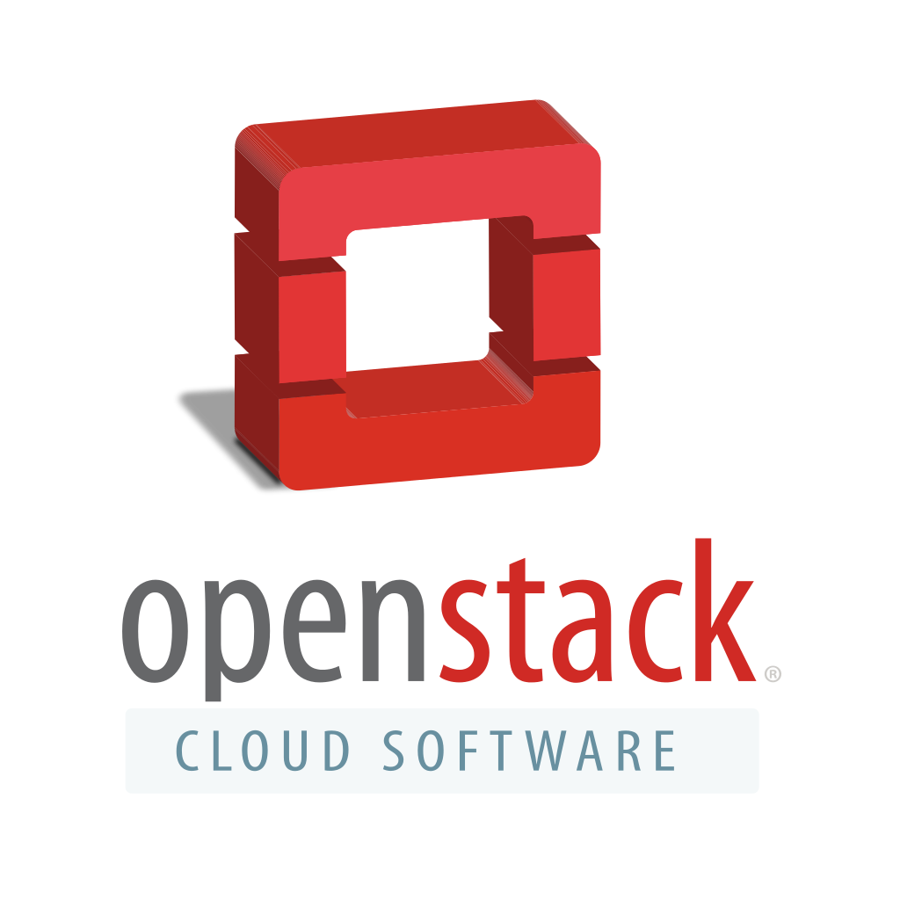
Presented by:
Himanshu Nailwal
I.T., 4th year
1308213007

Slide 2
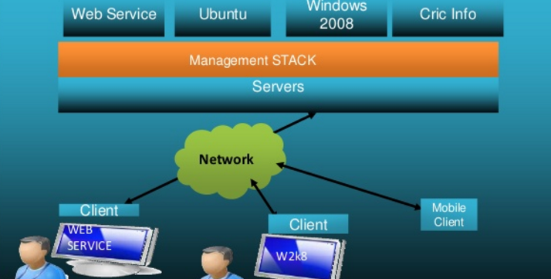
What is cloud computing?
Cloud computing is the set of services offered through the internet.

Slide 3

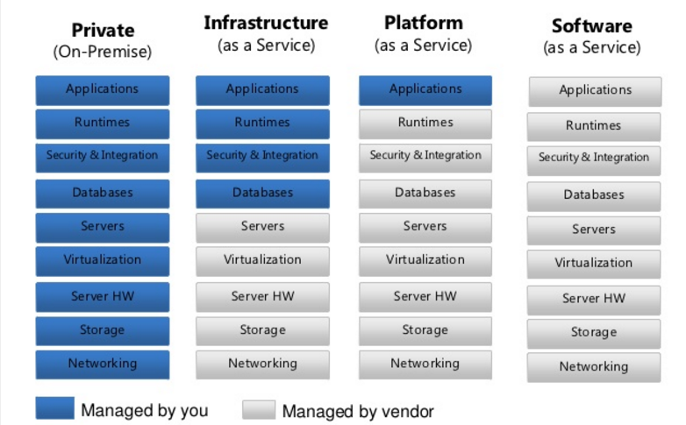
Cloud Service Model

Slide 4
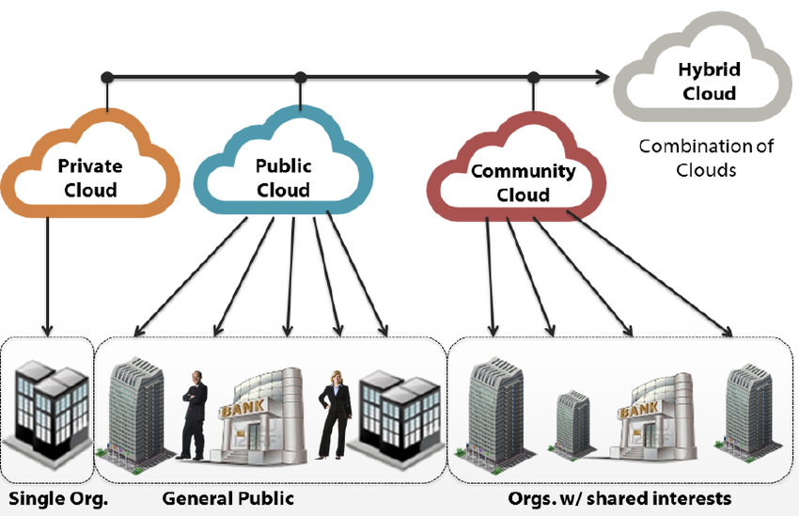
Cloud Deployment models

Slide 5
What is OpenStack?
OpenStack is a free and open-source software platform for cloud computing, mostly deployed as an infrastructure-as-a-service (IaaS). The software platform consists of interrelated components that control diverse, multi-vendor hardware pools of processing, storage, and networking resources throughout a data center.

Slide 6
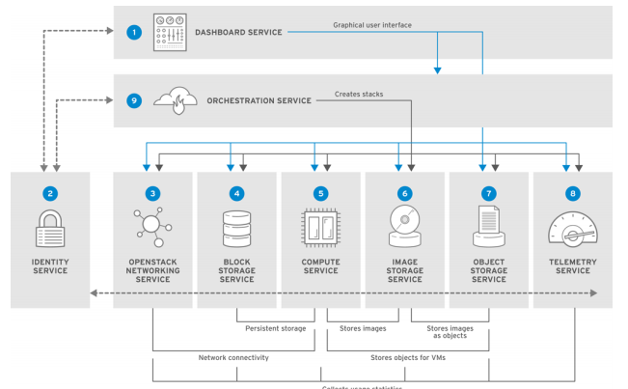
Components

Slide 7
OpenStack Networking (neutron)
handles creation and management of a virtual networking infrastructure
provides cloud administrators with flexibility to decide which individual services to run on which physical systems
All service daemons can be run on a single physical host for evaluation purposes

Slide 8
OpenStack Block Storage (cinder)
provides persistent block storage management for virtual hard drives
Block Storage enables the user to create and delete block devices, and to manage attachment of block devices to servers.
OpenStack Block Storage advantages include:
Creating, listing and deleting volumes and snapshots.
Attaching and detaching volumes to running virtual machines.

Slide 9
OpenStack Object Storage (swift)
provides an HTTP-accessible storage system for large amounts of data, including static entities such as videos, images, email messages, files, or VM images.
distributed architecture supports horizontal scaling as well as failover redundancy with software-based data replication

Slide 10
OpenStack Database-as-a-Service (trove)
allows users to select, provision, and operate a variety of relational and non-relational databases and handles more complex database administration tasks out-of-the-box.
Users and database administrators can provision and manage multiple database instances in the cloud.
High-performance resource isolation while automating complex administrative tasks such as deployment, configuration, patching, backup, restore, and monitoring.

Slide 11
OpenStack Compute (nova)
serves as the core of the OpenStack cloud by providing virtual machines on demand.
Compute schedules virtual machines to run on a set of nodes by defining drivers that interact with underlying virtualization mechanisms, and by exposing the functionality to the other OpenStack components

Slide 12
OpenStack Bare Metal Provisioning (ironic)
enables the user to provision physical, or bare metal machines, for a variety of hardware vendors with hardware-specific drivers.
Bare Metal Provisioning uses the Compute service for scheduling and quota management, and uses the Identity service for authentication.

Slide 13
OpenStack Image (glance)
OpenStack Image acts as a registry for virtual disk images.
Users can add new images or take a snapshot of an existing server for immediate storage.
You can use the snapshots for backup or as templates for new servers.

Slide 14
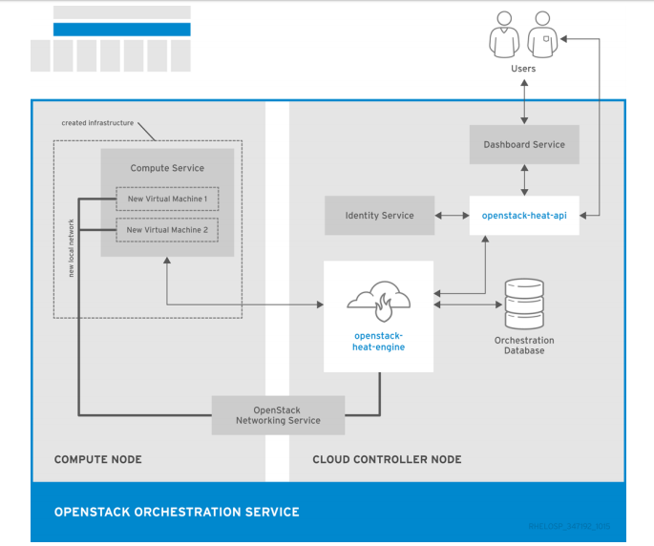
OpenStack Orchestration (heat)

Slide 15
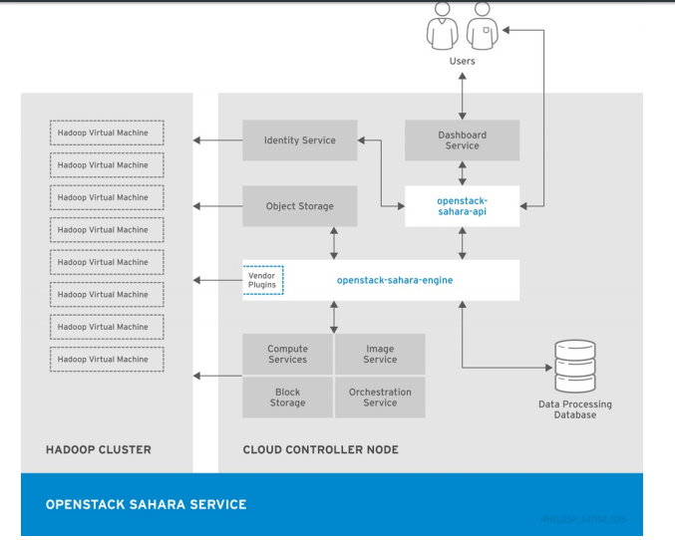
OpenStack Data Processing (sahara)

Slide 16
CONCLUSION
OpenStack is an early project but it is fully open source and based on open cloud standards.
Hundreds of the world’s largest brands rely on OpenStack
reducing costs and helping them move faster
OpenStack has a strong ecosystem

