Slide 1
TransitSync
Smart Intermediate Train Route Finder

Slide 2
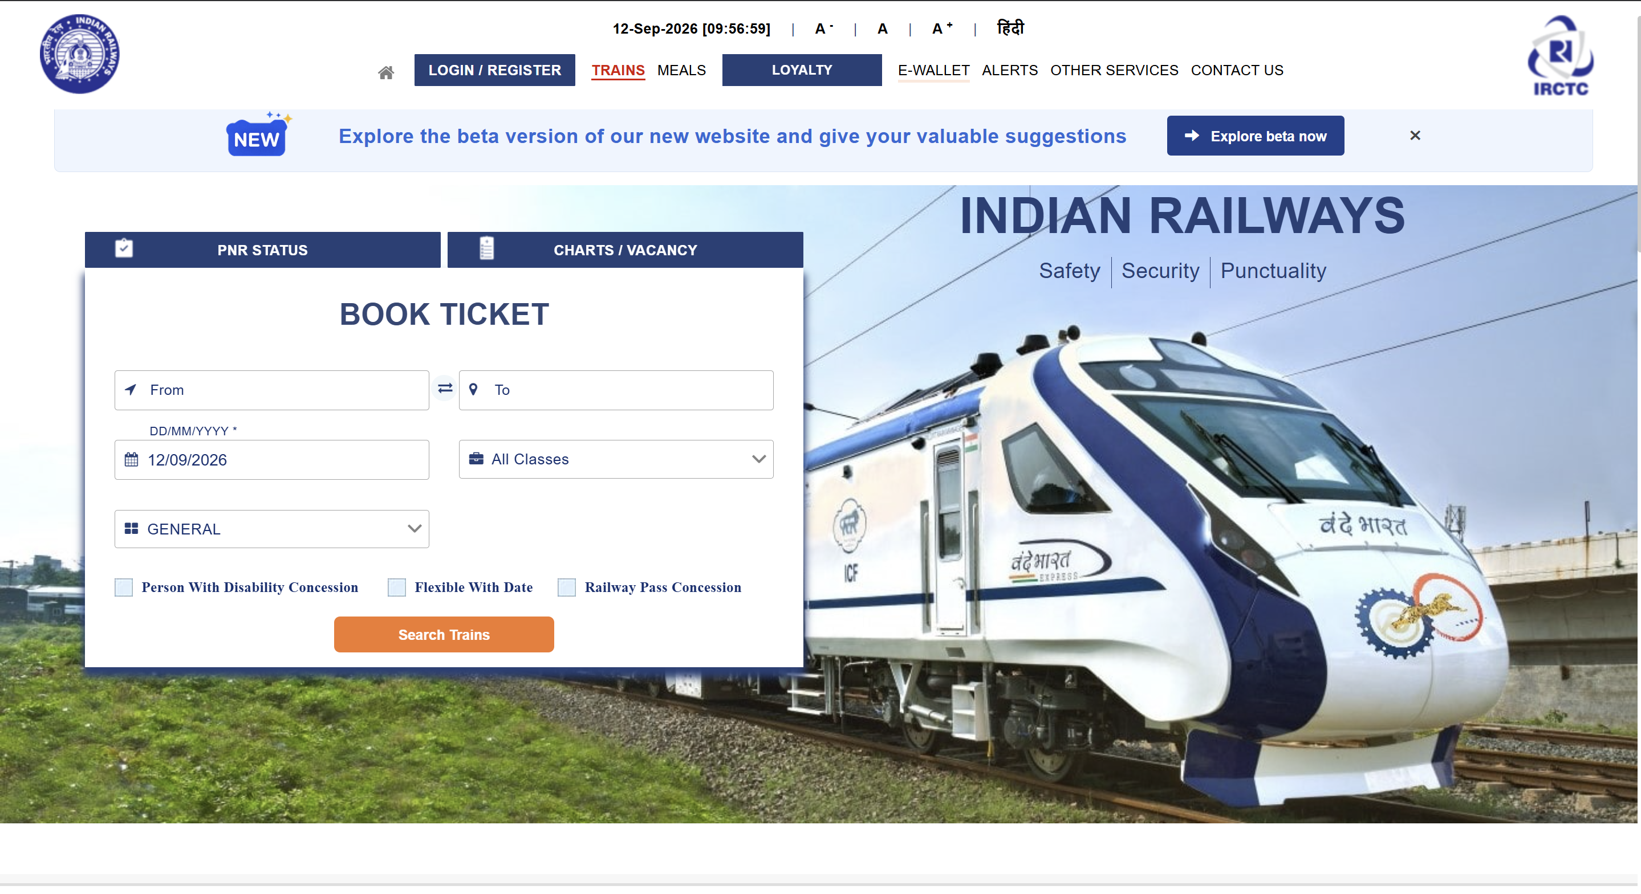
The Problem
Rigid Search Constraints
Platforms like IRCTC only allow searches by Departure Date, ignoring the passenger's actual deadline.
Manual Route Patching
If a direct train is unavailable or mistimed, users must guess hubs and manually piece together tickets.
High Risk Layovers
Manually calculating safe buffer times between trains is stressful and prone to costly errors.

Slide 3
The Problem
Rigid Search Constraints
Platforms like IRCTC only allow searches by Departure Date, ignoring the passenger's actual deadline.
Manual Route Patching
If a direct train is unavailable or mistimed, users must guess hubs and manually piece together tickets.
High Risk Layovers
Manually calculating safe buffer times between trains is stressful and prone to costly errors.

Slide 4
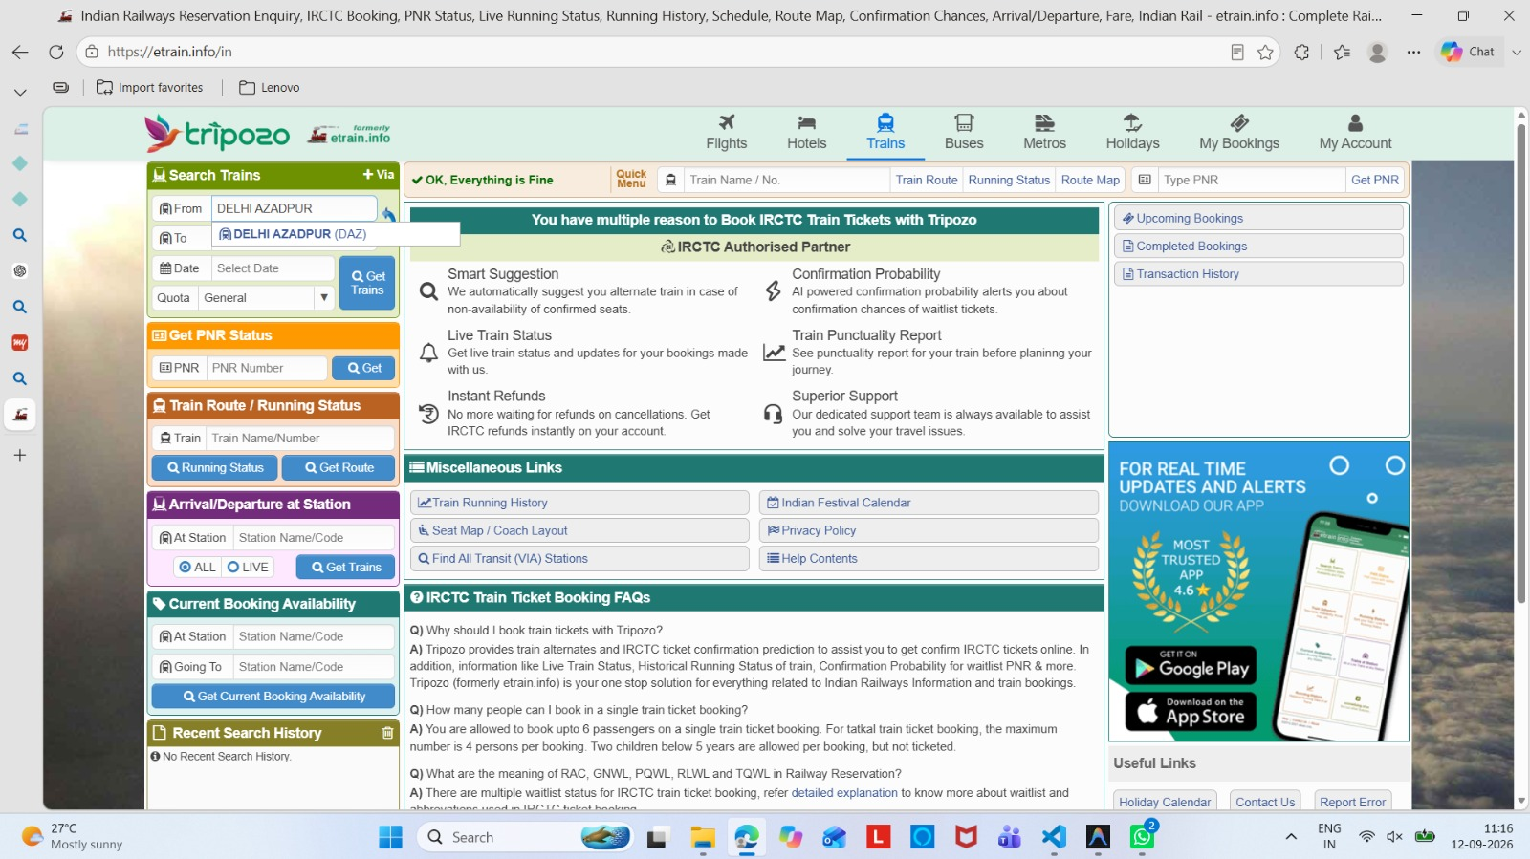
The Problem
Rigid Search Constraints
Platforms like IRCTC only allow searches by Departure Date, ignoring the passenger's actual deadline.
Manual Route Patching
If a direct train is unavailable or mistimed, users must guess hubs and manually piece together tickets.
High Risk Layovers
Manually calculating safe buffer times between trains is stressful and prone to costly errors.

Slide 5
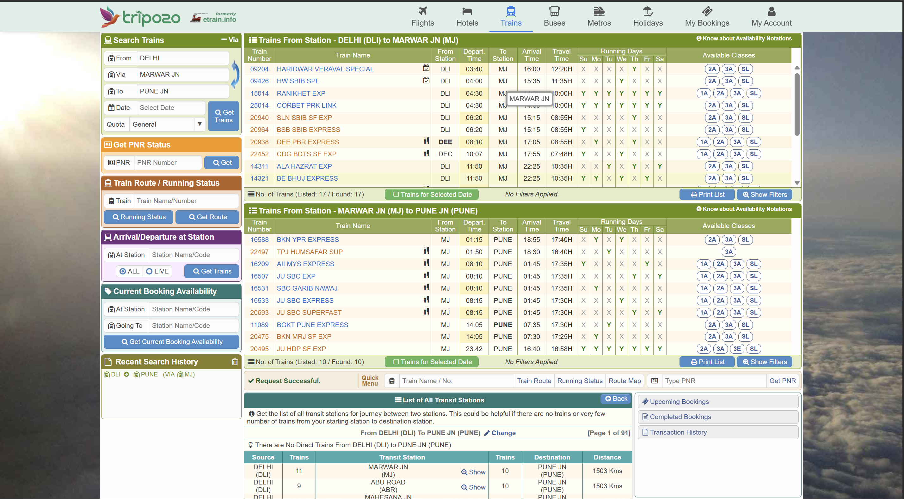
The Problem
Rigid Search Constraints
Platforms like IRCTC only allow searches by Departure Date, ignoring the passenger's actual deadline.
Manual Route Patching
If a direct train is unavailable or mistimed, users must guess hubs and manually piece together tickets.
High Risk Layovers
Manually calculating safe buffer times between trains is stressful and prone to costly errors.

Slide 6
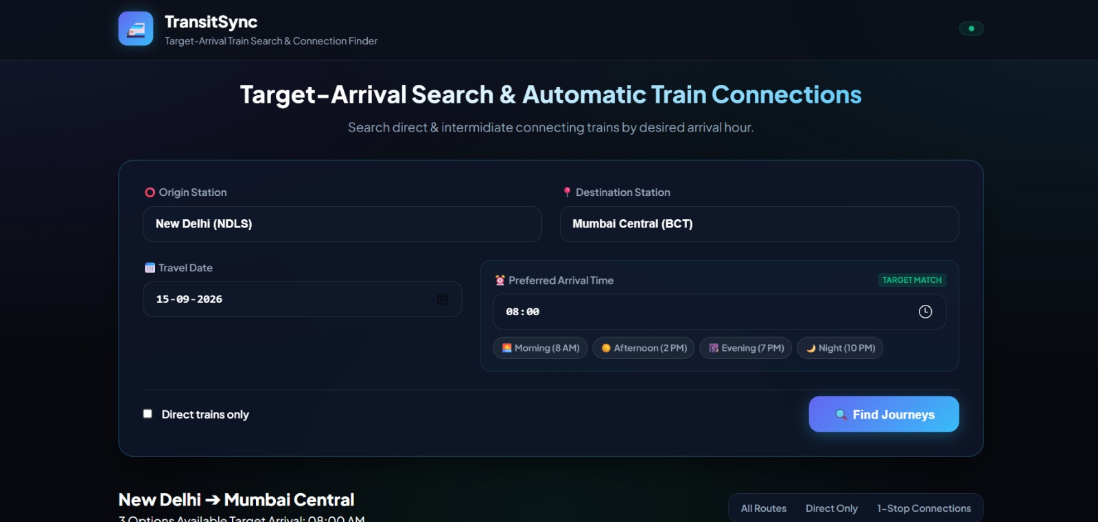
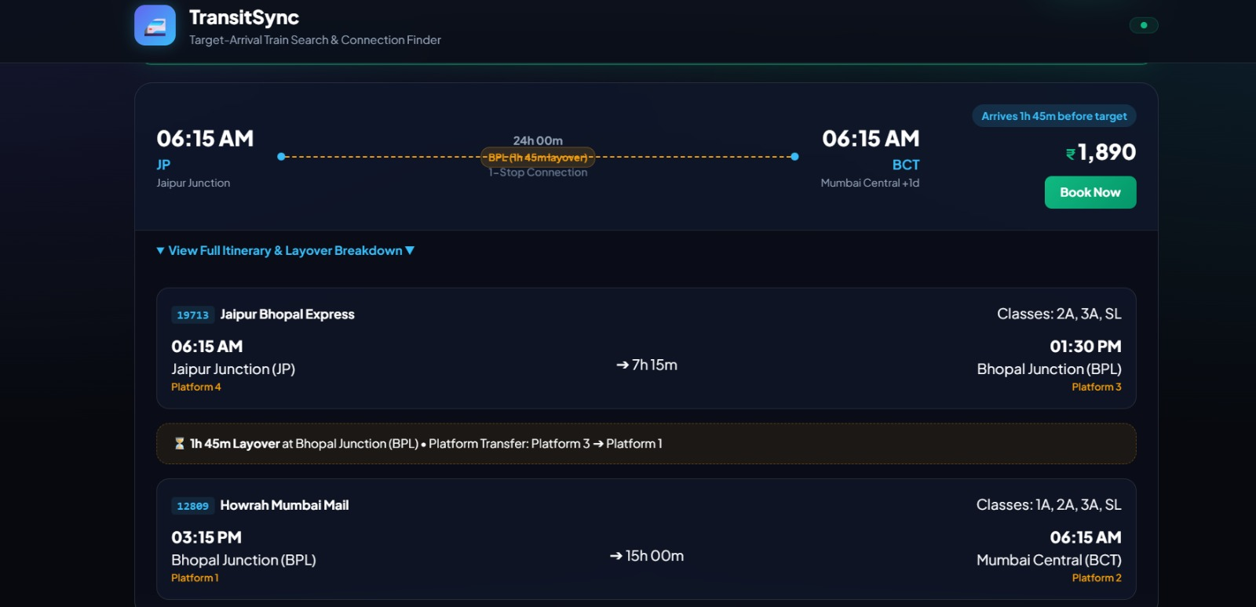
The Solution
Intelligent Transit Graphs
You tell us when you need to arrive, and we compute the math backwards.
Our graph-based algorithm automatically computes multi-leg journeys (A → C → B) when direct routes are unavailable, instantly uncovering hidden possibilities.

Slide 7
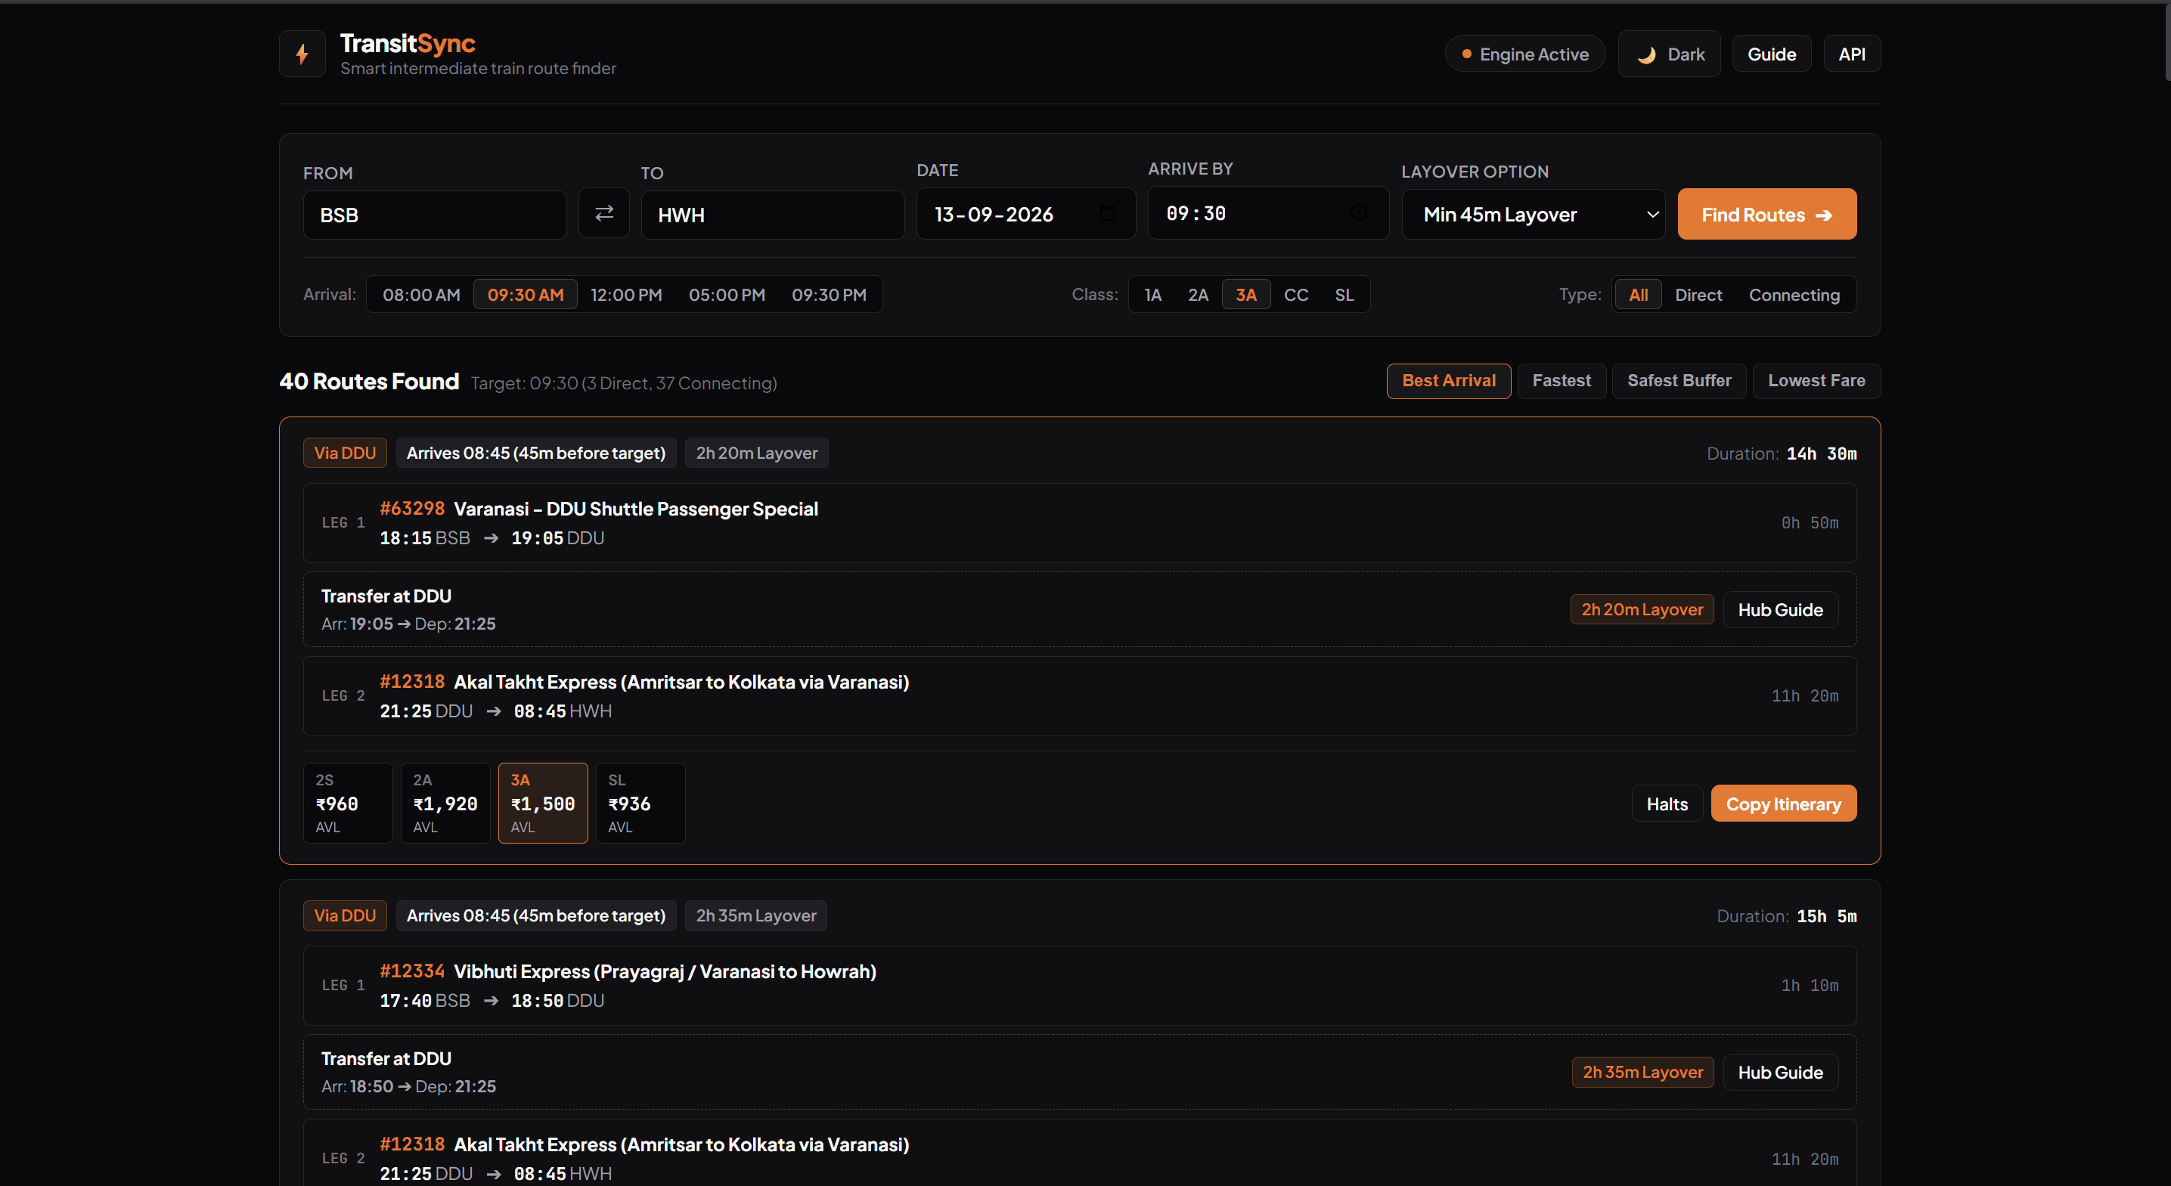
The Solution
Intelligent Transit Graphs
You tell us when you need to arrive, and we compute the math backwards.
Our graph-based algorithm automatically computes multi-leg journeys (A → C → B) when direct routes are unavailable, instantly uncovering hidden possibilities.

Slide 8



Core Features
Arrival First Search
Input a strict arrival deadline. The engine filters all possible permutations to ensure you reach your destination on time.
Smart Auto Connect
Seamlessly splices different trains at logical transit hubs to create viable itineraries when direct routes are sold out.
Buffer Optimization
Automatically enforces safe layover windows (e.g., min 45 mins) to protect against historical delay data of the first leg.

Slide 9
Core Features
Arrival First Search
Input a strict arrival deadline. The engine filters all possible permutations to ensure you reach your destination on time.
Smart Auto Connect
Seamlessly splices different trains at logical transit hubs to create viable itineraries when direct routes are sold out.
Buffer Optimization
Automatically enforces safe layover windows (e.g., min 45 mins) to protect against historical delay data of the first leg.

Slide 10
Core Features
Arrival First Search
Buffer Optimization
Input a strict arrival deadline. The engine filters all possible permutations to ensure you reach your destination on time.
Automatically enforces safe layover windows (e.g., min 45 mins) to protect against historical delay data of the first leg.
Smart Auto Connect
Seamlessly splices different trains at logical transit hubs to create viable itineraries when direct routes are sold out.

Slide 11
Core Features
Arrival First Search
Smart Auto Connect
Buffer Optimization
Input a strict arrival deadline. The engine filters all possible permutations to ensure you reach your destination on time.
Seamlessly splices different trains at logical transit hubs to create viable itineraries when direct routes are sold out.
Automatically enforces safe layover windows (e.g., min 45 mins) to protect against historical delay data of the first leg.

Slide 12
Graph Traversal
Result Ranking
Engine searches network for direct & 1-layover paths.
Final itineraries ranked by travel time and low friction.
How It Works
Parameter Input
Logic Filtering
Visual Timeline Render
Routes are pruned based on buffers & seat availability.
The system maps the highest-ranked itinerary, highlighting transit hubs and exact layover durations.
User defines Source, Dest, Date, and critical Arrival Time.

Slide 13
How It Works
Graph Traversal
Result Ranking
Engine searches network for direct & 1-layover paths.
Final itineraries ranked by travel time and low friction.
Parameter Input
Logic Filtering
Visual Timeline Render
Routes are pruned based on buffers & seat availability.
The system maps the highest-ranked itinerary, highlighting transit hubs and exact layover durations.
User defines Source, Dest, Date, and critical Arrival Time.

Slide 14
How It Works
Graph Traversal
Result Ranking
Engine searches network for direct & 1-layover paths.
Final itineraries ranked by travel time and low friction.
Parameter Input
Logic Filtering
Visual Timeline Render
Routes are pruned based on buffers & seat availability.
The system maps the highest-ranked itinerary, highlighting transit hubs and exact layover durations.
User defines Source, Dest, Date, and critical Arrival Time.

Slide 15
Projected Impacts
85%
3x
Reduced Search Time
More Viable Roots
Eliminates the hours spent cross-referencing multiple tabs and timetables manually.
By unlocking 1-stop connections, users have significantly higher chances of securing a ticket.

Slide 16
Projected Impacts
85%
Reduced Search Time
Eliminates the hours spent cross-referencing multiple tabs and timetables manually.
3x
More Viable Roots
By unlocking 1-stop connections, users have significantly higher chances of securing a ticket.

Slide 17
Projected Impacts
85%
3x
Reduced Search Time
More Viable Roots
Eliminates the hours spent cross-referencing multiple tabs and timetables manually.
By unlocking 1-stop connections, users have significantly higher chances of securing a ticket.

Slide 18
Tech Stack
Front End Prototype
A responsive web interface focused on inputting time constraints and visualizing multi-leg journeys.
HTML CSS
Routing Logic
Direct query, hub discovery, buffer validation, route scoring
JS Railradar API

Slide 19
Tech Stack
Front End Prototype
A responsive web interface focused on inputting time constraints and visualizing multi-leg journeys.
HTML CSS
Routing Logic
Direct query, hub discovery, buffer validation, route scoring
JS Railradar API

Slide 20
Thank You
Front End Prototype
A responsive web interface focused on inputting time constraints and visualizing multi-leg journeys.
HTML CSS
Routing Logic
Direct query, hub discovery, buffer validation, route scoring
JS Railradar API

