Slide 1


INTRODUCTION // WORKSHOP AGENDA
Web Development Workshop
— HTML Basics
No prior experience needed. We focus on hands-on creation of core web building blocks.
01
Web Fundamentals
02
Core Tags
03
Structuring Media & Forms
04
Capstone Project

Slide 2

HTML5 Boilerplate
The essential structure and core components of a standard web document
<!DOCTYPE html> — Declares the document as HTML5, ensuring correct standards-based browser rendering.
<html lang="en"> — The root element of the page; the lang attribute defines the language for SEO and accessibility.
<head> — Holds machine-readable metadata, including:
<meta charset="UTF-8">: Defines standard character encoding.
<meta name="viewport">: Configures responsive mobile scaling.
<title>: Sets the text visible on the browser tab.
<link>: Connects external CSS stylesheet files.
<body> — Contains all visible page content (text, images, interactive elements) and linked script files.
<!DOCTYPE html>
<html lang="en">
<head>
<meta charset="UTF-8">
<meta name="viewport" content="...">
<title>Document</title>
<link rel="stylesheet" href="style.css">
</head>
<body>
</body>
</html>
WEB DEVELOPMENT WORKSHOP
HTML BASICS

Slide 3
How the Web Works
Users request pages via Browsers (Clients). Servers send HTML responses back over the internet.
Structure
HTML
Acts as the Skeleton / Walls of the house, providing the foundational layout and raw content.
Styling
CSS
Acts as the Paint / Decor of the house, styling the colors, layout, and visual presentation.
Behavior
JavaScript
Acts as the Electricity / Appliances of the house, enabling dynamic functions and interactivity.
WEB DEVELOPMENT WORKSHOP
FRONT-END ROLES

Slide 4
Anatomy of an HTML Element
How tags and attributes organize and structure content on the web
HTML is a markup language, not a programming language. It uses defined tags to package and identify pieces of content for the browser.
Standard Element Structure
Attributes & Empty Tags
<p>Hello World</p>
<img src="cat.jpg" alt="A cat">
OPENING TAG
CLOSING TAG
TAG NAME
ATTRIBUTE
CONTENT
ATTRIBUTE
Most HTML tags act as dual containers, packaging the text
or other nested nodes inside to control formatting.
Attributes supply metadata inside the opening tag. Self-closing
empty tags (like <img>) require no content or closing tag.
WEB DEVELOPMENT WORKSHOP
HTML BASICS

Slide 5
Your First Website
Set up your workspace and write your first HTML file
01
Create Folder
02
index.html
03
Open in Editor
04
Refresh Browser
index.html
<!DOCTYPE html>
<html lang="en">
<head>
<title>My First Website</title>
</head>
<body>
<h1>Hello World!</h1>
</body>
</html>
EXERCISE 1
Create your first HTML page using this template in VS Code and view it in Chrome!
WEB DEVELOPMENT WORKSHOP
HTML BASICS

Slide 6
Document Structure
Use structural tags for document flow.
EXERCISE 2
Structural Elements
These foundational tags define block layout and layout separation:
• Headings: <h1> (main) to <h6> (smallest)
• Paragraphs: <p>
• Spacing: <br> (line break), <hr> (horizontal rule)
Create a Personal Intro
Apply what you have learned to structure your first section of web content:
Create a personal intro with a title, 3 headings of different levels, and 3 paragraphs.
WEB DEVELOPMENT WORKSHOP
HTML BASICS

Slide 7
Formatting Text & Creating Links
Semantic markup vs structure syntax in modern HTML
Semantic Inline Formatting
Semantic elements convey the importance and meaning of content to both browsers and screen readers, whereas physical styling tags only alter visual appearance.
<strong> vs <b>
Both render bold, but <strong> indicates heavy semantic importance.
<em> vs <i>
Both italicize, but <em> adds structural verbal emphasis.
Anchor Links Syntax
Hyperlinks are built using the <a> tag. Key attributes like href specify the destination while target controls window behavior.
<a href="url" target="_blank">Link Text</a>
Common Link Types:
• External: [link removed] | Internal Page: #section-id
• Email: mailto:name@xyz.com | Phone: tel:+1234...
EXERCISE 3
Add an external link and an email link to your introduction.
Incorporate an anchor tag linking to an outside resource and another using the mailto: protocol inside your main content intro block.
WEB DEVELOPMENT WORKSHOP
HTML BASICS

Slide 8
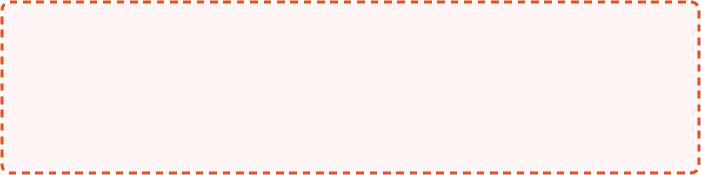
HTML Lists & Images
Structuring document lists and embedding visual media assets
index.html
localhost:3000
<!-- Unordered List -->
<ul>
<li>Unordered</li>
</ul>
<!-- Ordered List -->
<ol>
<li>Ordered</li>
</ol>
<!-- Description List -->
<dl>
<dt>Description</dt>
<dd>Details</dd>
</dl>
<!-- Embedding Images -->
<img src="image.jpg" alt="Description">
Lists Rendered Preview
Unordered list item
Ordered list item
Description term Definition details
image.jpg
Alt tag: "Description"
WEB DEVELOPMENT WORKSHOP
HTML BASICS

Slide 9
Tables & Layout Containers
Structuring datasets with tables and grouping elements with div and span
Data Structures: Tables
Layout Containers
<th> Tag
<th> Purpose
<div> <!-- Block Element -->
Groups large sections; starts on a new line.
<tr>
Table Row container
<span> <!-- Inline Element -->
Styles small text segments; stays flow-inline.
<td>
Standard Data Cell
EXERCISE 4
Hands-on Portfolio Setup
Add a cleanly structured <ul> skills list and a 2-row <table> summarizing your history.
WEB DEVELOPMENT WORKSHOP
HTML BASICS

Slide 10
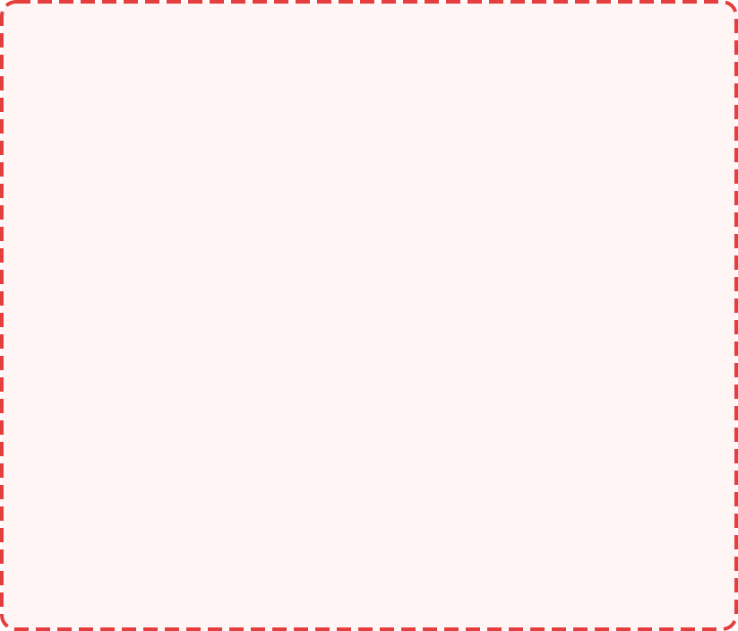
Avoid "Div Soup"
Use HTML5 semantic elements to improve structural hierarchy, accessibility, and SEO.
semantic_structure.html
div_soup_nightmare.html
<body>
<div>
<header>
<main>
<aside>
<footer>
<div>
<div>
<div>
<div>
<nav>
<section>
<div>
<div>
<article>
<div>
WEB DEVELOPMENT WORKSHOP
HTML BASICS

Slide 11
Forms & Media Elements
Building interactive user inputs and embedding multimedia players
User Input & Forms
Collect details via <form>, <label>, and <input> tags.
Core Types: text, email, password, radio, checkbox.
Multimedia & Embeds
Integrate video/audio players or external widgets seamlessly.
Core Tags: <audio>, <video>, and <iframe>.
form-media.html
<!-- Interactive Form Markup -->
<form>
<label>Email Address</label>
<input type="email" required>
<button type="submit">Subscribe</button>
</form>
<!-- Multimedia & Widgets -->
<video src="intro.mp4" controls></video>
<iframe src="map_embed"></iframe>
EXERCISE 5
Newsletter Sign-Up
Design a subscription form featuring instant client-side email validation using basic browser constraints.
WEB DEVELOPMENT WORKSHOP
HTML BASICS

Slide 12
Best Practices & Mistakes
Structural alignment guidelines for robust markup
RECOMMENDED PRACTICES
Comments <!-- Hidden Note -->
Entities &nbsp; and &copy;
Globals id and class
MISTAKES TO AVOID
Forgetting closing tags
Always balance structural elements correctly.
Incorrect nesting
Avoid overlap: <strong><em>text</strong></em>
Missing mandatory tags
Failing to include required alt attributes on images.
WEB DEVELOPMENT WORKSHOP
HTML BASICS

Slide 13
Capstone Challenge
Build a semantic Student Portfolio Website (HTML only!)
Project Specifications
01 Semantic Structure
Organize layout using structural elements.
02 Professional Skills List
Display developer capabilities using lists.
03 Education Credentials
Present schools and degrees in a table grid.
04 Interactive Contact Form
Enable user outreach with input fields & buttons.
HTML Cheat Sheet
Structure
<html> <head> <body>
Text Formatting
<h1-h6> <p> <br> <strong> <em>
Links & Media
<a> <img> <iframe>
Lists & Tables
<ul> <ol> <table> <tr> <td>
Forms
<form> <input> <button>
UP NEXT: CSS — Making Our HTML Beautiful
WEB DEVELOPMENT WORKSHOP
MODULE 01: HTML5

Slide 14
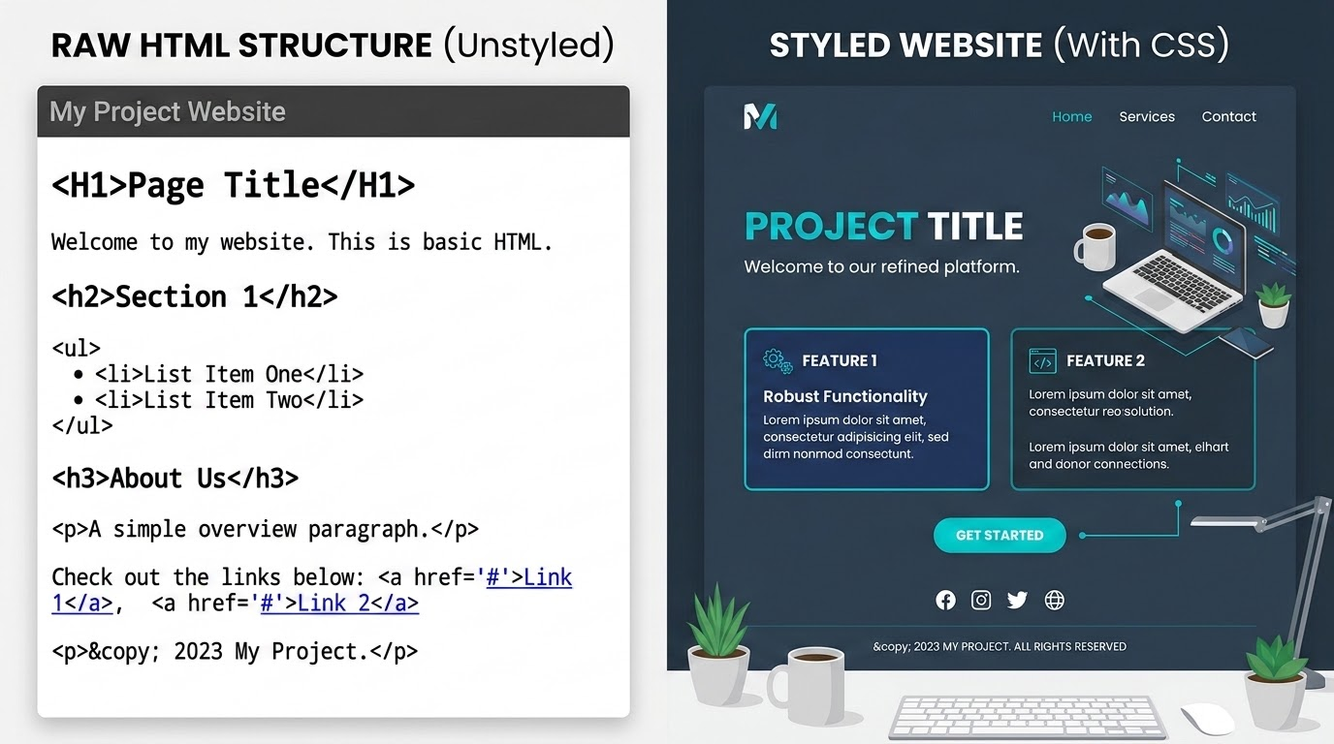
Web Development Workshop — CSS Basics
CSS
Cascading Style Sheets
CSS dictates the presentation of web pages. HTML provides the structural foundation, CSS applies the visual styling, and JavaScript adds interactive behavior.
Think of HTML as the skeleton and CSS as the skin and clothing.
HTML tells the browser WHAT is on the page, while CSS tells it HOW it should look.
/* Figure 1: HTML Structure vs. CSS Styling */

Slide 15

How CSS Works
CSS operates through a rule-based structure. A CSS rule consists of a selector and a declaration block.
In the example, p is the selector targeting paragraph elements. The declaration block is enclosed in braces {}.
Inside, declarations pair a property (like color) with a value (like blue), separated by a colon : and ending with a semicolon ;.
The browser reads these rules and applies the specified styles to the matching HTML elements.
style.css
/* CSS Rule-Based Snippet */
p {
color: blue;
font-size: 20px;
}
Anatomy of a CSS Rule
p
Selector
color
Property
blue
Value

Slide 16

Ways to Add CSS
01 // INLINE CSS
Inline CSS uses the style attribute directly on HTML elements.
02 // INTERNAL CSS
Internal CSS places rules within a <style> tag in the HTML head section.
03 // EXTERNAL CSS
External CSS links an independent stylesheet using the HTML <link> tag.
<p style="color: red;">Hello</p>
<style>
p { color: red; }
</style>
<link rel="stylesheet"
href="style.css">
INDUSTRY BEST PRACTICE
External stylesheets are the industry standard because they separate content from design, allowing you to style multiple pages from a single file, which improves maintainability and page load speed.

Slide 17
CSS Foundations
CSS Selectors
Selectors determine which HTML elements receive styling.
* Universal selector targets everything (e.g., * { margin: 0; }).
p Element selectors target all instances of a tag (e.g., p { color: blue; }).
.class Class selectors, prefixed with a dot, target elements with a specific class attribute (.card { background: white; }) and are highly reusable.
#id ID selectors, prefixed with a hash, target a single, unique element (#title { color: red; }).
Guideline
Use classes for general styling and IDs for unique page sections.
style.css
/* Universal - targets everything */
* { margin: 0; }
/* Element - targets tag instances */
p { color: blue; }
/* Class - highly reusable target */
.card { background: white; }
/* ID - single unique element */
#title { color: red; }

Slide 18

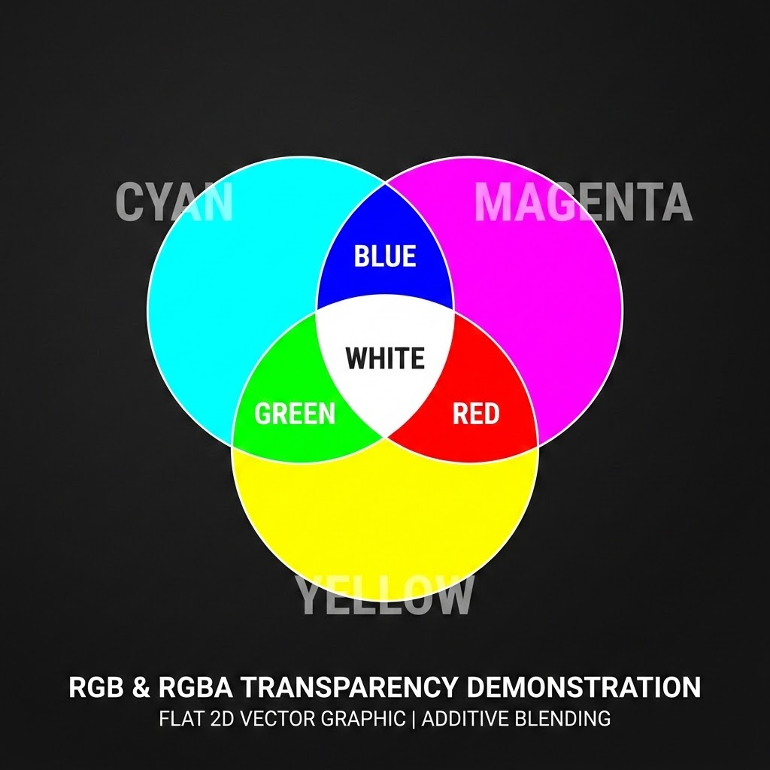

Colors & Backgrounds
CSS controls visual depth through properties like color, background-color, and background-image.
Scale background layers using background-size and anchor alignments using background-position inside their containers.
Blending & Alpha Opacities
HEX FORMAT
#569cd6
RGB FORMAT
rgb(220,220,170)
style.css
RGBA - 60%
rgba(197,134,192,0.6)
.hero-card {
color: #569cd6; /* HEX format */
background-color: rgba(197, 134, 192, 0.6);
background-size: cover;
background-position: center;
}
RGBA - 30%
rgba(106,153,85,0.3)

Slide 19
Typography
Documentation // Text styling
Typography properties control text appearance. The font-family property defines the typeface (e.g., h1 { font-family: Arial, sans-serif; }).
Use font-size for text scale and font-weight for thickness.
Adjust readability using line-height for vertical spacing and letter-spacing for horizontal gaps.
Additional styling includes text-align for alignment, text-decoration for underlines, and text-transform for casing.
External libraries like Google Fonts allow developers to easily import and apply custom typefaces to enhance web design.
styles.css
1
2
3
4
5
6
7
8
9
10
h1 {
font-family: 'Inter', sans-serif;
font-size: 48px;
font-weight: 700;
line-height: 1.2;
letter-spacing: -1px;
text-align: left;
text-decoration: none;
text-transform: uppercase;
}

Slide 20


The CSS Box Model
Every HTML element is a rectangular box governed by the CSS Box Model.
margin
Invisible external space between elements
border
Visible line wrapping the element
padding
Internal space around content
content
Innermost part
box-sizing: border-box;
By default, padding and borders increase total width. Applying border-box forces their inclusion within the specified width.

Slide 21

CSS Box Model
Width, Height, Margin & Padding
Dimensions and spacing are controlled via width, height, margin, and padding. Use max-width and min-width to create flexible elements that adapt to screen sizes.
Margin dictates the outside space pushing elements apart, while padding dictates the inside space pushing content away from the border.
styles.css
.card-container {
width: 400px;
max-width: 100%;
padding: 24px; /* Inside gap */
margin: 0 auto; /* Align center */
}
Fix the Code: Centering Tip
A common technique to horizontally center a block element is setting a specific width and applying margin: 0 auto;, which evenly distributes available horizontal space.

Slide 22

Borders, Border Radius & Shadows
Modern UI design relies heavily on borders and shadows to create depth.
border: 1px solid #ddd;
The border property defines thickness, style, and color.
border-radius: 12px;
The border-radius property rounds the corners of an element, softening its appearance.
box-shadow: 0 4px 15px rgba(0,0,0,0.1);
The box-shadow property adds a drop shadow using values for horizontal offset, vertical offset, blur radius, and color.
/* Combining these properties is the standard technique for creating modern card layouts. */

Slide 23
Display & Position
display
Dictates how elements flow.
Block elements take up full width, while inline elements take up only necessary space.
position
Removes elements from normal document flow.
static Default behavior.
relative Allows movement from original spot.
absolute Positioned relative to closest positioned parent.
style.css
/* Parent Container */
.container {
position: relative;
}
/* Absolute Notification Badge */
.badge {
position: absolute;
top: 10px;
right: 10px;
}

Slide 24


Flexbox
One-Dimensional Layout Model
Flexbox is a one-dimensional layout model designed for aligning elements in rows or columns.
Activating it with display: flex; grants the parent container absolute alignment authority over its children along two key layout directions.
MAIN AXIS justify-content
.navbar { display: flex; }
<Logo />
<Docs />
<GitHub />
navigation.css
CROSS AXIS align-items
.navbar {
display: flex;
justify-content: space-between;
align-items: center;
gap: 20px;
}
gap: 20px (between items)

Slide 25


CSS Grid
Two-Dimensional Layout System
CSS Grid is a two-dimensional layout system ideal for complex page structures. While Flexbox handles single rows or columns, Grid manages both simultaneously.
Activating display: grid; allows you to define structural tracks.
For example, grid-template-columns: repeat(3, 1fr); creates three equal-width columns using the fractional (fr) unit.
Grid containers hold grid items, and the gap property provides uniform spacing. Use Grid for overall page layouts and Flexbox for aligning components within them.
1fr
1fr
1fr
.item-1
.item-2
.item-3
row 1
gap: 20px
gap: 20px
.item-4
.item-5
.item-6
row 2
Visualizing a 3x2 Grid: grid-template-columns: repeat(3, 1fr);

Slide 26
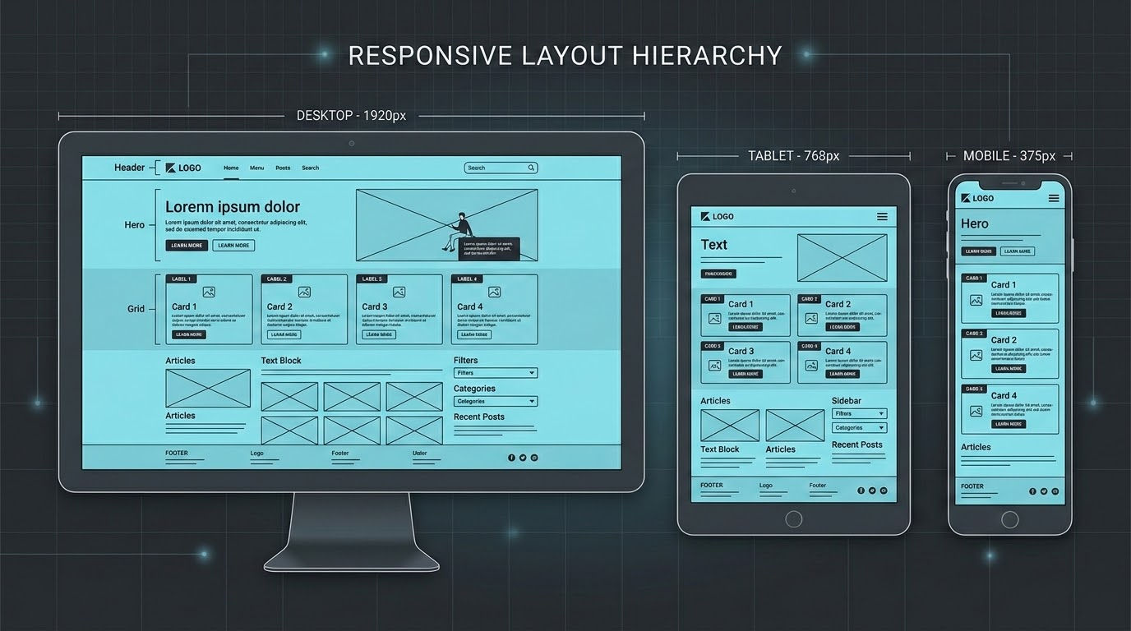
Responsive Design
Breakpoints & Fluid Layouts
Media queries apply specific CSS rules dynamically based on target viewport size or device breakpoints.
Adopting a mobile-first approach—styling for small screens first and scaling up—is a critical industry best practice.
Using relative units like width: 100% with max-width: 1200px prevents desktop layouts from breaking.
LAYOUT ADAPTATION VISUALIZATION
responsive.css
@media (max-width: 768px) {
.container {
grid-template-columns: 1fr;
}
}
/* Note: Grid columns dynamically collapse from multi-column desktop screens down to a 1fr single-column vertical flow on mobile. */

Slide 27
CSS Progressive Build
Putting Everything Together
Building a modern profile card requires combining all CSS concepts progressively.
HTML Structure — First, we establish the HTML structure.
Step 1 (Reset) — Step 1 applies a basic CSS reset.
Step 2 (Type) — Step 2 defines typography and fonts.
Step 3 (Color) — Step 3 introduces background colors.
Step 4 (Shape) — Step 4 shapes the card using borders, border-radius, and box-shadows.
Step 5 (Flex) — Step 5 aligns internal elements using Flexbox.
Step 6 (Grid) — Step 6 structures the outer layout using Grid.
Step 7 (Media) — Finally, Step 7 applies media queries to ensure the profile card stacks correctly on mobile devices.
profile-card.css
/* Step 1: CSS Reset */
* { box-sizing: border-box; margin: 0; }
/* Steps 2, 3, 4, 6: Layout & Card Base */
.profile-card {
display: grid; /* Step 6 */
background: #2d2d2d; /* Step 3 */
border-radius: 12px; /* Step 4 */
box-shadow: 0 8px 16px rgba(0,0,0,0.3); /* Step 4 */
}
/* Steps 2, 5: Internal Alignment */
.card-header {
display: flex; /* Step 5 */
font-family: 'Inter', sans-serif; /* Step 2 */
}
/* Step 7: Mobile Responsiveness */
@media (max-width: 600px) {
.profile-card { grid-template-columns: 1fr; }
}

Slide 28
CSS Cheat Sheet + Final Challenge
01. Text & BG
color / font-family
font-size / font-weight
background-color
background-image
02. Box Model
width / height
padding / margin
border / appearance
border-radius
03. Layout & Flex
display: flex
flex-direction
justify-content
align-items
04. Grid & Media
display: grid
grid-template-columns
gap: value
@media (max-width: ...)
portfolio-challenge.css
Final Challenge: Style Your Portfolio
Apply these concepts to style the portfolio HTML from the previous workshop. Your implementation must feature:
Custom typography & unified color scheme
Flexbox navigation bar & responsive breakpoints
Styled project cards with interactive buttons
* Next week, we will introduce JavaScript to add interactivity and logic to this fully styled portfolio.
/* Workshop Project Style Spec */
.navbar {
display: flex;
justify-content: space-between;
}
@media (max-width: 768px) {
.project-cards {
flex-direction: column;
}
}

Slide 29
JavaScript: The Behavior Layer
Ultimately: HTML creates it, CSS styles it, and JavaScript makes it do something.
// JavaScript is a powerful programming language that adds interactivity and dynamic behavior
HTML
Structural Skeleton
<!-- structural foundation -->
<button>Click Me</button>
Provides the structural foundation of web pages. Without scripting, websites are limited to static buttons, unvalidated forms, and unchanging layouts.
CSS
Visual Presentation
/* visual styling layers */
button { background: #F7DF1E; }
Dictates the visual appearance and design presentation. Shapes layouts, colors, typography, and controls static visual enhancements across devices.
JavaScript
Dynamic Behavior
// active behavior layers
button.addEventListener('click');
Acts as the functional behavior layer. Enables developers to build interactive menus, live form validations, calculators, popups, and web-based games.

Slide 30
Adding JavaScript to HTML
Three Methods of Script Integration
There are three primary ways to add JavaScript to an HTML document. Selecting the appropriate integration method is vital for clean code structure and optimal performance.
inline.html
<!-- Inline style (embedded in HTML tags) -->
<button onclick="alert('Hello!')">Click Me</button>
Best Practice: External with Defer
Separation of Concerns: External JavaScript is the industry standard for larger projects because it separates structure (HTML) from logic (JS), making code significantly easier to maintain.
Non-Blocking Execution: Using the defer attribute ensures that the HTML finishes loading completely before the JavaScript executes.
This prevents visual blocking, decreases layout shift, and avoids execution errors caused by script operations on missing elements.
internal.html
<!-- Internal style (embedded script block) -->
<script> alert("Hello World"); </script>
index.html (Preferred)
INDUSTRY STD
<!-- External script (separated logic with defer) -->
<script src="script.js" defer></script>

Slide 31
Declaring Variables
Stashing data with modern let & const keywords
Variables act as named storage containers for data in your programs. Modern JavaScript standardizes on let and const for declarations.
let — Use when you expect the value to change later, such as changing a dynamic game score or counter.
const — Use for permanent values that must remain constant, like a college name or mathematical formula.
⚠️ Avoid using the older var keyword to prevent scoping bugs.
variables.js
// Declaring variables
let name = "Rahul";
let age = 20;
const pi = 3.14;
// Changing a 'let' variable value
let score = 100;
score = 150; // Valid reassignment
// Attempting 'const' reassignments
const college = "IIT";
college = "NIT"; // ❌ Throws TypeError!
Live Exercise
Create variables for your name, age, city, and favorite programming language using the correct keyword choices.
// Code it on your machine!
Terminal
TypeError: Assignment to constant variable.
at variables.js:13

Slide 32
JavaScript Data Types
JavaScript handles multiple data types to represent different kinds of information, split between primitives and reference types.
variables.js
let name = "Alex";
let age = 20;
let isStudent = true;
let x;
let value = null;
let student = { name: "Alex", age: 20 };
let fruits = ["Apple", "Banana"];
console.log(typeof name);
Primitive Types
String
Number
Boolean
Undefined
Null
Reference Types
Object
Array
You can always check the type of a variable using the typeof operator. It returns a string indicating the type of the evaluated operand.
Console
node variables.js
"string"

Slide 33

JavaScript Operators
Operators allow you to manipulate data and compare values.
Arithmetic Operators
+ - * / % **
let a = 10; let b = 3; console.log(a + b);
Comparison Operators
> < >= <= === !==
Strict equality (===) checks value & type; preferred over loose equality (==).
Logical Operators
&& (AND) || (OR) ! (NOT)
Example rule validation: age >= 18 && hasID
Assignment Operators
= += -= *= /=
Shorthands used to assign values to variables and calculate simultaneously.
calculator.js
Console
// Simple backend processing with multiple operators
let num1 = 12, num2 = 5;
let op = "+";
if (op === "+") {
console.log(num1 + num2); // Adds num1 and num2
} else if (op === "-") {
console.log(num1 - num2);
}
17
Building Logic
Using these base operators, you can easily build logic to process scripts for a simple calculator.

Slide 34
Making Decisions with Conditions
Conditions allow your program to make decisions and execute different code based on specific criteria.
marks.js
// Chaining conditions with else if
let marks = 75;
if (marks >= 90) {
console.log("Grade A");
} else if (marks >= 75) {
console.log("Grade B"); // Qualifies!
} else {
console.log("Grade C");
}
// Shorthand: Ternary Operator
// Simple checks in a single line
let result = age >= 18 ? "Adult" : "Minor";
syntax.js
// Syntax
if (condition) { /* code */ }
// Basic Example
if (age >= 18) {
console.log("Adult");
} else {
console.log("Minor");
}
Live Challenge
Build a program that checks whether a number is positive, negative, or zero.

Slide 35

JavaScript Loops
Loops are essential tools used to run the same block of code multiple times, eliminating repetitive typing.
They are powered by three core concepts: Initialization, Condition, and Increment.
for-loop.js
// For Loop (Initialization; Condition; Increment)
for (let i = 1; i <= 5; i++) {
console.log(i);
}
while-loop.js
// While Loop (External Initializer & Step inside)
let i = 1;
while (i <= 5) {
console.log(i);
i++;
}
Quick Greeting Example (10 Iterations):
for (let i = 1; i <= 10; i++) { console.log("Hello"); }
The do...while loop is a variation that guarantees the code runs at least once.

Slide 36
JavaScript Functions
Functions are reusable blocks of code designed to perform a specific task.
Declaration
Defines a reusable block of code using the function keyword.
functions.js
// 1. Declaration (Parameters & Return)
function add(a, b) {
return a + b;
}
// 2. Call / Invoke (with Arguments)
let result = add(10, 20);
// 3. Concise Arrow Function Equivalent
const add = (a, b) => a + b;
Parameter
Placeholders listed in the function definition (e.g., a, b).
Return
Outputs a value back to the code that invoked the function.
Argument
The actual values passed into the function when calling it.
Call / Invoke
Runs the function's block of code by using its name followed by ().

Slide 37
JavaScript Arrays
Special variables capable of holding multiple values in a single collection.
Arrays use zero-based indexing, meaning fruits[0] retrieves "Apple".
Check the total items dynamically using the fruits.length property.
arrays.js
// 1. Declaration
let fruits = ["Apple", "Banana", "Mango"];
// 2. Modifying with Methods
fruits.push("Orange"); // Adds to end
fruits.pop(); // Removes from end
fruits.shift(); // Removes from start
fruits.unshift("Kiwi"); // Adds to start
// 3. Looping through the array
for (let fruit of fruits) {
console.log(fruit);
}
index [0]
index [1]
index [2]
"Apple"
"Banana"
"Mango"
Live Challenge
Create an array of 5 favorite movies and print each one using a standard loop.
// Expected Console Output:
Movie: Inception
Movie: Interstellar
Movie: The Matrix...

Slide 38
JavaScript Data Structures: Objects
student_record.js
Objects vs. Arrays
While arrays are ordered collections of values, Objects store related information structured as key-value pairs.
let student = {
name: "Rahul",
age: 20,
course: "Web Development"
};
// Modify & Add properties
student.age = 21;
student.city = "Ahmedabad";
// Practical Example
let product = { name: "Laptop", price: 50000, inStock: true };
Working with Properties
Dot Notation: Access object properties easily using a dot (e.g., student.name or student.age).
On-the-Fly Modification: You can easily update existing properties or add new ones at any time using a simple assignment.
Console
console.log(student.name); "Rahul"
console.log(student.age); 21
console.log(student.city); "Ahmedabad"

Slide 39
The Document Object Model (DOM)
When the browser reads your HTML, it creates a DOM Tree—a structured, hierarchical representation of the page.
It serves as a programming interface for web documents.
JavaScript uses targeted query methods to search through and locate these nodes in the active document model.
query_methods.js
document
Root Node
// 1. Select specific element by ID
document.getElementById("title");
// 2. Select first matching element by selector
document.querySelector(".class-name");
// 3. Select all matching elements in a node collection
document.querySelectorAll("p");
<body>
Hierarchical Parent
<h1 id="title">
"Hello"
For example, <h1 id="title">Hello</h1> becomes a selectable node in this tree.
The HTML source acts as the initial blueprint, but the active DOM is the real, live representation JavaScript actually interacts with and changes.

Slide 40
Dynamic DOM Manipulation
JavaScript can dynamically alter the content and appearance of your webpage.
dom-api-demo.js
http://localhost:3000 — original
// 1. Modifying Content
document.getElementById("title").textContent = "Welcome!";
// 2. Modifying Styles
document.getElementById("title").style.color = "red";
// 3. Modifying Classes
element.classList.add("active"); // or classList.toggle("active")
Original Text
Change Title
JS execution
http://localhost:3000 — dynamically updated
JavaScript Changed Me!
Change Title
01. Click
User clicks button
02. Engine
JS code runs
03. DOM
Properties change
04. Paint
UI visually paints

Slide 41
Working with Events
Events are actions that happen in the browser, such as a click, input, change, submit, mouseover, or keydown. JavaScript uses Event Listeners to wait for these actions.
counter.js
// Syntax: Defining an Event Listener for user interactions
button.addEventListener("click", function() { console.log("Button clicked!"); });
Mini Project Flow (Interactive Counter)
01
User Clicks Button
02
Event Listener Triggers
03
JavaScript Callback Function Runs
04
Variable Updates (count++)
05
DOM Updates (textContent = count)
06
Page Changes Instantly

Slide 42

Final Challenge: Build an Interactive Student Card
CHALLENGE SPECIFICATIONS
cheat_sheet.json
Combine variables, functions, DOM manipulation, and events to create a profile card with:
"Change Theme" Button to dynamically toggle styles
Custom Greeting Message personalized for students
DATA
let, const, String, Number, Array, Object
LOGIC
if/else, ===, &&, ||
LOOPS
for, while
Remember:
HTML is Structure
CSS is Style
JS is Behavior
Keep practicing!
getElementById, querySelector, textContent
DOM
EVENTS
addEventListener('click')

Slide 43
Web Development Workshop — Advanced JS
Advanced
JavaScript
From Functions → Async Logic → APIs
Modern web applications require dynamic data loading without freezing the user interface.
Whether fetching user profiles, processing logins, loading product catalogs, enabling live chat, or executing search queries, JavaScript must handle operations where the answer is not immediately available .
This transition from basic, synchronous scripts to modern, asynchronous JavaScript is the core of professional web development.
roadmap.js
// JS Conceptual Progression
const jsEvolution = [
"Variables", // [01] Done
"Functions", // [02] Done
"DOM Manipulation", // [03] Done
"Async Logic", // [04] ACTIVE
"Web APIs" // [05] NEXT
];
/* Figure 2: The Core of Professional JS Development */

Slide 44
Scope + Execution Context
Before diving into async logic, we must understand how JavaScript executes code.
Scope: Determines variable accessibility.
global.js
function.js
block.js
Global Scope
Accessible everywhere.
Function Scope
Accessible only within the function.
Block Scope
Variables declared with let and const are confined to their block {}.
var x = 'global';
function f() { var y; }
{ let z = 1; }
Execution Context: The environment where JS runs.
bash
> Creation Phase
Memory is allocated for variables and functions.
> Execution Phase
Code is executed line by line.

Slide 45

Callbacks + Functions as Values
In JavaScript, functions are first-class citizens. They can be treated like any other value.
Higher-Order Functions: Functions that accept other functions as arguments or return them.
Callbacks: A function passed into another function to be executed later.
setTimeout.js
// Async Transition Example
setTimeout(() => {
console.log('Executed after delay');
}, 1000);
$ exercise.js
Exercise: Create a function processUser(name, callback) that logs the name and then executes the callback.

Slide 46
Synchronous vs Asynchronous JavaScript
JavaScript is single-threaded but handles asynchronous operations via the browser environment.
sync.js
async.js
console.log('A');
console.log('B');
// Output: A, B
console.log('A');
setTimeout(() => console.log('B'), 0);
console.log('C');
Call Stack
Executes synchronous code sequence.
[active] log('A')
Sequential
Line-by-line execution. Each task blocks the thread.
Thread: Blocked
1. Call Stack
Executes sync code.
2. Web APIs
Handles async tasks.
4. Event Loop
Moves cb to stack when empty.
3. Callback Queue
Holds ready callbacks.
bash - sync execution
bash - async execution
$ node sync.js
A
B
$ node async.js
A
C
B (delayed callback)

Slide 47
Promises (Modern Async Foundations)
Promises
A Promise is an object representing the eventual completion (or failure) of an asynchronous operation and its resulting value.
promise.js
// Basic Promise Example
const myPromise = new Promise((resolve, reject) => {
const success = true;
if (success) {
resolve('Data loaded!');
} else {
reject('Error loading data.');
}
});
1. Pending
Initial state, neither fulfilled nor rejected.
2. Fulfilled
Operation completed successfully.
3. Rejected
Operation failed.

Slide 48

Promises Architecture
Consuming Promises (.then, .catch, .finally)
We interact with Promises using specific methods to handle the eventual result, avoiding deeply nested callbacks ("Callback Hell").
app.js
// Consuming a Promise
myPromise
.then(result => console.log(result))
.catch(error => console.error(error))
.finally(() => console.log('Operation complete.'));
.then()
Executes when the Promise is fulfilled (success).
.catch()
Executes when the Promise is rejected (error).
Flat Chaining vs. Nesting
Avoids "Callback Hell" by organizing asynchronous steps in a clean, vertical flow rather than growing horizontally.
.finally()
Executes regardless of the outcome (cleanup).

Slide 49
async / await
Introduced in ES2017, async/await provides a cleaner, more synchronous-looking syntax for working with Promises.
async: Placed before a function, ensuring it always returns a Promise.
await: Placed before a Promise, pausing the execution of that specific async function until the Promise settles.
* Note: await only pauses the async function, not the entire browser.
promise-style.js
// Promise Style
fetch(url) .then(res => res.json());
async-await-style.js
// async/await Style
async function getData() {
const res = await fetch(url);
const data = await res.json();
}

Slide 50
Error Handling with async / await
Documentation // Async Error Handling
Robust error handling is critical for real-world applications to prevent crashes when network requests fail.
Unlike Promise chains that use .catch(), async/await utilizes standard try...catch blocks.
loadData.js
1
2
3
4
5
6
7
8
9
10
11
async function loadData() {
try {
const response = await fetch('api/data');
const data = await response.json();
console.log(data);
} catch (error) {
console.error('Fetch failed:', error);
} finally {
console.log('Attempt finished.');
}
}

Slide 51
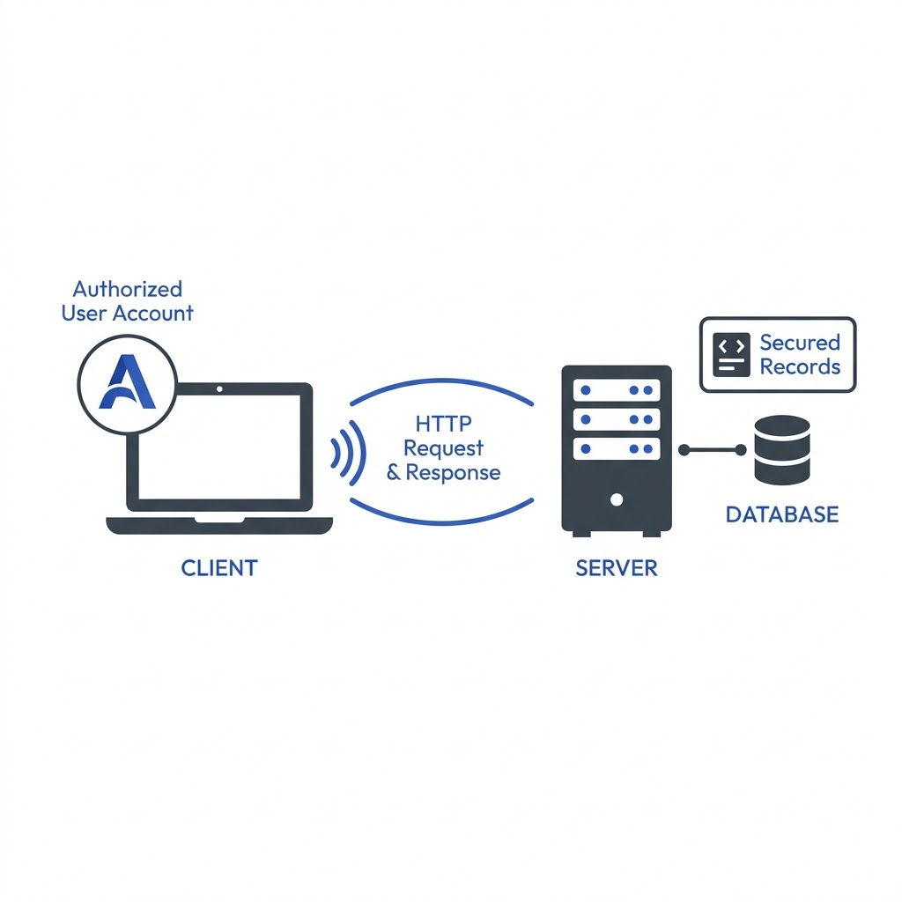
What is an API?
An Application Programming Interface (API) allows different software systems to communicate.
// The Restaurant Analogy
Client (You): Makes the request.
API (Waiter): Takes your request to the kitchen and brings back the food.
Server (Kitchen): Processes the request and prepares the data.
// Core Terms
Endpoint: The specific URL where the API is accessed.
Request/Response: The cycle of asking for and receiving data.
HTTP Methods:
GET: Retrieve data.
POST: Send new data.
api_flow_diagram.png

Slide 52
Asynchronous JavaScript
JSON + fetch()
JSON: JavaScript Object Notation. The standard text format for transmitting data across the web, structured as key-value pairs, objects, and arrays.
api.js
async function getUser() {
// 1. Fetch returns a Promise resolving to a Response object
const response = await fetch('[link removed]');
// 2. We MUST parse the body. .json() also returns a Promise!
const data = await response.json();
console.log(data.name);
}
// Schema representation
{
"key": "value",
"array": ["item1", "item2"]
}
fetch(): The modern browser API for making network requests. It returns a Promise.
Built-in Structure: Natively supported in modern runtimes, allowing clean handle chains instead of legacy asynchronous callback mechanisms.

Slide 53
Real API Project (Dynamic User List)
Connecting async logic to the Document Object Model (DOM).
loadUsers.js
async function loadUsers() {
try {
const res = await fetch('[link removed]');
const users = await res.json();
const container = document.getElementById('user-list');
container.innerHTML = users.map(user => `
<div class="card">
<h3>${user.name}</h3>
<p>${user.email}</p>
</div>
`).join('');
} catch (err) {
console.error(err);
}
}
fetch()
Request
Response
response.json()
DOM update

Slide 54
Advanced JS Mental Model + Final Challenge
01. Callback
function passed to be called later
elem.addEventListener(
'click', callback
)
02. Promise
object representing future data
new Promise((resolve) => {
resolve(data);
})
03. async/await
clean syntax for Promises
async function fetchData() {
await getAsyncPromise();
}
04. fetch()
modern API for network requests
fetch('/endpoint')
.then(r => r.json())
api-dashboard.js
Final Challenge: Build an API Dashboard
Build an interactive interface using clean async execution. Requirements:
[01] Fetch data using async/await & fetch()
[02] Implement robust try/catch error handling
[03] Render visual loading indicators during wait states
[04] Dynamically map fetched payload properties to DOM
[05] Wire up manual reload triggers via button DOM events
/* Event-to-UI Async Lifecycle Flow */
User Action ➔ DOM Event Triggered
└──➔ async function execution starts
└──➔ fetch() request sent to network
└──➔ API Server processes/sends payload
└──➔ parsing raw JSON data response
└──➔ DOM Updated instantly in browser

