Slide 1
CAPSTONE PROJECT
Capstone project presentation
Project title - Multi-Threaded Banking System
Presented by – himanshu raturi

Slide 2
PROJECT OVERVIEW
This project aims to provide an experience in developing a Multi-threaded programing help in Banking.
In this project we will learn how to interact with multiple tasks happening simultaneously.

Slide 3
MOTIVATION
Increased Efficiency: Multi-threading allows multiple operations to be performed simultaneously, which improves the overall efficiency and responsiveness of the banking system.
Real-Time Operations: In a real banking environment, transactions need to be processed in real-time. Multi-threading helps in handling multiple transactions at once without significant delays.
Scalability: Multi-threaded systems can handle a growing number of users and transactions more effectively compared to single-threaded systems.

Slide 4
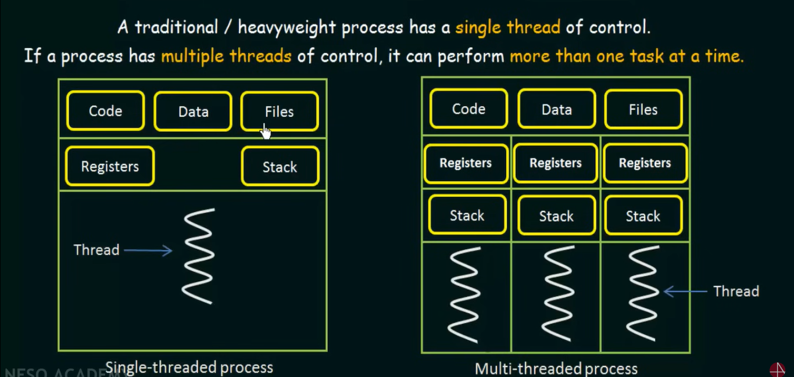
SYSTEM DESIGN

Slide 5
INTRODUCTION and SCOPE
Multi-threading refers to the ability to execute multiple threads concurrently within a single process. A thread is the smallest unit of execution in a program, and multiple threads can run in parallel, sharing the same memory space but executing different tasks.
Transaction Processing, Scalability, Performance Optimization, Database Management are the scope of multi-threading in Banking Software.

Slide 6
Transaction Processing
Concurrency Management: Explanation of handling multiple transactions simultaneously.
Real-time Processing: Benefits of real-time updates and processing.

Slide 7
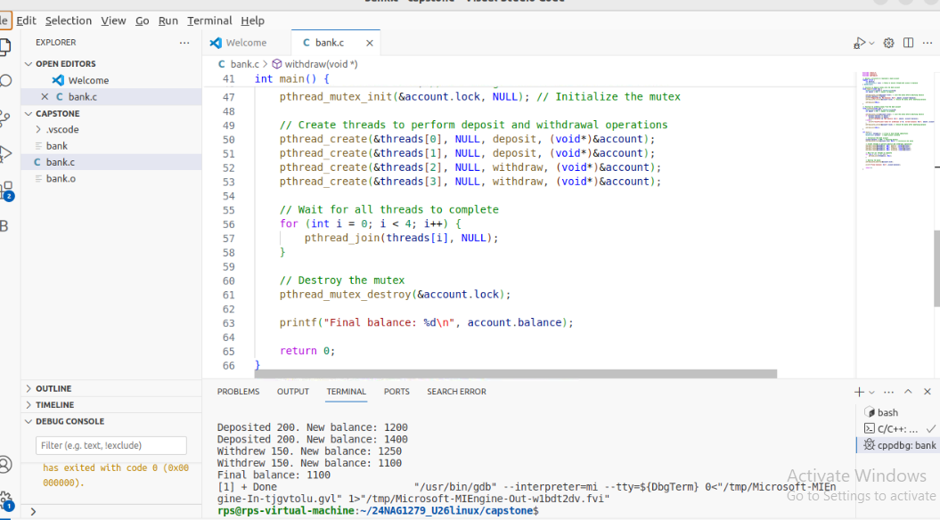

Slide 8
KEY CONCEPT
Key Concepts of Multi-Threading:
1. Thread: A thread is a sequence of executable commands that can be managed independently by a scheduler. Multiple threads within the same process share the same resources, such as memory space and file descriptors.
2. Concurrency: Multi-threading allows concurrent execution of tasks. This means multiple threads are making progress independently but may not necessarily run simultaneously on separate cores.

Slide 9
CONCLUSION
1. Thread Safety: Mutex locks ensure that only one thread can modify the balance at a time, preventing race conditions and ensuring thread-safe operations.
2. Concurrency: The program demonstrates how to create and manage multiple threads performing concurrent deposit and withdrawal operations.
3. Output: The output will vary based on the execution order of threads but should always result in a consistent final balance reflecting the total deposits and withdrawals.

