Slide 1
Create Reports from a Database
BUSINESS ANALYST NANO-DEGREE
PROJECT -2.2
The Text File has been submitted with the Zip folder..
Submitted By-
-> Himanshu Sharma.

Slide 2
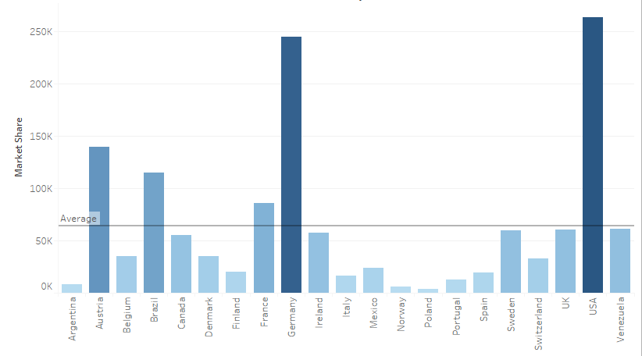
Where are my customers located?
From the visualization, we can see that :->
->USA is leading all the countries with the max. 260K revenue.
->USA, Australia, Germany and Brazil contains almost 50% of the total world’s revenue.
Total Revenue of Countries
Countries
Notes:
<SQL query>

Slide 3
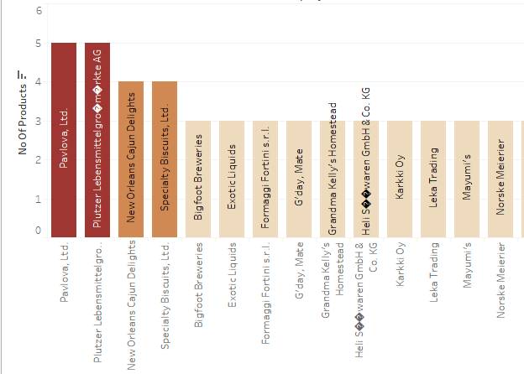
What companies supply the majority of the products I sell?
Distinct No. of Products Supplied by Companies
From the visualization, we can see that :->
-> Pavlova, Ltd. And Plutzer Lebensmittelgro�m�rkte AG supply the majority of the products with count 5.
-> New Orleans Cajun Delights and Specialty Biscuits, Ltd. Share the second position by supplying 4 types of products.
Companies
Notes:
<SQL query>

Slide 4
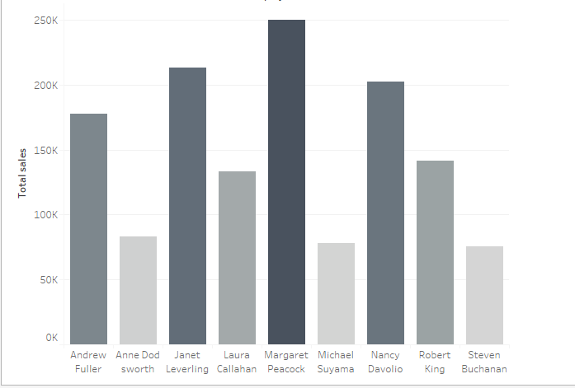
Who are my highest performing employees?
Employees and their total Sales
From the visualization, we can see that :
-> Margaret Peacock is the highest performing employee with around 250K sale amount.
-> Janet Leverling and Nancy Davolio are also leading employees with around 213k and 202K sale amount respectively.
Employee Name
Notes:
<SQL query>

Slide 5
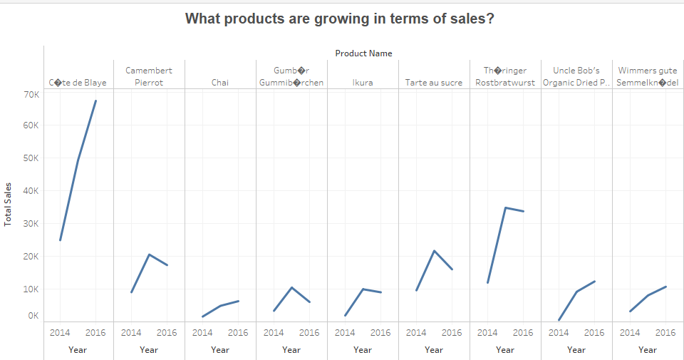
What products are growing in terms of sales?
From the visualization, we can see that :
-> C�te de Blaye is growing the most in terms of sales.
-> Th�ringer Rostbratwurst’s sales have also increased a lot.
Year from 2014 to 2016 ->
Notes:
<SQL query>

