Slide 1

Data Analysis & Interpretation Hypothesis Testing

Slide 2
DCOVA
Define
Collect
Organize
Visualize
Analyse

Slide 3
Table of Contents
Hypothesis Testing Concept
Types of Error
One Tail hypothesis Testing
Two tail hypothesis testing
Hypothesis Testing around the Proportion

Slide 4
What is a Hypothesis?
DCOVA
A hypothesis is a claim (assertion) about a
population parameter.
Hypothesis is a statement that might be true, which might then be tested.
population mean
population proportion
Ex: The mean monthly cell phone bill in this city is μ = $42
Ex: The proportion of adults in this city with cell phones is π = 0.68

Slide 5
Examples
In cereal filling example, mean weight is 368 gram per box.
The mean height of BBA-2019 boys is 5.5 feet.
The average score of BBA-2019 in DAI is 75.
The effectiveness of COVID vaccination is 95%.
There is no difference in average score of girls and boys in BBA-2019 for DAI subject.

Slide 6
Hypothesis Testing
Hypothesis testing is basically a method to test your hypothesis.
Hypothesis testing is a systematic way to test claims or ideas about a group or population.
Hypothesis testing is an act in statistics whereby an analyst tests an assumption regarding a population parameter.
Two Types of Hypothesis:
Null hypothesis
Alternate Hypothesis

Slide 7

The Null Hypothesis, H₀
DCOVA
States the claim or assertion to be tested
Ex: The average diameter of a manufactured bolt is 30mm
The hypothesis that the population parameter is equal to the certain specification is referred to as the null hypothesis.
Is always about a population parameter, not about a sample statistic

Slide 8
Examples
In cereal filling example, mean weight is 368 gram per box.
H₀ : µ = 368 gram per box.
The mean height of BBA-2019 boys is 5.5 feet.
H₀ : µ = 5.5 feet.
The average score of BBA-2019 in DAI is 75.
H₀ : µ = 75
The effectiveness of COVID vaccination is 95%.
H₀ : π = .95

Slide 9
The Null Hypothesis, H₀
DCOVA
(continued)
Begin with the assumption that the null hypothesis is true
Similar to the notion of innocent until proven guilty
Refers to the status quo or historical value
Always contains “=”, or “≤”, or “≥” sign
May or may not be rejected

Slide 10
The Alternative Hypothesis, H₁
DCOVA
Is the opposite of the null hypothesis
Ex: The average diameter of a manufactured bolt is not equal to 30mm ( H₁: μ ≠ 30 )
Challenges the status quo
Never contains the “=”, or “≤”, or “≥” sign
Is generally the hypothesis that the researcher is trying to prove

Slide 11
The Alternative Hypothesis, H₁
DCOVA
Whenever a null hypothesis is specified, an alternative hypothesis is also specified,
It must be true if the null hypothesis is false.
For example,
The mean height of BBA-2019 boys is 5.5 feet.
H₁ : µ != 5.5
The average score of BBA-2019 in DAI is 75.
H₁ : µ != 75
The effectiveness of COVID vaccination is 95%.
H₁ : π != .95
The alternative hypothesis represents the conclusion reached by rejecting the null hypothesis.

Slide 12
ALWAYS REMEMBER
Failure to reject the null hypothesis is not proof that it is true.
You can never prove that the null hypothesis is correct because the decision is based only on the sample information, not on the entire population.
Therefore, if you fail to reject the null hypothesis, you can only conclude that there is insufficient evidence to warrant its rejection.

Slide 13

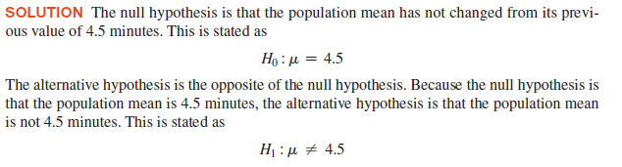
EXAMPLE-State the Null and Alternate Hypothesis Hypothesis

Slide 14
EXAMPLE-State the Null and Alternate Hypothesis Hypothesis

Slide 15
The Hypothesis Testing Process
DCOVA
Claim: The population mean age is 50.
H₀: μ = 50, H₁: μ ≠ 50
Sample the population and find sample mean.
Population
Sample

Slide 16
The Hypothesis Testing Process
DCOVA
(continued)
Suppose the sample mean age was X = 20.
This is significantly lower than the claimed mean population age of 50.
If the null hypothesis were true, the probability of getting such a different sample mean would be very small, so you reject the null hypothesis .
In other words, getting a sample mean of 20 is so unlikely if the population mean was 50, you conclude that the population mean must not be 50.

Slide 17
The Hypothesis Testing Process
DCOVA
(continued)
Sampling Distribution of X
X
20
μ = 50
If H₀ is true
... then you reject the null hypothesis that μ = 50.
If it is unlikely that you would get a sample mean of this value ...
... When in fact this were the population mean…

Slide 18
The Test Statistic and Critical Values
DCOVA
If the sample mean is close to the stated population mean, the null hypothesis is not rejected.
If the sample mean is far from the stated population mean, the null hypothesis is rejected.
How far is “far enough” to reject H₀?
The critical value of a test statistic creates a “line in the sand” for decision making -- it answers the question of how far is far enough.

Slide 19
The Test Statistic and Critical Values
DCOVA
Sampling Distribution of the test statistic
Region of Rejection
Region of Rejection
Region of
Non-Rejection
Critical Values
“Too Far Away” From Mean of Sampling Distribution

Slide 20
The Test Statistic and Critical Values
The sampling distribution of the test statistic is divided into two regions, a region of rejection (sometimes called the critical region) and a region of nonrejection.
If the test statistic falls into the region of nonrejection, you do not reject the null hypothesis.
If the test statistic falls into the rejection region, you reject the null hypothesis
The region of rejection and non rejection is determined by the critical value.

Slide 21
Determine the critical value of test Statistic
To make a decision concerning the null hypothesis, you first determine the critical value of the test statistic.
The critical value divides the nonrejection region from the rejection region.
Determining the critical value depends on the size of the rejection region.
However, the size of the rejection region is directly related to the risks involved in using only sample evidence to make decisions about a population parameter.

Slide 22
Risks in Decision Making Using Hypothesis Testing
Using hypothesis testing involves the risk of reaching an incorrect conclusion.
You might wrongly reject a true null hypothesis, H0.
Or, conversely, you might wrongly not reject a false null hypothesis, H0.
These types of risk are called Type I and Type II errors.

Slide 23
TYPE I error
Type I error occurs if you reject the null hypothesis, H0, when it is true and should not be rejected.
A Type I error is a “false alarm.”
The probability of a Type I error occurring is α.
Ex: In boys height example, you want to know the average height for boys for BBA -2019 for the JGU design trousers stitching process which stitches the trousers keeping in consideration that average height for BBA-2019 batch boys is 5.5. ft.
You would commit the Type I error if you concluded that BBA-2019 boys mean height is not 5.5 ft when it is 5.5.ft.
This error causes you to needlessly adjust the stitching process (the “false alarm”) even though the process is working properly.

Slide 24
Type II Error
A Type II error occurs if you do not reject the null hypothesis, H0, when it is false and should be rejected.
A Type II error represents a “missed opportunity” to take some corrective action.
The probability of a Type II error occurring is β.
In the same scenario of boys height, you would make a Type II error if you concluded that the BBA-2019 mean height is 5.5 ft when it is not 5.5ft.
In this case, you would allow the stitching process to continue without adjustment, even though an adjustment is needed (the “missed opportunity”).

Slide 25
Possible Errors in Hypothesis Test Decision Making
DCOVA
Type I Error
Reject a true null hypothesis
Considered a serious type of error
The probability of a Type I Error is α
determines level of significance of the test
Set by researcher in advance
Type II Error
Failure to reject false null hypothesis
The probability of a Type II Error is β
The confidence coefficient (1-α) is the probability of not rejecting H₀ when it is true.
The confidence level of a hypothesis test is (1-α)*100%.
The power of a statistical test (1-β) is the probability of rejecting H₀ when it is false.

Slide 26
Possible Errors in Hypothesis Test Decision Making
DCOVA
(continued)
Possible Hypothesis Test Outcomes
 | Actual Situation
Decision | H₀ True | H₀ False
Do not Reject H₀ | No Error (Correct decision) Probability 1 – α | Type II Error Probability β
Reject H₀ | Type I Error Probability α | No Error(Correct decision) Probability (Power) 1 – β

Slide 27
Let’s come back to determining the critical value of sample statistic

Slide 28
Step 1: Identify Level of Significance (α)
Traditionally, you control the Type I error by determining the risk level (α), that you are willing to have of rejecting the null hypothesis when it is true.
This risk, or probability, of committing a Type I error is called the level of significance (α).
Because you specify the level of significance before you perform the hypothesis test, you directly control the risk of committing a Type I error.
Traditionally, you select a level of 0.01, 0.05, or 0.10.
The choice of a particular risk level for making a Type I error depends on the cost of making a Type I error.
After you specify the value for α, you can then determine the critical values that divide the rejection and nonrejection regions.

Slide 29
Level of Significance and the Rejection Region
DCOVA
H₀: μ = 30 H₁: μ ≠ 30
Level of significance =
α
/2
α
α
/2
30
Critical values
Rejection Region
This is a two-tail test because there is a rejection region in both tails

Slide 30
Step 2: Identify β risk
The probability of committing a Type II error is called the β risk.
Unlike the Type I error (which you control through the selection of α), the probability of making a Type II error depends on the difference between the hypothesized and actual values of the population parameter.
Because large differences are easier to find than small ones, if the difference between the hypothesized and actual values of the population parameter is large, β is small.
Ex: if the population mean is 330 grams, there is a small chance (β) that you will conclude that the mean has not changed from 368 grams.
However, if the difference between the hypothesized and actual values of the parameter is small, β is large.
Ex: if the population mean is actually 367 grams, there is a large chance that you will conclude that the mean is still 368 grams.

Slide 31
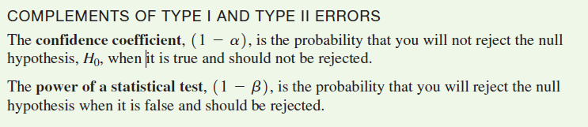
ALWAYS REMEMBER

Slide 32
Type I & II Error Relationship
DCOVA
Type I and Type II errors cannot happen at the same time
A Type I error can only occur if H₀ is true
A Type II error can only occur if H₀ is false
If Type I error probability (α) , then
Type II error probability (β)

Slide 33
Factors Affecting Type II Error
DCOVA
All else equal,
β when the difference between hypothesized parameter and its true value
β when α
β when σ
β when n

Slide 34
How to reduce the TYPE I and TYPE II error?
Increase the sample size to reduce the TYPE II error.
Large samples generally permit you to detect even very small differences between the hypothesized values and the actual population parameters.
For any given sample size, you must consider the trade-offs between the two possible types of errors.

Slide 35
How to reduce the TYPE I and TYPE II error? Contd.
Choose the small value of alpha(α) – To reduce the Type I error.
Because you can directly control the risk of a Type I error, you can reduce this risk by selecting a smaller value for α.
Ex: if the negative consequences associated with making a Type I error are substantial, you could select α = 0.01 instead of 0.05.
However, when you decrease α, you increase β risk.
However, to reduce β, you could select a larger value for α. Therefore, if it is important to try to avoid a Type II error, you can select α of 0.05 or 0.10 instead of 0.01.
The choice of reasonable values for α and β depends on the costs inherent in each type of error.

Slide 36
Types of Hypothesis testing
Two tail test
A two-tailed hypothesis test is a method in which the critical area of a distribution is two-sided and tests whether a sample is greater or less than a range of values.
Ex: In cereal filling example, mean weight is 368 gram per box.
H₀ : µ = 368 gram per box.
One Tail test
A one-tailed hypothesis test is a statistical test in which the critical area of a distribution is one-sided so that it is either greater than or less than a certain value, but not both.
Ex: In cereal filling example, mean weight is greater than 368 gram per box.
H₀ : µ_{s} > 368 gram per box.

Slide 37
Hypothesis Tests for the Mean
DCOVA
Hypothesis
Tests for μ
σ Known
σ Unknown
(Z test)
(t test)

Slide 38
Z Test of Hypothesis for the Mean (σ Known)
DCOVA
Convert sample statistic ( ) to a Z_{STAT} test statistic
X
Hypothesis
Tests for μ
σ Known
σ Known
σ Unknown
σ Unknown
(Z test)
(t test)
The test statistic is:

Slide 39
Hypothesis Testing can be performed in two ways
Critical Value Approach
p-value approach

Slide 40
Critical Value Approach to Testing
DCOVA
For a two-tail test for the mean, σ known:
Convert sample statistic ( ) to test statistic (Z_{STAT})
Determine the critical Z values for a specified level of significance α from a table or computer
Decision Rule: If the test statistic falls in the rejection region, reject H₀ ; otherwise do not reject H₀

Slide 41
Two-Tail Tests
DCOVA
H₀: μ = 30 H₁: μ ≠ 30
There are two cutoff values (critical values), defining the regions of rejection
α/2
α/2
30
X
Reject H₀
Do not reject H₀
Reject H₀
-Z_{α/2}
+Z_{α/2}
Z
0
Lower critical value
Upper critical value

Slide 42
6 Steps in Hypothesis Testing
DCOVA
State the null hypothesis, H₀ and the alternative hypothesis, H₁
Choose the level of significance, α, and the sample size, n
Determine the appropriate test statistic and sampling distribution
Determine the critical values that divide the rejection and nonrejection regions
Collect data and compute the value of the test statistic
Make the statistical decision and state the managerial conclusion. If the test statistic falls into the nonrejection region, do not reject the null hypothesis H₀. If the test statistic falls into the rejection region, reject the null hypothesis. Express the managerial conclusion in the context of the problem

Slide 43
Hypothesis Testing Example
DCOVA
Test the claim that the true mean diameter of a manufactured bolt is 30mm.
(Assume σ = 0.8)
1. State the appropriate null and alternative
hypotheses
H₀: μ = 30 H₁: μ ≠ 30 (This is a two-tail test)
2. Specify the desired level of significance and the sample size
Suppose that α = 0.05 and n = 100 are chosen for this test

Slide 44
Hypothesis Testing Example
DCOVA
(continued)
3. Determine the appropriate technique
σ is assumed known so this is a Z test.
4. Determine the critical values
For α = 0.05 the critical Z values are ±1.96
5. Collect the data and compute the test statistic
Suppose the sample results are
n = 100, X = 29.84 (σ = 0.8 is assumed known)
So the test statistic is:

Slide 45
Hypothesis Testing Example
DCOVA
(continued)
6. Is the test statistic in the rejection region?
α/2 = 0.025
α/2 = 0.025
Reject H₀ if Z_{STAT} < -1.96 or Z_{STAT} > 1.96; otherwise do not reject H₀
Reject H₀
Do not reject H₀
Reject H₀
-Z_{α/2} = -1.96
0
+Z_{α/2} = +1.96
Here, Z_{STAT} = -2.0 < -1.96, so the test statistic is in the rejection region

Slide 46
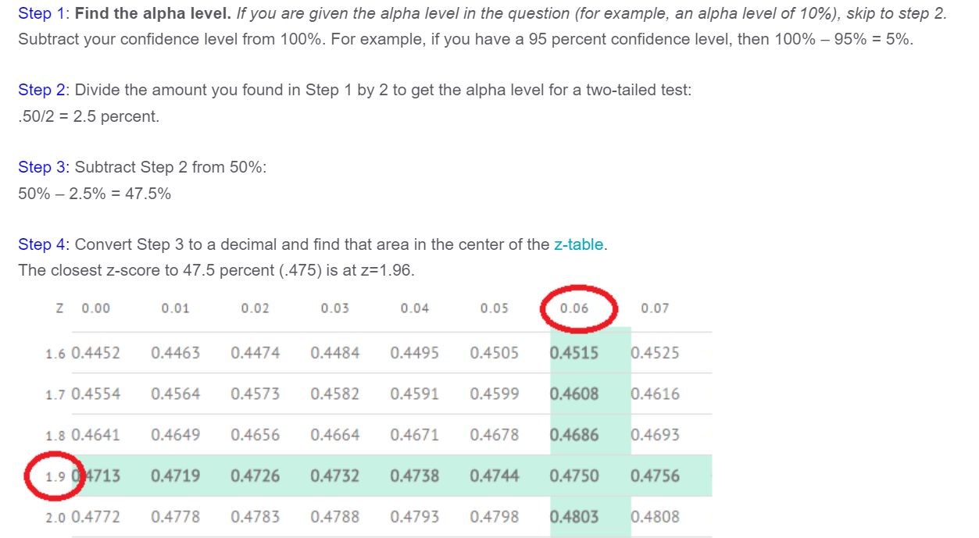

Slide 47
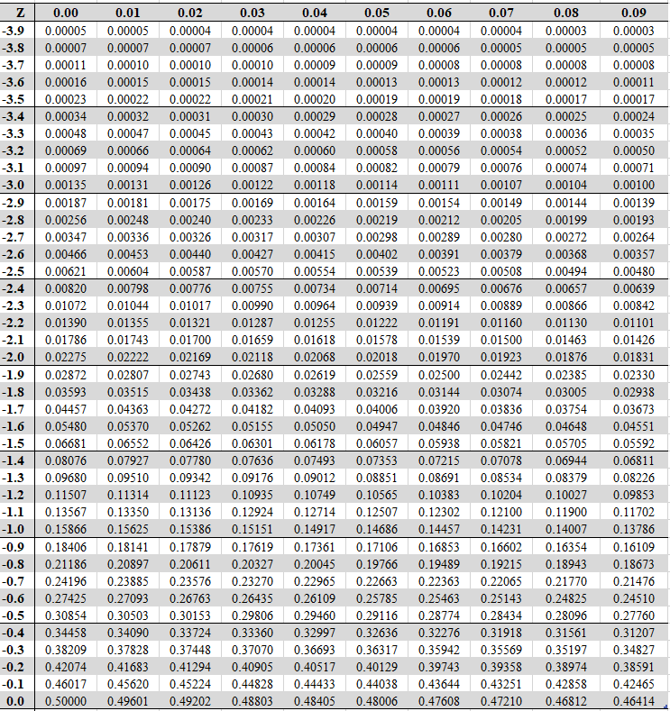

Slide 48
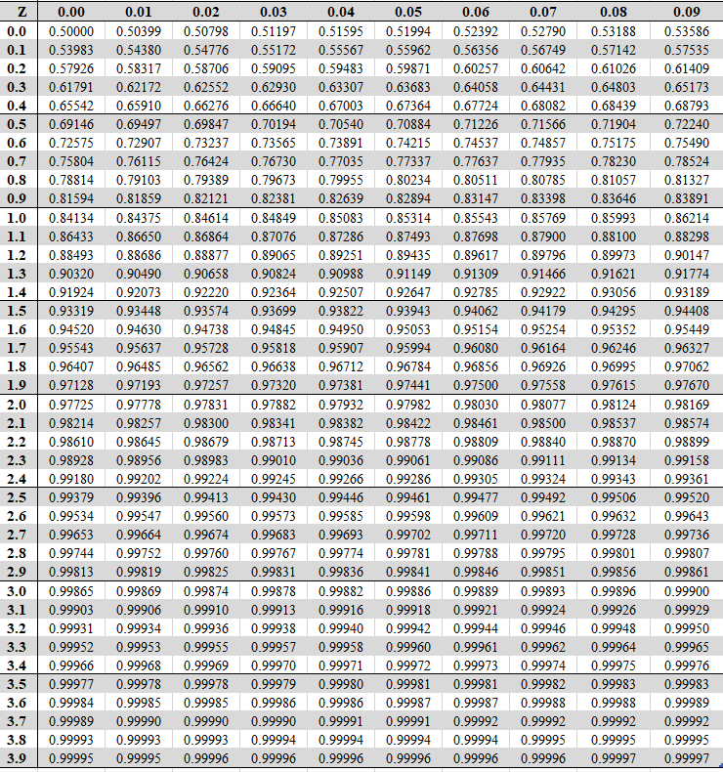

Slide 49
Hypothesis Testing Example
DCOVA
(continued)
6 (continued). Reach a decision and interpret the result
α = 0.05/2
α = 0.05/2
Reject H₀
Do not reject H₀
Reject H₀
-Z_{α/2} = -1.96
0
+Z_{α/2}= +1.96
-2.0
Since Z_{STAT} = -2.0 < -1.96, reject the null hypothesis and conclude there is sufficient evidence that the mean diameter of a manufactured bolt is not equal to 30

Slide 50
p-Value Approach to Testing
DCOVA
p-value: Probability of obtaining a test statistic equal to or more extreme than the observed sample value given H₀ is true
The p-value is also called the observed level of significance
It is the smallest value of α for which H₀ can be rejected

Slide 51
p-Value Approach to Testing: Interpreting the p-value
DCOVA
Compare the p-value with α
If p-value < α , reject H₀
If p-value ≥ α , do not reject H₀
Remember
If the p-value is low then H₀ must go

Slide 52
The 5 Step p-value approach to Hypothesis Testing
DCOVA
State the null hypothesis, H₀ and the alternative hypothesis, H₁
Choose the level of significance, α, and the sample size, n
Determine the appropriate test statistic and sampling distribution
Collect data and compute the value of the test statistic and the p-value
Make the statistical decision and state the managerial conclusion. If the p-value is < α then reject H₀, otherwise do not reject H₀. State the managerial conclusion in the context of the problem

Slide 53
p-value Hypothesis Testing Example
DCOVA
Test the claim that the true mean diameter of a manufactured bolt is 30mm.
(Assume σ = 0.8)
1. State the appropriate null and alternative
hypotheses
H₀: μ = 30 H₁: μ ≠ 30 (This is a two-tail test)
2. Specify the desired level of significance and the sample size
Suppose that α = 0.05 and n = 100 are chosen for this test

Slide 54
p-value Hypothesis Testing Example
DCOVA
(continued)
3. Determine the appropriate technique
σ is assumed known so this is a Z test.
4. Collect the data, compute the test statistic and the p-value
Suppose the sample results are
n = 100, X = 29.84 (σ = 0.8 is assumed known)
So the test statistic is:

Slide 55
p-Value Hypothesis Testing Example: Calculating the p-value
DCOVA
4. (continued) Calculate the p-value.
How likely is it to get a Z_{STAT} of -2 (or something further from the mean (0), in either direction) if H₀ is true?
P(Z < -2.0) = 0.0228
P(Z > 2.0) = 0.0228
0
Z
-2.0
2.0
p-value = 0.0228 + 0.0228 = 0.0456

Slide 56
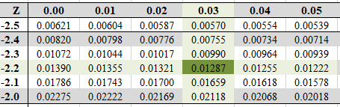
Here Z value =-2
So area under the curve =0.02275
Since it is a two tailed test
Z = 2 X 0.02275=0.0455

Slide 57
p-value Hypothesis Testing Example
DCOVA
(continued)
5. Is the p-value < α?
Since p-value = 0.0456 < α = 0.05 Reject H₀
5. (continued) State the managerial conclusion in the context of the situation.
There is sufficient evidence to conclude the average diameter of a manufactured bolt is not equal to 30mm.

Slide 58


