Slide 1
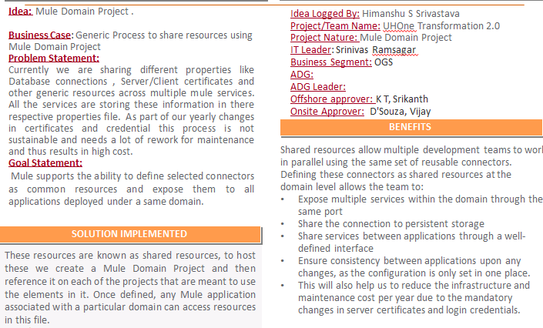
Mule Domain Project – UhOne-2.0
PROJECT BACKGROUND
OTHER DETAILS

Slide 2
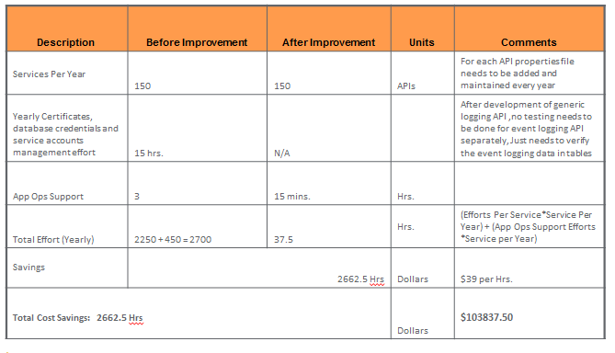
Financial Impact

Slide 3
Other Details
UTILIZATION DETAILS
Leveraging Opportunity
Generic Process to share resources using Mule Domain Project decreased the manual effort where resource has to spend time during yearly certificates, password and service account maintenance.
This Concept can be implemented in any project where Mulesoft is being used.
SIGN-OFF MAIL

