Slide 1
LIVE Award | Himanshu Srivastava (USD 600 )
Application - UHOne2.0 Facets
Punch Line - Application Steward and Leader
His role is Dev Lead for one of the UHOne 2.0 Facets Scrum Team.
He exhibited outstanding thought leadership and mentoring skills during the resolution of Mule Certificate issue. We had a compliance issue that needed all the Mule credentials to be changed, this was a big impact to all services running in PROD and non-PROD environments. This was when Himanshu came up with the approach of fixing this by analyzing the impact on all services. He took complete ownership and led this activity by collaborating with AppOps and we were able to fix this issue seamlessly.
His team has been tasked with the very critical blue-chip programs that are scheduled over next 6 months. UHOne is counting big on its next product Health Protector Guard 2 (HPG2) planned for go live in May-2019.
HPG2 go live is dependent on the core deliverables from his team and the team has already been on their toes to mark it’s footprint to set up two most complex functions claims and provider on the facets platform.
Himanshu has optimized the performance for Policy Packet Onbase application and reduced the file processing time from 8 hrs to 5 minutes in production.
There were space issues in UHOne 2.0 lower environments, he came up with an automated clean up script that saves monitoring time and effort. There were significant savings on time and effort.
Created the automation script for cleaning up old code versions that saves manual effort.

Slide 2
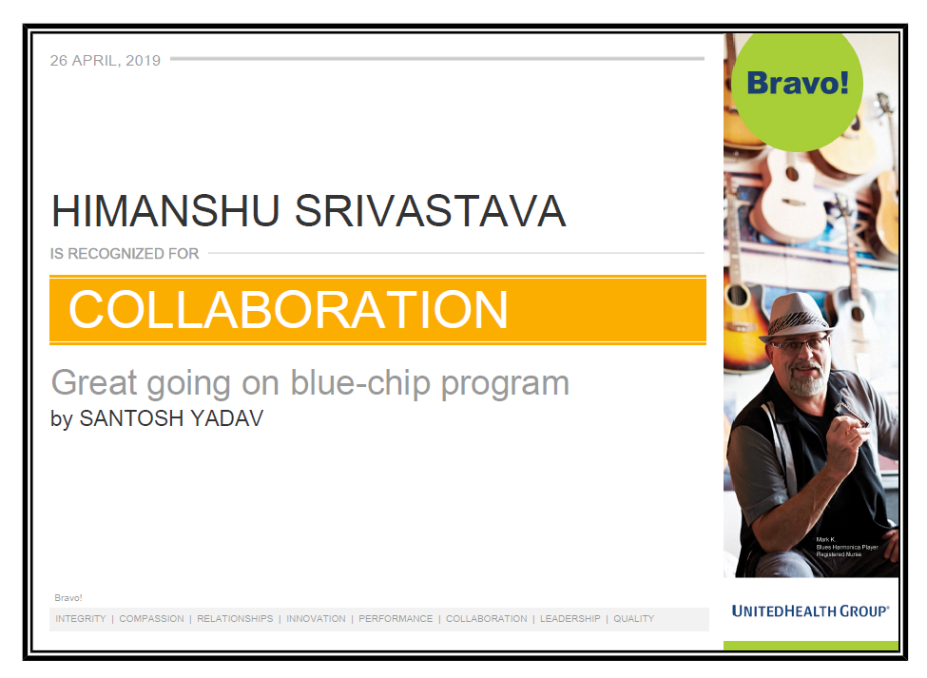
LIVE Award | Himanshu Srivastava (USD 600 )

Slide 3
STAR Award | Himanshu Srivastava (USD 250)
Application - UHOne2.0 Facets
Punch Line - Great ideas turning into reality
Implemented numerous ideas resulting thousands of dollar savings.
Generic Outbound Router : Approx Savings = $167K
Munit Implementation in Mule - Approx Savings =120K
Generic Host/Port centralization = $180K
Automated Member Creation = $450K
Reduction in time to build leading to savings of $450K/year by automating the bulk member and specific member enrollment.
He is a full stack developer playing all the roles SA,DEV,SDET as required.
Played SME role in HPG2 go live for main claims related area.
Himanshu has also been exceptionally outstanding in bringing in quick solution for Facets 5.6 upgrade initiative. He (in capacity of Dev lead) has been phenomenal in bringing up maturity within scrum team.
Himanshu helped in running Multiplan batches and CKMM based on Business request during Claims End to End testing and was appreciated for being flexible and responsive to Business queries and helping them to complete the testing within the timeline.
Proactively identifies the opportunities in the application and making them happen, Supports multiple scrum teams with their queries.

Slide 4
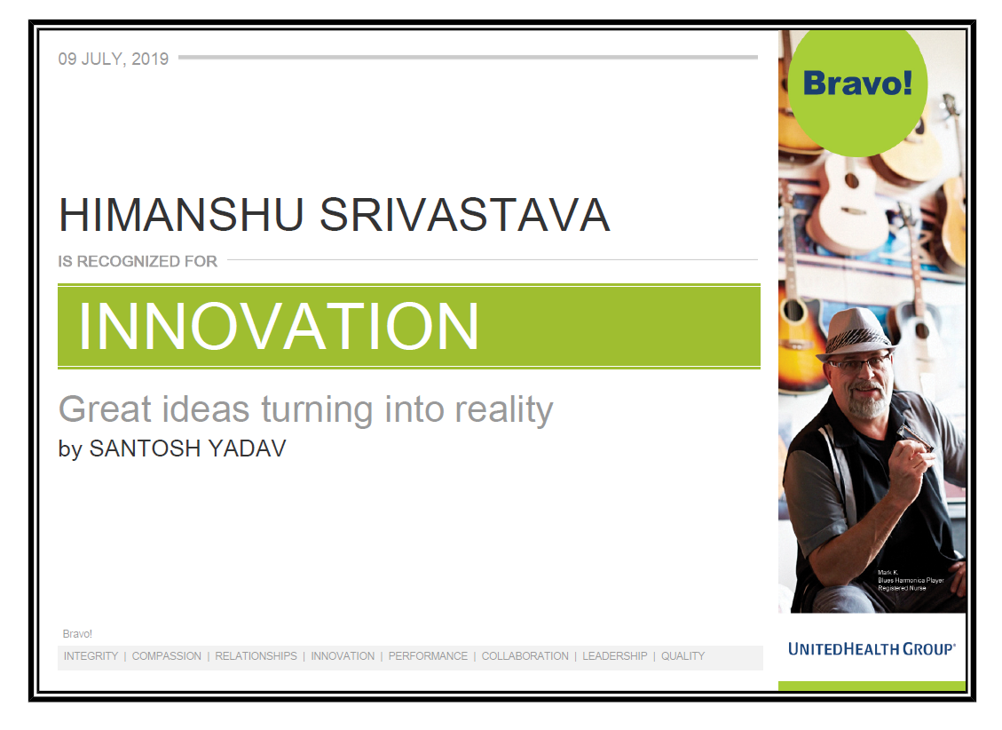
STAR Award | Himanshu Srivastava (USD 250)

Slide 5
Aquamarine Award | Himanshu Srivastava (USD 250)
Application - UHOne2.0 Facets
Punch Line - Great Job as Lead Developer
Himanshu have been instrumental in getting team to collaborate on the analysis, development, and quality assurance efforts in an effective way. The production of working software coming from his team has been efficient and of high quality; and he was a major reason for that success.
Business is very impressed and pleased in how he have taken charge and demanded excellence from the development team while grooming and refining the work.
He baselined the SQL server and mule development standards for UHOne 2.0 application and ensured that compliance & standards is maintained as per architecture road map for all critical deliveries.
Helped onsite development team in completing the 837 EDI File Image Creation (Receipt of claim) in OnBase. He provided required job information in EDI file transition to the OnBase NAS repository location and also pre-process setup of the EDI file dropping for an EDI Processor to pickup and load into OnBase to the.
Demonstrated great technical leadership, and contributed to the speedy and successful deployment of the Healthiest You Product to Production. The upfront analyses of the code and guidance he provided to the team was key getting in this product to market in a very short timeframe.
As a Lead Developer he encouraged the team with his mentorship, knowledge and drive. In addition, his leadership was key in the deployment of the Dental Gen 3 product.
He was also appreciated for submitting, championing, and leading efforts that resulted in the implementation of "Innovation" items in support of our Facets program.
A tool for performing the BRC impact analysis
Munit testing framework that allows us to easily build automated tests for integrations and APIs.

Slide 6
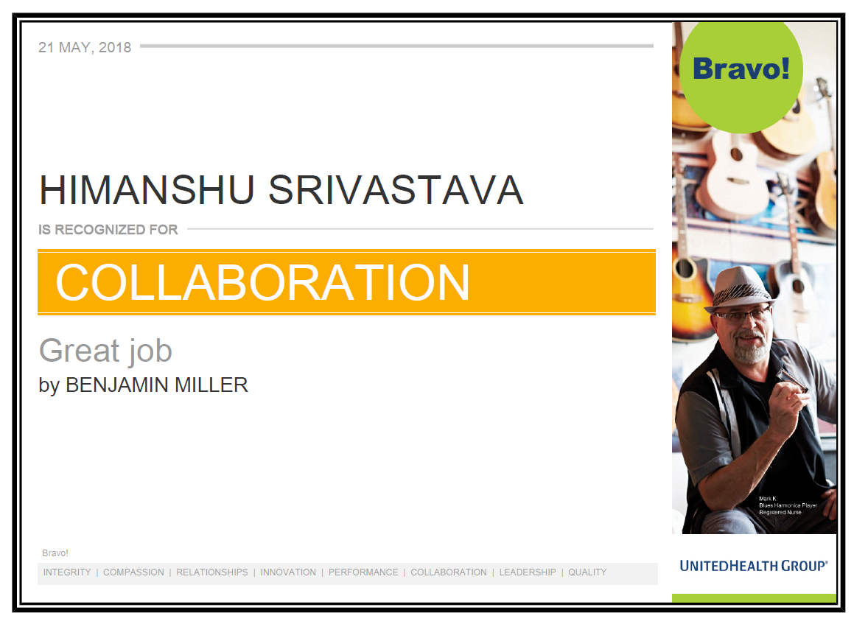
Aquamarine Award | Himanshu Srivastava (USD 250)

Slide 7
Sustaining Edge Award | Himanshu Srivastava (INR 26000)
Application – UHOne2.0 Facets
Punch Line – UHOne2.0 GO To Person
GIT Hub strategy set up and synchronization of artifacts through out ensuring efficient/quality deliverables.
Conducted several knowledge sharing sessions with team on new technologies & advancements (Mule/Talend).
Created the architecture, functional design and baselined the UHOne 2.0 enrollment process from its scratch and successfully developed, tested and deployed it in production.
Over 150 fields were exposed to external portals to store online application data, along with designing and implementing new micro services to store plan, product, billing and member demographics details.
Go to person for any query faced by the team , also ensures that the best practices are adhered to in the team.
Himanshu has analyzed Membership Retroactivity(FDRI) project and not only help identify a short-term fix that will eliminate incorrect reporting, but also identified an entirely new solution that will simplify the complex reporting criteria.
Enhanced User Experience by Optimizing batch processing & abend resolution by providing visual of Jenkins Pipeline to see which batch from the series of dependent batches failed.
Actively leading reducing tech debt in the application running into thousands of $$. A few tech debt items have delivered and addressed based on business values associated.
Implemented Bright idea of dynamic archival process which enables code reusability leading to business impact of $300K for the team

Slide 8
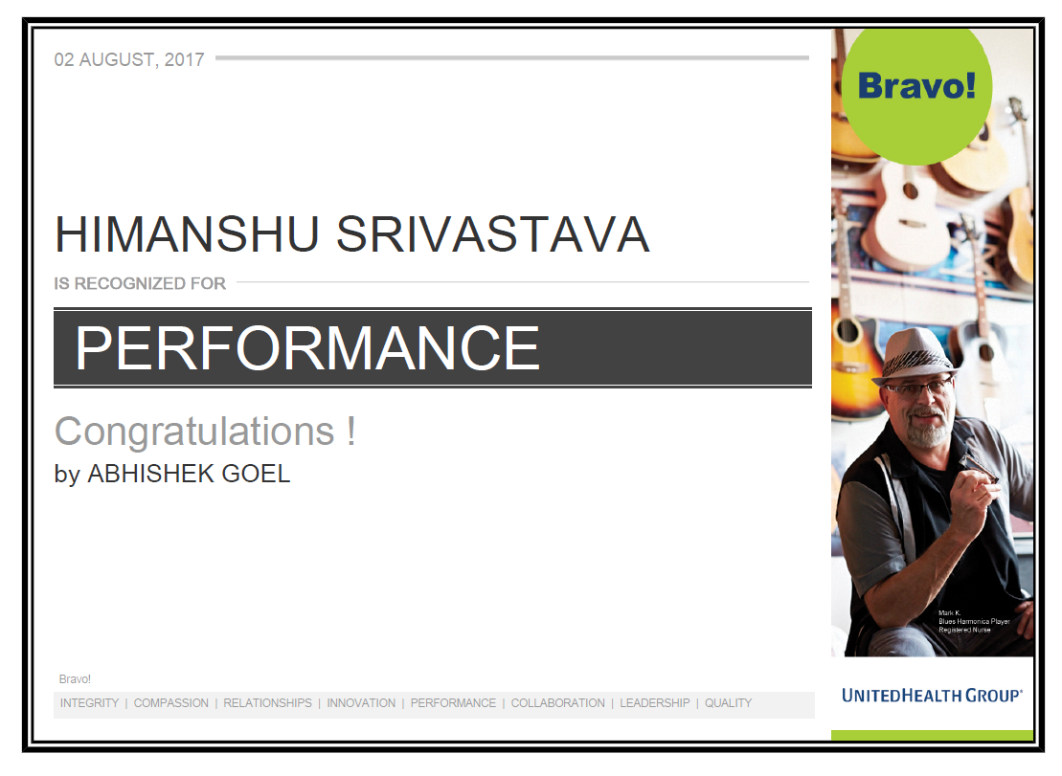
Sustaining Edge Award | Himanshu Srivastava (INR 26000)

Slide 9
Sapphire Award | Himanshu Srivastava (INR 15300)
Application – Dental Facets
Punch Line – Make Ideas Happen
Himanshu has worked extensively as a strong pillar on Dental critical projects like, Financial Tagging System , Duncan , Payment Integrity single handedly. He is an excellent developer and worked as a expert on every project which helped dental facets achieving all the milestones.
He is very innovative also and always try to automate various bottlenecks by creating tools. As a part of that he created configuration script Generator, Batch Automation & Schema generator tools which helped us in quick turnarounds of projects as well as the savings close to $114,628.He received several appreciations for performance optimization of projects as well.
During the last sprint 100% of the story points for Polaris project were accepted, which represented a more than 50% increase over Sprint 1. The team continues to see increase participation on the daily stand up calls which has led to quicker identification of issues and even faster resolutions.
He has successfully developed and implemented the Facets Payment Integrity (Pronto) . This project will standardize the Dental Claims Utilization Review process and provide business cost saving of $5.5M annually.
He is acting as a mentor for various resources already in the project and help them in technical difficulties.
Created the Template Express tool which not only reduced a very time intensive manual process, but also reduced the risk associated with manual intervention
Developed Deployment Utility tool that enables team members to deploy and validate DB components in a highly effective and efficient manner especially considering Dental & CMC deployments are handled by Trizetto. This has been very useful in terms of accuracy and time savings.

Slide 10
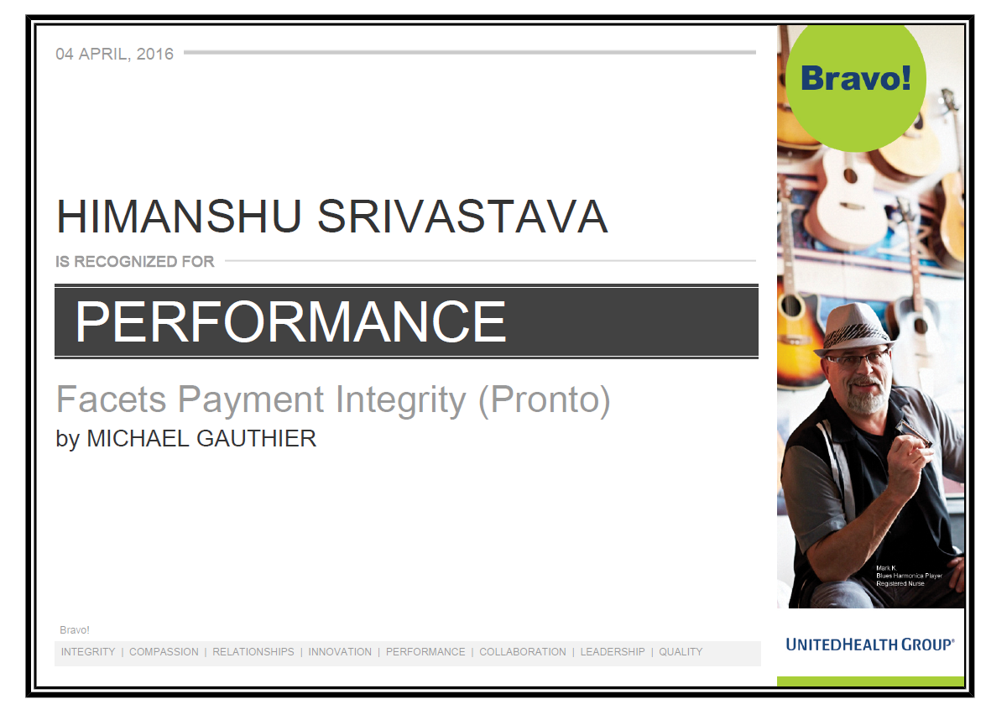
Sapphire Award | Himanshu Srivastava (INR 15300)

