Slide 1
FUNCTIONS
Name – Himanshu Sharma
Class – MCA

Slide 2
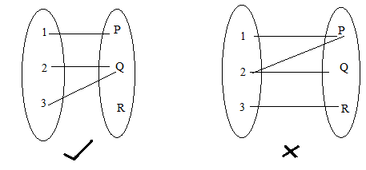
What is Function?
A function is a relation between a set of inputs and a set of permissible outputs with the property that each input is related to exactly one output. Let A & B be any two non-empty sets, mapping from A to B will be a function only when every element in set A has one end only one image in set B.
Example:-

Slide 3
What is Function?
Let A and B be two non-empty sets. A function f from set A to set B is a rule which associates each element of A to a unique element of B. It is denoted by
f : A -> B
Set A is called domain of function ‘f’
Set B is called co-domain of function ‘f’
If element x of A corresponds to y(𝞊B) under the function f, then we say that y is the image of x and we write f(x) = y.

Slide 4
Domain of Function :-
Domain of the function is set of all those real numbers x for which f(x) exists or f(x) is meaningful and finite.
For example:
f(x) = 1/x, f(x) exists,
if x ‡ 0, so domain is non-zero Real numbers.

Slide 5
Range of function :-
Set of all images of elements in domain is called the range.
Range = {f(x): x 𝞊 domain}
For examples:
Function Domain Range
x^{2n}, n𝞊N (-infinite, infinite) [zero, infinite)
√x (zero, infinite) [zero, infinite)
1/x R – {0} R – {0}
sin(x) (-infinite, infinite) [-1, 1]

Slide 6
Types of Function :-
One – one function
Many – one function
Onto – function
Into – function
Linear Function
Identical Function
Rational Function
Algebraic Functions
Modulus Function
Signum Function
Greatest Integer Function
Fractional Part Function
Periodic Function
Composite Function
Constant Function
Identity Function

Slide 7
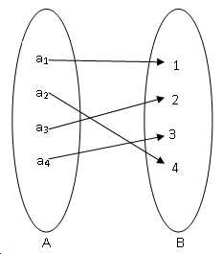
Types of Function :-
One – one function :-
A function is said to be one – one function if different elements in a domain in a domain have different images in co-domain .

Slide 8
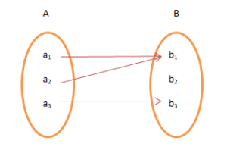
Types of Function :-
Many – One Function:-
A function f: A -> b is said to be many one if more than one element in set A have same image in Set B.
NOTE:
1. All even function, modulus function, periodic function are always many to one function
2. Square function, trigonometric function are also many – one function in their domain.

Slide 9
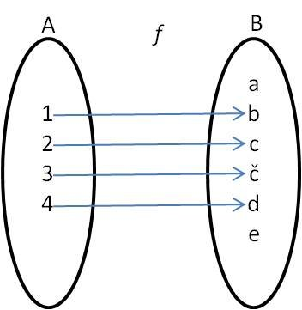
Types of Function :-
Into Function :-
A function f: A -> b is said to be into function if there exist at least one element in set B having no any pre-image in set A
In the below figure set B (co-domain) there is no pre-image, for element d, in set A, so function is into function.

Slide 10
Types of Function :-
ONTO Function :-
f: A B, said to be onto function if every element in set B has a pre-image in set A.
Range of f = co-domain of f.
Example:
Log x, linear polynomials , are always onto function defined from its domain to R.

Slide 11
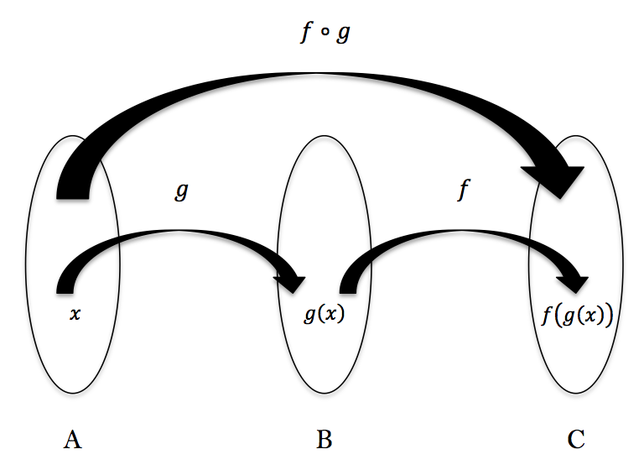
Types of Function :-
Composite Function :-
Consider function f: A ->B and g:B ->C; that is, where the codomain of f is the domain of g.Then we may define a new function from A to C, called the composition of f and g and written g.f, as follows:
(g.f)(a) = g(f(a))
For example:-
f(x) = x2 & g(x) = 2x
f(g(x)) = f(2x) = (2x)2 = 4x2
g(f(x)) = g(x2) = 2x2

Slide 12
Types of Function :-
Inverse Function :-
Two functions f and g are inverse of each other if f(g(x)) = x for x 𝞊 dom g and g(f(x)) = x for x 𝞊 dom f, i.e. gof = I_{dom} f and fog = I_{dom} g where I_{dom}f is identify function on dom f and I_{dom}g is identity function on dom g. We denote g by f⁻¹ or f by g⁻¹ to find the inverse of f, write down the equation y = f(x) and then solve x as a function of y. The resulting equation is x = f⁻¹(y).
NOTE:
1.For existence of inverse function, function must be one – one onto.
2. A function need not have an inverse. e.g. the function f(x) = x² has no inverse (where dom f = R). To have an inverse, a function mustbe both one – oneand onto, i.e. bijective.

Slide 13
Types of Function :-
POLYNOMIAL FUNCTION
The function f(x) = a + a₀x + a₁x + a₂x² ….. a_{n}x^{n} , where a_{0,} a_{1,} a_{2 …} a_{n} 𝞊 R and n 𝞊 N us called a polynomial function of degree n.
Rational FUNCTION
A function defined by quotient of two polynomial function is called rational function.
Example:
X² + 1 / x³ + x + 1 is a rational function.

Slide 14
Types of Function :-
^{ALGEBRAIC FUNCTION}
An algebraic function is one which consist of a finite number of terms involving power and roots of the variable x and simple operation, addition, subtraction, multiplication and division i.e. all rational, and irrational functions are algebraic function.
^{PERIODIC FUNCTION}
A function ‘f’ defined on its domain is said to be periodic function if their exists a positive number T such that f(x+T) = f(x), where all x 𝞊 D. Also both x + T and x – T should belong to D.
The least positive value of T, if exists is called, the fundamental period of the function.
^{Example:}
^{f(x) = sin x}
f(x) = sin (x + 2𝜫 ) = sin (x + 4𝜫 ) = sin ( x +6𝜫 ) …..
^{Here T = 0, 2, 4, 6, ……}
Least positive value of T is 2𝜫 , so fundamental period of sin x is 2𝜫.

Slide 15
Types of Function :-
Constant Function
A function denoted by f(x) = c (where c 𝞊 R) is known as constant function.
Domain = R
Range = {c}
Identity Function
A function which is associated to itself is known as identity function and denoted by f(x) = x.
Domain = R
Range = R

Slide 16
Types of Function :-
MODULUS FUNCTION
This is also known as absolute value function and is denoted by f(x) = |x|
Domain = R
Range = [0, infinite)
SIGNUM FUNCTION
A the function f(x), defined as
f(x) = {|x|/x or x/|x| : x ≠ 0
0 : x =0 }
Domain = R
Range = {-1, 0, 1}

Slide 17
Types of Function :-
GREATEST INTEGER FUNCTION
A It is also called floor function denoted by f(x) = [x] we mean greatest integer less then or equal to x. If n is an integer and x is any real number between n and n+1.
Thus [3.4] = 3, [3.99] = 3
[-4.99] = 5, [-4.0001] = -5
[0.3] = 0, [-0.2] = -1.
FRACTIONAL PART FUNCTION
It is noted by f(x) = {x}, also defined as f(x) = x – [x], if x 𝞊 Z, then f(x) = 0 and if x is not 𝞊 Z then f(x) lies between 0 and 1.
Domain = R
Range = [0, 1)

Slide 18
Thank you

