Slide 1
RELATIONS
NAME – Himanshu SHARMA
CLASS – MCA -1

Slide 2
What is RELATIONS ?
Let A and B be sets then a relation from A to B is a subset of A x B.
Suppose R is a relation from A to B. Then R is a set of Ordered pairs (a,b) where each first element comes from A and each second element comes from B. That is, for each pair a∈A and b∈B.
If (a,b)∈R;we then say “ a is related to b ”, written aRb.
If (a,b)∉R;we then say “a is not related to b”.

Slide 3
Example of Simple Relation:-
When (a, b) belongs to R, a is said to be related to b by R.
Example: Let P be a set of people, C be a set of cars, and D be the relation describing which person drives which car(s).
P = {Virat, Dhoni, Pooja, Neha},
C = {Duster, BMW, Scorpio}
D = {(Virat, BMW), (Pooja, Scorpio), (Dhoni, BMW), (Neha,Duster)}
This means that Virat and Dhoni drives BMW, Pooja drives Scorpio and Neha drives Duster.

Slide 4
Domain and Range of Relations :-
Domain :- The Domain of a Relation R is the set of all first elements of the ordered pairs which belong to R.
Range :- The Range of a Relation R is the set of all second elements of the ordered pairs which belong to R.
For eg:- Let A = {1,2,3} and B = {x,y,z} and let R is a relation from A to B since R is a subset of A x B.
R = {(1,y),(1,z),(3,y)} then,
Domain of R is {1,3}.
Range of R is {y,z}.

Slide 5
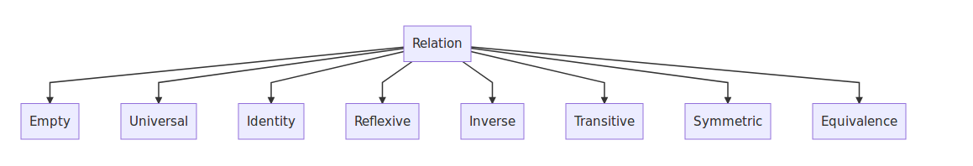
Types of Relation :-

Slide 6
Empty Relation:-
An empty relation (or void relation) is one in which there is no relation between any elements of a set.
For example, if set A = {1, 2, 3} then, one of the void relations can be R = {x, y} where, |x – y| = 8. For empty relation,
R = φ ⊂ A × A , the empty relation

Slide 7
Universal Realtion:-
A universal (or full relation) is a type of relation in which every element of a set is related to each other.
Consider set A = {a, b, c}. Now one of the universal relations will be
R = {x, y} where, |x – y| ≥ 0. For universal relation,
R = A × A

Slide 8
Identity Relations :-
In Identity relation, every element of set A is related to itself only.
R = {(a, a), ∈ A}.
For example, If we throw two dice, we get 36 possible outcomes, (1, 1), (1, 2), … , (6, 6). If we define a relation as R: {(1, 1), (2, 2), (3, 3), (4, 4), (5, 5), (6, 6)}, it is an identity relation.

Slide 9
Inverse Relations :-
Inverse relation is seen when a set has elements which are inverse pairs of another set. For example if set R = {(a, b), (c, d)}, then inverse relation will be R⁻¹ = {(b, a), (d, c)}.
Let R be a relation from set A to set B i.e., R ∈ A × B. The relation R⁻¹ is said to be an Inverse relation if R⁻¹ from set B to A is denoted by
R⁻¹ = {(b, a): (a, b) ∈ R}
Considering the case of throwing of two dice if R = {(1, 2), (2, 3)},
R⁻¹ = {(2, 1), (3, 2)}. Here, the domain of R is the range of R⁻¹ and vice-versa.

Slide 10
Reflexive Relations :-
In a reflexive relation, every element maps to itself.
For example,
consider the following relations on set A = {1, 2,3,4}.
R₁ = {(1,1),(1,2),(2,3),(1,3),(4,4)}
R₂ = {(1,1),(1,2),(2,1),(2,2),(3,3),(4,4)}
R₃ = A x B, the universal relation
Since A contains the four elements 1,2,3 and 4, a relation R on A is reflexive if it contains the four pairs (1,1),(2,2),(3,3),(4,4). Thus only R₂ and the universal relation R₃ are reflexive and R₃ is not reflexive.

Slide 11
Symmetric Relations :-
In a symmetric relation, if a=b is true then b=a is also true. In other words, a relation R is symmetric only if (b, a) ∈ R is true when (a,b) ∈ R.
An example of symmetric relation will be R = {(1, 2), (2, 1)} for a set A = {1, 2}.
So, for a symmetric relation,
aRb ⇒ bRa, ∀ a, b ∈ A

Slide 12
Transitive Relations :-
A Relation R on a set A is transitive if whenever aRb and bRc then aRc, that is, if whenever (a,b),(b,c)∈R then (a,c)∈R.
For Ex:
Consider following Relations on set A ={1,2,3,4}
R₁ = {(1,1),(1,2),(2,3),(1,3),(4,4)}
R₂ = {(1,3),(2,1)}
The Relation R₁ is transitive and Relation R₂ is not transitive because (1,3),(2,1) ∈ R₂ but (2,3) ∉ R₃.

Slide 13
Equivalence Relations :-
A relation is an Equivalence Relation if it is reflexive, symmetric, and transitive. i.e. relation R={(1,1),(2,2),(3,3),(1,2),(2,1),(2,3),(3,2),(1,3),(3,1)} on set A={1,2,3} is equivalence relation as it is reflexive, symmetric, and transitive.

Slide 14
Representation of Relations :-
Relations can be represented in many ways some of which are follows :-
1.Relation as a Matrix
2.Relation as a Directed Graph
3.Relation as an Arrow Diagram

Slide 15
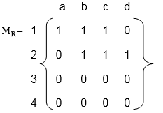
Matrix representation:-
Let P = [a1,a2,a3,.......n] and Q = [b1,b2,b3......m] are finite sets, containing n and m number of elements respectively. R is a relation from P to Q. The relation R can be represented by m x n matrix
M = [M_{ij}], defined as
M_{ij} = 0, if (a_{i},b_{j},) ∉ R
1, if (a_{i},b_{j},) ∈ R
For eg:
Let P = {1, 2, 3, 4}, Q = {a, b, c, d}
R = {(1, a), (1, b), (1, c), (2, b), (2, c), (2, d)}.
Matrix representatin of R is :-

Slide 16
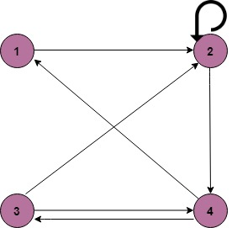
Directed Graph Representaion :-
We can Represent a Relation through a Directed graph.
For eg:-
Let A ={1,2,3,4},
R= {(1, 2) (2, 2) (2, 4) (3, 2) (3, 4) (4, 1) (4, 3)}
Directed Graph of Relation R is :-

Slide 17
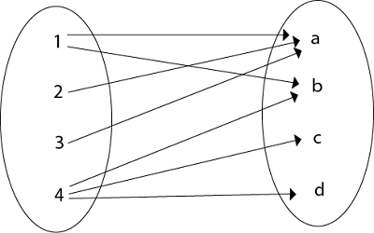
Arrow Diagram Representation :-
If P and Q are finite sets and R is a relation from P to Q. Relation R can be represented as an arrow diagram as follows.
Draw two ellipses for the sets P and Q. Write down the elements of P and elements of Q column-wise in two ellipses. Then draw an arrow from the first ellipse to the second ellipse if a is related to b and a ∈ P and b ∈ Q.
For eg:-
Let P = {1, 2, 3, 4}, Q = {a, b, c, d},
R = {(1, a), (2, a), (3, a), (1, b), (4, b), (4, c), (4, d)
Arrow diagram of relatation R is :-

Slide 18
Thank you

