Slide 1


The Future Of Electricity
Presented by :-
Himanshu Sharma & Prashant Yadav

Slide 2
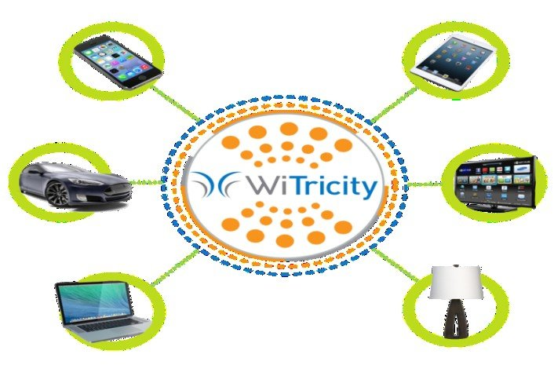
Contents:-
Introduction
History
Need of Witricity.
How it works?
Advantage
Limitation
Conclusion

Slide 3

Introduction:-
What is Witricity?
Witricity means wireless Electricity.
It is used to describe the ability to provide electricity to remote objects without wires, using oscillating magnetic fields.

Slide 4
History:-
In 1899, Sir Nikola Tesla Proposed a method of wireless power transmission.
Tesla enlighten 200 lamps at the distance of 40km but only 15% efficiency was achieved.
A group of engineers at MIT came up with the idea to use resonant induction to transmit power wirelessly.

Slide 5
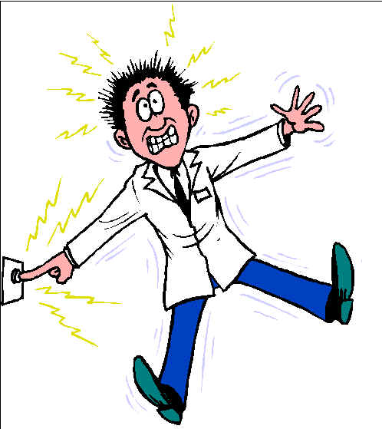
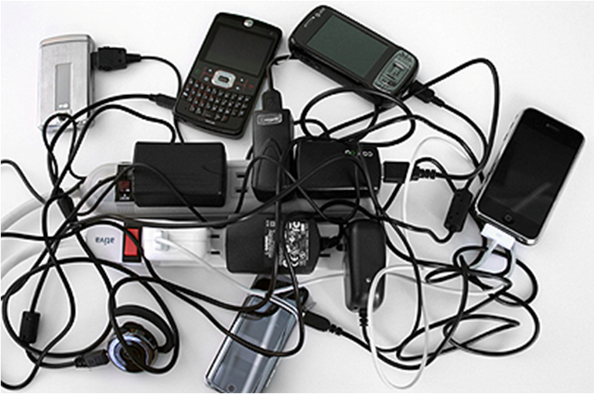
Need of Witricity:-
To avoid Electric Shock
No Wires , No Mess
Easy to Charge our Phones, Electric cars, Battery,etc.

Slide 6
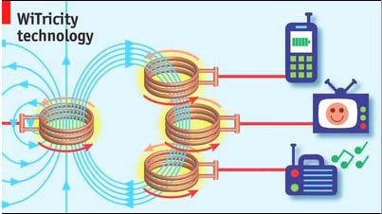
How it works?
There are witricity power sources(transmitter) and capture device(receiver)
Witricity is based on strong coupling between electromagnetic resonant objects to transfer energy wirelessly between them.

Slide 7
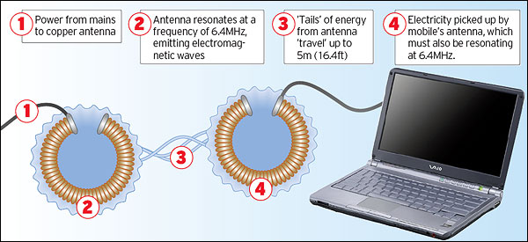
How it works?
The system uses two coils- one plugged into the main and the other enbedded or attached to the gadget. Each coil is carefully engineered with the same resonant frequency.
When the main coil is connected to an electricity supply the magnetic field it produces is resonant with that of with the second coil, allowing energy to between them.

Slide 8
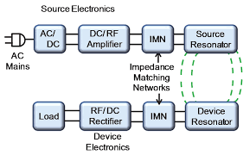
How it works?

Slide 9
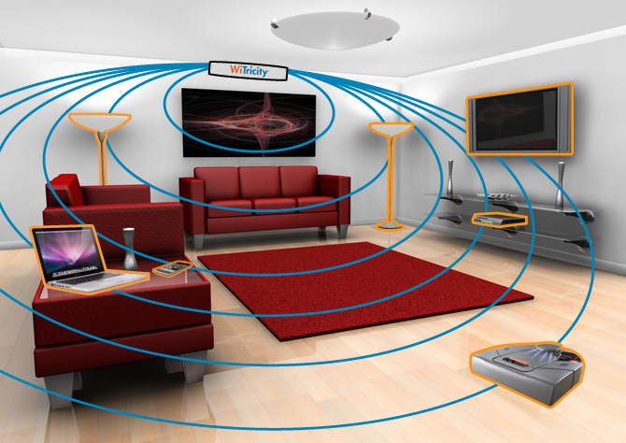
How it works:-

Slide 10
Application:-
Wireless charging,wirelessly supply electricity.

Slide 11
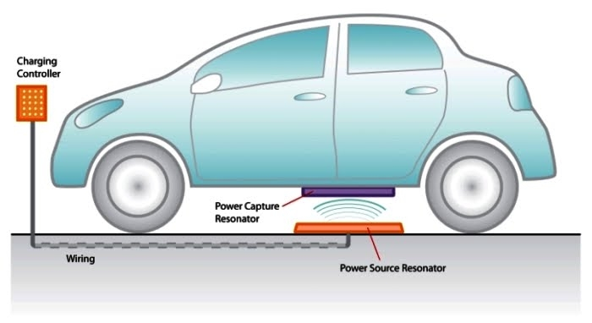
Application:-
Charging Electric car using Witricity.

Slide 12
Advantages:-
Witricity sources only transfer energy when it is needed.
Safe, fairly efficient, good range.
Getting rid of cables.
More secure, no risk of getting shocked.
E-waste (cables,batteries,etc) is eliminated.
Maintenance cost will be saved.
Easy to Charge our Phones,Electric cars, Battery,etc

Slide 13
Limitation:-
Possibility of “energy theft”.
Refitting old equipment or purchasing new equipment could become a very expensive endeavor.
Wireless power transmission can be possible only in few meters.

Slide 14
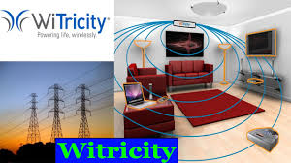
Conclusion:-
Think that the city will be covered with hotspots,just like Wireless Internet , there will be no need of charging batteries, or carrying chargers all around.

Slide 15

Thank you
Have a Nice Day...

