Slide 1
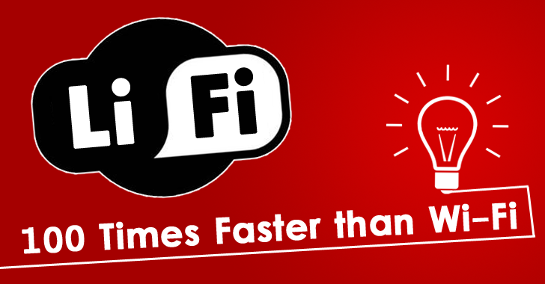

Slide 2
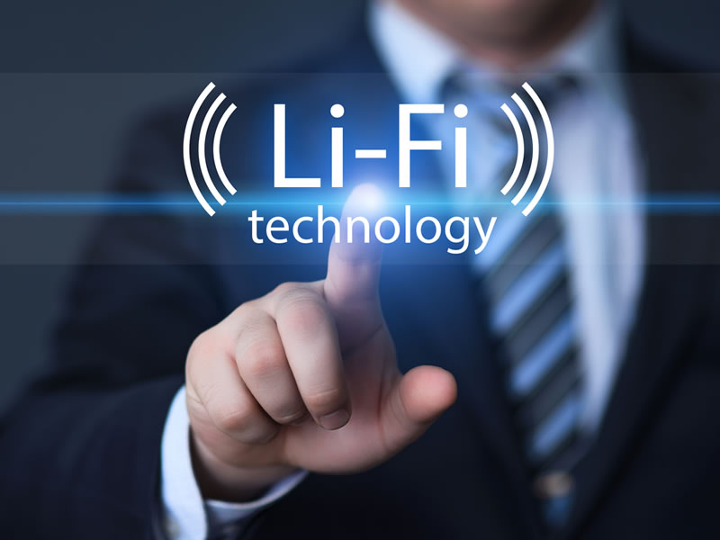
A Presentation by
Himanshu Sharma and Prashant Yadav

Slide 3
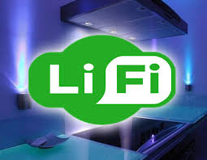
Contents
Introduction
History
How it Works ?
Why we need this ?
Advantages
Limitations
Application
Conclusion

Slide 4
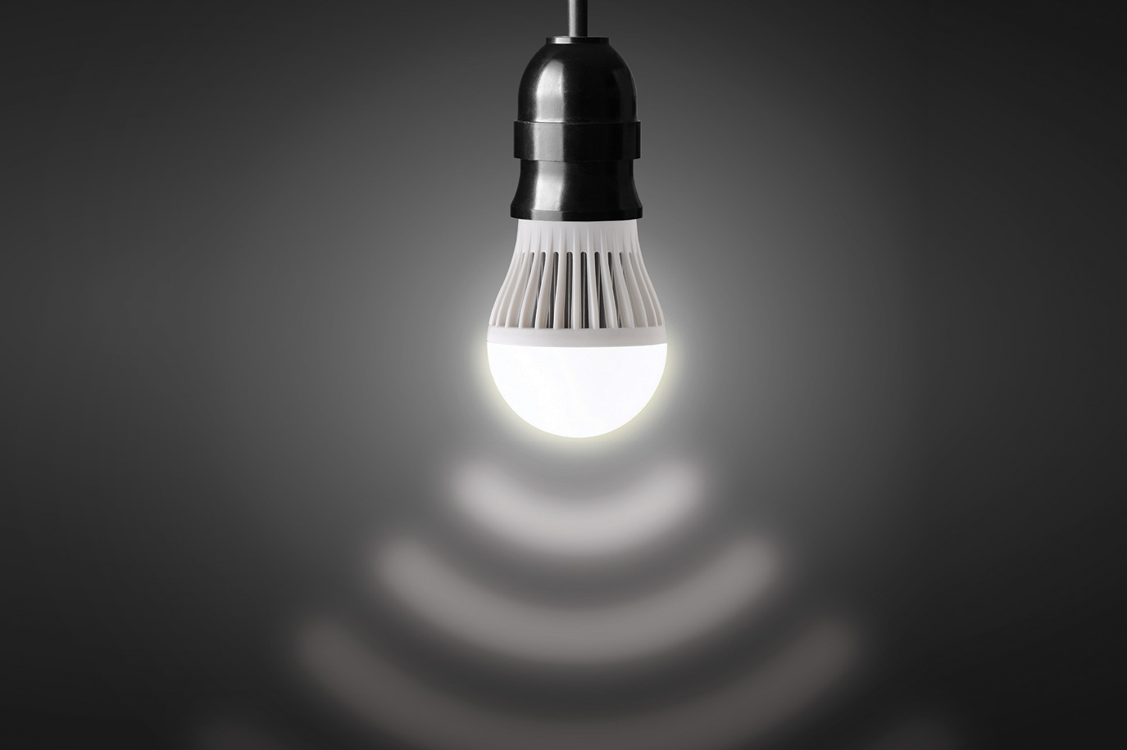
Introduction
What is Li-Fi ?
Li-Fi is light Fidelity. It is technology for wireless communication between devices using light to transmit data.
Li-Fi is transmission of data through illumination, sending data through a LED light bulb that varies intensity faster than human eye can follow.

Slide 5

History of Li-Fi
The Technology truly began during the 1990’s in countries like Germany, Korea and Japan where they discovered LED’s could be retrofitted to send information.
Harald Hass continues to wow the world with the potential to use light for communication . On 12thJuly 2011 He used a table lamp with an LED bulb to transmit a video of blooming flowers that was then projected onto a screen behind him. During the event he periodically blocked the light form the lamp to prove that the lamp wsa indeed the source of incoming data.
Prof. Harald Haas
University of Edinburgh

Slide 6
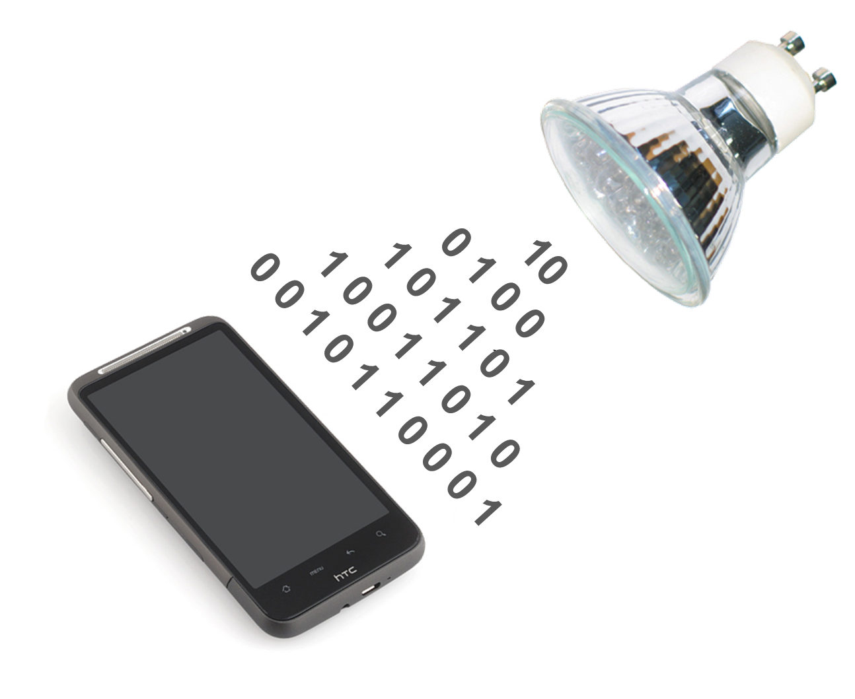
Working Process
Operation procedure is very simple , if the led is on, you transmit a digital 1, if its off you transmit 0. The LEDs can be switched on and off very quickly , which gives nice opportunities for transmitting data. Hence all that us required is some LEDs and a controller that code data into those LEDs. We have to just vary the rate at which the LED’s .
Flicker depending upon the data we want to encode.
Thus every light source will works as a hub for data transmission.

Slide 7
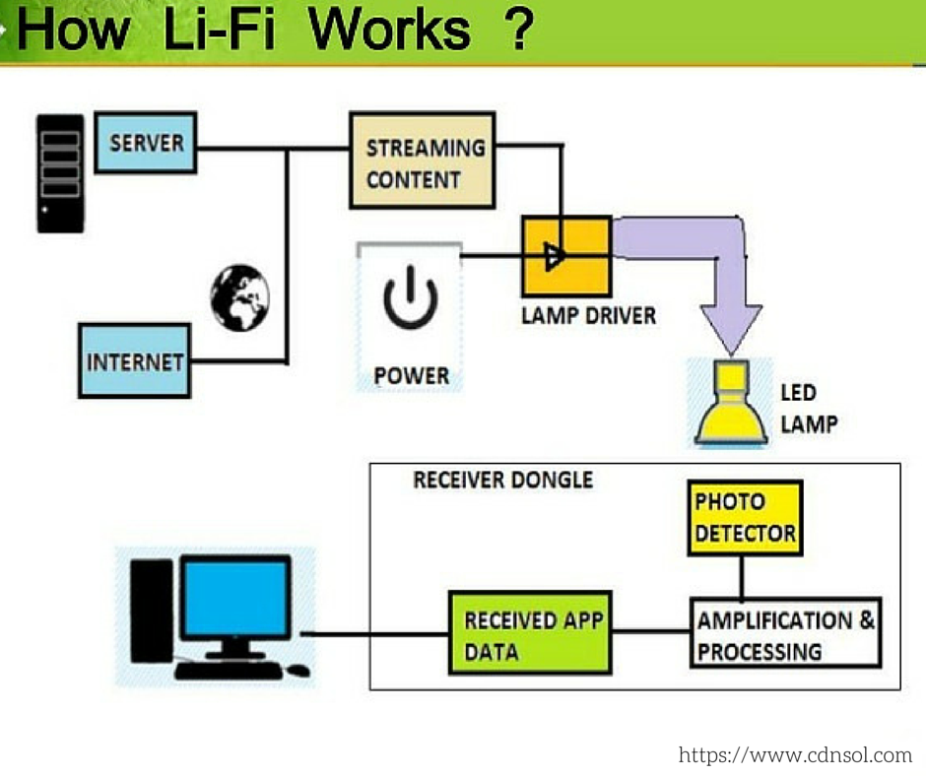
How Li-Fi works?

Slide 8

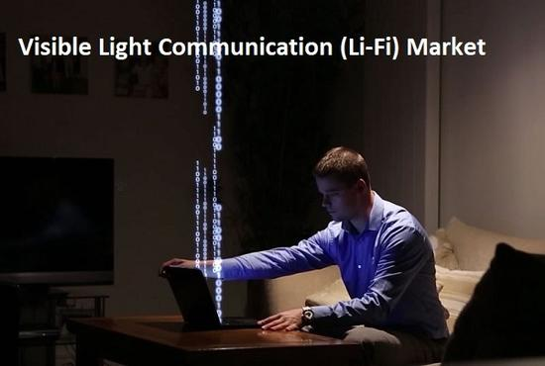
How Li-Fi works?
Here, the data is fed into LED light bulb (with signal processing technology) when the led is on the microchip converts the digital signal in form of light , it then sends data at rapid speeds to the photo detector (photodiode).
A light sensitive device (photo detector ) receives the signal and converts it back into original data. This method of using rapid pulses of light to transmit information wirelessly is technically refered as Visual Light Communication.

Slide 9
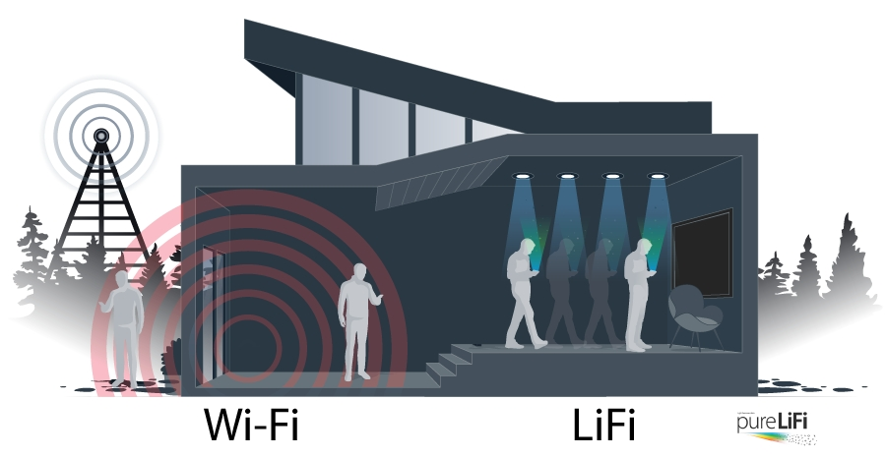
How Li-Fi works?

Slide 10
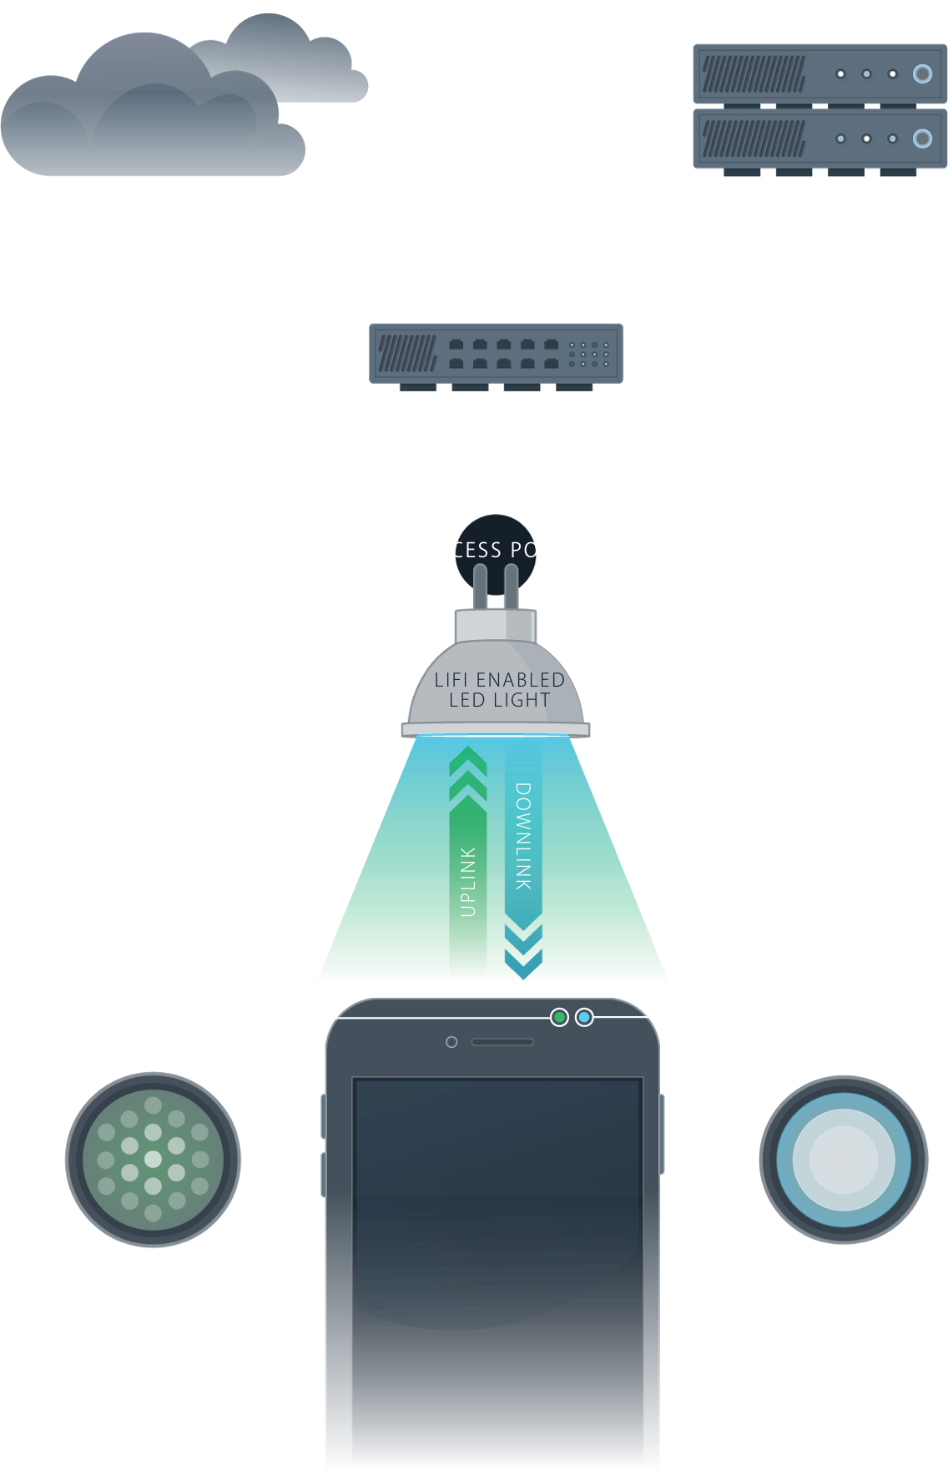
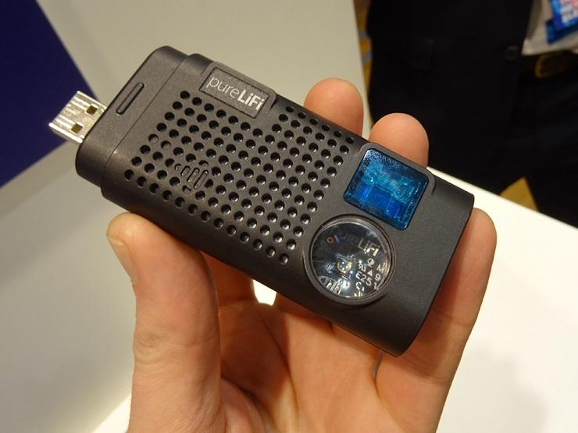
Some devices used for Li-Fi

Slide 11
Why we need this ?
Currently we are using Wi-Fi for Communication data. Which is based on Radio Wave to transfer the data.
Radio Spectrum is congested but the demand for wireless data double each year. Every thing, it seems want to use wireless data but the capacity is drying up. Nearly 5 Billion Mobile phones and 1.4 Million Base Stations are present at current.
Issues with Radio Spectrum or Wifi :-
Unavailable in aircrafts
Less secure
Health issues not used in O.T. etc

Slide 12
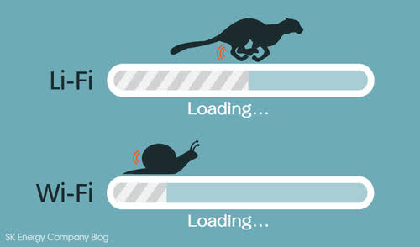
Comparision between Li-Fi and Wi-Fi
Li-Fi can be thought of as a light –based Wi-Fi. That is, it uses light instead of radio waves to transmit information.
Instead of Wi-Fi modems, Li-Fi would use transceiver-fitted LED lamps that can light a room as well as transmit and receive information.
Wi-Fi is great for general wireless coverage within bulidings, and li-fi is ideal for high density wireless data coverage in confined area and for relieving radio interference issues.
So the two technologies can be considered complimentary.

Slide 13
Advantages of Li-Fi
Data rate greater than 10Gbps.
Can be used anywhere , even in RF restricted areas; Since light waves will not interface with radio waves.
LED bulbs are used which consumes less energy.
As light waves cannot penetrate through walls. Thus provide secured communication.
Since it does not pollute, it can be green technology for device to device communication.

Slide 14
Limitations of Li-Fi
Its range is short, in order to use full connectivity more cabel LED bulbs will need to placed.
Li-Fi likely to face interface from external light sources, such as sunlight Hence may cause interruption in communication.
Li-Fi requires the lightbulb is on at all time to provide connectivity, meaning that the light will need to be on during the day and night.

Slide 15

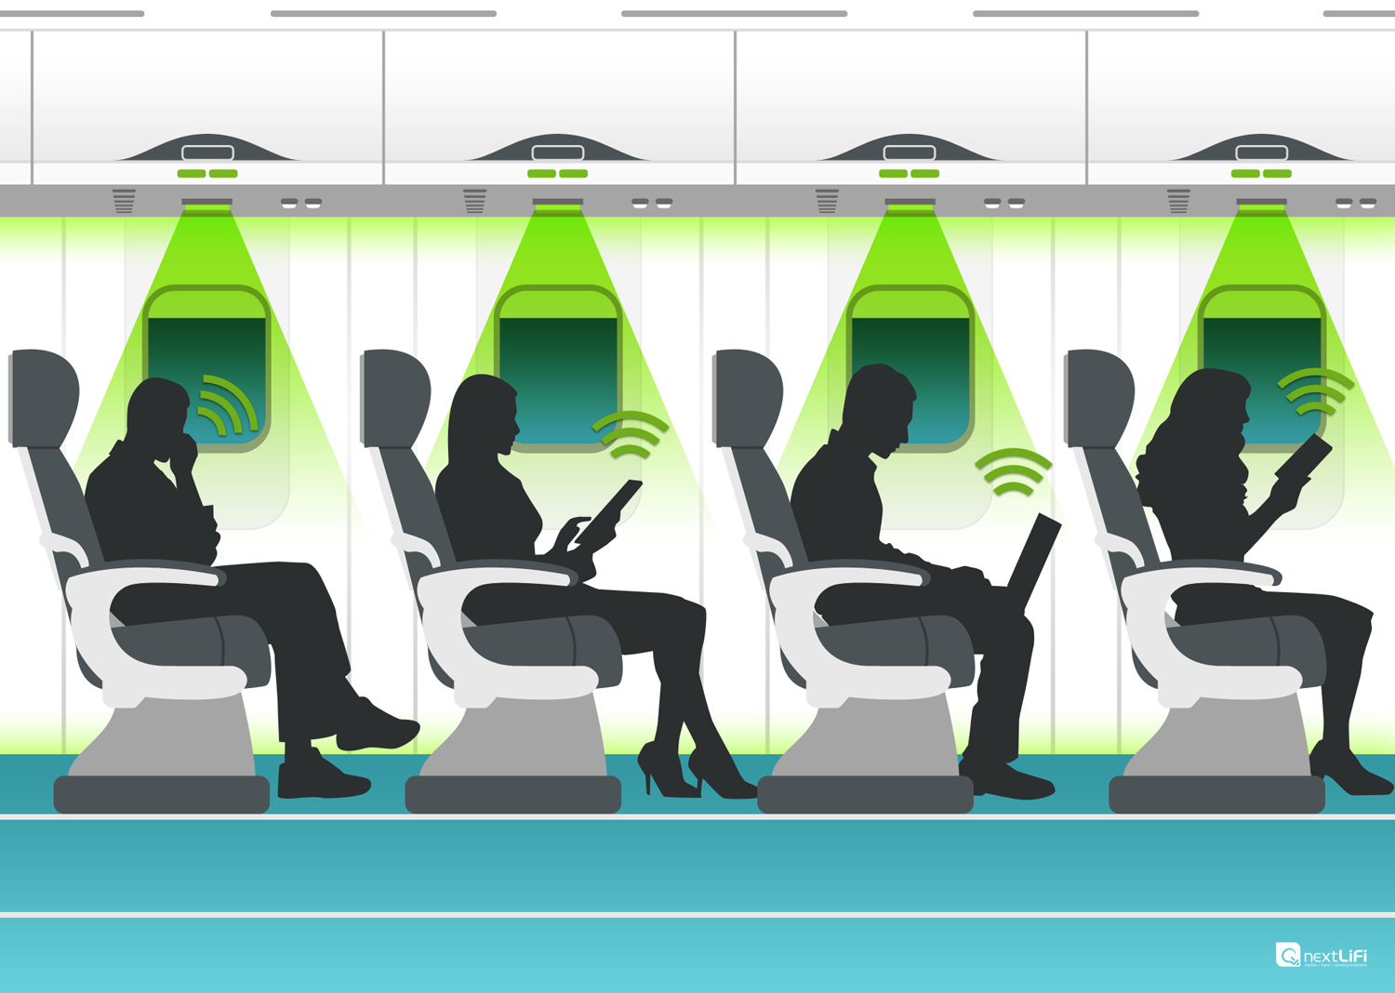
Potencial Application of Li-Fi
Hospitals (Medical Equipment)
Airlines

Slide 16

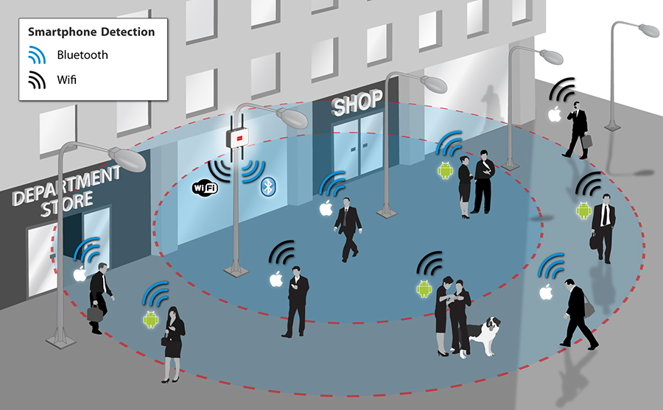
Potencial Application of Li-Fi
Under Water Communication
Street Lamps

Slide 17
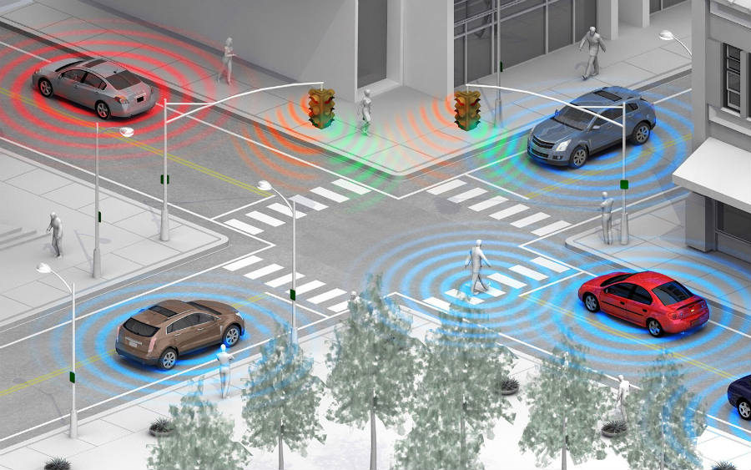
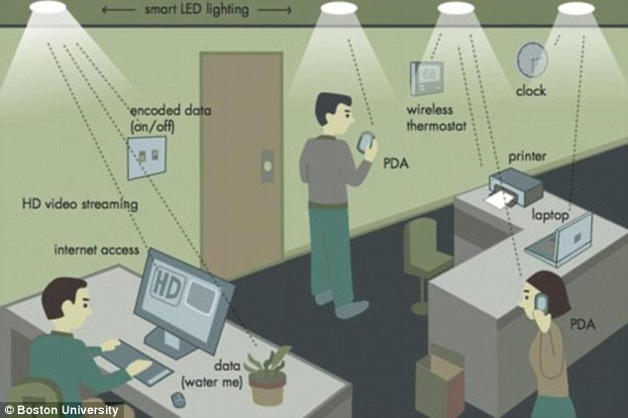
Potencial Application of Li-Fi
Vehicle Communication
At Office

Slide 18
Conclusion
Thus, If Li-Fi technology can be put into practical use, every bulb can be used as an alternative to Wi-Fi hotspot. It provides simple, faster and efficient wireless data communication. Li-Fi will make us to proceed towards the cleaner, greener, safer and brighter future.

Slide 19
Thanks For Watching

