Slide 1
HOUSE PRICE PREDICTION
Machine Learning Regression Analysis
Project Presentation
Himanshu Tomar
August 18, 2026
FINAL MODEL • LINEAR REGRESSION

Slide 2
PROJECT
02
From raw data to a defensible model
A complete end-to-end regression workflow
01
02
03
04
05
DATA
EDA
PREP
MODEL
EVALUATE
Inspect & clean
Understand patterns
Encode features
Train 3 regressors
Compare metrics
Project decision
Select the model with the strongest overall test-set performance, not simply the best single metric.
House Price Prediction • Machine Learning Project

Slide 3
DATASET
03
What the model learns from
House characteristics form the predictive feature space
Structure
Key predictors
Excluded
• Price is the target variable.
• Numerical and categorical predictors are included.
• Location is represented through city and state/ZIP.
• Bedrooms & bathrooms
• Living area & lot size
• Floors, waterfront, view, condition
• Construction & renovation year
• Date
• Street — very high cardinality
• Country — only one value
House Price Prediction • Machine Learning Project

Slide 4
EDA
04
Exploration before prediction
Six meaningful visualizations were used to understand price behavior
01
02
03
Price distribution
Price vs living area
Correlation heatmap
04
05
06
Price vs bedrooms
Price vs bathrooms
Price by waterfront
House Price Prediction • Machine Learning Project

Slide 5
PREPROCESSING
05
Feature engineering that keeps training and testing consistent
Categorical variables are encoded inside the modeling pipeline
Numerical
Categorical
Split
12 numerical features
Passed through the numeric branch of the ColumnTransformer.
city
statezip
One-Hot Encoding with handle_unknown='ignore'.
80% training
20% testing
random_state = 42
Test data remains unseen during fitting.
House Price Prediction • Machine Learning Project

Slide 6
MODELING
06
Three models, one evaluation framework
The same split and metrics make the comparison meaningful
Linear Regression
Decision Tree
Random Forest
Baseline regression model
Strong overall test performance in this project.
Nonlinear, rule-based model
Represents relationships through tree splits.
Ensemble of decision trees
Lowest MAE among the three models.
House Price Prediction • Machine Learning Project

Slide 7
EVALUATION
07
How model quality was judged
No single metric tells the whole story
MAE
MSE
RMSE
R²
121,307.27
5.4014e+10
232,409.25
0.6369
Reading the metrics
MAE = average absolute error • MSE = larger-error penalty • RMSE = error in price units • R² = explained variation. Lower is better for MAE/MSE/RMSE; higher is better for R².
House Price Prediction • Machine Learning Project

Slide 8
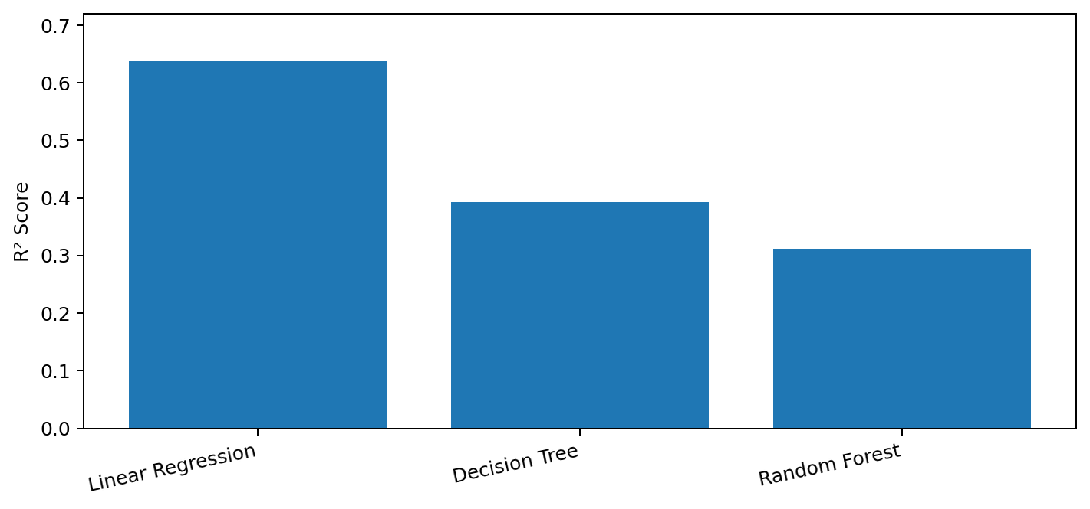
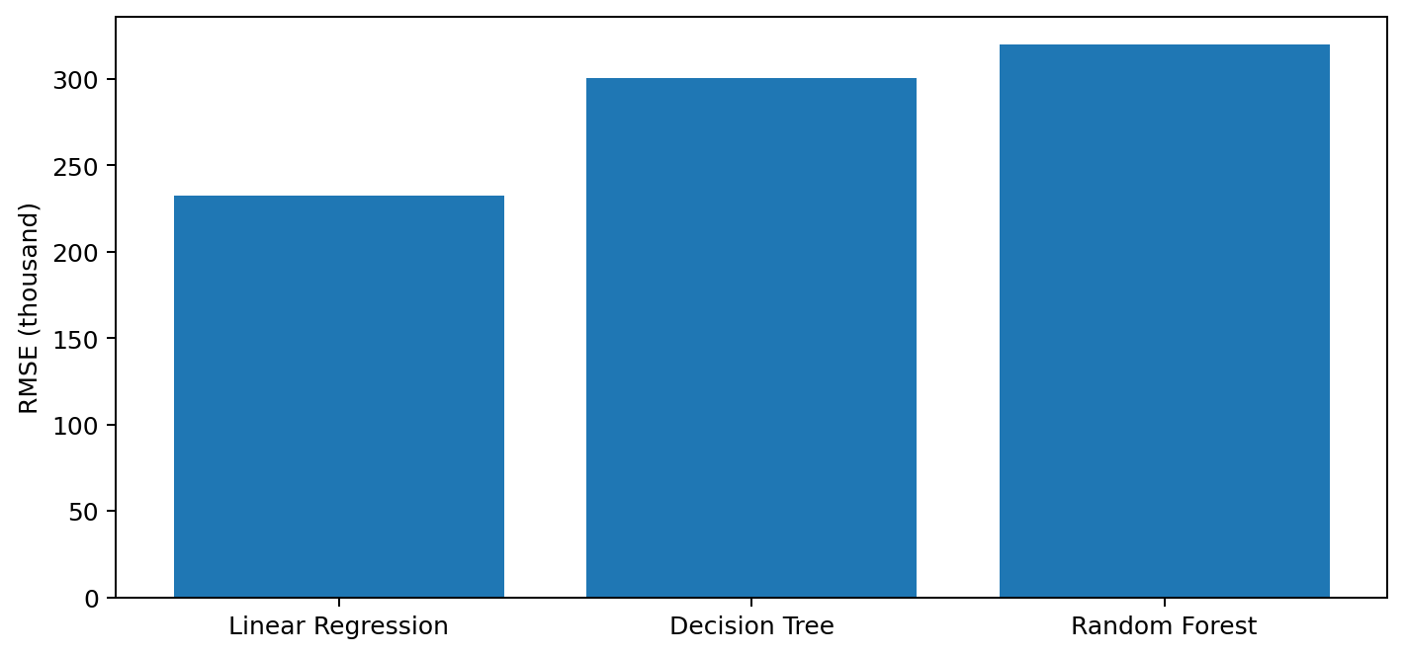
RESULTS
08
The comparison reveals a trade-off
Random Forest wins MAE; Linear Regression wins the broader performance picture
Highest R²
Lowest RMSE
Linear Regression • 0.6369
Linear Regression • 232,409.25
House Price Prediction • Machine Learning Project

Slide 9
DECISION
09
Why Linear Regression was selected
The final choice is based on overall test-set performance
R² SCORE
RMSE
MSE
0.6369
232,409.25
5.4014e+10
What Random Forest did better
Why it was not selected
• Lowest MAE: 121,307.27
• Smallest average absolute error.
• RMSE and R² were weaker than Linear Regression.
• Overall performance favored Linear Regression.
House Price Prediction • Machine Learning Project

Slide 10
CONCLUSION
10
A clear final result
The project completed the required regression workflow and identified a final model.
FINAL MODEL • LINEAR REGRESSION
R² SCORE
RMSE
MAE
0.6369
232,409.25
139,638.89
Three regressors were trained and evaluated on the same test set.
Linear Regression provided the strongest overall result based on R², MSE and RMSE.
House Price Prediction • Machine Learning Project

