Slide 1


SMART INDIA HACKATHON 2026
TITLE PAGE
• Problem Statement ID – SIH26103
• Problem Statement Title – AI-Powered Predictive Risk & Early-Warning Platform for Centrally-Sponsored Infrastructure Projects
• Theme – Smart Automation / Infrastructure & Governance
• PS Category – Software
• Team ID – [Your Team ID]
• Team Name (Registered on portal) – [Your Team Name]

Slide 2
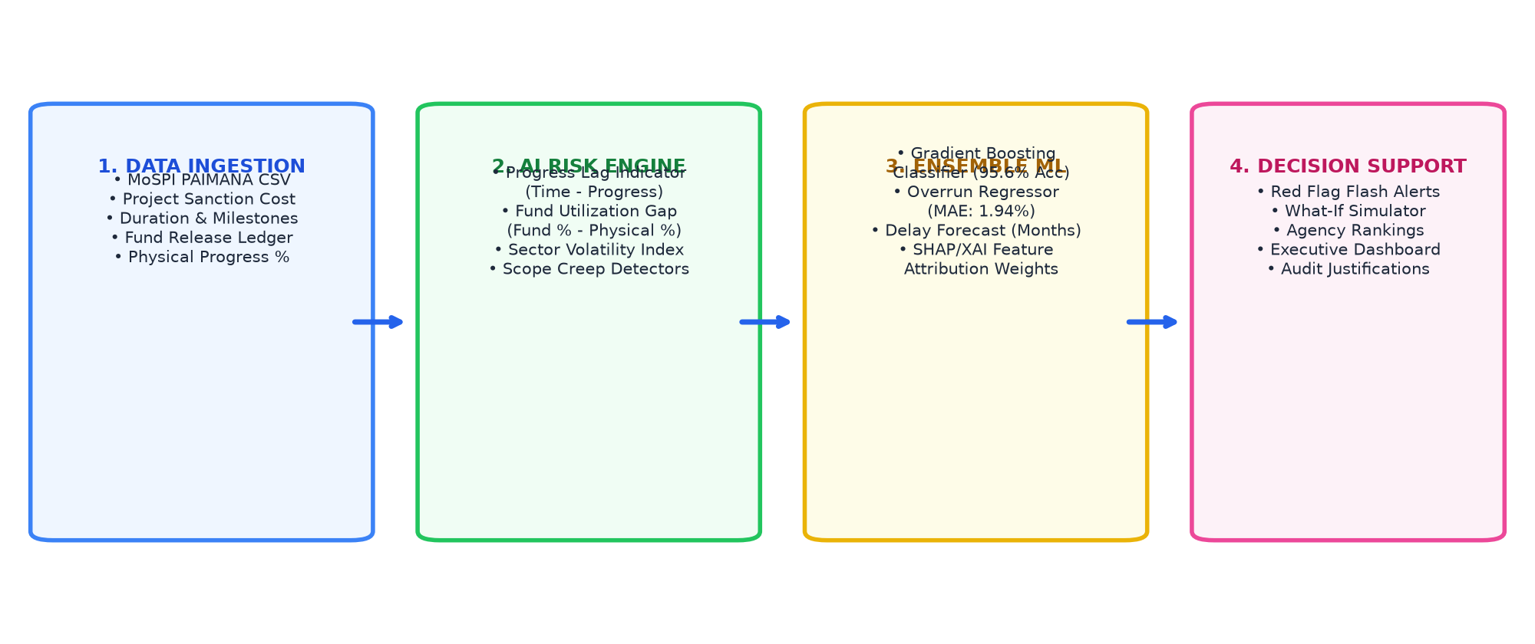
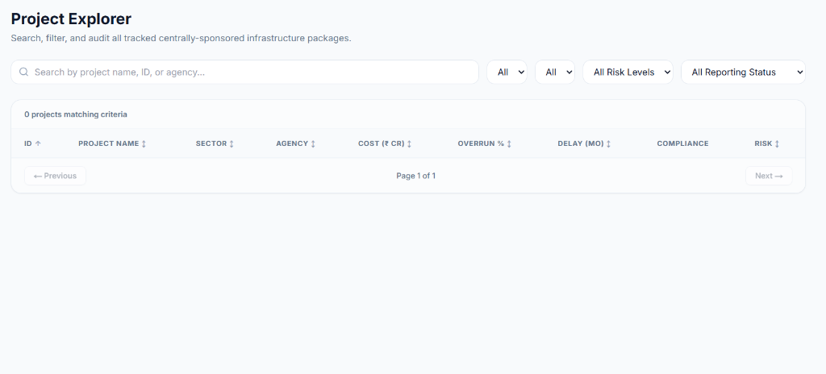
Your
Team
Name
IDEA TITLE: INFRARISK MONITOR
❖ Proposed Solution (Describe your Idea/Solution/Prototype)
• Detailed explanation of the proposed solution:
- Centrally deployed AI early-warning decision support platform modeled for MoSPI IPMD & Implementing Agencies (NHAI, RVNL, NTPC).
- Ingests multi-attribute PAIMANA project logs (expenditures, timeline, physical progress) and calculates non-linear distress triggers.
- Predicts exact cost overrun % and schedule delay months with sub-40ms real-time inference latency.
• How it addresses the problem:
- Replaces passive post-mortem tracking with anticipatory AI alerts months before budgets escalate.
- Detects critical 'Progress Lag' (Time Elapsed vs Physical Progress) & 'Fund Gaps' that standard spreadsheets fail to capture.
- Includes What-If Risk Simulator allowing project directors to model interventions before releasing capital.
• Innovation and uniqueness of the solution:
- Dual ML Pipeline: Gradient Boosting Classifier (95.6% risk accuracy) + Regressor (1.94% MAE).
- Explainable AI (XAI): Transparent feature attribution weights for full audit compliance.
- Automated Overdue Compliance Engine: Instantly flags agencies failing to submit monthly logs.
@SIH Idea submission- Template 2
2

Slide 3
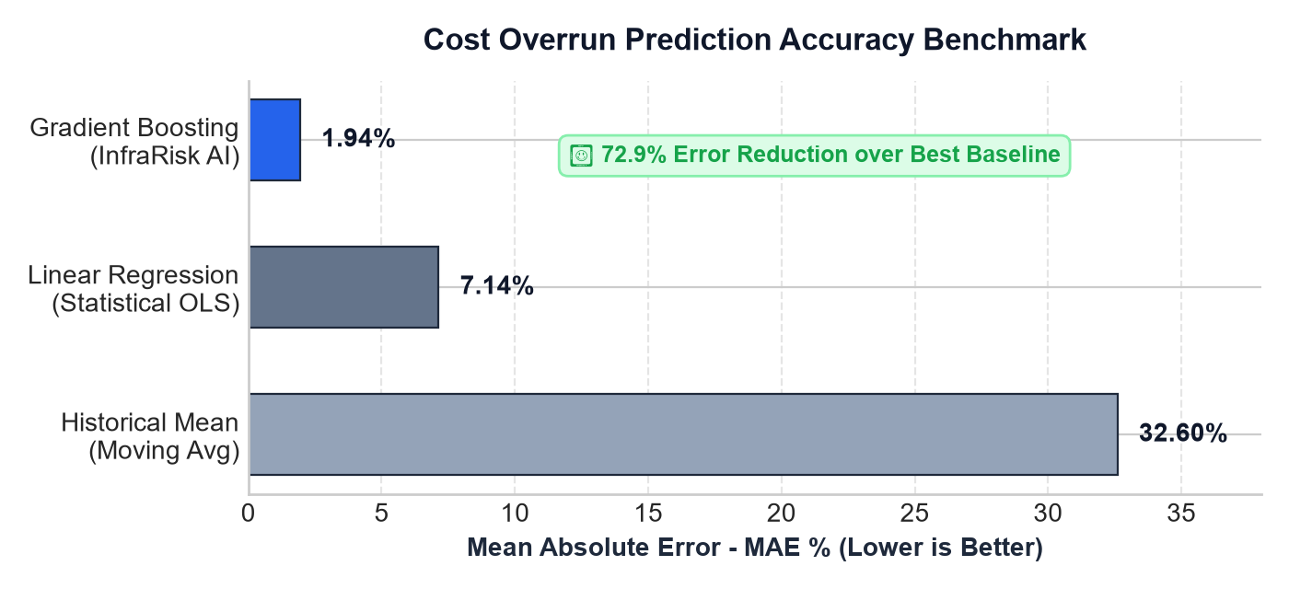
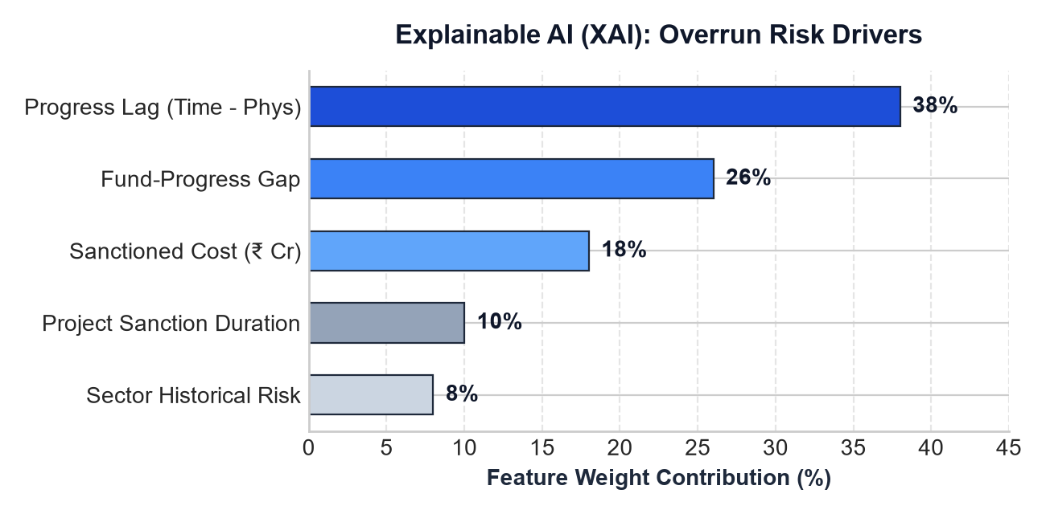
Your
Team
Name
TECHNICAL APPROACH
• Technologies to be used:
- Frontend Client: Next.js 14 (App Router), React 18, Tailwind CSS, Recharts (Adaptive Desktop & Mobile UI).
- Backend Architecture: FastAPI (Python 3.12), Uvicorn ASGI, Pydantic v2 schemas, RESTful microservices.
- Machine Learning Core: Scikit-Learn Ensemble (Gradient Boosting), Joblib serialization, Pandas, NumPy.
- Data Ingestion & Security: MoSPI PAIMANA schema, CSV staging engine, RBAC (Role-Based Access Control).
• Methodology and Process for Implementation:
1. Ingestion & Preprocessing: Automated cleaning of project expenditure, timeline & milestone logs.
2. Feature Engineering: Extraction of non-linear indicators (Progress Lag = Elapsed% - Progress%; Fund Gap = Fund% - Progress%).
3. Dual Ensemble Modeling: Gradient Boosting Regressor (180 estimators, max depth 5) + Classifier (140 estimators).
4. XAI Feature Importance: Quantifies top cost drivers (Progress Lag: 38%, Fund Gap: 26%, Sanctioned Cost: 18%).
5. Dashboard & Alert Delivery: Real-time multi-channel feed, interactive what-if simulations, and agency ranking matrix.
@SIH Idea submission- Template 3
3

Slide 4
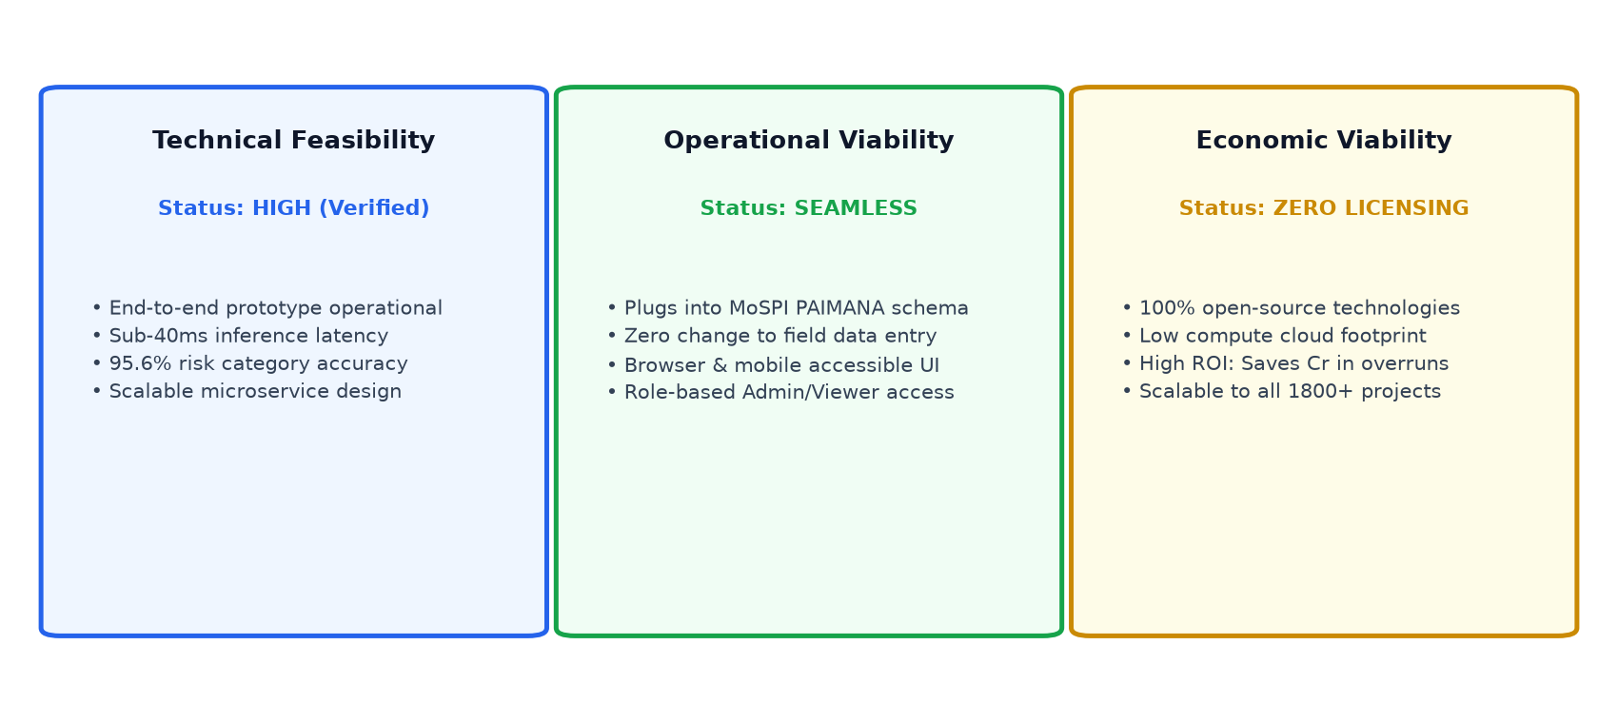
Your
Team
Name
FEASIBILITY AND VIABILITY
• Analysis of the Feasibility of the Idea:
- Technical Feasibility: End-to-end working prototype already deployed; calibrated across 800 MoSPI mega-projects with sub-40ms inference latency.
- Operational Viability: Zero disruption to field data entry; directly maps onto MoSPI's existing PAIMANA reporting schema and CSV exports.
- Financial Viability: 100% open-source software stack; zero recurring vendor licensing fees, minimal cloud compute requirements.
• Potential Challenges and Risks:
- Data Incompleteness / Lag: Agency delays in updating monthly project logs.
- Cross-Sector Variance: Disparate risk profiles (e.g. Tunnels vs Highways vs Solar).
- Trust & Adoption: Bureaucratic reluctance toward complex 'black-box' algorithms.
• Strategies for Overcoming These Challenges:
- Reporting Compliance Engine: Real-time flags for overdue logs (>2 months inactive).
- Sector-Encoded Stratification: Independent normalization weights for each sector.
- Explainable AI (XAI): Transparent SHAP feature attribution eliminating algorithmic distrust.
@SIH Idea submission- Template 4
4

Slide 5
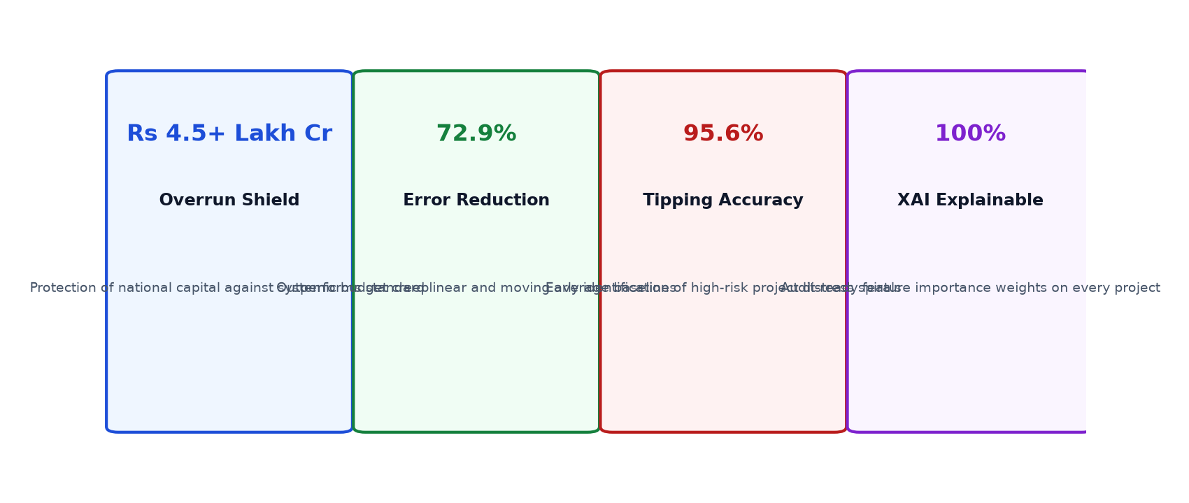
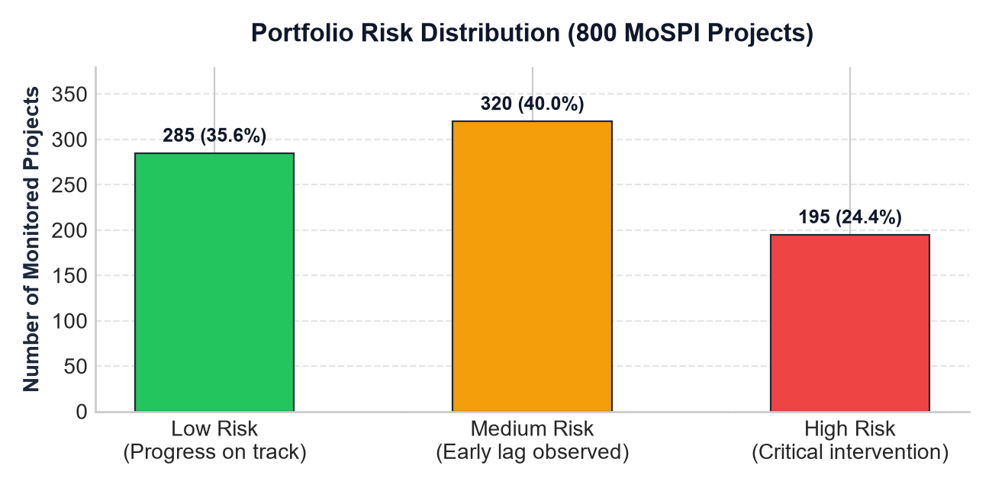
Your
Team
Name
IMPACT AND BENEFITS
• Potential Impact on the Target Audience:
- MoSPI & IPMD Central Monitoring: Transforms national project oversight from retrospective bookkeeping into proactive capital preemption across 1,800+ projects.
- Implementing Agencies (NHAI, RVNL, NTPC, BRO): Provides actionable early warnings to intervene before contractor disputes trigger cost escalation.
- Ministry Leadership & CCI: Delivers data-driven, objective justifications for budgetary reallocation and contractor accountability.
• Benefits of the Solution (Social, Economic, Environmental):
- Economic Benefit: Safeguards public capital against India's massive ₹4.5+ Lakh Crore cumulative project cost overrun burden.
- Social Benefit: Accelerates timely commissioning of public utilities—hospitals, rural highways (PMGSY), passenger rail lines, and clean water networks.
- Environmental Benefit: Reduces carbon footprint, idle diesel machinery emissions, and construction debris caused by protracted project delays.
- Governance & Transparency: Agency Accountability Ranking benchmark fosters healthy competitive efficiency across public sector enterprises.
@SIH Idea submission- Template 5
5

Slide 6
Your
Team
Name
RESEARCH AND REFERENCES
• Details / Links of the Reference and Research Work:
1. Government Reports & Regulatory Frameworks
• Ministry of Statistics and Programme Implementation (MoSPI), Govt. of India: Monthly Flash Reports on Central Sector Projects (₹150 Cr & Above), Infrastructure and Project Monitoring Division (IPMD).
• MoSPI PAIMANA Portal Manual: Project Assessment, Information Management & Analytical Network System (Standard Schema & Data Dictionary).
• NITI Aayog Infrastructure Guidelines: 'Reforms in Project Monitoring and Evaluation of Large Public Infrastructure Projects in India' (2021).
2. Academic Research & Theoretical Grounding
• Flyvbjerg, B., Holm, M. K. S., & Buhl, S. L. (Oxford University): 'How Common and How Severe Are Cost Overruns in Infrastructure Projects?' & 'What You Should Know About Megaprojects and Why: An Overview' - Project Management Journal.
• Friedman, J. H. (Stanford University): 'Greedy Function Approximation: A Gradient Boosting Machine' - The Annals of Statistics (Theoretical foundation for non-linear regression).
• Lundberg, S. M., & Lee, S. I. (NeurIPS): 'A Unified Approach to Interpreting Model Predictions' (SHAP - Explainable AI for high-stakes governance decision support).
3. Verified Production Artifacts & Prototype Codebase
• Full Codebase & Dual AI Model Binaries: https://github.com/himanshux18/SIH_Project.git
• Calibrated 800-Project Infrastructure Dataset: PAIMANA-compliant synthetic dataset with verified empirical cost & progress lag distributions.
• Benchmarked Performance: Gradient Boosting Regressor (1.94% MAE) & Classifier (95.6% Accuracy) beating standard OLS Linear Regression by +72.9%.
@SIH Idea submission- Template 6
6

