Slide 1
POLLUTION
Pollution is the introduction of harmful materials into the environment. These harmful materials are called pollutants. Pollutants can be natural, such as volcanic ash. They can also be created by human activity, such as trash or runoff produced by factories.6 Mar 2024

Slide 2
HISTORY OF POLLUTION
Although environmental pollution can be caused by natural events such as forest fires and active volcanos ,use of the word pollution generally implies that the contaminants have an anthropogenic source—that is, a source created by human activities. Pollution has accompanied humankind ever since groups of people first congregated and remained for a long time in any one place. Indeed, ancient human settlements are frequently recognized by their wastes—shell mounds and rubble heaps, for instance. Pollution was not a serious problem as long as there was enough space available for each individual or group. However, with the establishment of permanent settlements by great numbers of people, pollution became a problem, and it has remained one ever since.

Slide 3
TYPES OF POLLUTION
Water Pollution
Air Pollution
Noise Pollution
Thermal Pollution
Light Pollution
Plastic Pollution
Visual Pollution

Slide 4
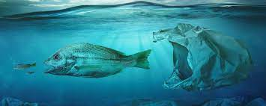
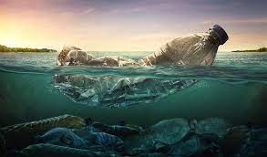
WATER POLLUTION
Water pollution is the release of substances into bodies of water that makes water unsafe for human use and disrupts aquatic ecosystems. Water pollution can be caused by a plethora of different contaminants, including toxic waste, petroleum, and disease-causing microorganisms

Slide 5
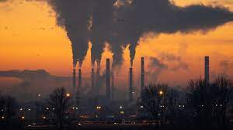
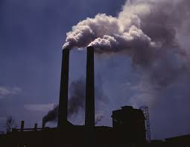
AIR POLLUTION
Air pollution is one of the greatest threats to children’s health. Ninety-nine per cent of people in the world live in places where the air is considered unhealthy. When children breathe toxic air, it harms their health and jeopardizes their future.
For children to grow up healthy, they need clean, safe air. Here are some ways you can reduce air pollution in your environment and help protect your child from its impacts.

Slide 6
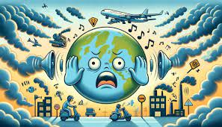
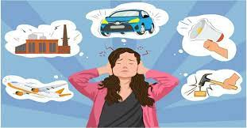
NOISE POLLUTION
Noise pollution can cause health problems for people and wildlife, both on land and in the sea. From traffic noise to rock concerts, loud or inescapable sounds can cause hearing loss, stress, and high blood pressure. Noise from ships and human activities in the ocean is harmful to whales and dolphins that depend on echolocation to survive.

Slide 7
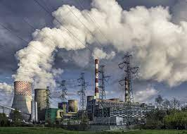
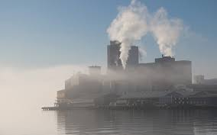
THERMAL POLLUTION
Thermal pollution is a rapid change in temperature in a natural body of water. This pollution is most often caused by heated discharge from an industrial facility or another human activity. Thermal pollution can result in disruptions in natural systems and stress, disease, or even death for affected organisms.

Slide 8
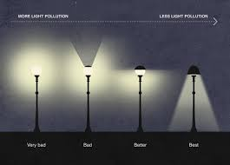
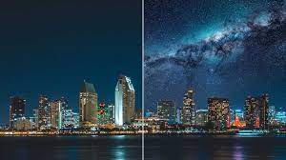
LIGHT POLLUTION
Thermal pollution is a rapid change in temperature in a natural body of water. This pollution is most often caused by heated discharge from an industrial facility or another human activity. Thermal pollution can result in disruptions in natural systems and stress, disease, or even death for affected organisms.

Slide 9
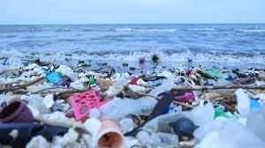
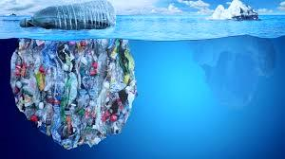
PLASTIC POLLUTION
Plastic pollution is a global problem. Every year 19-23 million tonnes of plastic waste leaks into aquatic ecosystems, polluting lakes, rivers and seas . Plastic pollution can alter habitats and natural processes, reducing ecosystems’ ability to adapt to climate change, directly affecting millions of people’s livelihoods, food production capabilities and social well-being.

Slide 10
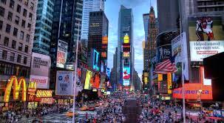
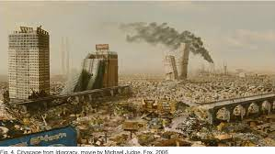
VISUAL POLLUTION
Visual pollution refers to the visible deterioration and negative aesthetic quality of the natural and human-made landscapes around people and to the study of secondary impacts of manmade interventions.

Slide 11
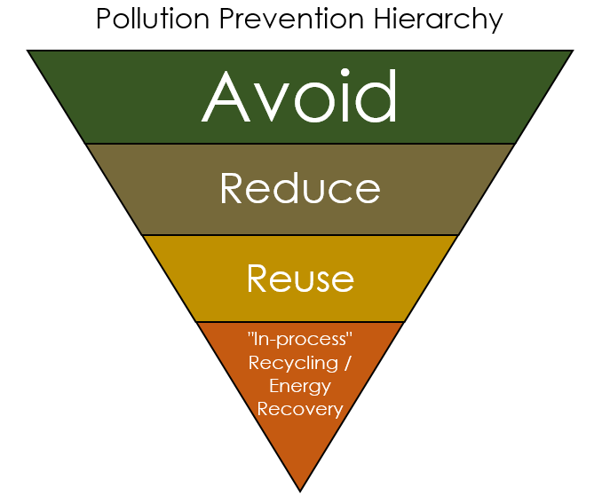
POLLUTION PREVENTION
Eliminating or reducing the amount and toxicity of potentially harmful substances at their sources, prior to generation, treatment, off-site recycling or disposal
Pollution prevention (P2) means working at the source of pollutants to prevent them from being generated or to reduce the amount generated. It is using materials and energy more efficiently, and conserving natural resources, including water. It is following best management practices, and involving all relative people in their implementation, to reduce and prevent pollution. Finally, P2 also means seeing the financial benefits of increased efficiency in the use of raw materials, energy, water or other resources. The “Pollution Prevention Hierarchy” illustration outlines the concepts of pollution prevention in the order of greatest effectiveness related to resource use and waste / pollution generation.l.

