Slide 1

Performance Testing: Overview and Lifecycle
Understanding the process of software performance testing
By Yamini Khisti
10-OCT-2026
Notes:
---
Performance testing is a crucial aspect of software development that ensures applications can handle expected loads. This presentation will cover the lifecycle of performance testing from definition to continuous improvement.

Slide 2


Agenda Overview
Introduction to Performance Testing
Planning and Preparation
Designing Test Cases
Test Execution and Monitoring
Analyzing Results and Reporting
Continuous Improvement and Maintenance
Notes:
We will begin with an introduction to performance testing, including its definition and importance. Next, we will discuss planning and preparation steps, followed by designing test cases. We will then delve into test execution and monitoring, analyzing results, and finally, continuous improvement and maintenance.

Slide 3
Introduction to Performance Testing
Performance testing is a type of non-functional testing which evaluates how a system performs under various conditions. It is essential to ensure that applications meet user expectations and operate efficiently under load.
Notes:
Performance testing evaluates how a system performs under various conditions. It is essential to ensure that applications meet user expectations and operate efficiently under load.

Slide 4

Definition and Importance
What is Performance Testing?
  Performance testing evaluates the speed, scalability, and reliability of a system under various conditions and loads.
Identifying Bottlenecks
  It helps in identifying potential bottlenecks before deployment, ensuring that systems function smoothly under expected load.
Ensuring User Satisfaction
  Performance testing ensures user satisfaction by verifying that applications meet performance standards during peak usage times.
Maintaining Application Performance
  Regular performance testing maintains application performance over time, allowing for continuous improvements and updates.
Notes:
Performance testing is the process of assessing the speed, scalability, and reliability of a system. Its importance lies in identifying potential bottlenecks before deployment, ensuring user satisfaction, and maintaining application performance.

Slide 5

Types of Performance Testing
Load Testing
  Load testing measures the system's performance under expected conditions to identify any bottlenecks.
Stress Testing
  Stress testing determines the system's limits by pushing it beyond normal operational capacity.
Endurance Testing
  Endurance testing evaluates the system's stability over an extended period under a specific load.
Spike Testing
  Spike testing assesses how the system reacts to sudden increases in load, helping to identify weaknesses.
Scalability Testing
  Scalability testing is a type of performance testing that evaluates a system's ability to scale up or down in response to changes in workload or user demand.
Notes:
There are several types of performance testing, including load testing, stress testing, endurance testing, and spike testing. Each type focuses on different aspects of performance and helps in understanding the system's capabilities.

Slide 6
Quiz
What is the primary goal of performance testing?
A) To find functional defects
B) To evaluate system performance under load
C) To test user interface design
D) To ensure security compliance
Which of the following is NOT a type of performance testing?
A) Load Testing
B) Stress Testing
C) Usability Testing
D) Scalability Testing
Notes:
There are several types of performance testing, including load testing, stress testing, endurance testing, and spike testing. Each type focuses on different aspects of performance and helps in understanding the system's capabilities.

Slide 7
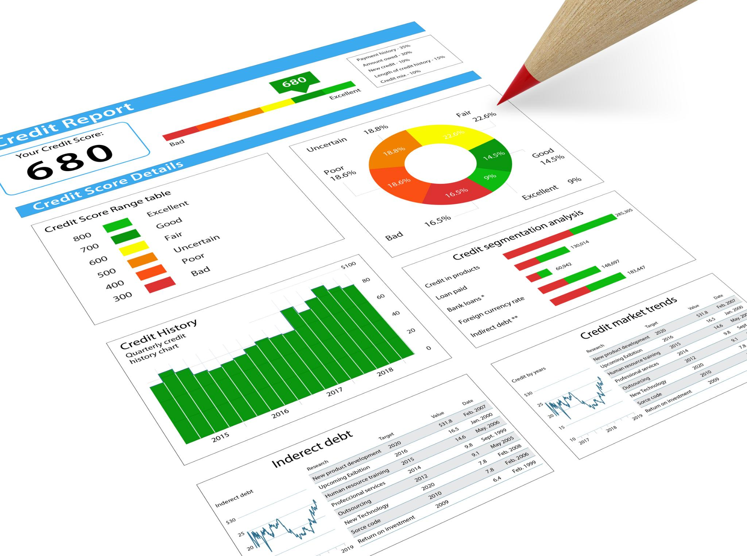
Key Performance Metrics
Response Time
  Response time measures how quickly a system reacts to a request, indicating user experience and system efficiency.
Throughput
  Throughput quantifies the amount of work performed by a system in a given time frame, reflecting productivity levels.
Resource Utilization
  Resource utilization measures how effectively system resources are being used, helping identify potential bottlenecks.
Error Rates
  Error rates track the frequency of errors occurring in a system, aiding in troubleshooting and performance enhancement.
Notes:
Key performance metrics include response time, throughput, resource utilization, and error rates. These metrics help to quantify the performance and identify areas for improvement.

Slide 8
Planning and Preparation
Proper planning and preparation are critical for successful performance testing. This phase involves defining objectives, identifying criteria, and selecting appropriate tools.

Slide 9

Defining Objectives and Scope
Alignment with Business Requirements
  Establishing clear objectives ensures the testing process aligns with business needs, enhancing relevance and effectiveness.
Focus on Critical Aspects
  Defining scope helps maintain focus on essential system performance aspects, critical for successful outcomes.
Notes:
Defining clear objectives and scope helps to align the testing process with business requirements. This step ensures that the focus remains on critical aspects of system performance.

Slide 10

Selecting Tools and Environments
Importance of Tool Selection
  Selecting the right tools is crucial for conducting effective performance testing, impacting overall testing outcomes.
Simulating Loads
  Tools should be capable of simulating loads to help accurately assess system performance under various conditions.
Measuring Performance Metrics
  Accurate measurement of performance metrics is vital for identifying bottlenecks and improving system efficiency.
Notes:
Choosing the right tools and test environments is essential for effective performance testing. This includes selecting software tools that can simulate loads and accurately measure performance metrics.

Slide 11
Quiz
Which metric is used to identify bottlenecks in a system?
A) Error rate
B) Response time
C) CPU utilization
D) All of the above
Which tool is commonly used for performance testing?
A) Selenium
B) JMeter
C) Postman
D) Figma
Notes:
There are several types of performance testing, including load testing, stress testing, endurance testing, and spike testing. Each type focuses on different aspects of performance and helps in understanding the system's capabilities.

Slide 12
Designing Test Cases
Test case design is vital for ensuring comprehensive testing of the system. It involves creating scenarios that reflect real-world usage patterns and system requirements.

Slide 13

Creating Test Scenarios
User Interaction Simulation
  Creating test scenarios that closely mimic user interactions is essential for assessing system responsiveness and usability.
Workload Variability
  Test scenarios should reflect a variety of workloads to evaluate how the system performs under different conditions and stress levels.
Performance Evaluation
  Understanding system performance under diverse conditions is crucial for identifying potential bottlenecks and improving efficiency.
Notes:
Test scenarios should be designed to mimic various user interactions and workloads. This helps in understanding how the system performs under different conditions and loads.

Slide 14

Determining Test Data Requirements
Importance of Test Data
  Identifying the necessary test data is essential for executing meaningful tests that yield reliable results.
Representative Data
  Test data must be representative of actual user data to ensure the validity of test outcomes and performance evaluations.
Performance Evaluations
  Well-defined test data can support performance evaluations and help identify system limitations and areas for improvement.
Notes:
Identifying the necessary test data is crucial for executing meaningful tests. This includes ensuring that data is representative of actual user data and can support performance evaluations.

Slide 15

Defining Test Scripts and Automation
Enhanced Efficiency
  Automating test scripts significantly increases testing efficiency, allowing for quicker identification of issues.
Consistent Performance
  Automated tests ensure consistent performance evaluation by executing the same tests repeatedly without variation.
Notes:
Defining test scripts for automation can significantly enhance efficiency. Automated tests can be executed repeatedly to ensure consistent performance evaluation.

Slide 16
Quiz- Practical Questions
What should you do if a system fails under load during testing?
A) Ignore the failure and proceed
B) Analyze logs and identify bottlenecks
C) Reduce the number of virtual users
D) Increase the system's security measures
Which of the following is a challenge in using production data for performance testing?
A) Ensuring data security and privacy
B) Generating sufficient data volume
C) Masking sensitive information
D) All of the above
Notes:
There are several types of performance testing, including load testing, stress testing, endurance testing, and spike testing. Each type focuses on different aspects of performance and helps in understanding the system's capabilities.

Slide 17
Test Execution and Monitoring
Executing tests and actively monitoring system performance is the next step in the lifecycle. This phase involves collecting data for analysis and identifying any performance issues.

Slide 18

Executing Tests and Collecting Data
Defined Testing Scenarios
  Tests must follow predefined scenarios to ensure accurate and reliable results in various conditions.
Data Collection Process
  Collecting relevant data during tests is essential for thorough analysis and understanding of performance metrics.
Performance Insights
  Analyzing collected data provides insights into system performance, helping to identify areas for improvement.
Notes:
Tests should be executed according to the defined scenarios, and relevant data must be collected for later analysis. This helps in gaining insights into system performance.

Slide 19

Handling Performance Issues and Bottlenecks
Importance of Identification
  Identifying performance issues early in the testing phase is essential for effective resolution and improved outcomes.
Corrective Actions
  Implementing corrective actions based on identified issues can significantly enhance system performance and reliability.
User Experience Enhancement
  Addressing bottlenecks leads to an improved user experience, making the application more responsive and efficient.
Notes:
Identifying and addressing performance issues during testing is critical. Implementing corrective actions can improve system performance and ensure a better user experience.

Slide 20
Analyzing Results and Reporting
After test execution, analyzing results is crucial for understanding system performance. This involves interpreting data and preparing reports for stakeholders.

Slide 21

Interpreting Performance Data
Understanding Key Metrics
  A solid grasp of key metrics is essential for effective performance data analysis, allowing for informed decision-making.
Analyzing Trends
  Analyzing trends in performance data reveals valuable insights that can drive strategic improvements and enhance outcomes.
Identifying Strengths and Weaknesses
  Effective performance analysis identifies both strengths to leverage and weaknesses to address for continuous improvement.
Notes:
Interpreting performance data requires an understanding of key metrics and trends. Analyzing this data helps identify performance strengths and weaknesses.

Slide 22
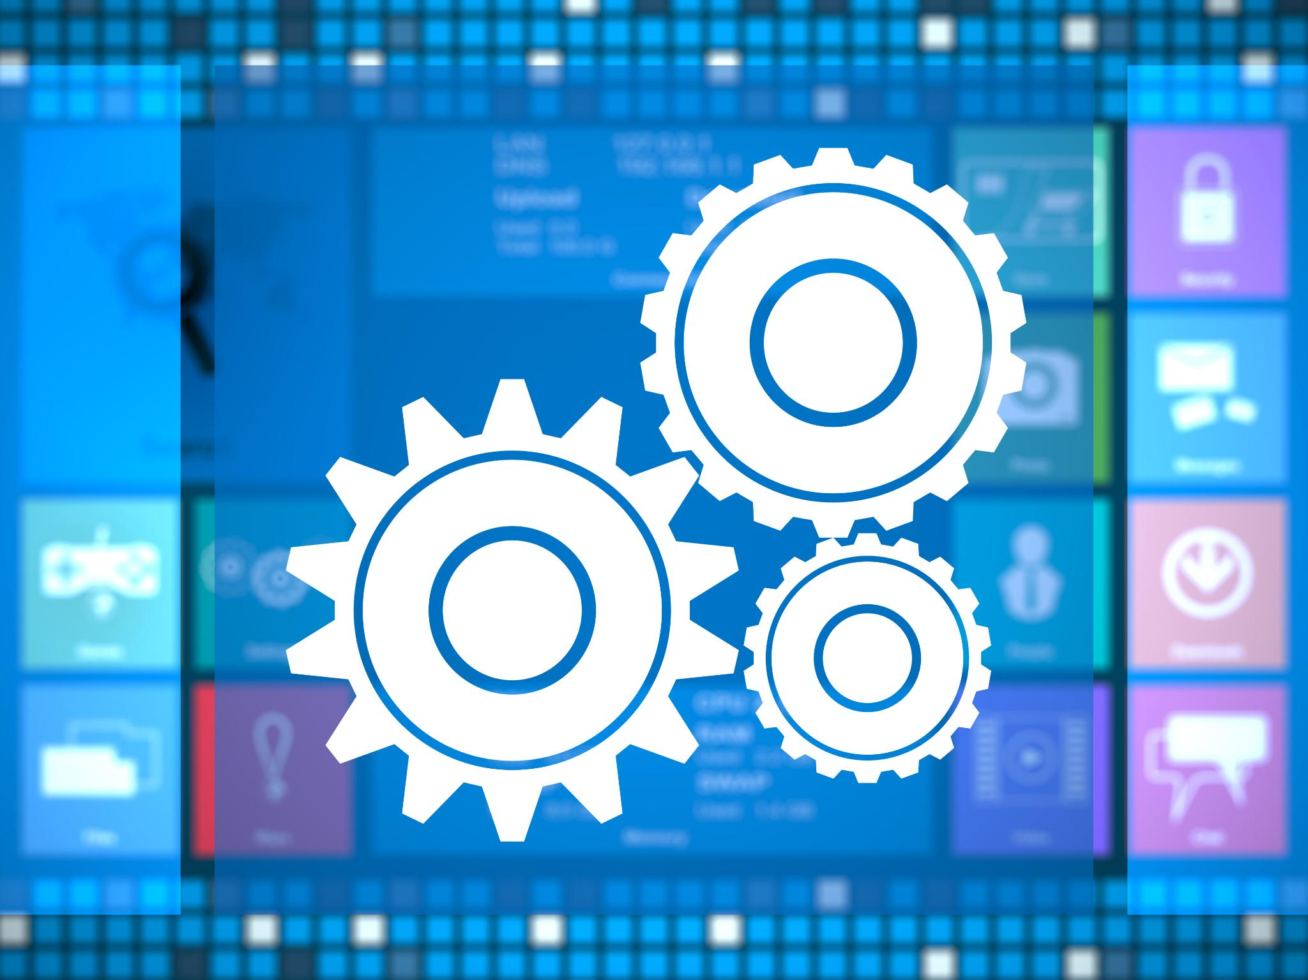
Identifying Areas for Improvement
Importance of Analysis
  Thorough analysis helps identify specific areas needing improvement to enhance performance effectively.
Enhancing Application Performance
  Focusing on improvement areas is crucial for optimizing application performance and meeting user needs.
Meeting User Expectations
  Identifying improvement areas ensures that applications continually meet and exceed user expectations.
Notes:
Based on analysis, areas for improvement can be pinpointed. This step is essential for enhancing application performance and ensuring it meets user expectations.

Slide 23

Creating Comprehensive Reports
Importance of Detailed Reports
  Detailed reports are crucial for effectively communicating testing results and findings to all stakeholders involved.
Highlighting Key Issues
  Reports should focus on key issues identified during testing to ensure stakeholders understand critical areas that need attention.
Recommendations for Improvement
  Including actionable recommendations in reports helps stakeholders make informed decisions for future improvements.
Notes:
Creating detailed reports that summarize testing results and findings is essential for communication with stakeholders. These reports should highlight key issues and recommendations.

Slide 24
Quiz- Practical Questions
What is the role of benchmarking in performance test analysis?
A) To compare system performance against industry standards
B) To identify security vulnerabilities
C) To validate user interface design
D) To reduce system errors
Which of the following is a best practice for performance test reporting?
A) Use technical jargon without explanation
B) Provide clear and concise summaries of findings
C) Exclude recommendations for improvement
D) Avoid using visual aids like graphs
Notes:
There are several types of performance testing, including load testing, stress testing, endurance testing, and spike testing. Each type focuses on different aspects of performance and helps in understanding the system's capabilities.

Slide 25
Continuous Improvement and Maintenance
Performance testing is not a one-time process. Continuous improvement and maintenance ensure that applications remain performant as technology and user needs evolve.

Slide 26

Implementing Performance Improvements
Importance of Performance Improvements
  Implementing performance enhancements is essential to address test findings and improve overall system functionality.
User Experience Elevation
  Enhancements play a significant role in elevating user experience, leading to higher satisfaction and engagement.
Application Efficiency
  Improving performance directly contributes to application efficiency, optimizing resource usage and response time.
Notes:
Based on test findings, implementing performance improvements is critical. These enhancements can significantly elevate the user experience and application efficiency.

Slide 27

Essential Tools for Performance Testing
Scripting Tools:
JMeter
LoadRunner
Gatling
Neoload
Execution Tools:
Performance Center
Load Runner Cloud(SRL)
Monitoring Tools:
Dynatrace
New Relic
AppDynamics
Notes:
This slide discusses various performance testing tools beneficial for scripting and monitoring. Scripting tools help automate the creation of performance test scripts, making it easier to execute tests. Monitoring tools provide real-time insights into system performance, allowing for immediate detection of issues. Selecting the correct tools significantly influences the testing process's overall efficiency.

Slide 28
Thank You
Notes:
In conclusion, performance testing is a vital part of software development that ensures systems are efficient, scalable, and reliable. By following a structured lifecycle, organizations can enhance user satisfaction and maintain high performance.

