Slide 1

GitLab Duo in Testing
Trainer:​
Ritu S Tilekar​
SDET
Notes:
Open with: “GitLab Duo is like a helpful assistant sitting beside a tester. It can suggest tests and explain failures, but the tester still checks and decides.”
[Sources]
Visual on this slide was generated with Microsoft Copilot.

Slide 2
THE IDEA
What is GitLab Duo?
A simple comparison
Imagine a smart assistant inside your coding and GitLab tools.
You show it
It suggests
You decide
Code, a requirement, a test case, or an error message.
Test ideas, sample automation code, explanations, and possible causes.
Whether the suggestion is correct, safe, useful, and ready to use.
Duo helps. The tester owns the result.
Notes:
Explain that GitLab Duo provides AI-native help in GitLab and IDE workflows. Avoid saying it replaces testers.
[Sources]
https://docs.gitlab.com/user/gitlab_duo/

Slide 3
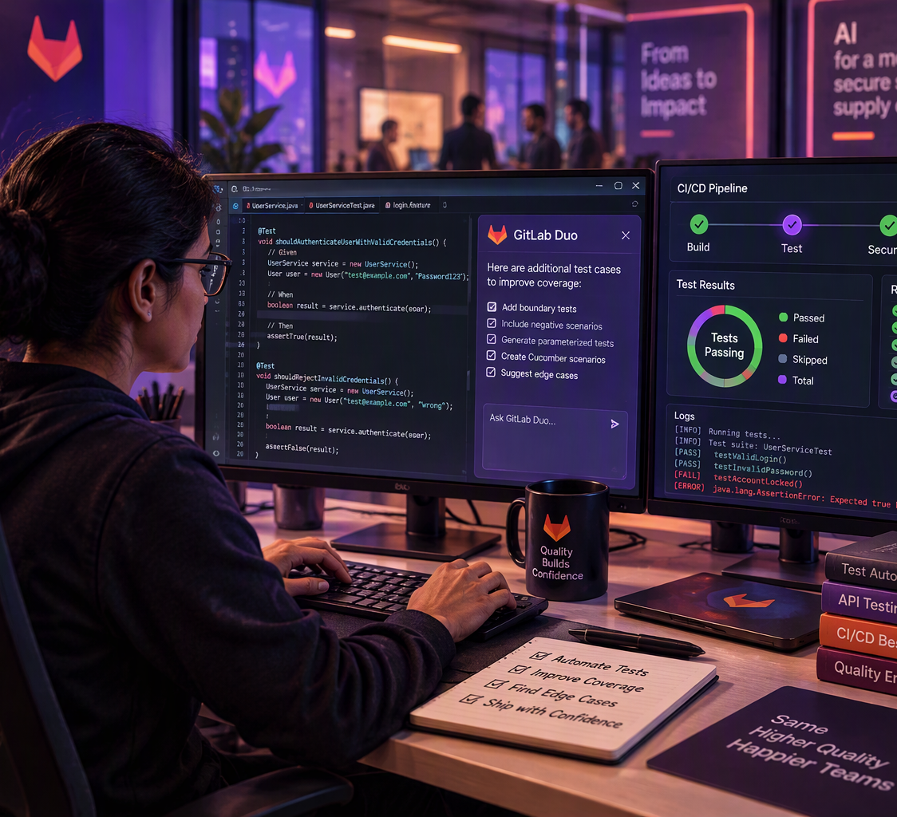
EVERYDAY WORK
How can it help a tester?
Four common tasks
Create tests
Write automation
Suggest normal, negative and boundary test cases.
Create a first draft of unit, API or BDD tests.
Find missing cases
Explain failures
Spot empty values, limits, errors and unusual conditions.
Summarize a failed job and suggest what to check next.
Notes:
Use a familiar example: for a login screen, Duo can suggest valid login, wrong password, empty fields, locked account and very long input.
[Sources]
Visual on this slide was generated with Microsoft Copilot.
https://docs.gitlab.com/user/gitlab_duo/use_cases/

Slide 4
SIMPLE FLOW
How does it work?
Five easy steps
1
2
3
4
5
Give context
Ask clearly
Review
Run
Improve
Show the code or requirement
Say what type of tests you need
Check the suggested tests
Execute them in the real system
Fix gaps and add stronger checks
Important: A suggested test is not finished until it has been reviewed and run.
Notes:
Repeat the sequence: show, ask, check, run, improve. This is the main learning point.
[Sources]
https://docs.gitlab.com/user/gitlab_duo/prompt_examples/generate_tests/

Slide 5
EXAMPLE
A simple login-page example
How one requirement becomes several tests
Requirement
✓
Correct username and password
“A registered user should be able to log in with the correct username and password.”
×
Wrong password
×
Empty username or password
!
Locked account
Ask Duo: “Suggest positive, negative and boundary test cases.”
!
Very long input
!
Special characters
Notes:
Ask the audience for one more test case. Then explain that Duo helps expand thinking, but business rules decide which cases matter.
[Sources]

Slide 6
GOOD QUESTIONS
How to ask GitLab Duo
Clear questions produce better suggestions
Too broad
Clear and useful
“Write tests.”
“Create JUnit 5 tests for this login method. Include successful login, wrong password, empty values and locked accounts. Follow our existing test naming style.”
Simple formula: What to test + tool/framework + important cases + team rules
Notes:
GitLab recommends selecting a specific function or class, naming the testing framework, requesting edge and error cases, and refining the generated tests.
[Sources]
https://docs.gitlab.com/user/gitlab_duo/prompt_examples/generate_tests/

Slide 7

SAFETY
What GitLab Duo cannot do for us
It is helpful, but it can still be wrong
It may guess
A field, endpoint, cause, or expected result may be incorrect.
It may miss risks
Important business rules or rare conditions may be absent.
It cannot own quality
People must review, run and approve the tests.
Never share secrets
Do not paste passwords, tokens or sensitive customer data.
Notes:
Use the phrase: “Duo is like a junior helper with great speed but incomplete context.” Always apply your organization’s approved data-handling rules.
[Sources]
Visual on this slide was generated with Microsoft Copilot.

Slide 8
TAKEAWAY
Remember these three points
1
Duo suggests
It can create test ideas, draft automation and explain failures.
2
Tester checks
Review the logic, data, assertions and missing cases.
3
Evidence decides
Run the tests and use real results before approving changes.
GitLab Duo helps us move faster. Good testing still needs human thinking.
Notes:
Close by asking: “What is one testing task in your project where a first draft from Duo would save time?”
[Sources]

