Slide 1

ETL and SQL Fundamentals
Topics covered:
Introduction to ETL
Unix and Basic commands
Introduction to SQL
SQL Statements
Data types in SQL

Slide 2
What is ETL?
E - Extraction
T - Transformation
L - Loading
Extraction , transform and load is the process of combining data from multiple sources into central repository called as data warehouse.
ETL uses a set of rules to clean and organize data and prepare it for storage.

Slide 3
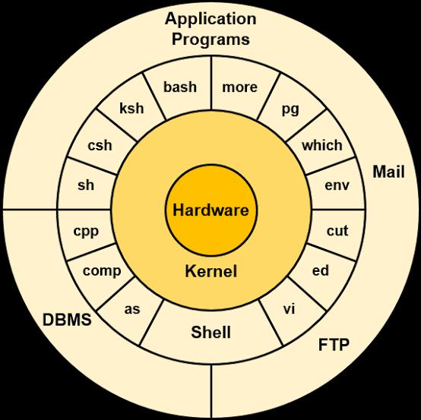
Unix
Unix is the computer operating system which is capable of handling activities from multiple user at the same time. It is a set of programs that acts as a link between the computer and the user.

Slide 4
Basic Commands:
cat [filename] : To read the contents of a file
vi [filename] : To edit a file contents
wq: Save and exit from vi editor mode
cp: Copy an existing file
tail [filename] : Read last lines of a file
head [filename] : Read first lines of a file
touch [filename] : Create a 0-byte file
rm [filename] : Remove a file
grep : Search in a file
chmod: To change file permissions
cd [path] : Change Directory to reach specified path
Cd/-:Go back to previous directory path
cd..: Go to immediate previous directory to current path
Is -ltr: List contents of a directory
pwd :Present Working Directory
mkdir : Create a new directory
rmdir : Remove a directory
chmod : Change directory permissions

Slide 5
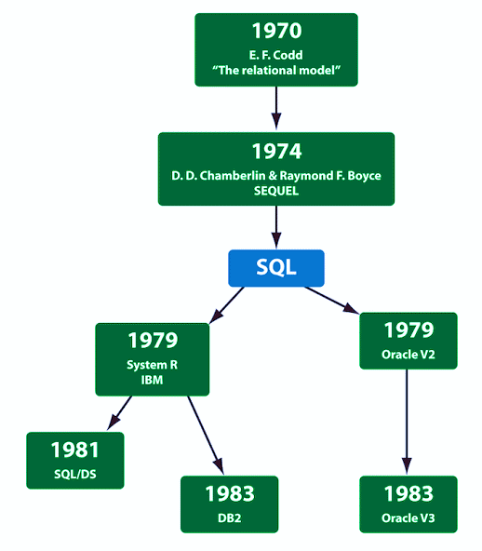
What is
SQL (Structured
Query Language) ?
A standardized programing language which is used to manage relational data base and performs various operation on data.
SQL is used to communicate with database. According to ANSI(American National Standards Institute), it is standard language for RDBMS (Relational database management system).
SQL Comes in many flavors. Oracle databases use its proprietary PL/SQL. Microsoft SQL server makes use of Transact-SQL. All the variations are based upon the industry standard ANSI SQL.

Slide 6
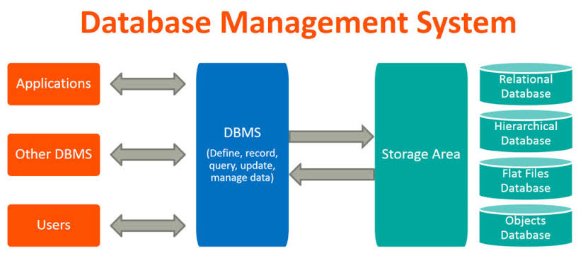
What is
Database ?
A Database is an organized collection of structured information or data typically stored electronically in computer.
Data within the most common types of databases in operation today is typically modeled in rows and columns in series of tables to make processing and data querying effect.
It is usually controlled by DBMS(Database management system).
There are many types of data bases.
Example: Relational databases, Distributed databases, object-oriented databases, Centralized databases, open-source databases cloud databases etc.

Slide 7
SQL Statements
Data Definition Language(DDL)
Data Manipulation language
Data Control Language
Transaction control Language

Slide 8
Data Definition Language(DDL) Statement
DDL statement are used to define, alter, or drop database objects.
S. No | Usage | SQL Statement
1 | Create schema objects | Create
2 | Alter schema objects | Alter
3 | Delete schema objects | Drop
4 | Rename schema objects | Rename

Slide 9
Data Manipulation Language(DML) Statement
Once the tables have been created, the DML statement enable user to quer or manipulate data in existing schemas objects.
S. No | Usage | SQL Statement
1 | Remove rows from the table or view | delete
2 | Add rows from the table or view | Insert
3 | Retrieve data from one or more tables | Select
4 | Change column values in existing rows of a table or view | update

Slide 10
Data Control Language(DCL) Statement
DCL statements are used to grant the privilege to the user.
S. No | Usage | SQL Statement
1 | Grant or take away the privileges | Grant/Revoke
2 | Add a comment to the data dictionary | Comment

Slide 11
Transaction Control Language(DCL) Statement
TCL statements manages the changes mae by DML statements and group DML statements into transactions.
S. No | Usage | SQL Statement
1 | Make transaction Statement Permanent | commit
2 | Undo changes | Rollback
3 | Set point to rollback | savepoint
4 | Establish properties for transaction | Set transaction

Slide 12
SQL Commonly used Operators
Arithmetic Operators:
Logical Operators:
Operator | Description
+ | Add
- | Subtract
* | Multiple
/ | Divide
% | Modulo
Operator | Description
ALL | True if all the subquery values meet the condition
AND | True if all the conditions separated AND is true
ANY | True if any od the subquery values meet the condition
BETWEEN | True if the operand is within the range
EXISTS | True if thesubquery returns one or more records.
IN | True if the operand is equal to one of a list of expressions
LIKE | True if the operand matches the pattern
NOT | Display a records if the conditions is NOT True
OR | True if any of the conditions separated by OR is True
SOME | True if any of the subquery values mee the condition
Bitwise Operators:
Operator | Description
& | Bitwise AND
| | Bitwise OR
^ | Bitwise exclusive OR
Comparison Operators:
Operator | Description
= | Equal to
> | Greater than
< | Less than
>= | Greater than or Equal to
<= | Less than or Equal to
<> | Not equal to

Slide 13
SQL DATA TYPES
The information in the database is maintained in the form of tables and each tables consist of rows and columns, which store the data and therefore this data must have some data type.
The most commonly used data types are:
Char
Varchar or varchar2
Number
Date
Long

Slide 14
Structure of an SQL Statement
A typical SQL statement consist of:
a statement keywords (e.g., Select, Create, Update).
One or more column names(e.g., id, name, address).
From (database name, table name ).
One or more optional clauses keywords (Where, group by, having, order by ).

Slide 15
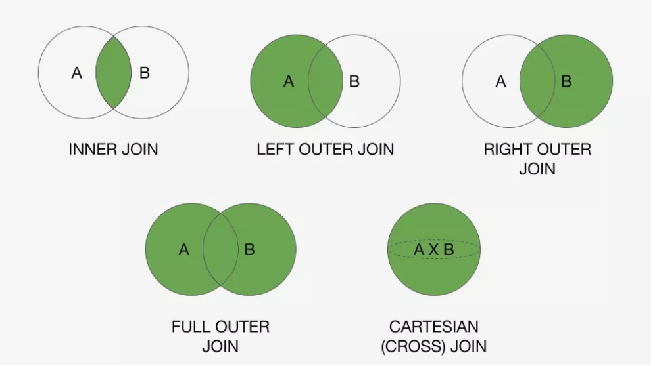
SQL Joins
Inner join:
Inner join returns all the records that have matching values in both the tables.
Full Outer join:
Full Outer join returns all the records when there is a match in either left or right tables
Left join:
Left join returns all the records from the left table and then matched records from the right table.
Right join:
Right join returns all the records from the right table and then matched records from the left table.

Slide 16
SQL Commonly used Functions
  For performing operations on data SQL has many built-in functions
  Aggregate Functions:
  These functions are used to perform operations on the the values from the columns.
  AVG()- It returns the average values after calculating the numeric values from columns. Syntax: SELECT AVG(Column)from table
  COUNT()-It returns the count the number of rows returned in SELECT. Syntax: SELECT COUNT(Column)from table
  FIRST()-It returns the first values from columns. Syntax: SELECT FIRST(Column)from table
  LAST()- It returns the last values from columns. Syntax: SELECT LAST(Column)from table
  MAX()- It returns the maximum values of selected columns. Syntax: SELECT MAX(Column)from table
  MIN()-It returns the Minimum values of selected columns. Syntax: SELECT MIN(Column)from table
  SUM()-It returns the sum of all the values of selected columns. Syntax: SELECT SUM(Column)from table
  Scalar Functions:
  These functions are based on user input.
  UCASE()-It convert value of a field to uppercase. Syntax: SELECT UCASE(Column) from table
  LCASE()- It convert value of a field to Lowercase. Syntax: SELECT LCASE(Column) from table
  MID()- It extracts text from the text field. Syntax: SELECT MID(Column, Start, length) from table
  LENGTH()- It returns the length of the value in text field. Syntax: SELECT LENGTH(Column) from table
  ROUND()-It is used to roundoff the numeric value. SELECT ROUND(Column, decimals) from table
  NOW()-It returns current system date and time. SELECT NOW(Column) from table
  FORMAT()-It is used to format how the fields are to be displayed. SELECT FORMAT(Column,format) from table

Slide 17
Knowledge Check
True or False
SQL is usually controlled by File management system.
According to ANSI(American National Standards Institute), SQL is standard language for Relational database management system.
Rm command is used to remove directory from the location.

Slide 18
Any Questions?

Slide 19
Thank you.!

