Slide 1
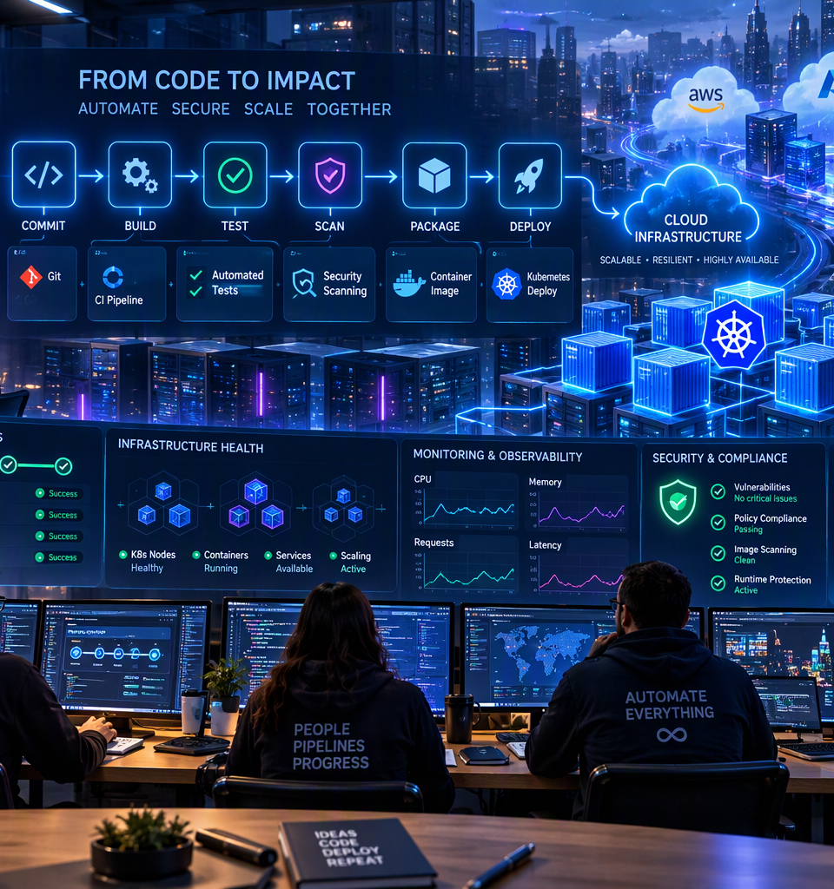
DEVOPS TECHNOLOGIES
From Code
to Cloud
A practical knowledge transfer on delivery, containers, orchestration, cloud, security and operations.
CI/CD
DOCKER
KUBERNETES
Knowledge Transfer Session | Shrey Saxena
Notes:
[Sources]
Visual on this slide was generated with Microsoft Copilot.
[/Sources]

Slide 2
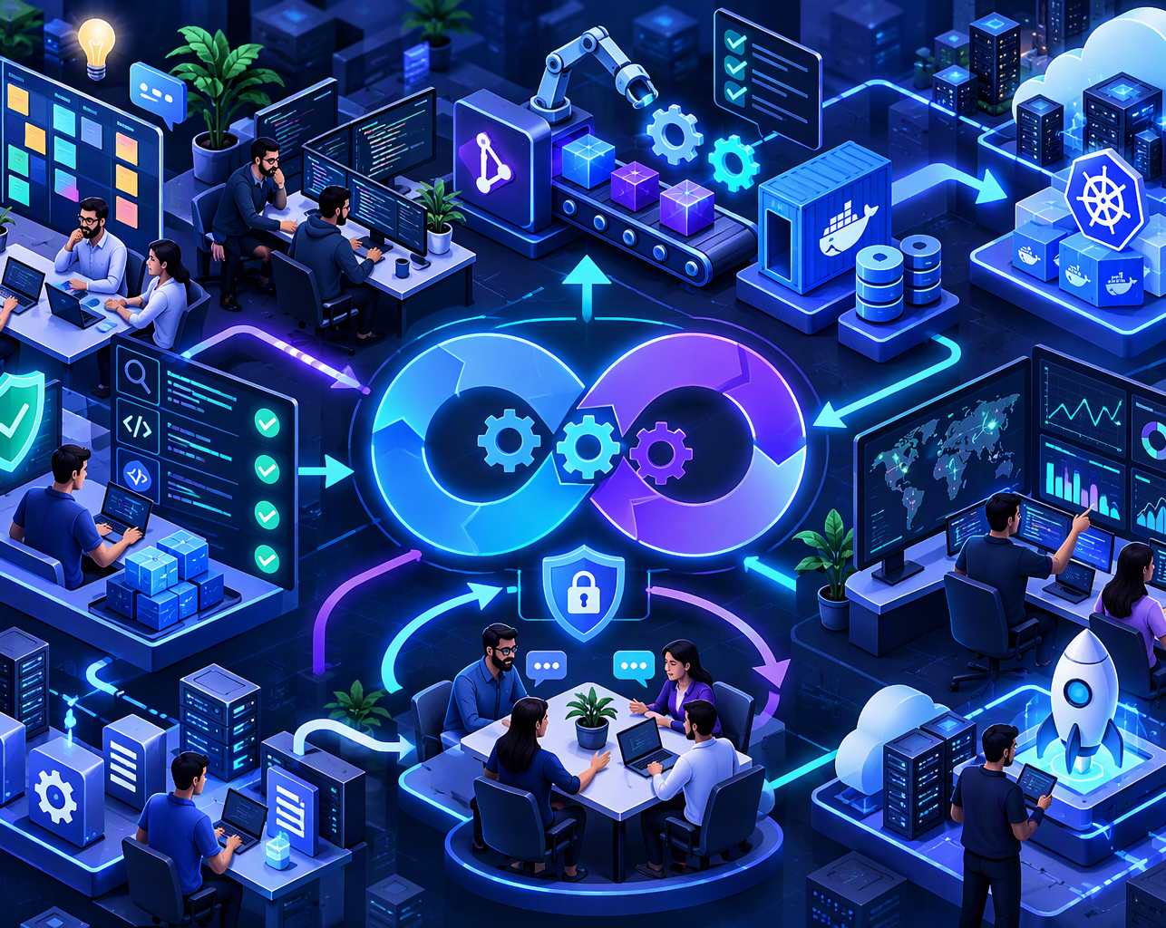
01 • FOUNDATION
What DevOps really means
A delivery model powered by culture, automation, feedback and shared ownership.
PEOPLE
PROCESS
Development, operations, quality and security collaborate.
Small changes, repeatable flow and fast feedback.
AUTOMATION
MEASUREMENT
Build, test, provision, deploy and recover consistently.
Lead time, quality, reliability and recovery guide improvement.
Goal: deliver business value safely, repeatedly and with visibility.
Notes:
[Sources]
Visual on this slide was generated with Microsoft Copilot.
[/Sources]

Slide 3
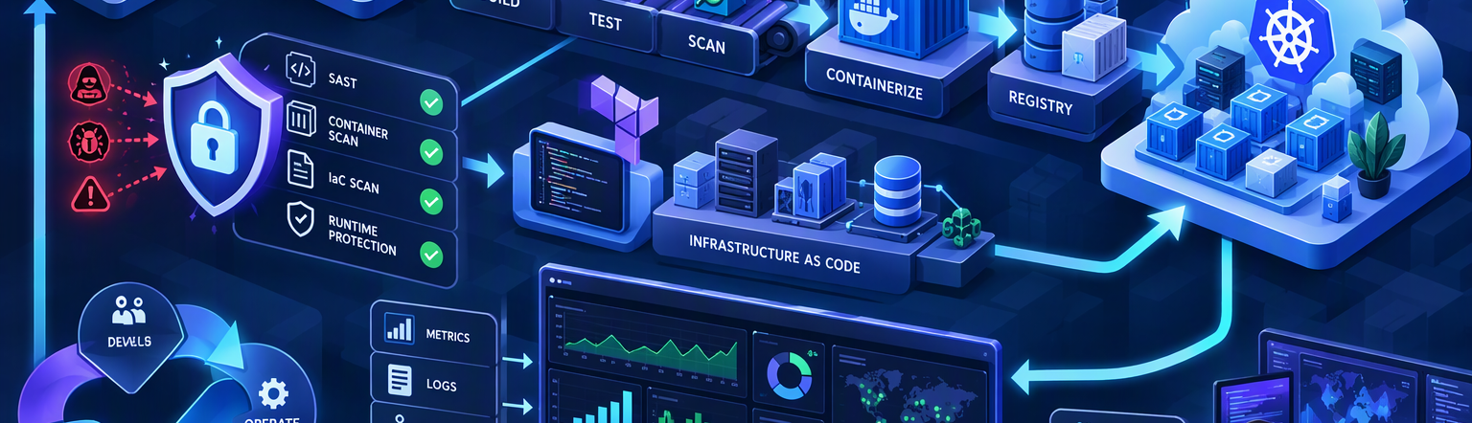
02 • END-TO-END
The DevOps delivery lifecycle
One connected flow converts a requirement into a monitored production service.
PLAN
CODE
BUILD & TEST
PACKAGE
DEPLOY
OPERATE
Jira / Azure Boards
Git / GitHub / GitLab
Jenkins / Actions / ADO
Docker / Registry
Kubernetes / Helm / Argo CD
Prometheus / Grafana / ELK
Notes:
[Sources]
Visual on this slide was generated with Microsoft Copilot.
[/Sources]

Slide 4
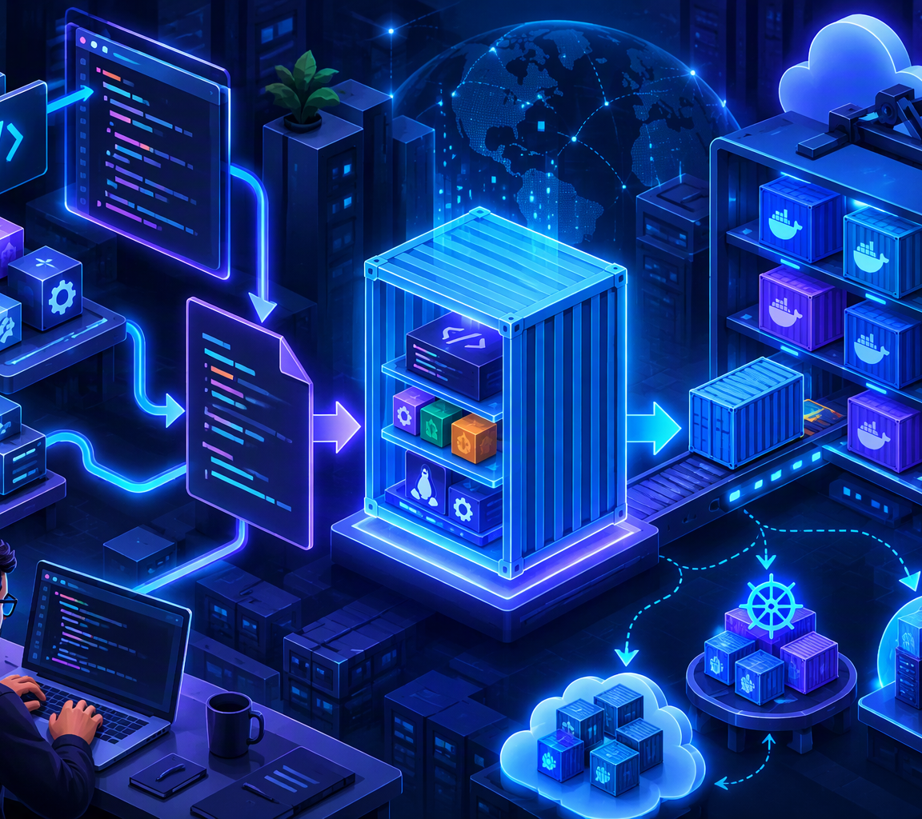
03 • CI/CD
Automate every code change
A pipeline turns a controlled commit into a tested, scanned and versioned artefact.
1
2
3
4
5
6
COMMIT
BUILD
TEST
SCAN
PACKAGE
PROMOTE
Git
Compile
Quality
Security
Image
Deploy
Pipeline outcomes
Repeatable
Same steps every time
Traceable
Commit to release history
Fast feedback
Failures detected earlier
Controlled
Approvals and policy gates
Notes:
[Sources]
Visual on this slide was generated with Microsoft Copilot.
[/Sources]

Slide 5
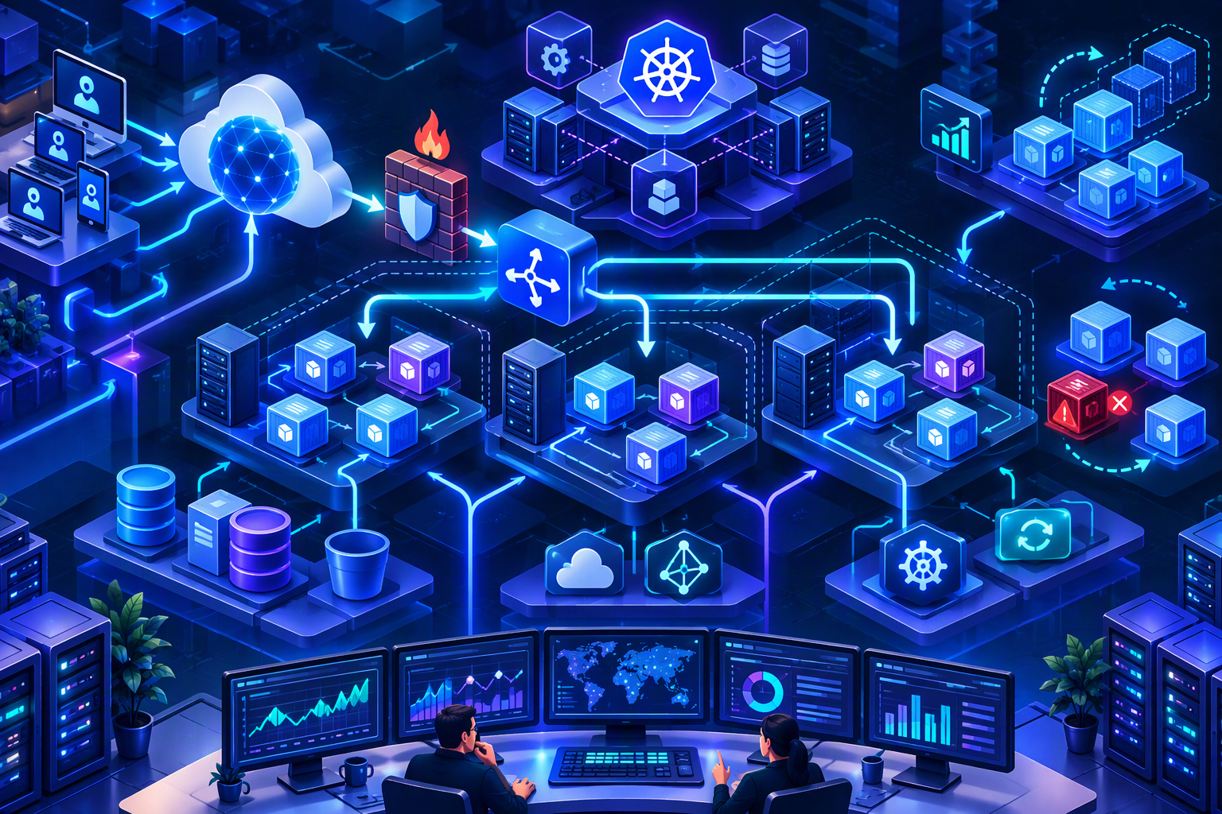
04 • CONTAINERS
Docker packages the application
Build once, promote the same immutable image through environments.
DOCKERFILE
Repeatable build instructions, like a recipe.
IMAGE
Immutable application package with runtime and dependencies.
CONTAINER
A running instance created from the image.
REGISTRY
Stores and distributes versioned images, such as customer-app:1.2.
Notes:
[Sources]
Visual on this slide was generated with Microsoft Copilot.
[/Sources]

Slide 6
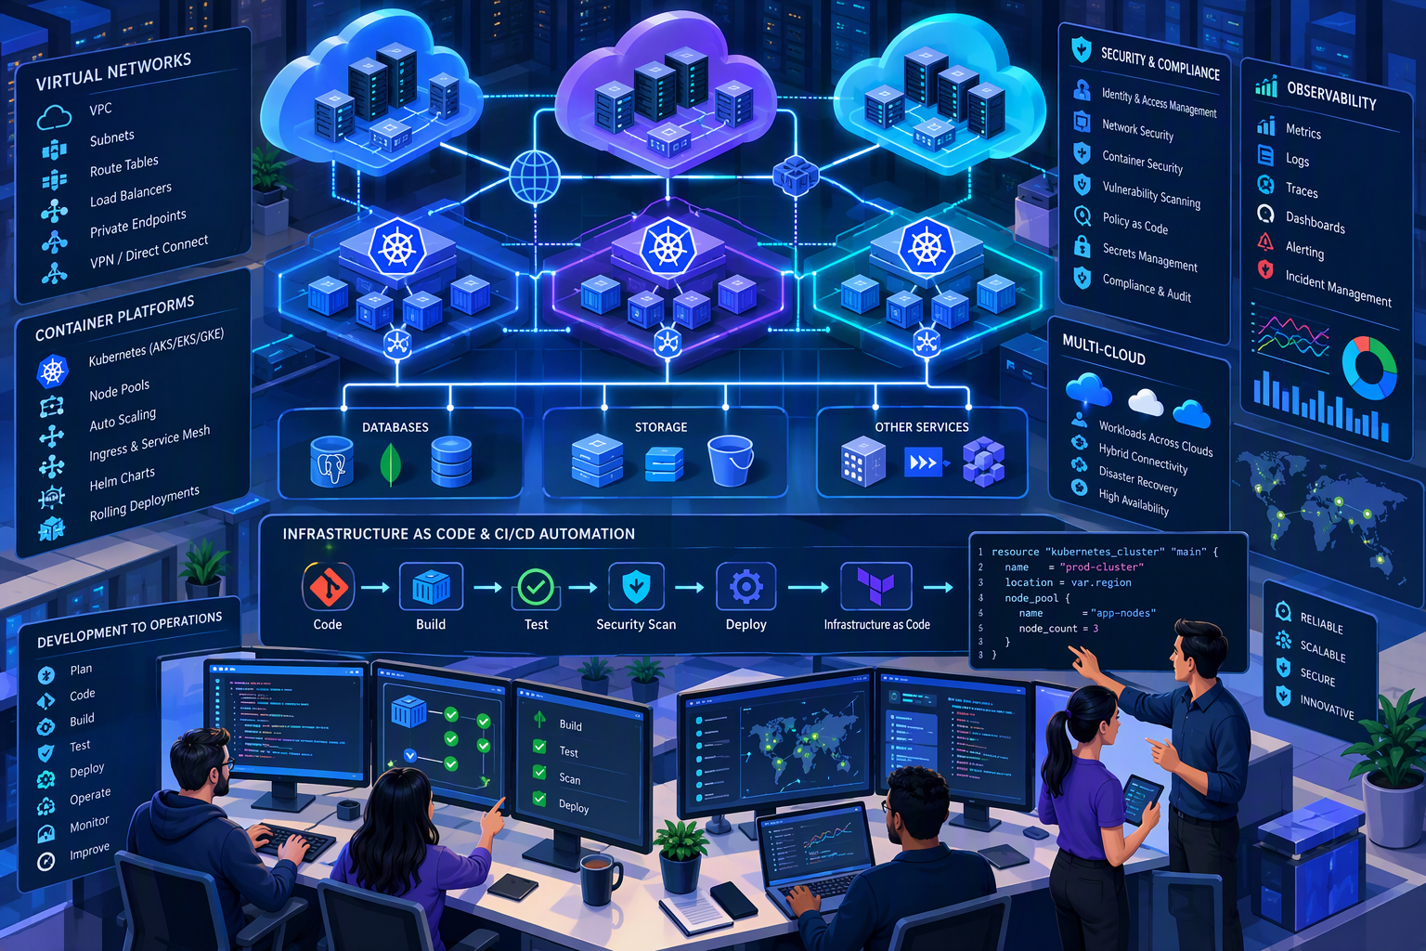
05 • ORCHESTRATION
Kubernetes runs containers at scale
Kubernetes coordinates replicas, networking, updates, configuration and recovery.
INGRESS
External HTTP/S routing
SERVICE
Stable access and discovery
DEPLOYMENT
Replicas and rolling updates
PODS
Running application workloads
User → Ingress → Service → Pods → Containers
Notes:
[Sources]
Visual on this slide was generated with Microsoft Copilot.
[/Sources]

Slide 7
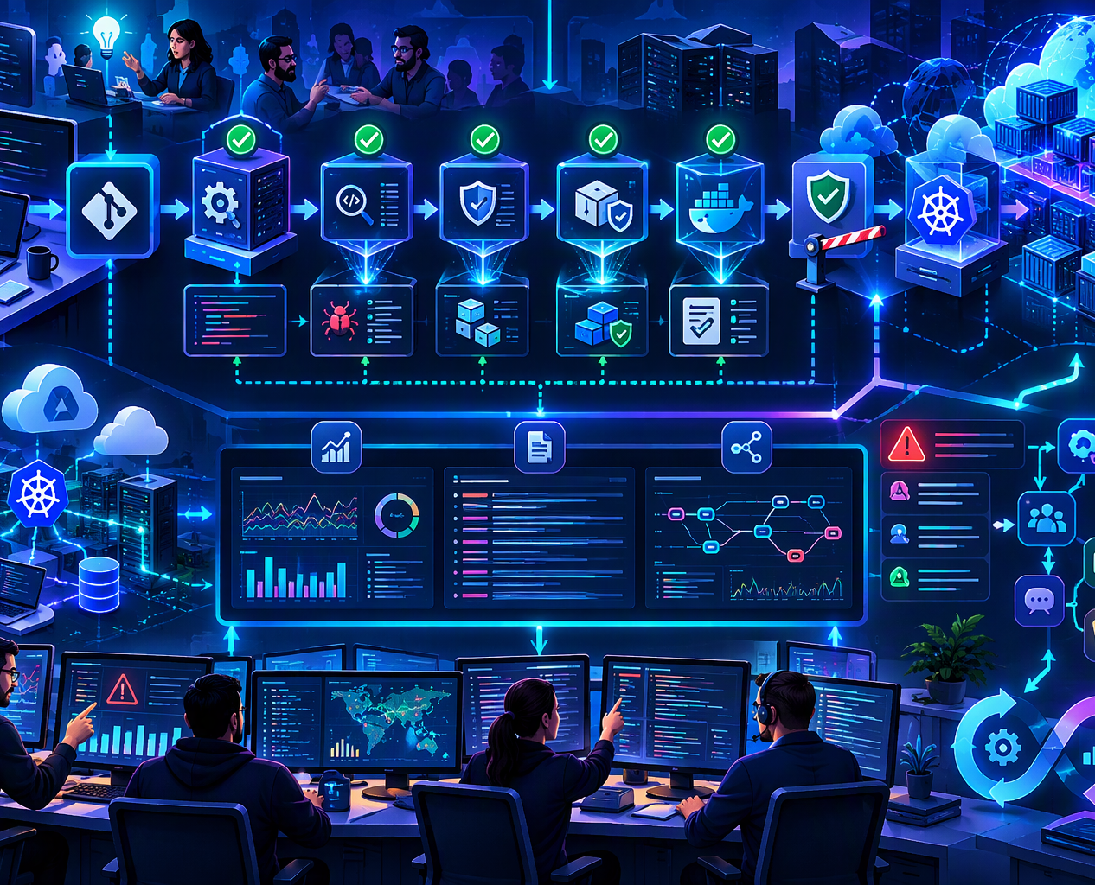
06 • PLATFORM
Cloud and Infrastructure as Code
Compute, networking, storage, identity and repeatable provisioning support the application.
CLOUD FOUNDATION
INFRASTRUCTURE AS CODE
Azure • AWS • GCP
Compute • Network • Storage • IAM
Terraform • Bicep • CloudFormation
Version and review infrastructure.
CONFIGURATION
OPERATING MODEL
Ansible and platform automation
Keep environments consistent.
Managed services, resilience, backup, scaling and cost control.
Application code defines what the application does.
Infrastructure code defines the environment it needs.
Notes:
[Sources]
Visual on this slide was generated with Microsoft Copilot.
[/Sources]

Slide 8
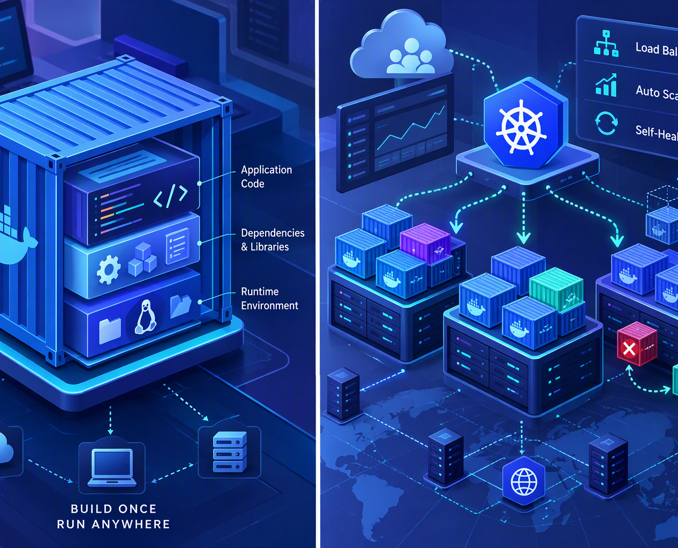
07 • PRODUCTION
Secure, observe and continuously improve
Production success means safer change, reliable service and fast recovery.
DEVSECOPS
OBSERVABILITY
SAST • SCA • image scanning
Secrets • least privilege • policy gates
Metrics • logs • traces
Dashboards and actionable alerts
SRE PRACTICES
IMPROVEMENT
SLI / SLO • runbooks
Incident response • postmortems
Review delivery speed, quality, reliability, capacity and cost.
DevOps is the end-to-end capability to deliver and operate software safely, repeatedly and visibly.
Notes:
[Sources]
Visual on this slide was generated with Microsoft Copilot.
[/Sources]

