Slide 1
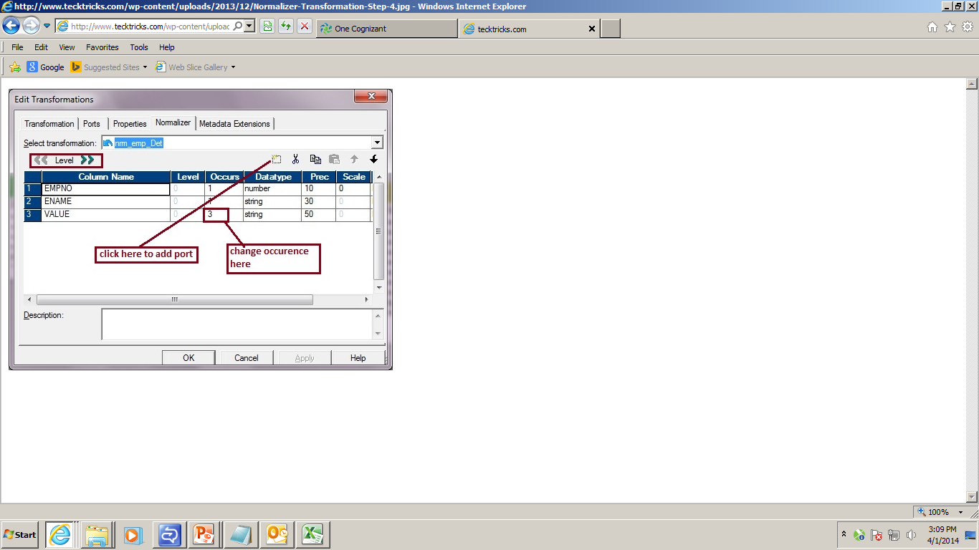
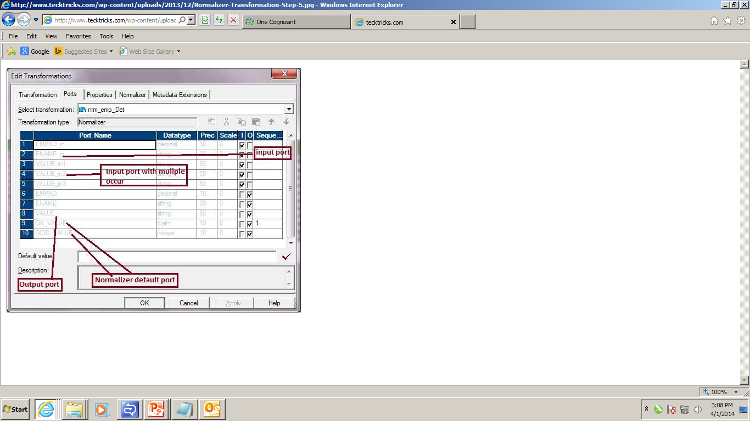
Normalizer Transformation

Slide 2
Mapplets
Mapplet is the reusable object with set of transformations(combined logic), which will be used in different mappings directly.
Mapplet will be created in the mapplet designer of informatica.
Changing the mapplet, will affect all related mappings where its used.
Mapplets don’t have source/target definitions and objects like Normalizer, XML source qualifier & other mapplets.

Slide 3
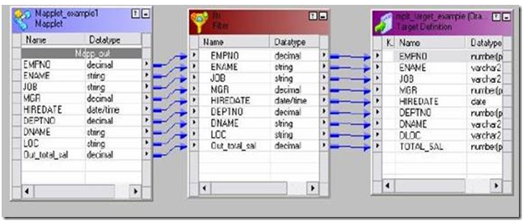
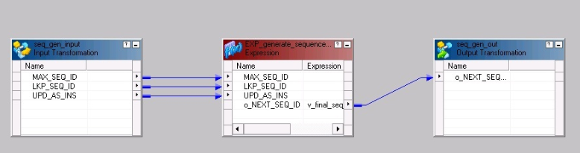
Mapplets
Right click -->
Open mapplet

Slide 4
Shared objects concepts
Shared objects are the objects which are available for all folders of the same repository.
Shared folder is a folder which can be accessed by all the users. Its main use is to share the objects between the folders for reusability.
All the transformations, sources, targets can be kept in shared folder and those can be used across the folders by creating shortcut to those.
This increases usability of the code. Changes made at one place will reflects the changes for all shortcuts.
Depending on the permissions(Read, Write and Execute Permissions) provided to shared folder, the users can access the objects in the shared folder.

Slide 5
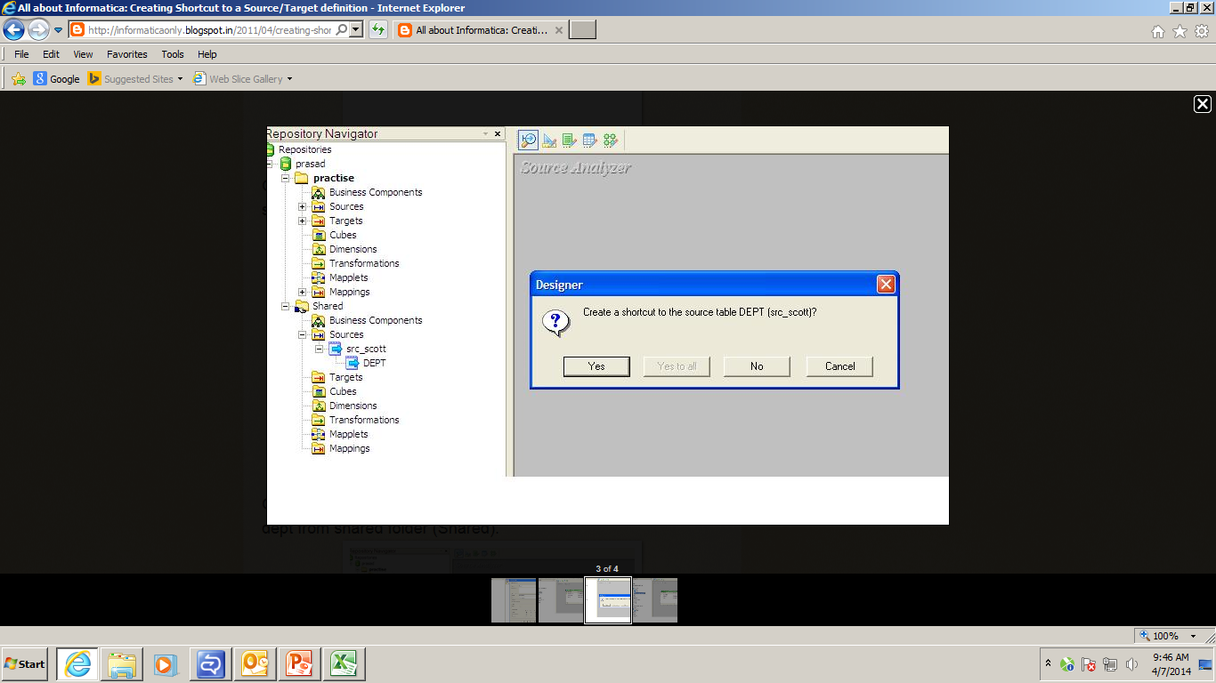
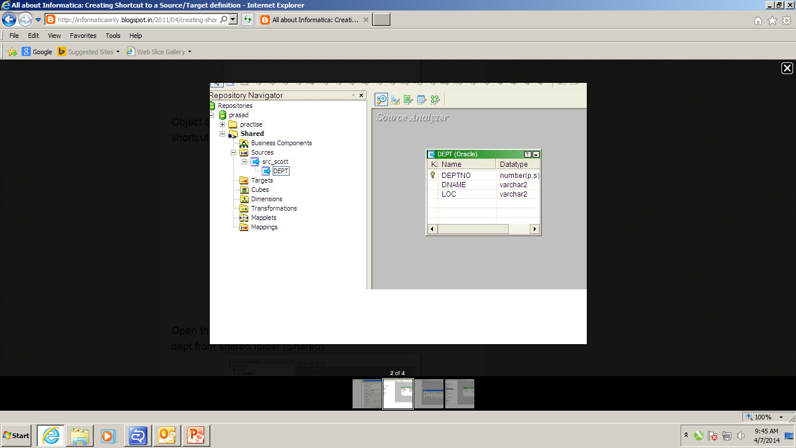
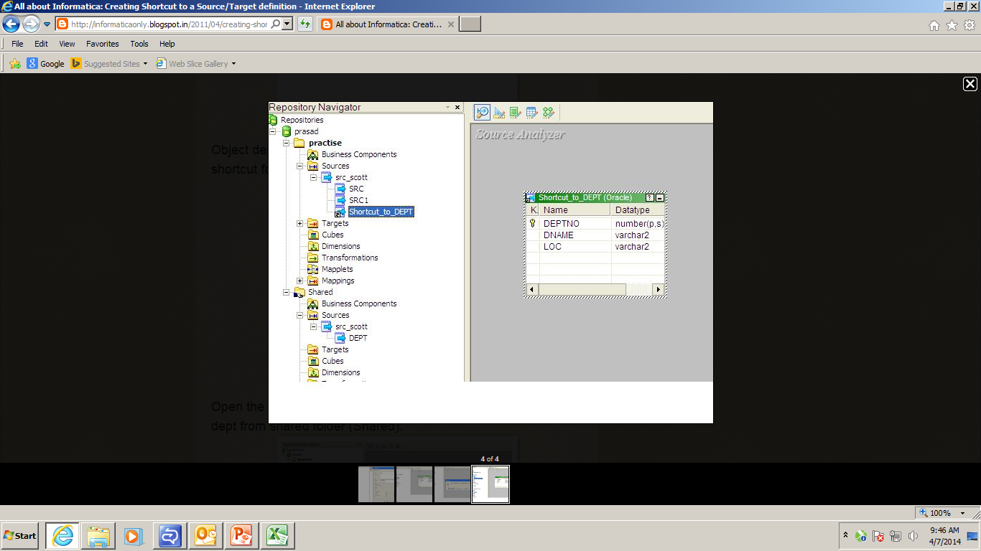
Shared objects concepts
Share folder
Share object
Dragging and dropping shared object to other folder
Shortcut created for the shared object

Slide 6
Informatica Scheduler
Informatica ETL tool has a buit-in scheduler, which is used to schedule the workflows or jobs to run at specified time intervals.
The schedules can be made Reusable or Non Reusable.
There are 3 Run options available in scheduler.
Run on Integration Service Initialization
Run on Demand
Run Continuously
Scheduler also contains, customized repeat options like Repeat every, Run on, Run on day, Run on the & Daily Frequency.

Slide 7
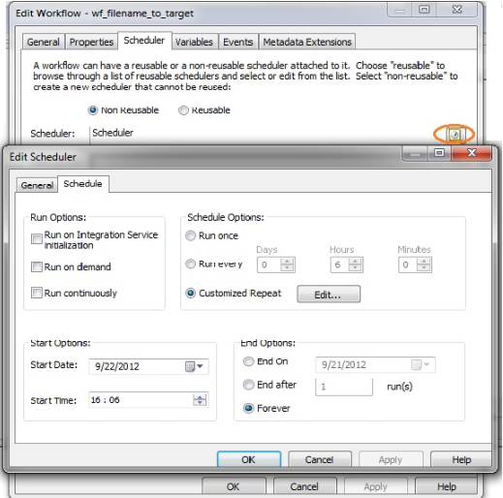
Informatica Scheduler

Slide 8
Thank you !!

