Slide 1
Impact of HTTP Cookie Violations in Web Archives
Sawood Alam, Plinio Vargas, Michele C. Weigle, Michael L. Nelson
( arXiv:1906.07141, 2019)
CS895 - Web Archiving Forensics, Fall 2020
Old Dominion University
Department of Computer Science
Kritika Garg, kgarg001@odu.edu
@kritika_garg (kgarg001@odu.edu) CS895 Web Archiving Forensics, Fall 2020

Slide 2
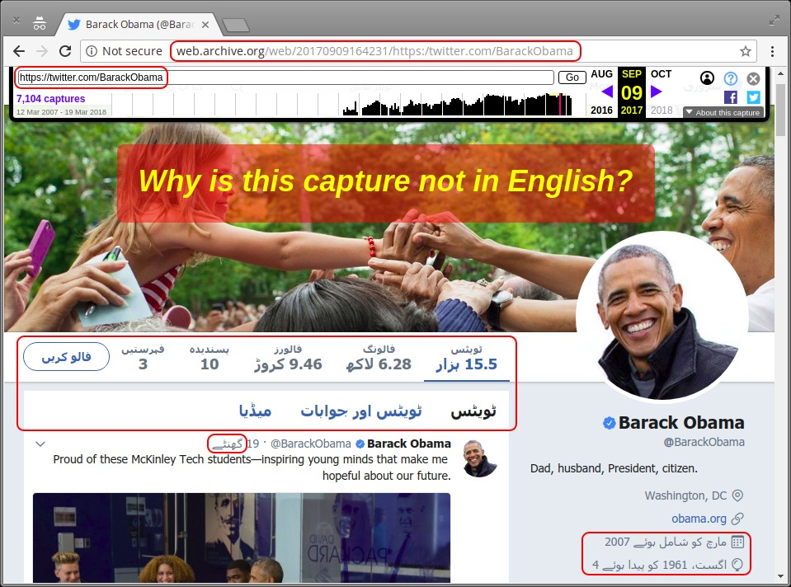
Ex-President Obama's archived Twitter page in Urdu
http://web.archive.org/web/20170909164231if_/https://twitter.com/BarackObama
https://ws-dl.blogspot.com/2018/03/2018-03-21-cookies-are-why-your.html
@kritika_garg (kgarg001@odu.edu) CS895 Web Archiving Forensics, Fall 2020

Slide 3
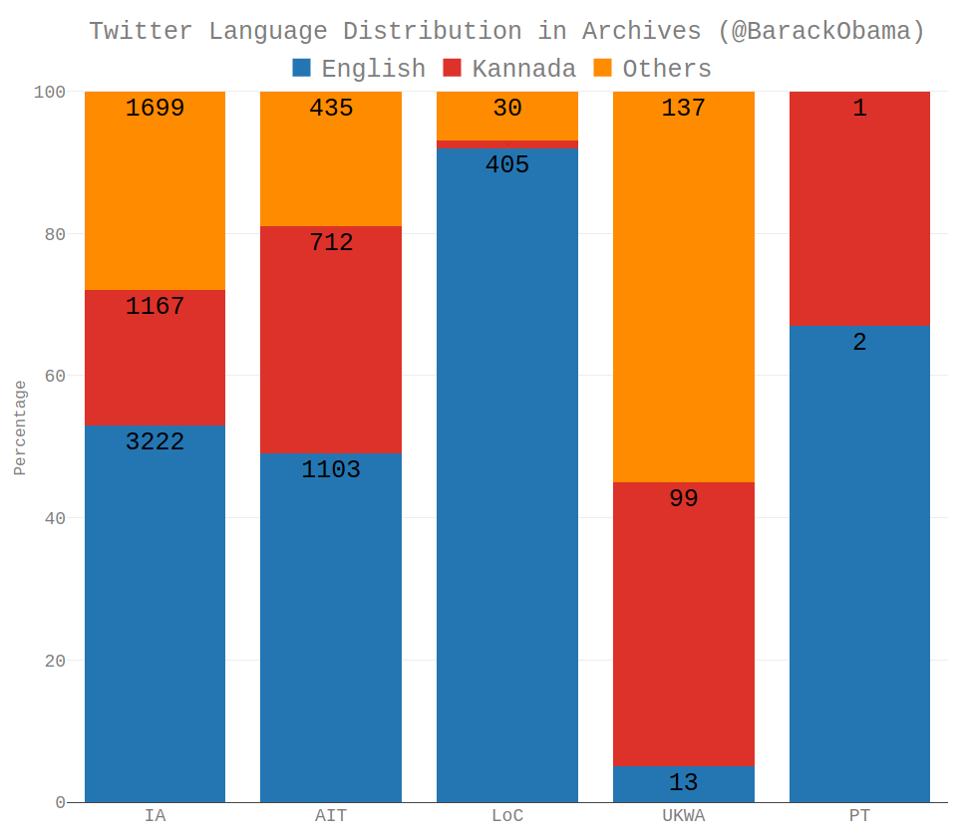
Kannada is a prominent language in web archives
Overall Twitter language distribution of over 9,000 @BarackObama mementos:
53% English
22% Kannada
25% Other languages
https://ws-dl.blogspothttps://blog.dshr.org/2018/04/all-your-tweets-are-belong-to-kannada.html.com/
https://ws-dl.blogspot.com/2018/03/2018-03-21-cookies-are-why-your.html

Slide 4
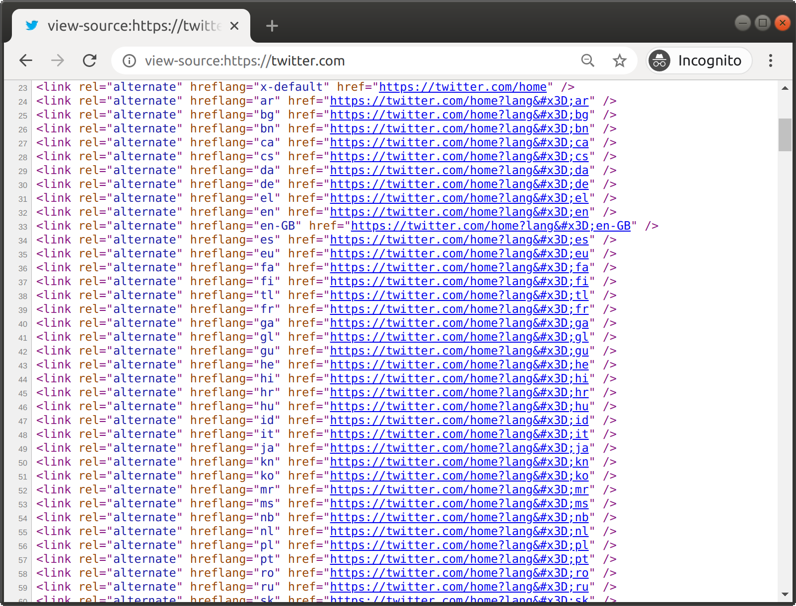
Twitter’s list of alternate links for 47 language
The page source of twitter provides a list of alternate links for each language.
List: https://gist.github.com/ibnesayeed/c7e5773318d6ea041984fb2433bf1d1e
https://developer.twitter.com/en/docs/twitter-for-websites/supported-languages

Slide 5
Twitter's language negotiation
#"lang" query parameter
$ curl -s https://twitter.com/?lang=hi | grep "<html"
<html dir="ltr" lang="hi">
#Accept-Language request header
$ curl --silent -H "Accept-Language: hi" https://twitter.com/ | grep "<html"
<html dir="ltr" lang="hi">
$ curl --silent -A "googlebot" -c /tmp/twitter.cookie.old https://twitter.com/?lang=hi | grep "<html"
<html lang="hi" data-scribe-reduced-action-queue="true">
$ curl --silent -A "googlebot" -b /tmp/twitter.cookie.old https://twitter.com/ | grep "<html"
<html lang="hi" data-scribe-reduced-action-queue="true">

Slide 6
Session cookies
$ cat /tmp/twitter.cookie.old
# Netscape HTTP Cookie File
# https://curl.haxx.se/docs/http-cookies.html
# This file was generated by libcurl! Edit at your own risk.
#HttpOnly_.twitter.com TRUE / TRUE 1604589198 fm 0
#HttpOnly_.twitter.com TRUE / TRUE 0 _twitter_sess BAh7CSIKZmxhc2hJQzonQWN0aW9uQ29udHJvbGxlcjo6Rmxhc2g6OkZsYXNo%250ASGFzaHsABjoKQHVzZWR7ADoPY3JlYXRlZF9hdGwrCHMa%252BJh1AToMY3NyZl9p%250AZCIlOWFiY2VkZGJiMjM4M2U0ZmYzZjUwY2I0NzMyODg2Yzk6B2lkIiUyOTU1%250AZDdhNTMyMGUyZjFjYjdlMTRiMjFmOWFlMmNjMA%253D%253D--1ccc619bf24402d1bbc3ef90dc2ee5d9bf30606e
.twitter.com TRUE / TRUE 1667661198 personalization_id "v1_N5t2gb9AlH2GDksMP3a2Tg=="
twitter.com FALSE / FALSE 0 lang hi
.twitter.com TRUE / TRUE 1667661198 guest_id v1%3A160458919793691525
.twitter.com TRUE / TRUE 1604610798 ct0 e948c8891fb71e0be1c0b7bbe24f7659

Slide 7
Sticky cookies are the real culprit
The crawler’s use of session cookies while archiving the Twitter pages impacts the language displayed in the resulting memento.
Traditional crawlers such as Heritrix uses cookies for language negotiation with Twitter.
Twitter’s list of 47 alternate language links get added to the frontier queue of the crawler while crawling a Twitter page.
Once any of the link is loaded, the language gets set based on cookie for the consecutive links in the frontier queue as well, until the language is overwritten or session expires.
<link rel="alternate" hreflang="fr" href="https://twitter.com/?lang=fr">
<link rel="alternate" hreflang="en" href="https://twitter.com/?lang=en">

Slide 8
Cookies & Crawlers
Replicated the crawling process to verify the impact of the Twitter cookies on archiving Twitter page in Internet Archive.
Used Heritrix to crawl the following seeds in this particular sequence:
https://twitter.com/?lang=ar
https://twitter.com/phonedude_mln/

Slide 9
WARC request and response headers for 1st seed.
WARC/1.0
WARC-Type: response
WARC-Target-URI: https://twitter.com/?lang=ar
WARC-Date: 2018-03-16T21:58:44Z
WARC-Payload-Digest: sha1:FCOPDBN2U5LXU7FEUUGQ4WXYGR7OP5JI
WARC-IP-Address: 104.244.42.129
WARC-Record-ID: <urn:uuid:7dbc3a67-5cf8-4375-8343-c0f6b03039f4>
Content-Type: application/http; msgtype=response
Content-Length: 151985
HTTP/1.0 200 OK
cache-control: no-cache, no-store, must-revalidate, pre-check=0, post-check=0
content-length: 150665
content-type: text/html;charset=utf-8
date: Fri, 16 Mar 2018 21:58:44 GMT
expires: Tue, 31 Mar 1981 05:00:00 GMT
last-modified: Fri, 16 Mar 2018 21:58:44 GMT
pragma: no-cache
server: tsa_b
set-cookie: fm=0; Expires=Fri, 16 Mar 2018 21:58:34 UTC; Path=/; Domain=.twitter.com; Secure; HTTPOnly
set-cookie: _twitter_sess=BAh7CSIKZmxhc2hJQzonQWN0aW9uQ29udHJvbGxlcjo6Rmxhc2g6OkZsYXNo%250ASGFzaHsABjoKQHVzZWR7ADoPY3JlYXRlZF9hdGwrCGKB0jBiAToMY3NyZl9p%250AZCIlZmQ1MTY4ZjQ3NmExZWQ1NjUyNDRmMzhhZGNiMmFhZjQ6B2lkIiU0OTQ0%250AZDMxMDY4NjJhYjM4NjBkMzI4MDE0NjYyOGM5ZA%253D%253D--f571656f1526d7ff1b363d527822ebd4495a1fa3; Path=/; Domain=.twitter.com; Secure; HTTPOnly
set-cookie: lang=ar; Path=/
set-cookie: ct0=10558ec97ee83fe0f2bc6de552ed4b0e; Expires=Sat, 17 Mar 2018 03:58:44 UTC; Path=/; Domain=.twitter.com; Secure
status: 200 OK
strict-transport-security: max-age=631138519
x-connection-hash: 2a2fc89f51b930202ab24be79b305312
x-content-type-options: nosniff
x-frame-options: SAMEORIGIN
x-response-time: 100
x-transaction: 001495f800dc517f
x-twitter-response-tags: BouncerCompliant
x-ua-compatible: IE=edge,chrome=1
x-xss-protection: 1; mode=block; report=https://twitter.com/i/xss_report
<!DOCTYPE html>
<html lang="ar" data-scribe-reduced-action-queue="true">
WARC/1.0
WARC-Type: request
WARC-Target-URI: https://twitter.com/?lang=ar
WARC-Date: 2018-03-16T21:58:44Z
WARC-Concurrent-To: <urn:uuid:7dbc3a67-5cf8-4375-8343-c0f6b03039f4>
WARC-Record-ID: <urn:uuid:473273f6-48fa-4dd3-a5f0-81caf9786e07>
Content-Type: application/http; msgtype=request
Content-Length: 301
GET /?lang=ar HTTP/1.0
User-Agent: Mozilla/5.0 (compatible; heritrix/3.2.0 +http://cs.odu.edu/)
Connection: close
Accept: text/html,application/xhtml+xml,application/xml;q=0.9,*/*;q=0.8
Host: twitter.com
Cookie: guest_id=v1%3A152123752160566016; personalization_id=v1_uAUfoUV9+DkWI8mETqfuFg==
https://ws-dl.blogspot.com/2018/03/2018-03-21-cookies-are-why-your.html

Slide 10
WARC request and response headers for 2nd seed.
WARC/1.0
WARC-Type: response
WARC-Target-URI: https://twitter.com/phonedude_mln/
WARC-Date: 2018-03-16T21:58:48Z
WARC-Payload-Digest: sha1:5LI3DGWO6NGK4LWSIHFZZHW43H2Z2IWA
WARC-IP-Address: 104.244.42.129
WARC-Record-ID: <urn:uuid:634dea88-6994-4bd4-af05-5663d24c3727>
Content-Type: application/http; msgtype=response
Content-Length: 518086
HTTP/1.0 200 OK
cache-control: no-cache, no-store, must-revalidate, pre-check=0, post-check=0
content-length: 516921
content-type: text/html;charset=utf-8
date: Fri, 16 Mar 2018 21:58:48 GMT
expires: Tue, 31 Mar 1981 05:00:00 GMT
last-modified: Fri, 16 Mar 2018 21:58:48 GMT
pragma: no-cache
server: tsa_b
set-cookie: fm=0; Expires=Fri, 16 Mar 2018 21:58:38 UTC; Path=/; Domain=.twitter.com; Secure; HTTPOnly
set-cookie: _twitter_sess=BAh7CSIKZmxhc2hJQzonQWN0aW9uQ29udHJvbGxlcjo6Rmxhc2g6OkZsYXNo%250ASGFzaHsABjoKQHVzZWR7ADoPY3JlYXRlZF9hdGwrCGKB0jBiAToMY3NyZl9p%250AZCIlZmQ1MTY4ZjQ3NmExZWQ1NjUyNDRmMzhhZGNiMmFhZjQ6B2lkIiU0OTQ0%250AZDMxMDY4NjJhYjM4NjBkMzI4MDE0NjYyOGM5ZA%253D%253D--f571656f1526d7ff1b363d527822ebd4495a1fa3; Path=/; Domain=.twitter.com; Secure; HTTPOnly
status: 200 OK
strict-transport-security: max-age=631138519
x-connection-hash: ef102c969c74f3abf92966e5ffddb6ba
x-content-type-options: nosniff
x-frame-options: SAMEORIGIN
x-response-time: 335
x-transaction: 0014986c00687fa3
x-twitter-response-tags: BouncerCompliant
x-ua-compatible: IE=edge,chrome=1
x-xss-protection: 1; mode=block; report=https://twitter.com/i/xss_report
<!DOCTYPE html>
<html lang="ar" data-scribe-reduced-action-queue="true">..
WARC/1.0
WARC-Type: request
WARC-Target-URI: https://twitter.com/phonedude_mln/
WARC-Date: 2018-03-16T21:58:48Z
WARC-Concurrent-To: <urn:uuid:634dea88-6994-4bd4-af05-5663d24c3727>
WARC-Record-ID: <urn:uuid:eef134ed-f3dc-459b-95e7-624b4d747bc1>
Content-Type: application/http; msgtype=request
Content-Length: 655
GET /phonedude_mln/ HTTP/1.0
User-Agent: Mozilla/5.0 (compatible; heritrix/3.2.0 +http://cs.odu.edu/)
Connection: close
Accept: text/html,application/xhtml+xml,application/xml;q=0.9,*/*;q=0.8
Host: twitter.com
Cookie: lang=ar; _twitter_sess=BAh7CSIKZmxhc2hJQzonQWN0aW9uQ29udHJvbGxlcjo6Rmxhc2g6OkZsYXNo%250ASGFzaHsABjoKQHVzZWR7ADoPY3JlYXRlZF9hdGwrCGKB0jBiAToMY3NyZl9p%250AZCIlZmQ1MTY4ZjQ3NmExZWQ1NjUyNDRmMzhhZGNiMmFhZjQ6B2lkIiU0OTQ0%250AZDMxMDY4NjJhYjM4NjBkMzI4MDE0NjYyOGM5ZA%253D%253D--f571656f1526d7ff1b363d527822ebd4495a1fa3; ct0=10558ec97ee83fe0f2bc6de552ed4b0e; guest_id=v1%3A152123752160566016; personalization_id=v1_uAUfoUV9+DkWI8mETqfuFg==
https://ws-dl.blogspot.com/2018/03/2018-03-21-cookies-are-why-your.html

Slide 11
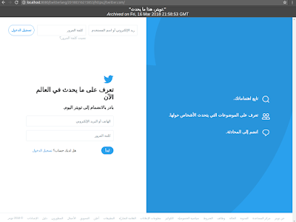
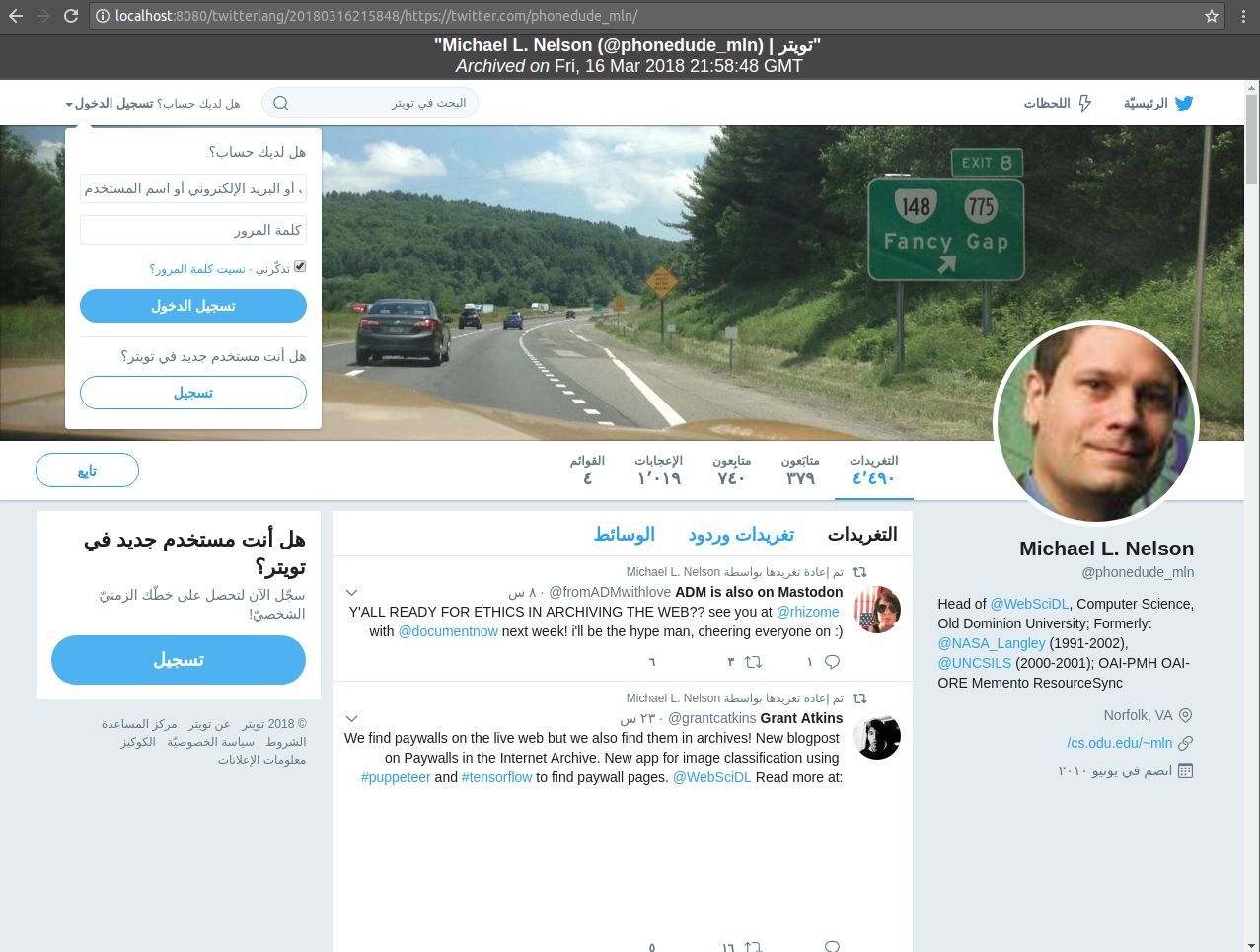
Replay the captured WARC using PyWb
https://twitter.com/?lang=ar
https://twitter.com/phonedude_mln/
https://github.com/webrecorder/pywb
https://ws-dl.blogspot.com/2018/03/2018-03-21-cookies-are-why-your.html

Slide 12
Why was Kannada so dominant?
Kanada was the last language in the list.
The languages gets overwritten when the next language specific link in the frontier queue is loaded.
Similarly, Bengali was last language in the list for year 2015 making it a dominant language for archival activities between July 2014 to July 2015.
<link rel="alternate" hreflang="x-default" href="https://twitter.com/">
<link rel="alternate" hreflang="fr" href="https://twitter.com/?lang=fr">
<link rel="alternate" hreflang="en" href="https://twitter.com/?lang=en">
<link rel="alternate" hreflang="ar" href="https://twitter.com/?lang=ar">
---------- (43 links truncated)
<link rel="alternate" hreflang="kn" href="https://twitter.com/?lang=kn">

Slide 13
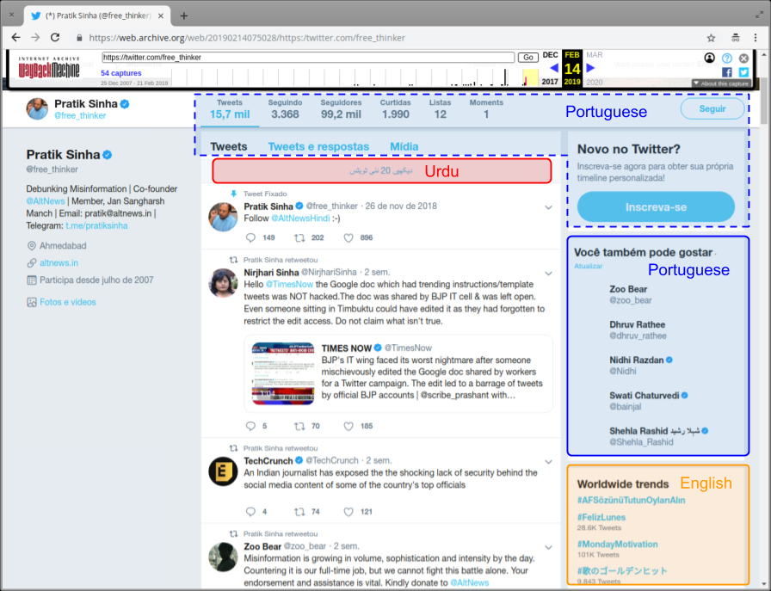
Defaced composite memento
https://ws-dl.blogspot.com/2019/03/2019-03-18-cookie-violations-cause.html

Slide 14
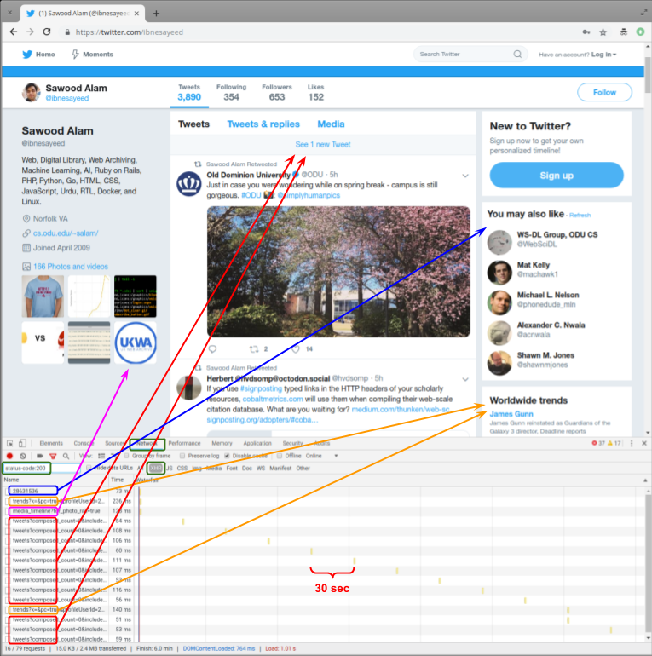
Anatomy of a Twitter timeline of old interface.
Bio and initial 20 tweets are embedded in the HTML.
“You might like” section and media timeline are lazily loaded.
New tweets after every 30 sec for an active page.
Global trends are loaded after every 5 min.
https://ws-dl.blogspot.com/2019/03/2019-03-18-cookie-violations-cause.html

Slide 15
Defaced composite memento
memento is archived in Portuguese
Embedded in HTML
closest archived copy in Urdu
(2019:02:27T22:04:50)
Loaded right after main page
Media not archived
closest archived copy in English (2019:02:11T13:21:45)
https://ws-dl.blogspot.com/2019/03/2019-03-18-cookie-violations-cause.html

Slide 16
Prior cookies may impact subsequent XHR responses
$ curl --silent -b /tmp/twitter.cookie "https://twitter.com/i/trends?k=&pc=true&profileUserId=28631536&show_context=true&src=module" | jq
{
"module_html": "<div class=\"flex-module trends-container context-trends-container\">\n <div class=\"flex-module-header\">\n \n <h3><span class=\"trend-location js-trend-location\">دنیا بھر کے میں رجحانات</span></h3>\n </div>\n <div class=\"flex-module-inner\">\n <ul class=\"trend-items js-trends\">\n <li class=\"trend-item js-trend-item context-trend-item\"\n data-trend-name=\"#PiDay\"\n data-trends-id=\"1025618545345384837\"\n data-trend-token=\":location_request:hashtag_trend:taxi_country_source:moments_metadescription:moments_badge:\"\n \n >\n\n <a class=\"pretty-link js-nav js-tooltip u-linkComplex \"\n
.
.
.
.
.
</div>\n</div>\n",
"personalized": false,
"woeid": 1
}
https://ws-dl.blogspot.com/2019/03/2019-03-18-cookie-violations-cause.html

Slide 17
Proposed solutions
Cookies with short expiration time.
Isolating sessions by sandboxing the crawl jobs from same domain.
Advertise content negotiation in “Vary” header.
Utilize cookies during replay (renaming cookies).

Slide 18
Backup Slides

Slide 19
No session cookie in new Twitter UI
#Accept-Language request header
$ curl --silent -H "Accept-Language: hi" https://twitter.com/ | grep "<html"
<html dir="ltr" lang="hi">
#"lang" query parameter
$ curl --silent -c /tmp/twitter.cookie https://twitter.com/?lang=hi | grep "<html"
<html dir="rtl" lang="hi">
$ curl --silent -b /tmp/twitter.cookie https://twitter.com/ | grep "<html"
#Saved Cookie (No lang, no session information)
$ cat /tmp/twitter.cookie
# Netscape HTTP Cookie File
# https://curl.haxx.se/docs/http-cookies.html
# This file was generated by libcurl! Edit at your own risk.
.twitter.com TRUE / TRUE 1667659100 personalization_id "v1_k4XhlqGYDP2KKq+3uw0hEg=="
.twitter.com TRUE / TRUE 1667659100 guest_id v1%3A160458710070234309

Slide 20
Twitter language list
<link rel="alternate" hreflang="x-default" href="https://twitter.com/home" />
<link rel="alternate" hreflang="ar" href="https://twitter.com/home?lang&#x3D;ar" />
<link rel="alternate" hreflang="bg" href="https://twitter.com/home?lang&#x3D;bg" />
<link rel="alternate" hreflang="bn" href="https://twitter.com/home?lang&#x3D;bn" />
<link rel="alternate" hreflang="ca" href="https://twitter.com/home?lang&#x3D;ca" />
<link rel="alternate" hreflang="cs" href="https://twitter.com/home?lang&#x3D;cs" />
<link rel="alternate" hreflang="da" href="https://twitter.com/home?lang&#x3D;da" />
<link rel="alternate" hreflang="de" href="https://twitter.com/home?lang&#x3D;de" />
<link rel="alternate" hreflang="el" href="https://twitter.com/home?lang&#x3D;el" />
<link rel="alternate" hreflang="en" href="https://twitter.com/home?lang&#x3D;en" />
<link rel="alternate" hreflang="en-GB" href="https://twitter.com/home?lang&#x3D;en-GB" />
-----
<link rel="alternate" hreflang="ro" href="https://twitter.com/home?lang&#x3D;ro" />
<link rel="alternate" hreflang="ru" href="https://twitter.com/home?lang&#x3D;ru" />
<link rel="alternate" hreflang="sk" href="https://twitter.com/home?lang&#x3D;sk" />
<link rel="alternate" hreflang="sr" href="https://twitter.com/home?lang&#x3D;sr" />
<link rel="alternate" hreflang="sv" href="https://twitter.com/home?lang&#x3D;sv" />
<link rel="alternate" hreflang="ta" href="https://twitter.com/home?lang&#x3D;ta" />
<link rel="alternate" hreflang="th" href="https://twitter.com/home?lang&#x3D;th" />
<link rel="alternate" hreflang="tr" href="https://twitter.com/home?lang&#x3D;tr" />
<link rel="alternate" hreflang="uk" href="https://twitter.com/home?lang&#x3D;uk" />
<link rel="alternate" hreflang="ur" href="https://twitter.com/home?lang&#x3D;ur" />
<link rel="alternate" hreflang="vi" href="https://twitter.com/home?lang&#x3D;vi" />
<link rel="alternate" hreflang="zh" href="https://twitter.com/home?lang&#x3D;zh" />
<link rel="alternate" hreflang="zh-Hant" href="https://twitter.com/home?lang&#x3D;zh-Hant" />
Now sorted in alphabetical order.
“zh-Hant” traditional chinese is the last language.

