Slide 1
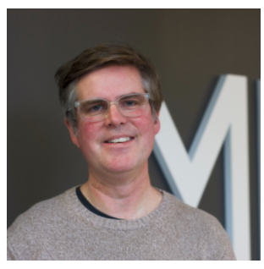
Blacktivists in the Archive
By Ed Summers, Research Faculty University of Maryland
Documenting DocNow
October 4, 2017
Presented by
Valentina Neblitt-Jones
CS 895 Web Archiving Forensics – Fall 2020
December 10, 2020
vneblitt@gmail.com
https://news.docnow.io/blacktivists-in-the-archive-71c807aa247e

Slide 2

Documenting the Now
https://www.docnow.io/
Twitter: @documentnow

Slide 3
About Documenting the Now
Studies the public’s use of social media for chronicling historically significant events
Seeking a user-friendly means of collecting and preserving this type of digital content
Partners: Shift Collective, University of Maryland, and University of Virginia
Funder: Andrew W. Mellon Foundation
https://www.docnow.io/#about

Slide 4
Tools
DocNow – application that helps archivists discover what resources are in need of archiving
Tweet Catalog – collectively curated listing of Twitter datasets
Hydrator – application that turns tweet IDs back into JSON and also CSV
Social Humans Labels – labels to express intent and wishes of content creators
Twarc – for archiving Twitter JSON data
Diff Engine – utility that watches RSS feeds to see what story content changes
https://www.docnow.io/#tools

Slide 5
@blacktivists

Slide 6
@blacktivists on FB and Twitter
Specific Facebook and Twitter account (@blacktivists) operated by the Russian government to increase racial tensions in the lead up to the 2016 election.
Both accounts are suspended and can no longer be viewed.

Slide 7
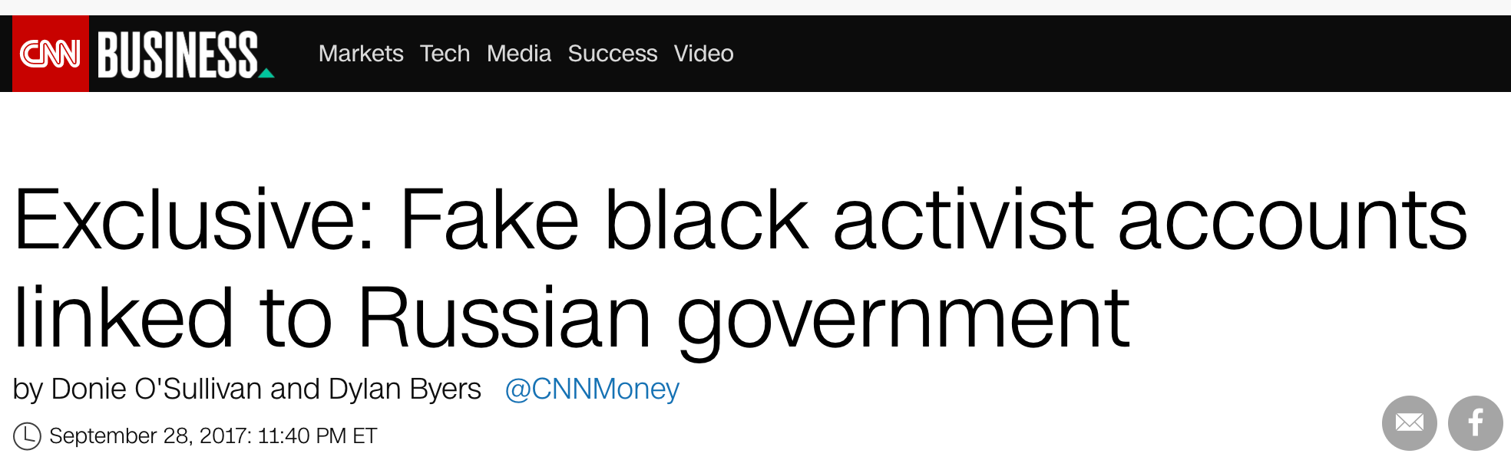
“A social media campaign calling itself ‘Blacktivist’ and linked to the Russian government used both Facebook and Twitter in an apparent attempt to amplify racial tensions during the U.S. presidential election”
https://money.cnn.com/2017/09/28/media/blacktivist-russia-facebook-twitter/index.html

Slide 8
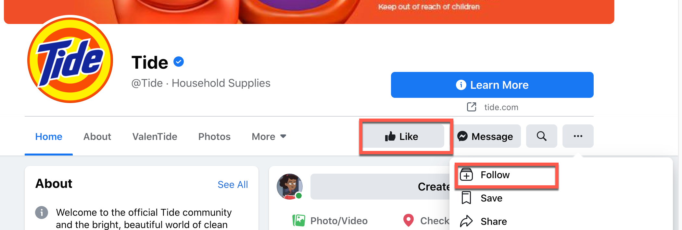
Popularity of the Facebook Account
According to the CNN article (9/28/2017), the Facebook account had 360,000 likes which was more than the verified Black Lives Matter account which had just a little over 301,000.
like vs. follow

Slide 9
Rallies/Events
The page also publicized at least seven rallies and demonstrations in 2016
50th anniversary of the Black Panther Party
A march in Baltimore commemorating the death of Freddie Gray
It appears that the several events were real. They were organized by other groups. @blacktivist was working to increase turnout.
In my own study of some Blacktivist tweets, it promoted a Sandra Bland rally in early July 2016, but I could not find an event page or news story about the rally.
https://money.cnn.com/2017/09/28/media/blacktivist-russia-facebook-twitter/index.html

Slide 10
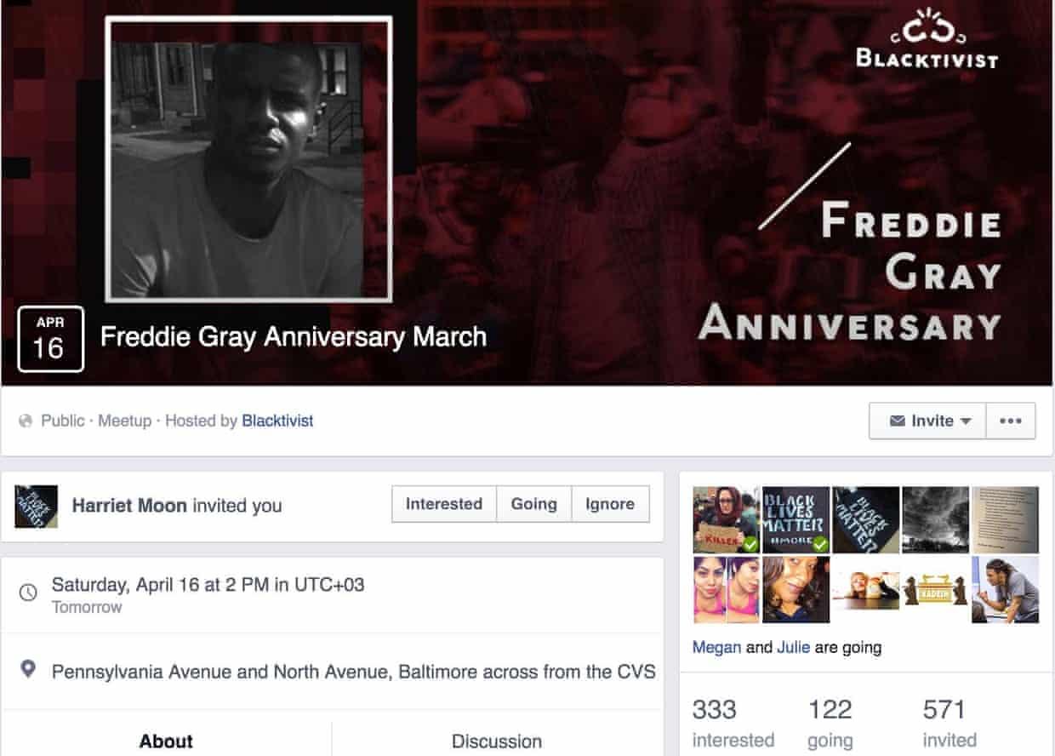
The Freddie Gray Event
A police brutality incident in Baltimore that occur on April 12, 2015 resulting in Freddie Gray’s death on April 19, 2015. April 2016 would have been an anniversary and Blacktivists Facebook page advertised an anniversary march.
When several Baltimore activists saw a Facebook account called “Blacktivist” organizing a local police brutality march, they were suspicious. The event page acquired a sizable following, but no one knew who was responsible for it.
https://en.wikipedia.org/wiki/Death_of_Freddie_Gray
https://www.theguardian.com/technology/2017/sep/30/blacktivist-facebook-account-russia-us-election

Slide 11
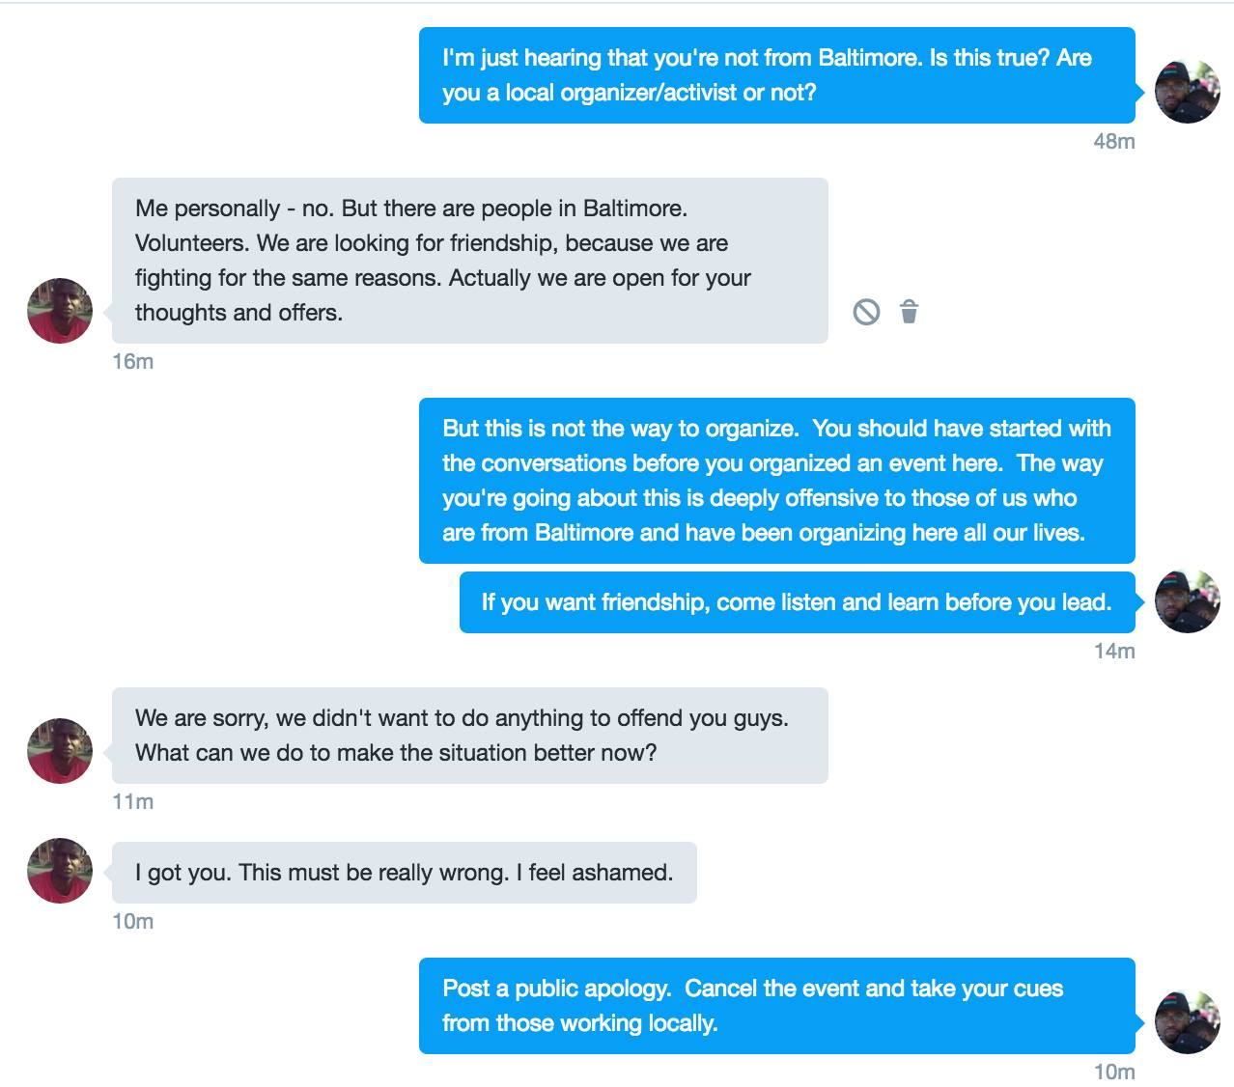
Heber Brown III, pastor and community organizer investigated
https://www.facebook.com/photo.php?fbid=10154097683603610&set=a.423996223609.197367.505488609

Slide 12
Investigations by Facebook and Twitter
“The Blacktivist Facebook account was among the 470 Russian-linked accounts identified by the social media network and disclosed to Congress earlier this month, the sources said. The matching Twitter account was among the roughly 200 accounts Twitter identified with links to those found by Facebook.”
“Facebook shared its findings about the accounts with Twitter, enabling Twitter to identify 22 matching accounts and an additional 179 accounts that linked back to those accounts, the sources said. This matching process went beyond public-facing similarities and included private information that could link the accounts.”
https://money.cnn.com/2017/09/28/media/blacktivist-russia-facebook-twitter/index.html

Slide 13
Facebook Ads and Targeting
CNN reported “that at least one of the Facebook ads bought by Russians during the 2016 presidential campaign referenced Black Lives Matter and was specifically targeted to reach audiences in Ferguson, Missouri and Baltimore, two cities that had gained widespread attention for the large and violent protests over police shootings of black men.”
”All of the ads handed over by Facebook were linked to the Internet Research Agency, a shadowy company that U.S. military intelligence has described as ‘a state-funded organization that blogs and tweets on behalf of the Kremlin.’ A senior Kremlin spokesman said last week that Russia did not buy ads on Facebook to influence the election.”
http://money.cnn.com/2017/09/28/media/blacktivist-russia-facebook-twitter/index.html

Slide 14
DocNow Dataset & Findings

Slide 15
Justin Littman looked for @blacktivists in a tweet collection
Social Feed Manager had a collection of tweets – 2016 U.S. presidential election
250 million tweets collected between July 13 to November 19, 2016
Looked for tweets containing the term Blacktivist
parallel -a source.lst -a dest.lst --xapply "twitter_stream_warc_iter.py {1} | jq -c 'select((.text | test(\"blacktivist\"; \"i\")) or (.user.screen_name | test(\"blacktivist\"; \"i\")))' > {2}"
Justin got 87 matches. Spreadsheet is gone, but his summary says that some of the tweets are probably not directly related to @Blacktivist
However, this Documenting the Now article stated that there only two of the tweets were from @blacktivists. Documenting the Now decided to look for @blacktivists tweets in their own tweet collection.
https://web.archive.org/web/20171003184615/https://gwu-libraries.github.io/sfm-ui/posts/2017-10-03-blacktivist

Slide 16
Foundation for the @blacktivists tweet dataset
The Documenting the Now project had been creating archival collections of social media related to the 2014 protests in Ferguson as well as the larger Black Lives Matter movement.
13,732,829 tweets that used the #blacklivesmatter hashtag between January 2016 and March 2017
Checked to see if the @blacktivists user was in the collection
Found 90 tweets sent by @blacktivists that used the #blacklivesmatter hashtag.
https://docs.google.com/spreadsheets/d/1OZcRCZuz83bMpxVjpUYEALiS4OtKU-pTVtTveG_Ljs0/edit?usp=sharing

Slide 17
@blacktivists Tweets Almost Always Included Media
This article stated that 98% of the tweets included a photo.
The dataset had a way to distinguish photo from video so in my own study, I did separate them.
Includes Photos | Total Tweets | %
81 | 90 | 90%
Includes Video | Total Tweets | %
6 | 90 | 7%

Slide 18
@blacktivists Links in Tweets
https://goo.gl/KiGF7W
https://goo.gl/kLn32c
https://goo.gl/TIilPK
https://goo.gl/9gf7oZ
https://goo.gl/bzKcbq
https://goo.gl/9WvP0G
https://goo.gl/KcCnC7
https://goo.gl/Sl37z8
https://goo.gl/Af5AO6
https://goo.gl/EiRh7X
https://goo.gl/iQMts1
There are 18 links in the dataset.
11 of them used a Google shortener.
7 of them were already expanded.
All of them directed to a suspended and deleted Facebook account with the name Blacktivist.
curl -v https://goo.gl/KiGF7W
…
location: https://www.facebook.com/blacktivists/photos/a.128374344172337.1073741827.128371547505950/290792234597213/?type=3&theater

Slide 19
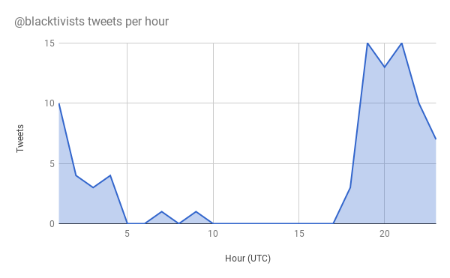
90% of the tweets were sent between 17:00 and 03:00 UTC, or 8PM and 6AM Moscow time.
The timing appears organic rather than bot driven.
Not a bot churning out retweets as there were no retweets in this set of 90.
https://news.docnow.io/blacktivists-in-the-archive-71c807aa247e
Notes:
90% of the tweets were sent between 17:00 and 03:00 UTC, or 8PM and 6AM Moscow time. The timing appears organic rather than bot driven. The user profile metadata in each tweet claims that the user is on Pacific Time. Of course this could be easily faked, but that would translate the time range into 9AM to 7PM PT, which seems a lot more reasonable for a person who likes to sleep during the night. This isn’t your run of the mill bot churning out retweets. In fact there are no retweets in this set of 90. If this is orchestrated from Russia it shows a high degree of sophistication.

Slide 20
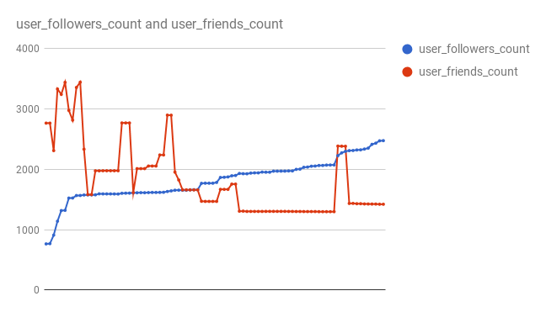
Data included a snapshot of a user’s friend and follower counts at that point in time.
Number of @blacktivists followers is growing over time
Number of users they follow (their friends) is erratic.
Ability to add and remove a thousand followers rapidly like that points to automated behavior.
https://news.docnow.io/blacktivists-in-the-archive-71c807aa247e

Slide 21
Summary
The Facebook and Twitter Blacktivist accounts were setup to increase racial tensions during a U.S. presidential election period.
The Facebook account was very popular even having more likes than the verified Black Lives Matter Facebook account.
The Facebook account publicized events.
Facebook and Twitter shared data to find matching Russian-linked accounts.
Documenting the Now found the tweet time to be organic.
Documenting the Now found the accounts @blacktivists was following to be to erratic to not be automated.

Slide 22
Background Slides

Slide 23
Tweet Length Metrics
Mean | Min | Max
121 | 61 | 139
unit = number of characters
This is before the upgrade to 280 characters in November 2017.

Slide 24
Hashtag Usage – How Many? Most Used?
Unique Hashtags | Most Used
22 | BlackLivesMatter - 90
Because the @Blacktivists dataset was created from a dataset where all tweets had BlackLivesMatter hashtags, it was expected that this would be the most used hashtag in that set.

Slide 25
@Blacktivists Hashtags
Hashtag | Times Used
AllLivesDidntMatter | 1
AltonSterling | 1
BlackLivesMatter | 90
BlackPower | 4
BlackResistanceMarch | 1
BlackUnite | 3
BLM | 1
FreddieGray | 1
JusticeorElse | 1
KorrynGaines | 1
MikeBrown | 1
Hashtag | Times Used
NoJustice | 1
NoJusticeNoPeace | 1
PhilandoCastile | 3
PoliceBrutality | 2
PoliceReform | 5
PoliceReforms | 1
PowerToBlack | 1
SandraBland | 2
SayHerName | 1
shooting | 1
TuesdayMotivation | 1

Slide 26
Includes Links
Includes Links | Total Tweets | %
18 | 90 | 20%
Tweets that included one or more links

Slide 27
Includes Images
Includes Photos | Total Tweets | %
81 | 90 | 90%
Tweets that included one or more photos

Slide 28
Includes Videos
Includes Video | Total Tweets | %
6 | 90 | 7%
Tweets that included one or more videos

Slide 29
Assigning Topics to @Blacktivists Tweets
Near exact title match to a news story = posting a news org story
General statement or lament about being black in America = statement
Even though this was not a real organization, it had 5 tweets that read like an event promotion and got counted as such

Slide 30
Blacktivist Topics
Topic | # of Tweets
consoling a community | 1
court outcome | 6
event promotion | 5
incident anniversary | 7
police violence incident | 5
posting news org story | 5
praising an individual | 1
responding | 1
statement | 59

Slide 31
What are “statements”?
These do not reflect standard organization business – membership, events, promotion, reporting specific incidents, etc. They are also not news stories.
Tweets
Wake up, Black America before this is your father, brother or son. #BlackLivesMatter
Not "All Lives" are being simply killed because of the color of their skin. #BlackLivesMatter
Racism marks certain people as full human, and others as more killable. #BlackLivesMatter
The government always turns a blind eye to what is happening to Blacks, Hispanics and Latinos. #BlackLivesMatter
66% of the @Blacktivists account tweets were like this.

Slide 32
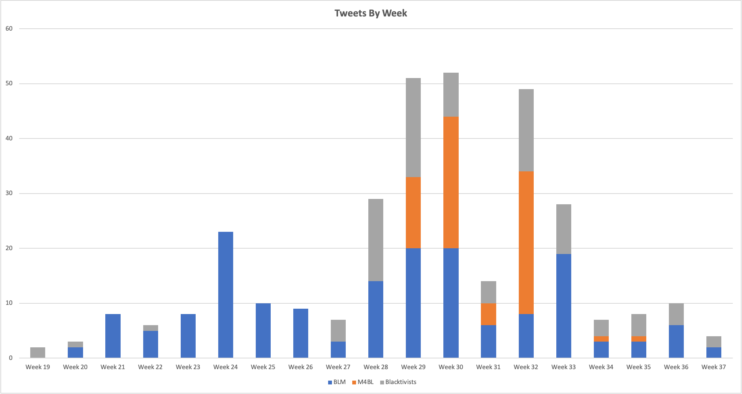

Slide 33
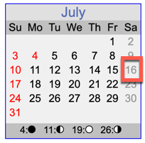
@Blacktivists Hosting Events?
Neither BLM or M4BL had a Sandra Bland event that this account could have taken advantage of.
Did not find a story about this event, but did find an account of them trying to have an April 2016 event in Baltimore that was questioned and discouraged by a community organizer there.
Sun Jul 03 19:50:05 +0000 2016 | Join our rally in a memory of Sandra Bland in Chicago! #BlackLivesMatter #BlackPower
Fri Jul 08 18:50:08 +0000 2016 | Come and support our rally in memory of Sandra Bland! #SandraBland #BlackLivesMatter
Tue Jul 12 19:15:06 +0000 2016 | Now the time has to come for you to join us this Saturday! #BlackLivesMatter
Wed Jul 13 17:50:05 +0000 2016 | Come and join our protest in a memory of Sandra Bland this Saturday. #BlackLivesMatter
Thu Jul 21 22:12:04 +0000 2016 | Thanks guys for joining our rally in a memory of Sandra Bland last Saturday. #BlackLivesMatter #SayHerName
https://www.theguardian.com/technology/2017/sep/30/blacktivist-facebook-account-russia-us-election

Slide 34
@Blacktivists Posting News Stories
@Blacktivists posted 5 news stories, which would be normal for real organization account. I counted them as news stories only if I found a near exact title match when searching.
BLM and M4BL did not post these same news articles.
NYPD OFFICER WILL NOT ABIDE BY THE “UNLAWFUL” ORDER TO RESIGN #BlackLivesMatter
OFF-DUTY COP FATALLY SHOT BLACK MAN AFTER ALLEGED ROAD RAGE ATTACK #BlackLivesMatter
POLICE OFFICER POINTS ASSAULT WEAPON AT HUFFPOST REPORTER AND PROTESTERS #BlackLivesMatter
Black man is a moving target and this is a horrifying fact. #BlackLivesMatter
Police pulled over #BlackLivesMatter activist Mercutio Southall for picking up garbage.

