Slide 1
Black Lives in the Twitterverse
Valentina Neblitt-Jones
CS 895 Web Archiving Forensics – Fall 2020
November 19, 2020
vneblitt@gmail.com

Slide 2
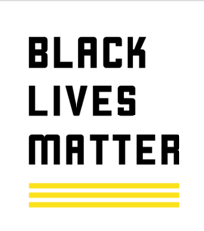

How is a fake black lives movement account different from a real movement’s account?
A fake Twitter account (@Blacktivists) created and operated by the Russian government had been partially captured by the Document the Now project.
After looking the tweets, I decided to compare them to the actual Black Lives Matter organization along with another black lives movement.
https://news.docnow.io/blacktivists-in-the-archive-71c807aa247e

Slide 3
Characteristics of the Datasets
Date range was determined by the @Blacktivists dataset
May 5, 2016 through September 8, 2016
@Blklivesmatter (Black Lives Matter BLM) – 169 tweets
@Mvmnt4BlkLives (Movement 4 Black Lives M4BL) – 69 tweets
@Blacktivists – 90 tweets [sock puppet account]

Slide 4
Acquiring the Datasets
https://github.com/twintproject/twint
For @Blklivesmatter
twint -u Blklivesmatter --since 2016-05-06 --until 2016-09-08 --csv --hashtags --count --stats -o blmfeed.csv
For @Mvmnt4BlkLives
twint -u Mvmnt4BlkLives --since 2016-05-06 --until 2016-09-08 --csv --hashtags --count --stats -o m4blfeed.csv
For @Blacktivists [sock puppet account]
Used a dataset provided by the Documenting the Now project’s Blacktivists in the Archive report https://docs.google.com/spreadsheets/d/1OZcRCZuz83bMpxVjpUYEALiS4OtKU-pTVtTveG_Ljs0/edit?usp=sharing

Slide 5
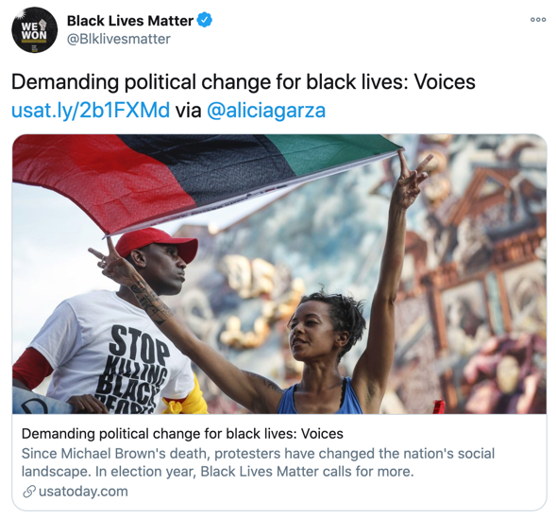
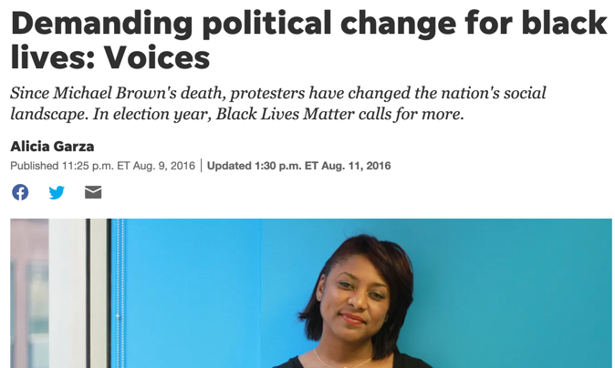
Assigning the Tweet Topics
Extremely manual; easier with the active accounts than the deleted account
Required much digging and research to figure out the topic of the tweets
One topic per tweet → 34 total topics created
twint output
Demanding political change for black lives: Voices https://t.co/f60mjT7AKb via @aliciagarza
1
2
3
Link to posted story
4
Topic =
org media coverage
Actual tweet
https://twitter.com/Blklivesmatter/status/763466661529788416

Slide 6
Timeline of Events/Victims
Date | Event/Victim
1955-08-28 | Emmitt Till
2005-08-23 | Hurricane Katrina
2012-07-06 | Stephanie Hicks
2014-07-17 | Eric Garner
2014-08-09 | Michael Brown [Ferguson Incident]
2014-08-19 | Kajieme Powell [Ferguson Incident]
2015-06-17 | Charleston church shooting
2015-07-13 | Sandra Bland
2016-06-22 | Essence Bowman
2016-07-04 | Delrawn Small
2016-07-05 | Alton Sterling
2016-07-06 | Philando Castile
2016-07-18 | Charles Kinsey
2016-08-01 | Korryn Gaines
Criteria:
Mentioned in the tweets
Had an anniversary during the dataset time period
Incident occurred during the dataset time period (bolded)

Slide 7
Black Lives Matter (BLM)
@Blklivesmatter

Slide 8
Black Lives Matter (BLM)
Established in 2013
Global organization – U.S., United Kingdom, and Canada
Eradicate white supremacy
Black Lives Matter (BLM)
https://blacklivesmatter.com/
Twitter: https://twitter.com/Blklivesmatter
@Blklivesmatter
21,200 tweets as of 11/2/2020
Joined Twitter July 2013

Slide 9
@Blklivesmatter Topics
Topic | # of Tweets
org blog post | 6
org media coverage | 10
partnerships | 1
police violence incident | 6
posting new org story | 8
praising an individual | 3
promoting chapters | 10
protesting court outcome | 26
questioning the community | 3
refuting a story | 2
responding | 5
statement | 1
supporting a cause | 14
supporting an event | 1
supporting an exhibit | 1
supporting an organization | 18
Topic | # of Tweets
being supported | 1
blocking a person | 2
call to action | 2
condemning an organization | 1
consoling a community | 5
court outcome | 10
event anniversary | 3
event participation | 4
event promotion | 5
fundraising | 2
incident anniversary | 14
membership drive | 1
mentioning an individual | 1
message to twitter | 1

Slide 10
Movement 4 Black Lives (M4BL)
@Mvmnt4BlkLives

Slide 11
Movement 4 Black Lives (M4BL)
Established in December 2014
Coordinate Black organizations across the U.S. to assess strategy to achieve equality and fairness
https://m4bl.org/
Twitter: https://twitter.com/Mvmnt4BlkLives
@Mvmnt4BlkLives
4,533 tweets as of 11/2/2020
Joined Twitter May 2015

Slide 12
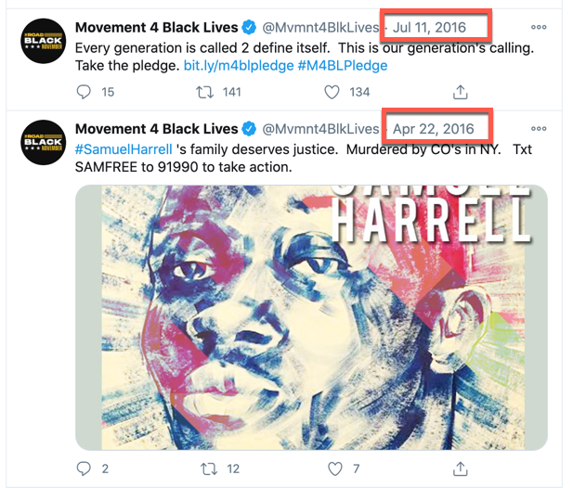
Tweet Gap for @Mvmnt4BlkLives
This dataset is smaller and there appears to be a gap from April 23, 2016 through July 10, 2016.
Twitter search
(from:Mvmnt4BlkLives) until:2016-07-12 since:2016-04-22
curl "http://web.archive.org/cdx/search/cdx?matchType=prefix&url=https://twitter.com/mvmnt4blklives" > output-cdx-m4bl.txt
awk '{print $2}' output-cdx-m4bl.txt | sort | less
No captures before 2019

Slide 13
@Mvmnt4BlkLives Topics
Topic | # of Tweets
being supported | 2
call to action | 6
event anniversary | 3
event promotion | 17
event reporting | 12
mentioning an individual | 2
org promotion | 1
police violence incident | 3
policy document | 4
praising an individual | 3
responding | 1
supporting a cause | 1
supporting an organization | 1
survey chat | 13

Slide 14
Blacktivist
@Blacktivists
Sock puppet account

Slide 15
Assigning Topics to @Blacktivists Tweets
Near exact title match to a news story = posting a news org story
General statement or lament about being black in America = statement
Even though this was not a real organization, it had 5 tweets that read like an event promotion and got counted as such

Slide 16
Blacktivist Topics
Topic | # of Tweets
consoling a community | 1
court outcome | 6
event promotion | 5
incident anniversary | 7
police violence incident | 5
posting news org story | 5
praising an individual | 1
responding | 1
statement | 59

Slide 17
@Blacktivists Links in Tweets
https://goo.gl/KiGF7W
https://goo.gl/kLn32c
https://goo.gl/TIilPK
https://goo.gl/9gf7oZ
https://goo.gl/bzKcbq
https://goo.gl/9WvP0G
https://goo.gl/KcCnC7
https://goo.gl/Sl37z8
https://goo.gl/Af5AO6
https://goo.gl/EiRh7X
https://goo.gl/iQMts1
There are 18 links in the dataset.
11 of them used a Google shortener.
7 of them were already expanded.
All of them directed to a suspended and deleted Facebook account which was also operated by the Russian government.
curl -v https://goo.gl/KiGF7W
…
location: https://www.facebook.com/blacktivists/photos/a.128374344172337.1073741827.128371547505950/290792234597213/?type=3&theater

Slide 18
Were any of them archived? No.
Used memgator to look for the links in the tweets
docker container run -it --rm oduwsdl/memgator "https://www.facebook.com/blacktivists/videos/295593284117108/"
https://github.com/oduwsdl/MemGator
Used CDX to look for the links in the tweets in 2016
curl "http://web.archive.org/cdx/search/cdx?matchType=prefix&url=https://www.facebook.com/blacktivists"
https://github.com/internetarchive/wayback

Slide 19
Metrics

Slide 20
Total Number of Tweets
Twitter Account | # of Tweets
Black Lives Matter @Blklivesmatter | 169
Movement 4 Black Lives @Mvmnt4BlkLives | 69
Blacktivist @Blacktivists | 90

Slide 21
Tweet Length Metrics
Twitter Account | Mean | Min | Max
Black Lives Matter @Blklivesmatter | 98 | 11 | 157
Movement 4 Black Lives @Mvmnt4BlkLives | 111 | 31 | 146
Blacktivist @Blacktivists | 121 | 61 | 139
unit = number of characters
This is before the upgrade to 280 characters in November 2017.

Slide 22
Hashtag Usage – How Many? Most Used?
Twitter Account | Unique Hashtags | Most Used
Black Lives Matter @Blklivesmatter | 47 | blacklivesmatter - 40
Movement 4 Black Lives @Mvmnt4BlkLives | 8 | vision4blacklives - 23
Blacktivist @Blacktivists | 22 | BlackLivesMatter - 90
Because the @Blacktivists dataset was created from a dataset where all tweets had BlackLivesMatter hashtags, it was expected that this would be the most used hashtag in that set.
However, during that same time period, neither BLM nor M4BL used the hashtag even close to that amount.

Slide 23
BLM Hashtags
Hashtag | Times Used
dakar | 1
dayofrage | 1
ezellford | 1
firebeck | 2
freedomnow | 18
freejasmine | 29
freepalestine | 1
hurricanekatrina | 2
jamarclark | 1
kajiemepowell | 1
m4blpledge | 1
mikebrown | 8
mikebrownforever | 2
minnesotalynx | 1
neverforget | 1
nice | 1
Hashtag | Times Used
noprideinpolicing | 1
orlando | 1
policeoutofpride | 4
politicon2016 | 1
regginajefferies | 1
reinventca | 4
sandrabland | 1
sayhername | 12
shutdown | 1
staywokebet | 1
takebackyourstreetsdc | 1
thankyoumsjanetta | 1
trustblackwomen | 1
weaintforget | 1
weeverywhere | 1
wellnesswed | 1
Hashtag | Times Used
23ways | 1
allafricans | 1
allysonfelix | 1
altonsterling | 3
batonrouge | 1
bbw16 | 1
blackgirlmagic | 1
blacklivematter | 1
blacklivesmatter | 40
blacklivesstillmatter | 1
blackpower50 | 1
blacktranslivesmatter | 2
blm | 2
charleskinsey | 1
charleston | 1

Slide 24
M4BL Hashtags
Hashtag | # of Times Used
freedomnow | 21
ilovebeingblack | 1
korryngaines | 3
m4bl | 7
m4blpledge | 4
safetyis | 2
sayhername | 1
vision4blacklives | 23

Slide 25
@Blacktivists Hashtags
Hashtag | Times Used
AllLivesDidntMatter | 1
AltonSterling | 1
BlackLivesMatter | 90
BlackPower | 4
BlackResistanceMarch | 1
BlackUnite | 3
BLM | 1
FreddieGray | 1
JusticeorElse | 1
KorrynGaines | 1
MikeBrown | 1
Hashtag | Times Used
NoJustice | 1
NoJusticeNoPeace | 1
PhilandoCastile | 3
PoliceBrutality | 2
PoliceReform | 5
PoliceReforms | 1
PowerToBlack | 1
SandraBland | 2
SayHerName | 1
shooting | 1
TuesdayMotivation | 1

Slide 26
Includes Links
Twitter Account | Includes Links | Total Tweets | %
Black Lives Matter @Blklivesmatter | 91 | 169 | 54%
Movement 4 Black Lives @Mvmnt4BlkLives | 44 | 69 | 64%
Blacktivist @Blacktivists | 18 | 90 | 20%
Tweets that included one or more links

Slide 27
Includes Images
Twitter Account | Includes Photos | Total Tweets | %
Black Lives Matter @Blklivesmatter | 35 | 169 | 21%
Movement 4 Black Lives @Mvmnt4BlkLives | 25 | 69 | 36%
Blacktivist @Blacktivists | 81 | 90 | 90%
Tweets that included one or more photos

Slide 28
Includes Videos
Twitter Account | Includes Video | Total Tweets | %
Black Lives Matter @Blklivesmatter | 43 | 169 | 25%
Movement 4 Black Lives @Mvmnt4BlkLives | 28 | 69 | 41%
Blacktivist @Blacktivists | 6 | 90 | 7%
Tweets that included one or more videos

Slide 29
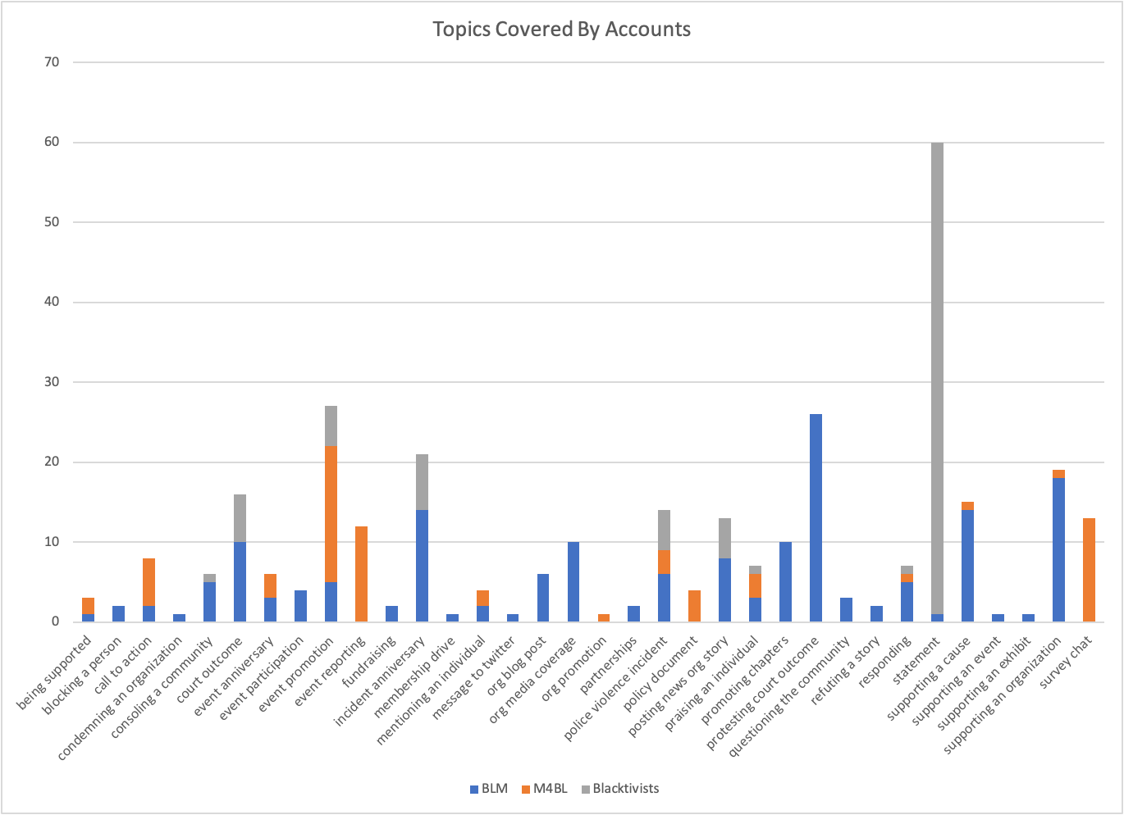

Slide 30
Metrics Summary
@Blacktivists tweets were on average longer.
@Blklivesmatter had the highest number of unique hashtags.
@Blacktivists had the lowest percentage of links.
@Blacktivists had the highest percentage of images.
@Blacktivists had the lowest percentage of videos.
66% of @Blacktivists tweets were general statements and/or laments.

Slide 31
What are “statements”?
These do not reflect standard organization business – membership, events, promotion, reporting specific incidents, etc. They are also not news stories.
There was only one of these that I could find outside of the @Blacktivists account.
Tweets
Wake up, Black America before this is your father, brother or son. #BlackLivesMatter
Not "All Lives" are being simply killed because of the color of their skin. #BlackLivesMatter
Racism marks certain people as full human, and others as more killable. #BlackLivesMatter
The government always turns a blind eye to what is happening to Blacks, Hispanics and Latinos. #BlackLivesMatter
66% of the @Blacktivists account tweets were like this.

Slide 32
@Blacktivists Motivation
Occurred during the 2016 election campaign period
“Both Blacktivist accounts, each of which used the handle Blacktivists, regularly shared content intended to stoke outrage. "Black people should wake up as soon as possible," one post on the Twitter account read. "Black families are divided and destroyed by mass incarceration and death of black men," another read. The accounts also posted videos of police violence against African Americans.”
“The Blacktivist accounts provide further evidence that Russian-linked social media accounts saw racial tensions as something to be exploited in order to achieve the broader Russian goal of dividing Americans and creating chaos in U.S. politics during a campaign in which race repeatedly became an issue.”
Exclusive: Fake black activist accounts linked to Russian government
https://money.cnn.com/2017/09/28/media/blacktivist-russia-facebook-twitter/index.html

Slide 33
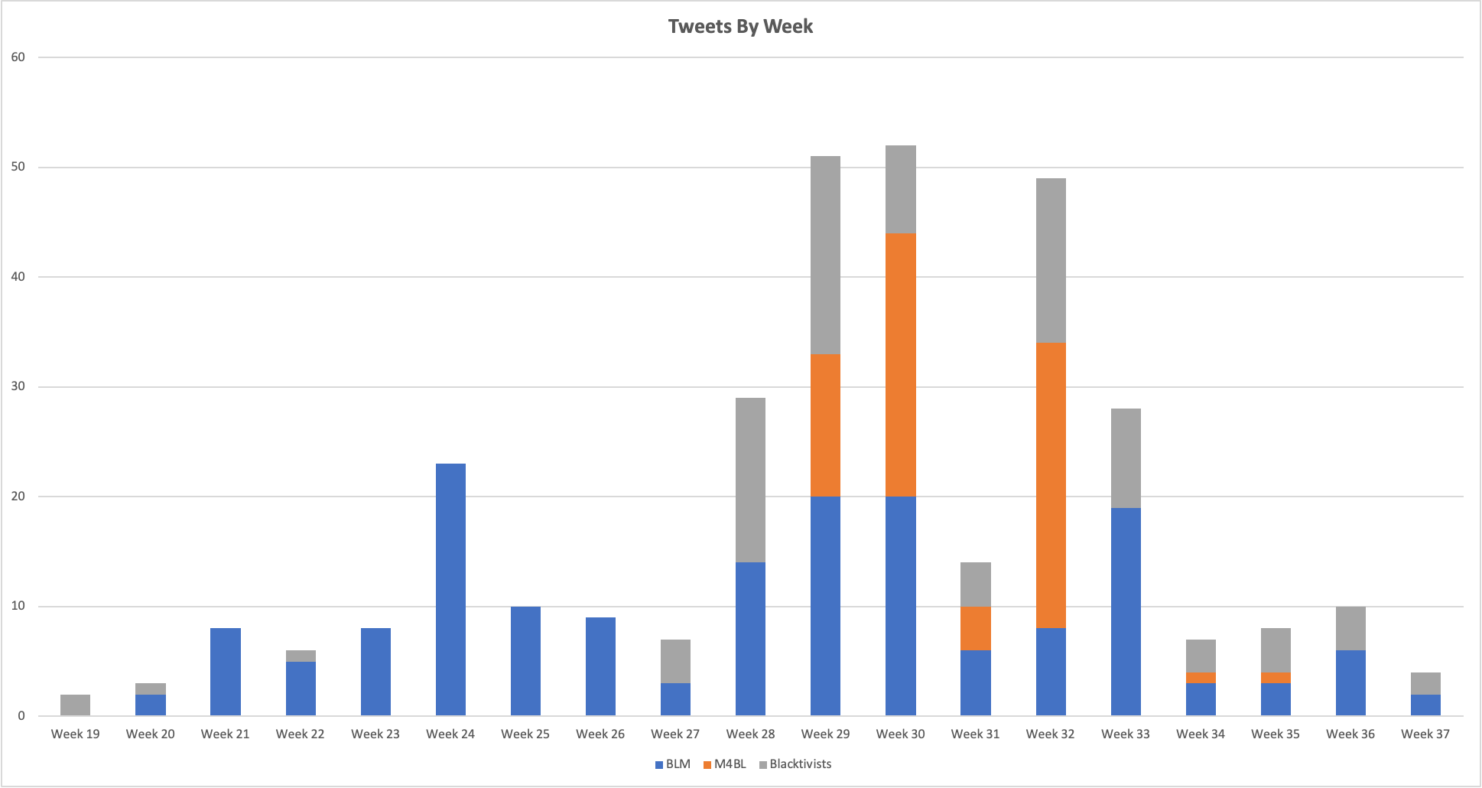

Slide 34
The Busy Weeks: Week 28 – Week 33
Otherwise known as July 4 – August 14, 2016
New police violence incidents – Delrawn Small, Alton Sterling, Philando Castile, Charles Kinsey, Korryn Gaines
Incident anniversaries – Stephanie Hicks, Eric Garner, Michael Brown [Ferguson], Sandra Bland
Movement for Black Lives Events
FreedomNow – nationwide two-day event to protest the police
BLM chapters participated in FreedomNow
Vision4BlackLives – twitter chat town hall to develop this policy document/platform

Slide 35
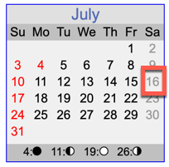
@Blacktivists Hosting Events?
Neither BLM or M4BL had a Sandra Bland event that this account could have taken advantage of.
Did not find a story about this event, but did find an account of them trying to have an April 2016 event in Baltimore that was questioned and discouraged by a community organizer there.
Sun Jul 03 19:50:05 +0000 2016 | Join our rally in a memory of Sandra Bland in Chicago! #BlackLivesMatter #BlackPower
Fri Jul 08 18:50:08 +0000 2016 | Come and support our rally in memory of Sandra Bland! #SandraBland #BlackLivesMatter
Tue Jul 12 19:15:06 +0000 2016 | Now the time has to come for you to join us this Saturday! #BlackLivesMatter
Wed Jul 13 17:50:05 +0000 2016 | Come and join our protest in a memory of Sandra Bland this Saturday. #BlackLivesMatter
Thu Jul 21 22:12:04 +0000 2016 | Thanks guys for joining our rally in a memory of Sandra Bland last Saturday. #BlackLivesMatter #SayHerName
https://www.theguardian.com/technology/2017/sep/30/blacktivist-facebook-account-russia-us-election

Slide 36
@Blacktivists Posting News Stories
@Blacktivists posted 5 news stories, which would be normal for real organization account. I counted them as news stories only if I found a near exact title match when searching.
BLM and M4BL did not post these same news articles.
NYPD OFFICER WILL NOT ABIDE BY THE “UNLAWFUL” ORDER TO RESIGN #BlackLivesMatter
OFF-DUTY COP FATALLY SHOT BLACK MAN AFTER ALLEGED ROAD RAGE ATTACK #BlackLivesMatter
POLICE OFFICER POINTS ASSAULT WEAPON AT HUFFPOST REPORTER AND PROTESTERS #BlackLivesMatter
Black man is a moving target and this is a horrifying fact. #BlackLivesMatter
Police pulled over #BlackLivesMatter activist Mercutio Southall for picking up garbage.

Slide 37
Summary
Real accounts have tweets about membership, chapters, events, reporting incidents, commemorating lost lives, media coverage, etc.
Black Lives Matter (BLM) had the widest range of topics.
Fake accounts rely on statements to stoke emotion – mostly outrage. This accounts for 66% of @Blacktivists tweets.
@Blacktivists had the lowest percentage of links, highest percentage of images, and lowest percentage of videos.
@Blacktivists was setup to stir up racial tensions especially since it was a presidential election year.

