Slide 1






Examining Twitter’s policy against election-related misinformation in action
By Kate Starbird and Carly Miller
Presented By:
Himarsha R Jayanetti
PhD Student
Department of Computer Science
Old Dominion University, Norfolk, Virginia
@HimarshaJ @WebSciDL
Created as a course requirement for CS895 Web Archiving Forensics (by Dr. Michael Nelson), Fall 2020

Slide 2
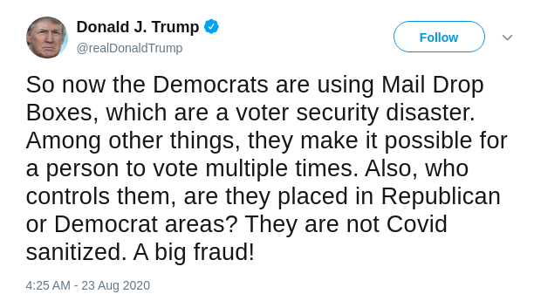
President Trump tweets misleading information!
https://twitter.com/realDonaldTrump/status/1297495295266357248

Slide 3
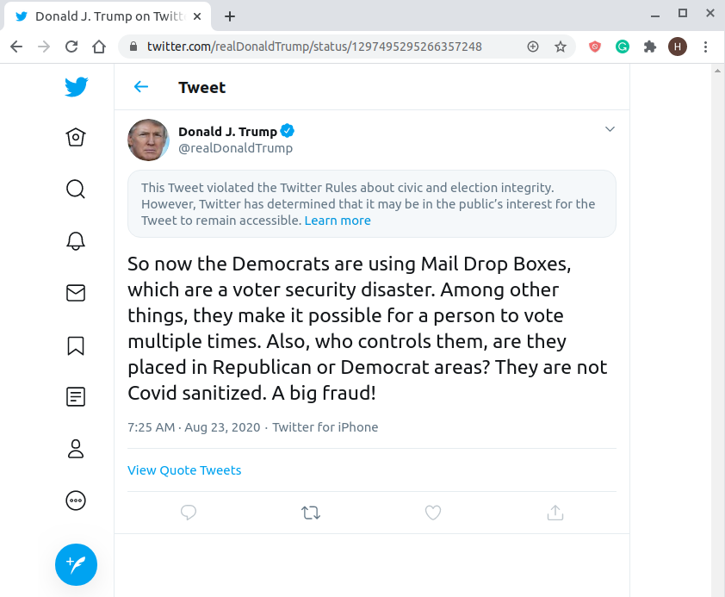
Twitter taking action
A few hours after Trump posting the tweet, Twitter adds a label to this tweet as the tweet violated their civic and election integrity policy.
To reduce the engagement with this tweet, Twitter also disabled retweets, likes, and replies.
The platform decided not to remove the tweet from Twitter under their public-interest exception.
Twitter ‘s disclaimer
https://twitter.com/realDonaldTrump/status/1297495295266357248

Slide 4
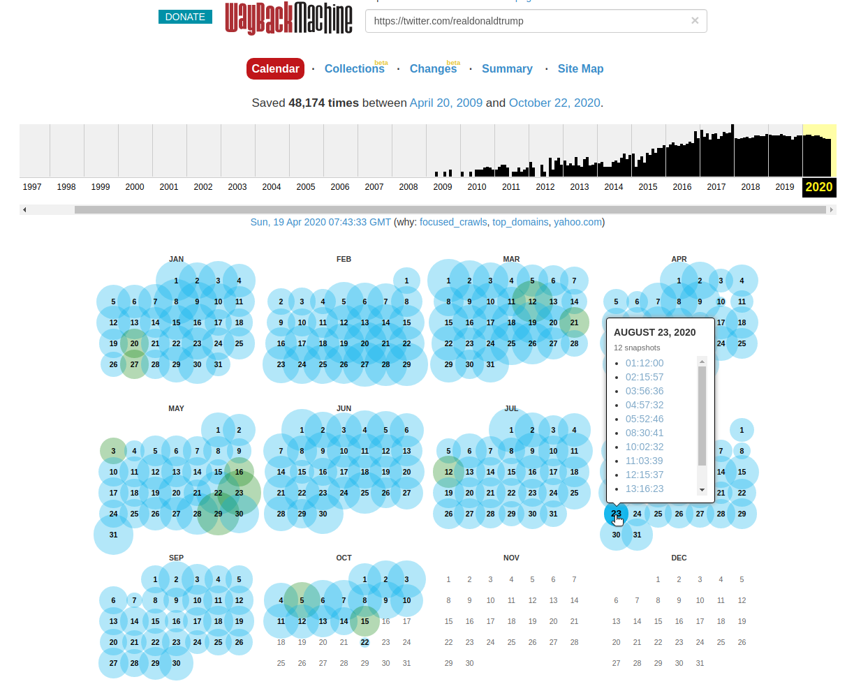
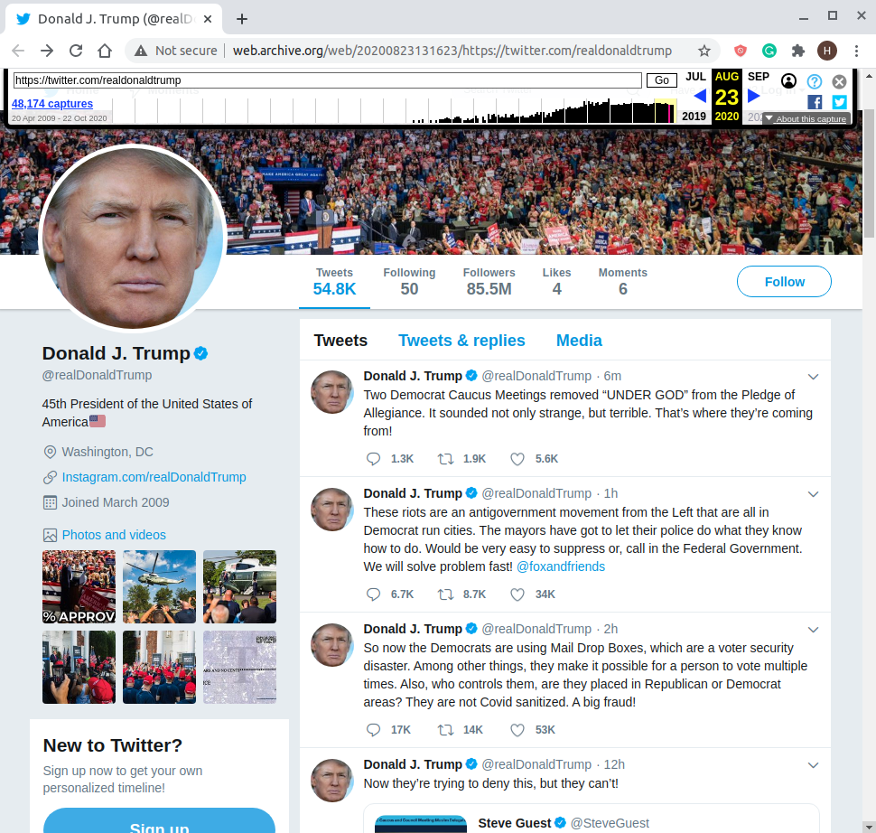
A memento of @realDonaldTrump’s Twitter account in Internet Archive included this tweet
http://web.archive.org/web/20200823131623/https://twitter.com/realdonaldtrump
http://web.archive.org/web/*/https://twitter.com/realdonaldtrump

Slide 5
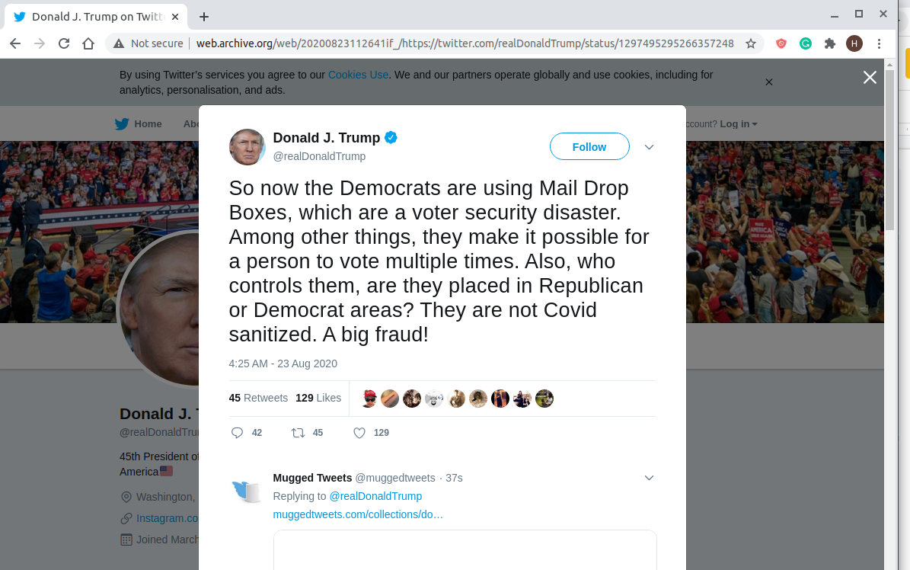
The individual tweet is archived in Internet Archive
Prior to Twitter enabling the disclaimer
Number of likes, replies, and retweets are displayed
http://web.archive.org/web/20200823112641if_/https://twitter.com/realDonaldTrump/status/1297495295266357248

Slide 6
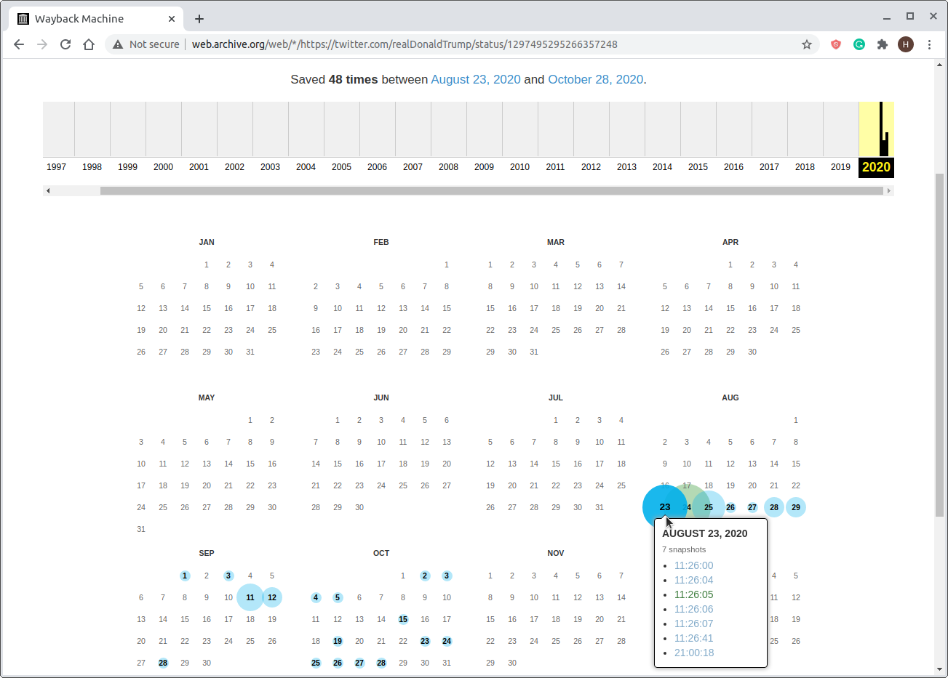
TimeMap for the individual tweet
The mementos for this tweet are of two kinds. For example, on 2020-08-23 the memento count distribution across the two kinds are as follows:
Twitter’s old UI - 2
Twitter’s new UI - 4
Redirect - 1
All new UI copies have the disclaimer on it.
http://web.archive.org/web/*/https://twitter.com/realDonaldTrump/status/1297495295266357248

Slide 7
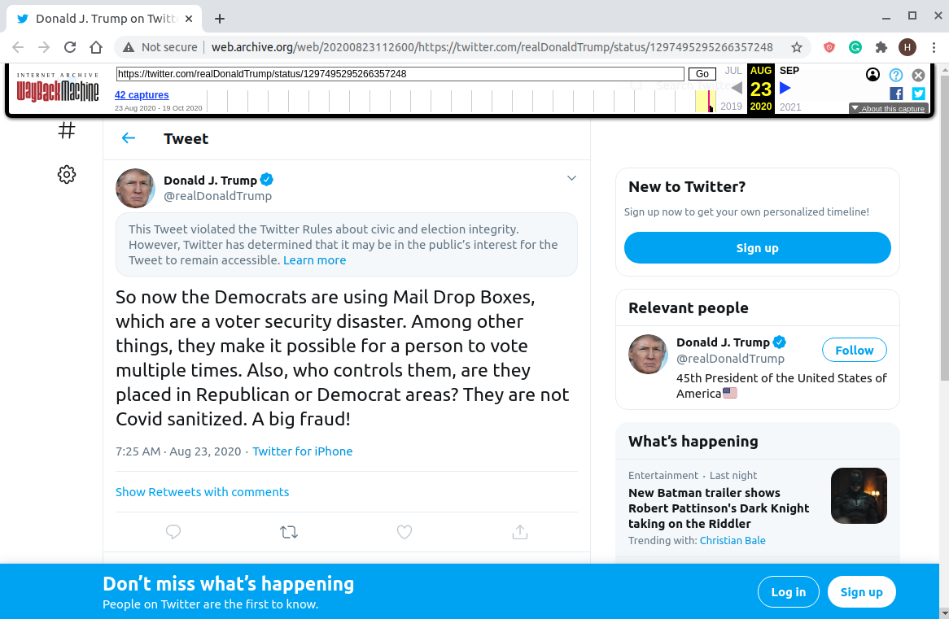
A new UI memento of the tweet with the disclaimer
http://web.archive.org/web/20200823112600/https://twitter.com/realDonaldTrump/status/1297495295266357248

Slide 8
Dataset
Data (retweets, quote tweets, and retweets of the quote tweet) was collected from Twitter in real-time using their public APIs between the time it was tweeted and the time of this analysis (Aug. 25 1:15 UTC).
Distribution:
24,721 retweets of the original Trump tweet.
13,754 quote tweets (retweets with comment) of the original tweet.
72,779 retweets of the quote tweets of the original tweet.

Slide 9
Effect of the platform’s response
Twitter disabled retweets, likes, and replies but their policy of action does not include quote tweets.
The analysis breaks down how each of the below actions responds to the spread of this misleading tweet.
Retweets were disabled for the original tweet.
It was allowed to quote tweet the original tweet.
Retweets of quote tweets were possible.
Notes:
Temporary feature change - Now retweet is simple quote tweet without actually writing any text. Same number of clicks for a simple retweet. https://twitter.com/Twitter/status/1318900658217648128

Slide 10
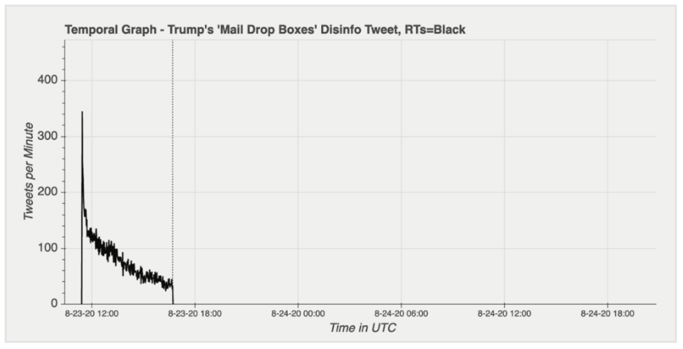
Retweets of the original tweet
Twitter’s action went into effect
16:42 UTC
Trump posted the tweet
11:25 UTC
https://www.eipartnership.net/policy-analysis/twitters-policy-election-misinfo-in-action

Slide 11
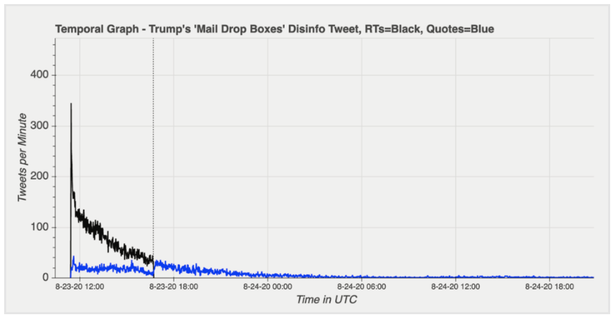
Retweets seem to be replaced by quote tweets
Twitter’s action went into effect
16:42 UTC
Retweets
Quote tweets
Trump posted the tweet 11:25 UTC
https://www.eipartnership.net/policy-analysis/twitters-policy-election-misinfo-in-action

Slide 12
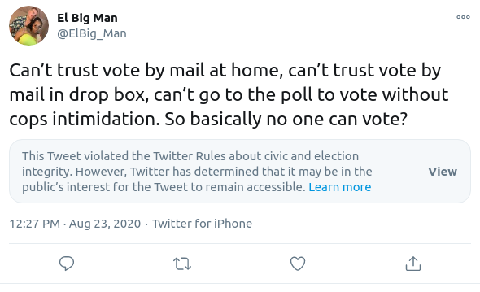
Content of quote tweets were primarily critical of Trump’s tweet
https://twitter.com/ElBig_Man/status/1297571135131803648

Slide 13
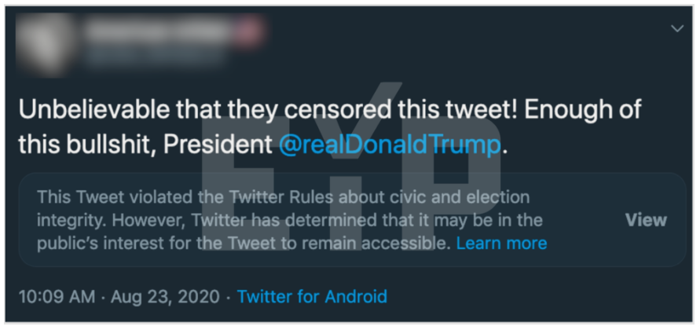
Surge in quote tweets echoing the original sentiment of Trump’s tweet after Twitter taking action
https://www.eipartnership.net/policy-analysis/twitters-policy-election-misinfo-in-action

Slide 14
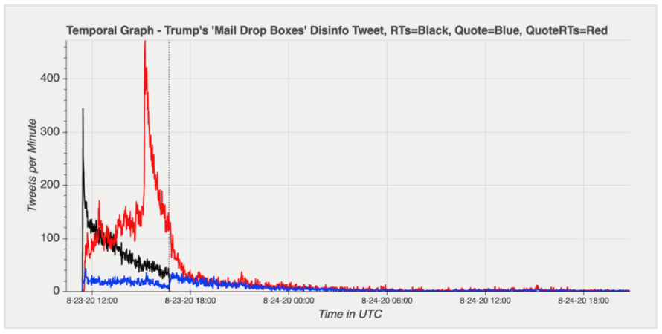
Retweets of Quote Tweets
Retweets
Quote tweets
Retweets of quote tweets
Twitter’s action went into effect
16:42 UTC
Trump posted the tweet 11:25 UTC
https://www.eipartnership.net/policy-analysis/twitters-policy-election-misinfo-in-action

Slide 15
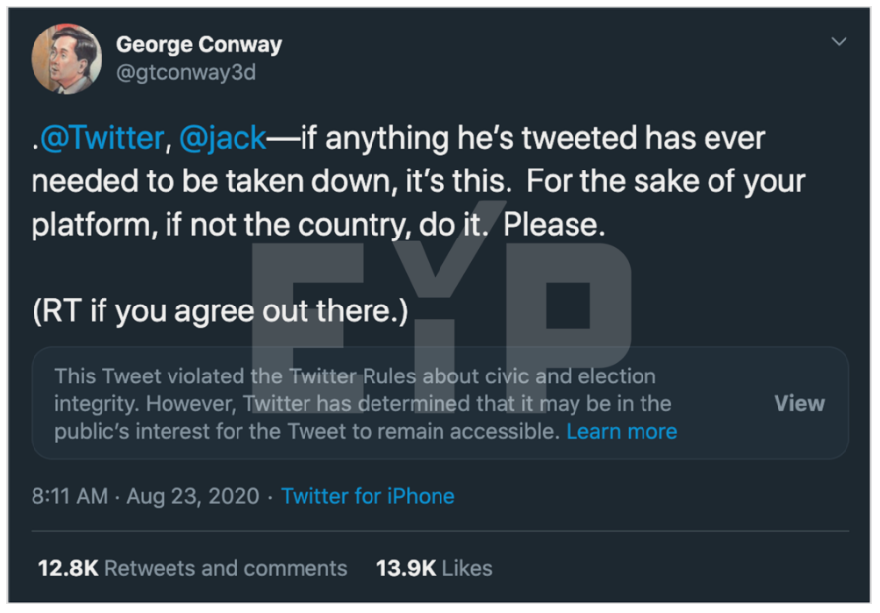
Several of the highly retweeted quote tweets were authored by political pundit George Conway
https://www.eipartnership.net/policy-analysis/twitters-policy-election-misinfo-in-action

Slide 16
The tweet rate for those predominantly critical quote tweets falls off rapidly after its peak
Retweets
Quote tweets
Retweets of quote tweets
https://www.eipartnership.net/policy-analysis/twitters-policy-election-misinfo-in-action

Slide 17
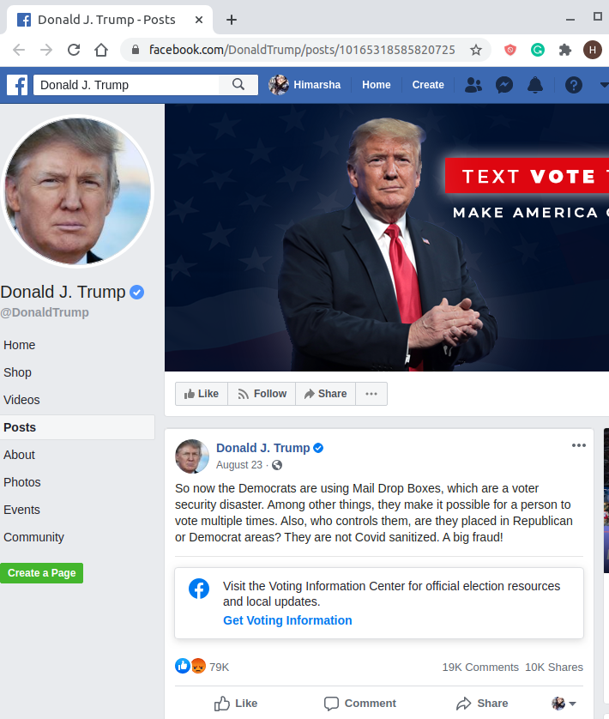
What did Facebook do?
President posted the same content on his Facebook profile.
Facebook did not take any additional action to stop the spread of the post like Twitter did.
What Facebook did was to apply a link to get voting information which is something they apply to all posts on voting in the US and Facebook.
https://about.fb.com/news/2020/08/launching-voting-information-center/
https://www.facebook.com/DonaldTrump/posts/10165318585820725

Slide 18
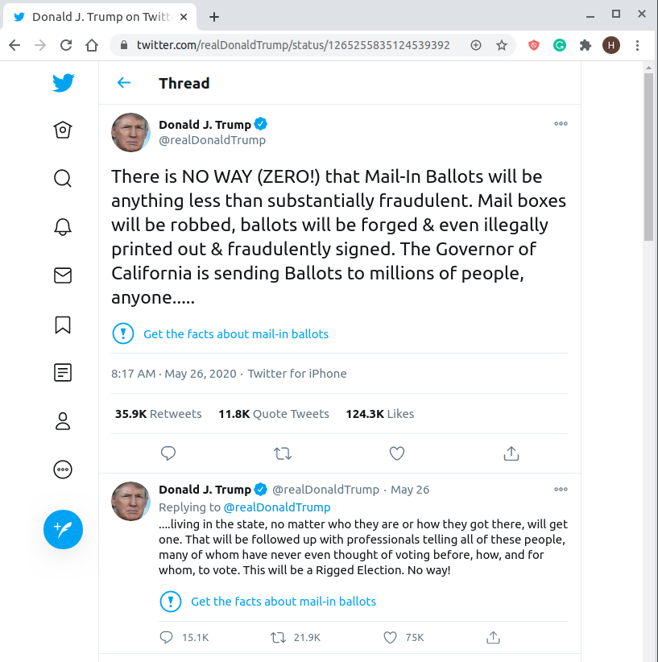
Policy Analysis — Twitter’s Civic integrity policy
Earlier on May 26, 2020, Donald Trump had tweeted about misleading information that would confuse the voters.
The tweet thread was only fact checked and labeled. But the spread of those tweets through engagement was not disabled.
https://twitter.com/realDonaldTrump/status/1265255835124539392
Notes:
https://blog.twitter.com/en_us/topics/company/2020/2020-election-changes.html

Slide 19
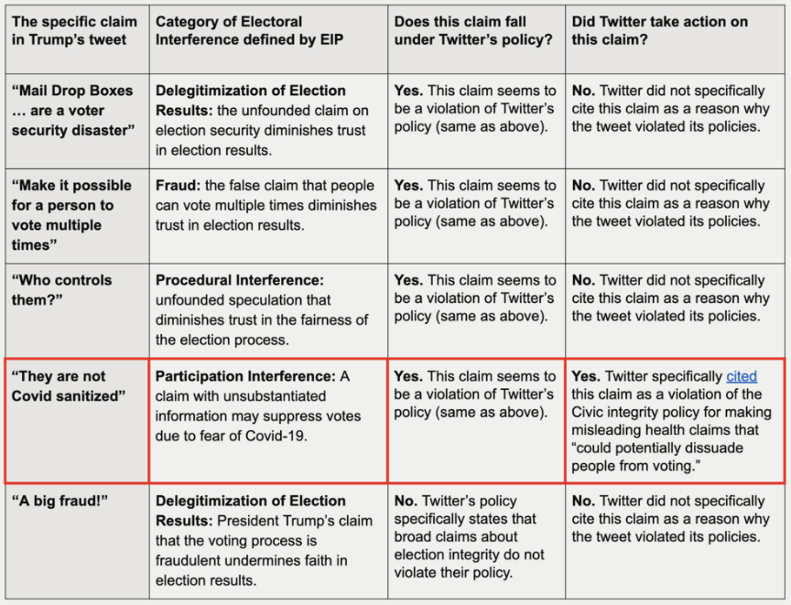
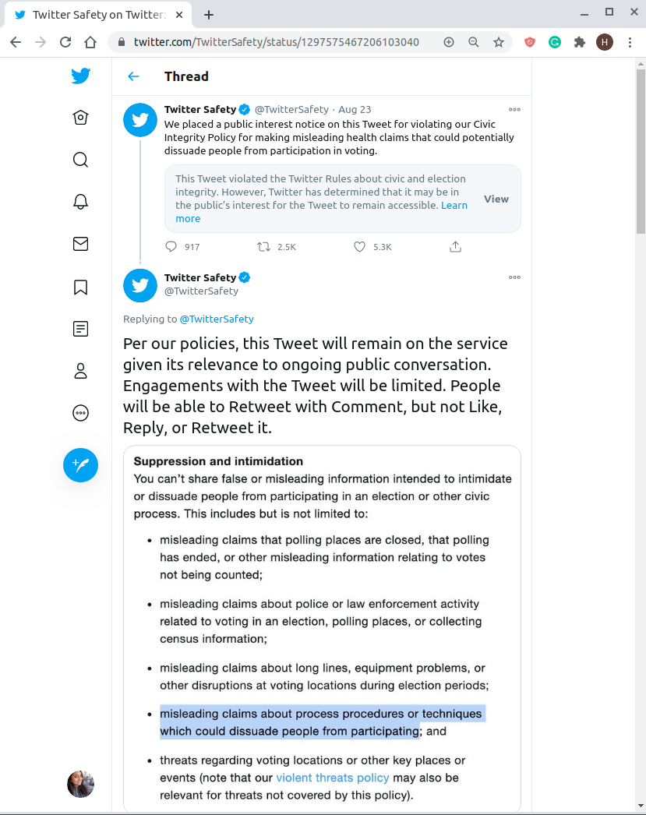
Measuring Trump’s tweet against Twitter’s policy
https://www.eipartnership.net/policy-analysis/twitters-policy-election-misinfo-in-action
https://twitter.com/TwitterSafety/status/1297575466061053957
Notes:
EIP:
https://www.eipartnership.net/policy-analysis/platform-policies

Slide 20
Key Takeaways:
Twitter took action on President Trump’s tweet by disabling retweets. Even though the spread of the tweet through retweets came to an end, Trump’s supporters shifted from simply retweeting to quote tweeting.
Quote tweets prior to Twitter’s action were largely critical of his tweet (and encouraging Twitter to take action), while quote tweets after Twitter took action were in support of the president’s original tweet (and criticized Twitter for taking action).
Social media platforms must act promptly to enforce their policies if they want to make an impact on the spread of election-related mis- and disinformation as the majority of the damage had likely already occured with the spread of this tweet prior to Twitter taking any action on it.

