Slide 1

Pull Request Automation in Azure Devops
-- Hima Sivani bathula

Slide 2
There are 2 ways to Automate Pull Request Set up Branching policies for pull Request automation Adding a Create pull Request Task in CI pipeline

Slide 3
Set up Branch policies for PR Automate​
1. Go to project settings and open repositories
2. select your Repository
3. click on policies of repository
4. Select for which branch you want to create policy
5. Go to Build validation and
6. add policy for The build is success your updated code is automatically merged to master branch
7. whenever you run the pipeline the build success your code has been merged to master branch

Slide 4
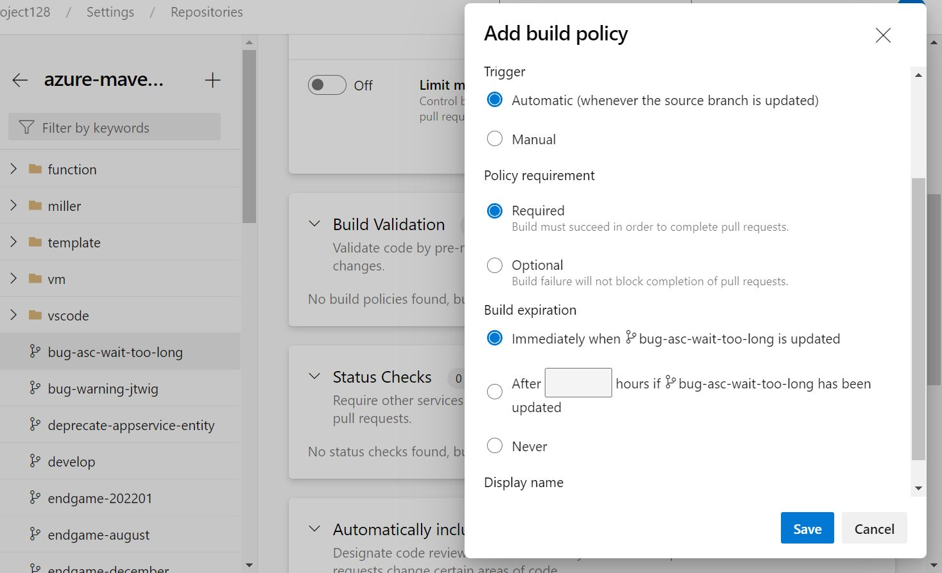
Add policy for PR or updated code merge

Slide 5
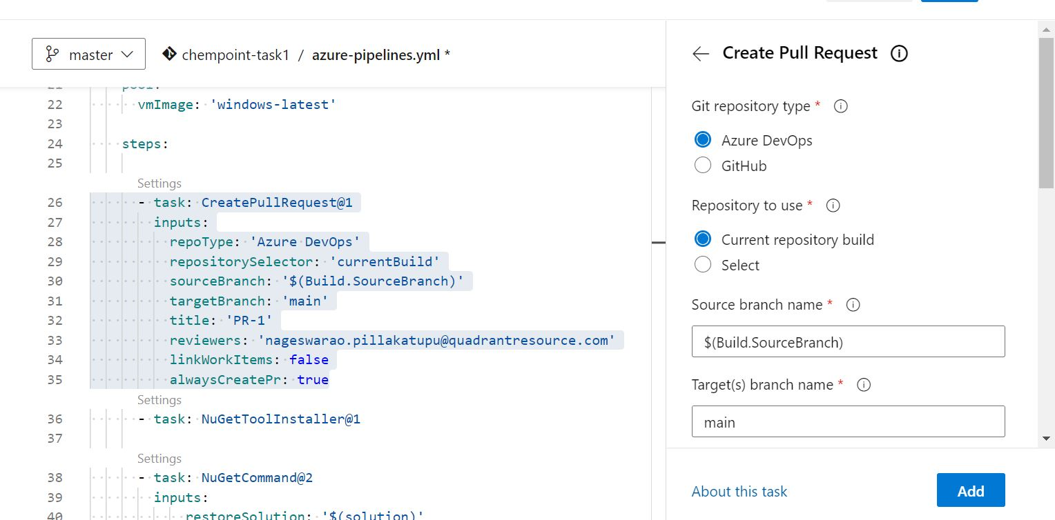
Adding Pull Request task in CI pipeline

