Slide 1
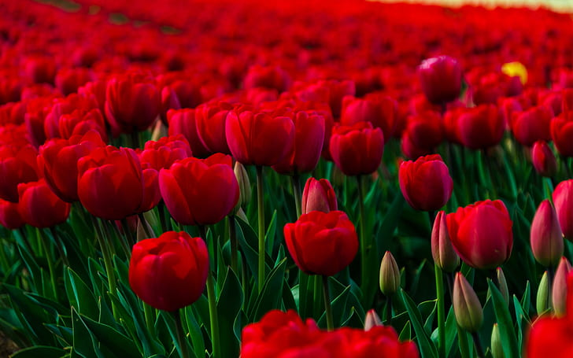
Summer Internship
Vadlamudi Himatha Sree
190031670

Slide 2
Today's Agenda
About Organization
Project Title
Technical Learning
Collaborative Learning
Tools Learnt
Hurdles Faced

Slide 3

Organization
"AVISHKAR TECH SOLUTIONS" was incorporated on 2019 which also providing the DESIGN and MANUFACTURING and FABRICATION of ANTENNAS useful for INDUSTRIAL purposes.
AVISHKAR TECH SOLUTIONS has managed to establish a wide network of clients ranging from small and medium size businesses within Kakinada, Tirupati, Hyderabad in INDIA .
Robotics and Data Science Analytical Startup
They provide excellent services to focus on BLUEPRINT services to ensure everything in the right place as required by their clients.
Alongside this, they design produce and supply unique and innovative Antennas and RF components.
www.avishkartechsolutions.com

Slide 4

Project Title
"Flower Recognition"
Flower Recognition is basically using the concepts of Data Science and Machine Learning to implement a model in python language that recognizes the flower when the picture is given as an input.
Flower recognition uses the edge and color characteristics of flower images to classify flowers.

Slide 5
Software's Used
Jupyter Notebook / Google Colaboratory
Python

Slide 6
Technical Learning
Data preprocessing
Learnt how to use the pre-trained Deep Convolutional Neural Nets to extract features from the images with keras.
Learnt how to design ML models using scikit-learn, test their accuracies & compare them while avoiding overfitting with the help of cross validation techniques.

Slide 7
Collaborative Learning
Teamwork
Interactive learning
Worked co-operatively as a team in implementing the model.
Promotes learning from other's viewpoints.
Implementing the learnt topics in the final group project and showcasing the skills gained.
We gained experience to do further internships.

Slide 8
Tools Learnt
TensorFlow : Backend engine to run keras on top of it.
Scikit-Learn : A framework to build several machine learning models.
The following python packages are required to do the project :
Numpy : Used for different mathematical and data manipulation operations.
Keras : A wrapper for Deep Learning libraries namely TensorFlow and to build Deep Neural Nets.
Conv2D : Used for achieving high accuracy in image recognition.
ImageDataGenerator : Used for implementing Image augmentation and it has the ability to produce real-time image augmentation.

Slide 9
Technical Hurdles
Takes huge time in understanding the dependencies and tools required in the implementation of the project.
Errors occurred during installing and implementing the libraries.
Faced issues while using fit_generator() function in execution.

Slide 10
Internship Journey
Duration of my Internship lasts for 45-days at Avishkar Tech Solutions.
I had a very positive learning experience where I learnt some topics from scratch.
The mentors and whole team of Avishkar Tech solutions guided well and resolved the issues we faced.
I got better understanding of Machine Learning and Data Science concepts and use these skills in future.
Iam glad in working with team for implementing the project.

Slide 11


