Slide 1
AUTONOMOUS MEETING INTELLIGENCE & EXECUTION
ECHOES AI 2.0
From Voice Conversations to Actionable Team Execution in Seconds
THE BIG PICTURE (IN ONE SENTENCE)
"You talk in a meeting → Echoes listens and writes down who said what → AI extracts the summary, decisions, and to-do list → Everything gets saved and organized so your team can act without ever re-listening to the recording."
Speaker Diarization
Structured Extraction
Meeting Health Score
Enterprise Multi-Tenancy
AssemblyAI Voice Tagging
Google Gemini 1.5/2.0 AI
0–100 Weighted Analytics
PostgreSQL Database RLS
Notes:
JUDGE HOOK:
Open by reciting the 1-sentence big picture. Highlight that Echoes closes the entire loop from sound waves in the room to assigned tasks in sprint boards.

Slide 2
THE CORE PROBLEM & OUR ANSWER
Why Echoes? Solving The "Meeting Black Hole"
Traditional meetings generate talk, not execution. Echoes automates accountability.
⚠️ THE PAIN: MEETING FATIGUE & LOST VALUE
✨ THE SOLUTION: AUTONOMOUS EXECUTION ENGINE
• 67% of Action Items Forgotten: Key commitments made in conversations vanish unless manually transcribed.
✓ Zero-Loss Audio Ingestion: Instant browser recording or file drop with direct-to-storage background upload.
• 4+ Hours Wasted Weekly: Re-listening to 1-hour audio recordings to find one specific consensus point or deadline.
✓ Diarized Speaker Separation: Know exactly who spoke each sentence with millisecond-precision timestamps.
• Unstructured Meeting Bloat: No objective measure of whether meetings are effective, balanced, or rambling.
✓ Gemini Structured Synthesis: Instant executive summaries, key decisions, and prioritized tasks with assignees.
• Siloed Execution: Notes live in personal documents instead of flowing directly into sprint boards and calendars.
✓ Connected Workflow: Push tasks straight to Kanban, sync to Google Calendar, and send email digests with 1-click.
ECHOES AI 2.0 • OFFICIAL JURY PITCH DECK
Notes:
TALKING POINTS:
Contrast the manual pain with our automated solution. Teams do not suffer from lack of talk; they suffer from lack of post-meeting execution.

Slide 3
HOW ECHOES WORKS • STEP-BY-STEP
The 5-Step Lifecycle: From Speech to Final Task
What actually happens under the hood when a user clicks record.
1
2
3
4
5
Record / Upload Audio
Speech-to-Text & Diarization
AI Structured Synthesis
Dynamic Health Score
Finalize & Execute
Browser captures live mic audio or file. Sends directly to Supabase Storage. Saves instant "Needs Review" draft in database.
AssemblyAI transcribes speech and attributes dialogue to distinct speakers using an asynchronous job-ticket polling pattern.
Google Gemini extracts structured JSON: Executive Summary, Key Decisions, Action Items with assignees, and Mood Sentiment.
Evaluates engagement balance, clarity conciseness, and task assignment clarity to calculate a 0–100 meeting quality score.
User reviews and finalizes. Items auto-populate Kanban Board, Google Calendar, and automated attendee email digests.
ECHOES AI 2.0 • OFFICIAL JURY PITCH DECK
Notes:
STEP-BY-STEP EXPLANATION:
Walk the jury sequentially through this 5-step slide. Emphasize that audio files go straight to storage to prevent timeouts, and transcription uses an async job-ticket polling mechanism.

Slide 4
ENGINEERING EXCELLENCE • SOLVING TRADEOFFS
Solving Heavy Audio & Server Timeout Limits
How we overcame serverless execution caps and large file size barriers.
1. SOLVING THE 4.5MB BODY SIZE LIMIT
2. SOLVING THE 60-SECOND FUNCTION TIMEOUT
Problem: Serverless hosts (like Vercel) block request payloads larger than 4.5MB. An hour-long meeting audio file easily exceeds 50MB.
Problem: Serverless API functions time out after 60 seconds. A 1-hour meeting takes several minutes to transcribe and diarize.
Our Solution: Client-Direct Storage Ingestion
Our Solution: The "Pizza Tracker" Polling Pattern
• Audio streams directly from the browser into Supabase Storage.
• The server only receives the encrypted storage link (a few bytes).
• Eliminates server bottlenecks entirely and supports long recordings.
• Server submits transcription to AssemblyAI and receives a job ticket.
• Client polls endpoint every few seconds: "Is transcript ready?"
• No server function is forced to wait around; timeouts are 100% avoided.
• Once ready, the transcript transitions seamlessly to Gemini extraction.
🛡️ Zero-Loss Guarantee: The moment upload completes, a draft record is created in the database. Even if the browser tab closes, the recording is never lost.
⚡ Production Scale: Handles meetings from 2 minutes to 2+ hours effortlessly.
ECHOES AI 2.0 • OFFICIAL JURY PITCH DECK
Notes:
CRITICAL JURY DEFENSE:
Judges love to ask: "How does your architecture handle a 1-hour recording on Vercel without hitting the 4.5MB request limit or 60-second execution timeout?" Explain this slide confidently!

Slide 5
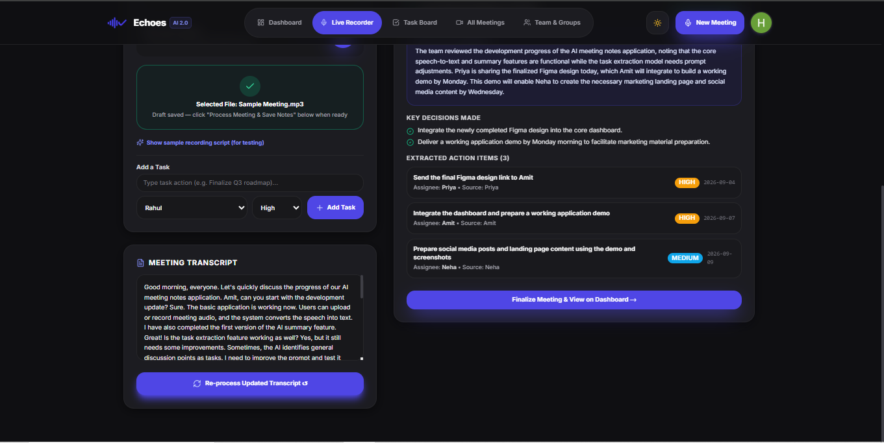
AI CAPABILITIES & QUANTITATIVE METRICS
Speaker Diarization, Gemini Extraction & Health Score
Transforming conversational audio into structured, quantifiable business assets.
🎙️ ASSEMBLYAI SPEAKER DIARIZATION
Labels dialogue by speaker ("Speaker A", "Speaker B") with millisecond timestamps. Solves the hardest problem in speech: knowing who committed to what.
🧠 GOOGLE GEMINI STRUCTURED EXTRACTION
Gemini reads unstructured text and formats it into clean JSON objects: Executive Summary, Key Decisions, and Action Items with priority levels and suggested assignees.
📊 0–100 MEETING HEALTH SCORE ALGORITHM
Weighted algorithm: (1) Engagement Balance (nobody dominates) + (2) Clarity (decisions agreed upon) + (3) Actionability (all tasks assigned to real owners).
ECHOES AI 2.0 • OFFICIAL JURY PITCH DECK
Notes:
TALKING POINTS:
Explain the Health Score formula! It quantifies whether a meeting was actually productive vs a waste of time. Show the screenshot on the left.

Slide 6
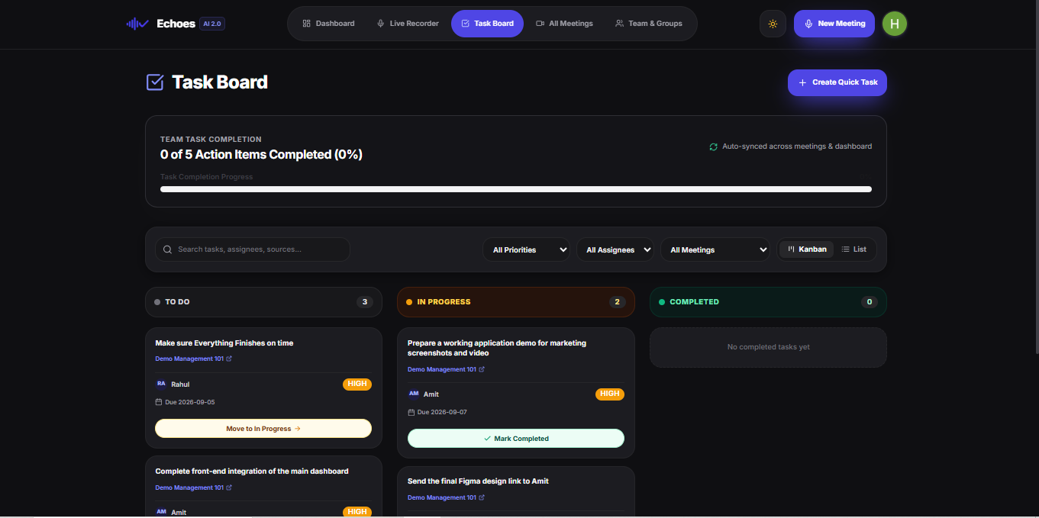
POST-MEETING WORKFLOW & INTEGRATIONS
The Execution Ecosystem: Kanban, Calendar & Digests
How Echoes moves meeting outcomes directly into existing team workflows.
📋 Interactive Kanban Task Board
Real-Time Sync
Action items automatically convert into task cards organized by To Do, In Progress, and Done. Team velocity is tracked continuously.
📅 1-Click Google Calendar Sync
OAuth 2.0
Schedule follow-up meetings or milestones directly into Google Calendar with deep-links back to meeting transcripts.
✉️ Automated Email Digests
Nodemailer SMTP
Send formatted summaries and personalized task lists to all attendees. Unregistered members receive an instant workspace invite link.
📄 Native PDF & Word DOCX Export
In-Browser / Server
Generate executive-ready PDF documents or editable Microsoft Word files without requiring external conversion tools.
ECHOES AI 2.0 • OFFICIAL JURY PITCH DECK
Notes:
TALKING POINTS:
Echoes is an end-to-end platform. Once meeting notes are finalized, they immediately populate the Kanban board, Google Calendar, and email inboxes.

Slide 7
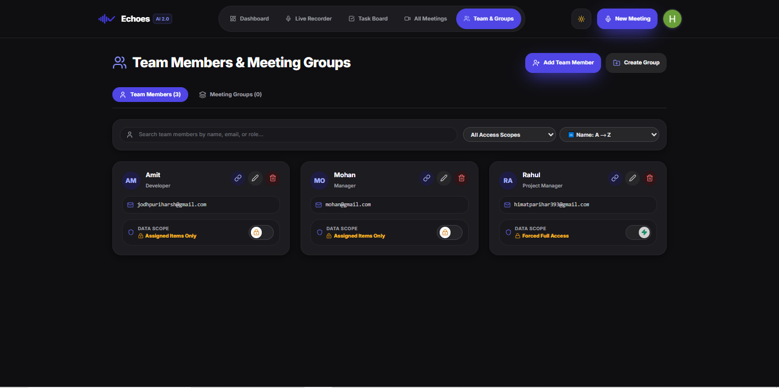
DATA PRIVACY & ARCHITECTURE
Multi-Tenancy & Security: The "Apartment Building"
Database-level security rules ensure zero data leakage between client workspaces.
🏢 THE "APARTMENT BUILDING" ANALOGY (RLS)
• Shared Infrastructure: Everyone uses the same database and code, but each workspace has its own locked door.
• Enforced at PostgreSQL Layer: Row Level Security (RLS) is executed by the database itself, not just application code.
• Zero Leakage Guarantee: Even if app code had a bug, the database engine strictly blocks queries outside your authenticated workspace.
🏦 THE "BANK TELLER" (SECURITY DEFINER)
• Restricted Vault Access: Users cannot directly alter workspace tables.
• Specific Teller Functions: Actions like creating an organization, joining with an invite code, or deleting resources run through pre-approved PostgreSQL functions.
• Default "Assigned Items Only": Newly invited members only see meetings & tasks assigned to them, enforced via direct URL address-bar guards.
ECHOES AI 2.0 • OFFICIAL JURY PITCH DECK
Notes:
CRITICAL JURY DEFENSE:
Judges frequently probe security: "Is user data safe from cross-tenant leakage?" Use the Apartment Building analogy (PostgreSQL RLS) and Bank Teller analogy (SECURITY DEFINER).

Slide 8
TECHNICAL JUSTIFICATION
Why We Picked Each Piece of Technology
Every framework and API was selected for production scalability and speed.
Next.js 14 (App Router)
Supabase (PostgreSQL)
AssemblyAI Diarization
Full-stack TypeScript in a single codebase. Server actions keep API keys (Gemini, AssemblyAI) completely hidden from browser bundles.
Relational data integrity for organizations, members, meetings, and tasks. Combines Auth, Storage, and PostgreSQL RLS in one platform.
Specialized speech-to-text with millisecond speaker attribution. Solves multi-speaker labeling far better than generalist LLMs.
Google Gemini 1.5/2.0
Vercel Platform
Nodemailer & Google Calendar
Unmatched long-context comprehension and rigid structured JSON schema adherence. Turns conversational transcripts into strict tasks.
Instant edge deployment with automated GitHub CI/CD pipeline. Generous global CDN bandwidth optimized for Next.js architectures.
Direct integration with existing team tools. Users act on meeting outcomes through their everyday inbox and calendar.
ECHOES AI 2.0 • OFFICIAL JURY PITCH DECK
Notes:
TALKING POINTS:
Explain why Next.js was chosen over plain React (server-side security), Supabase over Firebase (relational structure fits orgs/tasks), and AssemblyAI over generic audio transcription.

Slide 9
ANTICIPATED QUESTIONS & BULLETPROOF ANSWERS
Jury Q&A Cheat Sheet: Defend Like a Pro
Straightforward, credible answers to the most probable jury inquiries.
Q: What if the AI hallucinates or gets a summary wrong?
A: Human-in-the-loop guarantee. The meeting sits in "Needs Review" first. Users can edit transcripts, reassign tasks, or tweak decisions before clicking "Finalize."
Q: What if two different companies use this app simultaneously?
A: Strict multi-tenant isolation. PostgreSQL Row-Level Security automatically tags and isolates all rows by organization_id. Data leakage is mathematically prevented.
Q: How do you handle a full 1-hour recording on Vercel without timeouts?
A: We solved it using client-to-storage direct uploads (bypassing 4.5MB limits) and an asynchronous "job-ticket polling" pattern with AssemblyAI (bypassing 60s limits).
Q: Is audio stored securely? Could an unauthorized user steal it?
A: Stored in private Supabase Storage buckets governed by the same Row-Level Security policies. Only authenticated members of the respective workspace can access audio files.
Q: What is not built yet / what is on your roadmap?
A: Direct Zoom/Google Meet bots, subscription billing tiers, and automated error telemetry with Sentry. We built a production-grade core engine first.
ECHOES AI 2.0 • OFFICIAL JURY PITCH DECK
Notes:
JURY TIP:
Be honest and confident. If asked about what is next, proudly explain that you solved the hard core architectural problems first (diarization, RLS, timeouts).

Slide 10
THE FUTURE OF TEAM INTELLIGENCE
Turn Meetings from Time Sinks
Into Finished Results.
🤖 Live Bot Attendance
📈 Cross-Meeting Intelligence
🔒 Enterprise Compliance
Direct calendar integration to auto-join Zoom, Teams, and Google Meet rooms as a silent listener.
AI analysis across 50+ meetings to track recurring blockers, project drift, and team sentiment over time.
SOC2 readiness, custom corporate retention policies, and self-hosted private LLM deployment options.
Thank You! We are now open for Jury Questions.
Notes:
CONCLUSION:
Wrap up on a high note. Emphasize that Echoes turns dead audio into actionable momentum.

