Slide 1
MOBILE BASED OPTICAL CHARACTER RECOGNITION AND TEXT-TO-SPEECH
SYSTEM
Submitted by
Hima M H
S3 MCA

Slide 2

OBJECTIVE OF THE PROJECT
DESCRIPTION OF THE PROJECT
INPUT/OUTPUT AND CODE DESCRIPTION
UI DESIGNS
USE CASE DIAGRAM
SAMPLE SCREEN SHOTS
FUTURE SCOPE OF THE PROJECT

Slide 3
OBJECTIVE OF THE PROJECT
To develop a text from an image by OCR system.
To develop text recognition software that can be gotten from an image or even directory written into text editor system.
To develop a read the text contained in the text editor by using Speech
Recognition System.
To develop the above system to exist on a programmable OCR suchthat it operates independently of an external computing source, and interacts with its software inputs and outputs independently.

Slide 4
DESCRIPTION OF THE PROJECT
A smartphone app that detects text on a page ,photograph it, OCR’s(Optical
Character Recognition) it &then reads it in life-like audio voice .
This technology allows users to access text that is on signs, hangouts,mail and
other documents.
While they’re no replacement for a screen reader on a desktop or laptop computer
these smartphone apps are a handy accessory.
We can encrypt the scanning images and documents with password.
The algorithm used in this project is AES(Advanced Encryption Standard).
Notes:
4

Slide 5
User Module:
There are stages and steps in which the user can use the system and functionalities where the system can perform its own tasks.An actor is nothing but the use of the system / application.
There are two easy ways by which user can interact with the system, also there are two main functionalities by which system
comes into a picture.
Initially the user will start the app. The rear camera is kept open by default in the system, so that it is easy for users to use the
system without much hurdle.
The actor will scan hardcopy document by the camera of this android device phone. The scanned image can be anything like printed or handwritten document.
Once there is image in front of the screen the system functionality come into picture. The system will try to identify and generate
the text from the image that is provided to the OCR engine.
Once the user sees the detected text and is converted into a machine identified and generated text, the actor has choice to select the text he desired.
Once the actor selects the block of identified text it is considered as an input to the text-to-speech.
The another functionality of the system comes into picture and the system will convert the text into an effective speech.
Notes:
5

Slide 6
Methodology:
OCR(Optical Character Recognition):
Optical character recognition,or OCR ,is a method of converting a saved image into text.
Generating Image Files from Text Files
Creating Box Files
Processing Box Files
Computing the Character Set
Font Properties
Shape Clustering
The Final Crunch
OpenCV(Open source computer vision):
It is an library using which we can develop real time computer vision application.This library consists of
inbuilt features of functions.It mainly focuses on image processing including featureslike physical object,
face and text identification and recognition.

Slide 7
TTS(Text to speech):
It is a type of speech synthesis application that is used to create a spoken sound version
of text in a computer document or image.
Training
Synthesis
Optimization
Transform FestVox Voice to Android Supportive Voice

Slide 8
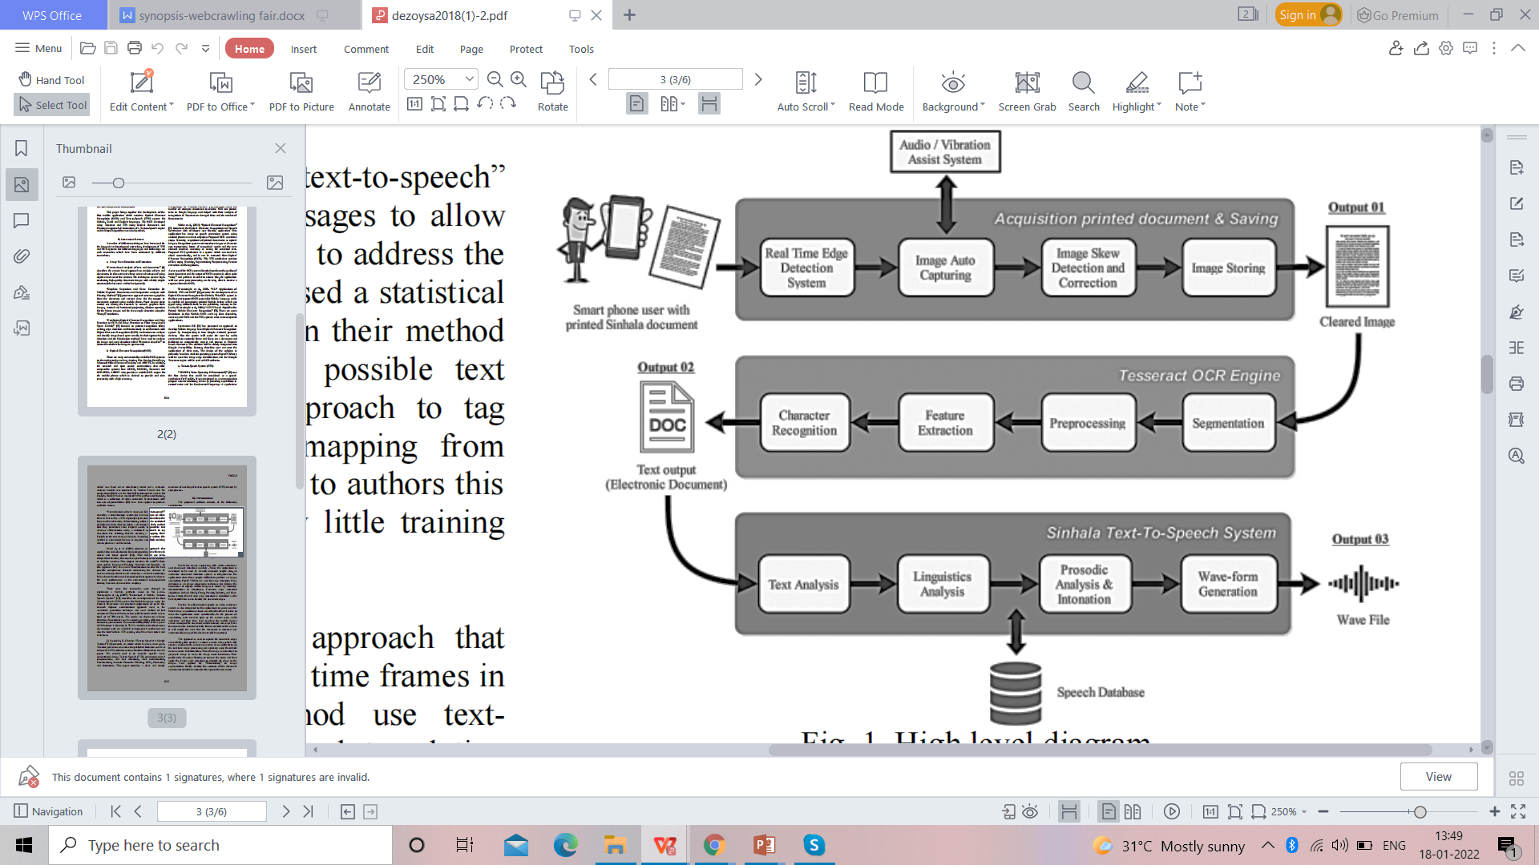
System Architecture:

Slide 9
FlowChart:
start
A
Input files
Recognition
Check
extension
Text to speech
Image files
(jpg,png)
Doc files
(doc,pdf)
Voice output
OpenCV
Pre processing
Stop
A

Slide 10
EXISTING SYSTEM
In existing OCR systems the printed text is converting into a computer readable text.
In TTS systems, the converted text is again converted into an audio output which can be directly
given to human ears.
When consider about the today’s market the existing OCR and TTS systems for Sinhala are
computer based online and offline systems.
Currently both OCR and TTS system are available as two separate applications.
There is no mobile based product available in the current market either as an OCR or TTS system, which means there is no mobile based application available for the visually impaired and illiterate
people to read Sinhala documents.
DISADVANTAGES:
We cannot encrypt the scanning images and documents with password.
Already saved images or clicked images are required for scanning.
Notes:
10

Slide 11
PROPOSED SYSTEM
It is an android based mobile application contains OCR and TTS for Sinhala, Tamil and English languages as single product
by resolving problems in existing systems.
In order to make the proposed system, user needs to acquire printed document as optical image using a camera of the
mobile phone.
The image skew will reduce the OCR accuracy drastically due to the angle view of the document.
Therefore after doing the image skew detection optical image is passing to the OCR engine to convert the image to character
streams representing letters of recognized words.
Finally, the converted text output is access by TTS system to convert the textual content into a voice output. Additionally, it
consists audio assist system to navigate through the pages in the diligence for differently abled users.
This is easier, portable and faster solution comparing to the existing systems which are made for visually impaired.
Advantages:
We can encrypt the scanning images and documents with password.
Auto Image Capturing is possible,so already saved images or clicked images are not required for scanning.
Notes:
11

Slide 12
SYSTEM REQUIREMENTS
Hardware Specification:
PROCESSOR : AMD ATHLON GOLD 3150U WITH RADEON GRAPHICS
RAM : 4 GB RAM
HARD DISK : 500 GB
MOUSE : STANDARD TWO BUTTON OR HIGHER
KEYBOARD : STANDARD 101-102 KEY KEYBOARD
SCREEN RESOLUTION : 1920×1080
OTHER DEVICES : MODEM
Software Specification:
OPERATING SYSTEM : WINDOWS 10
LANGUAGE USED : JAVA
FRONT END : ANDROID
BACK END : PHP

Slide 13
REFERENCES
[1] H. Jiang, T. Gonnot, W. Yi and J. Saniie, "Computer vision and text recognition for assisting visually impaired people using
Android smartphone," 2017 IEEE International Conference on Electro Information Technology (EIT), 2017, pp. 350-353,
doi: 10.1109/EIT.2017.8053384.
[2] Text Detection and Recognition with Speech Output for Visually Challenged Person. Rupali D. Dharmale, Dr. P. V. Ingole, 2016.
[3] Designing mobile application for retrieving book information using optical character recognition. Nana Ramadijanti, Achmad
Basuki, AgrippinaG.J, W. 2016.
[4] D. S. S. De Zoysa, J. M. Sampath, E. M. P. De Seram, D. M. I. D. Dissanayake, L. Wijerathna and S. Thelijjagoda,
"Project Bhashitha - Mobile Based Optical Character Recognition and Text-to-Speech System," 2018 13th International
Conference on Computer Science & Education (ICCSE), 2018, pp. 1-5, doi: 10.1109/ICCSE.2018.8468858.
[5] D. Berchmans and S. S. Kumar, "Optical character recognition: An overview and an insight," 2014 International
Conference on Control, Instrumentation, Communication and Computational Technologies (ICCICCT), 2014, pp. 1361-1365,
doi: 10.1109/ICCICCT.2014.6993174.

Slide 14


