Slide 1
BIOMETRIC AUTHENTICATION FRAMEWORK BASED ON GENETIC ENCRYPTION ALGORITHM

Slide 2
RELEVANCE
It recognize and verify the unique features accurately, rapidly,and appropriately to control the entry process in dedicated system.
to control the access process and prevent intruders.
satisfy user data security .

Slide 3
DESCRIPTION
It is presenting a novel authentication framework.
It produces an entirely unrecognized biometric template.
Firstly, the GA initiates its search from a population of templates.
Secondly, some statistical operators
Finally, the crossover and mutation operations are performed.
Different biometric databases of the face templates are tested and analyzed.

Slide 4
OBJECTIVE
It achieve high privacy with security and uniqueness for authorized individuals.
Encryption keys provide increased protection to the biometric cryptosystems.
In these cryptosystems, the genuine biometric features are not kept directly in the cloud.

Slide 5
EXISTING SYSTEM
In conventional biometric identification and authentication techniques, cross-matching(diversity) and cross-application invariance are the majorchallenges
That make an obstacle towards these systems because all services and applications involved in user biometrics can be easily hacked.
The information of the users will be easily tracked.

Slide 6
PROPOSED SYSTEM
It is presenting a novel authentication framework.
It produces an entirely unrecognized biometric template.
Firstly, the GA initiates its search from a population of templates.
Secondly, some statistical operators
Finally, the crossover and mutation operations are performed.
Different biometric databases of the face templates are tested
and analyzed.

Slide 7
MODULES
Image Preprocessing.
1st level image distortion.
Sub image selection.
2nd level distortion using Genetic Algorithm.
Biometric Authentication.

Slide 8
USED ALGORITHM
Genetic Algorithm
Genetic algorithms are heuristic search algorithms used for solving complex problems.
Generational phases such as initialization,fitness assignment,selection,reproduction,replacement, and termination.

Slide 9
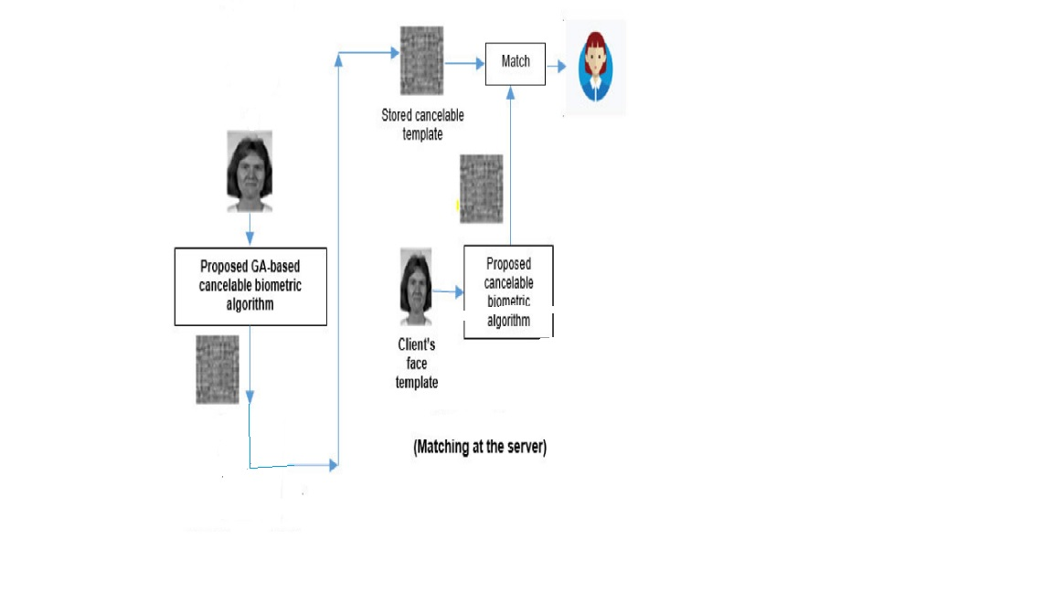
SYSTEM ARCHITECTURE

Slide 10
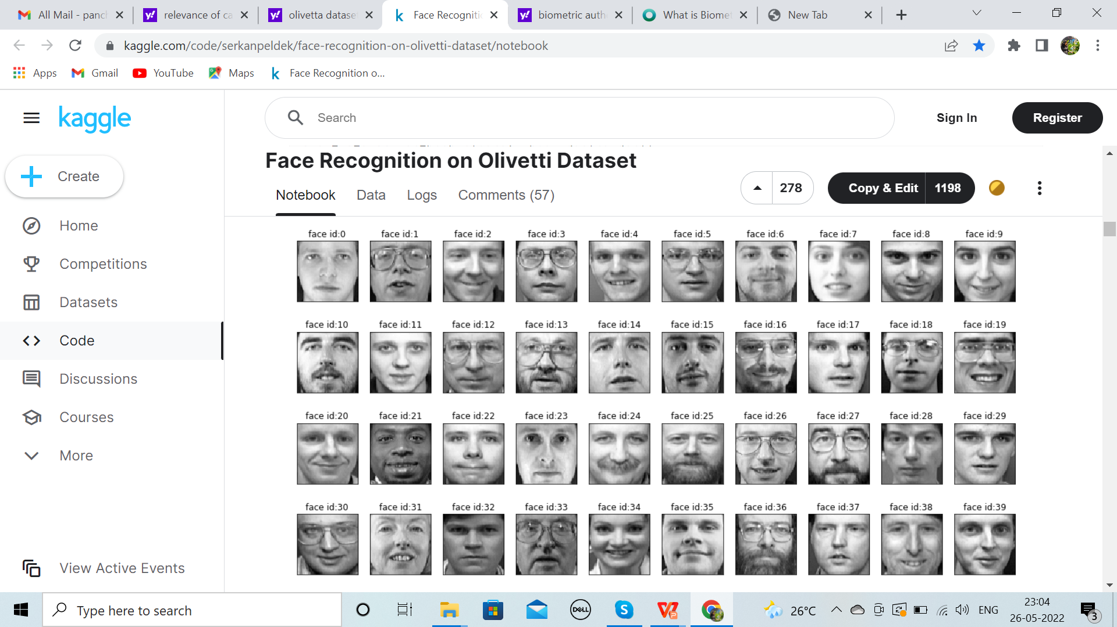
DATASET
Olivetti Dataset

Slide 11
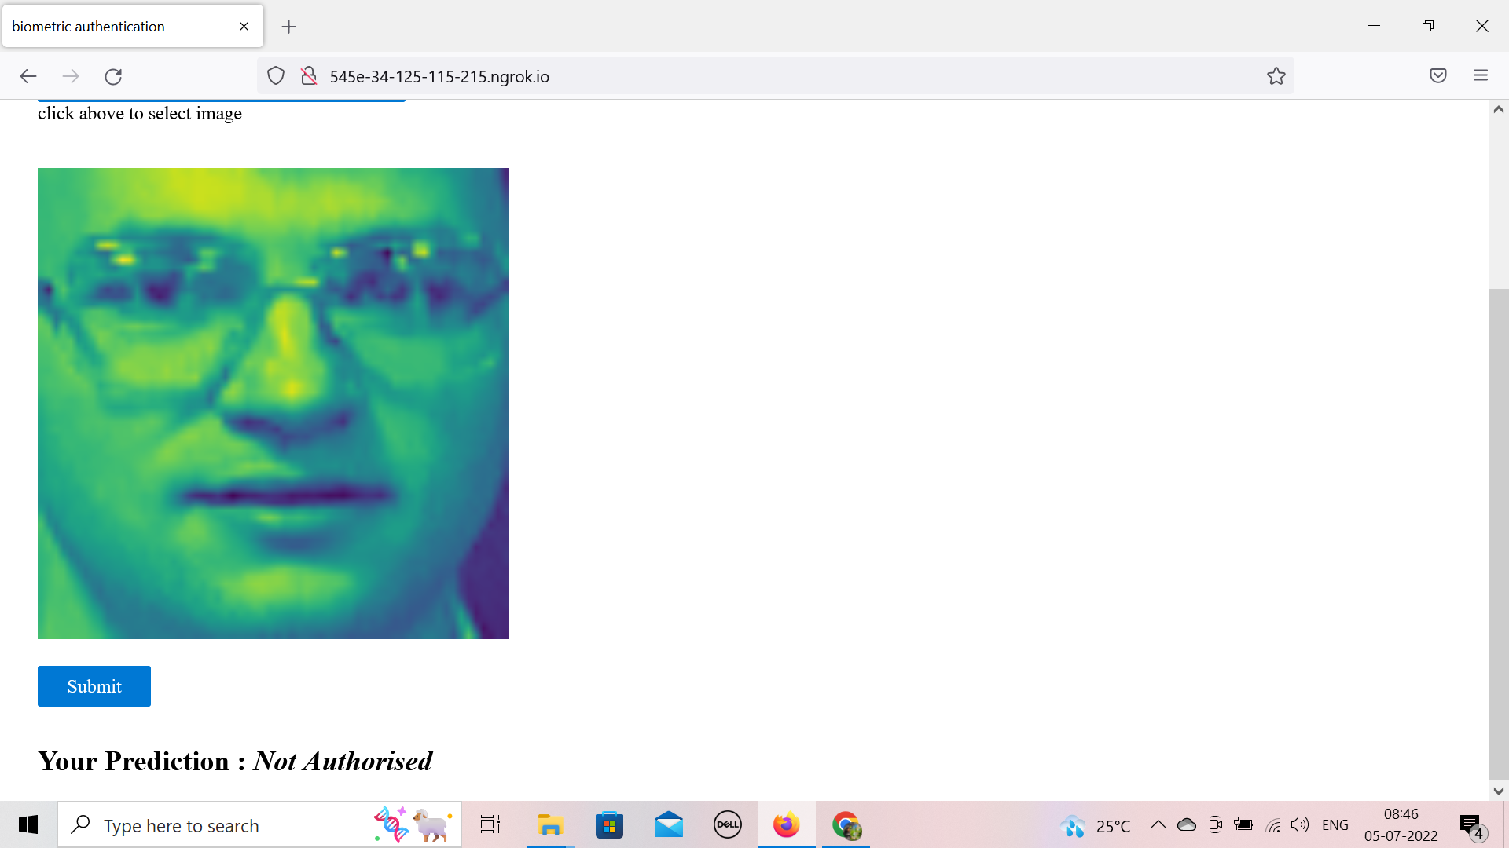
SCREENSHOTS

Slide 12
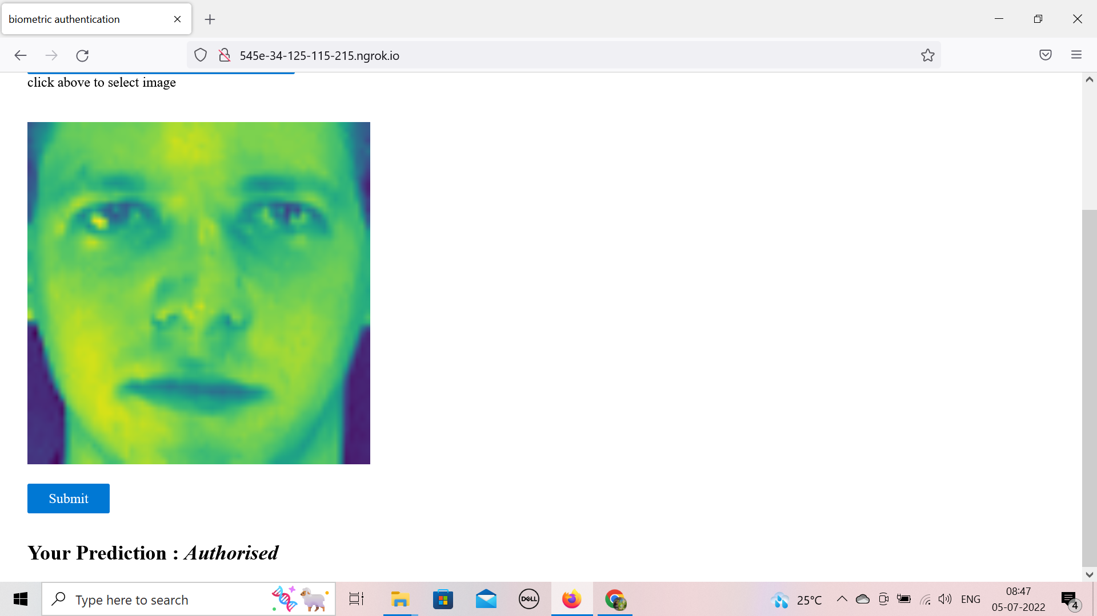
screenshots

Slide 13
THANKYOU

