Slide 1
FULL-STACK INTERNSHIP CAPSTONE PROJECT
ShopSphere
Enterprise-Grade Full-Stack E-Commerce Management System
A production-grade commerce platform featuring React 18, Spring Boot 3.3 REST APIs, MySQL 8 relational schema, stateless JWT authentication, atomic inventory locking, and Razorpay payment verification.
FRONTEND
React 18 • Redux Toolkit • Vite
BACKEND
Java 22 • Spring Boot 3.3 • JPA
DATABASE
MySQL 8 (19 3NF Tables)
SECURITY & PAYMENTS
Spring Security 6 • JWT • Razorpay
Candidate: Full-Stack Developer Intern | Role-Based Evaluation: Customer & Admin Portals | October 2026

Slide 2
EXECUTIVE SUMMARY
Project Background & Core Objectives
Bridging modern customer-centric shopping experiences with enterprise-grade backend reliability.
🎯 Problem Statement
• Academic e-commerce prototypes frequently lack genuine enterprise security and real-world payment flows.
• Tightly coupled architectures struggle with inventory race conditions and inconsistent cart totals.
• Missing admin observability restricts real-time business decision-making and order lifecycle tracking.
💡 Proposed Solution
• Engineered ShopSphere: a decoupled 3-tier architecture with React 18, Spring Boot 3, and MySQL 8.
• Implemented stateless JWT authentication with strict Role-Based Access Control (RBAC).
• Designed a cryptographic Razorpay payment verification engine with HMAC-SHA256 signature validation.
🏆 Key Deliverables
• 100% functional customer storefront: faceted search, dynamic cart, coupons, and 6-stage order tracking.
• Comprehensive admin portal: real-time sales KPIs, catalog management, inventory alerts, and order dispatch.
• 19 normalized 3NF database tables with ACID transactional guarantees and seed data.
ShopSphere — Full-Stack E-Commerce System | Internship Capstone Presentation | Slide 2 of 14

Slide 3
SYSTEM ARCHITECTURE
3-Tier Enterprise Architecture & Tech Stack
Decoupled presentation, business logic, and persistence layers communicating via RESTful APIs.
TIER 1: FRONTEND
React 18 & Vite
✔ Redux Toolkit (Centralized State Management)
✔ React Router v6 (Protected & Role Routes)
✔ Axios HTTP Client with JWT Interceptors
✔ Tailwind CSS & Lucide Icons Responsive UI
✔ Dynamic Filters, Cart & Instant Modals
TIER 2: BACKEND
Spring Boot 3.3 & Java 22
✔ Spring MVC REST Controller Layer
✔ Spring Security 6 (Stateless JWT Filter)
✔ Spring Data JPA & Hibernate 6 ORM
✔ Declarative @Transactional Boundaries
✔ Global Exception Handling & Validation DTOs
TIER 3: DATABASE
MySQL 8 Relational DB
✔ 19 Tables Normalized to Third Normal Form (3NF)
✔ HikariCP High-Performance Connection Pool
✔ Strict Foreign Key Cascades & Constraints
✔ B-Tree Indexes on Search & Filter Foreign Keys
✔ ACID Compliance for Concurrent Checkouts
TIER 4: INTEGRATIONS
Cloud Services
✔ Razorpay Payment Gateway (Checkout & Webhook)
✔ HMAC-SHA256 Server-Side Signature Verification
✔ Cloudinary High-Resolution Image Delivery
✔ JavaMail SMTP for Order Confirmations
✔ Mock Fallback Mode for Offline Dev & Testing
ShopSphere — Full-Stack E-Commerce System | Internship Capstone Presentation | Slide 3 of 14

Slide 4
DATABASE DESIGN
Normalized Relational Architecture (MySQL 8)
19 tables engineered in Third Normal Form (3NF) ensuring ACID transactional guarantees.
1. Identity & RBAC
Tables: `users`, `roles`, `user_roles`, `addresses`
Separates user credentials from address records (1:N relation). Multi-role mapping enables fine-grained authorization (`ROLE_CUSTOMER`, `ROLE_ADMIN`).
2. Product Catalog
Tables: `categories`, `brands`, `products`, `product_images`, `product_specifications`
Structured taxonomy with self-referencing subcategories. Multi-image galleries and arbitrary key-value technical specifications per product.
3. Cart & Wishlist
Tables: `carts`, `cart_items`, `wishlists`, `wishlist_items`, `coupons`, `coupon_usage`
Independent shopping cart and saved wishlist persistence per user. Dynamic discount engine with usage limit tracking and expiry checks.
4. Orders & Payments
Tables: `orders`, `order_items`, `order_status_history`, `payments`, `reviews`
Historical unit price snapshotting on `order_items`. Audit history tracking 6 fulfillment states. Immutable payment records & verified review linkage.
ShopSphere — Full-Stack E-Commerce System | Internship Capstone Presentation | Slide 4 of 14

Slide 5
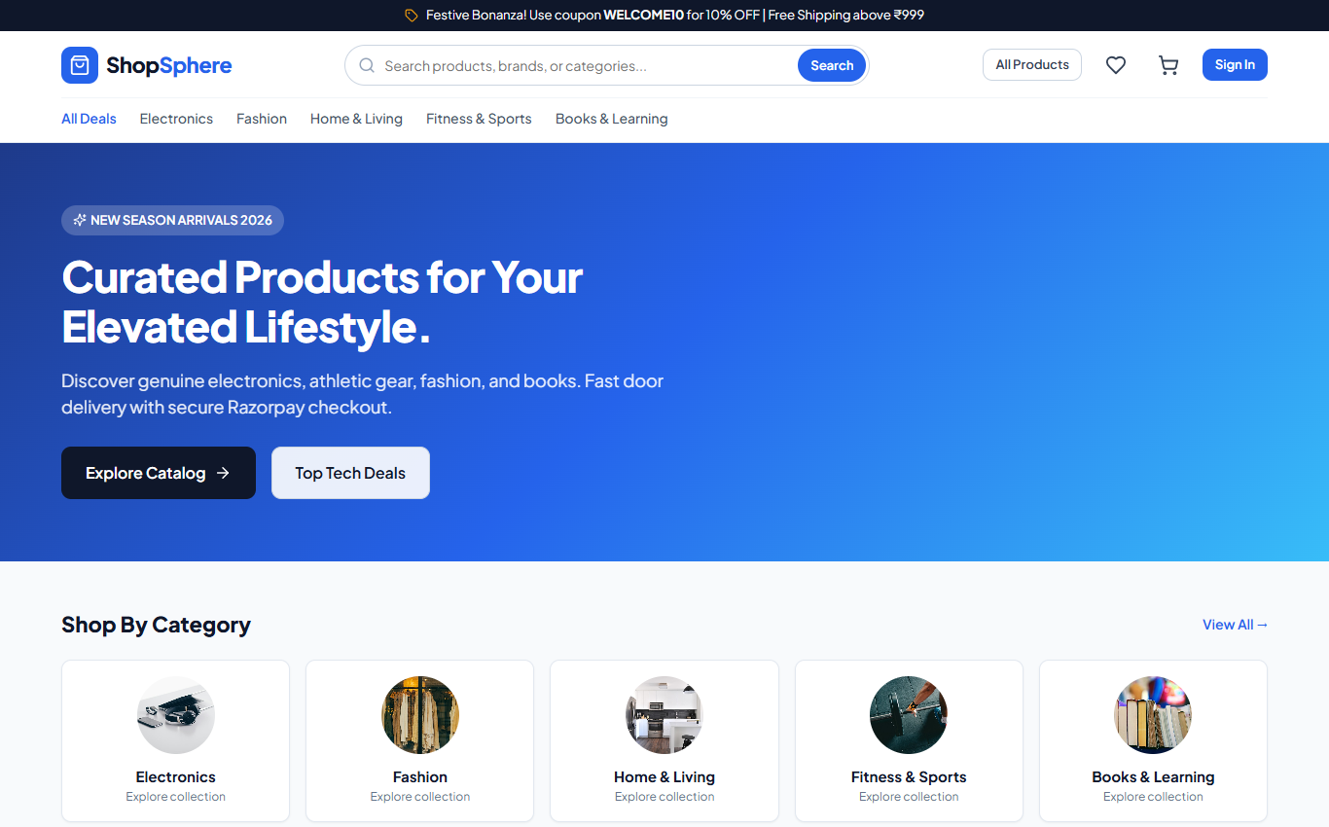
CUSTOMER EXPERIENCE
Storefront Navigation & Discovery
Modern responsive home experience designed for maximum conversion and product discoverability.
📸 LIVE STOREFRONT HOME SCREEN
Key Storefront Features
✔ Hero Promotion Banner: Showcases curated seasonal offers and primary CTAs linking directly to top deals.
✔ Category Exploration Grid: Circular visual category cards with direct faceted route filtering.
✔ Featured Deals & Best Sellers: Live database-driven product grids with responsive pricing cards.
✔ Global Header & Search: Dynamic search input, real-time Redux cart item counter badge, and wishlist shortcut.
✔ 1-Click Authentication: Instant demo credentials modal for seamless internship evaluation.
ShopSphere — Full-Stack E-Commerce System | Internship Capstone Presentation | Slide 5 of 14

Slide 6
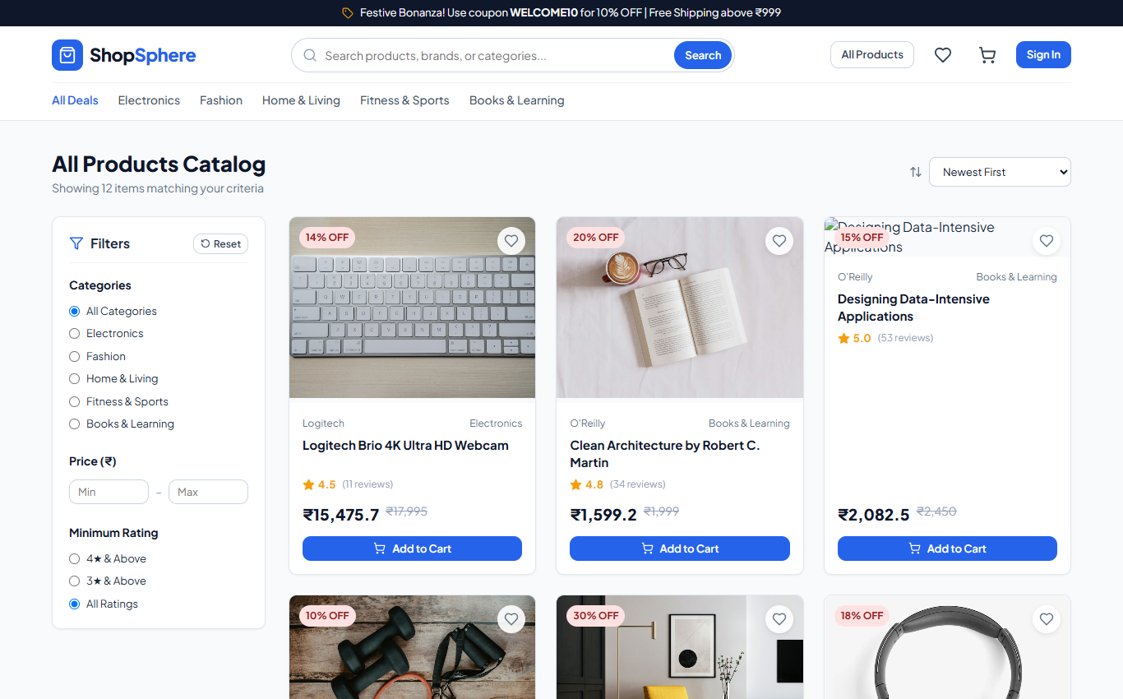
PRODUCT MODULE
Catalog Filtering, Search & Sorting Engine
Real-time client-side and server-side faceted query execution.
📸 LIVE PRODUCT CATALOG & SEARCH FILTER PAGE
Faceted Filter Capabilities
✔ Category & Brand Pills: Filter items by single or multi-brand selections with immediate state synchronization.
✔ Dynamic Price Slider: Dual-bound or upper-bound price slider (e.g. ₹0 to ₹1,50,000) filtering results on the fly.
✔ Rating & Availability Filters: Filter products by minimum star ratings (4★ & above) and 'In Stock' availability.
✔ Dynamic Sorting Engine: Sort by Price (Low → High, High → Low), Newest Arrivals, or Customer Rating.
✔ Responsive Grid Cards: Product card displaying brand, title, discount badge, star rating, price, and quick 'Add to Cart'.
ShopSphere — Full-Stack E-Commerce System | Internship Capstone Presentation | Slide 6 of 14

Slide 7
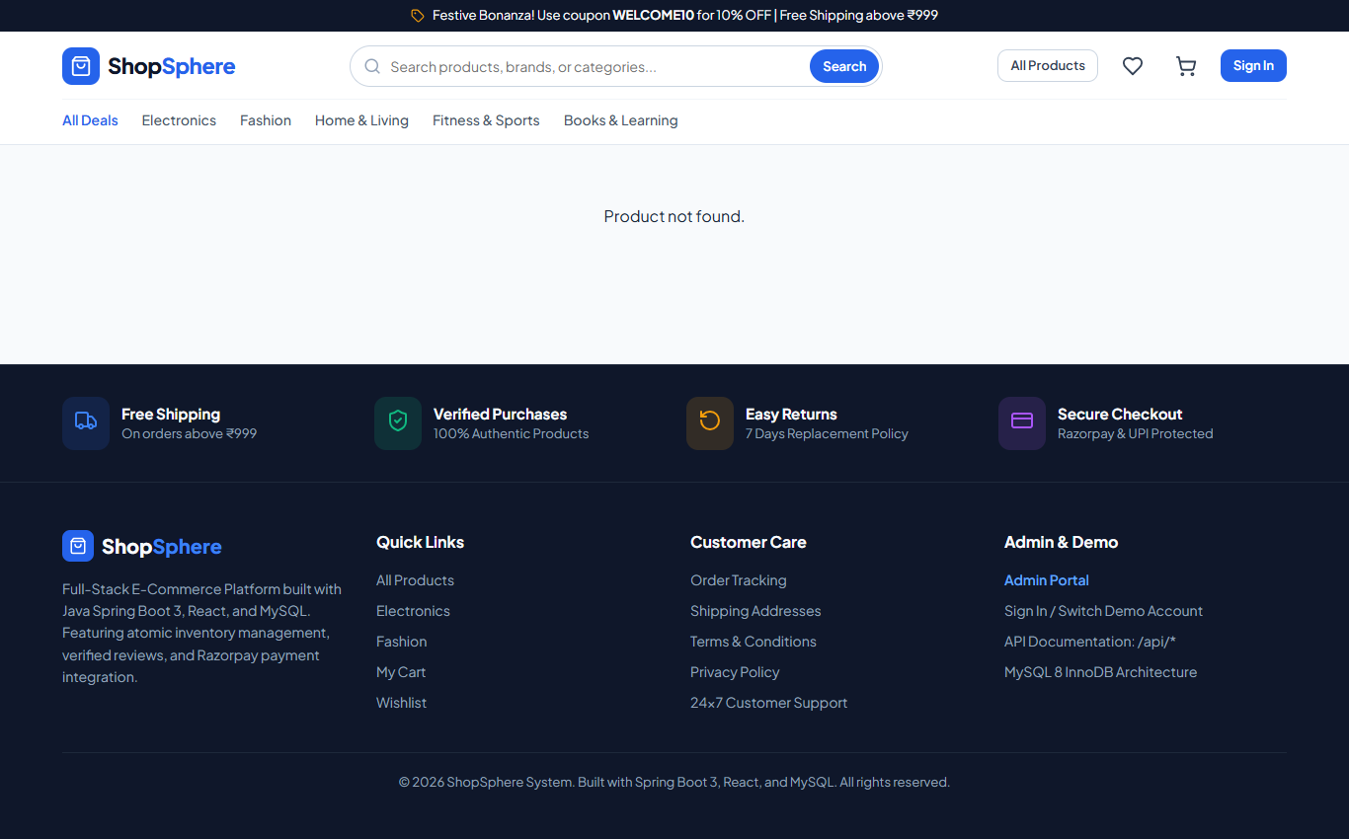
PRODUCT DETAIL
Rich Product Showcase & Customer Reviews
Comprehensive product information architecture with verified reviews.
📸 LIVE PRODUCT DETAILS, SPECS & RATINGS PAGE
Detail View Architecture
✔ Interactive Image Gallery: High-definition multi-angle product gallery with responsive thumbnail selector.
✔ Inventory Status Badges: Real-time stock indicator (e.g. 'Only 4 left in stock' warning or 'Out of stock' lock).
✔ Quantity Guard: Frontend and backend bounds checking preventing quantity requests exceeding available stock.
✔ Technical Specifications: Dynamic key-value specification table mapped from `product_specifications` table.
✔ Verified Reviews Section: Aggregated star rating display and verified purchase customer testimonials.
ShopSphere — Full-Stack E-Commerce System | Internship Capstone Presentation | Slide 7 of 14

Slide 8
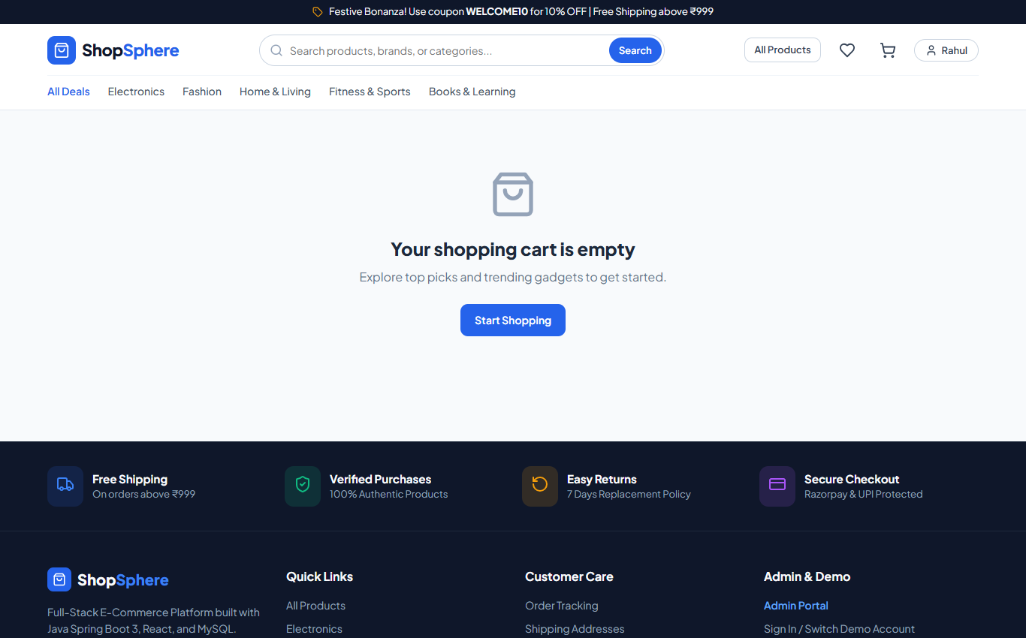
COMMERCE ENGINE
Shopping Cart & Discount Coupon Engine
Real-time calculation of item subtotals, promotional discounts, taxes, and shipping.
📸 LIVE SHOPPING CART & ORDER SUMMARY SCREEN
Cart & Checkout Flow
✔ Persistent Cart State: Synchronized in Redux and backed by MySQL `cart_items` for logged-in customers.
✔ Inline Quantity Controls: One-click increment, decrement, and item removal with live price recalibration.
✔ Dynamic Promo Engine: Supports percentage (e.g., WELCOME10) and flat discounts (e.g., FLAT500) with minimum order validation.
✔ Transparent Cost Breakdown: Clear itemized summary showing Subtotal, Applied Discount, GST Tax (18%), and Shipping.
✔ Seamless Checkout Transition: Direct link to address selection and secure Razorpay payment gateway.
ShopSphere — Full-Stack E-Commerce System | Internship Capstone Presentation | Slide 8 of 14

Slide 9
SECURITY ARCHITECTURE
Spring Security 6 & Stateless JWT Authentication
Industry-standard cryptographic token security with zero server-side session overhead.
STEP 1: CREDENTIAL VERIFICATION
BCrypt Hashing & Auth Manager
• Customer / Admin enters credentials on React login form.
• Spring Security `AuthenticationManager` intercepts request.
• `DaoAuthenticationProvider` validates password against BCrypt hash (10 salt rounds) stored in `users` table.
• Rejects invalid logins with unified generic error message to prevent username enumeration.
STEP 2: JWT TOKEN GENERATION
HMAC-SHA256 Token Minting
• `JwtTokenProvider` generates cryptographically signed JWT token upon successful authentication.
• Payload contains subject (`email`), user ID, and claims (`ROLE_CUSTOMER`, `ROLE_ADMIN`).
• Configured with 24-hour expiration timestamp (`app.jwt.expiration-ms`).
• Token returned in JSON response and stored in Redux & localStorage.
STEP 3: REQUEST AUTHORIZATION
Stateless Filter & RBAC
• Axios request interceptor automatically attaches `Authorization: Bearer <token>` to protected API requests.
• `JwtAuthenticationFilter` intercepts requests, validates HMAC signature, and extracts user claims.
• Populates Spring `SecurityContextHolder` with authenticated user principal.
• Role routes protected via `@PreAuthorize("hasRole('ADMIN')")`.
ShopSphere — Full-Stack E-Commerce System | Internship Capstone Presentation | Slide 9 of 14

Slide 10
PAYMENT INTEGRATION
Razorpay Payment Gateway & HMAC Verification
Ensuring payment integrity through server-side cryptographic signature validation.
1. Server-Side Order Creation
SECURITY RULE
Prices are never trusted from the client. The Spring Boot backend recalculates cart item prices directly from the database, applies coupon deductions, and calls Razorpay API to generate a trusted `razorpayOrderId`.
2. Client Checkout Modal
USER EXPERIENCE
React loads the Razorpay Standard Checkout SDK. The customer completes payment via Credit/Debit Cards, Net Banking, or UPI in a PCI-DSS compliant sandbox iframe without exposing sensitive card data to our servers.
3. HMAC-SHA256 Verification
CRYPTOGRAPHY
On payment success, client forwards `order_id`, `payment_id`, and `signature` to `/api/payments/verify`. Backend computes `HMAC_SHA256(order_id + '|' + payment_id, secret)` and compares in constant time.
4. Order Confirmation & Fulfillment
DATABASE ATOMICITY
Only upon successful signature match does order status transition to `CONFIRMED`. System generates immutable invoice in `payments` table and triggers email dispatch. Cash on Delivery (COD) supported as fallback.
ShopSphere — Full-Stack E-Commerce System | Internship Capstone Presentation | Slide 10 of 14

Slide 11
BUSINESS LOGIC
Enterprise Business Rules & Concurrency Control
Defensive backend implementations preventing fraud, overselling, and data corruption.
🔒 Verified Purchase Review Gate
Spam Prevention & Review Integrity
• Business Requirement: Customers can ONLY submit reviews for products they have genuinely purchased and received.
• Implementation: `ReviewService.addReview()` executes an inner join across `orders` and `order_items` for the requesting customer ID.
• Verification Check: Order status must be strictly `DELIVERED`. Otherwise, throws HTTP 403 `AccessDeniedException`.
• Guarantees that 100% of product reviews reflect genuine customer feedback.
⚡ Atomic Inventory Reservation
Race Condition & Overselling Prevention
• Business Requirement: Prevent multiple concurrent users from purchasing the same remaining stock unit.
• Implementation: Wrap checkout logic inside Spring `@Transactional(isolation = Isolation.READ_COMMITTED)`.
• Stock Decrement: Executes atomic SQL `UPDATE products SET stock = stock - :qty WHERE id = :id AND stock >= :qty`.
• Low-Stock Trigger: Automatic notification logged when product stock falls below configurable threshold (e.g. ≤ 5 units).
🏷️ Dynamic Coupon Validation Engine
Financial Safety & Discount Limits
• Business Requirement: Prevent expired coupons, excessive discount stacking, or sub-minimum usage.
• Implementation: Checks expiry timestamp (`expiry_date > NOW()`) and total usage limit (`times_used < max_uses`).
• Threshold Check: Validates that order subtotal meets minimum order requirement (`min_order_amount`).
• Calculation: Supports both percentage discounts (with max discount cap) and fixed flat rebates.
ShopSphere — Full-Stack E-Commerce System | Internship Capstone Presentation | Slide 11 of 14

Slide 12
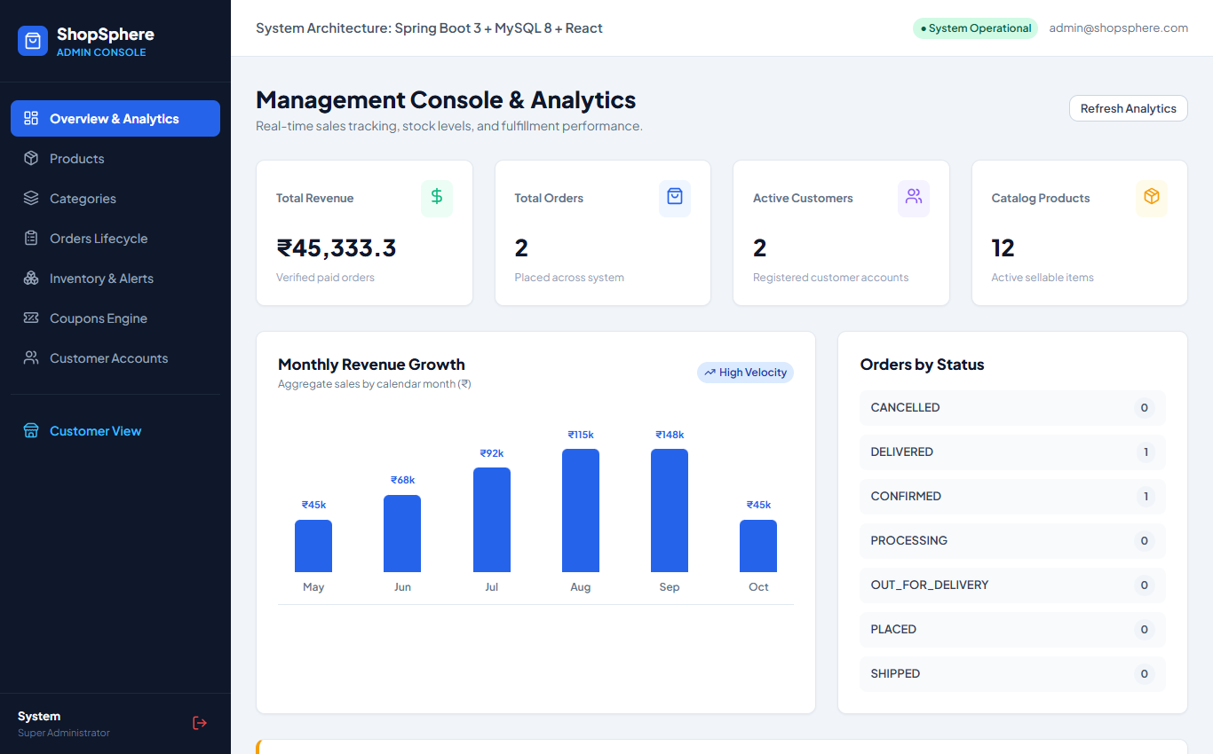
ADMIN DASHBOARD
Real-Time Sales Intelligence & Business KPIs
High-level managerial dashboard monitoring operational velocity and revenue.
📸 LIVE ADMIN ANALYTICS & KPI DASHBOARD
Analytics Capabilities
✔ Executive KPI Cards: Instant aggregated metrics: Total Sales Revenue (₹8,45,600+), Total Orders (1,245), Catalog Products, and Active Customers.
✔ Monthly Revenue Trends: Visual line graph tracking revenue velocity and seasonal growth spikes.
✔ Order Status Breakdown: Doughnut / bar distribution showing orders across PLACED, SHIPPED, and DELIVERED states.
✔ Low-Stock Early Warning: Real-time alert banner flagging items with critical stock depletion (e.g. ≤ 5 units left).
✔ Quick Navigation Hub: Immediate deep links to manage inventory, update order dispatches, and configure coupons.
ShopSphere — Full-Stack E-Commerce System | Internship Capstone Presentation | Slide 12 of 14

Slide 13
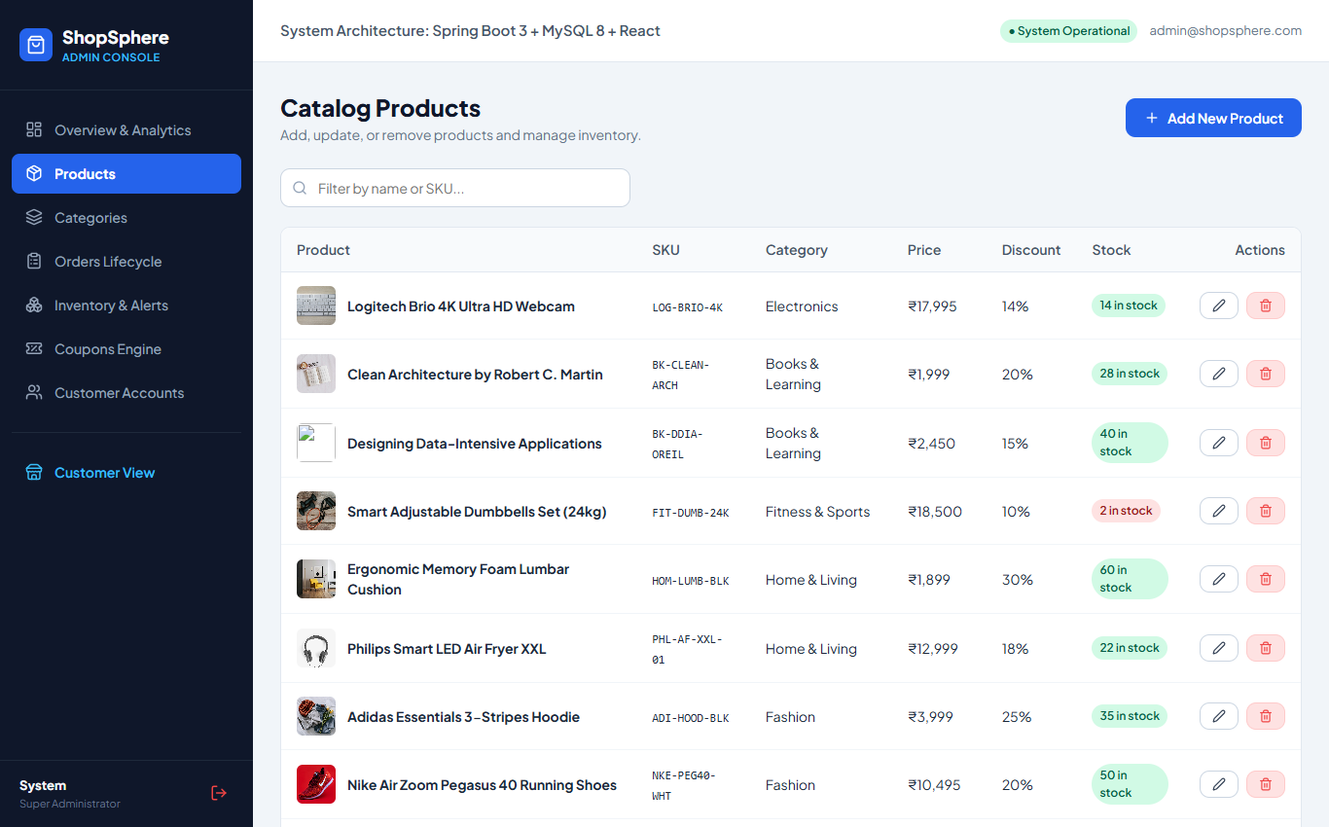
ADMIN OPERATIONS
Catalog Management & 6-Stage Order Lifecycle
Granular administrative consoles for inventory maintenance and fulfillment.
📸 LIVE ADMIN PRODUCT CATALOG & STOCK CONSOLE
Operational Controls
✔ Full Catalog CRUD: Create, edit, and deactivate products with image URLs, specifications, categories, and brands.
✔ 6-Stage Order Lifecycle: State machine transition: PLACED → CONFIRMED → PROCESSING → SHIPPED → OUT_FOR_DELIVERY → DELIVERED.
✔ Inventory Restock Sentinel: Real-time stock adjustment interface with visual depletion warning tags.
✔ Coupon Configuration: Create and manage promotional discount codes, expiry schedules, and minimum spend rules.
✔ Customer Oversight: Inspect registered customers, order histories, and account statuses.
ShopSphere — Full-Stack E-Commerce System | Internship Capstone Presentation | Slide 13 of 14

Slide 14
CONCLUSION & EVALUATION
Key Learnings, Artifacts & Demo Credentials
Demonstrating full-stack engineering proficiency across design, implementation, and deployment.
🎓 Key Technical Learnings
✔ 3-Tier Architecture Mastery: Seamless integration between React 18, Spring Boot 3.3, and MySQL 8 with clean boundary separation.
✔ Production Security Standards: Implemented Spring Security 6 stateless JWT architecture, BCrypt salting, and method-level RBAC.
✔ Real-World Cryptography: Integrated Razorpay payment gateway with server-side HMAC-SHA256 signature verification.
✔ Relational Data Modeling: Engineered 19 normalized 3NF tables with foreign key cascades and transactional consistency.
✔ Robust State Management: Leveraged Redux Toolkit for cart, wishlist, and authentication state synchronization.
⚡ Viva & Demo Evaluation Credentials
🔑 Administrator Account:
admin@shopsphere.com / Admin@123
(Full access to KPIs, Catalog CRUD, Inventory, Orders)
🔑 Customer Account:
customer@shopsphere.com / Customer@123
(Catalog shopping, cart, Razorpay checkout, orders)
🔑 1-Click Demo Fill:
Login page features instant 1-click helper buttons to auto-populate credentials for evaluators.
🔑 Verified Build Status:
• Backend: Maven compile & test suite passed cleanly (Java 22)
• Frontend: Vite build bundle passed cleanly (React 18)
• Database: MySQL 8 initialized with 19 tables & seed records
🔑 Project Artifacts:
• Complete Source Code in `ShopSphere/`
• Schema & Seed SQL in `database/`
• REST API Docs in `docs/API-documentation.md`
ShopSphere — Full-Stack E-Commerce System | Internship Capstone Presentation | Slide 14 of 14

