Slide 1
COVID-19 Tracking
Selected Counties
2021-Apr-20

Slide 2
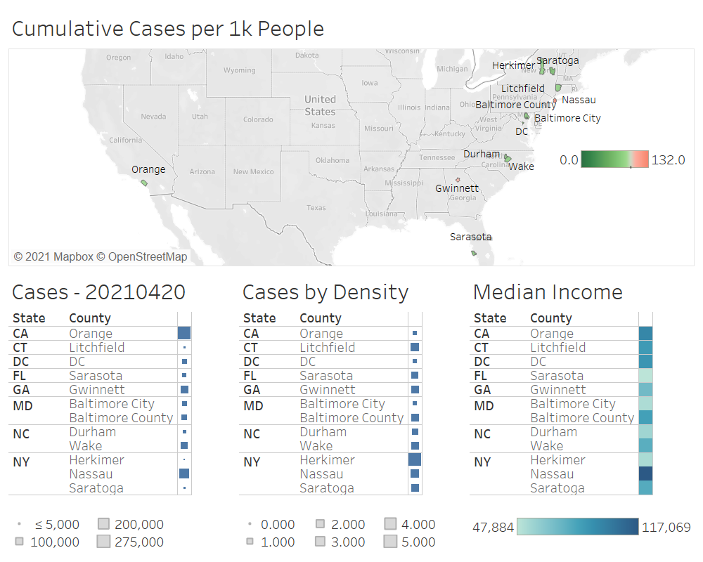

Slide 3
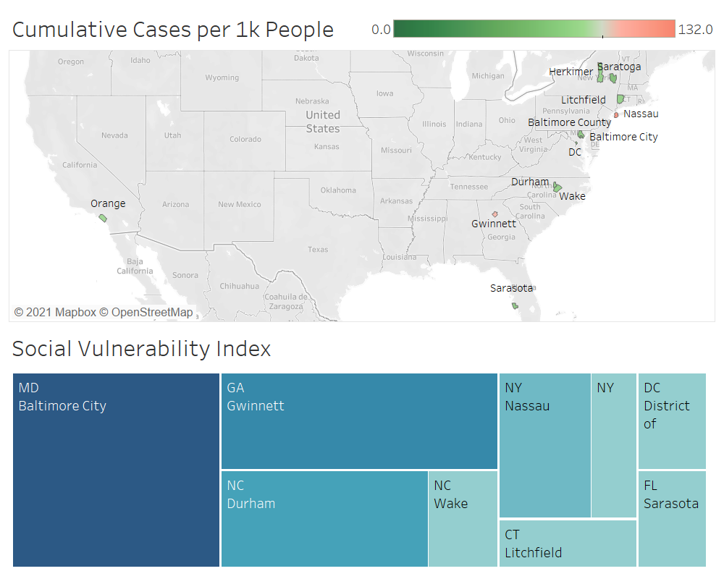

Slide 4
Additional Slide
Example metrics used to calculate Social Vulnerability Index (SVI)

Slide 5
