Slide 1
Influence of IgG amino acid sequence on attached N-glycans
Olga Zaitseva, Anika Mijakovac
Genos Glycoscience Research Laboratory, Zagreb
Faculty of Science, University of Zagreb

Slide 2
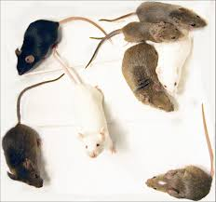
Collaborative Cross Mice
Two IgG1 allotypes with
distinct Fc-linked glycoprofiles
IgG3
IgG1F
EEQFNSTFR
IgG2
IgG1I
EEQINSTFR
Krištić et al., 2018

Slide 3
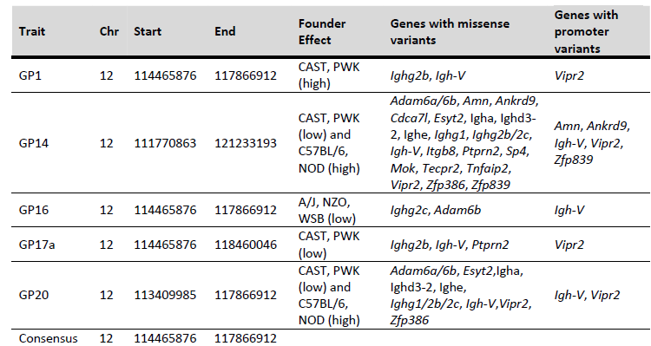
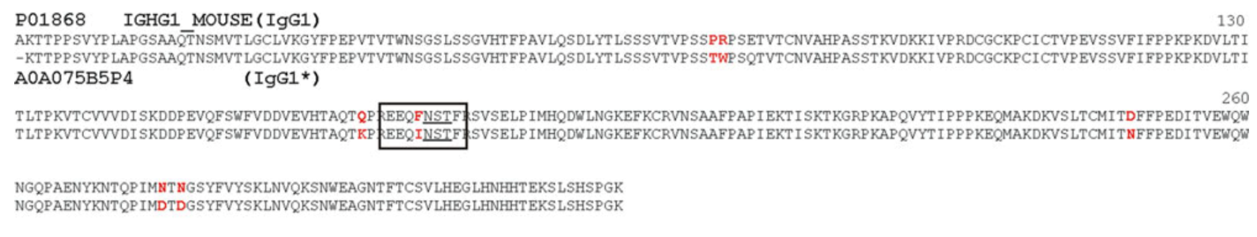
Krištić et al., 2018
Zaytseva et al., 2018

Slide 4
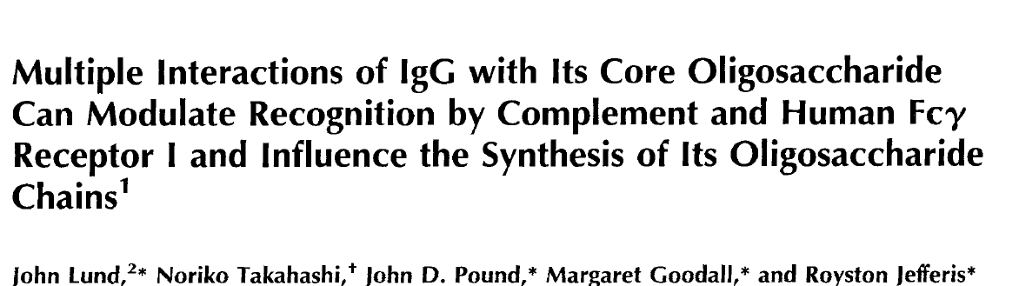
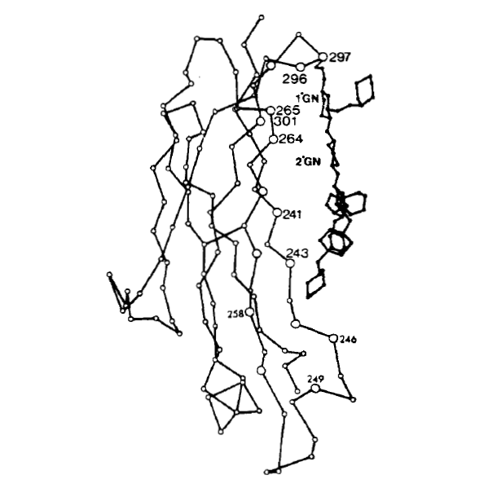
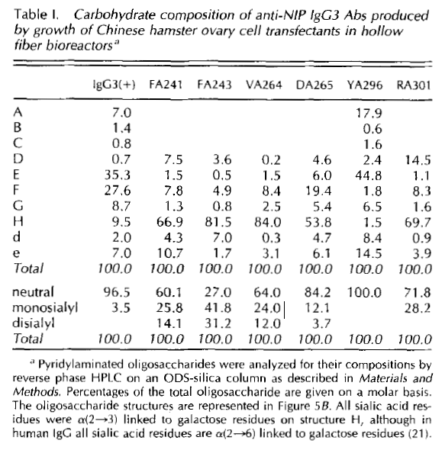
YA296 leads to reduction in galactosylation and sialylation
Human IgG3 with introduced
mutations

Slide 5
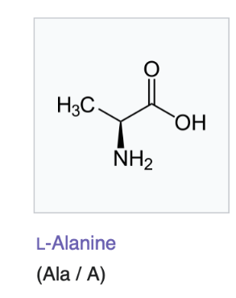
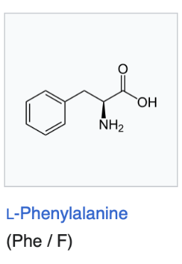
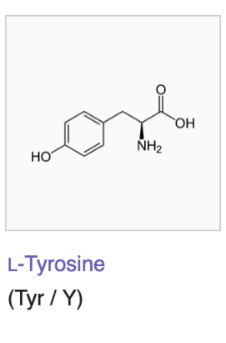
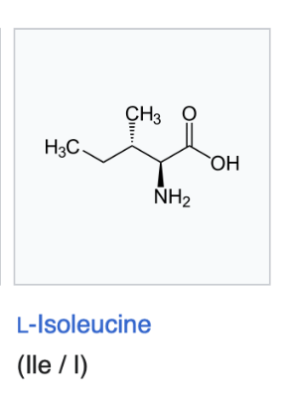
Experiment setup
Human IgG1
1 wild type heavy chain and 3 mutations:
Y296, YA296, YI296, YF296
2 types of light chain
Every type of samples produced in triplicates

Slide 6
IgG production in cell culture
Site-directed mutagenesis of IgG heavy chain (Q5 Site-Directed Mutagenesis Kit)
Sequencing to confirm the mutations
Assembly into backbone plasmid for transfection (Modules: Cbh promoter, IgG heavy chain, IgG light chain, pTerH terminator)
Transfection of FreeStyle 293-F cells
IgG secretion for 5 days
Supernatant isolation for IgG glycome analysis

Slide 7
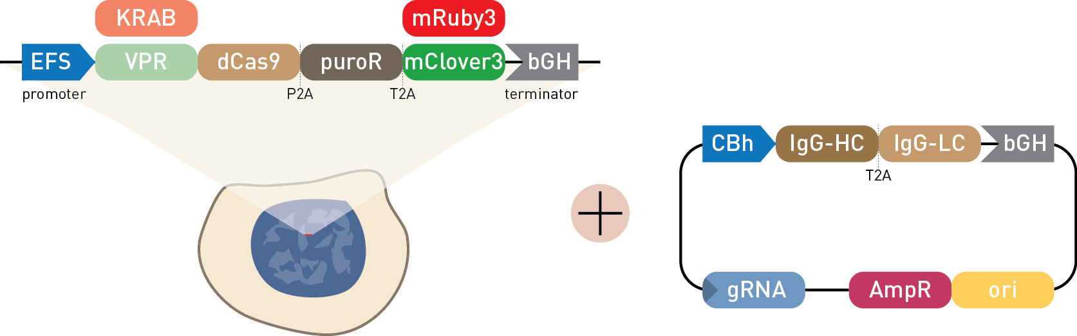
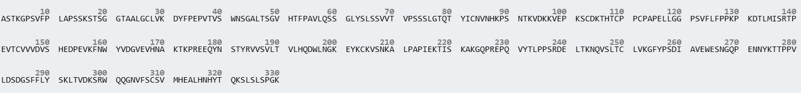
WT
NO
N-Glycosylation site
HC
LC
HC
LC
Heavy Chain
Tryptic glycopeptide
Mutated IgG1 (WT and NO)
Wild-type IgG1 (WT and NO)
EEQANSTYR
IgG1_YA
EEQYNSTYR
IgG1_Y
EEQINSTYR
IgG1_YI
EEQFNSTYR
IgG1_YF

Slide 8
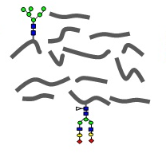
IgG isolation from cell supernatant
Clean-up and enrichment on C18 beads
Nano-reverse-phase-LC-ESI-MS
Digestion with trypsin
IgG1_Y
Quantification of glycoforms per subclass with LaCyTools
IgG1_YF
IgG1_YA
IgG1_YI

Slide 9
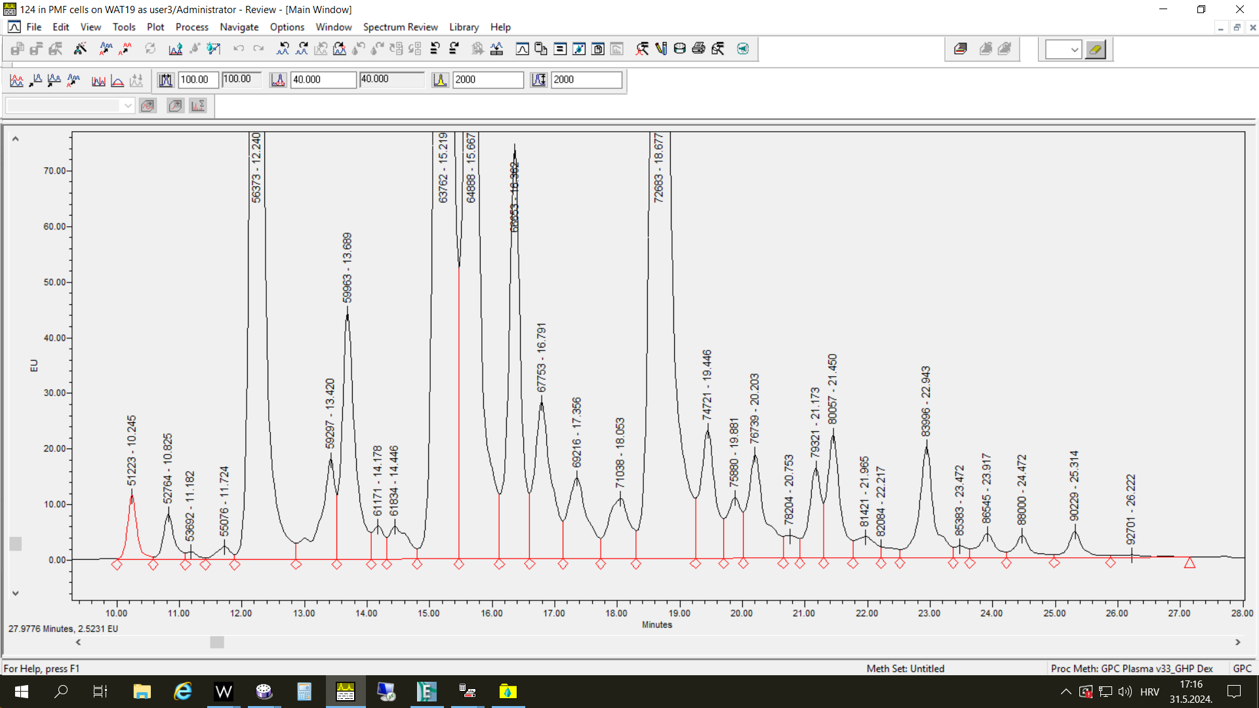
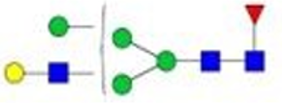
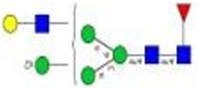
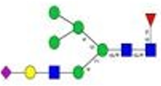


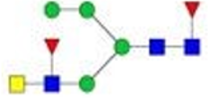
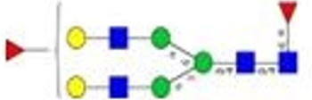
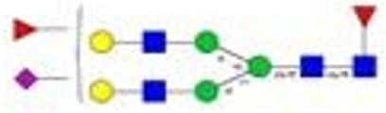
Fc-linked glycome
Free Fc-linked glycans in Free Style cells were analyzed LC-MS
18 compositions in EXP02
19 compositions in EXP03
Hybrid structures
Weird structures
Antennary fucosylation

Slide 10
Derived traits
A1 = H3N3F1
G0 = H3N3F1 + H3N4F1 + H3N5F1
G =H4N4F1+H4N5F1+H5N4F1+H5N4F2+H5N5F1+H6N3F1
S = H4N4F1S1 + H5N4F1S1 + H5N4F1S2 + H6N3F1S1
M = H4N2 (EXP03) + H5N2+H6N2
B = H3N5F1+H4N5F1+H5N5F1
AntennaryF = H5N4F2
H = H5N3F1 + H6N3F1 + H6N3F1S1

Slide 11
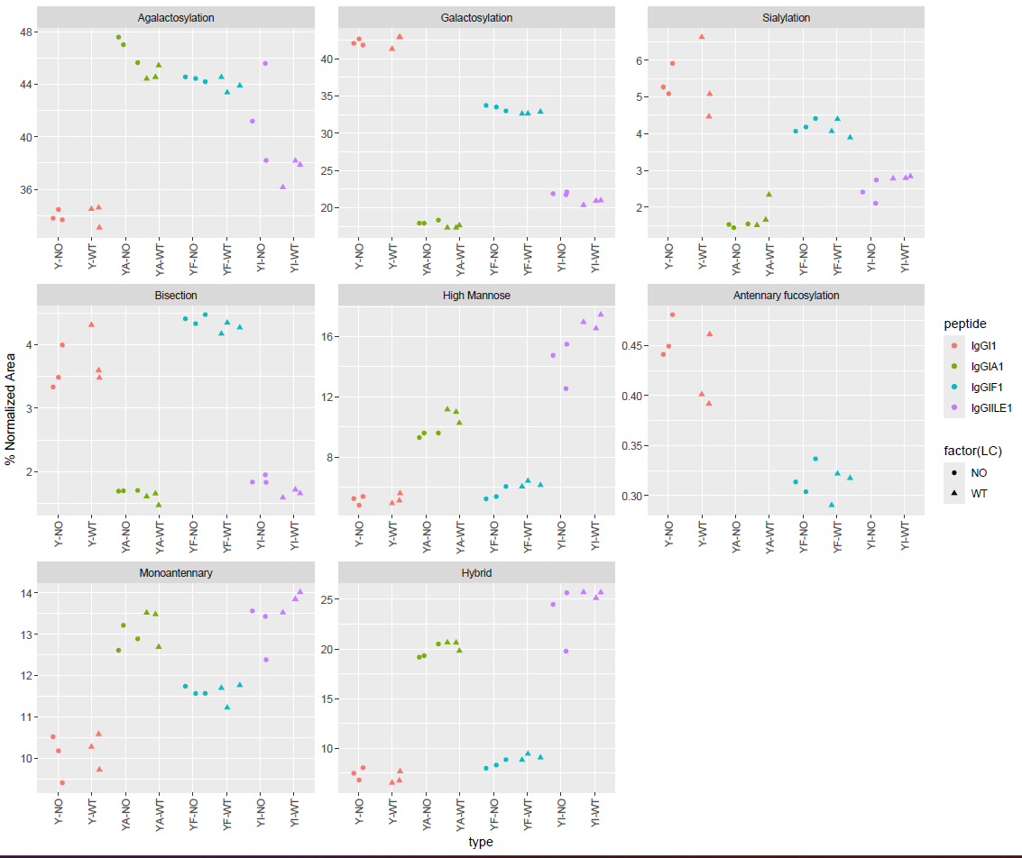
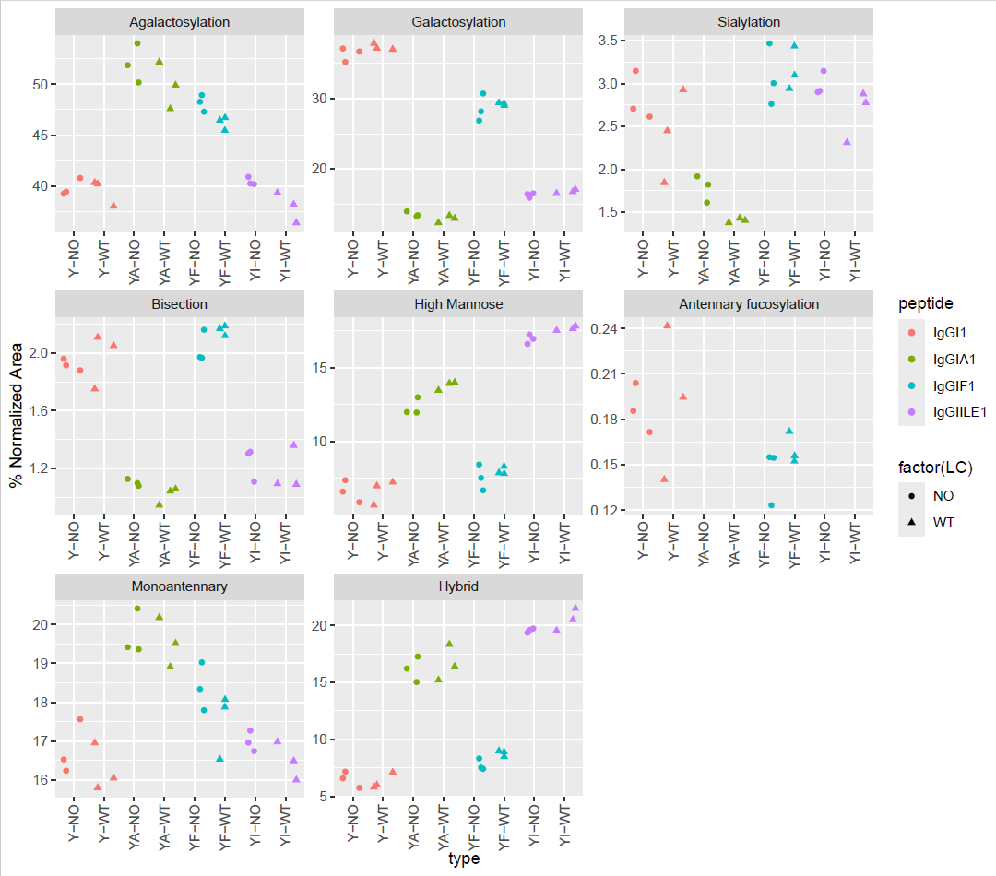
EXP02
EXP03

Slide 12
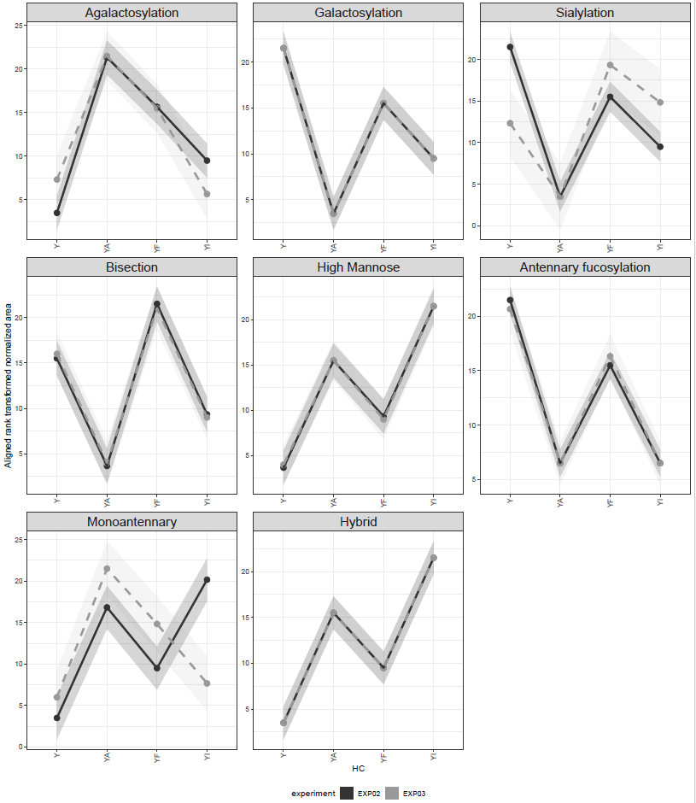
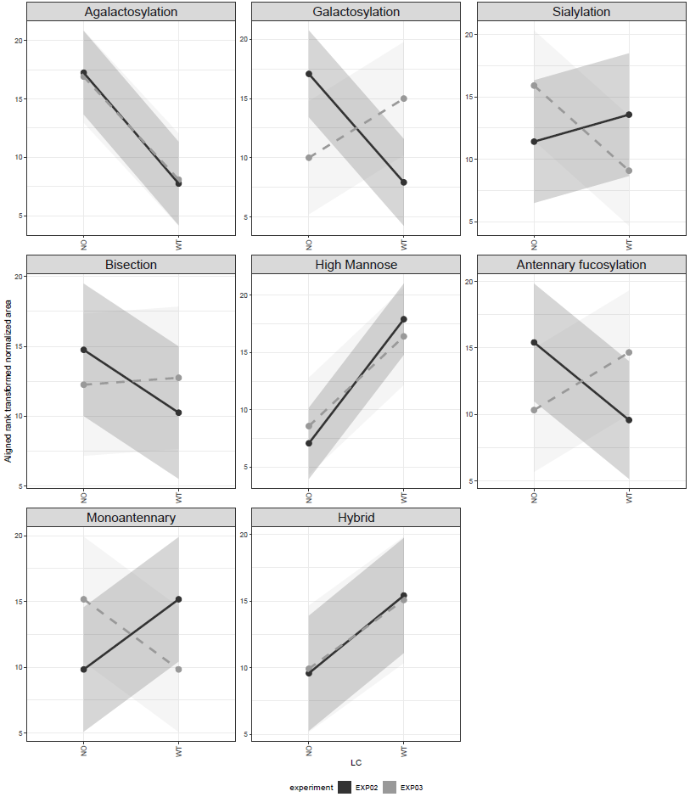
Effect of HC
Effect of LC

Slide 14
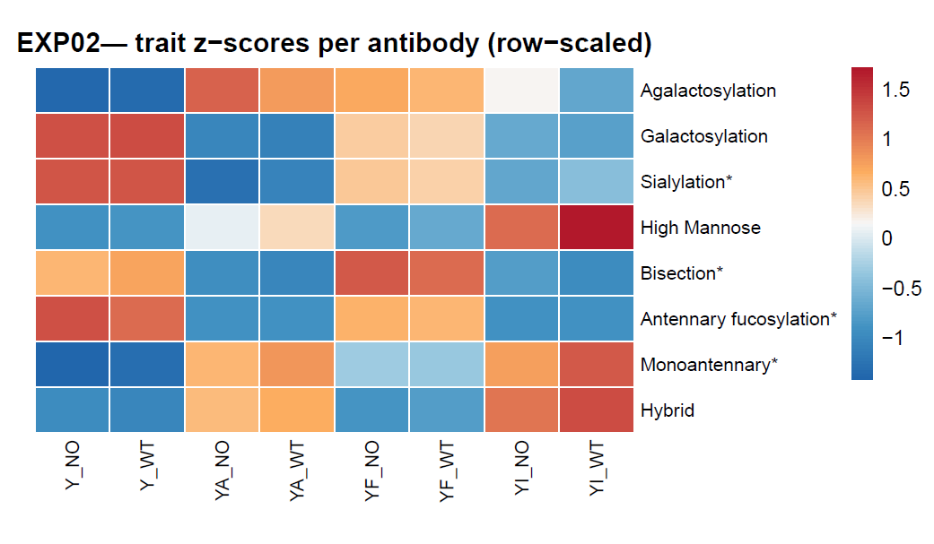
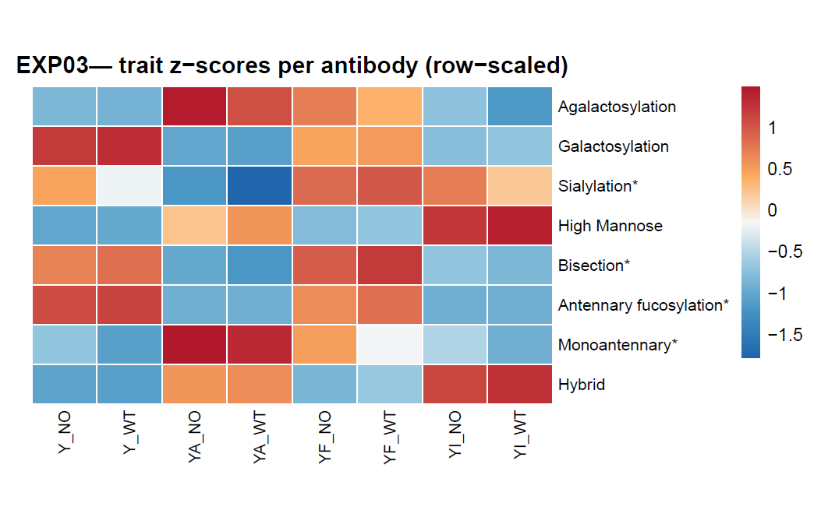
Compare traits in different IgG variants (by line)

Slide 15
Compare structures in different IgG variants (by line)
Different patterns for H3N3F1, H3N5F1, H4N3F1.

Slide 16
Conclusions
IgG Fc N-glycome composition is similar within IgGs with the same heavy chain but different light chains (WT and NO) have an impact only on agalactosylation, fucosylation and high-mannose content
Bisection, antennary fucosylation, galactosylation and sialylation are higher in IgG1_Y and IgG1_YF as compared to IgG1_YI and IgG1_YA
High mannose and hybrid structures are more abundant on IgG1_YA and IgG1_YI as compared to IgG1_YF and IgG1_Y
Core fucosylation is less abundant in IgG1_YI than on other heavy chain variants
Levels of agalactosylated glycans and monoantennary structures were lower on IgG1_Y than on other heavy chain variants

Slide 17
Conclusions
Glycan profiles are broadly consistent between the two experiments. For all sample types, the most abundant species are asialylated complex glycans. Most abundant species for all sample types is H3N4F1 (FA2G0).
Differences: in all sample types there is an increase in truncated H3N3F1 structure in EXP03. At the same time, there is a drop in the most abundant sialylated structures H4N4F1S1 (FA2G1S1) and H5N4F1S1 (FA2G2S1). Levels of bisected structures H3N5F1 and H4N5F1 also dropped.
Significance of some effects consecutively disappeared in the statistical tests.

