Slide 1
Influence of IgG amino acid sequence on attached N-glycans
Olga Zaitseva, Anika Mijakovac
Genos Glycoscience Research Laboratory, Zagreb
Faculty of Science, University of Zagreb

Slide 2
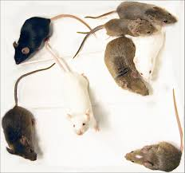
Collaborative Cross Mice
Two IgG1 allotypes with
distinct Fc-linked glycoprofiles
IgG3
IgG1F
EEQFNSTFR
IgG2
IgG1I
EEQINSTFR
Krištić et al., 2018

Slide 3
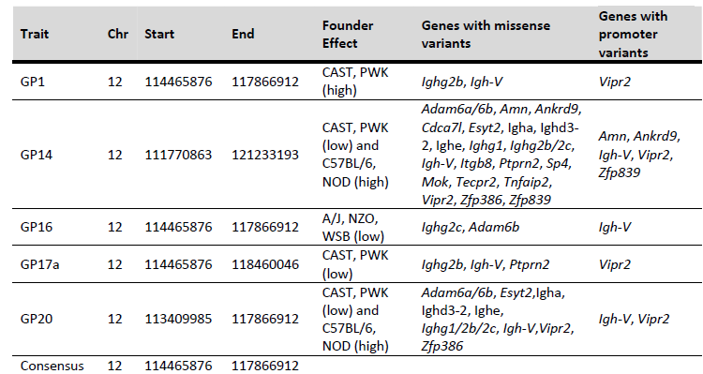
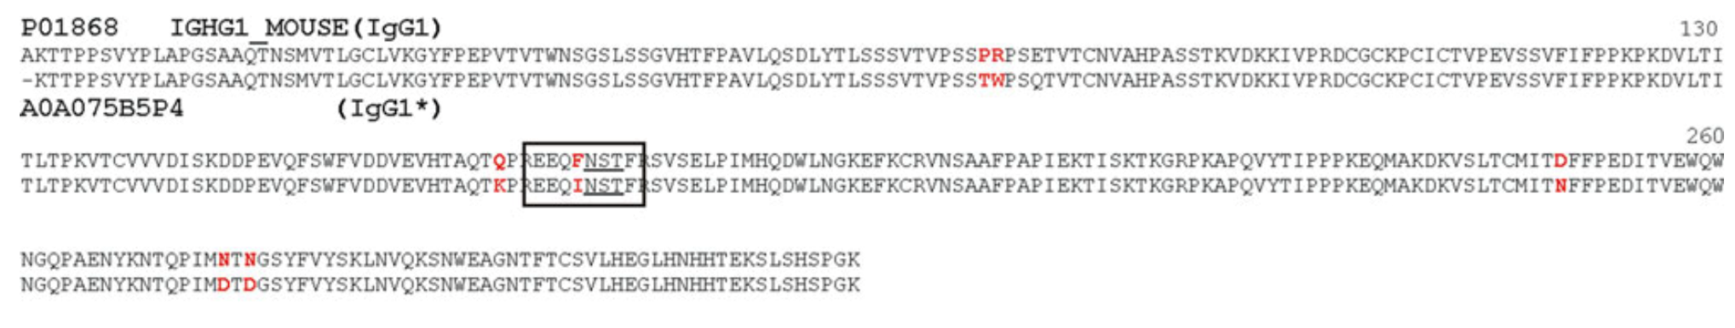
Krištić et al., 2018
Zaytseva et al., 2018

Slide 4
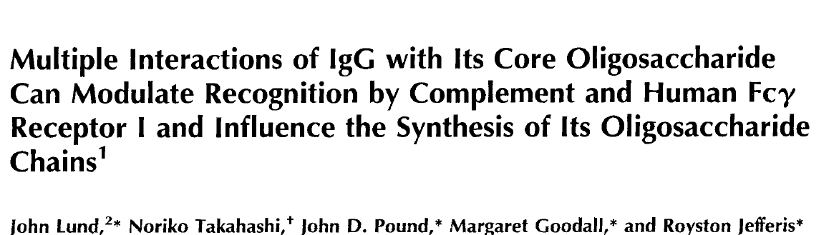
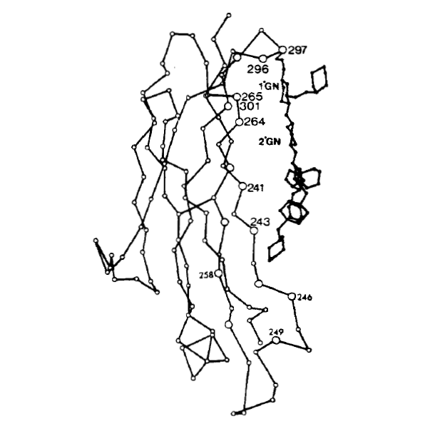
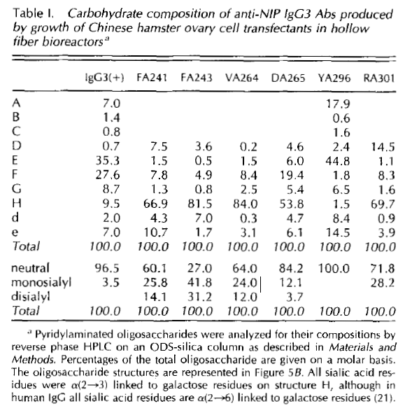
YA296 leads to reduction in galactosylation and sialylation
Human IgG3 with introduced
mutations

Slide 5
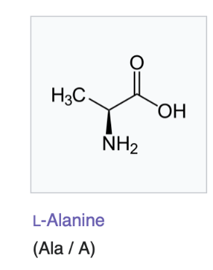
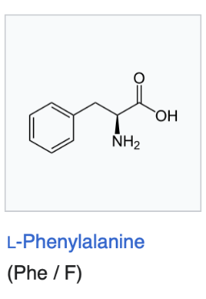
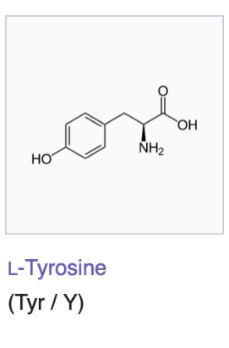
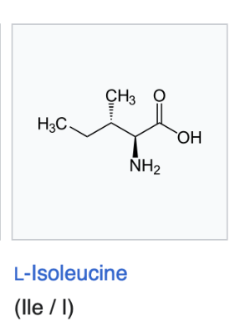
Experiment setup
Human IgG1
1 wild type heavy chain and 3 mutations:
Y296, YA296, YI296, YF296
2 types of light chain
Every type of samples produced in triplicates

Slide 6
IgG production in cell culture
Site-directed mutagenesis of IgG heavy chain (Q5 Site-Directed Mutagenesis Kit)
Sequencing to confirm the mutations
Assembly into backbone plasmid for transfection (Modules: Cbh promoter, IgG heavy chain, IgG light chain, pTerH terminator)
Transfection of FreeStyle 293-F cells
IgG secretion for 5 days
Supernatant isolation for IgG glycome analysis

Slide 7
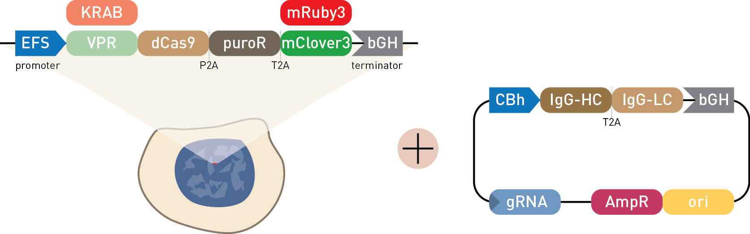
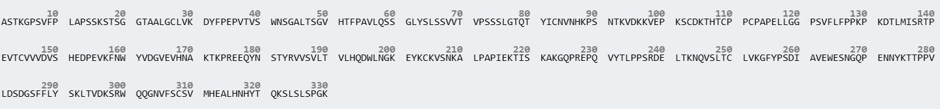
WT
NO
N-Glycosylation site
HC
LC
HC
LC
Heavy Chain
Tryptic glycopeptide
Mutated IgG1 (WT and NO)
Wild-type IgG1 (WT and NO)
EEQANSTYR
IgG1_YA
EEQYNSTYR
IgG1_Y
EEQINSTYR
IgG1_YI
EEQFNSTYR
IgG1_YF

Slide 8
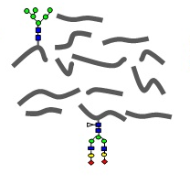
IgG isolation from cell supernatant
Clean-up and enrichment on C18 beads
Nano-reverse-phase-LC-ESI-MS
Digestion with trypsin
IgG1_Y
Quantification of glycoforms per subclass with LaCyTools
IgG1_YF
IgG1_YA
IgG1_YI

Slide 9
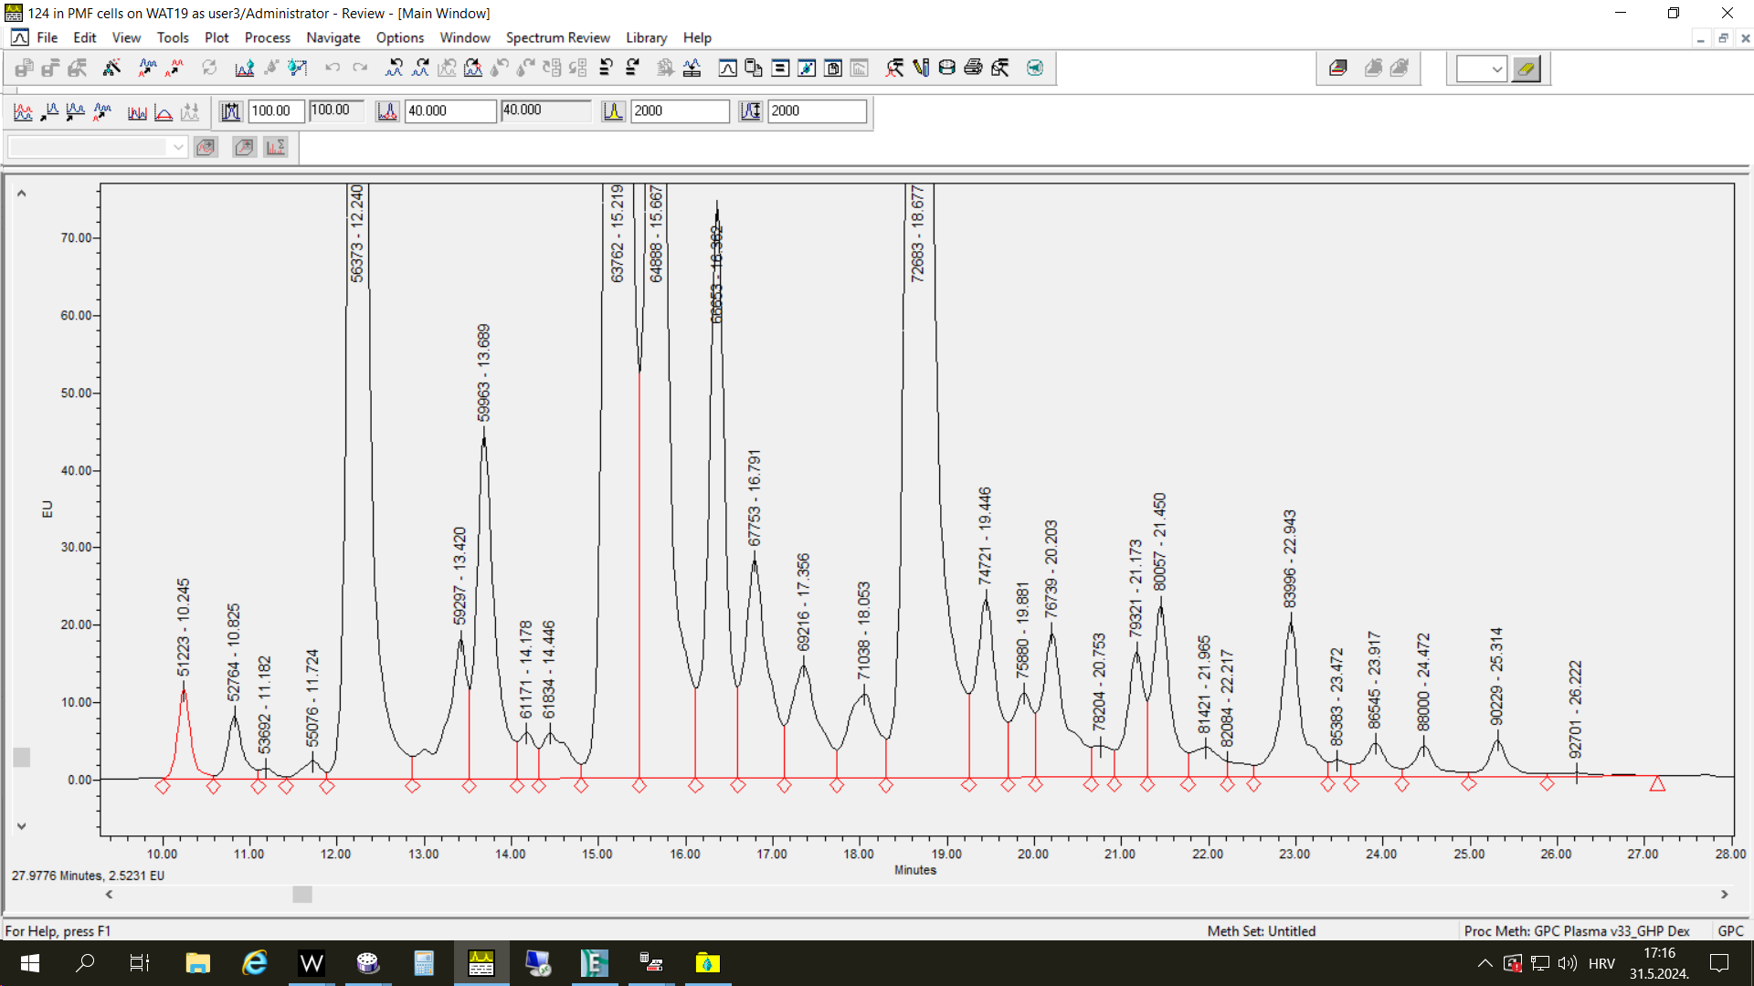
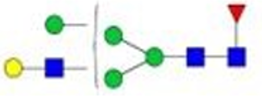
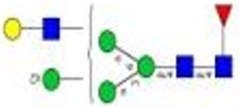
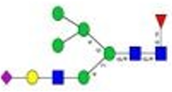


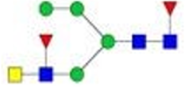
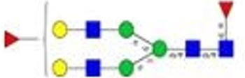
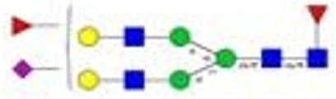
Fc-linked glycome
Free Fc-linked glycans in Free Style cells were analyzed LC-MS
18 compositions in EXP02
19 compositions in EXP03
Hybrid structures
Weird structures
Antennary fucosylation

Slide 10
Derived traits
A1 = H3N3F1
G0 = H3N3F1 + H3N4F1 + H3N5F1
G =H4N4F1+H4N5F1+H5N4F1+H5N4F2+H5N5F1+H6N3F1
S = H4N4F1S1 + H5N4F1S1 + H5N4F1S2 + H6N3F1S1
M = H4N2 (EXP03) + H5N2+H6N2
B = H3N5F1+H4N5F1+H5N5F1
AntennaryF = H5N4F2
H = H5N3F1 + H6N3F1 + H6N3F1S1

Slide 11
Compare structures in different IgG variants
EXP02
EXP03
H3N4F1, H4N4F1 and H3N3F1-major structures in both exps
H3N3F1 is higher in EXP03 though

Slide 12
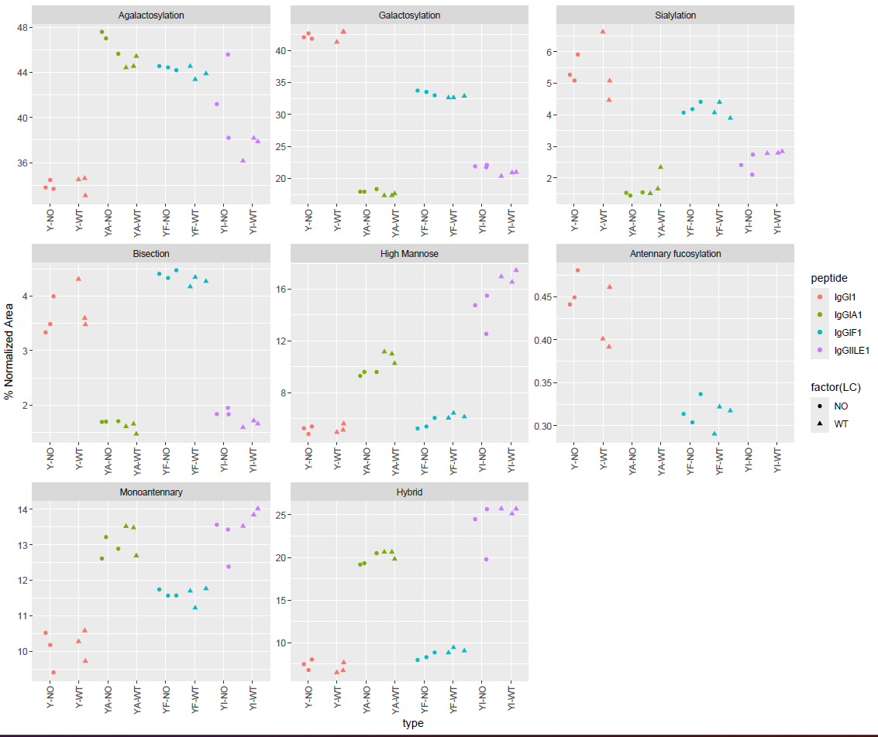
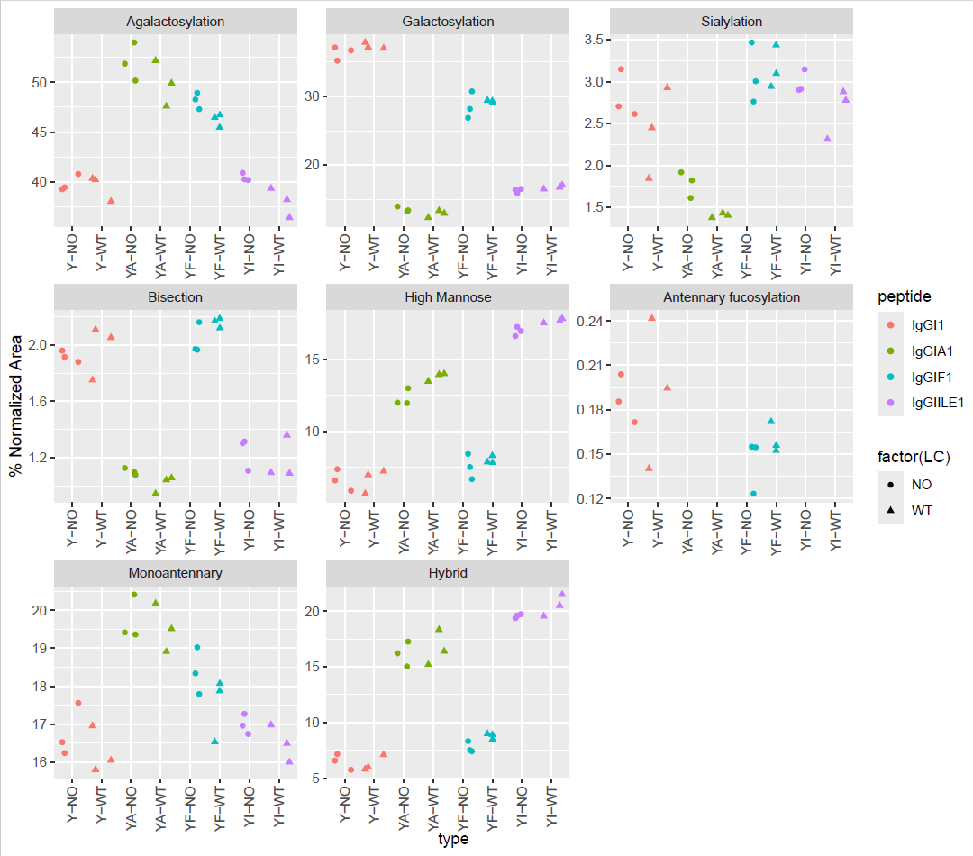
EXP02
EXP03

Slide 13
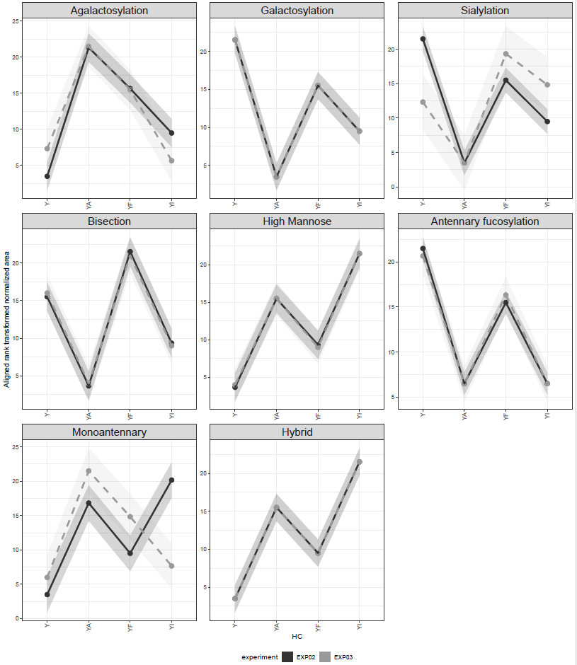
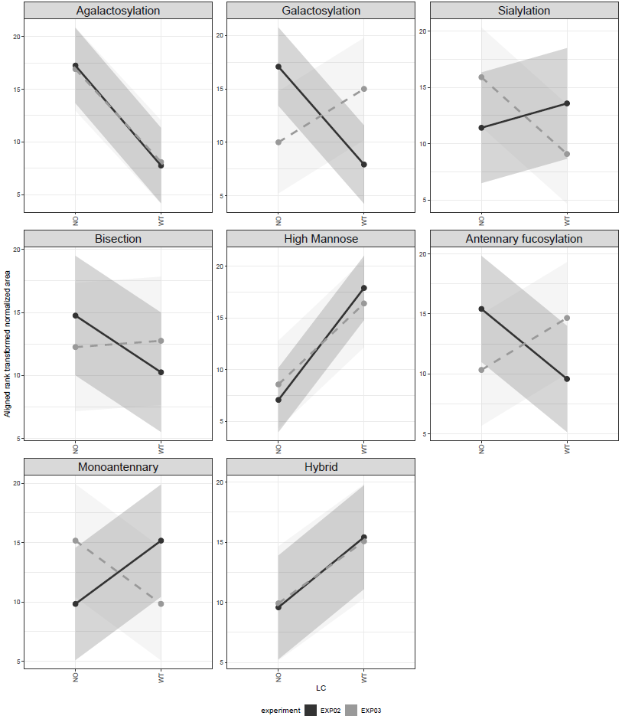
Effect of HC
Effect of LC

Slide 15
Compare traits in different IgG variants
Samples cluster according to the HC not the LC
B, AF and G are high Y and YF and low in YA and YI
G0 is high in YA and YF and low in Y and YI
H and HM are high in YA and YF and low in Y and YF

Slide 16
Conclusions
The primary driver of IgG Fc N-glycome composition is the HC sequence with a significant HC main effect replicated across both experiments for 7 of 8 traits (except for monoantennary glycans).
The effects of LC chain are limited and replicated only for agalactosylation (NO > WT) and high-mannose content (WT > NO).
No HC×LC interactions replicated between the experiments.
Two groups of traits show opposite HC-dependent patterns. Galactosylation, sialylation, bisection, and antennary fucosylation are elevated in Y and YF relative to YA and YI in both experiments. High-mannose and hybrid structures show the reverse — elevated in YA and YI. Hierarchical clustering of antibody z-score profiles groups Y with YF and YA with YI in both experiments, reflecting this shared directionality.
Agalactosylation peaks at YA, is second high in YF, further declines at YI and is lowest at Y. This pattern is not shared by any other structure.
Monoantennary structures show a significant HC effect in both experiments but with inconsistent direction at YI between experiments and are therefore not considered robustly replicated.
For all antibodies, the most abundant species are asialylated complex glycans dominated by H3N4F1 (FA2), H4N4F1 (FA2G1) and H3N3F1 (FA1). An increase in H3N3F1 is observed in EXP03 relative to EXP02 across all sample types.

