Slide 1
BidDrive.com MVP site-flow
(November 2014)
BidDrive.com is a reverse auction platform for new car sales, powered by the Edmunds API. We are hoping to be a strong contestant in the 2015 Hackomotive contest. This presentation will explain the “flow” of the car buying process on our website, for both buyers and dealers.
Disclaimer- BidDrive.com is currently undergoing graphical redesigns and internal optimizations. Therefore certain features and functions are subject to change before the contest. This presentation will contain screenshots from various versions of the web application in order to demonstrate the site-flow most efficiently.

Slide 2
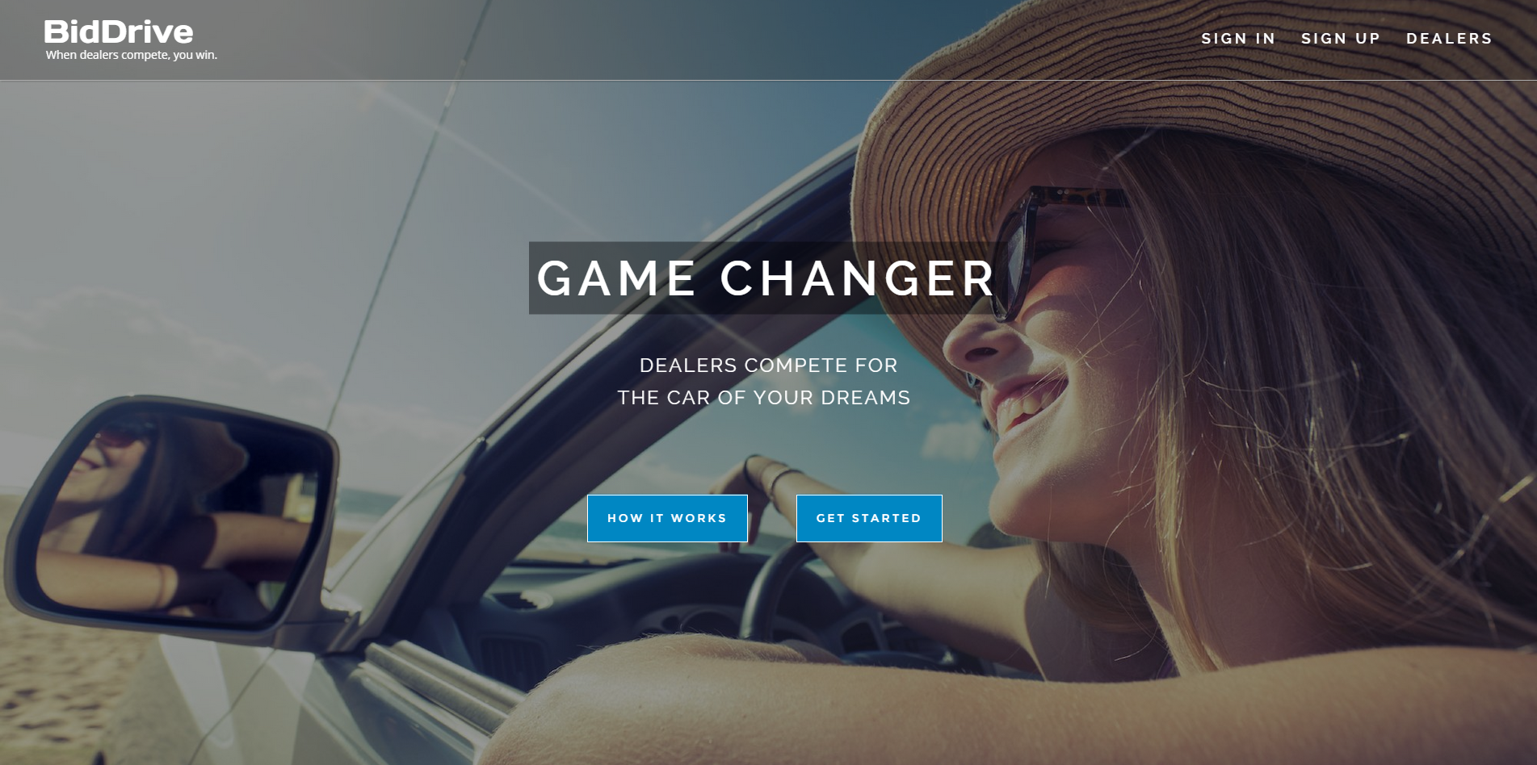
Intro: Sleek responsive website

Slide 3
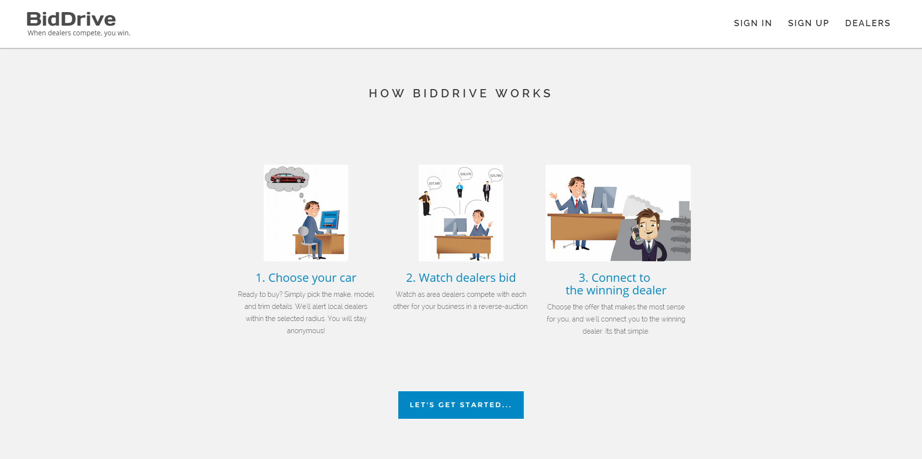
Intro: Sleek responsive website

Slide 4
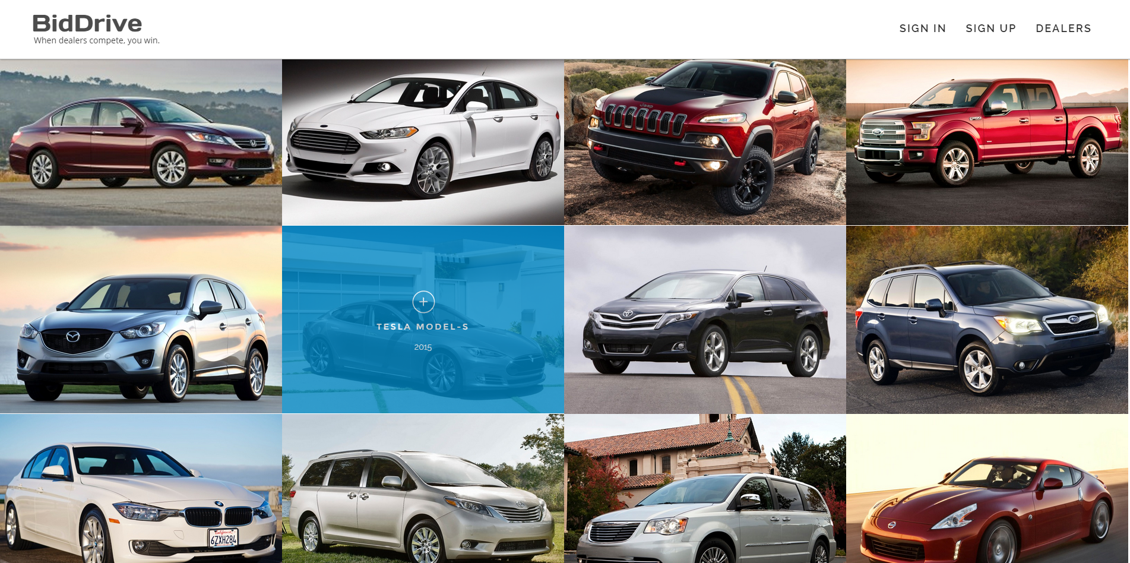
Intro: Sleek responsive website

Slide 5
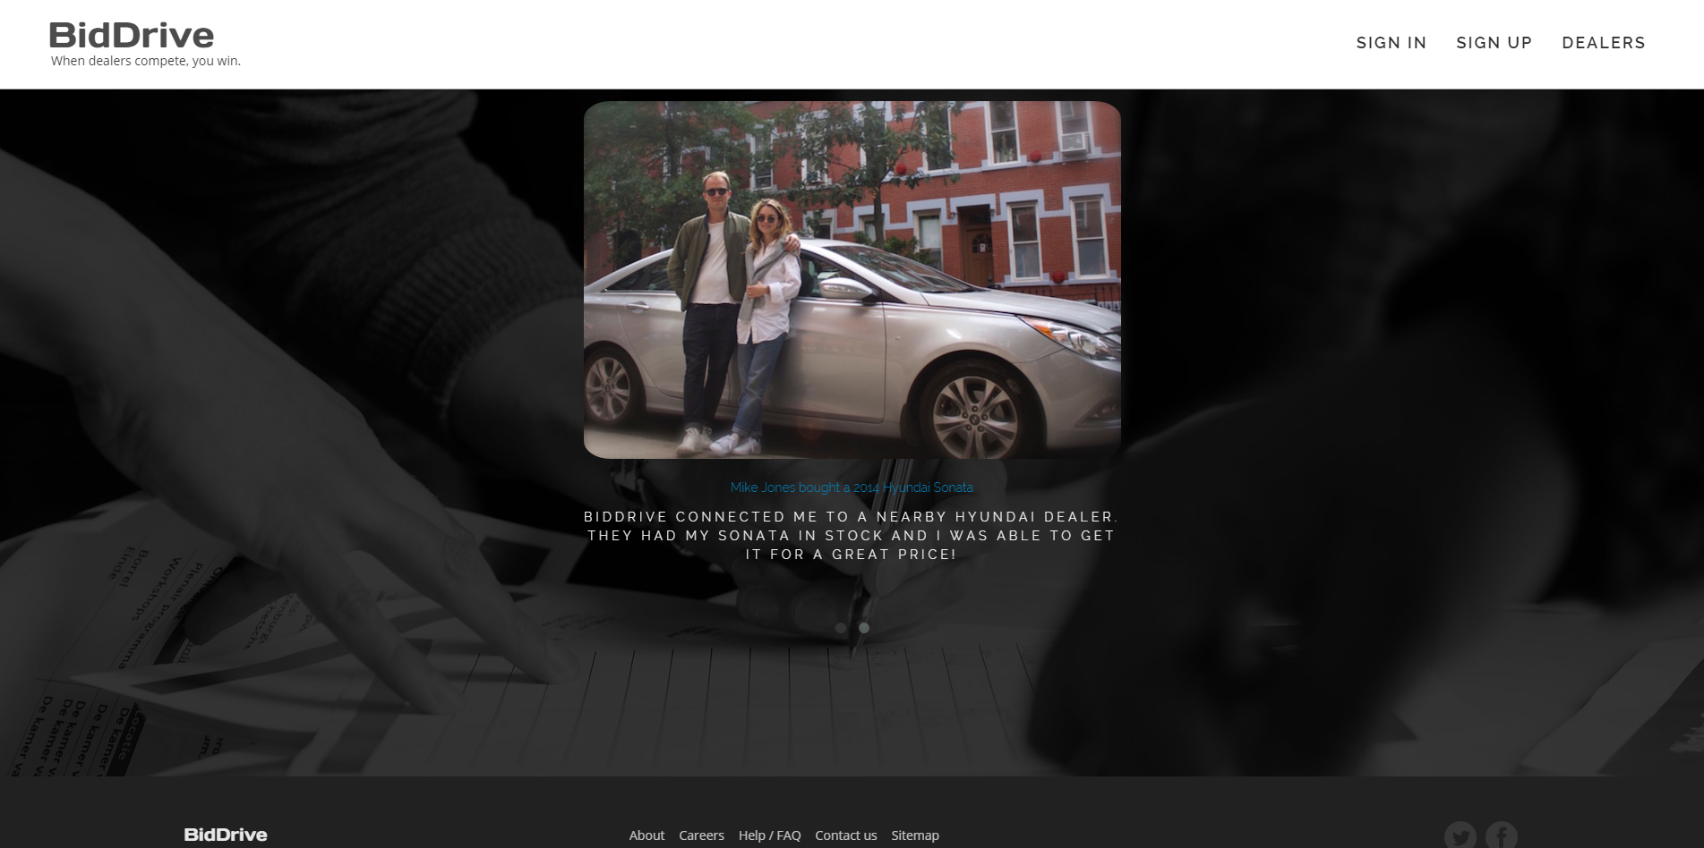
Intro: Sleek responsive website

Slide 6
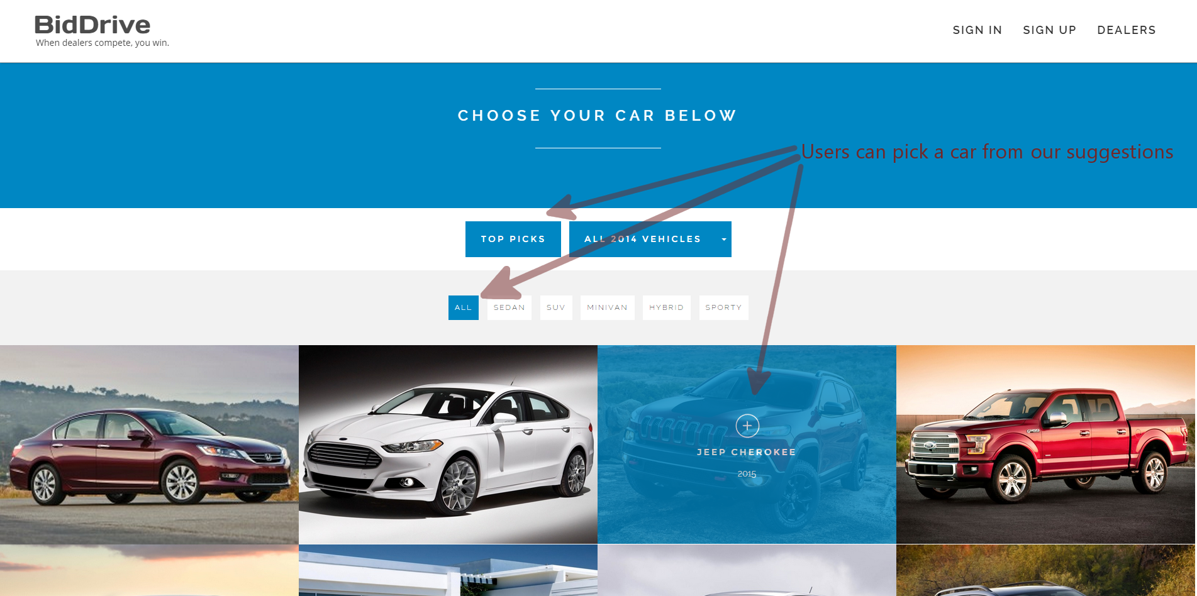
Buyer has two ways to choose a car

Slide 7
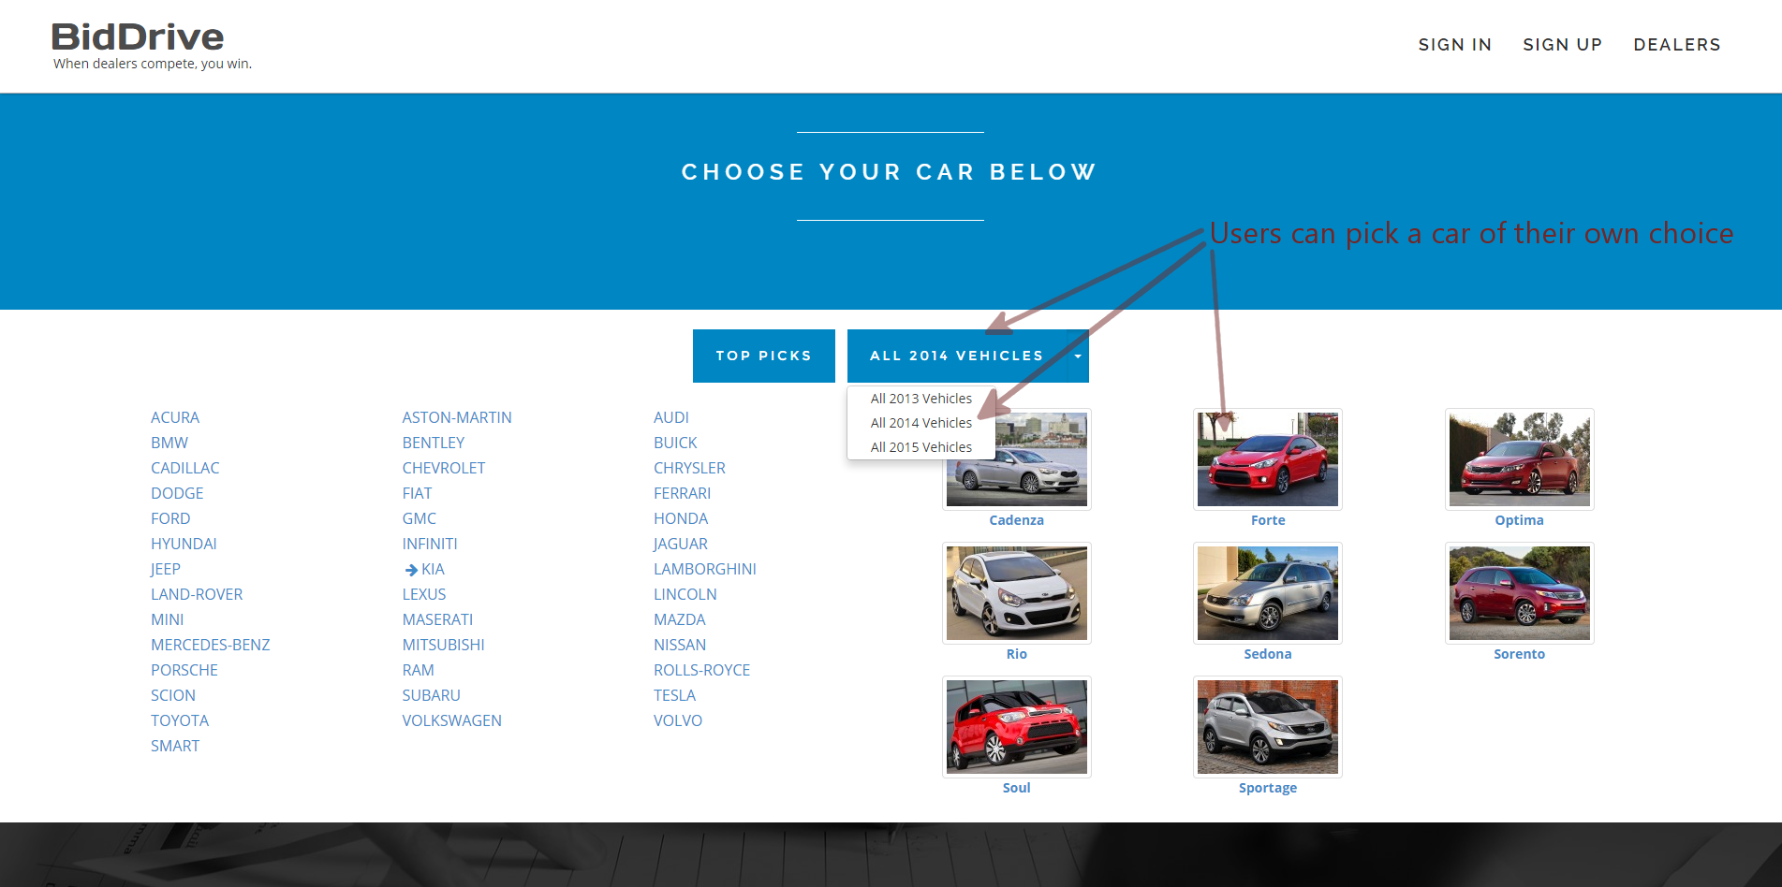
Buyer has two ways to choose a car

Slide 8
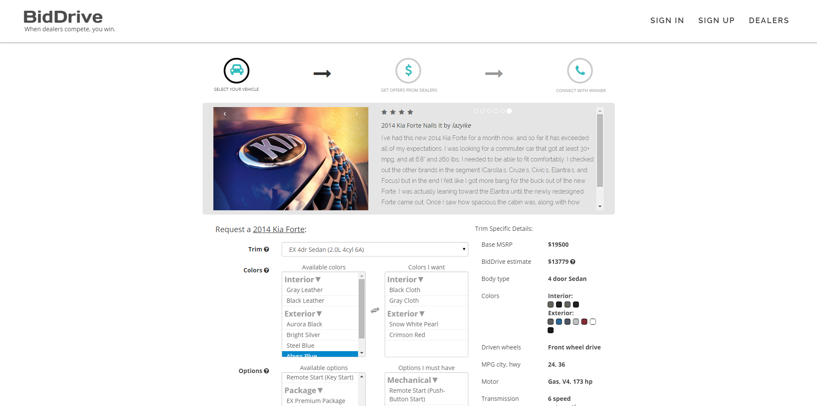
Buyer specifies her car and herself

Slide 9
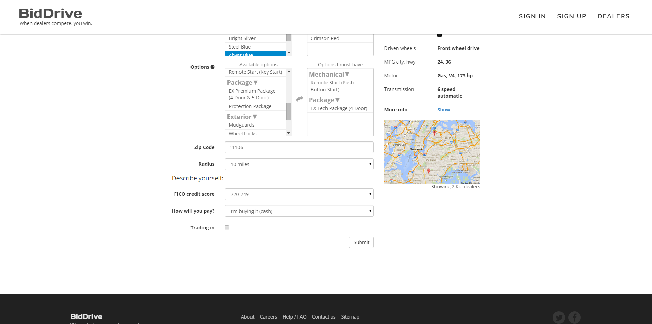
Buyer specifies her car and herself

Slide 10
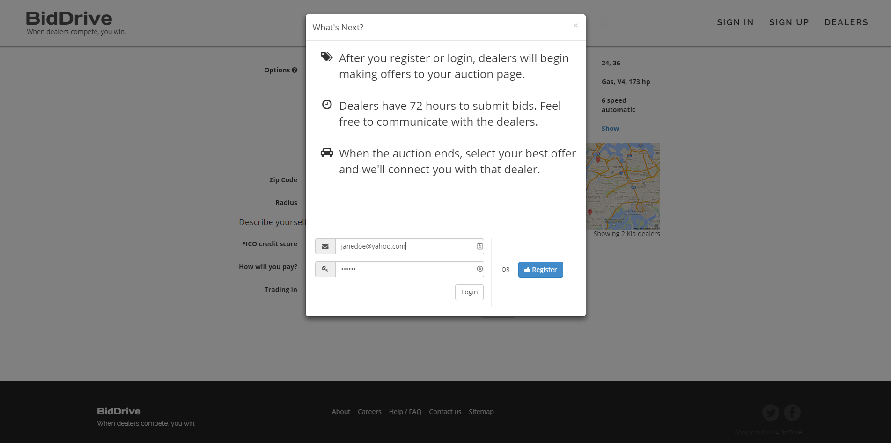
Buyer registers or logs in

Slide 11
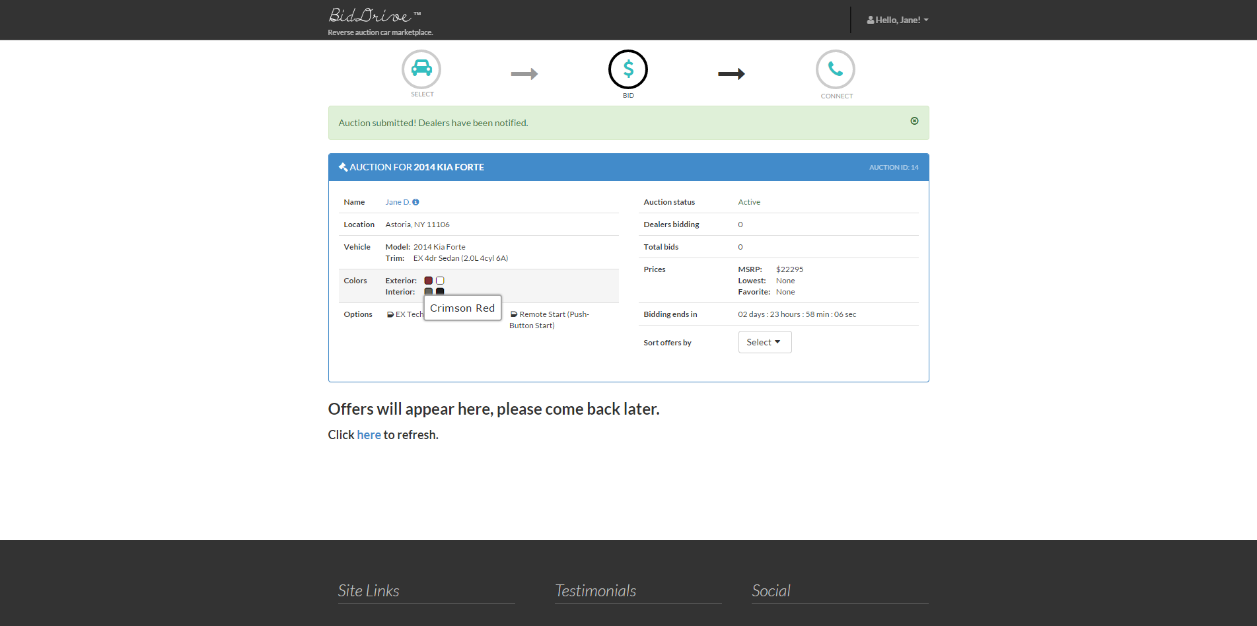
Buyer waits for offers from dealers

Slide 12
The BidDrive auction process
Registered Kia dealers within the buyer's radius will be alerted via email, phone call, and/or SMS.
Dealers will submit their vehicle and compete with other dealers by gradually decreasing their prices (reverse auction).
The auction will end after 72 hours. Within this time the buyer can communicate with dealers via private messages. The buyer and dealers will also receive email/SMS alerts regarding the status of the auction (ie new offers, changes to bids, private messages, etc.).
After the auction ends, the buyer has an additional 24 hours to choose a winner.
Alternatively, a dealer can submit a tantalizing “final offer,” and the buyer will have the option to end the auction short.
After the buyer picks a winner, the buyer calls our automated “middleman” hotline to connect with the winning dealer. Email or telephone numbers are NEVER exposed between the buyer and the dealer. This is the crux of our “no hassle” approach.
Our servers detect when a conversation initiated, and a “certificate of guarantee” appears on the buyer's screen, thus completing the auction process. The buyer prints this certificate and takes it to the winning dealer to purchase the car at the guaranteed price.

Slide 13
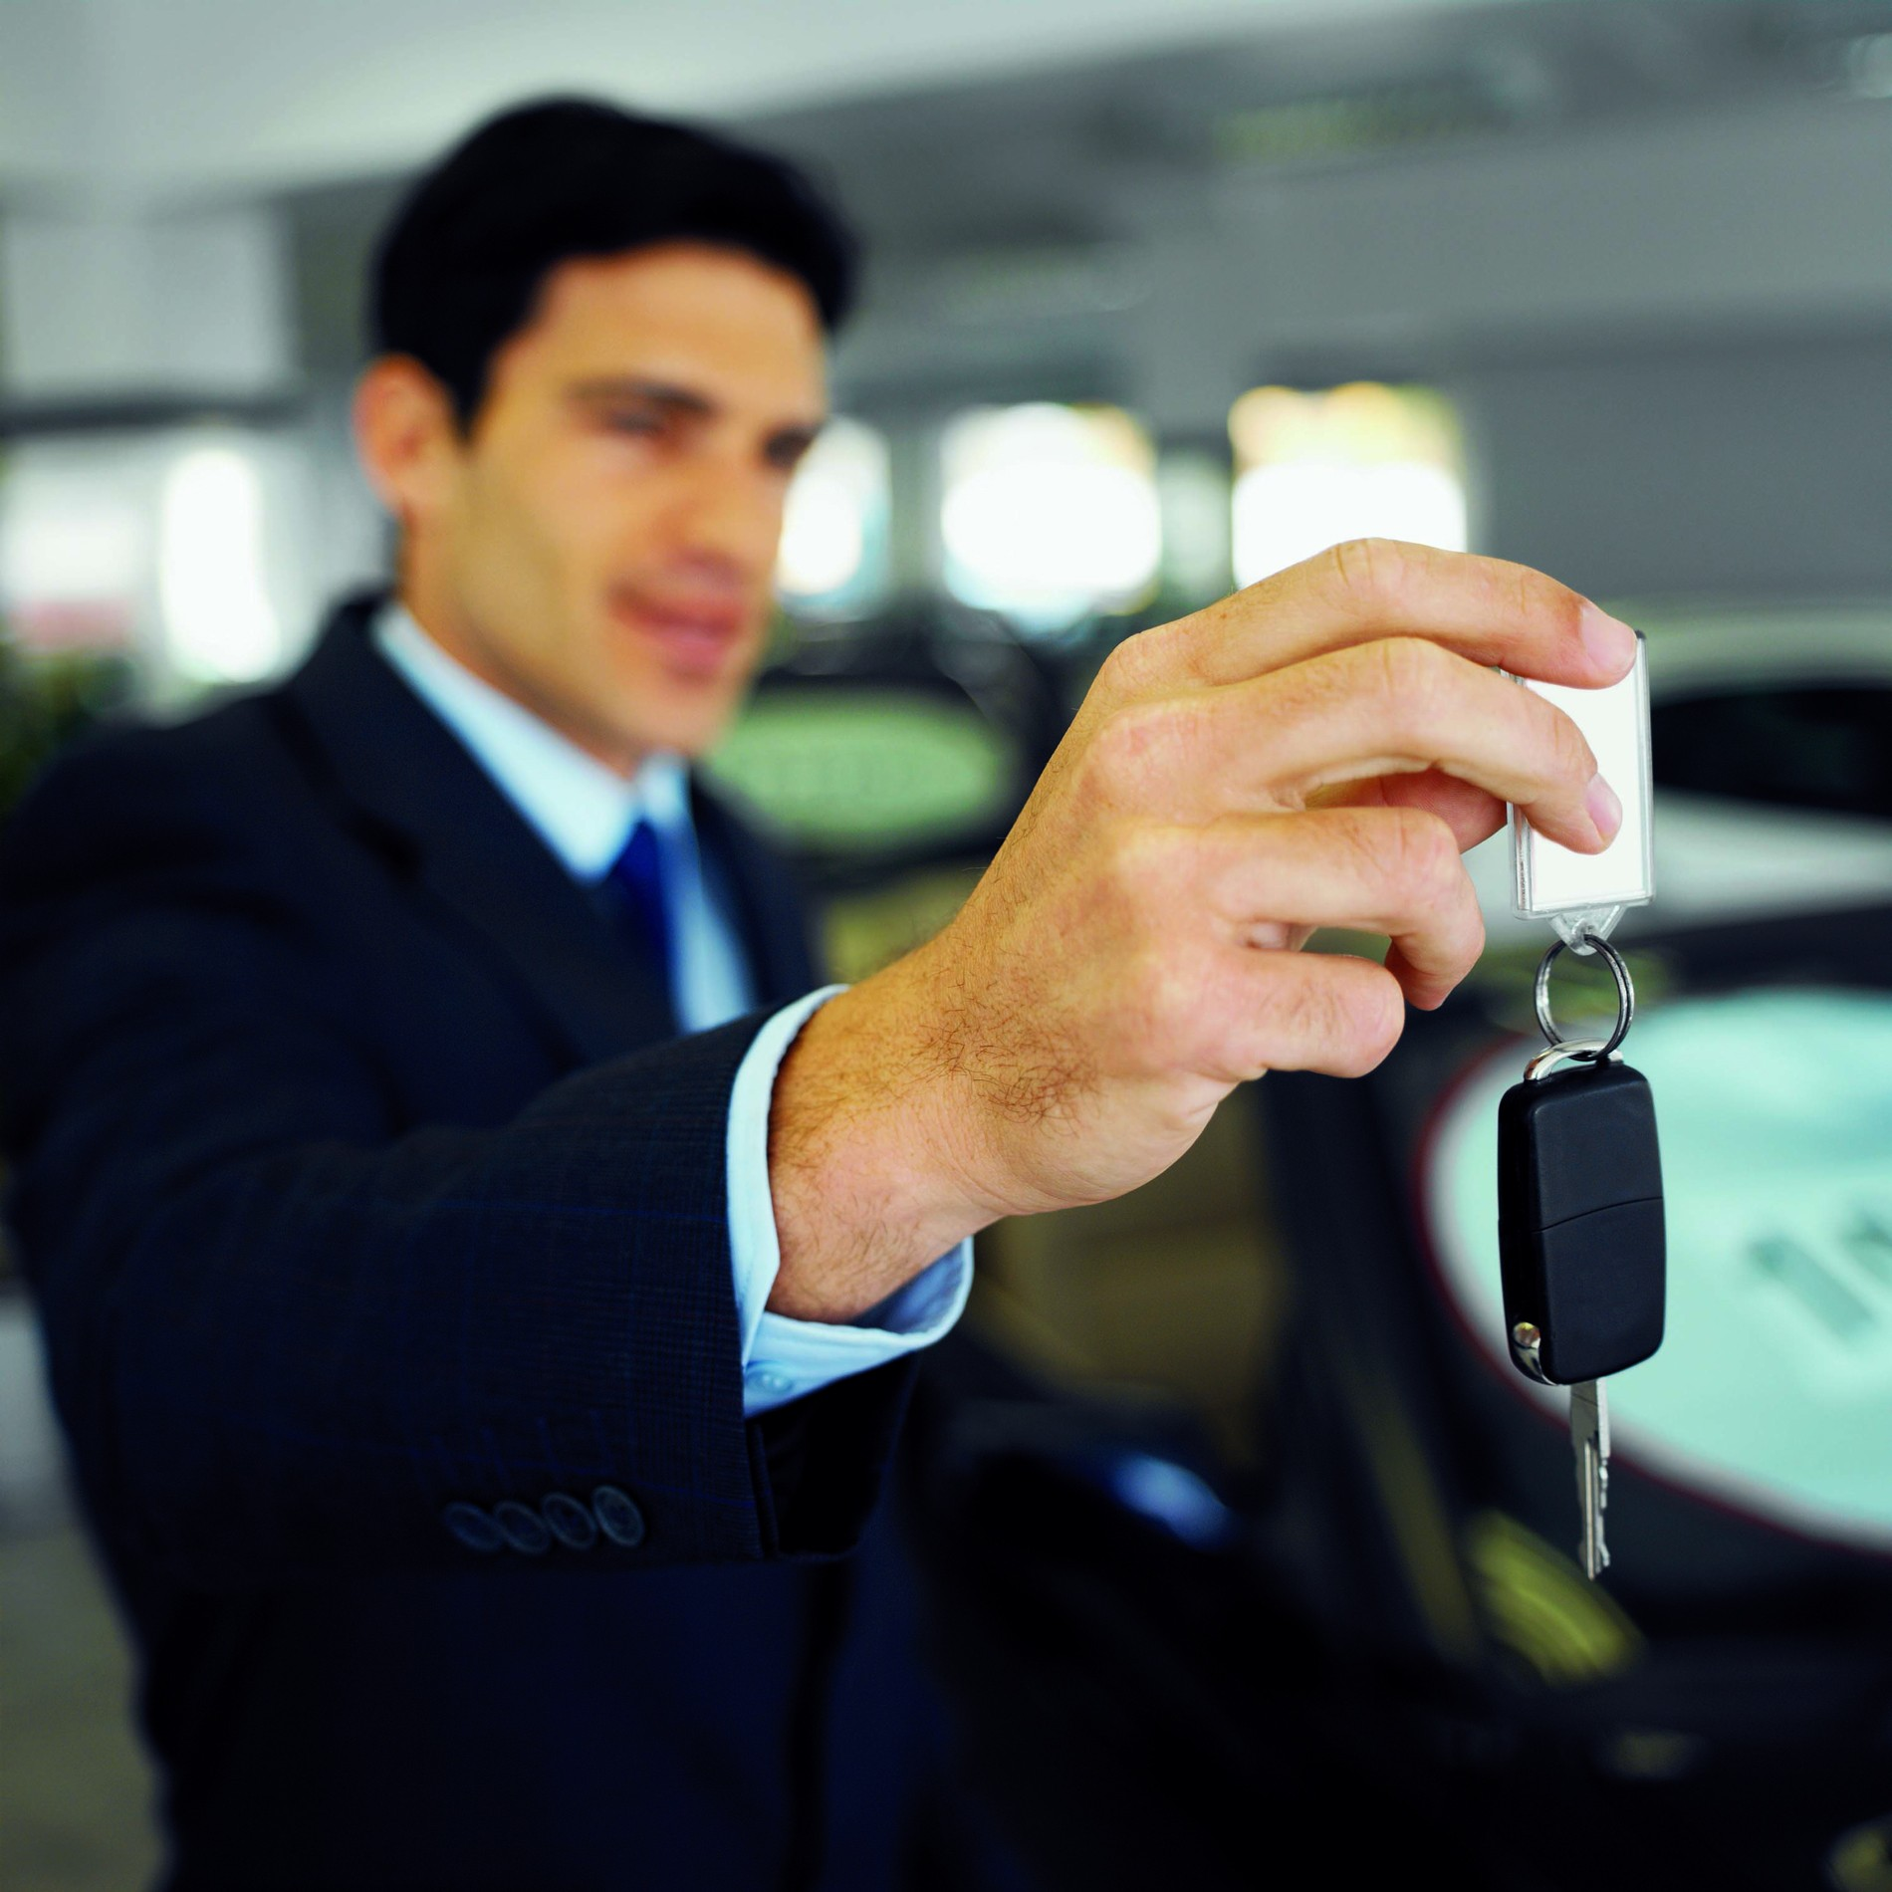
Now to the dealer...

Slide 14
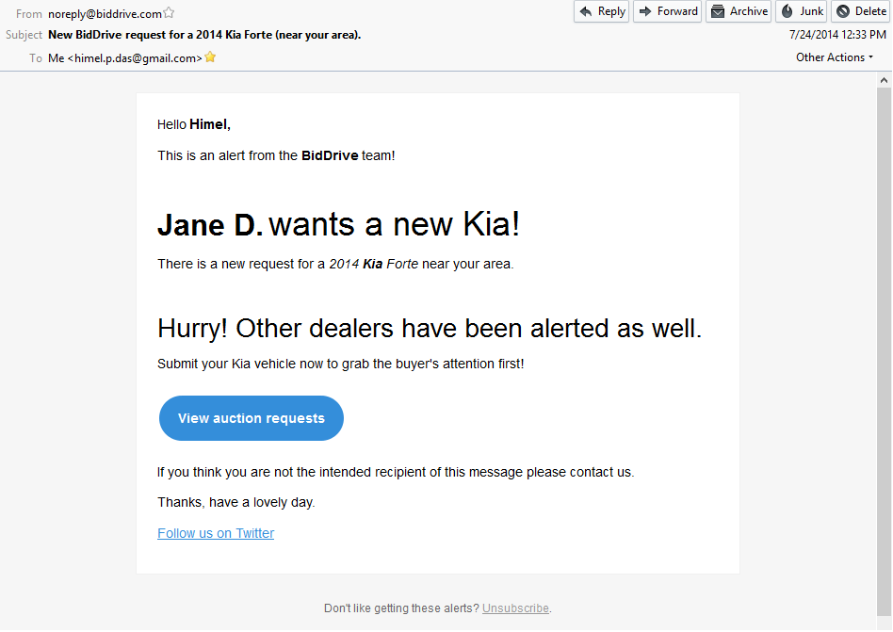
Dealer gets an alert about a request and is directed to the website

Slide 15
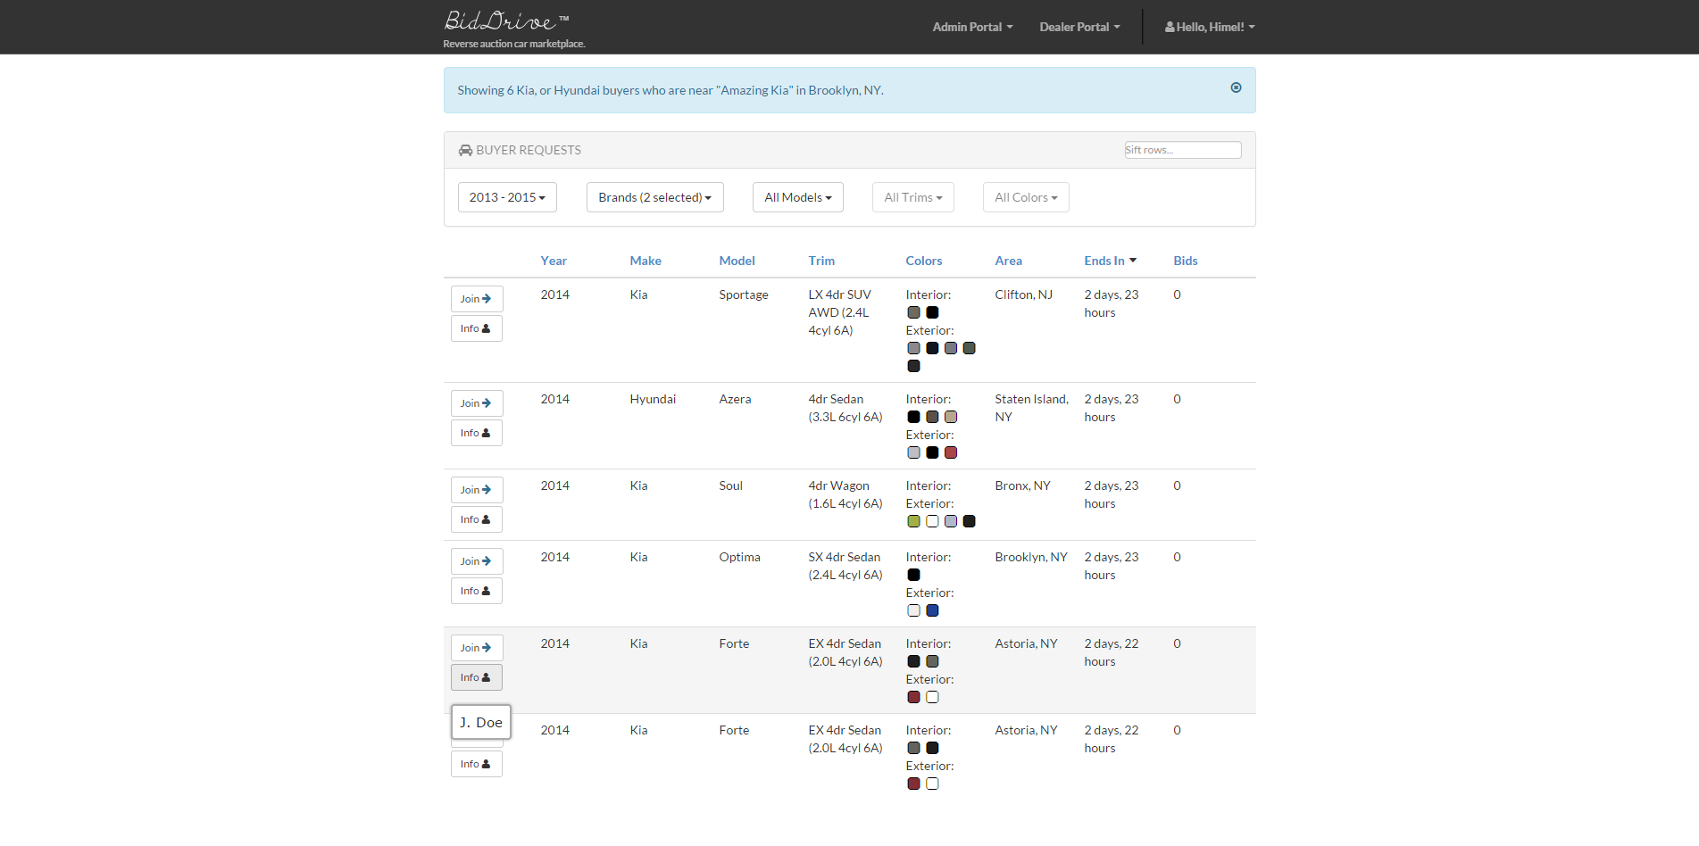
Dealer views nearby requests and selects one that matches inventory

Slide 16
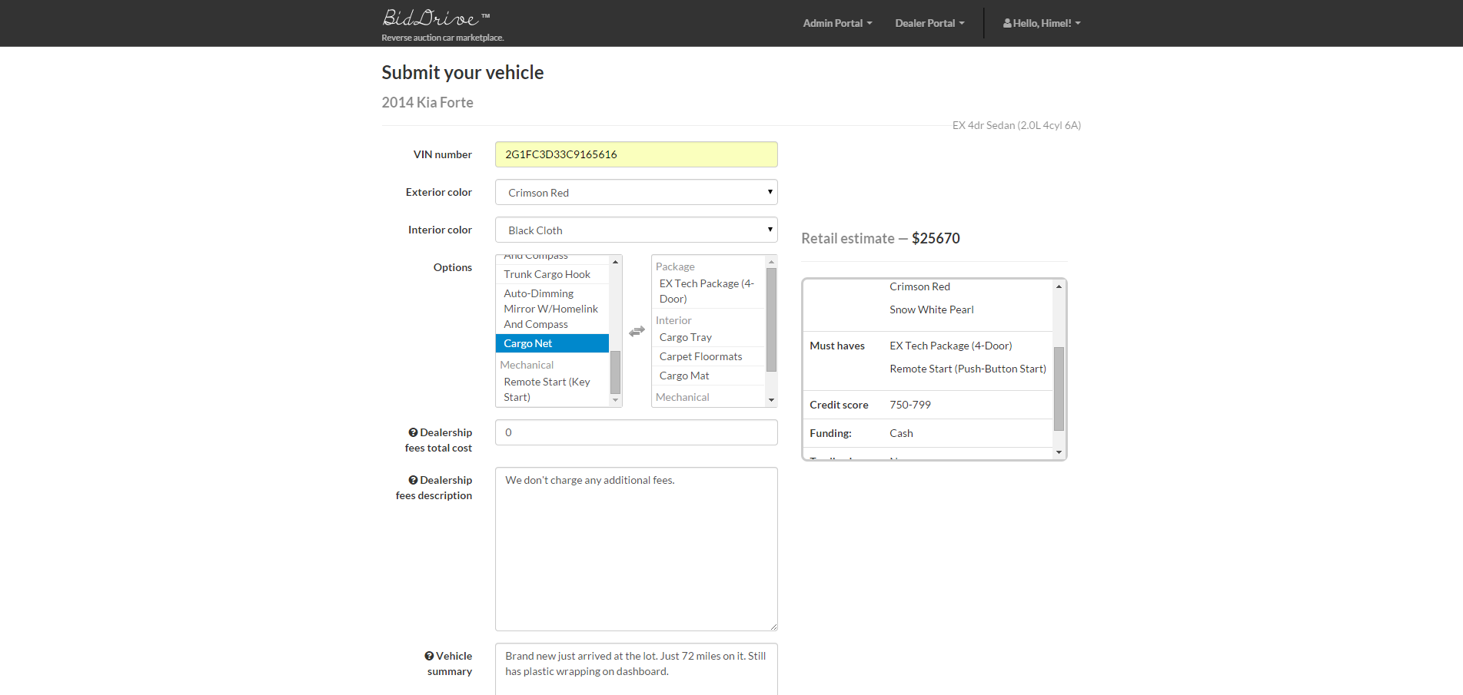
Dealer fills in details about the car that he wants entered in the auction

Slide 17
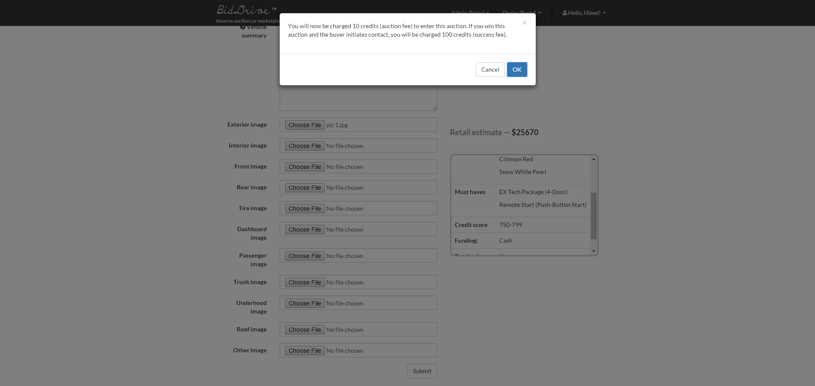
Dealer fills in details about the car that he wants entered in the auction

Slide 18
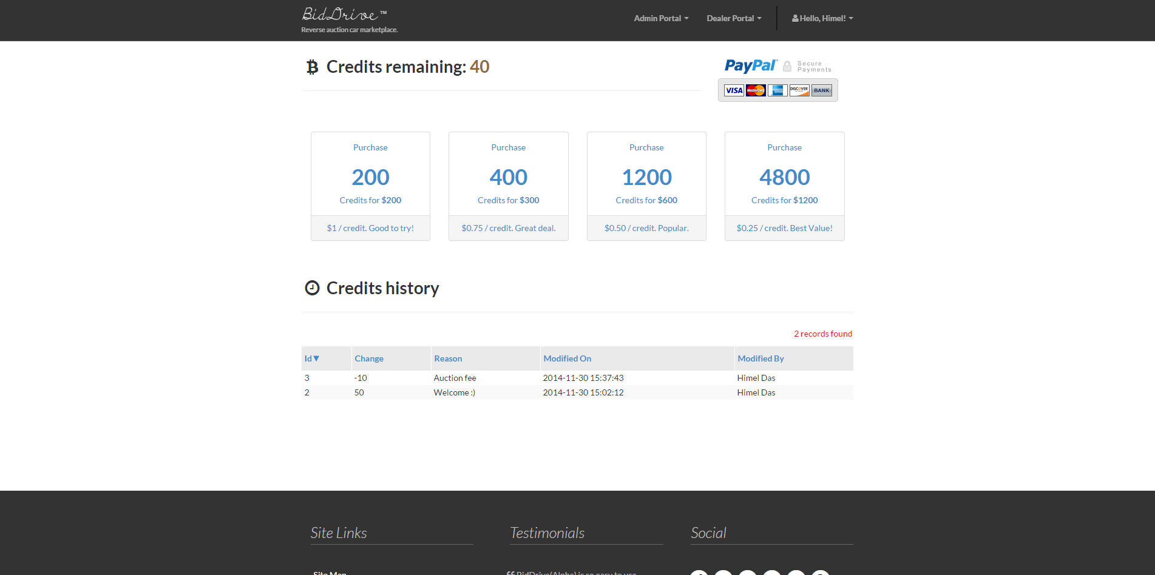
Dealer can purchase more credits to enter auctions whenever necessary (sample pricing shown)

Slide 19
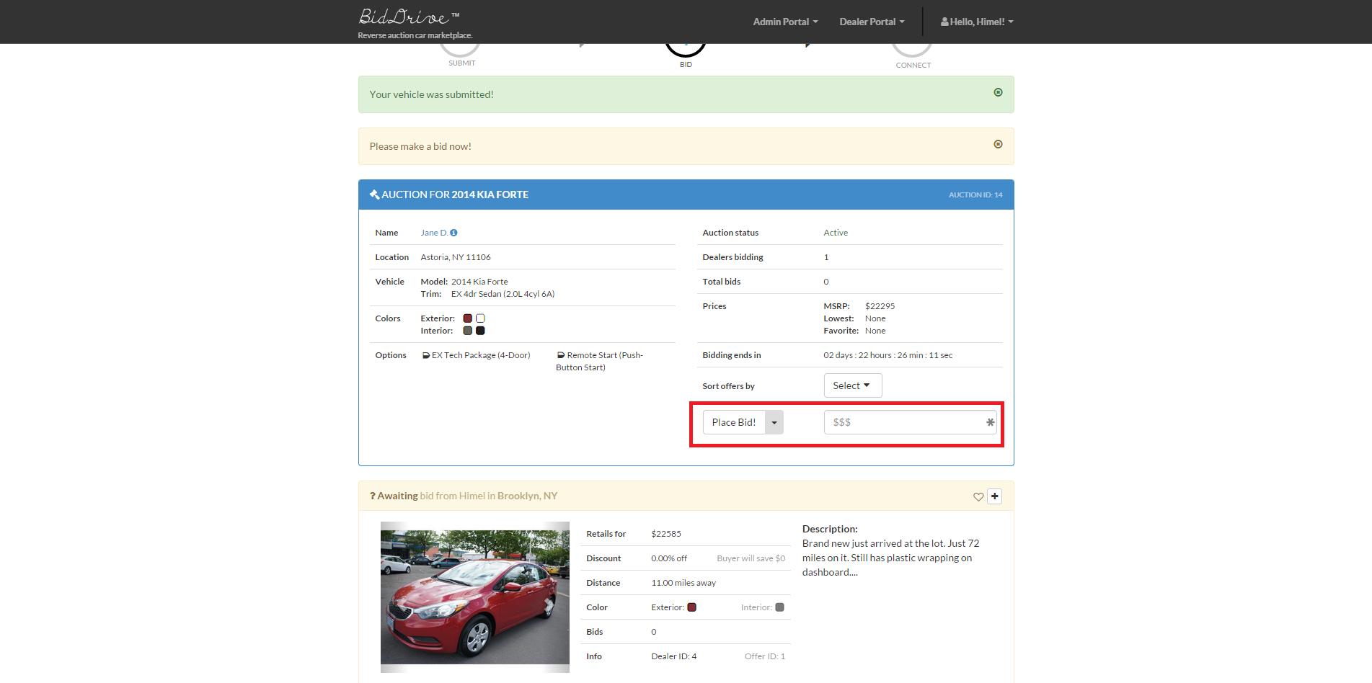
Dealer now enters the auction and can set/adjust the bid price

Slide 20
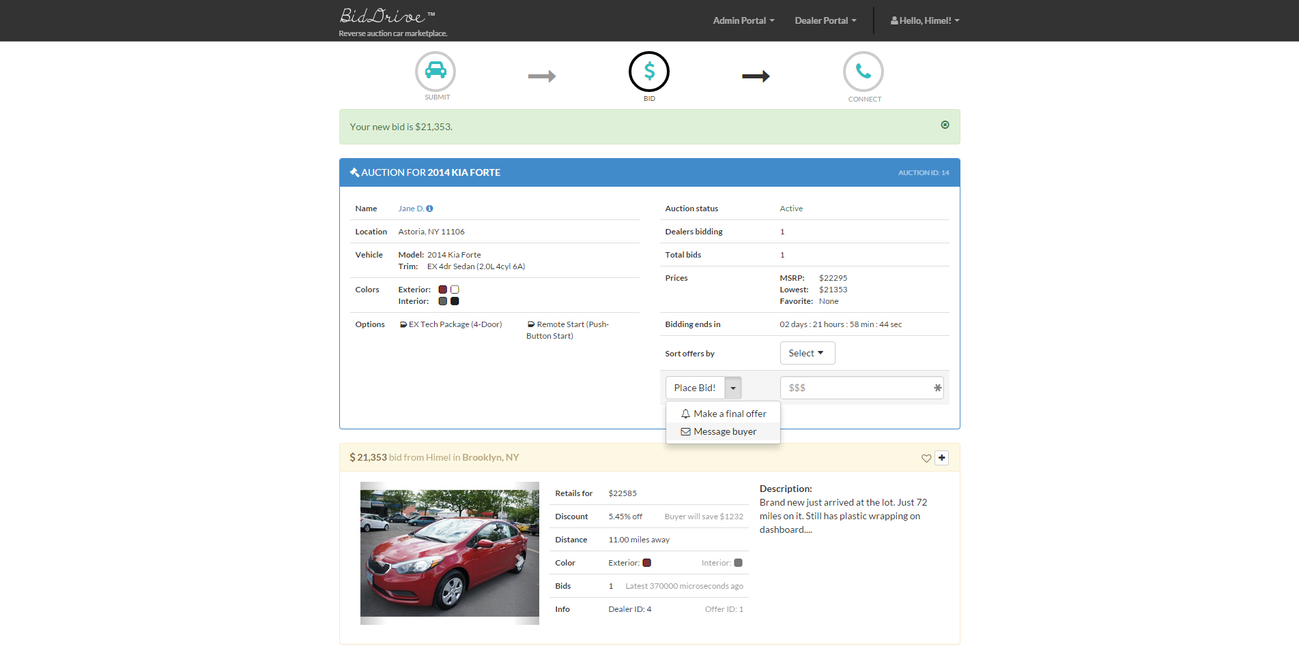
Dealer can message the buyer to convince her this is the right vehicle

Slide 21
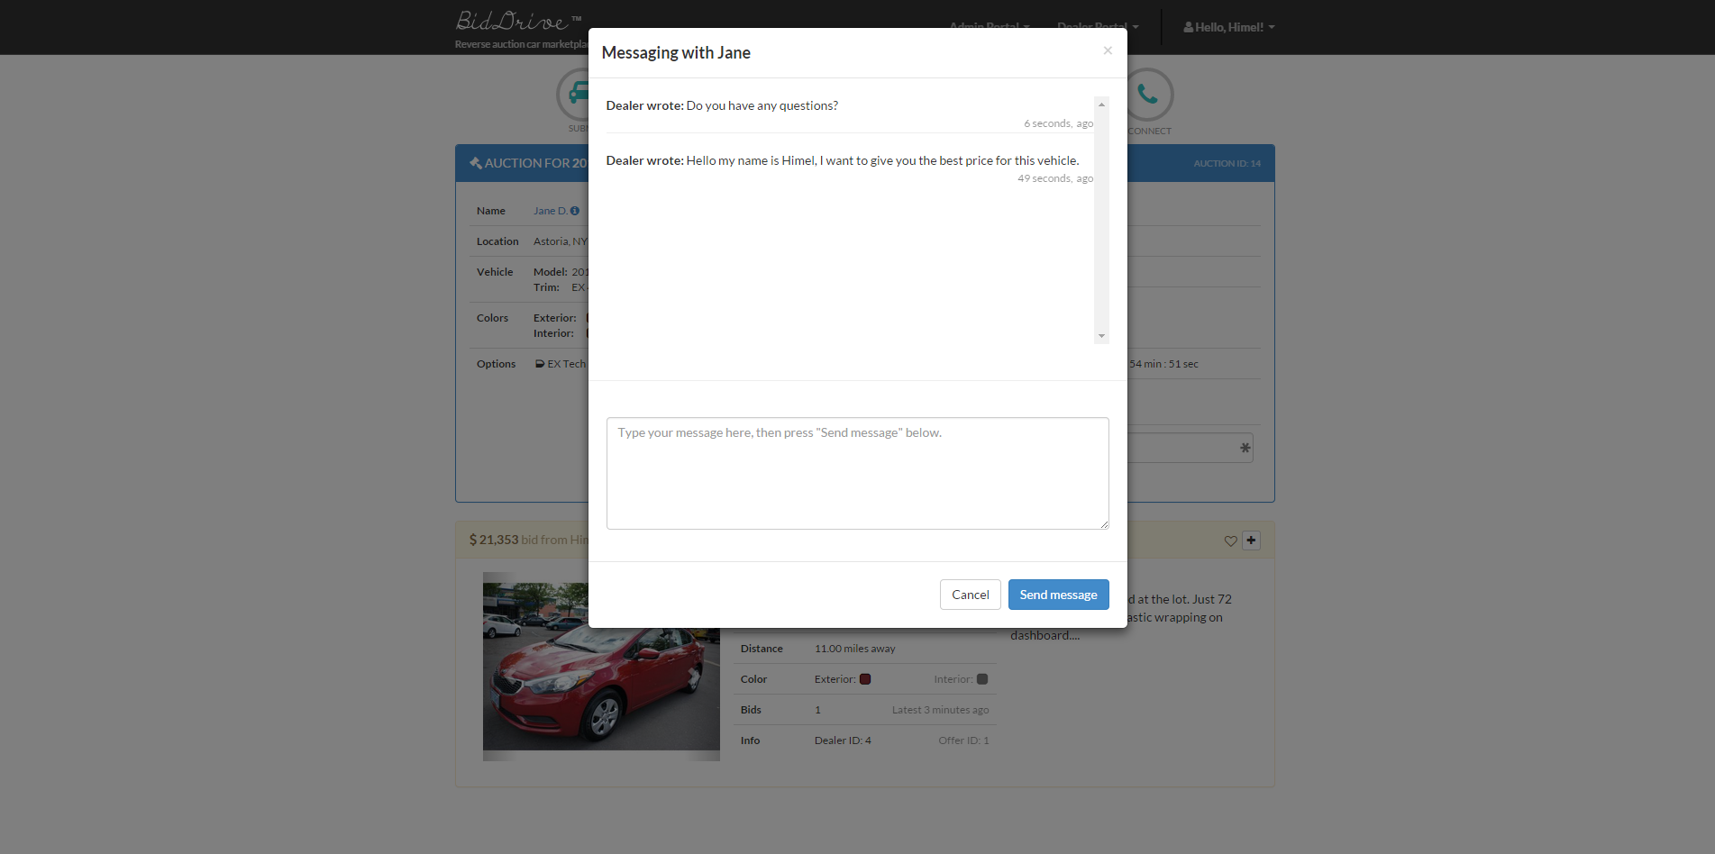
Dealer can message the buyer to convince her this is the right vehicle

Slide 22
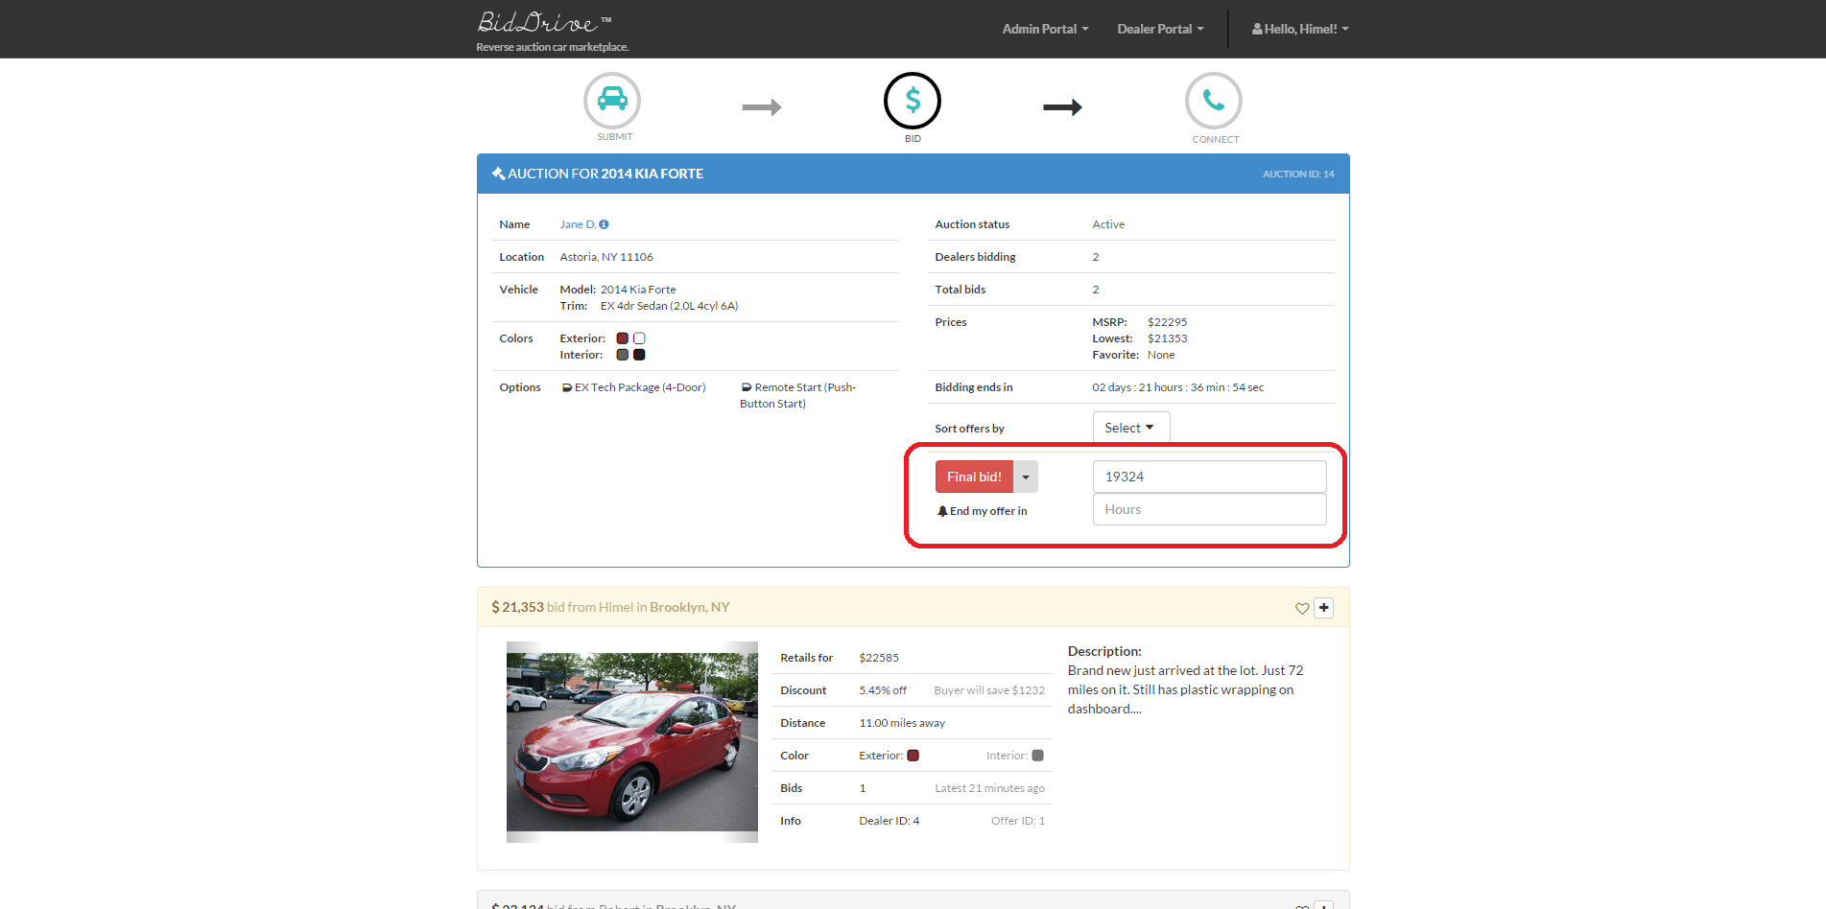
Dealer can also entice the buyer by making a “final bid,” which is the lowest price that he can offer her

Slide 23

Final bid submitted

Slide 24

Back to the buyer...

Slide 25
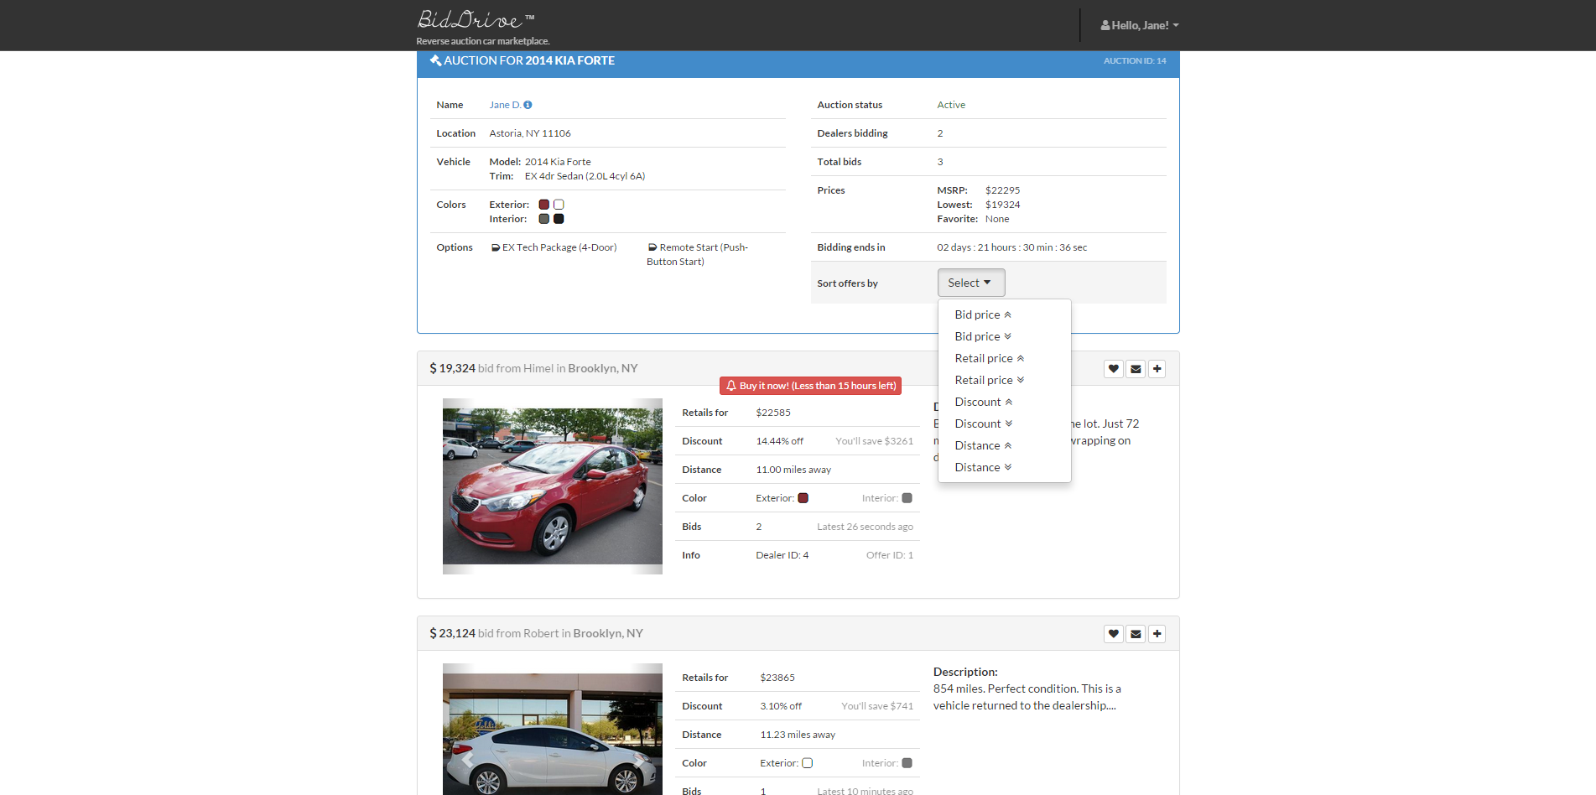
Buyer begins to receive new vehicle submissions

Slide 26
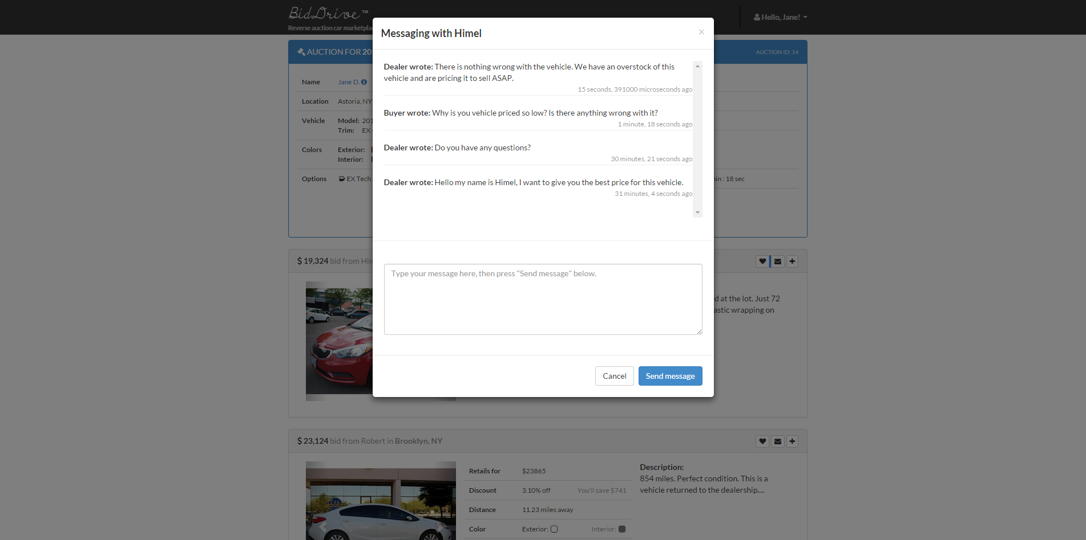
Buyer can view messages and reply to any participating dealer

Slide 27
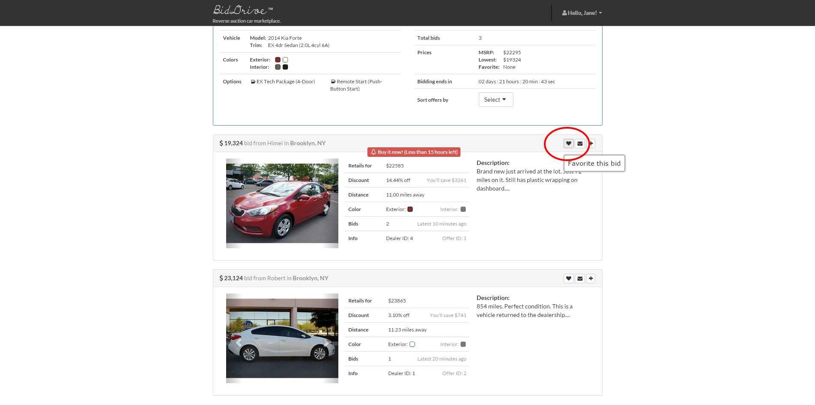
Buyer can choose a “favorite bid” to pressure other dealers into lowering their prices

Slide 28
Let's speed things up...
As mentioned auctions are 72 hours long. However, buyers are allowed to end the auction short if there are any bids with a “buy it now” button.
We just saw a dealer who submitted a final bid, which generated a “buy it now” button for his vehicle.
Now let's have the buyer pick a winner and end the auction by pressing this button.

Slide 29
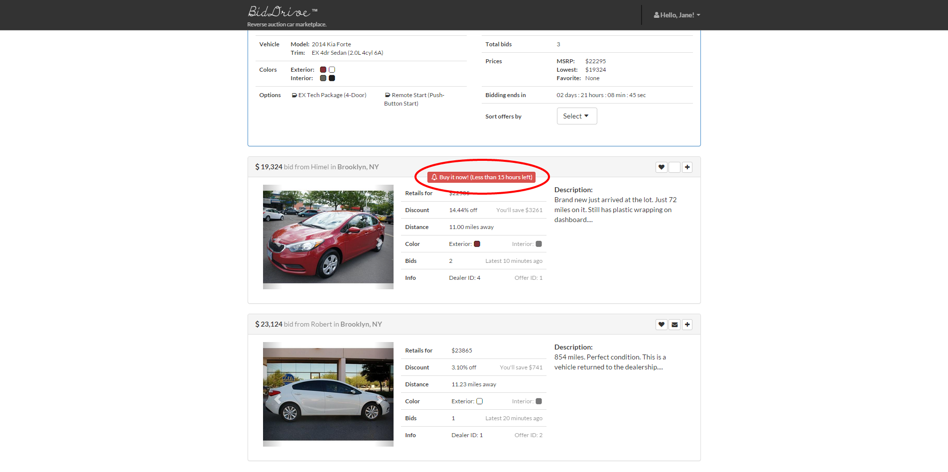
Buyer picks a winner...

Slide 30
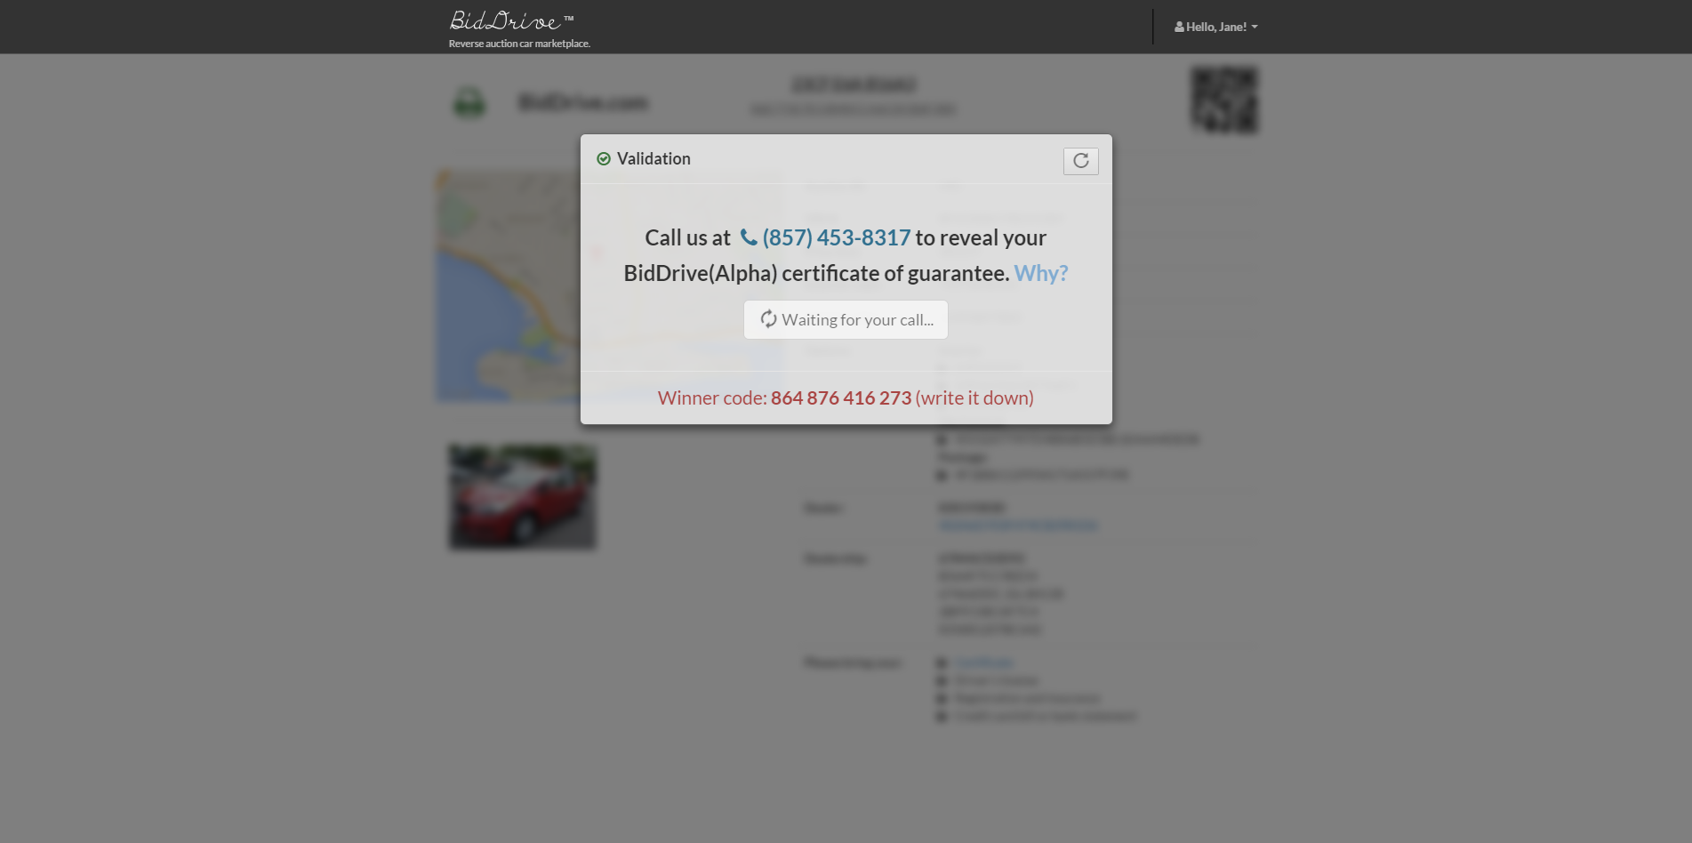
...But must call the dealer via our automated hotline first to get the “certificate of guarantee”

Slide 31
Why is this necessary? 3 reasons...
It helps assure the winning dealer that the buyer is seriously interested in the vehicle. From collaborating with real dealers, BidDrive learned that these so-called “leads” are very valuable to them.
It allows the buyer to directly speak with the dealer without having to worry about annoying callbacks, or the sharing/sale of her personal information to other dealers or spammers.
BidDrive can record this phone conversation to resolve future disputes.

Slide 32
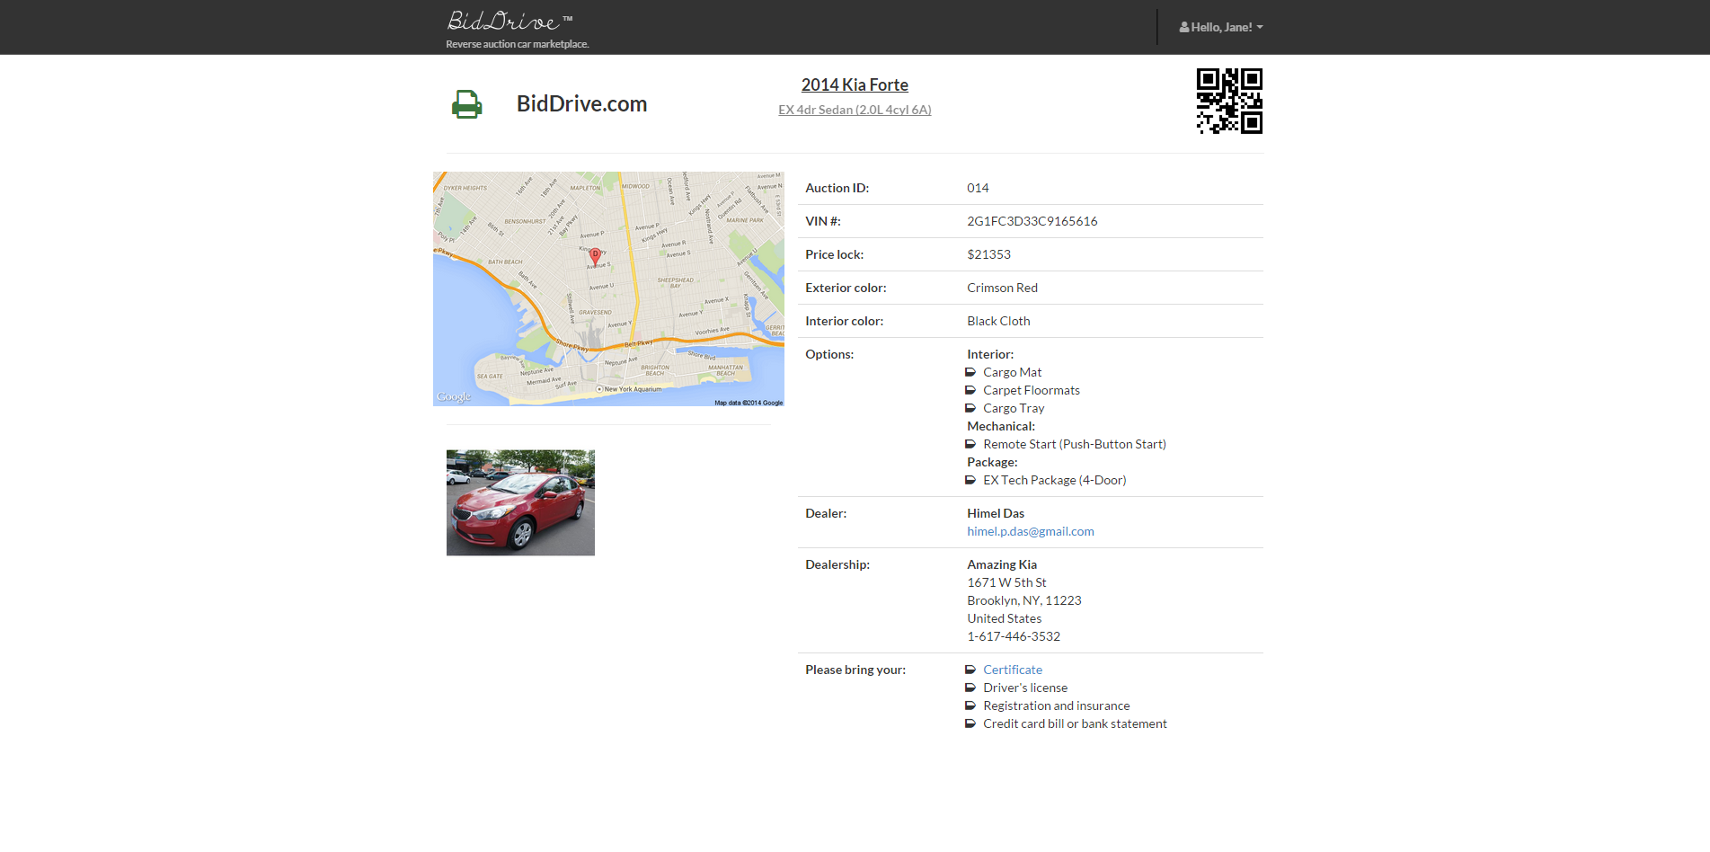
Once the buyer calls, the printable certificate automatically appears, which the buyer shows to the dealer

Slide 33

©2014 BidDrive.com
Compiled by Himel Das (himel.p.das@gmail.com)

