Slide 1

Health Literacy:
Hidden Barriers and
Practical Strategies
Notes:
This presentation is on the topic of health literacy. The purpose of having this discussion is to understand what health literacy is and how it affects our patients. We will also touch on some practical strategies that can help our practice do a better job caring for people with low health literacy.

Slide 2
Hidden Barriers to Communicating with Patients
Clients/Patients:
Education/ Literacy/ Language
Health Literacy:
    Capacity to
    Obtain, process, understand basic health information and services
    Make appropriate healthcare decisions (act on information)
    Access/ navigate healthcare system
Notes:
Our clients or patients come to us with various levels of education or literacy, and they may prefer to speak a different language, and these issues can become barriers for them to understand health information. As researchers realized this was an issue, they began to talk about health literacy which is defined as the capacity to:
Obtain, process and understand basic health information and services.
And to make appropriate health care decisions or act on health information.
And lastly the ability to access or navigate the health care system which we all know is extremely complicated.
Any client who doesn’t read well or speaks a different language could have trouble with these areas.

Slide 3
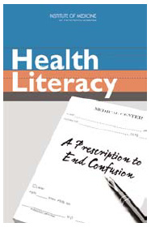
IOM Report on Health Literacy
90 million adults have trouble understanding and acting on health information
Health information is unnecessarily complex
Providers need health literacy training
Healthy People 2010
Improve health communication/health literacy
Joint Commission (1993)
Patients must be given information they understand
Notes:
In 2004, the Institute of medicine issued a report on health literacy called “A Prescription to End Confusion.” That report describes that 90 million adults have trouble understanding and acting on health information. They go on to document how health information is unnecessarily complex, and that providers throughout the health care system need health literacy training to improve how we communicate.
Healthy people 2010 made improving communication and health literacy one of their key target areas. And JCAHO has mandated that patients be given information that they understand.

Slide 4
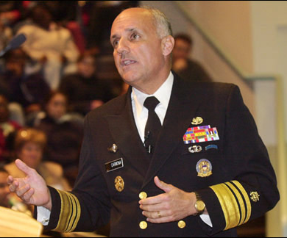
“As a former nurse, trauma surgeon, and public health director [I realized] there was a wall between us and the people we were trying to serve.
Health care professionals do not recognize that patients do not understand the health information we are trying to communicate.
We must close the gap between what health care professionals know and what the rest of America understands.”
Dr. Richard Carmona,
Former U.S. Surgeon General
mentioned health literacy in
200 of last 260 speeches
Notes:
Dr. Richard Carmona who was recently the US Surgeon General adopted health literacy is one of his primary interests. In one speech he said “As a former nurse trauma surgeon and public health director I realize there is a wall between us and the people we were trying to serve. Healthcare professionals do not recognize that patients do not understand the health information we are trying to communicate. We must close the gap between what healthcare professionals know and what the rest of America understands.”
This quote sums up the charge to us as a primary care practice.

Slide 5
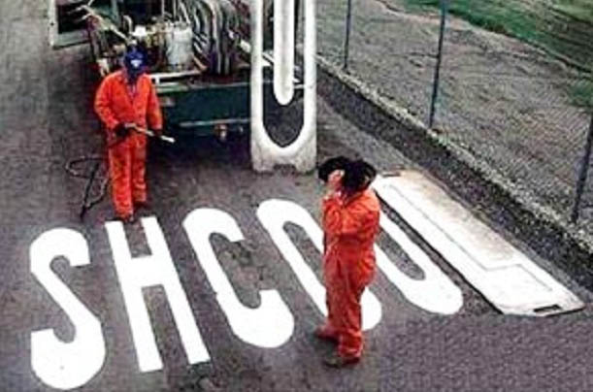
U.S. high school dropout rate is 30%
EPE Research Center (2008). “Cities in Crisis”
Notes:
This next slide has a very funny picture. But the statistic underneath is concerning. In the United States 30% of our youth do not graduate from high school. Another thing that is even more concerning is that this number hasn’t changed in 30 years. We have a lot of people who, for a variety of different reasons, are not receiving the basic education the need to function well in a healthcare system.

Slide 6

Red Flags for Low Literacy
Frequently missed appointments
Incomplete registration forms
Non-compliance with medication
Unable to name medications, explain purpose or dosing
Identifies pills by looking at them, not reading label
Unable to give coherent, sequential history
Ask fewer questions
Lack of follow-through on tests or referrals
Notes:
So what are some of the warning signs that our patients may have low literacy. None of these are perfect indicators. But when we observe these in our patients, we should consider that low health literacy could be a barrier. Lets discuss some of the items listed:
Frequently missing appointments. It could be that the patient is unable to read the appointment slip, or it may also mean that they don’t have an organizational system at home to remember appointment.
Incomplete registration forms may result because the form is overly complicated for that individual patient.
Noncompliance with medication therapy. Many clinicians get very frustrated with patients that don’t take medications correctly. But this may result not because the patient doesn’t want to do it right, but because the patient doesn’t have a clear understanding of the importance of the medication and that they need to continue taking their medications after the pill bottles are empty. Some people don’t understand how to get medications refilled.
Unable to name medications or explain the purpose or dosing of the medications.
Identifying the pill by looking at them and not by reading the label. A lot of people do this even when they can read well. But if you can’t read well, you don’t have any other choice.
Unable to give coherent sequential history. This may be a more specific sign that this person has had trouble in school because one of the things that school teaches us is how to organize our thoughts and presentation.
Asking fewer questions. If the patient is one that doesn’t ask any questions, they may be trying to hide that they don’t understand.
Lack of follow-through on tests or referrals. A common frustration for us as clinicians, but what we don’t consider is that the patient may be struggling with understanding how to make the follow up occur.

Slide 7
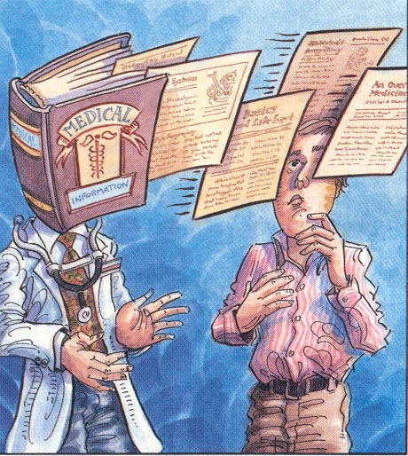
Mismatched Communication
Provider Process: Giving information
Patient Process: Understanding, remembering, and acting on information
Notes:
This slide expresses a common scenario. As providers we are constantly providing information to patients. The patient must understand, remember, and act on that information. Many of our patients can feel like we’re just reciting a textbook or procedure manual.

Slide 8
Our Expectations of Patients are Increasing…
Prevention (eating, exercise, sunscreen, dental)
Immunization
Self Assessment of Health Status
  Peak flow meter
  Glucose testing
Self-treatment
  Insulin adjustments
Health Care Use
  When to go to clinic/ ER
  Referrals and follow-up
  Insurance/ Medicare
Notes:
Another part of the issue is that we expect more and more of our patients. We want them to eat right , exercise, use sunscreen, and have regular dental exams. We have many more immunizations to give. We ask them to assess their health status using glucose testing or a peak flow meter. We asked them to adjust their medicine such as insulin. We expect them to know exactly when they should go to the clinic or the emergency room and follow up on all of the referrals we make. And of course we always expect that they will understand their insurance.

Slide 9
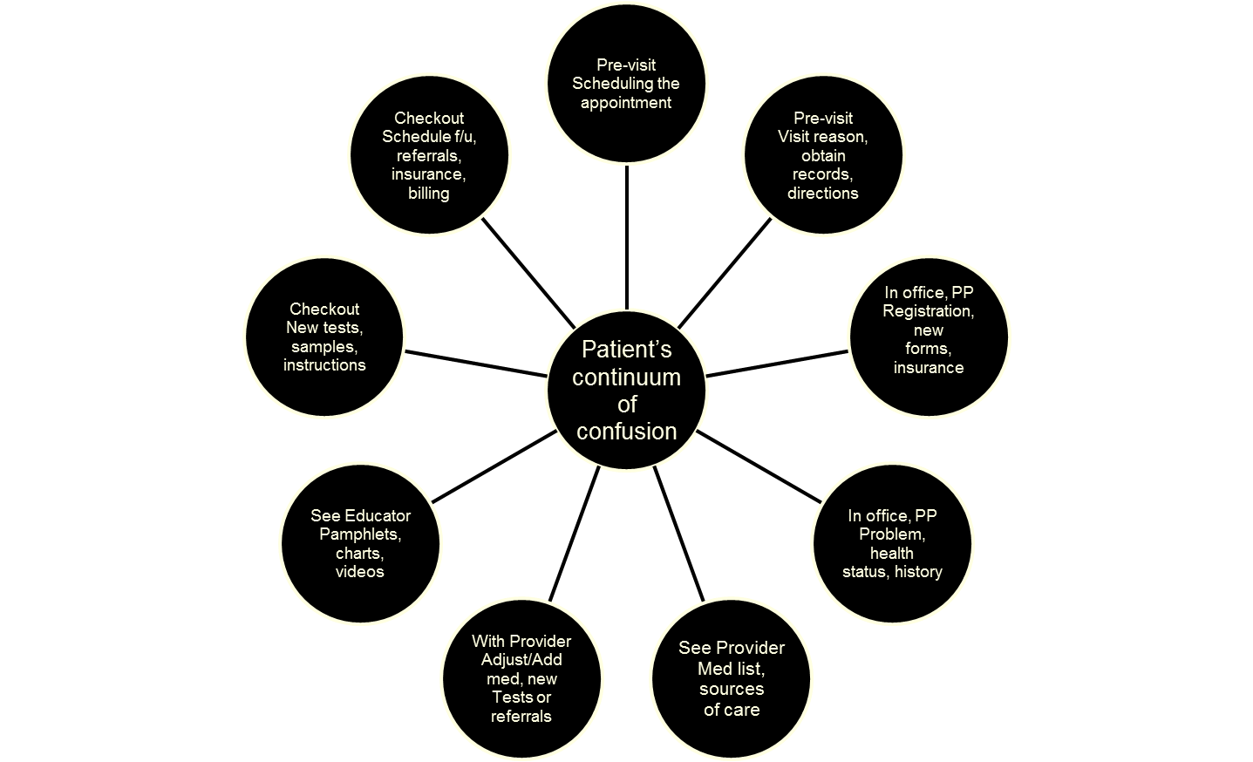
And the Process is Becoming More Complex
PP – Prior to seeing physician
ED – Emergency Department
F/U – Follow up
HCP – Health care professional
Health Literacy and Patient Safety:
AMA Foundation, 2007
Notes:
When a patient comes into our office and has to follow through several steps. Some have called this the continuum of confusion.

Slide 10
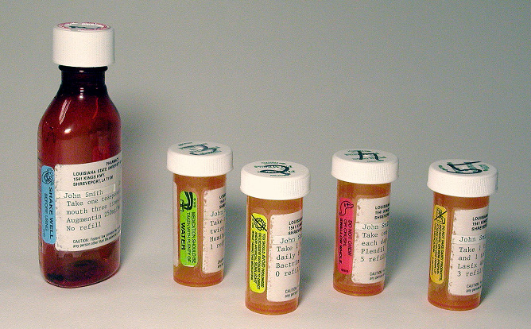
“
Patient Safety: Medication Errors
“How would you take this medicine?”
395 primary care patients in 3 states
46% did not understand instructions ≥ 1 labels
38% with adequate literacy missed at least 1 label
Davis TC , et al. Annals Int Med 2006
Notes:
Let’s look at some interesting research that was done. When researchers asked patients how would you take this medicine and handed them a pill bottle, almost half did not understand the instructions on a least one of the labels they looked at. And it is interesting to note that for patients with adequate literacy, 38% missed at least one label.

Slide 11
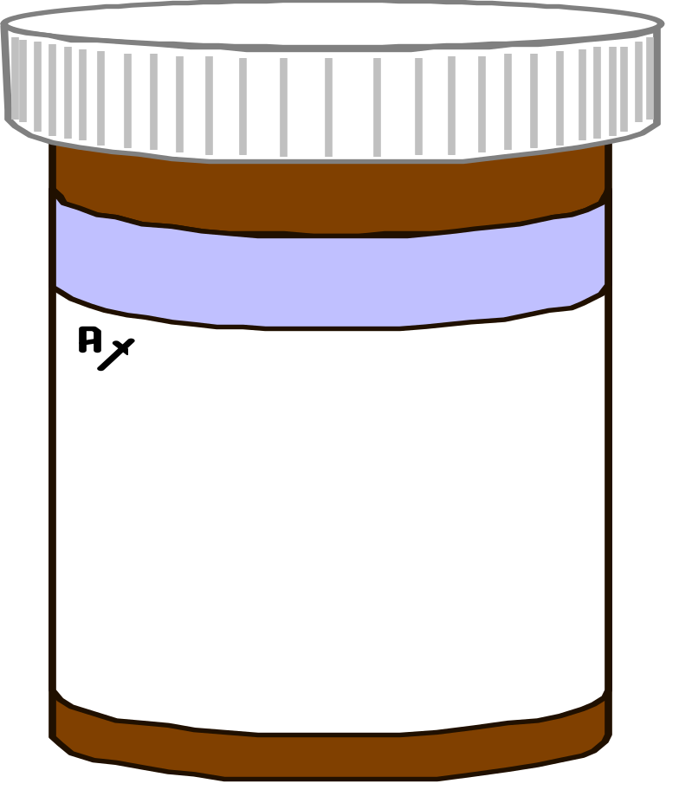
“Show Me How Many Pills You Would Take in 1 Day”
John Smith Dr. Red
Take two tablets by mouth twice daily.
Humibid LA 600MG
1 refill
Slide by Terry Davis
Notes:
These researchers went on to have patients show them how they take their medicines. So the first question was to have them read the bottle to show that they can actually read it. Then they asked them to take the pills out of the bottle and show how many pills you would take each day and when you’re going to take them.

Slide 12
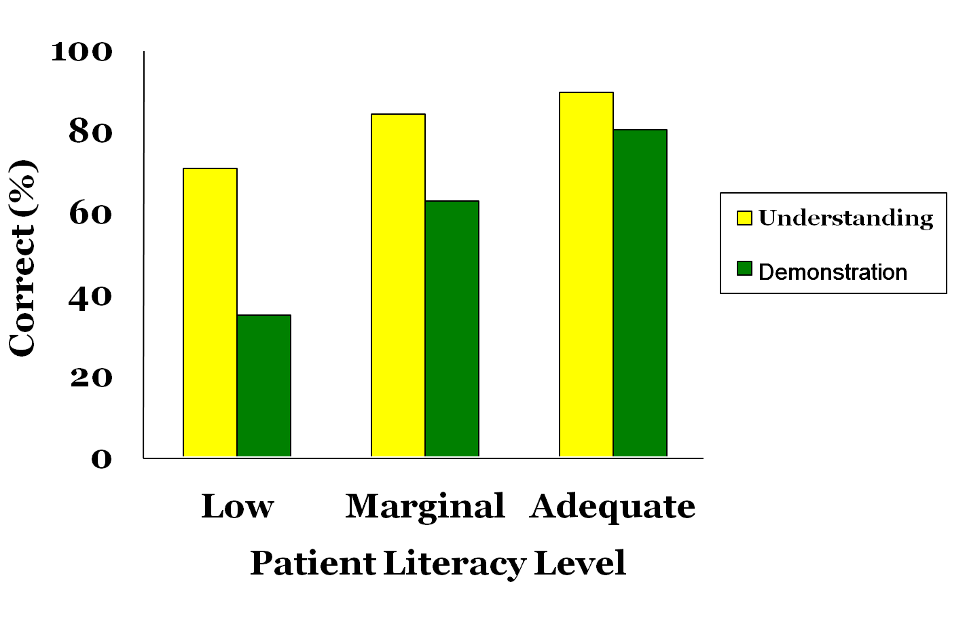
Rates of Correct Understanding vs. Demonstration “Take Two Tablets by Mouth Twice Daily”
89
84
80
71
63
35
Davis TC , et al. Annals Int Med 2006
Notes:
This slide shows some results from this study . Along the bottom (x-axis) you have the patient literacy level. Patients were categorized as having low, marginal or adequate literacy. The yellow bars show the percent of patients in each literacy level who can read the instructions on the pill bottle correctly. The green bar shows the percentage of patients who actually took the right amount of pills out of the bottle when showing how they would take the medicine.
It is troubling to see how many patients would be taking this prescription incorrectly. Most of us assume that when we write a prescription, that the patient will be able to take it correctly.

Slide 13
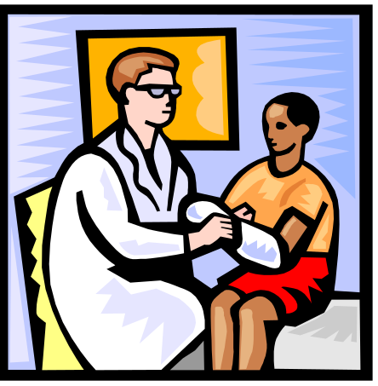
Lessons Learned From Patients
  Tell me what’s wrong (briefly)
  What do I need to DO & why
  Emphasize benefits (for me)
If meds, break it down for me:
What it is for
How to take (concretely)
Why (benefit)
What to expect
Remember: what’s clear to you is clear to you!
Notes:
What do we learn from patients? From interviewing hundreds of patients and performing many focus groups, experts have found that patients have some good ideas for us. They want us to tell them what’s wrong, but keep it brief, and then tell them what they need to do and why. And to emphasize the benefits for the patient.
For example, If it’s about taking a medication, we should break it down:
What is the medication
Exactly how do I take this medicine
What is the benefit for me if I take this medicine
And what can I expect in terms of side effects and benefits

Slide 14
Strategies to Improve Patient Understanding
Focus on ‘need-to-know’ & ‘need-to-do’
Use “Teach Back”
Demonstrate/ draw pictures
Use clearly written education materials
Notes:
A few things that we can do and where working with patients are:
Focus on the need to know and need to do. Patients say that we often give them a lot of extra and he is information. They want concrete steps.
Used to teach back method to confirm understanding - I will a talk about this in a minute
Use pictures or demonstrate. Don’t just talk about it.
And always use clearly written education materials that we know the patient can understand.

Slide 15
Focus on “Need-to-know”
& “Need-to-do”
What do patients need to know/do…?
  When they leave the exam room
  When they check out
  What do they need to know about?
    Taking medicines
    Self-care
    Referrals and follow-ups
    Filling out forms
Notes:
When focusing on what patients “need to know” and “need to do”, it’s helpful to think about what the patient needs when they leave the exam room, when they check out, and what they need to do when they get home. How do they take their medicines, what self-care strategies can they use, what about any referrals or follow-up items, what forms do they need to fill out?

Slide 16
“Teach-back”
Ensuring agreement and understanding about the care plan is essential to achieving adherence
“I want to make sure I explained it correctly. Can you tell me in your words how you understand the plan?”
Some evidence that use of “teach-back” is associated with better diabetes control
Schillinger, D. Archives of Internal Med, 2003
Notes:
Another strategy is to ask the patient to teach-back the information we discussed. This is called the teach-back method. It is a way to ensure agreement and understanding about the care plan, and is essential to achieving adherence. One way to do this is after discussing a care strategy with the patient, you can say “I want to make sure I explained it correctly, can you tell me in your own words how you understand the plan we have made to control your blood sugar?”
There is some evidence to suggest that using the teach back is associated with better diabetes control.

Slide 17
‘Teach-back’ Improves Outcomes Diabetic Patients with Low Literacy
Audio taped visits – 74 patients, 38 physicians
Patients recalled < 50% of new concepts
Physicians assessed recall 13% of time
When physicians used “teach back” the patient was more likely to have HbA1c levels below the mean
Visits that assessed recall were not longer
Schillinger, D. Archives of Internal Med, 2003
Notes:
In another study researchers assessed whether or not physicians used the teach-back method during office visits and some interesting information was observed:
Patients recalled less than half of new concepts presented during the visit
Physicians assess patient recall only 13% of the time
When physicians used the teach back the patient was more likely to have HbA1c levels below the mean value
Visits that assessed patient recall were not longer

Slide 18
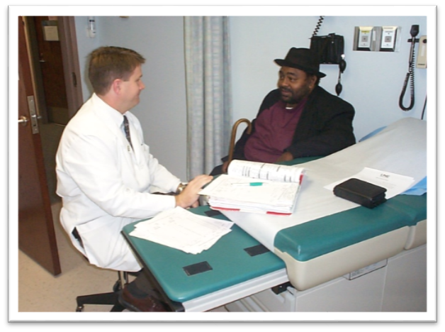
Teach-back
Explain
Assess
Clarify
Understanding
Notes:
Here is a schematic of the teach back method. The idea is to explain the self-management process, then assess the person’s knowledge by asking them to teach it back to the clinician. The clinician can then clarify if the patient doesn’t quite have it down. This cycle can be repeated until there is a shared understanding.

Slide 19
Confirm patient understanding
“Tell me what you’ve understood”
“I want to make sure I explained your medicine clearly. Can you tell me how you will take your medicine?”
Do you understand?
Do you have any questions?
Notes:
When you are confirming patient understanding, it’s best to avoid questions such as “Do you understand?” or “Do you have any questions?” That strategy usually leads to the answer of “No”.
Rather we want to say, “Tell me what you’ve understood about this medicine?” or “I want to make sure I have explained your medicine clearly, can you tell me how you think you will take this medicine?”

Slide 20
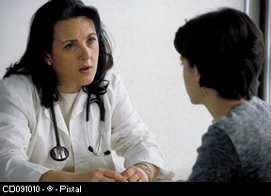
Patient Education: What We Know
Written materials, when used alone, will not adequately inform
Patients prefer receiving key messages from their clinician with accompanying pamphlets
Focus needs to be “need-to-know” & “need-to do”
Patients with low literacy tend to ask fewer questions
Bring a family member and medication to appointment
IOM: Report on Health Literacy 2004 Berkman et al. AHRQ Report 2004
Notes:
Beyond using the teach-back method, we need to consider how we organize patient education. Written materials, when used alone, will not adequately inform. Patients prefer receiving key messages from their physician with accompanying pamphlets. It is better to think of a pamphlet as a facilitator of a conversation rather than a replacement of a conversation.
When we design our messages for patients, we should focus on the need to know and need to do. Often times those of us in the medical field give a lot of extraneous information. For example, pathophysiology rarely helps the patient. What patient’s generally want is what they “need to know” and “need to do”.
It is important to remember that patients with low literacy tend to ask fewer questions. It is dependent upon us, the staff, to help patients identify what they need to hear again, and to assess whether they understand.
Lastly, it can be very helpful to have a patient bring a family member or friend, AND their medications to any appointment. Having a family member present helps ensure that questions get asked and helps the patient to remember what was discussed. Bringing their medicine bottles helps to facilitate a discussion with the doctor.

Slide 21
Visuals Improve Understanding/ Recall
Pictures/demonstrations most helpful to patient with low literacy & visual learners
Most health drawings too complicated
Physician drawings often very good (not too complex)
Patients say “show me” & “I can do it”
Notes:
Using pictures can help patients remember more. People with low literacy and visual learners tend to rely more on pictures
Most of the drawings we use in health care are too complex and are hard to figure out. Rather, patients like the physician drawings because they are usually not very complex.
It is also helpful to demonstrate how to do things. Rather than talking about it, actually demonstrate what the patient needs to do.

Slide 22
7 Tips for Clinicians
Use plain language
Limit information (3-5 key points)
Be specific and concrete, not general
Demonstrate, draw pictures, use models
Repeat/Summarize
Teach-Back (Confirm Understanding)
Be positive, hopeful, empowering
Notes:
Here are 7 tips for all of us when working with our patients.
Use plain language. Think about how you would explain things to the cashier at the grocery store.
Limit the key points to no more than 3 to 5. Think about what you want the patient to remember and focus on those.
Be specific and concrete. Not general. If action is involved, go through every detail.
Demonstrate actions, draw pictures. Use models if you have them.
Repeat and summarize the information. Most of us don’t remember when we are told something once. We need to hear it a few times.
Use the teach back method to confirm understanding and to help patients move the information into long-term memory.
Lastly, be positive, hopeful and empowering. Our patients are relying upon us to get through this complicated health care system. Let’s keep a positive attitude and help them all we can.

Slide 23
Use Plain Language
20 complicated and commonly used words
Screening
Mental Health
Dermatologist
Annually
Immunization
Depression
Contraception
Respiratory problems
Hypertension
Community Resources
Oral
Monitor
Diabetes
Cardiovascular
Diet
Referral
Hygiene
Eligible
Prevention
Arthritis
Notes:
Here is a list of words we often use that are considered complicated. Can you think of other words we could use in their place?

Slide 24
Examples of Plain Language
Plain Language
Annually
Arthritis
Cardiovascular
Dermatologist
Diabetes
Hypertension
Yearly or every year
Pain in joints
Having to do with the heart
Skin doctor
Elevated sugar in the blood
High blood pressure
The Plain Language Thesaurus for Health Communications
http://depts.washington.edu/respcare/public/info/Plain_Language_Thesaurus_for_Health_Communications.pdf
Notes:
Here are some examples.

Slide 25
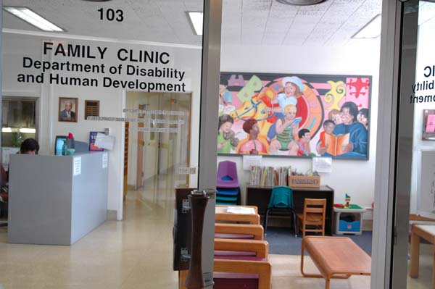
Is your Clinic/ Site Patient-centered?
What is the ‘tone,’ 1st impression?
A welcoming, calm environment
An attitude of helpfulness by all staff
Patients treated as if your family
Patient-centered check-in & scheduling
Easy to follow instructions/ directions
Patient-centered handouts
Brief telephone followup
Case management
Notes:
As we reflect on how we provide care, let’s also think about the impressions we give patients. Are we providing patient-centered care. Have we created a welcoming, calm environment?
Do we see an attitude of helpfulness from all staff including patient-friendly appointment scheduling, patient-friendly check-in procedures, and easy to follow instructions for referrals and tests. Have we incorporated patient centered handouts? Are we following-up with our patients over the phone? Do we provide any type of case-management for patients that need extra help?

Slide 26
Discussion Questions
Looking back, have there been instances when you suspected, or now suspect, that a patient might have low literacy? What were the signs?
Do we do things in our practice that make it easier for patients with low literacy to understand services and information?
  Consider the entire process of patient visits, from scheduling an appointment to check-out
What strategies could all of us adopt to minimize barriers and misunderstanding for low literacy patients?
Notes:
Here are some discussion questions to help us talk about the issue of health literacy for our practice:
Looking back, have there been instances when you suspected, or now suspect, that a patient might have low literacy? What were the signs?
Do we do things in our practice that make it difficult for patients with low literacy to understand services and information?
Consider the entire process of patient visits, from scheduling an appointment through check-out
What strategies could all of us adopt to minimize barriers and misunderstanding for low literacy patients?

