Slide 1
Computer Security CS 419
Cryptography I

Slide 2
Readings for This Lecture
Required readings:
Cryptography on Wikipedia
Interesting reading
The Code Book by Simon Singh
Notes:
Lessons to be learned:
A sense that cryptography is hard and needs to be carefully developed and examined.
That you don’t know how to break your system doesn’t mean that others cannot find out a way to do so.

Slide 3
Goals of Cryptography
The most fundamental problem cryptography addresses: ensure security of communication over insecure medium
What does secure communication mean?
confidentiality (privacy, secrecy)
only the intended recipient can see the communication
integrity (authenticity)
the communication is generated by the alleged sender
What does insecure medium mean?
Two possibilities:
Passive attacker: the adversary can eavesdrop
Active attacker: the adversary has full control over the communication channel
Notes:
Now the goal of cryptography is much broader.

Slide 4
Approaches to Secure Communication
Steganography
“covered writing”
hides the existence of a message
depends on secrecy of method
Cryptography
“hidden writing”
hide the meaning of a message
depends on secrecy of a short key, not method
Notes:
Herodotus, an entertaining but less than reliable Greek historian, reports a more ingenious method. Histaeus, ruler of Miletus, wanted to send a message to his friend Aristagorus, urging revolt against the Persians. Histaeus shaved the head of his most trusted slave, then tattooed a message on the slave's scalp. After the hair grew back, the slave was sent to Aristagorus with the message safely hidden.
Later in Herodotus' histories, the Spartans received word that Xerxes was preparing to invade Greece. Their informant, Demeratus, was a Greek in exile in Persia. Fearing discovery, Demeratus wrote his message on the wood backing of a wax tablet. He then hid the message underneath a fresh layer of wax. The apparently blank tablet sailed easily past sentries on the road.
A more subtle method, nearly as old, is to use invisible ink. Described as early as the first century AD, invisible inks were commonly used for serious communications until WWII. The simplest are organic compounds, such as lemon juice, milk, or urine, all of which turn dark when held over a flame. In 1641, Bishop John Wilkins suggested onion juice, alum, ammonia salts, and for glow-in-the dark writing the "distilled Juice of Glowworms." Modern invisible inks fluoresce under ultraviolet light and are used as anti-counterfeit devices. For example, "VOID" is printed on checks and other official documents in an ink that appears under the strong ultraviolet light used for photocopies.
A modern area that is related to both is information hiding or covert channels. Embed messages in places not intended for storing information. They can use cryptographic approaches to ensure secrecy, and do not rely only on secrecy of method.

Slide 5
Basic Terminology
Plaintext original message
Ciphertext transformed message
Key secret used in transformation
Encryption
Decryption
Cipher algorithm for encryption/decryption

Slide 6
Shift Cipher
The Key Space:
[0 .. 25]
Encryption given a key K:
each letter in the plaintext P is replaced with the K’th letter following corresponding number (shift right)
Decryption given K:
shift left
History: K = 3, Caesar’s cipher
Notes:
One can argue that Caeser Cipher is not a cipher, because there is no random key.

Slide 7
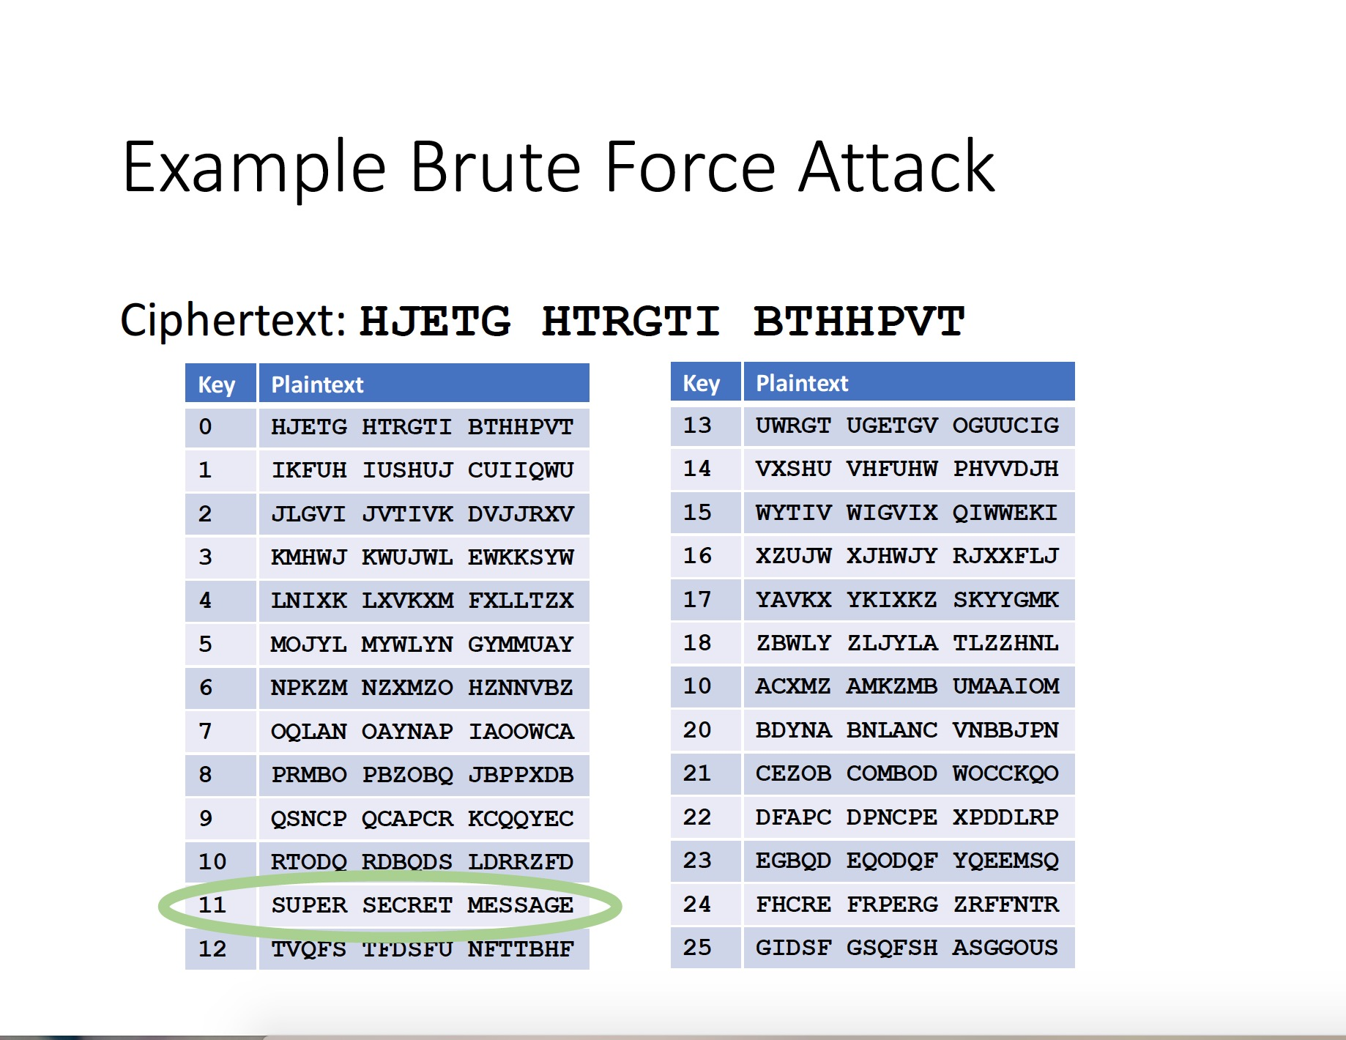

Slide 8
Shift Cipher: Cryptanalysis
Can an attacker find K?
YES: by a bruteforce attack through exhaustive key search,
key space is small (<= 26 possible keys).
Lessons:
Cipher key space needs to be large enough.
Exhaustive key search can be effective.

Slide 9
Mono-alphabetic Substitution Cipher
The key space: all permutations of Σ = {A, B, C, …, Z}
Encryption given a key π:
each letter X in the plaintext P is replaced with π(X)
Decryption given a key π:
each letter Y in the cipherext P is replaced with π⁻¹(Y)
Example:
A B C D E F G H I J K L M N O P Q R S T U V W X Y Z
π= B A D C Z H W Y G O Q X S V T R N M L K J I P F E U
BECAUSE → AZDBJSZ
Notes:
Cipher alphabet

Slide 10
Strength of the Mono-alphabetic Substitution Cipher
Exhaustive search is difficult
key space size is 26! ≈ 4×10²⁶ ≈ 2⁸⁸
Dominates the art of secret writing throughout the first millennium A.D.
Thought to be unbreakable by many back then
How to break it?

Slide 11
Cryptanalysis of Substitution Ciphers: Frequency Analysis
Basic ideas:
Each language has certain features: frequency of letters, or of groups of two or more letters.
Substitution ciphers preserve the language features.
Substitution ciphers are vulnerable to frequency analysis attacks.

Slide 12
Frequency of Letters in English

Slide 13
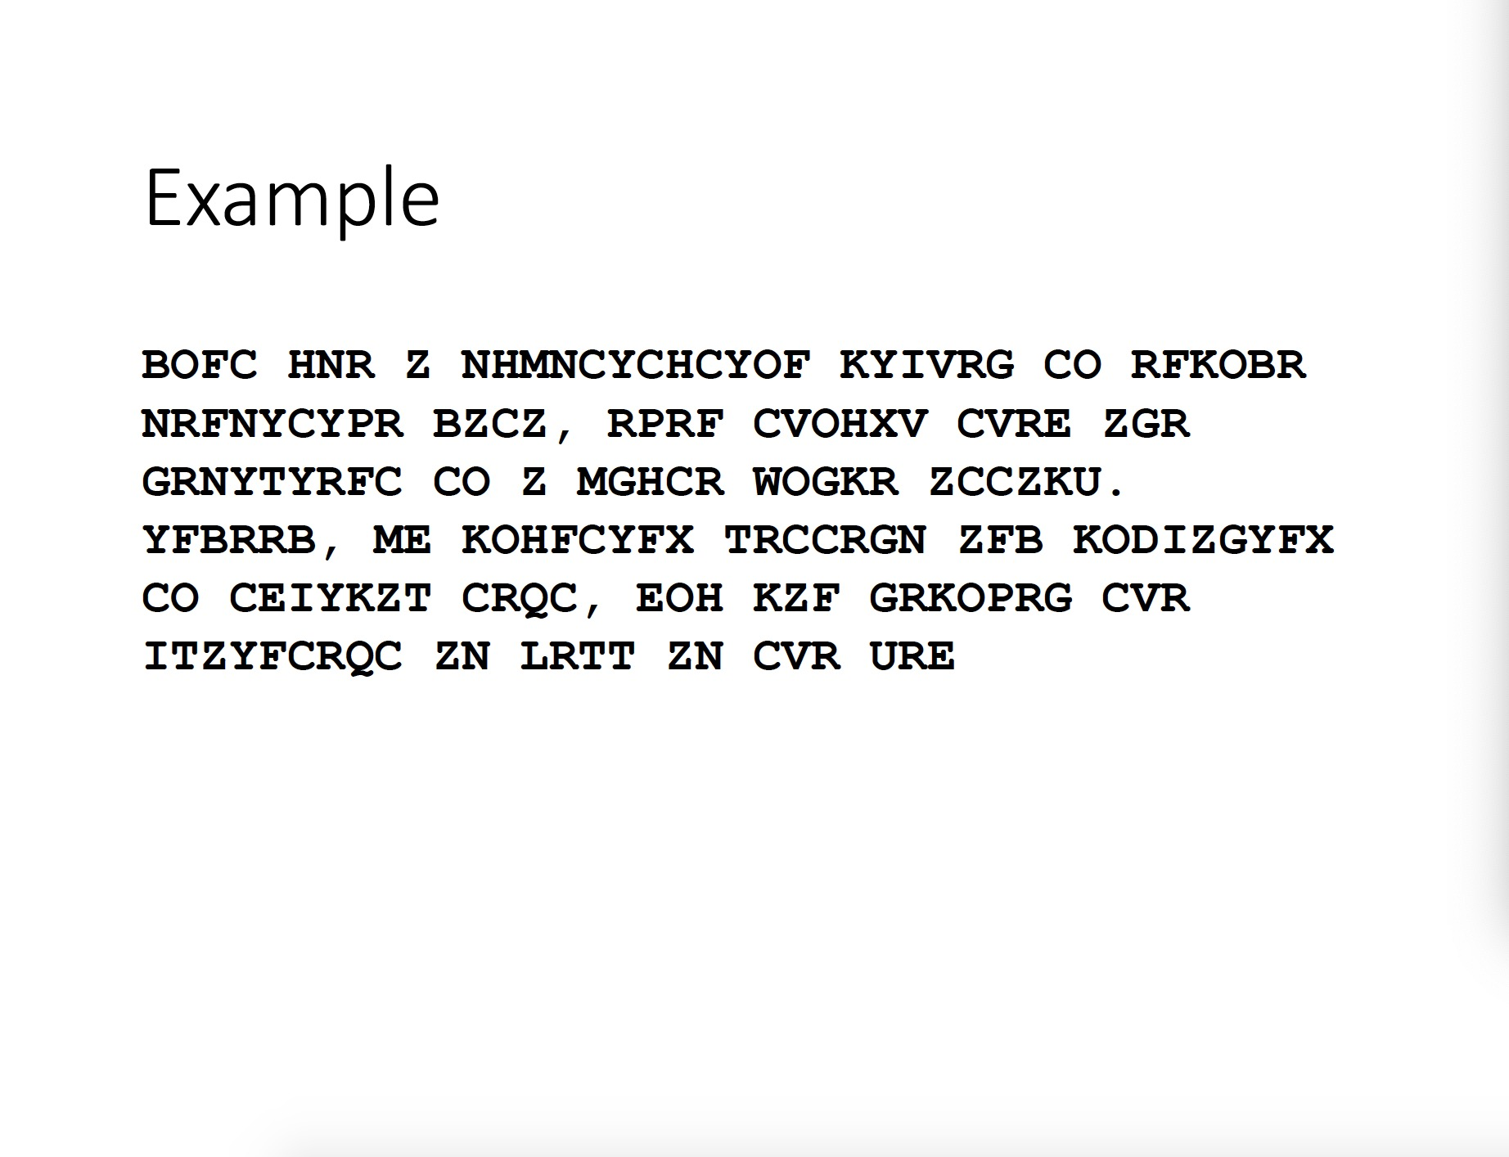

Slide 14
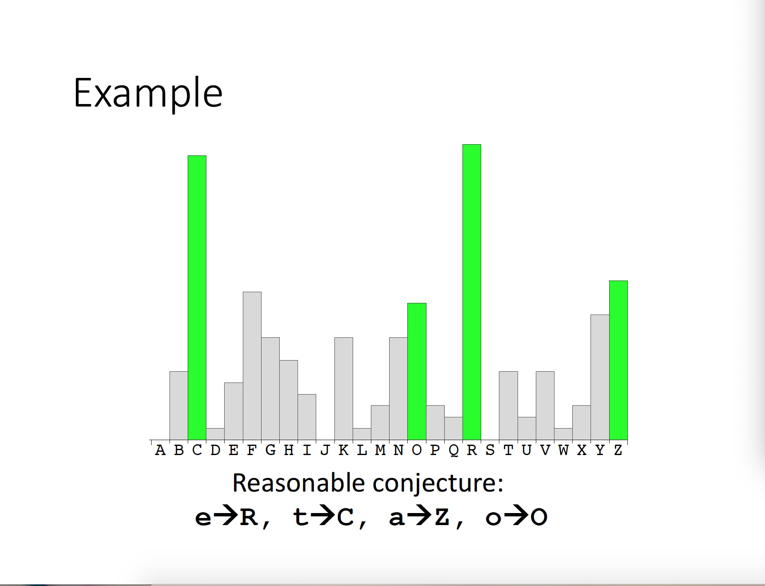

Slide 15
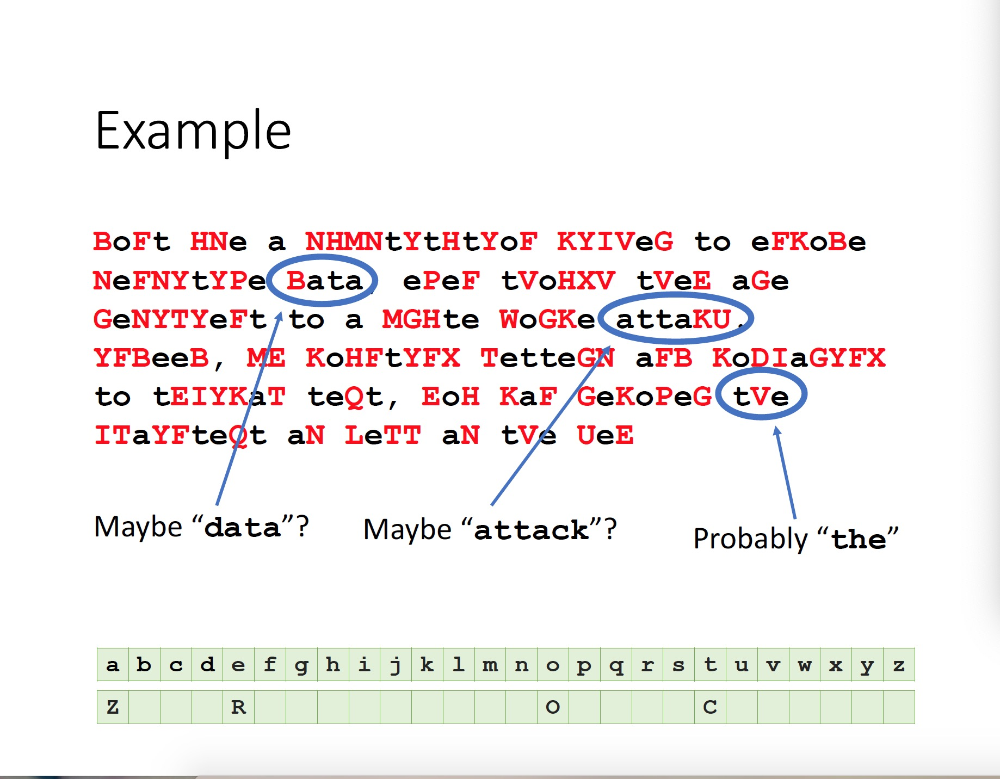

Slide 16
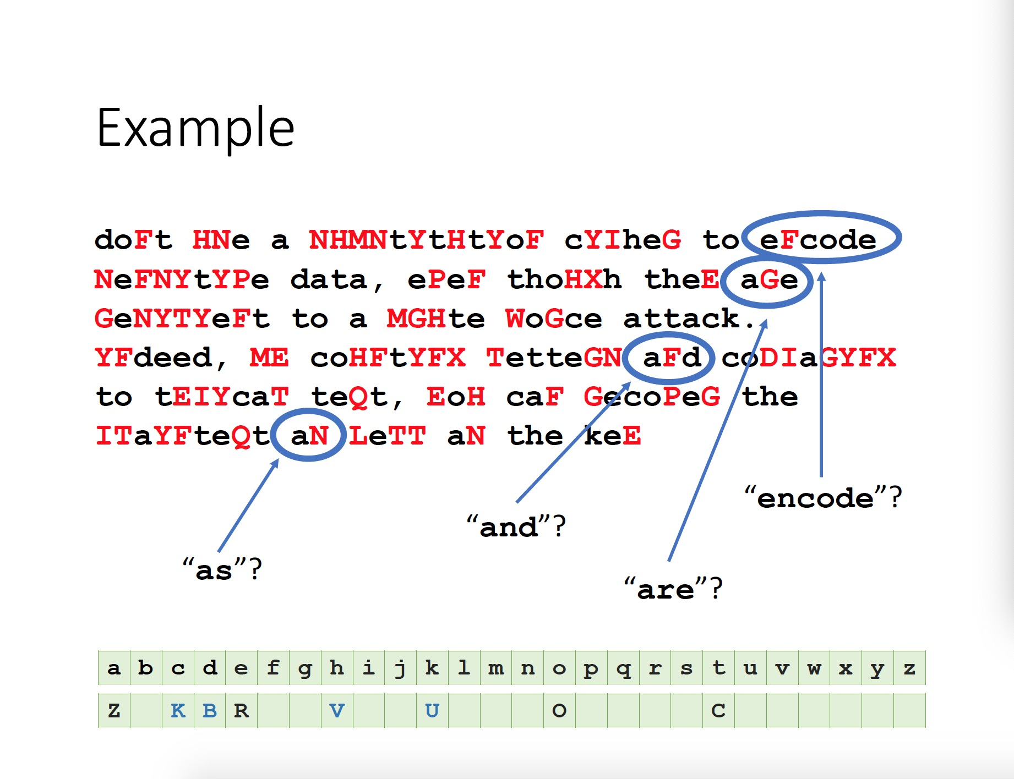

Slide 17
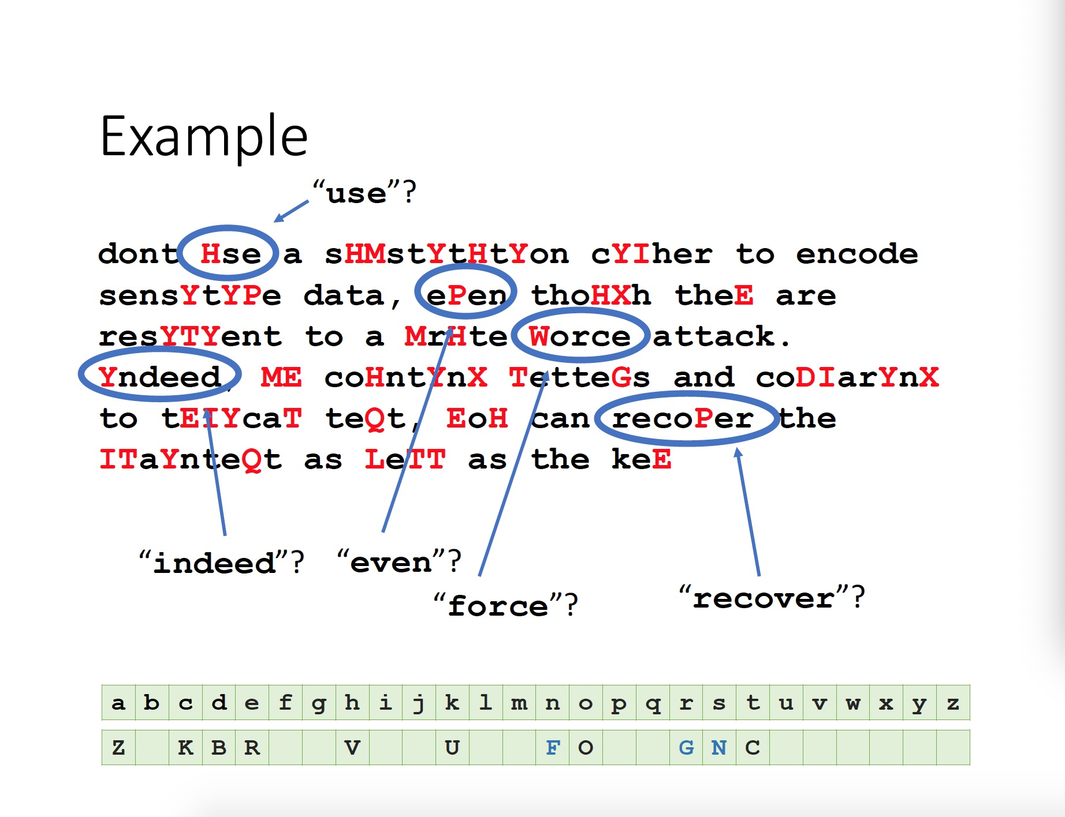

Slide 18
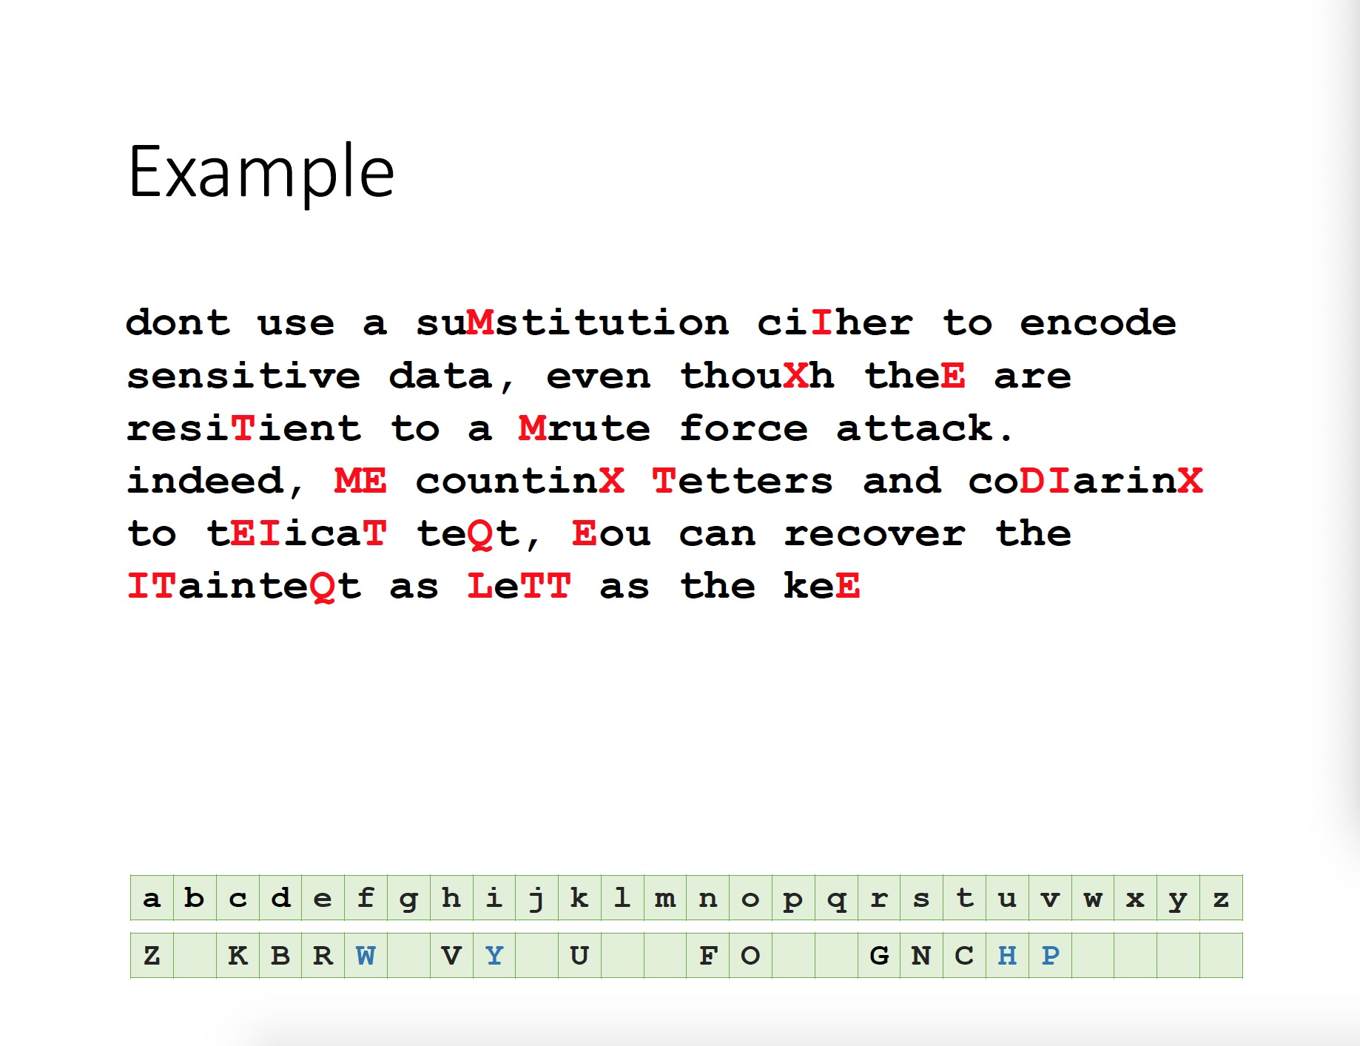

Slide 19
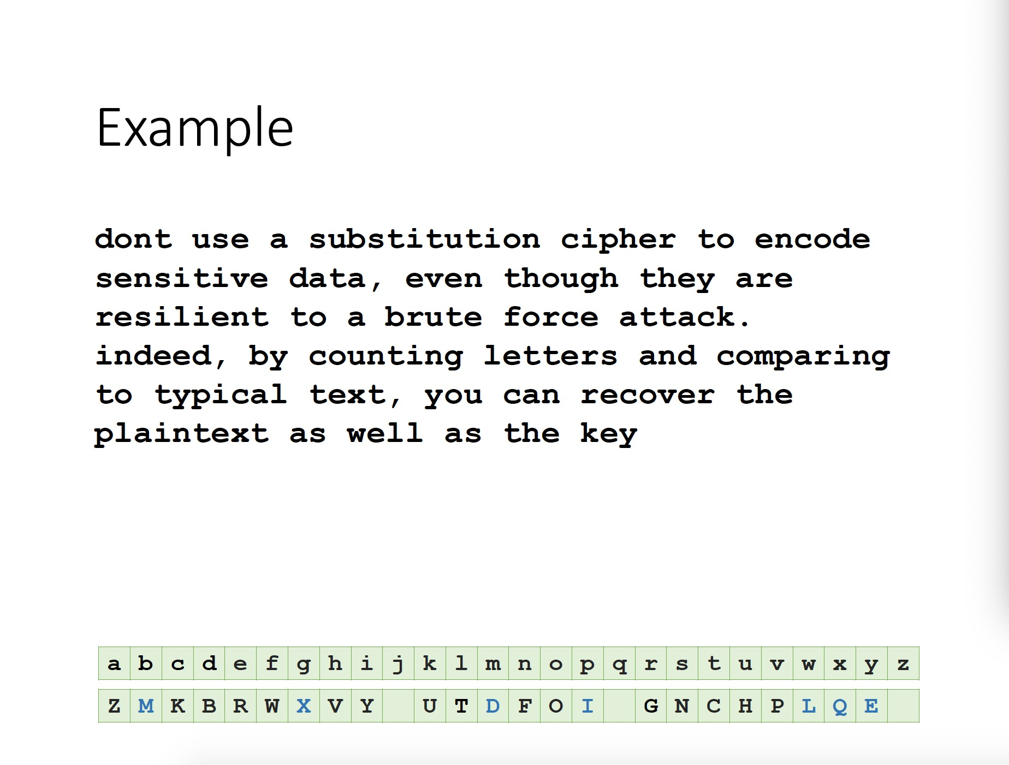

Slide 20
How to Defeat Frequency Analysis?
Use larger blocks as the basis of substitution. Rather than substituting one letter at a time, substitute 64 bits at a time, or 128 bits.
Leads to block ciphers such as DES & AES.
Use different substitutions to get rid of frequency features.
Leads to polyalphabetical substituion ciphers
Stream ciphers

Slide 21
Towards the Polyalphabetic Substitution Ciphers
Main weaknesses of monoalphabetic substitution ciphers
In ciphertext, different letters have different frequency
each letter in the ciphertext corresponds to only one letter in the plaintext letter
Idea for a stronger cipher (1460’s by Alberti)
Use more than one cipher alphabet, and switch between them when encrypting different letters
As result, frequencies of letters in ciphertext are similar
Developed into a practical cipher by Vigenère (published in 1586)

Slide 22
The Vigenère Cipher
Treat letters as numbers: [A=0, B=1, C=2, …, Z=25]
Number Theory Notation: Z_{n}= {0, 1, …, n-1}
Definition:
Given m, a positive integer, P = C = (Z₂₆)^{n}, and K = (k₁, k₂, … , k_{m}) a key, we define:
Encryption:
e_{k}(p₁, p₂… p_{m}) = (p₁+k₁, p₂+k₂…p_{m}+k_{m}) (mod 26)
Decryption:
d_{k}(c₁, c₂… c_{m}) = (c₁-k₁, c₂-k₂ … c_{m}- k_{m}) (mod 26)
Example:
Plaintext: C R Y P T O G R A P H Y
Key: L U C K L U C K L U C K
Ciphertext: N L A Z E I I B L J J I

Slide 23
Security of Vigenere Cipher
Vigenere masks the frequency with which a character appears in a language: one letter in the ciphertext corresponds to multiple letters in the plaintext. Makes the use of frequency analysis more difficult.
Any message encrypted
by a Vigenere cipher is a
collection of as many shift ciphers as there
are letters in the key.

Slide 24
Vigenere Cipher: Cryptanalysis
Find the length of the key.
Kasisky test
Index of coincidence
Divide the message into that many shift cipher encryptions.
Use frequency analysis to solve the resulting shift ciphers.
How?
Notes:
Vigenere-like substitution ciphers were regarded by many as practically unbreakable for 300 years. In 1863, a Prussian major named Kasiski proposed a method for breaking a Vigenere cipher that consisted of finding the length of the keyword and then dividing the message into that many simple substitution cryptograms. Frequency analysis could then be used to solve the resulting simple substitutions.
Checking which of the 26 possible shifts give rises to the correct decryption. Can be done by checking how well the resulting frequency distribution matches that of the underling language.

Slide 25
Kasisky Test for Finding Key Length
Observation: two identical segments of plaintext, will be encrypted to the same ciphertext, if the they occur in the text at the distance Δ, (Δ≡0 (mod m), m is the key length).
Algorithm:
Search for pairs of identical
segments of length at least 3
Record distances between
the two segments: Δ1, Δ2, …
m divides gcd(Δ1, Δ2, …)

Slide 26
Example of the Kasisky Test
Key K I N G K I N G K I N G K I N G K I N G K I N G
PT t h e s u n a n d t h e m a n i n t h e m o o n
CT D P R Y E V N T N B U K W I A O X B U K W W B T
Repeating patterns (strings of length 3 or more) in ciphertext are likely due to repeating plaintext strings encrypted under repeating key strings; thus the location difference should be multiples of key lengths.

Slide 27
Adversarial Models for Ciphers
The language of the plaintext and the nature of the cipher are assumed to be known to the adversary.
Ciphertext-only attack: The adversary knows only a number of ciphertexts.
Known-plaintext attack: The adversary knows some pairs of ciphertext and corresponding plaintext.
Chosen-plaintext attack: The adversary can choose a number of messages and obtain the ciphertexts
Chosen-ciphertext attack: The adversary can choose a number of ciphertexts and obtain the plaintexts.
What kinds of attacks have we considered so far?
When would these attacks be relevant in wireless communications?
Notes:
What kinds of attacks against ciphers have we considered so far?
How to carry out known-plaintext attack?

Slide 28
Security Principles
Kerckhoffs's Principle:
A cryptosystem should be secure even if everything about the system, except the key, is public knowledge.
Shannon's maxim:
"The enemy knows the system."
Security by obscurity doesn’t work
Should assume that the adversary knows the algorithm; the only secret the adversary is assumed to not know is the key
What is the difference between the algorithm and the key?
Notes:
The key can be changed easily; the algorithm cannot.

Slide 29
Next Class
Cryptography
One-time Pad, Informational Theoretical Security, Stream Ciphers

