Slide 1


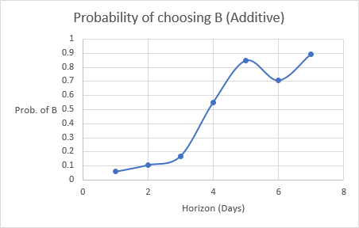
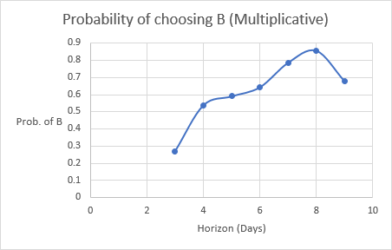
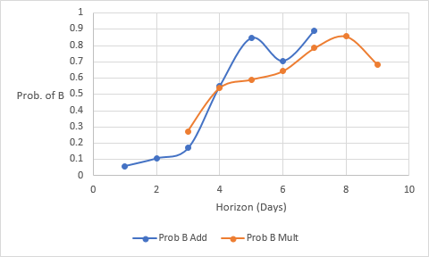
Intertemporal Choice: A Laboratory Investigation of Choice Behavior under Additive and Compound Wealth Growth
Aaron Scheiner, James Hadley, Himesh Buch, Barry Sopher
Department of Economics, Rutgers University – New Brunswick
Introduction
Objectives
Results and Conclusions
Economic theory has traditionally treated time discounting, or the devaluation in one’s mind of future payoffs compared to present ones, as part of a decision maker’s preferences. A new literature, sometimes referred to as “Ergodicity Economics,” focuses on alternate decision-making models under which time discounting is dependent on environmental factors rather than individual preferences. In this study, we begin an investigation of a new model that predicts decision makers will maximize the likelihood of a positive rate of growth in wealth.
We consider the choice between two payment plans
under two different environments. Option A is a plan of small but frequent payments, while Option B is a plan of larger payments over longer intervals, both options ending after a fixed number of days. The first environment is one without interest rates, while the second is with compounding interest on the current balance of each account.
Our main objective is to compare the choices made when the wealth generation is a simple additive process versus when wealth generation is a more complex multiplicative process with compound interest. For both additive and multiplicative processes, as the interval between payments is increased for both the more and less frequent payment processes, there is a switch point at which the larger, less frequent payment is preferred to the smaller, more frequent payment scheme. But the switch-over point is at a longer interval for the multiplicative process.
Overall, the results showed that the model correctly predicts that a horizon of 4 days results in preference for option B.
The results were most consistent with predictions in the additive case rather than the multiplicative case. Though less sharply consistent, the results of the second environment, the compound processes, were still broadly consistent with the predicted answers of the questions. The difficulty in calculating with the inclusion of an interest rate likely contributed to this result.
Methods and Materials
Participants were invited into a laboratory where they answered a 21-question survey. Each question let the participants selected their preference or indifference between options A and B, as demarcated in the theory. These questions were selected such that participants should be indifferent when the “horizon”, (symbolized H), or the difference between the interval between accumulations of A and accumulations of B, was equal to 4. There were two surveys in use: one where participants could earn interest on their earnings during each interval (Multiplicative), and one where they would not (Additive). Each group was randomly selected to participate in either multiplicative or additive surveys. Decision makers were also given the option of receiving their payment in 10 days by participating in a lottery that could lower their total earnings. The smaller the total they were willing to accept, the more likely that they’d receive that total early. Below is a graph combining the results of the additive and multiplicative processes.
Background
Experimental studies of intertemporal choice have focused mainly on very simple wealth generation processes in which choices between a smaller, earlier amount of money and a larger, later amount of money are offered. Most studies focus on imputing implicit discount rates implied by choices, with focus on violations of stationarity, most typically interpreted as "present bias." We focus instead on wealth generation processes in which either a smaller sum is received at regular, shorter intervals or in which a larger sum is received at regular, longer intervals. Our theory makes point predictions about the behavior of all participants, rather than relying on weaker consistency requirements as in the earlier studies.
Future Steps and Acknowledgments
Our primary focus for the future is to introduce uncertainty about payments to study choice between alternative stochastic wealth generation processes. Our theory based on ergodic considerations makes similarly sharp predictions for this environment as for the deterministic environment.
Thank you to the Aresty Research Center for hosting the 2019-2020 Research Assistant Program. Thank you to Professor Sopher for mentoring us throughout the school year.

