Slide 1
Diversity of Age
By: Himesh Buch and Dilkaran Gill

Slide 2
What I didn’t know (Himesh)
The Age Discrimination in Employment Act (ADEA) forbids age discrimination against people who are age 40 or older. It does not protect workers under the age of 40
The law doesn't prohibit teasing and offhand comments
Every state except South Dakota has a law prohibiting age discrimination in the workplace.
The Supreme Court has established that an employer does not violate the ADEA by providing preferential treatment to older worker over younger ones, even where the younger workers are over the age of 40.
Notes:
It’s really surprising that the ADEA doesn’t protect workers under the age of 40. There could potentially be a case where a worker is younger than 40 years and is still get discriminated just because they are too young. They might face the issue of inclusion, and the worst part is that there is nothing they can do to fight against it, legally at least.
The law has very fine boundaries that it doesn’t consider offhand teasing and “isolated incidents that aren’t too serious” (from the ADEA official website)
It’s hard to even think why a state will not consider the discrimination against it as it is a very serious and neglected issue.
If there are multiple workers who are discriminated against age at a workplace, then despite of them both being older than 40 years, the oldest among those will take precedence and will have higher chance of successfully legally fight back and win

Slide 3
What I didn’t know (Dilkaran)
Age discrimination can start before 40
Attributing an individual to a generation is a type of stereotyping
Because of ADEA, an employer cannot hire a 43-year-old rather than a 53-year-old simply based on age.
ADEA also applies to state governments, although their employees cannot sue them directly for age discrimination
New York City law prohibits employers with four or more employees from making hiring, firing or any other employment decisions based on age, even if you are under 40 years old [1]
Notes:
[1]: From NYC bar’s official website: https://www.nycbar.org/get-legal-help/article/employment-and-labor/age-discrimination/

Slide 4
Should Not Be Missed
Companies prefer to hire younger people over older people because of retirement anticipation, expensive health benefits, and higher salary expectations
Older people are often portrayed as helpless victims in movies and on TV which only leads people to believe in that [1]
Older people still lack protection from bias and discrimination in many other areas, such as housing and in day-to-day life
Notes:
[1]: Even in movies older people are portrayed as inefficient. Some films like “Up” and “The Intern” have defied this stereotype and presented older people as an important asset
Age based bias exist in every industry and because of this, older people can lose jobs, or even not get car or travel insurance, or even be denied by doctors!

Slide 5
Identities
Generation Name | Years | Youngest Age Today | Oldest Age Today
The Lost Generation | 1890-1915 | 105 | 130
The Greatest Generation | 1910-1924 | 96 | 110
The Silent Generation | 1925-1945 | 75 | 95
Baby Boomer Generation | 1946-1964 | 56 | 74
Generation X | 1965-1979 | 41 | 55
Millennials (Gen Y) | 1980-1994 | 26 | 40
Generation Z | 1995-2012 | 8 | 25
Generation Alpha | 2013-2025 | 0 | 7
Notes:
https://www.careerplanner.com/Career-Articles/Generations.cfm
As we can see there are a lot of generations and identities. While generational identities are not uniform for all in a particular generation, a reference to an individual's period in time can be ascertained.

Slide 6
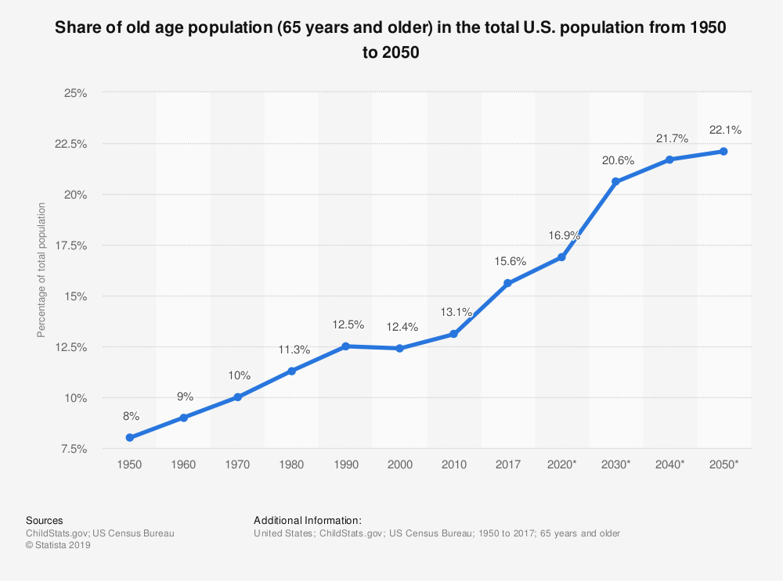
Age based classifications and Stereotypes
Population aging is occurring in about all the nations of the world.
It is assessed that the quantity of the older will increment quickly in most developed nations and it will have an unforeseen effect (Kinsella and Wan He 2009).
United States Census Bureau also predicted that older people are projected to outnumber children for the first time in the US history[1]
Notes:
[1]: https://www.census.gov/newsroom/press-releases/2018/cb18-41-population-projections.html
It has been proven that the number of older people are constantly growing, and it was predicted in 2018 that it’ll outnumber the number of children for the first time in the US history. Hence, the businesses should start adjusting accordingly and start valuing older people at a workplace.
--Himesh

Slide 7
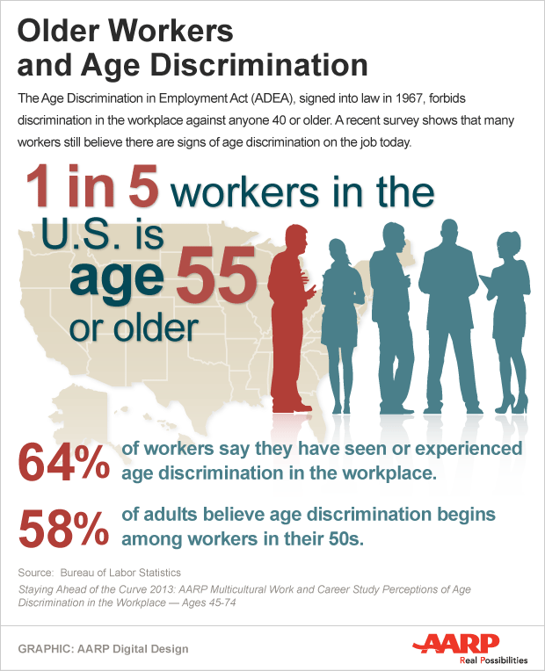
Age based classifications and Stereotypes
With regards to age, youth is regularly taken to be the standard. Age appears to emerge just when it is understood as an issue in regular reasoning, which happens mostly comparable to the 'older' worker
Stereotypes like older people at a workplace cost too much still exists in most of the places. The research study presented by AARP has proved that the correlation between aging employees and employer costs is now minimal, in part because employers focus less on seniority now when they reward workers
People still believe that older people are the ones who are afraid of technology and studies have again proved that this is not the case[1]
Notes:
[1]: The AARP survey suggests that the older workers learn new things, such as technology, as fast as younger workers which is also does not support the conventional stereotype of older people taking more time to learn new things. https://www.shrm.org/resourcesandtools/legal-and-compliance/employment-law/pages/5-age-stereotypes-workplaces-need-to-eradicate.aspx
It has been proven that having older people at a workplace does not affect the cost at all as opposed to the stereotype. The image is an AARP published image that discusses some surprising stats of age related discrimination at a workplace
-- Himesh

Slide 8

Age based classifications and Stereotypes
It turns out in the research that older workers are actually the most engaged employees in the workforce, still stereotypes like older people aren’t as motivated as others exist[1]
Workplaces are more concerned about their cost on employees the most and the belief of older people get sick more and often than younger people is one of the main motivations of age discrimination at a workplace
Workplaces often think that older people will require more medical attention and the cost of their health insurance and absence will harm the business in one way or another[2]
Another stereotype is that older people are resistant to change and stick to what they have dealt with and learned in their lives
People, in general, need to understand that experience of an older person can help in so many ways not to mention how it diversifies the workplace environment, which will eventually help solve issues like discrimination and exclusion
Notes:
All of the points made here were part of the AARP research that was done (https://www.shrm.org/resourcesandtools/legal-and-compliance/employment-law/pages/5-age-stereotypes-workplaces-need-to-eradicate.aspx)
[1]: One of the AARP surveys suggest that 65% employees who were older than 55 years were more engaged than most people at a work
[2]: The research shows that old people are less likely to get sick, as they focus more on theirs and their family’s well being
The image here, according to me, says a lot of things and fits perfectly to the given topic. The image of, maybe, a younger person at the core and an older person on the outside, really says a lot of things about how a person grows and still be the same person, and how they shouldn’t be discriminated against age, as they are still the “same(young) person”
-- Himesh

Slide 9
Bias and Discrimination
As discussed in the previous topic, employers might take unnecessary steps, given some stereotypes, towards older people at a workplace which eventually results in performance of the company as a whole and unemployment.
At a workplace, there are basically three main areas where the bias will happen:
Recruitment and hiring
On the job basis
Termination
One of the main reasons of bias in this field is the Title VII legislation not being able to protect from discrimination against age[1]
Notes:
[1]: Title VII made it illegal for employers to discriminate based on race, color, religion, sex and national origin. It does not protect against discrimination against age. An amendment to include age discrimination as one of the protected categories in Title VII has also failed
--Himesh

Slide 10

Bias and Discrimination
One of the most famous examples of discrimination at a workplace, was the Starbucks Dyslexia Case. When Starbucks employee Meseret Kumulchew realized that she was being discriminated because of the most minor things like checking fridge temperature, she decided to fight back.
Meseret took Starbucks to an employment tribunal for disability discrimination, and told them that she was dyslexic. The tribunal found that Starbucks failed to make reasonable adjustments for Meseret and had discriminated against her due to the effects of her Dyslexia. [1]
Notes:
[1]:https://www.staffsquared.com/blog/real-life-examples-of-discrimination-in-the-workplace/
“Starbucks employee Meseret Kumulchew was accused of fraud as her employer claimed she was falsifying documents after she mistakenly entered incorrect information when recording fridge temperatures in a duty roster. As a result, she was given lesser duties.” The statement from the article about the actual issue. It was also found that she was victimised by her employer and that there appeared to be little or no knowledge or understanding of equality issues within the business.
The image is of Meseret Kumulchew interviewing with BBC
--Himesh

Slide 11
Bias and Discrimination
It is also important how the bias starts at a workplace. Here are some microaggression that old people get which are not acceptable at all.
Making fun of old people dancing and calling it adorable is very disrespectful
Joking about how older people are not good at using smartphones [1]
Workplace hiring only young or recent graduates is another step that causes such bias
Making proper conversation with older people and being polite will make things only better
It is important for people to understand that this is a serious issue, and everyone needs to be a little more sensible towards others, and treat everyone like humans
Notes:
[1]: Sometimes people do not realize that the things they say can affect others in a mental and psychological level. Making fun of the smallest thing can still affect others as we do not necessarily know what they have been going through
I personally believe that talking to anyone with a smile will make their day better, and i can say that from my personal experience. It is now a high time that we take ageism seriously and start acting accordingly. Everytime when i feel like saying harsh things to others, what i do is to think that how would i feel if the exact same things was told to me, and the answer is almost always “bad”, and hence, i try to be as nice as i could. It’s a small step but if everyone starts practicing it on a daily basis, the results are going to be delightful
--Himesh

Slide 12
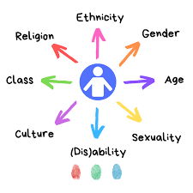
Intersectionality
Age is only a piece of the puzzle
Individuals born in a generational cohort have different experiences across the world
Ex: Millennials in France have different outlooks, experiences than millennials in America
Notes:
From what generation an individual belongs to is only a piece of the puzzle that creates intersectionality. Individuals have different experiences across the world even if they are a part of the same generational cohort due to variations of cultures, religions, ethnicities etc.
Image: https://medium.com/dna-s-blog/identity-beyond-disability-3d59d19b1dad

Slide 13
Exclusion
Direct discrimination
Indirect discrimination
Harassment
Victimisation
Overlooked for challenging, rewarding work assignments
Left out
Encouraged to retire
Retaliation for formal complaints of age discrimination
Notes:
https://www.equalityhumanrights.com/en/advice-and-guidance/age-discrimination
Exclusion can manifest in multiple ways. It can be direct, indirect, could include harassment and victimisation. Direct discrimination could mean being overtly overlooked for bigger and more rewarding work assignments. Indirect discrimination can mean being left out of work social circles or important work related information that would help one's career. Harassment could be being encouraged to retire either by peers or by management. Victimisation occurs when one makes a formal complaint or backs a peers complaint against age discrimination and co-workers start to further discriminate or retaliate via overt or covert methods.

Slide 14

Inclusion
Offer age inclusive training opportunities
Review hiring process to make sure individuals of all ages are given an equal opportunity
Evaluate potential of bias in organization
Foster a multigenerational workplace
Develop programs that support older workers
Provide cross-generational mentorship
Age-inclusive employee events
Notes:
https://blog.hrps.org/blogpost/12-Ways-to-Eliminate-Ageism-and-Be-More-Inclusive#:~:text=To%20stay%20engaged%2C%20workers%20need,both%20workers%20and%20your%20business.
There are many ways to make sure that individuals of all ages are included in the workplace. The most important is to make sure that people of all ages have exposure to each other. If a generational cohort only stays with their generational cohort and are not given the opportunity of cross-generational mentorship, they have higher chances of developing biases.

Slide 15
Legislation and Legal Remedies
Not only US but for countries within the European Union, the Employment Equality Framework Directive aims to combat discrimination in the workplace
The law can help fighting against discrimination against disability, sexual orientation, religion and age, and all European Union member states are required to implement this in their national laws.
The Organisation for Economic Co-operation and Development (OECD) has recommended the eventual elimination of all mandatory retirement policies in order to benefit workers, employers and economies
Notes:
Notes taken from WHO official website on ageism section

Slide 16
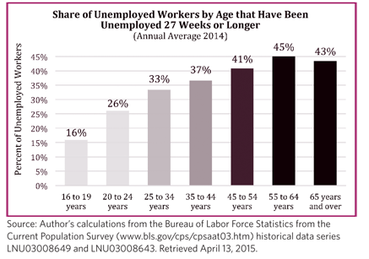
Legislation and Legal Remedies
Older people are losing their jobs more and more, as workplaces have always given preference to younger people. Here is an interesting graph of the unemployed people by age for the year 2014
One of the main reasons why this is still an issue is because there are very few legislations that exist to protect from it. The Age Discrimination in Employment Act of 1967 (ADEA), was essentially defanged by the U.S. Supreme Court in 2009. [1]
Notes:
[1]: despite of having so many issues in the society that rectifies ageism and discrimination of this kind at a workplace, are still there because of the lack of any strong laws’ existence in the constitution. The key act regarding this, ADEA, was defanged by Supreme court in 2009, not to mention how title VII does not consider discrimination against age as a real issue

Slide 17
Legislation and Legal Remedies
Many states have laws to prohibit discrimination against age [1]
The federal Older Workers Benefit Protection Act, or OWBPA (29 U.S.C. § 623 and following), amended the ADEA to make it illegal for employers to use an employee's age as a basis for discrimination in benefits and retirement. [2]
One of the biggest advantages of OWBPA is that employers must provide equal benefits such as life insurance, health insurance, disability benefits, pensions, and retirement benefits to older and younger workers.
Under the Equality Act of 2010, older people are protected from ageism in employment, training and education, and in memberships of clubs and associations
Notes:
[1]: The problem with these laws is that most of them are a copy of the federal laws and does not apply to people aged under 40 years. Not only that, most of these laws tend to apply to employers with fewer than 20 employees
[2]: Just like other laws, this one also does not protect employees under 40 years of age

Slide 18
Things we can do..
Treating others like how you’d like to be treated will solve the problem quite easily
Not making fun of older people and not taking part in any activities that might hurt someone’s feelings can also be a good step to take
Age is not a reliable indicator when judging a worker’s potential productivity or employability, and the sooner we and people we work with understand that the better.
United states has one of the highest rates of labour participation among people older than 65 years [1], and the situation can get a lot worse if necessary steps are not taken on time
Notes:
[1]: According to WHO (https://www.who.int/ageing/features/workplace-ageism/en/)

Slide 19
Things we can do..
An intervention that provides information about the myths and realities of ageing at a workplace can educate people about the real issue
If mandatory retirement age can be abolished, it would be of great help. Organizations like UN also have fixed retirement ages which can be changed for good
Notes:
Policies implementing compulsory retirement ages don't help make occupations for youth, as was at first imagined, yet they diminish more older workers' capacity to contribute and decrease an organization’s chances to profit by the abilities and experience of older workers

Slide 20
Bibliography
https://www.eeoc.gov/age-discrimination
https://www.workplacefairness.org/age-discrimination
What’s Age Got to do with it by Robby Thoms, Cynthia Hardy, Leanne Cutcher, Susan Ainsworth
https://www.census.gov/newsroom/press-releases/2018/cb18-41-population-projections.html
https://www.statista.com/graphic/1/457822/share-of-old-age-population-in-the-total-us-population.jpg
https://encrypted-tbn0.gstatic.com/images?q=tbn%3AANd9GcRq2_mXh3txIwYoZ64EzOdyPpTSUGy7tNoCnw&usqp=CAU
https://www.shrm.org/resourcesandtools/legal-and-compliance/employment-law/pages/5-age-stereotypes-workplaces-need-to-eradicate.aspx

Slide 21
Bibliography
https://www.aarp.org/work/working-at-50-plus/info-2019/age-discrimination-in-america.html
https://i.dailymail.co.uk/i/pix/2016/02/09/07/3103767B00000578-3438335-image-m-6_1455002458083.jpg
https://www.staffsquared.com/blog/real-life-examples-of-discrimination-in-the-workplace/
https://www.huffpost.com/entry/10-microaggressions-of-ageism-that-are-not-ok-to-ignore_n_564f7155e4b0d4093a57ab9d
https://www.nolo.com/legal-encyclopedia/rights-against-age-discrimination-29577.html
https://www.nycbar.org/get-legal-help/article/employment-and-labor/age-discrimination/
https://www.who.int/ageing/features/workplace-ageism/en/

Slide 22
Bibliography
https://www.equalityhumanrights.com/en/advice-and-guidance/age-discrimination
https://medium.com/dna-s-blog/identity-beyond-disability-3d59d19b1dad
https://www.careerplanner.com/Career-Articles/Generations.cfm
https://bstigmafree.org/fast-facts-ageism/
https://blog.hrps.org/blogpost/12-Ways-to-Eliminate-Ageism-and-Be-More-Inclusive#:~:text=To%20stay%20engaged%2C%20workers%20need,both%20workers%20and%20your%20business.

